Slide 1




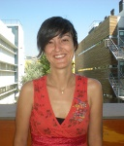
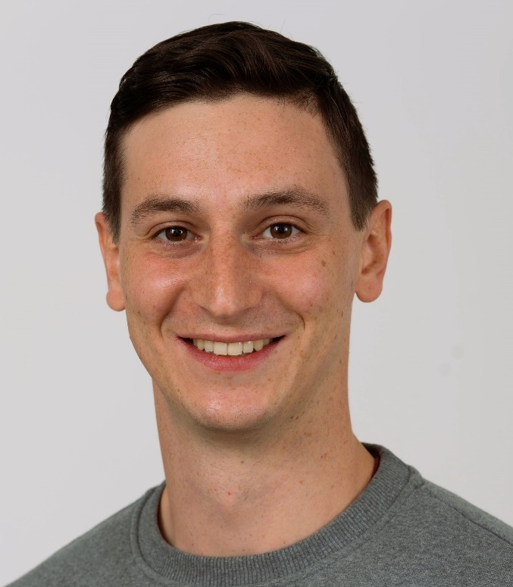

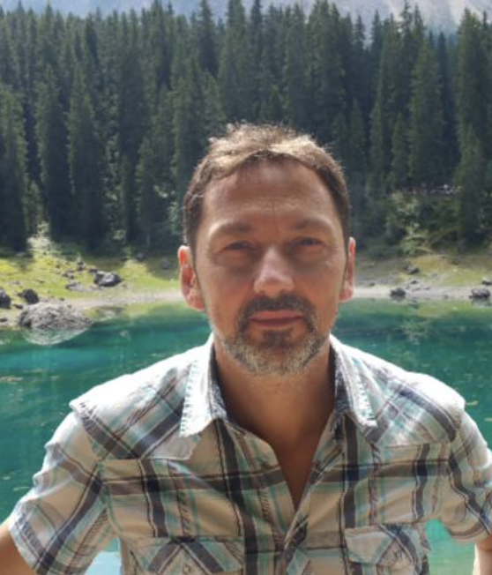
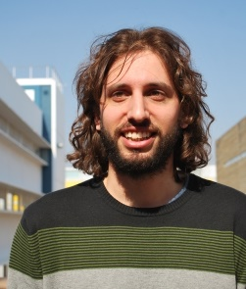
Deep Learning and Sentinel-2 data for Artisanal Mine Detection in a semi-desert area
Maria Cuevas¹, Lorenzo Nava², Sansar Raj Meena², Filippo Catani², Oriol Monserrat¹
¹ Department of Remote Sensing, Geomatic Research Unit, Centre Tecnològic Telecomunicacions Catalunya, Spain
² Machine Intelligence and Slope Stability Laboratory (MISSlab), Department of Geosciences, University of Padova, Italy
EGU General Assembly 2022 - Session NH3.8 - Tuesday, 24 May, 08:40–13:47

Slide 2
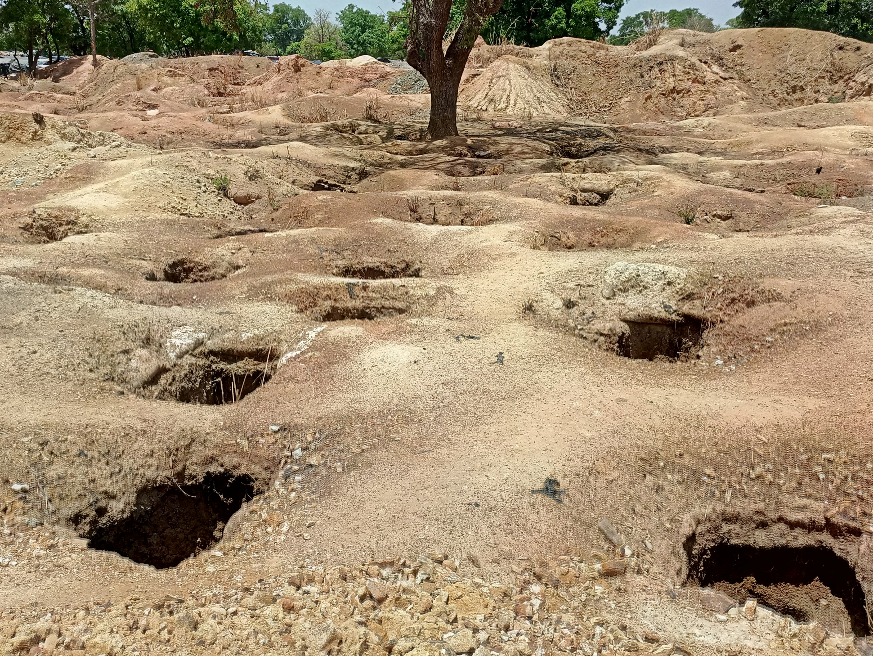
EGU General Assembly 2022
Introduction:
Artisanal and small scale mining (ASM) represent a source of subsidence for 150 million people in sub-Saharan Africa.
ASM are often illegal and uncontrolled.
Materials involved in the excavation process are highly dangerous for the environment.
Land-use conflicts and terrorist attacks targeting ASM activities have grown regular in Burkina Faso.
Source: reuters.com

Slide 3
EGU General Assembly 2022
Research problem:
Record of spatial location of ASM in Africa is often missing.
Few are the studies in which Machine Learning based automated mapping approaches are applied to ASM detection.
None of them is applied in a semi-desert area (challenging to map).
Source: poandpo.com

Slide 4
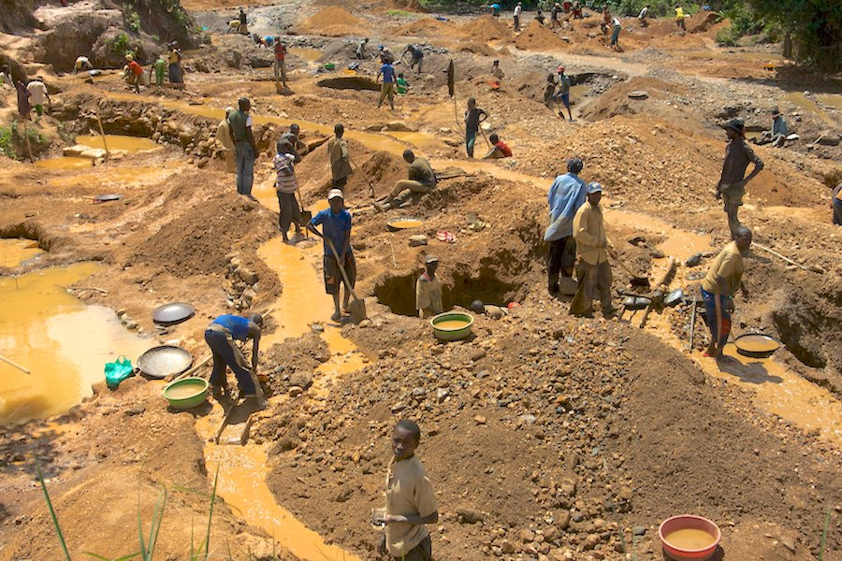
EGU General Assembly 2022
Purpose of the study:
Propose an automated approach to map ASM in a semi desert area by exploiting limited training data.
Evaluate how rainy and dry season affect model performances.
Compare the well-known U-Net mapping performances against an improved U-Net.
Source: mining.com

Slide 5
EGU General Assembly 2022
Study area - Burkina Faso:

Slide 6
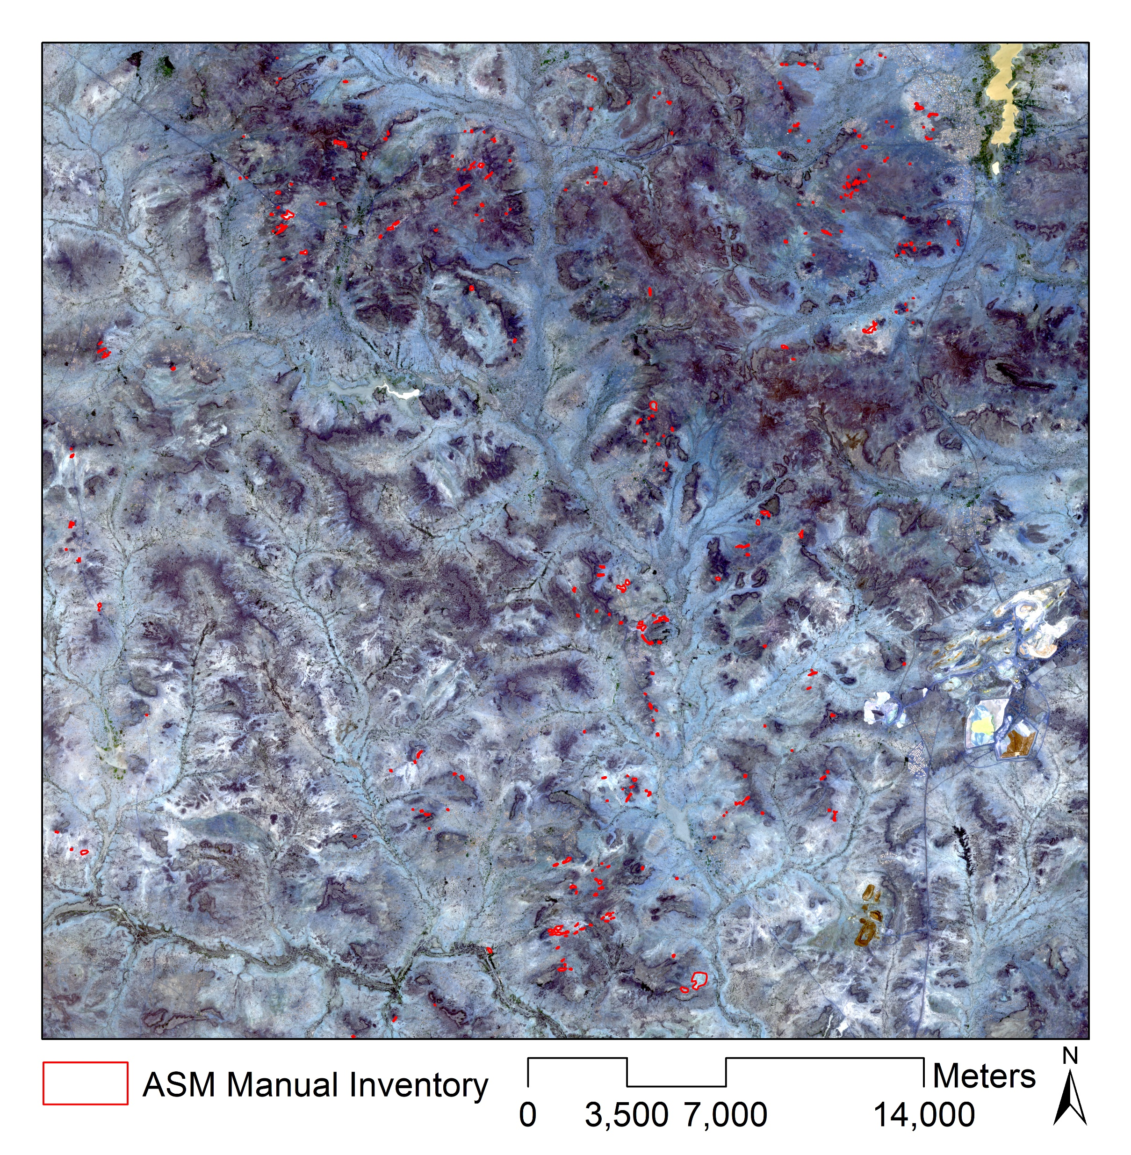
EGU General Assembly 2022
Study area - Burkina Faso:

Slide 7
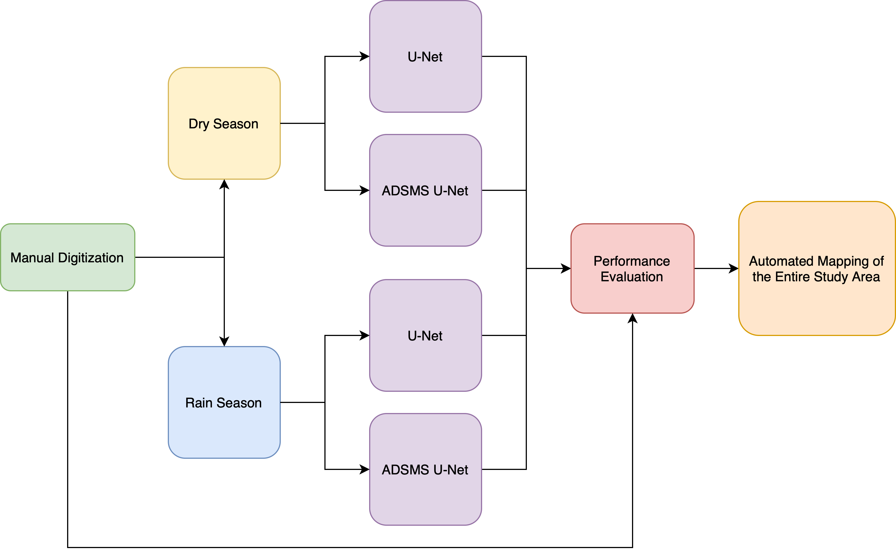
EGU General Assembly 2022
Methodology:

Slide 8
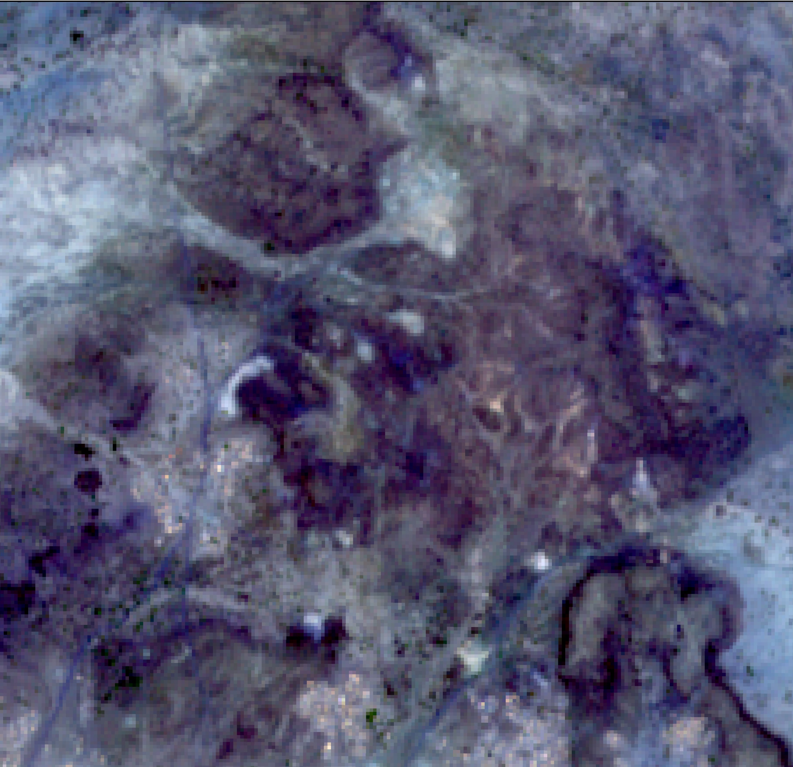

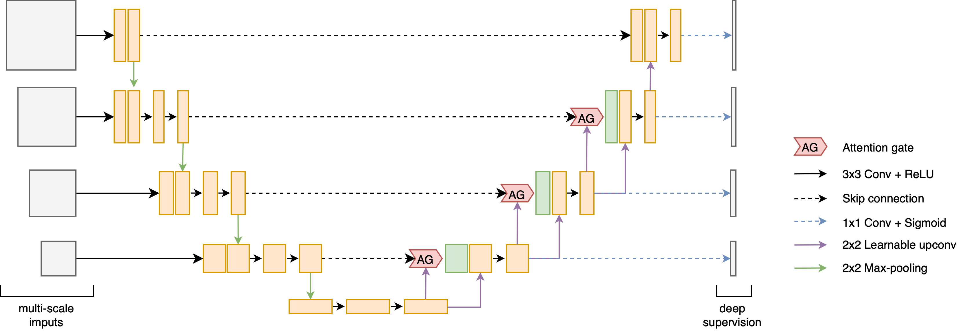


EGU General Assembly 2022
Methodology:
Sentinel-2 - RGB + Near Infrared (10m)
IMAGE SEGMENTATION
Abraham et al. 2019

Slide 9
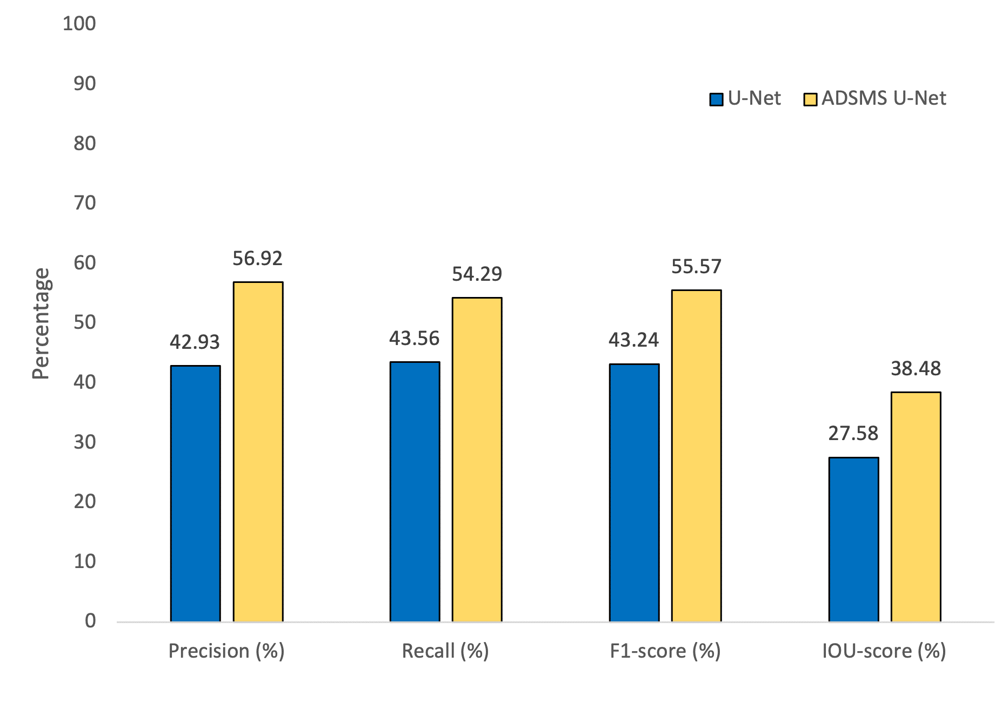
EGU General Assembly 2022
Rain season:

Slide 10
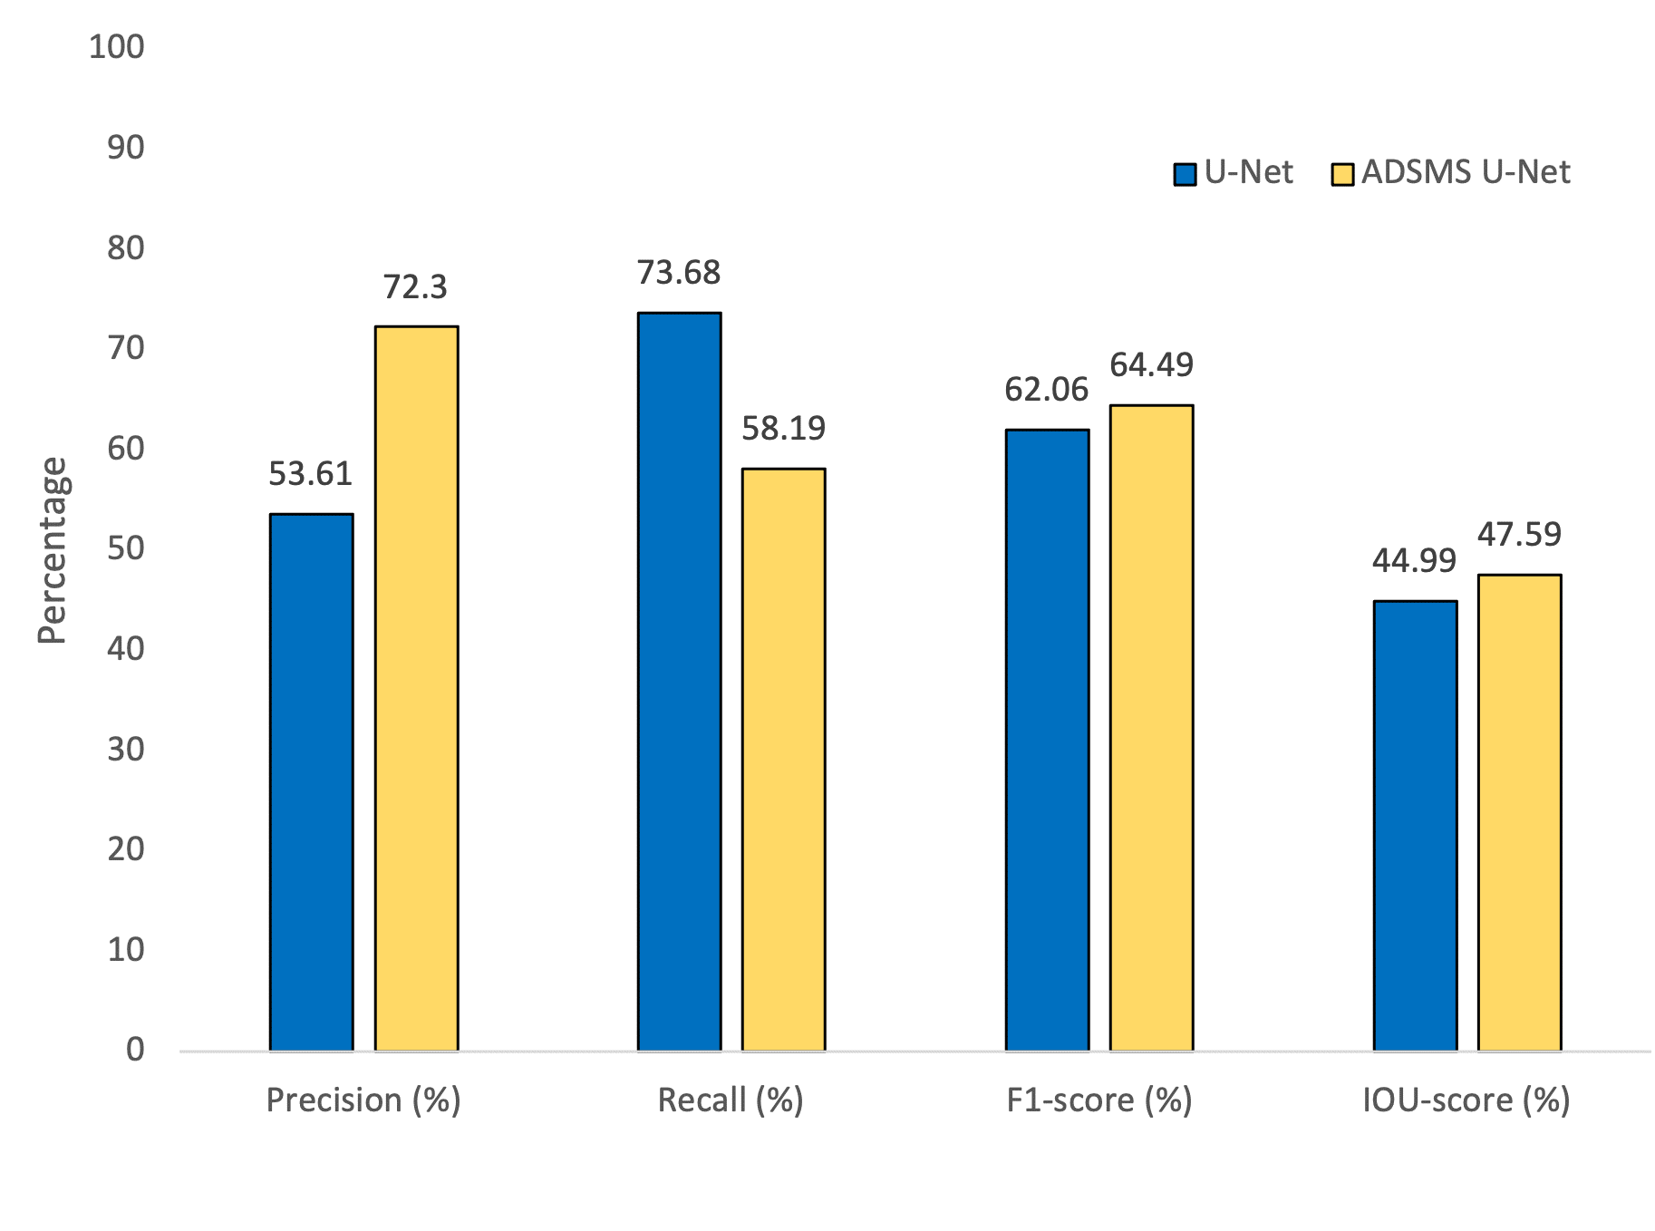
EGU General Assembly 2022
Dry season:

Slide 11
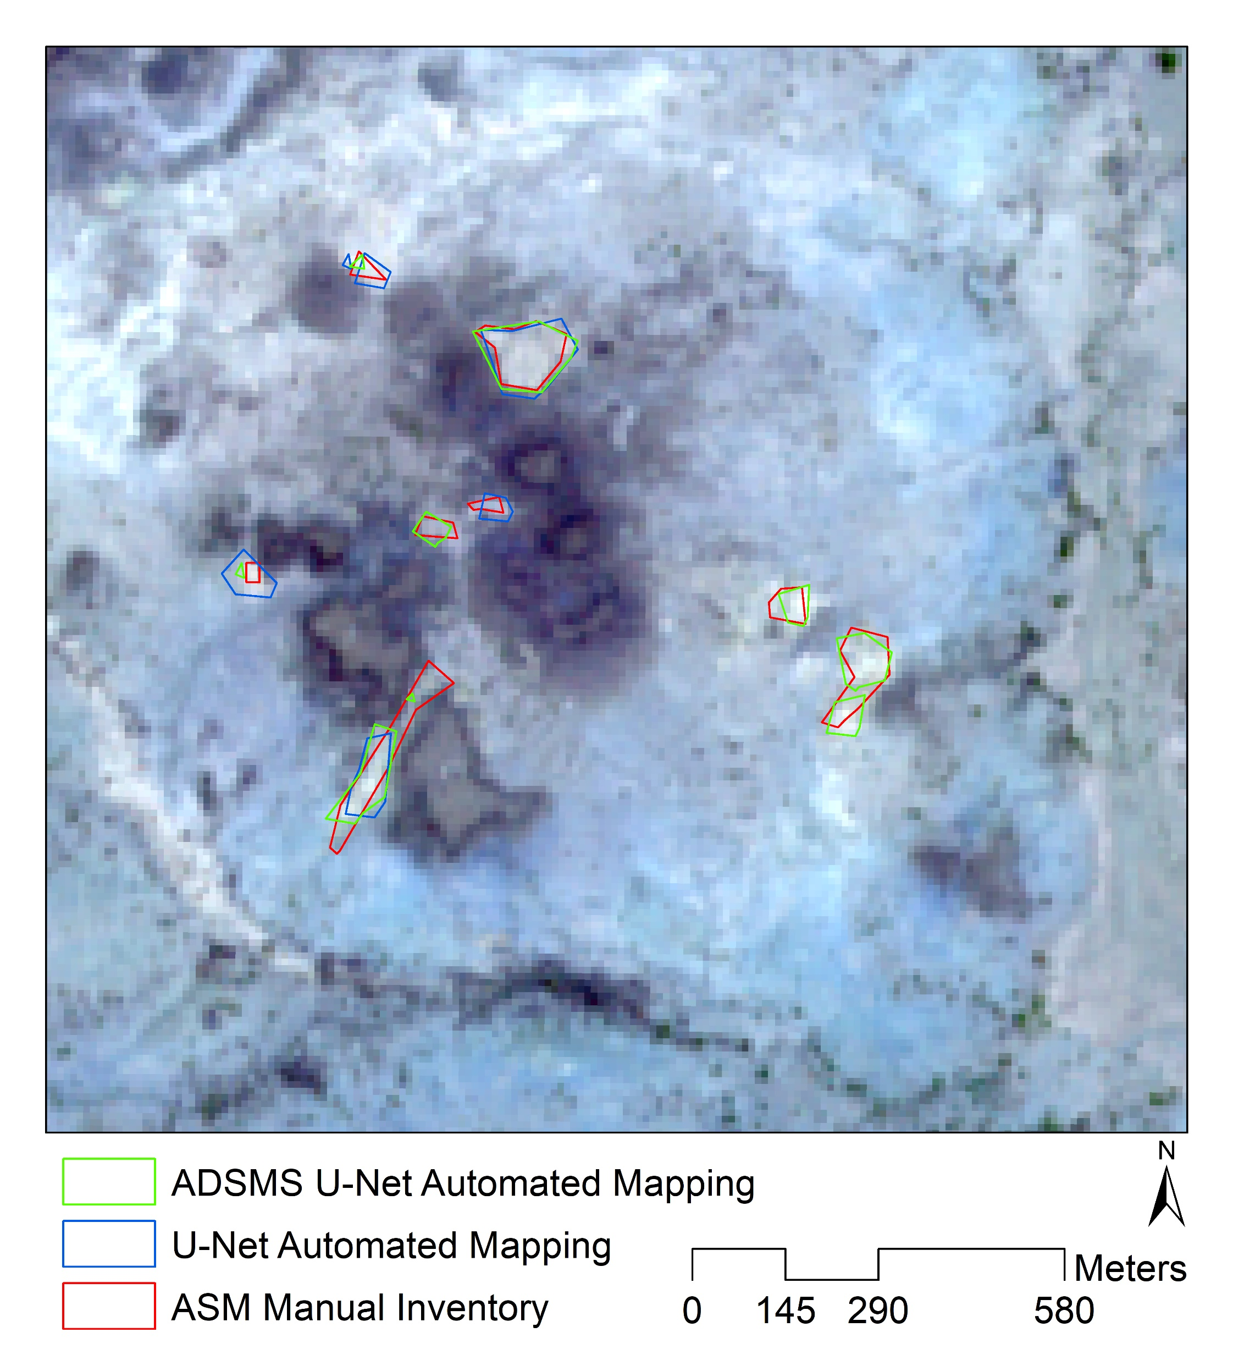
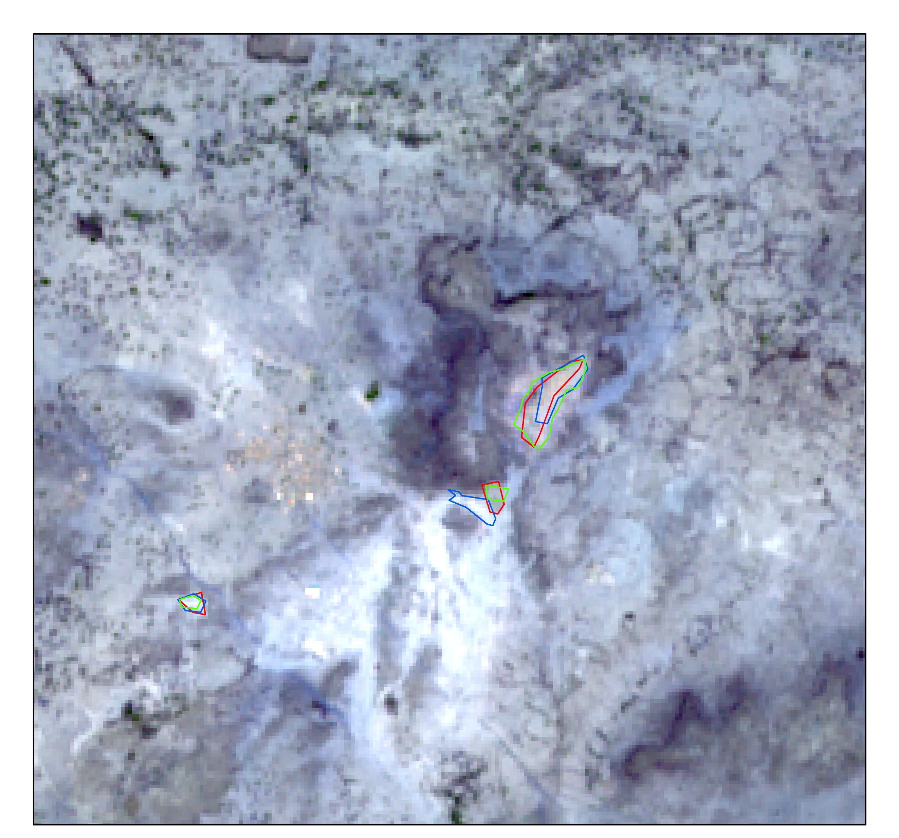
EGU General Assembly 2022
Dry season:

Slide 12
EGU General Assembly 2022
Conclusions:
The proposed approach is able to map ASMs even in the vey challenging semi-desert area starting with few training samples.
Best mapping performances in dry season.
ADSMS U-Net achieve better mapping performances than U-Net for ASM detection.
Help to implement management strategies for ASM formalization as well as to plan for environmental remediation interventions.

Slide 13
EGU General Assembly 2022
References:
Abraham, N., & Khan, N. M. (2019, April). A novel focal tversky loss function with improved attention u-net for lesion segmentation. In 2019 IEEE 16th international symposium on biomedical imaging (ISBI 2019) (pp. 683-687). IEEE.

Slide 14
THANK YOU
FOR YOUR ATTENTION
lorenzo.nava@phd.unipd.it

