Slide 1




Inundation Impacts on Agriculture:
Reconstruction and Preliminary Findings of the Recent Event occurred along the Panaro River
I.Borzì¹, A. Magnini², B. Monteleone³, R. Giusti³, N. Petruccelli², L. Marinelli², M. Arosio³, A. Domeneghetti², A. Castellarin², M. Martina³
¹Department of Engineering, University of Messina, Italy
²Department of Civil, Chemical, Environmental and Materials Engineering, Alma Mater Studiorum – Università di Bologna, Bologna, Italy
³IUSS - University School for Advanced Studies of Pavia, Pavia, Italy
Corresponding author: beatrice.monteleone@iusspavia.it

Slide 2
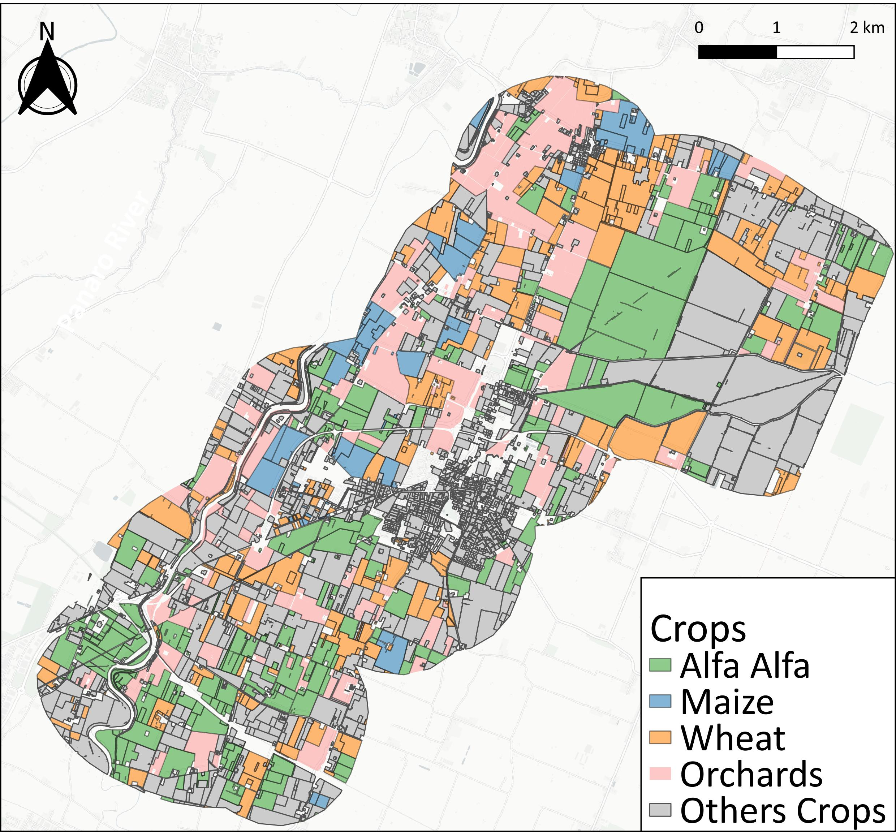
Event and case study location
6th December 2020
Breach on the right levee of the Panaro River
Agricultural area
Crop | Sowing window
Winter wheat | October-November
Sorghum | April-May
Sugar beet | February-March
Maize | April-May
Soybean | April-May
Barley | October-November
Alfalfa | Spring or late summer
Orchards | Perennial
Sunflower | March-April
Forage | Perennial
Tomato | April-May

Slide 3
Aim of the study
Show a methodology to estimate the agricultural damage through the use of multiple sources
Identification of inundated agricultural areas
Agricultural damage estimation
Comparison of the damage estimations from the various sources

Slide 4





Methodology
Identification of inundated agricultural areas
Agricultural damage estimation
Hydraulic modelling integrated with info from local sources
Crop models
Expert-based models
Info from local farmers
AGRIDE-c

Slide 5

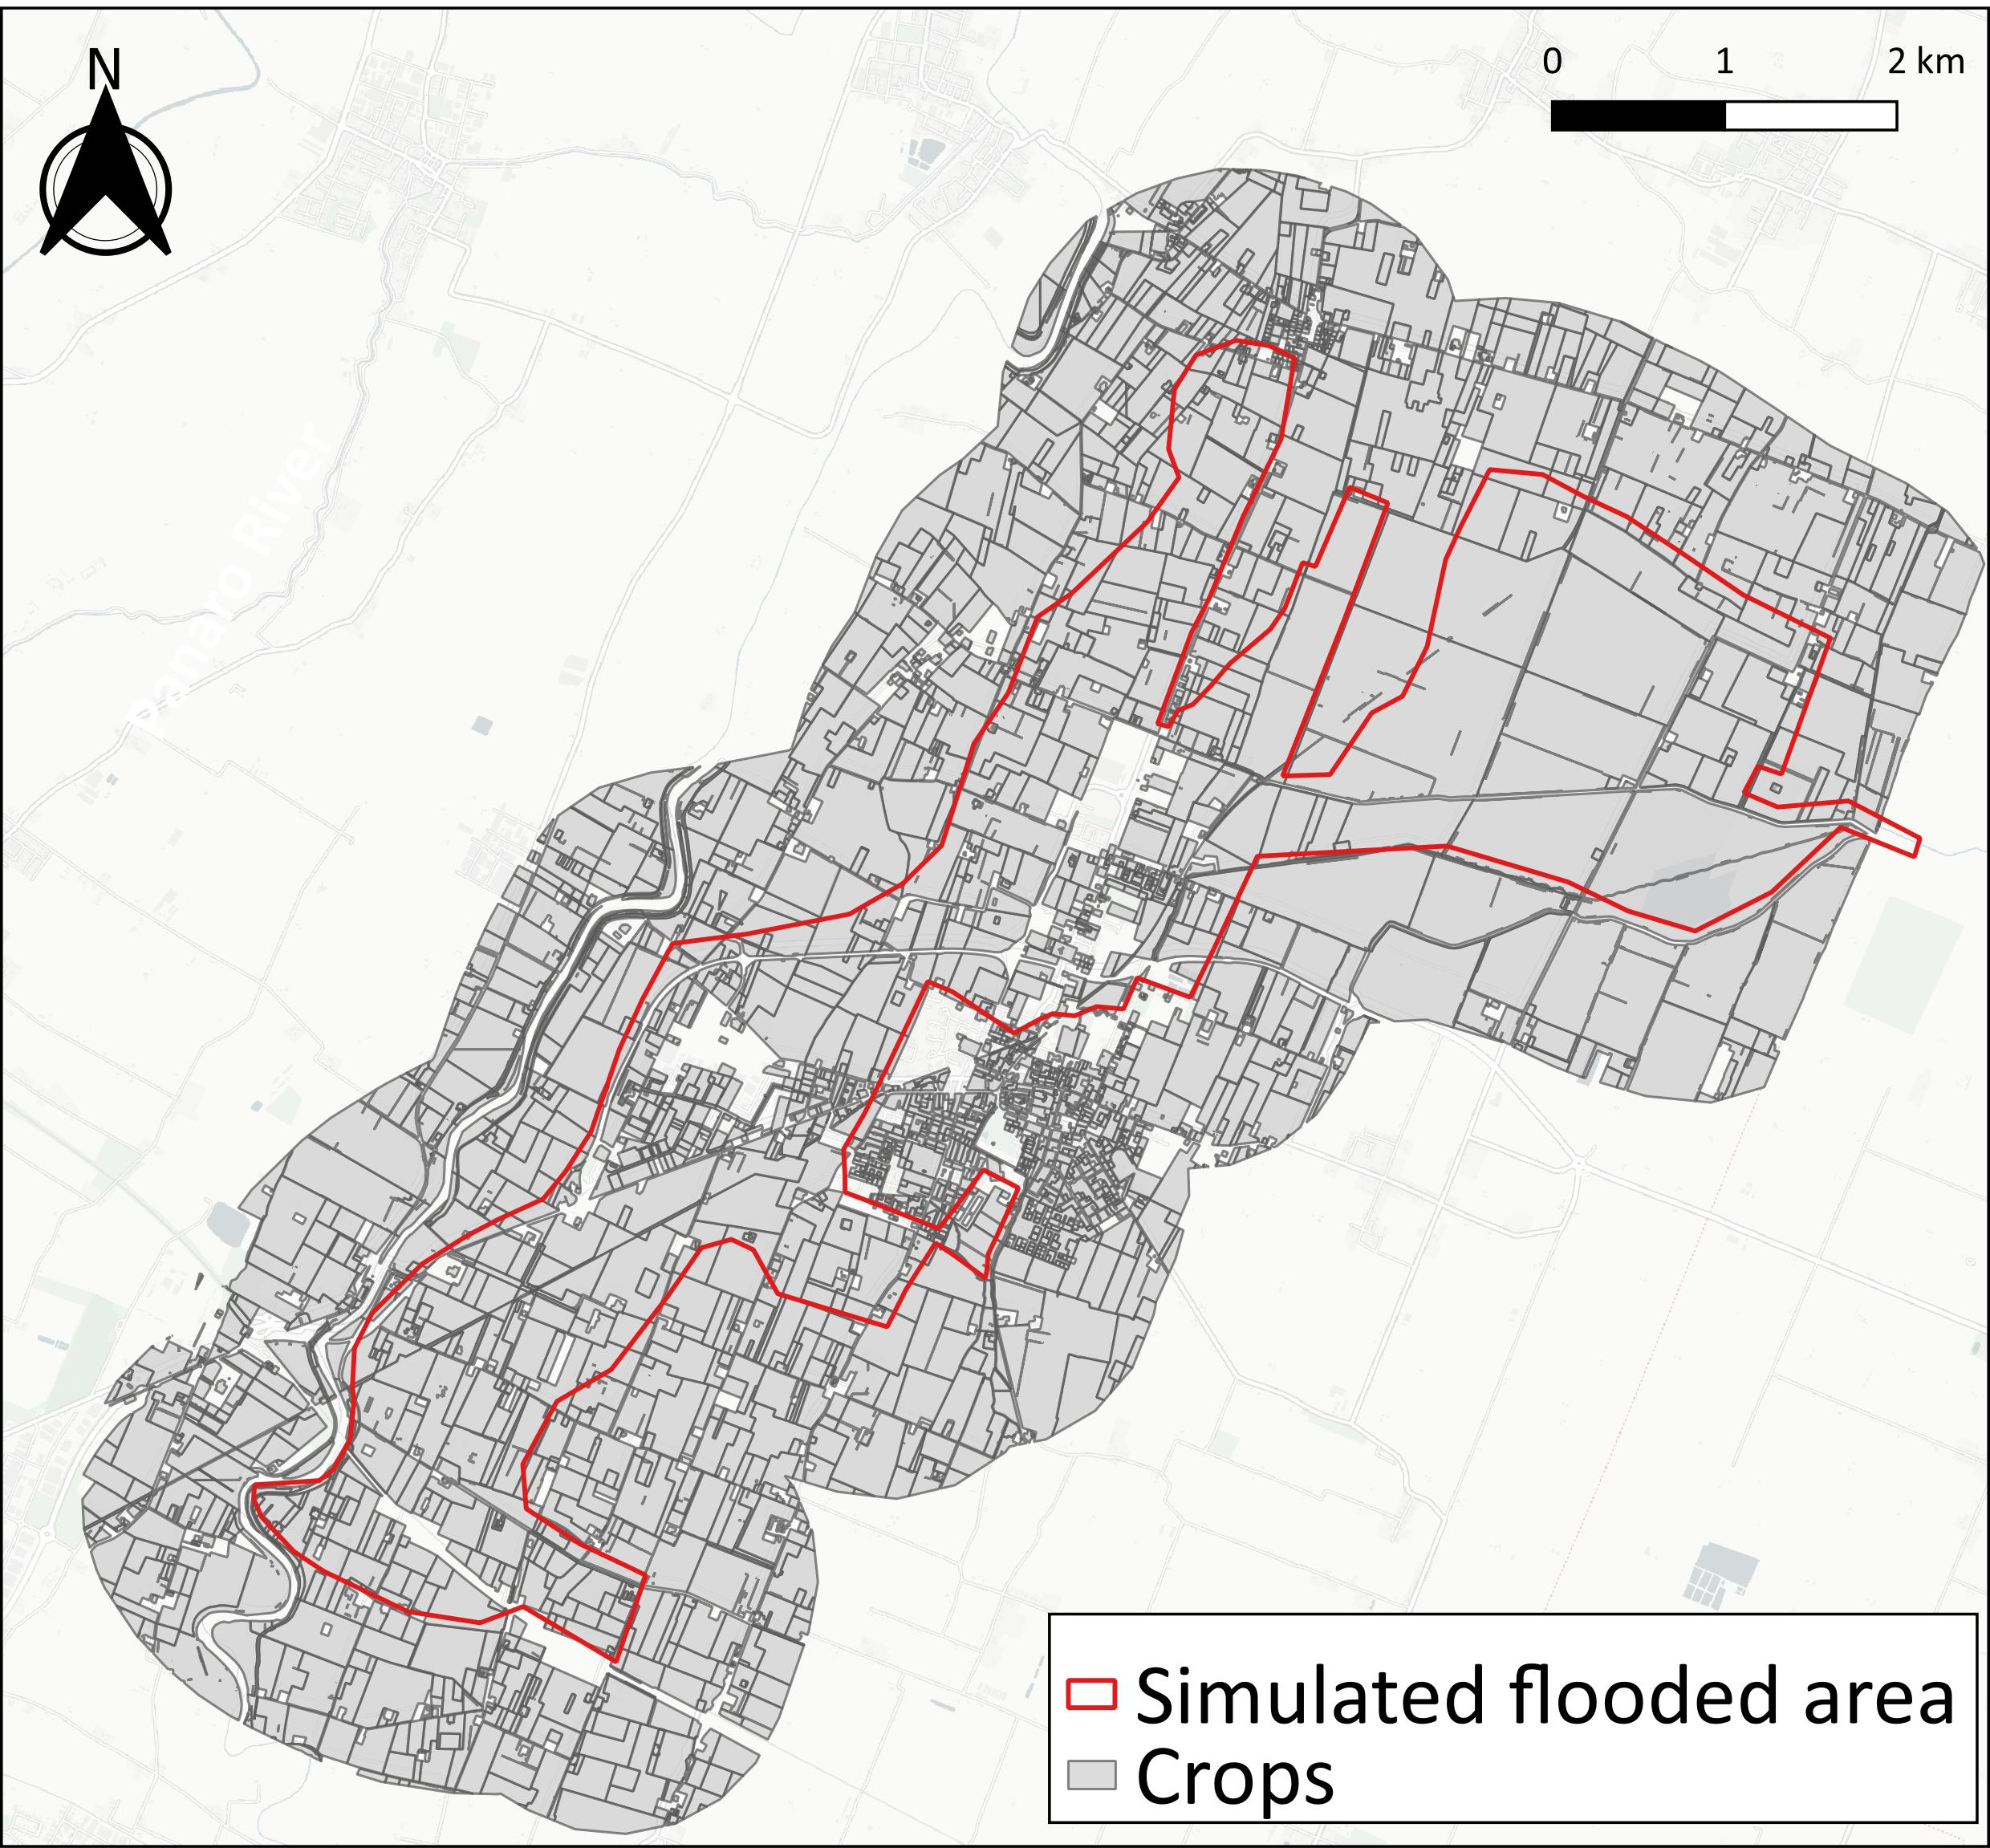
Results
Inundated areas
Agricultural damage: comparison of results
Wheat
Alfalfa
No crop models able to simulate flood damage on alfalfa
AGRIDE-c: no damage
Local farmers: damage depends on debris
700ha

Slide 6
Conclusions and next steps
Conclusions:
  Utility of crop models to simulate yield losses due to flood for wheat
  Damage underestimation with models (both for wheat and alfalfa) with respect to local farmers
  Development of a complete framework
Future steps:
  Scalability of the framework
  Better estimation of damage to forage crops

Slide 7
Thank you
beatrice.monteleone@iusspavia.it

