Slide 1
Healthy soils, a fresh start.
European Commission, Joint Research Centre (JRC), Ispra, Italy
Anna Muntwyler, Anne Marechal, Alberto Orgiazzi, Arwyn Jones, Calogero Schillaci, Constantin Ciupagea, Daniele Belitrandi, Daniela de Medici, Daniele de Rosa, Diana Vieira, Francis Mathews, Juan Martin Jimenez, Julia Koeninger, Leonidas Liakos, Luca Montanarella, Maeva Labouyrie, Marc Van Liedekerke, Panos Panagos, Piotr Wojda, Simone Scarpa

Slide 2
Soil Health. Why now?

Slide 3
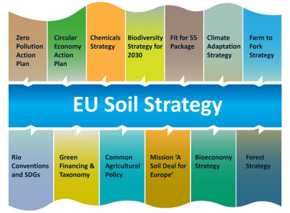
Soil strategy ambition
achieve a land degradation-neutral world;
restore degraded and carbon-rich ecosystems;
greenhouse gas removal for the land use, land use change and forestry sector;
reduce:
nutrient losses by at least 50%;
use and risk of chemical pesticides by 50%;
use of hazardous pesticides by 50% by 2030.
significant progress in the remediation of contaminated sites.
reach no net land take.
creating a toxic-free environment.
achieve land-based climate neutrality in the EU by 2035.

Slide 4
Healthy Soils
‘(…) when they are in good chemical, biological and physical condition, and thus able to continuously provide as many of the following ecosystem services as possible (…)’
In Soil strategy for 2030.
Soil health is the capacity of a soil to sustain, within natural or managed ecosystem boundaries, the delivery of ecosystem services according to intrinsic soil properties, climate and land use.
Healthy soils are characterized by physical, chemical, and biological conditions that ensure their multifunctionality and governs their capacity to provide the best tradeoffs between ecosystem services, while ensuring resilience to different stressors.

Slide 5

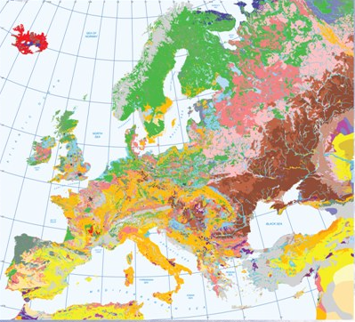
Ecosystem services provision
provide food and biomass production, including in agriculture and forestry;
absorb, store, filter and transform water and nutrients and substances, thus protecting groundwater bodies;
provide the basis for life and biodiversity, including habitats, species and genes;
act as a carbon reservoir;
provide a physical platform and cultural services for humans and their activities;
act as a source of raw materials;
constitute an archive of geological, geomorphological and archaeological heritage.
Compatibility
Variability

Slide 6
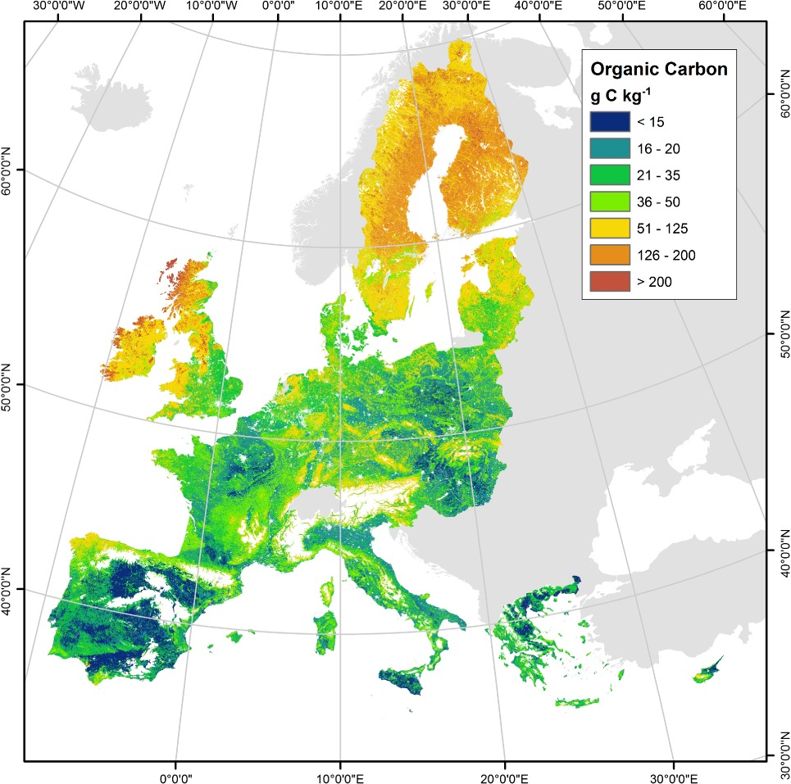
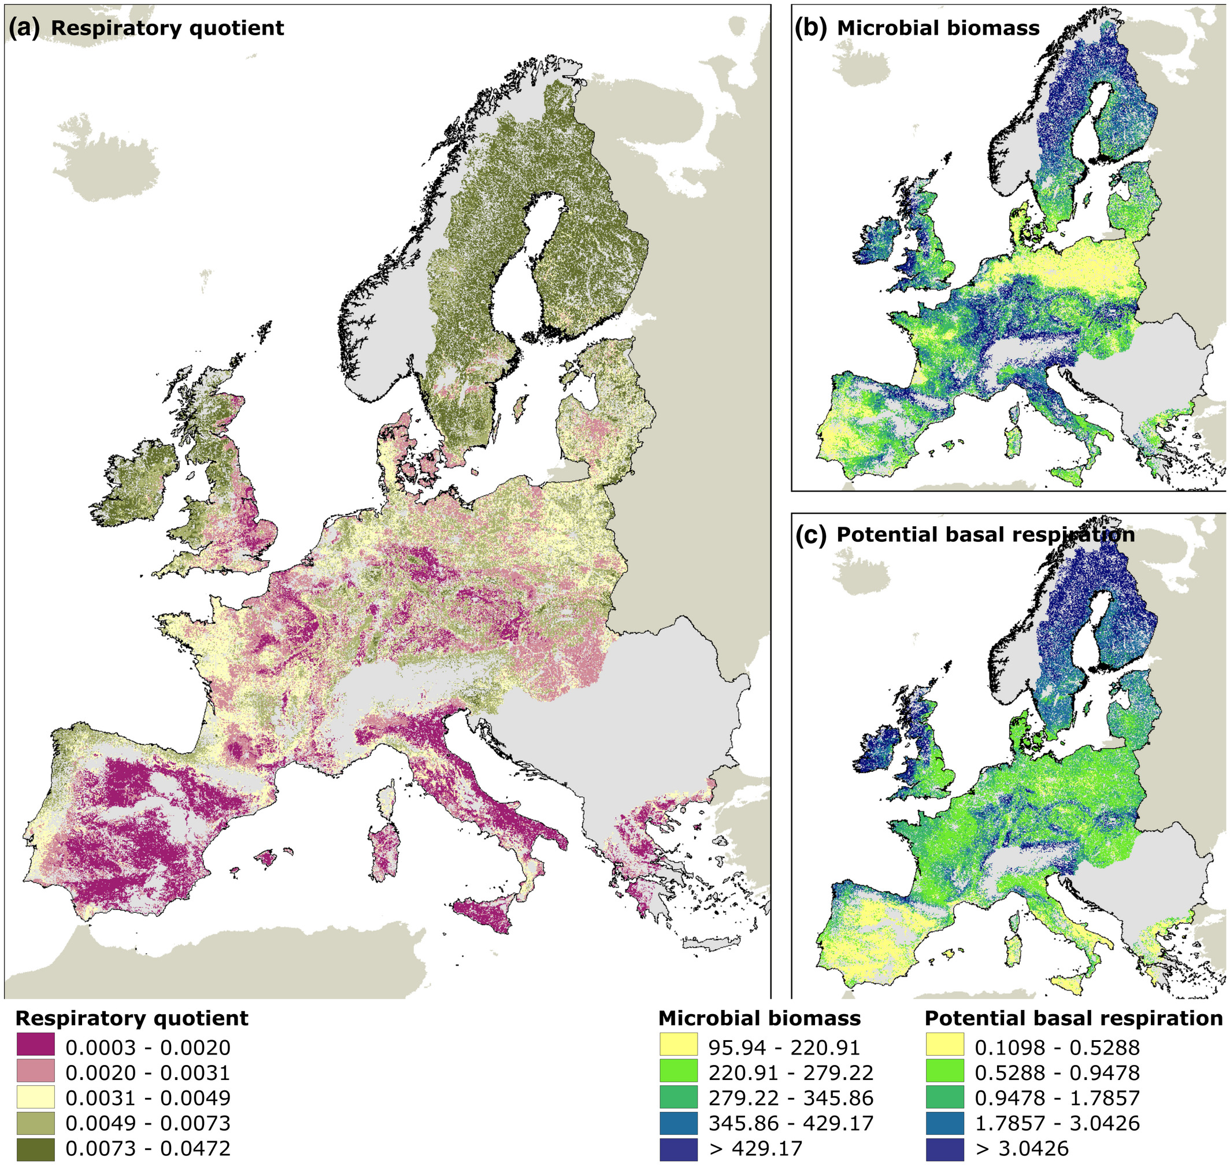
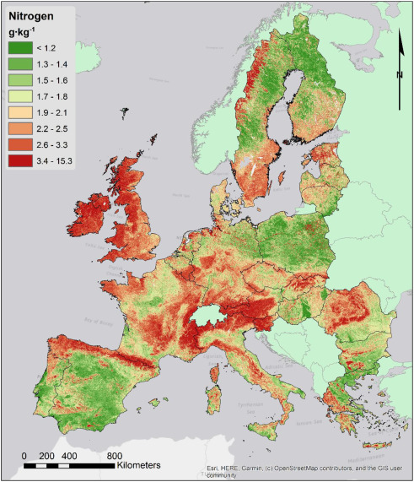
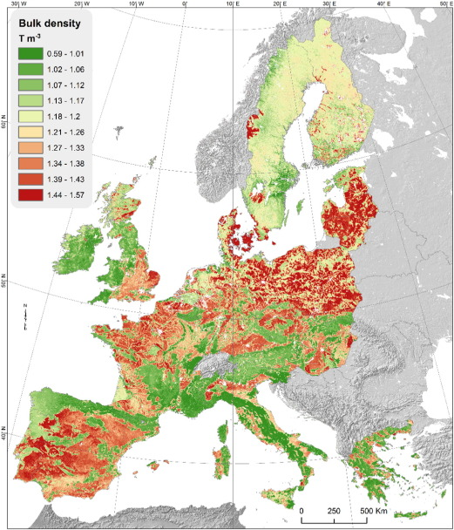
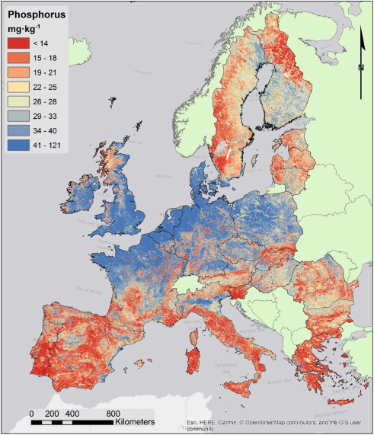
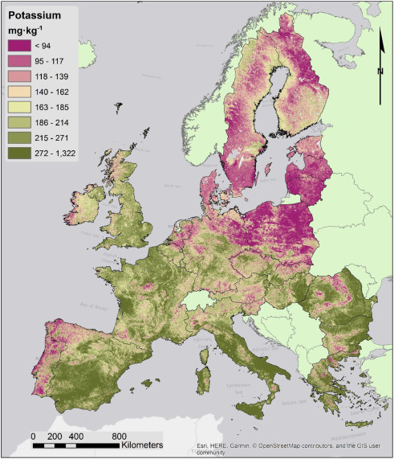
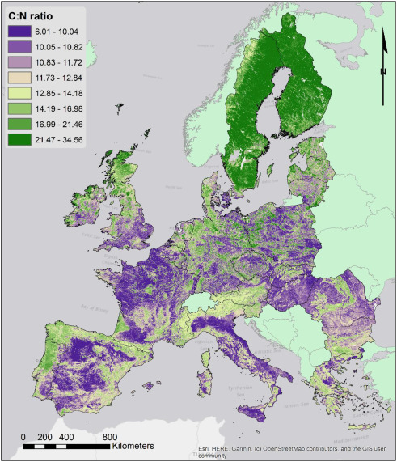
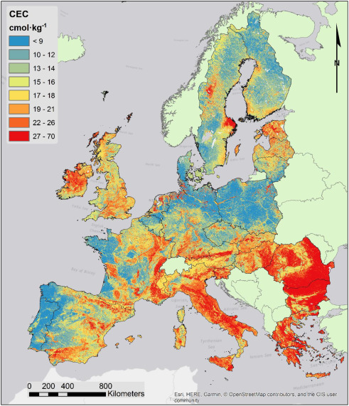
Healthy Soils
EUSO, LUCAS, ESDAC
…can already provide us some insights, but additional efforts are still required.
Maps from Ballabio et al., 2019; 2016; de Brogniez et al., 2014; Smith et al., 2021;
located at https://esdac.jrc.ec.europa.eu/

Slide 7
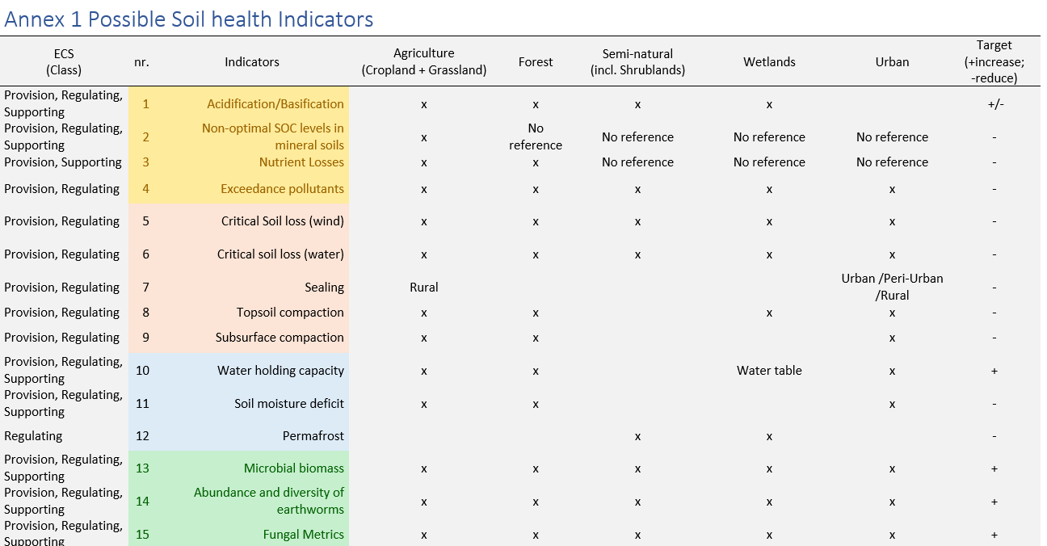
Healthy Soils – Ongoing work

Slide 8


Thank you
More information on https://esdac.jrc.ec.europa.eu/
European Soil Observatory - EUSO
European Soil Data Centre – ESDAC
@EU_ScienceHub
@dicasivi
© European Union 2020
Unless otherwise noted the reuse of this presentation is authorised under the CC BY 4.0 license. For any use or reproduction of elements that are not owned by the EU, permission may need to be sought directly from the respective right holders.
Notes:
Update/add/delete parts of the copy right notice where appropriate.
More information: https://myintracomm.ec.europa.eu/corp/intellectual-property/Documents/2019_Reuse-guidelines%28CC-BY%29.pdf

