Slide 1

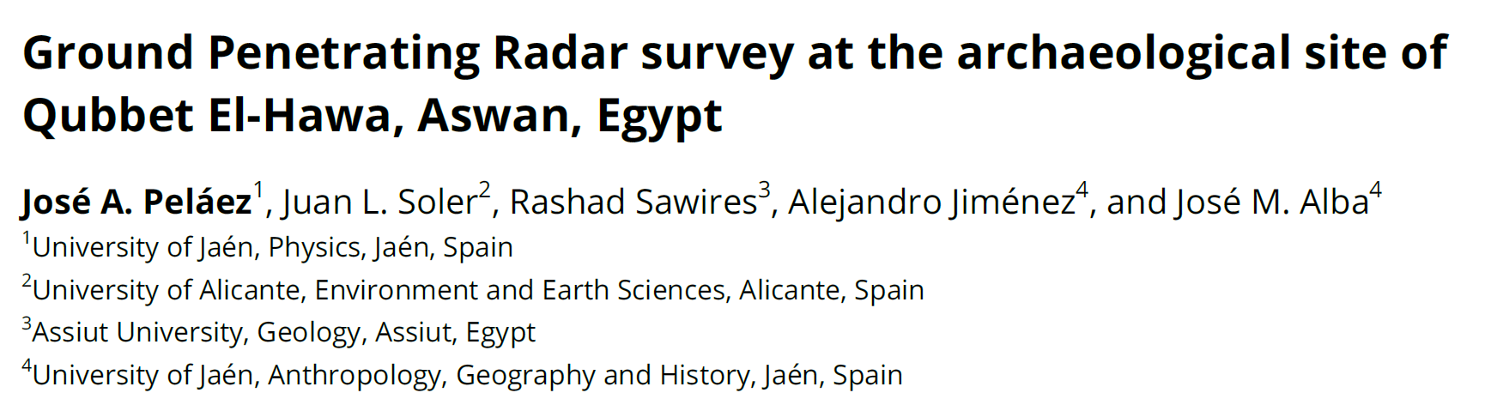

Slide 2
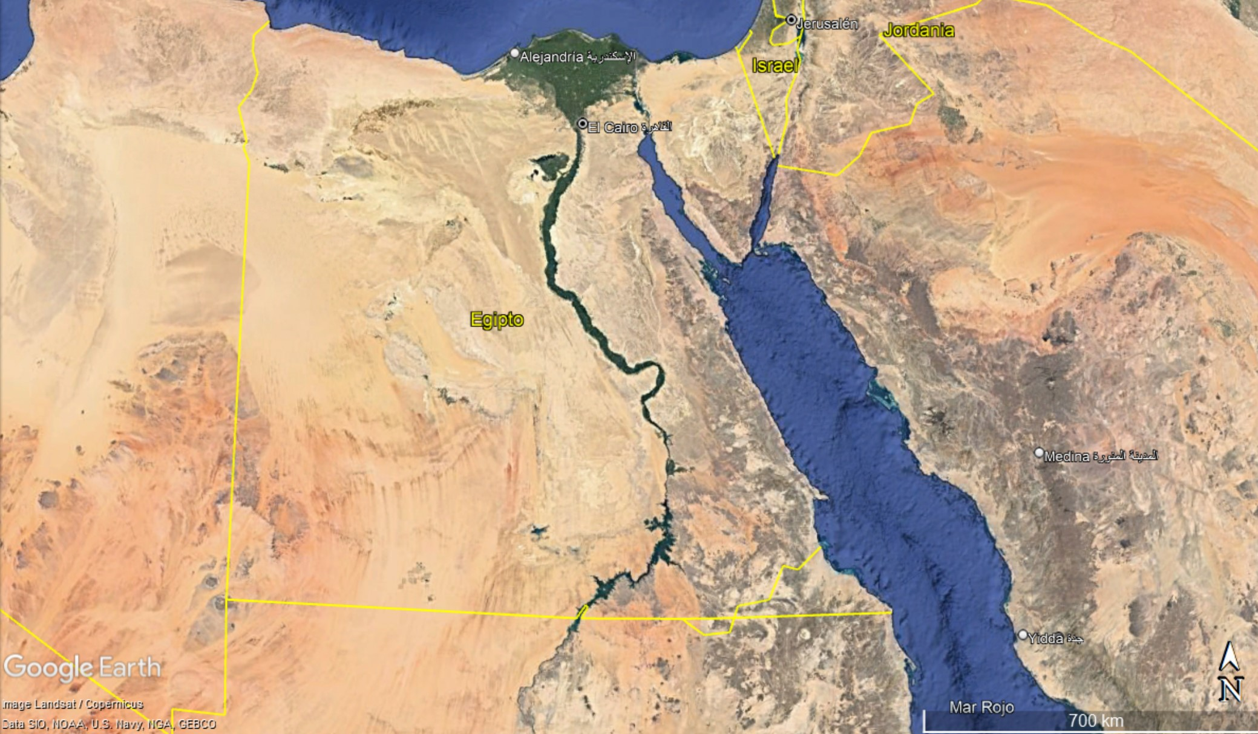
ASWAN

Slide 3
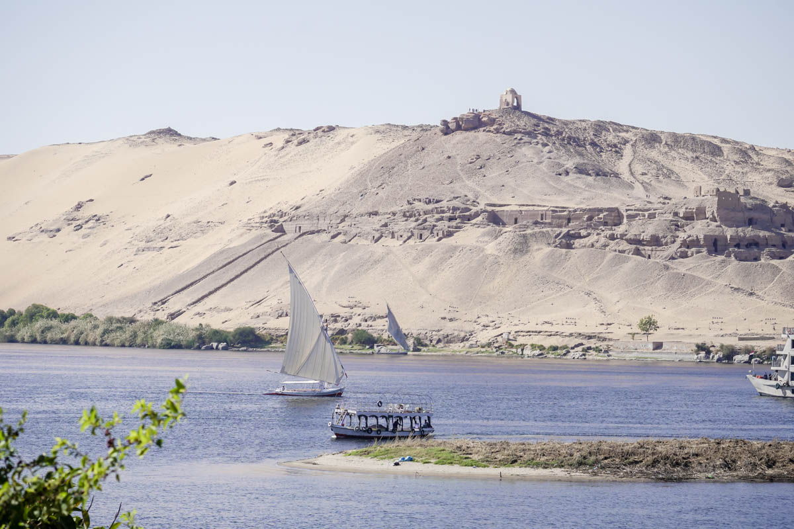
Qubbet el-Hawa
The dome of the winds
2500 B.C. – Roman times

Slide 4
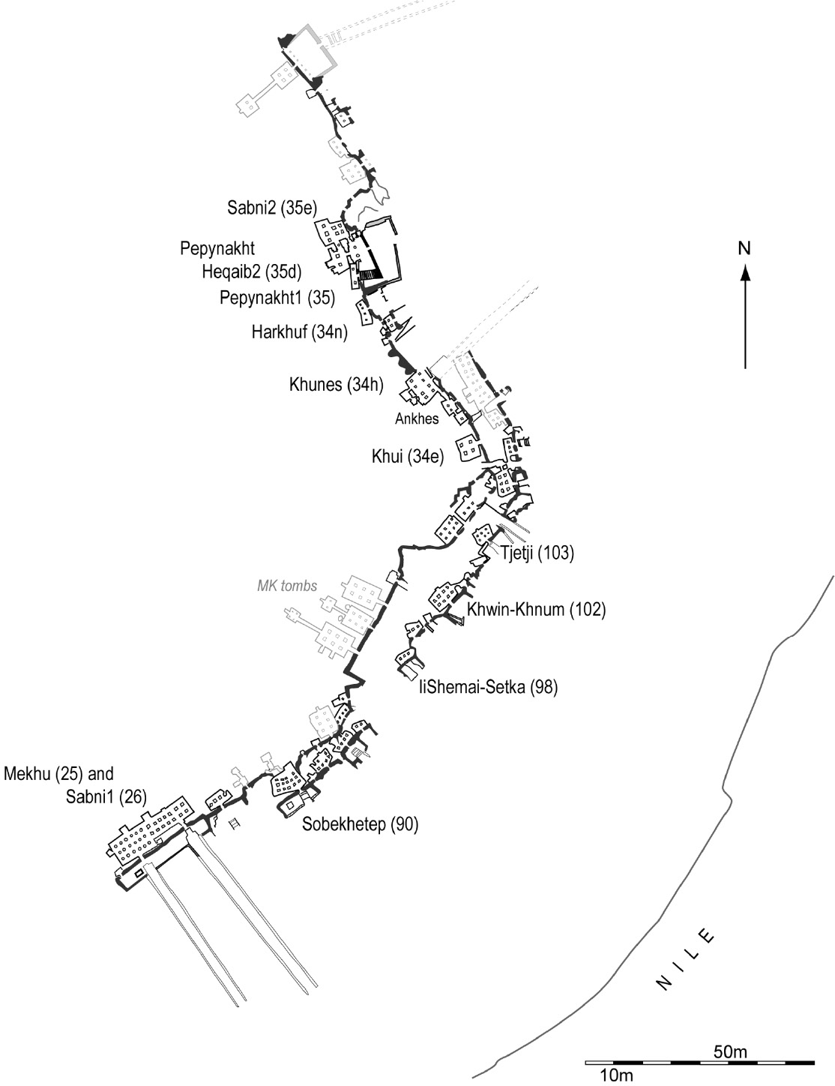
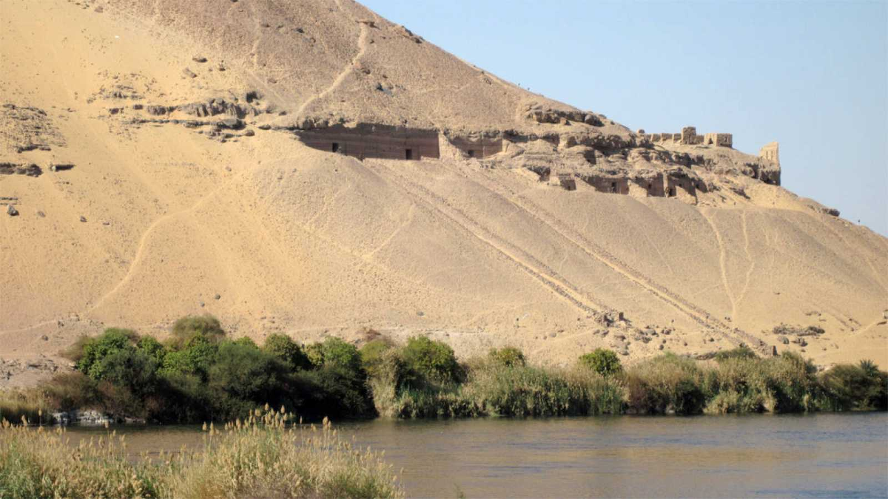
Funerary structures in the rock

Slide 5
Nubian sandstone
Normal faults and diaclases

Slide 6
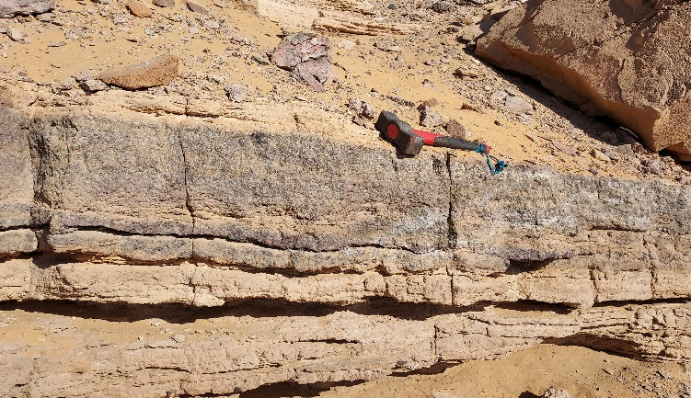
Nubian sandstone
Stratigraphic discontinuities

Slide 7
Nubian sandstone
Stratigraphic discontinuities

Slide 8
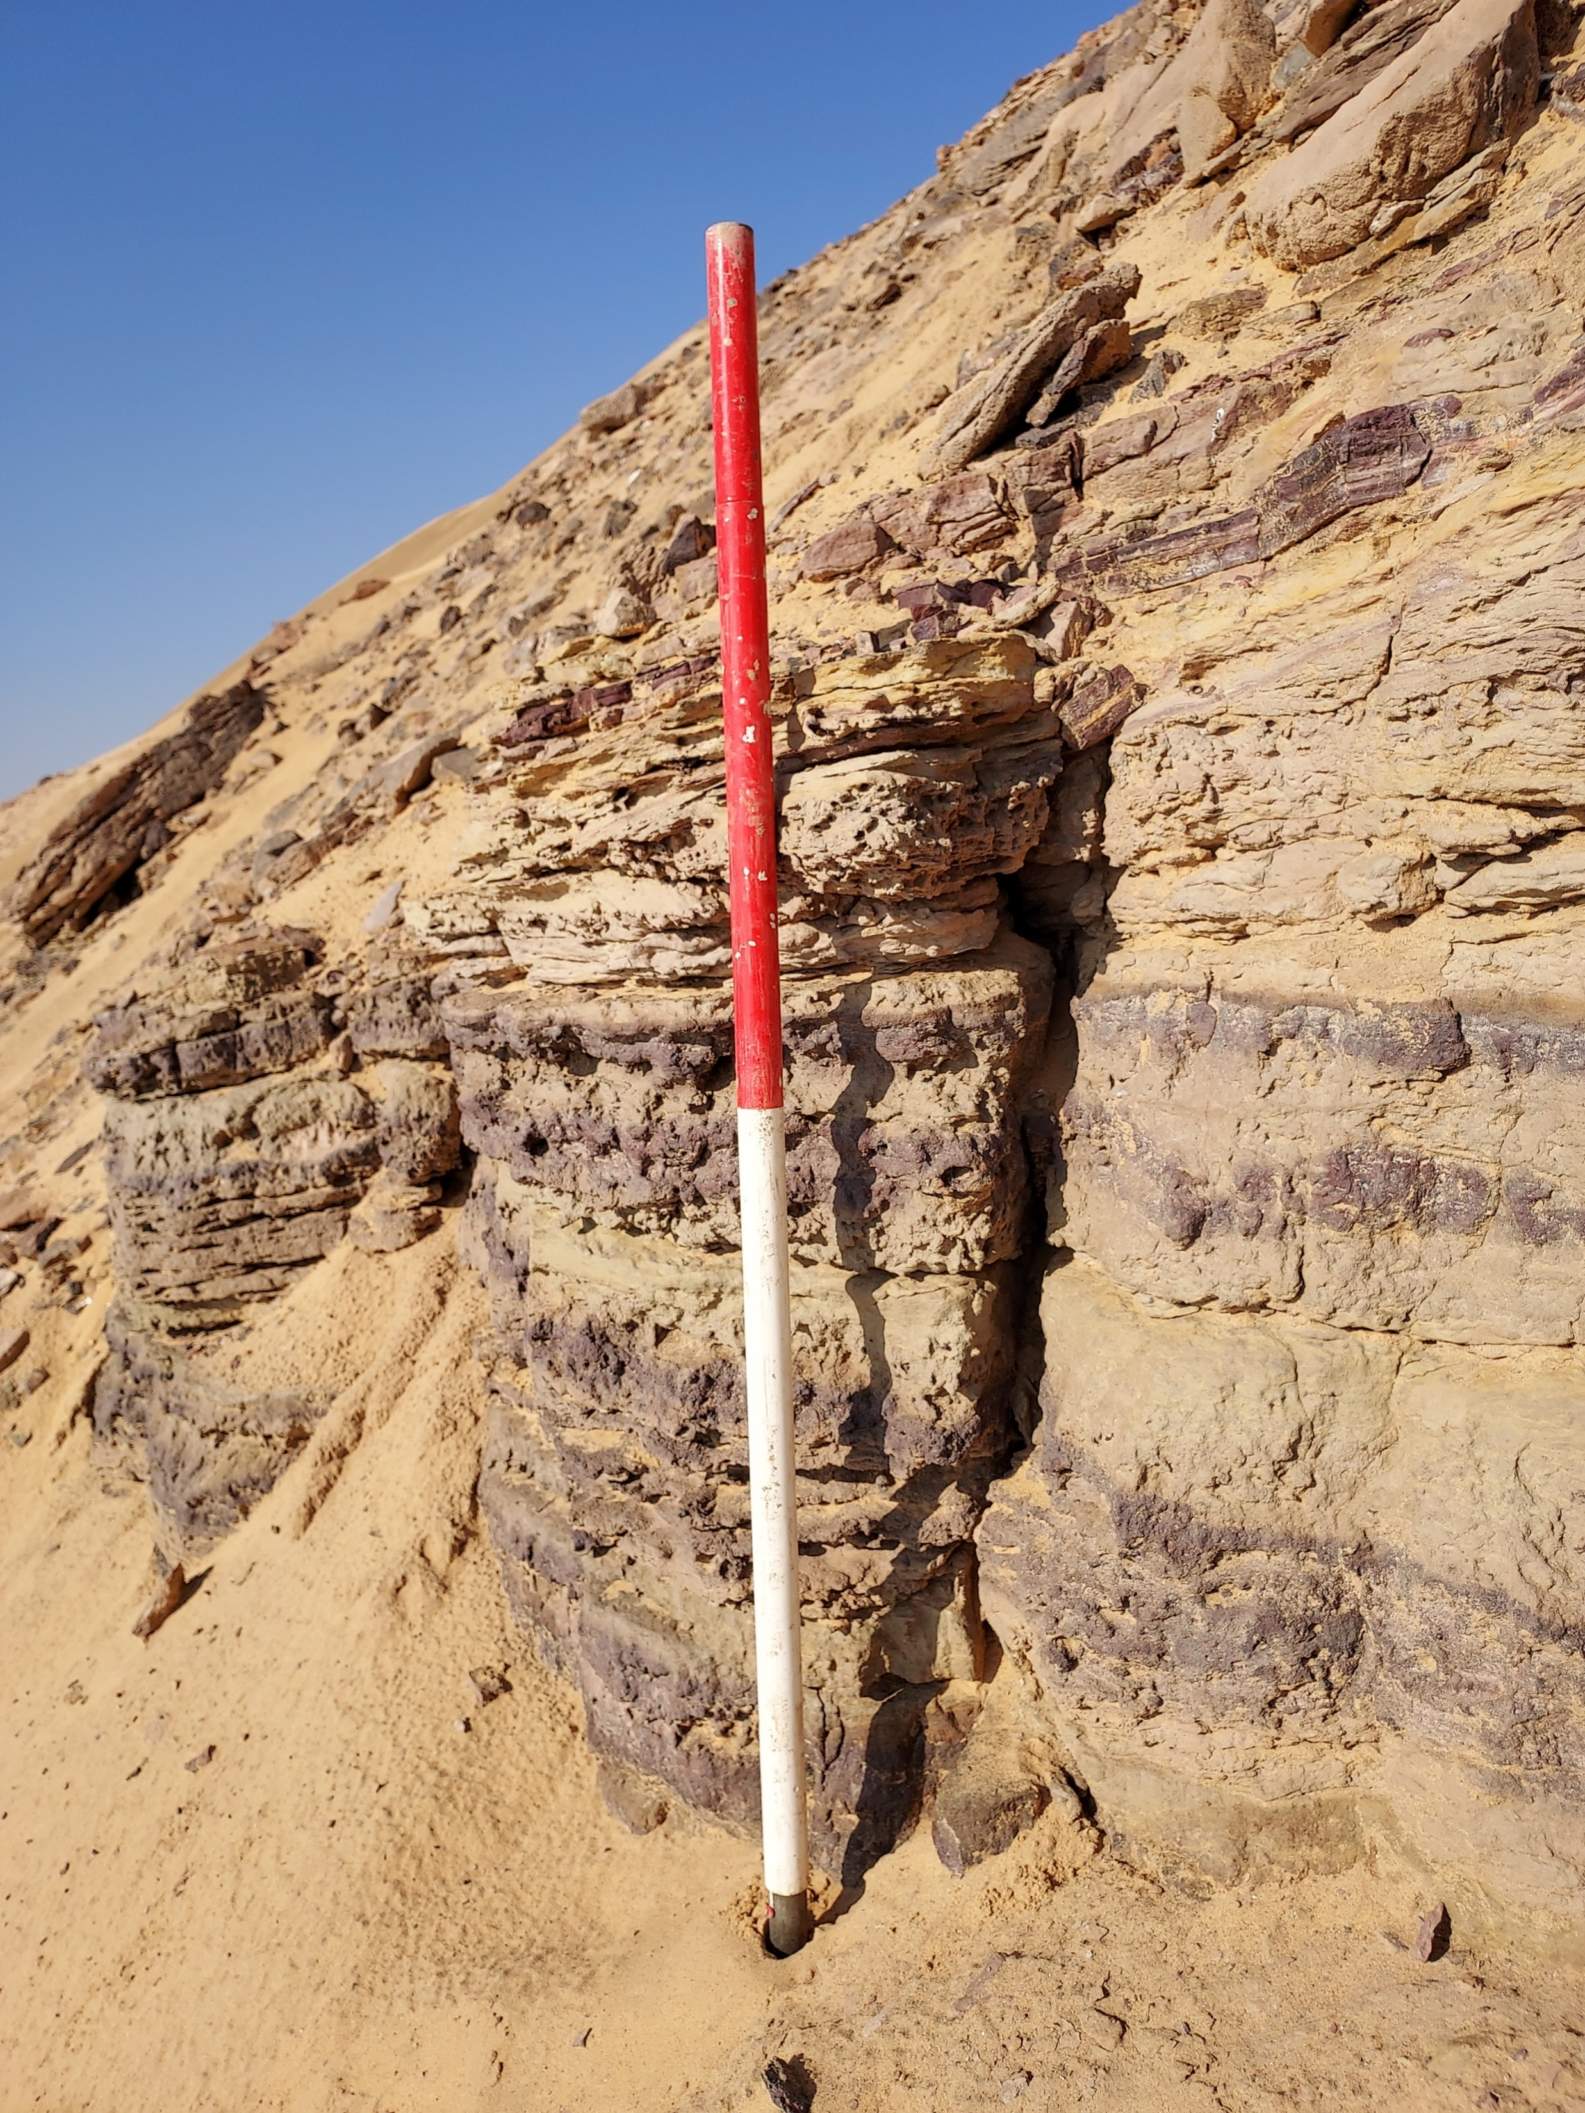
Nubian sandstone
Stratigraphic discontinuities

Slide 9
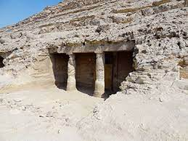
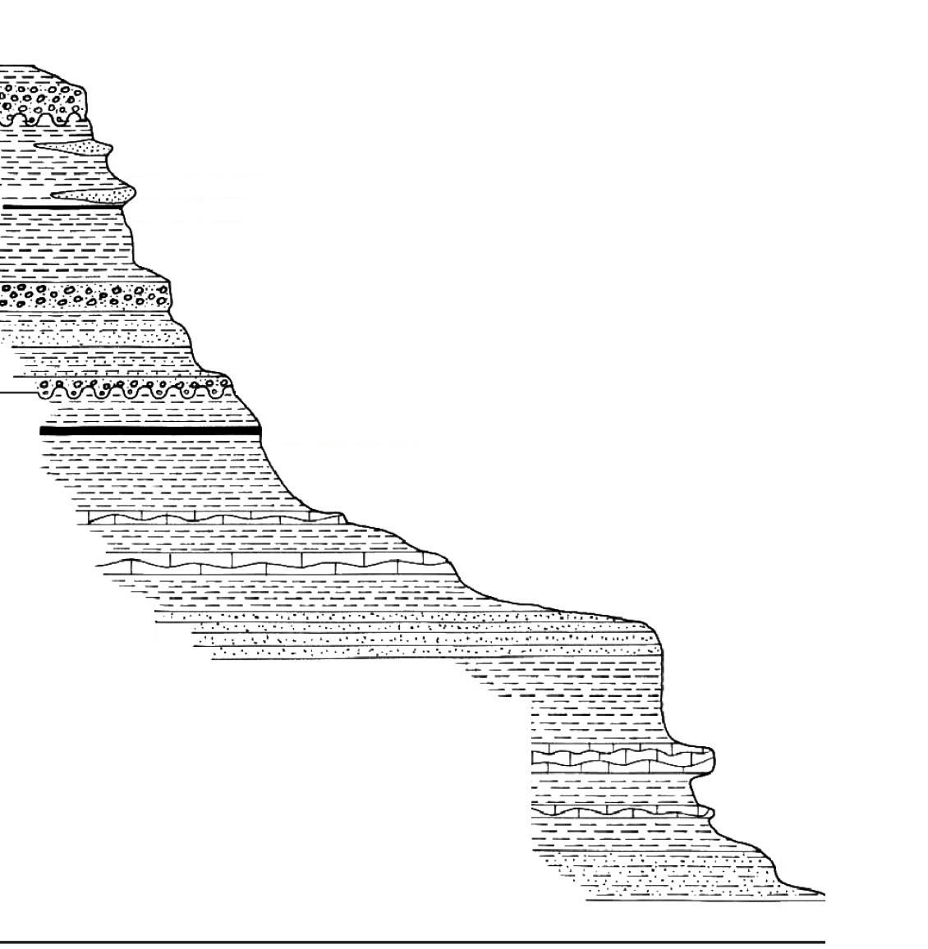

- Dry loose sand area
- High slope area (> 25%)
- Rocks along the slope
- Interface sand - sandstone

Slide 10
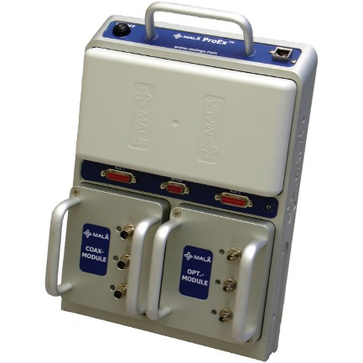
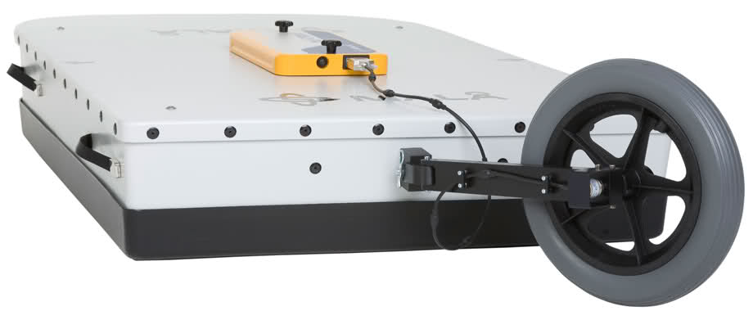
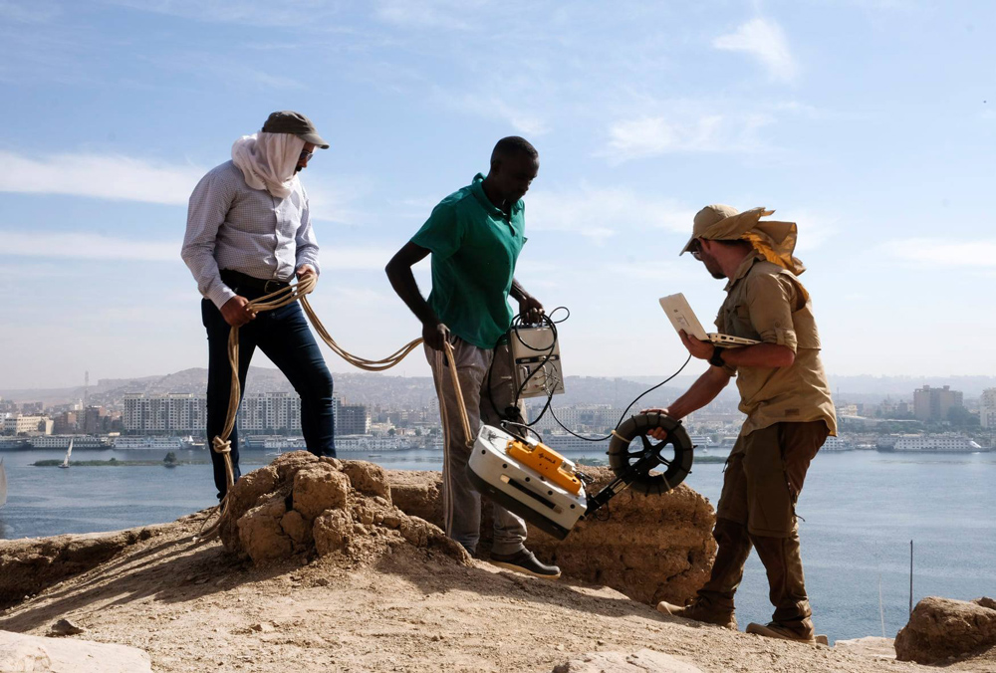

Slide 11
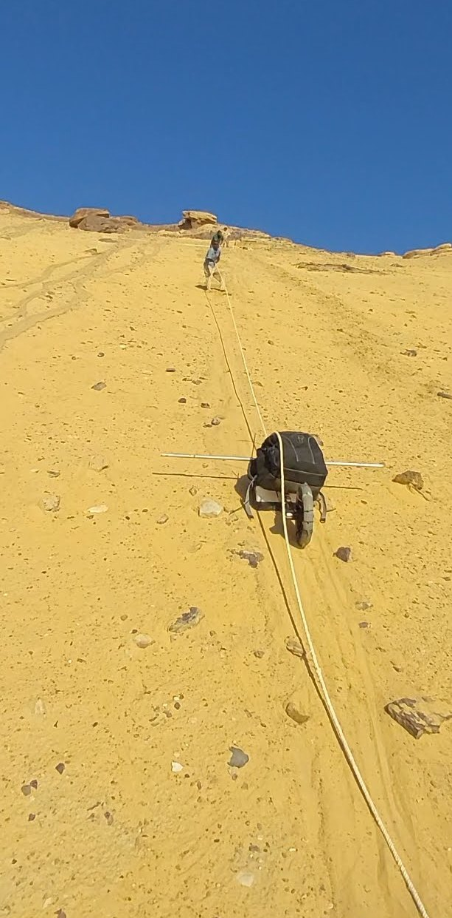
- Lengt profile: 45 - 50 m
- 500 MHz antenna
- Ropes to pull the device
- Rope wrapped around the wheel
- Attached rod

Slide 12
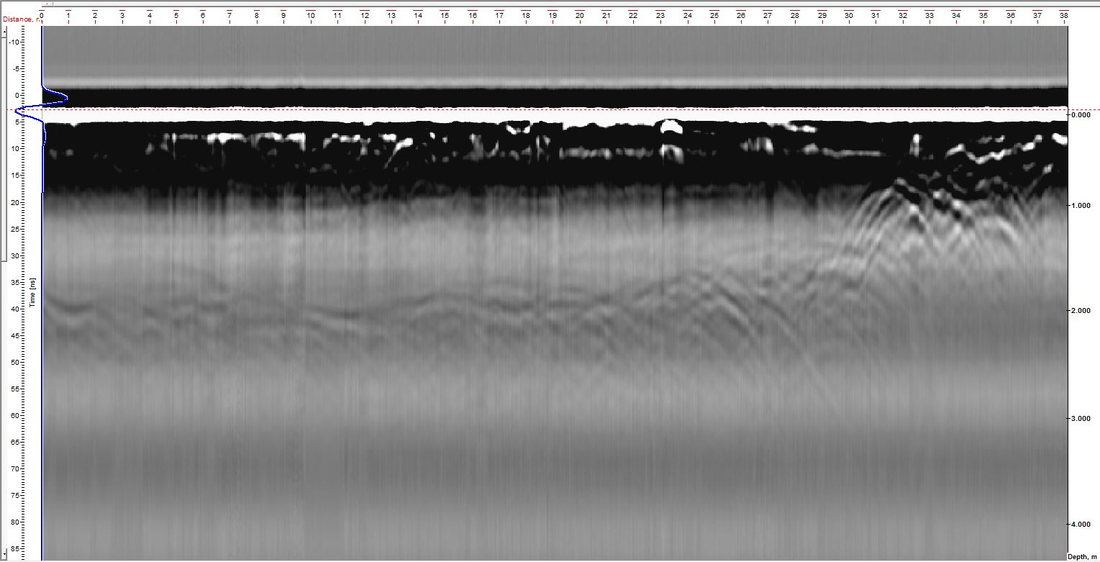
250 MHz antenna
Bottom
38 m
Top

Slide 13
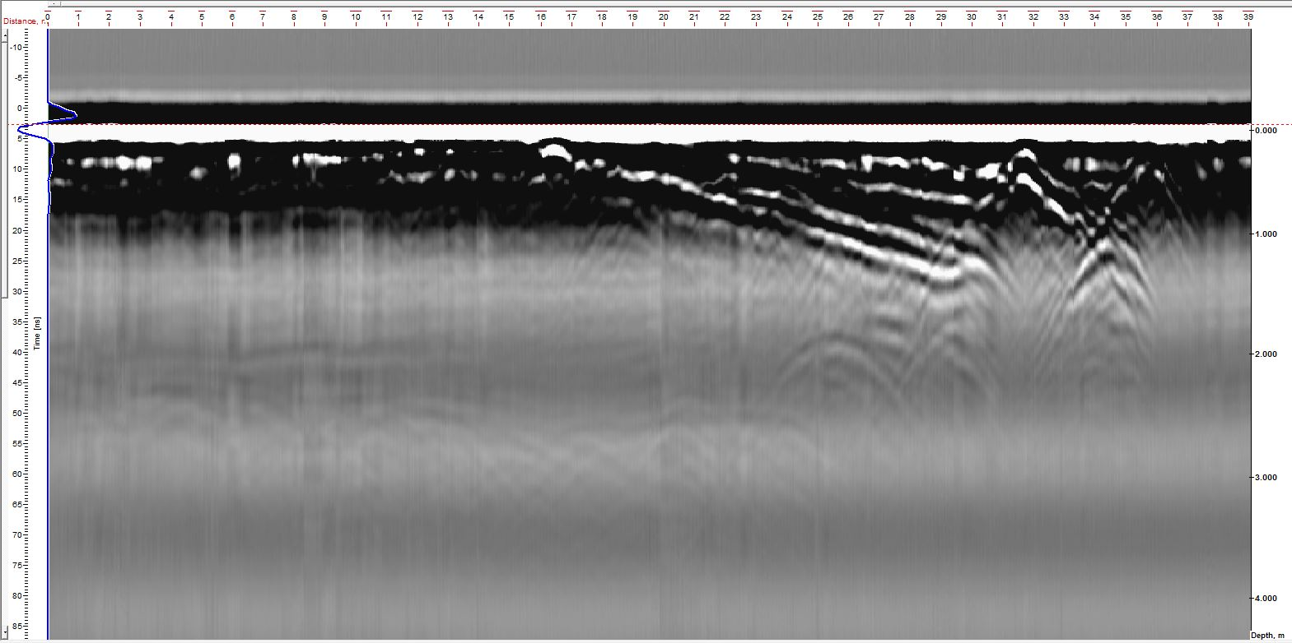
250 MHz antenna
Bottom
39 m
Top

