Slide 1
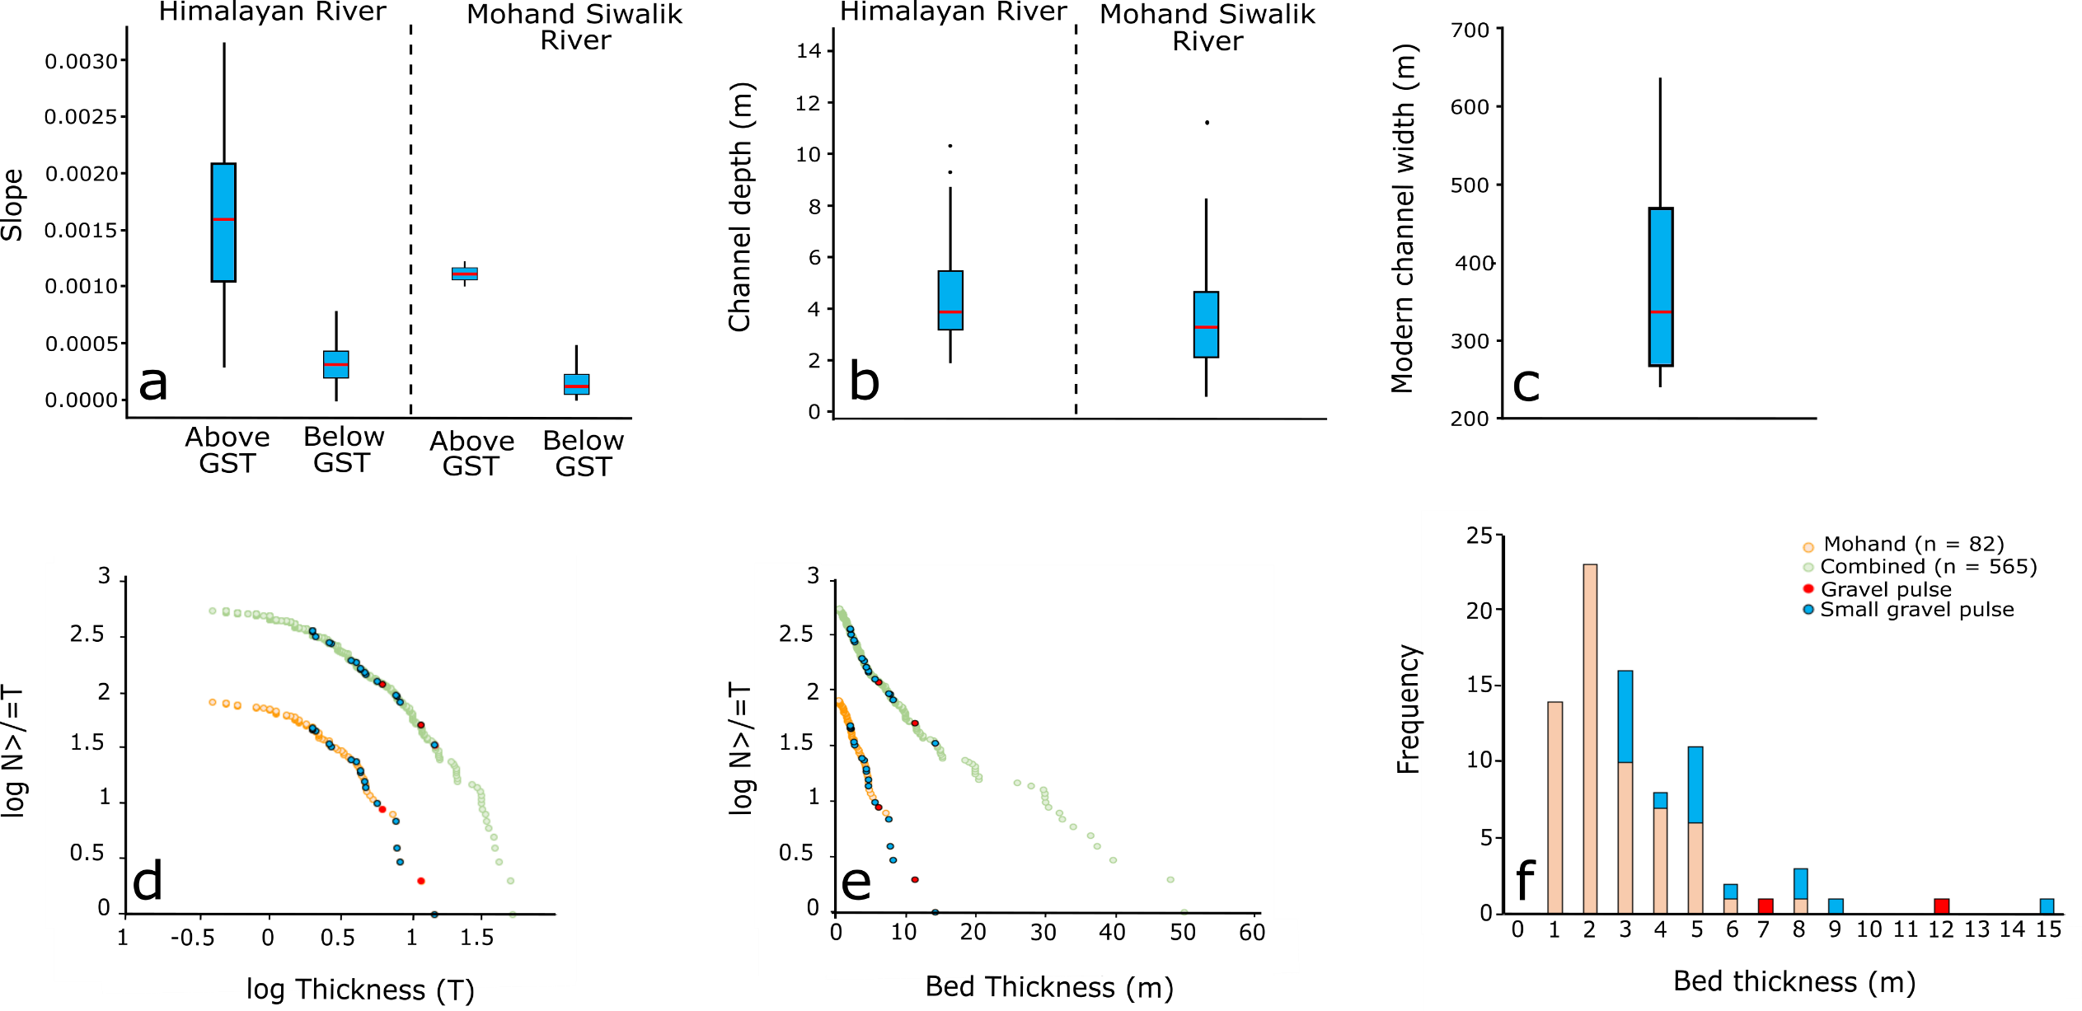
River geometries (a – Slope, b – Channel depth, c – Channel width) of modern rivers of the Ganga plain and the studied ancient Siwalik Mohand River . Horizontal line is the median. Frequency vs bed thickness data for the Mohand, Surai Khola, and Karnali sections (d, e, f) [10] plotted in the format d) log/linear axes, e) log/log axes, and f) binned data (Mohand section only). Further details on calculations used to determine ancient river geometries and bed thickness descriptions can be found in Methods and Supplementary Material . State the source of this data
These figures are rather small, particularly d and e. I suggest making three rows with two figures per row. Fig. C is not really necessary as its not comparing with anything.

Slide 5
a-b. Contour plots of suspended sediment concentration and return interval discharge combinations required to transport 2 m thick gravel bed 10 km downstream of the GST in 12 hrs (a) and 24 hrs (b); coloured lines represent the concentration and return interval discharge combinations for each experimentally constrained value of the modification coefficient, φ, used in the Meyer-Peter-Müller bedload transport equation; dashed lines represent the concentration of suspended sediment (D₅₀ = 0.25 mm, 0.35 mm, 0.5 mm) to discharge magnitude, or return interval, estimated using standard sediment transport equations [Methods and Supplementary Information]; grey shaded area represents supply-limited concentration of suspended sediment; intersection of coloured and dashed lines are minimum estimated discharges required to transport the gravel 10 km downstream. Higher φ values facilitate a higher frequency of hyperconcentrated flow events.

