Slide 1




Can tree stem and shoot emissions close the gap in the methane budget
of a boreal Scots pine forest during the summer months?
Mari Pihlatie^{1,2,3}, Lukas Kohl^{1,2}, Elisa Vainio^{1,2}, Anas Emad⁴, Lukas Siebicke⁴, Ivan Mammarella⁵, and Katerina Machacova⁶
¹Department of Agricultural Sciences, University of Helsinki, Finland (mari.pihlatie@helsinki.fi)
²Institute for Atmospheric and Earth System Research/Forest Sciences, Finland
³VIPS – Viikki Plant Science Center, Department of Agricultural Sciences, Helsinki, Finland
⁴University of Göttingen, Göttingen, Germany
⁵Institute for Atmosphere and Earth System Research / Physics, Finland
⁶Global Change Research Institute of the Czech Academy of Sciences, Czech Republic

Slide 2
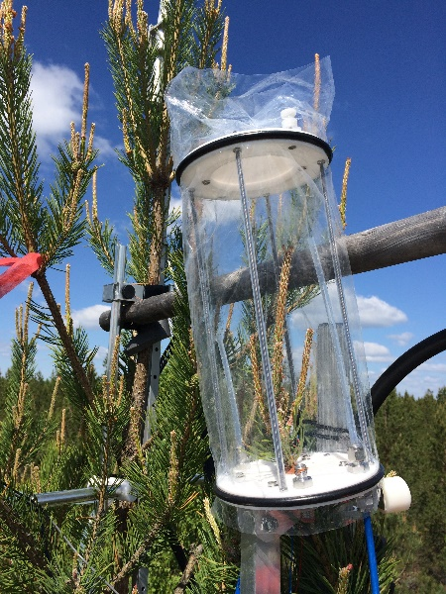
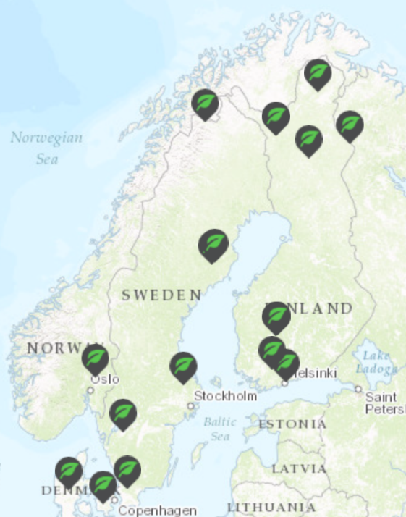
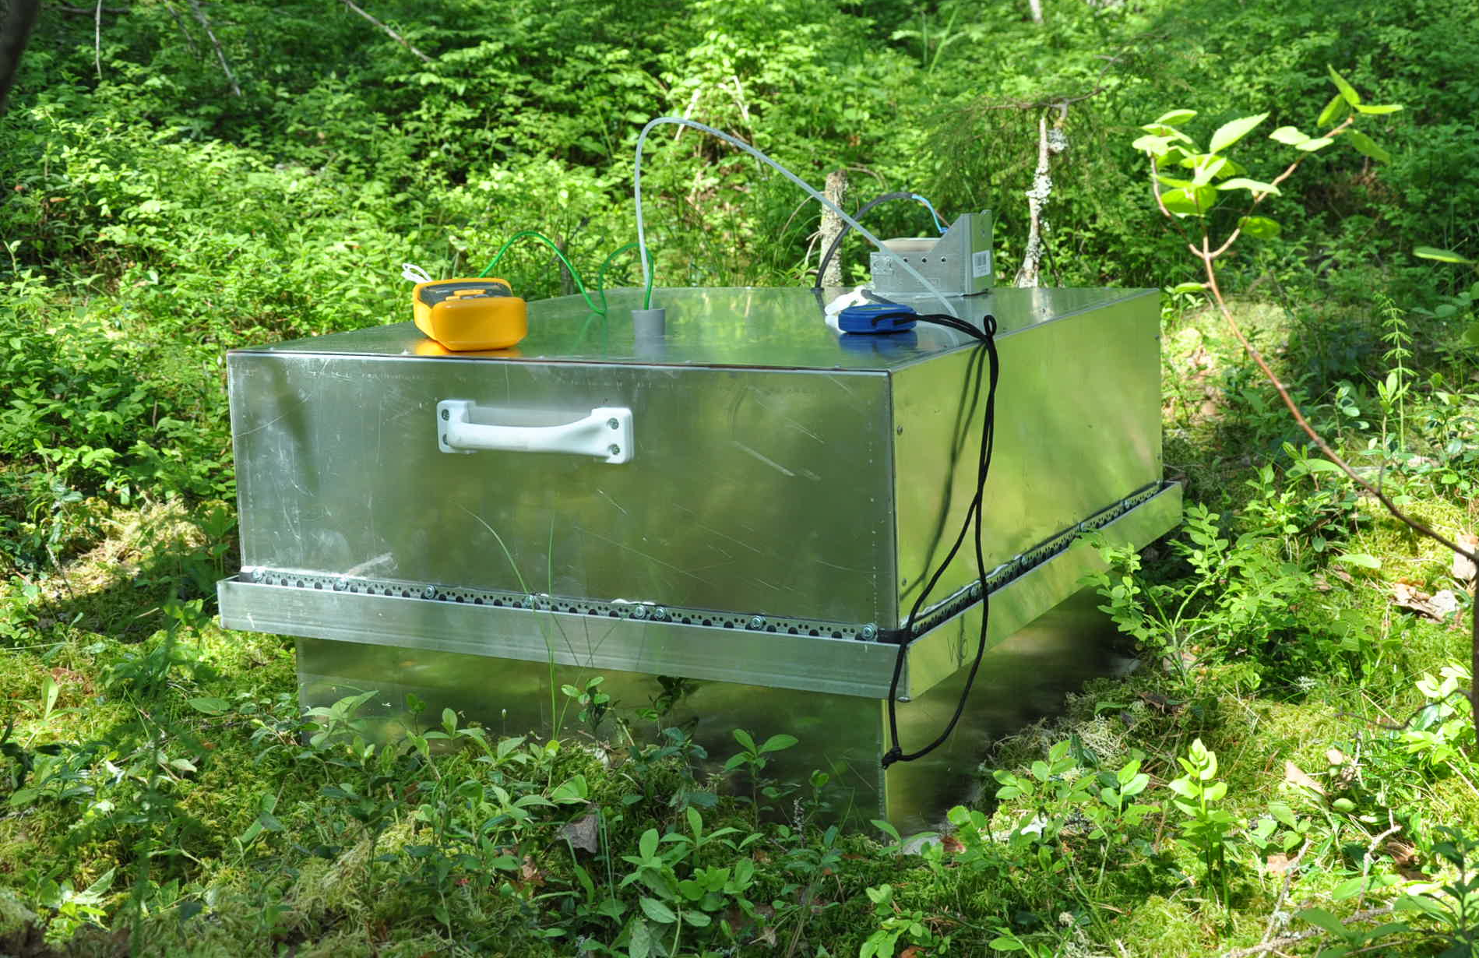
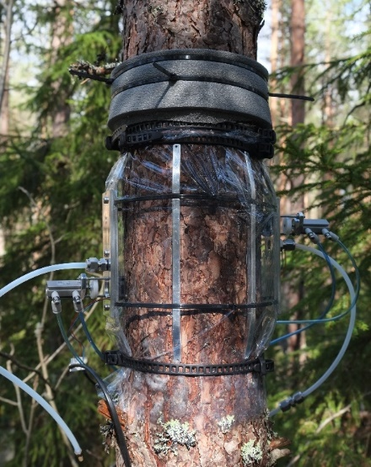
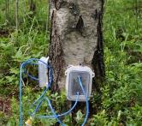
MEASUREMENT CAMPAIGN @HYYTIÄLÄ, 2017 SUMMER
Chambers: 15 soil, 47 stem, 6 shoot
Micromet: eddy covariance (EC), true eddy accumulation (TEA), gradient method

Slide 3
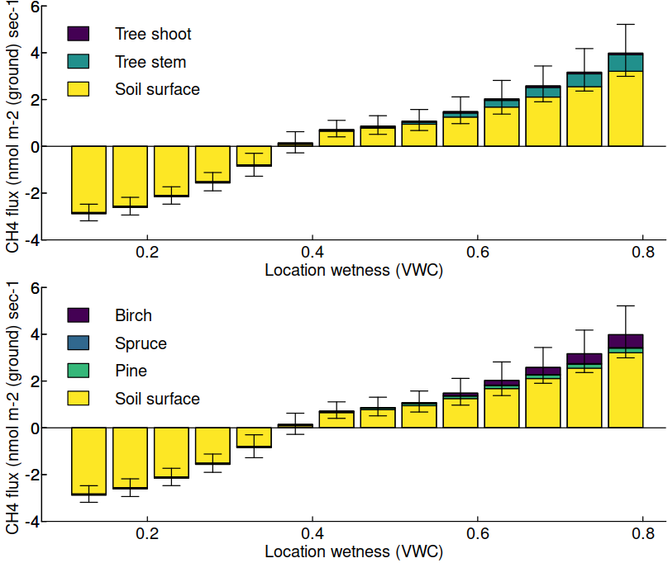
TREE STEMS AND SHOOTS ARE MINOR SOURCES OF METHANE
Upscaled soil fluxes (Vainio et al., 2021): -1.75 to -1.35 nmol m⁻² s⁻¹
Upscaled tree stem emissions: ~- 0.03 to + 0.10 nmol m⁻² ground s⁻¹
Upscaled tree shoot emissions: ~0.01-0.02 nmol m⁻² s⁻¹
Micromet methods: -0.29±0.24 nmol m⁻² s⁻¹ (EC) -0.25±0.16 nmol m⁻² s⁻¹ (TEA)

Slide 4
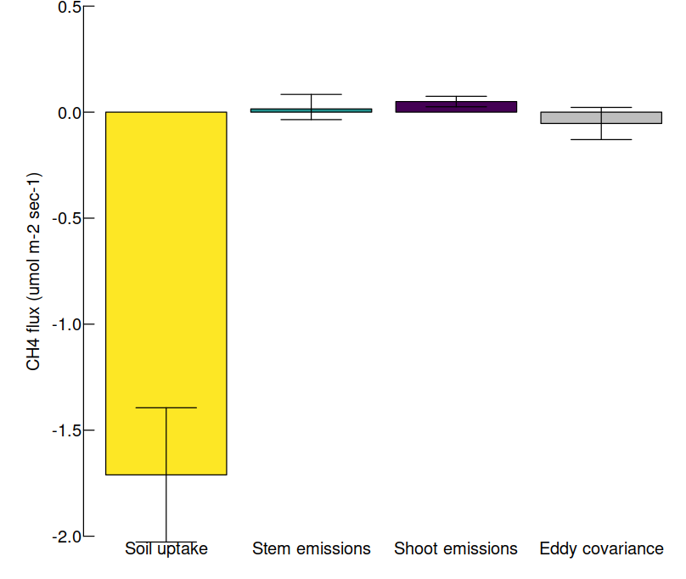
A persistent gap between chamber- and micrometeorological flux measurements
Tree stems and shoots accounted <10% of the missing methane gap.
Soil Stem Shoot EC
A missing source: ~1 nmol m⁻² s⁻¹

Slide 5
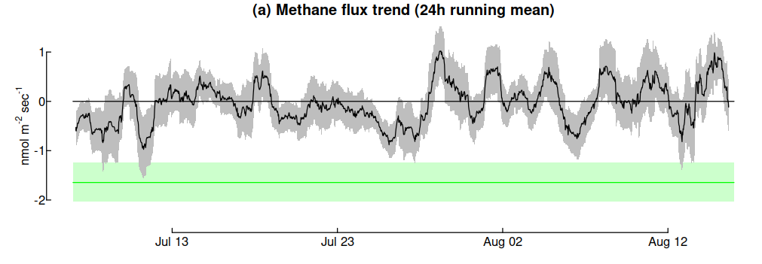
Can tree stem and shoot emissions close the gap in the methane budget
of a boreal Scots pine forest during the summer months?
No they cannot
During summer time when soil is dry

