Slide 1








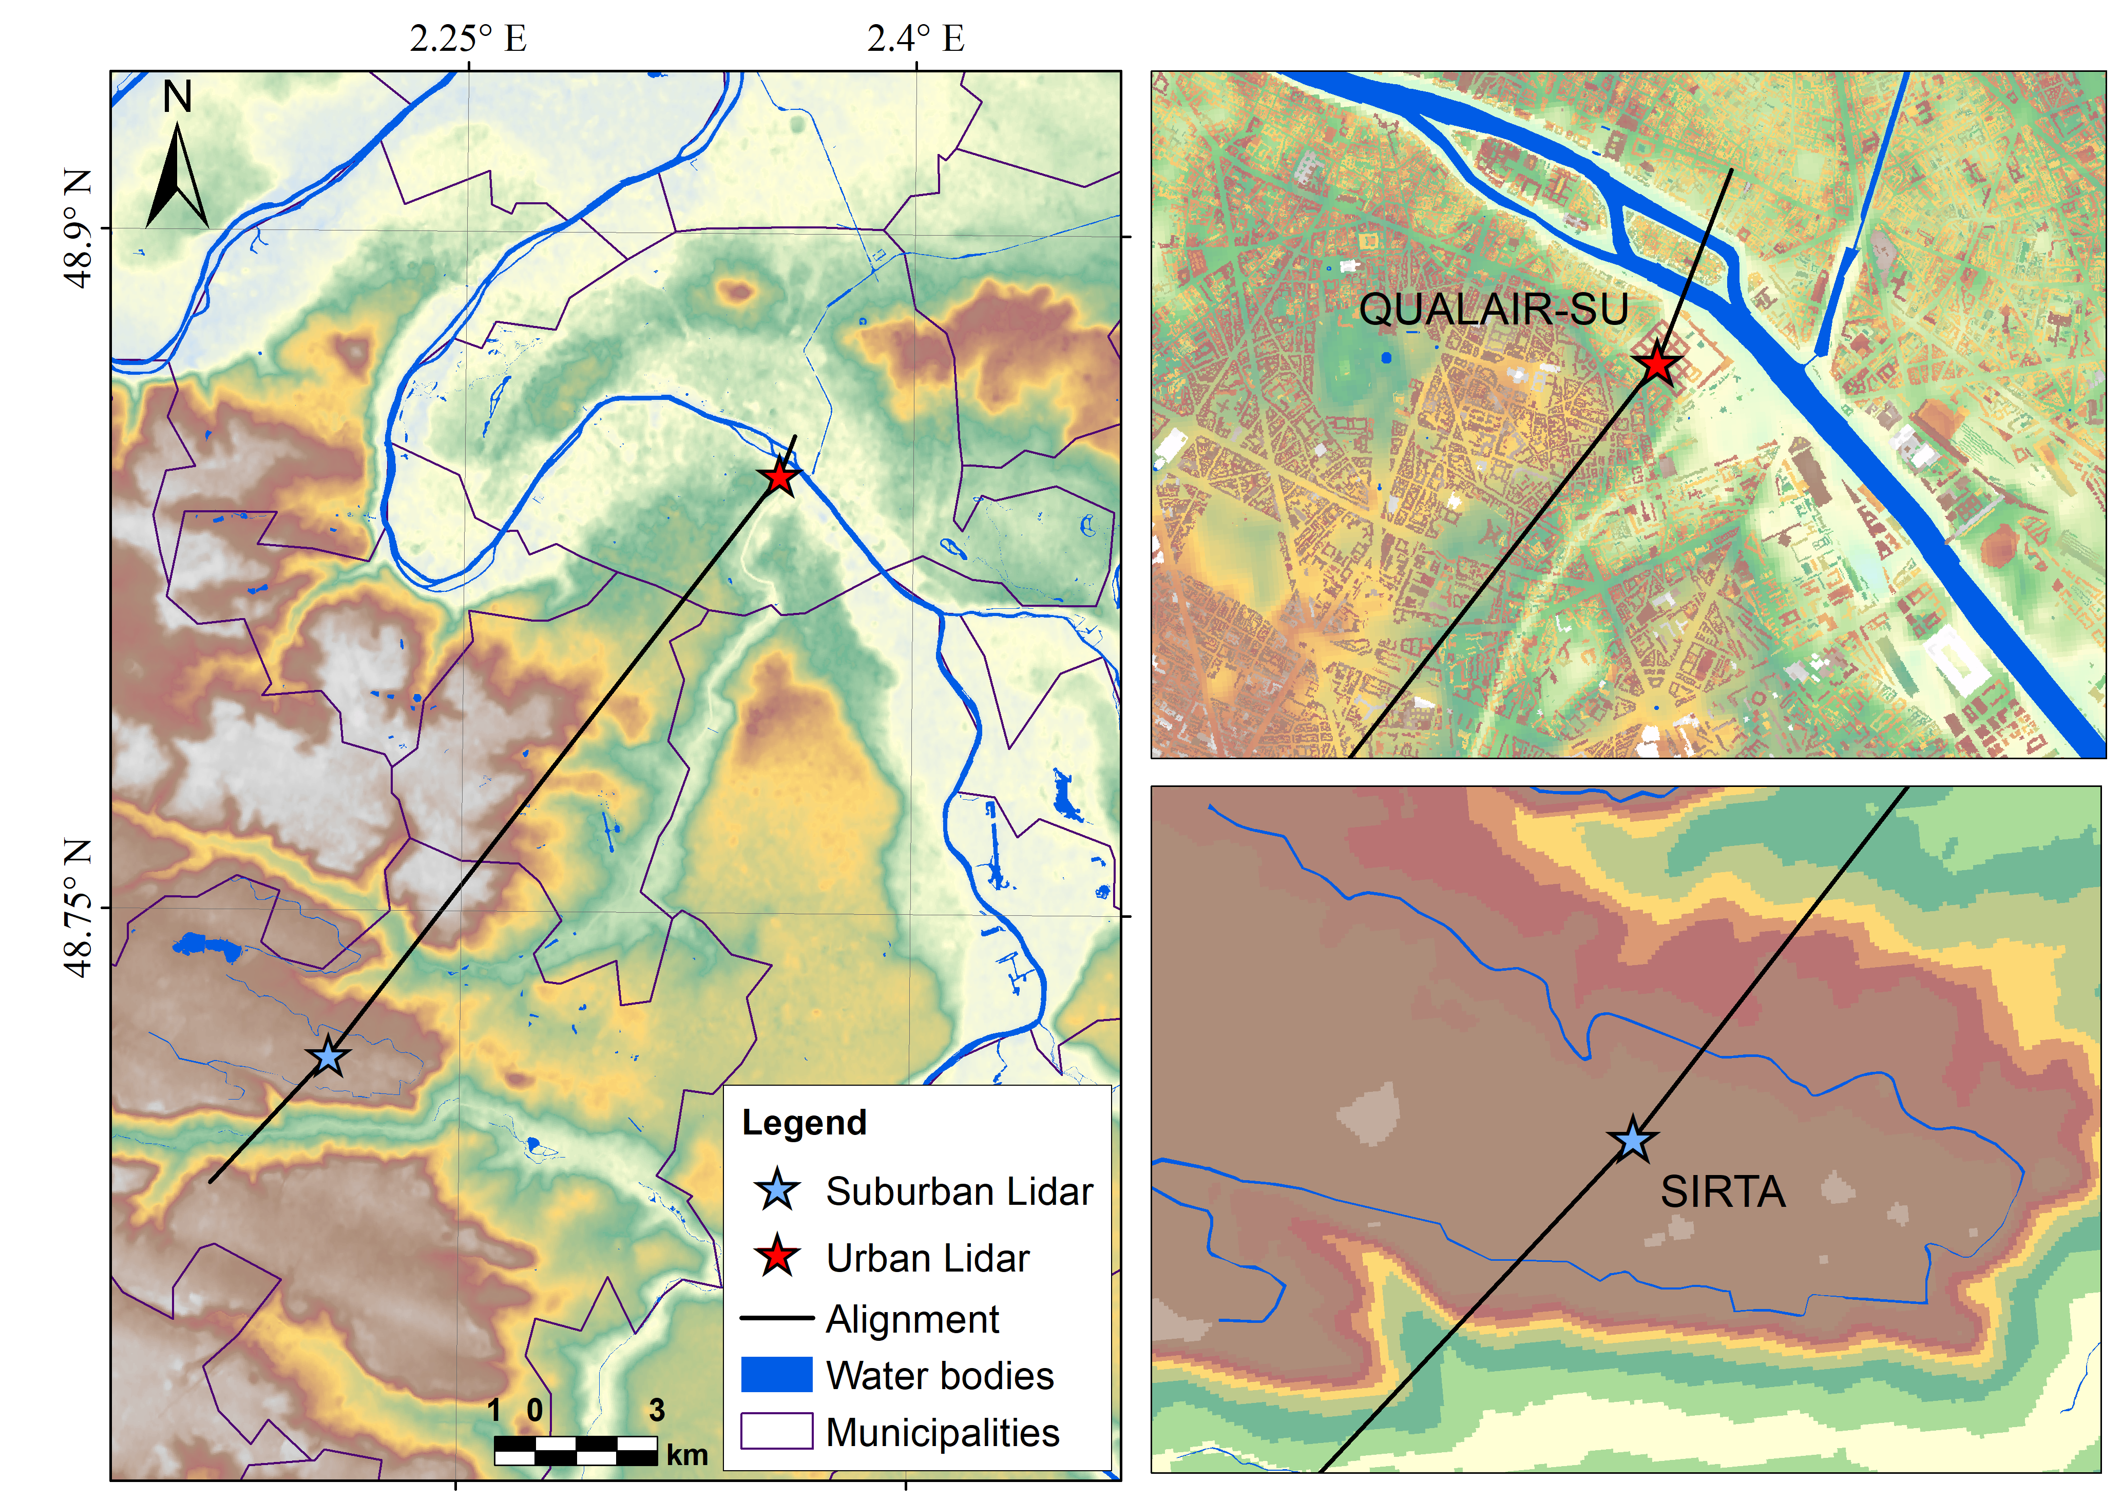
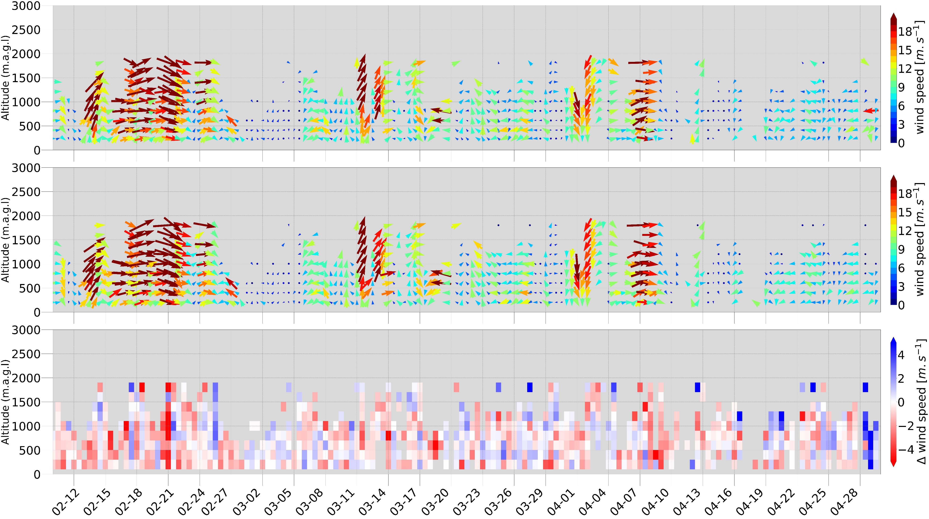
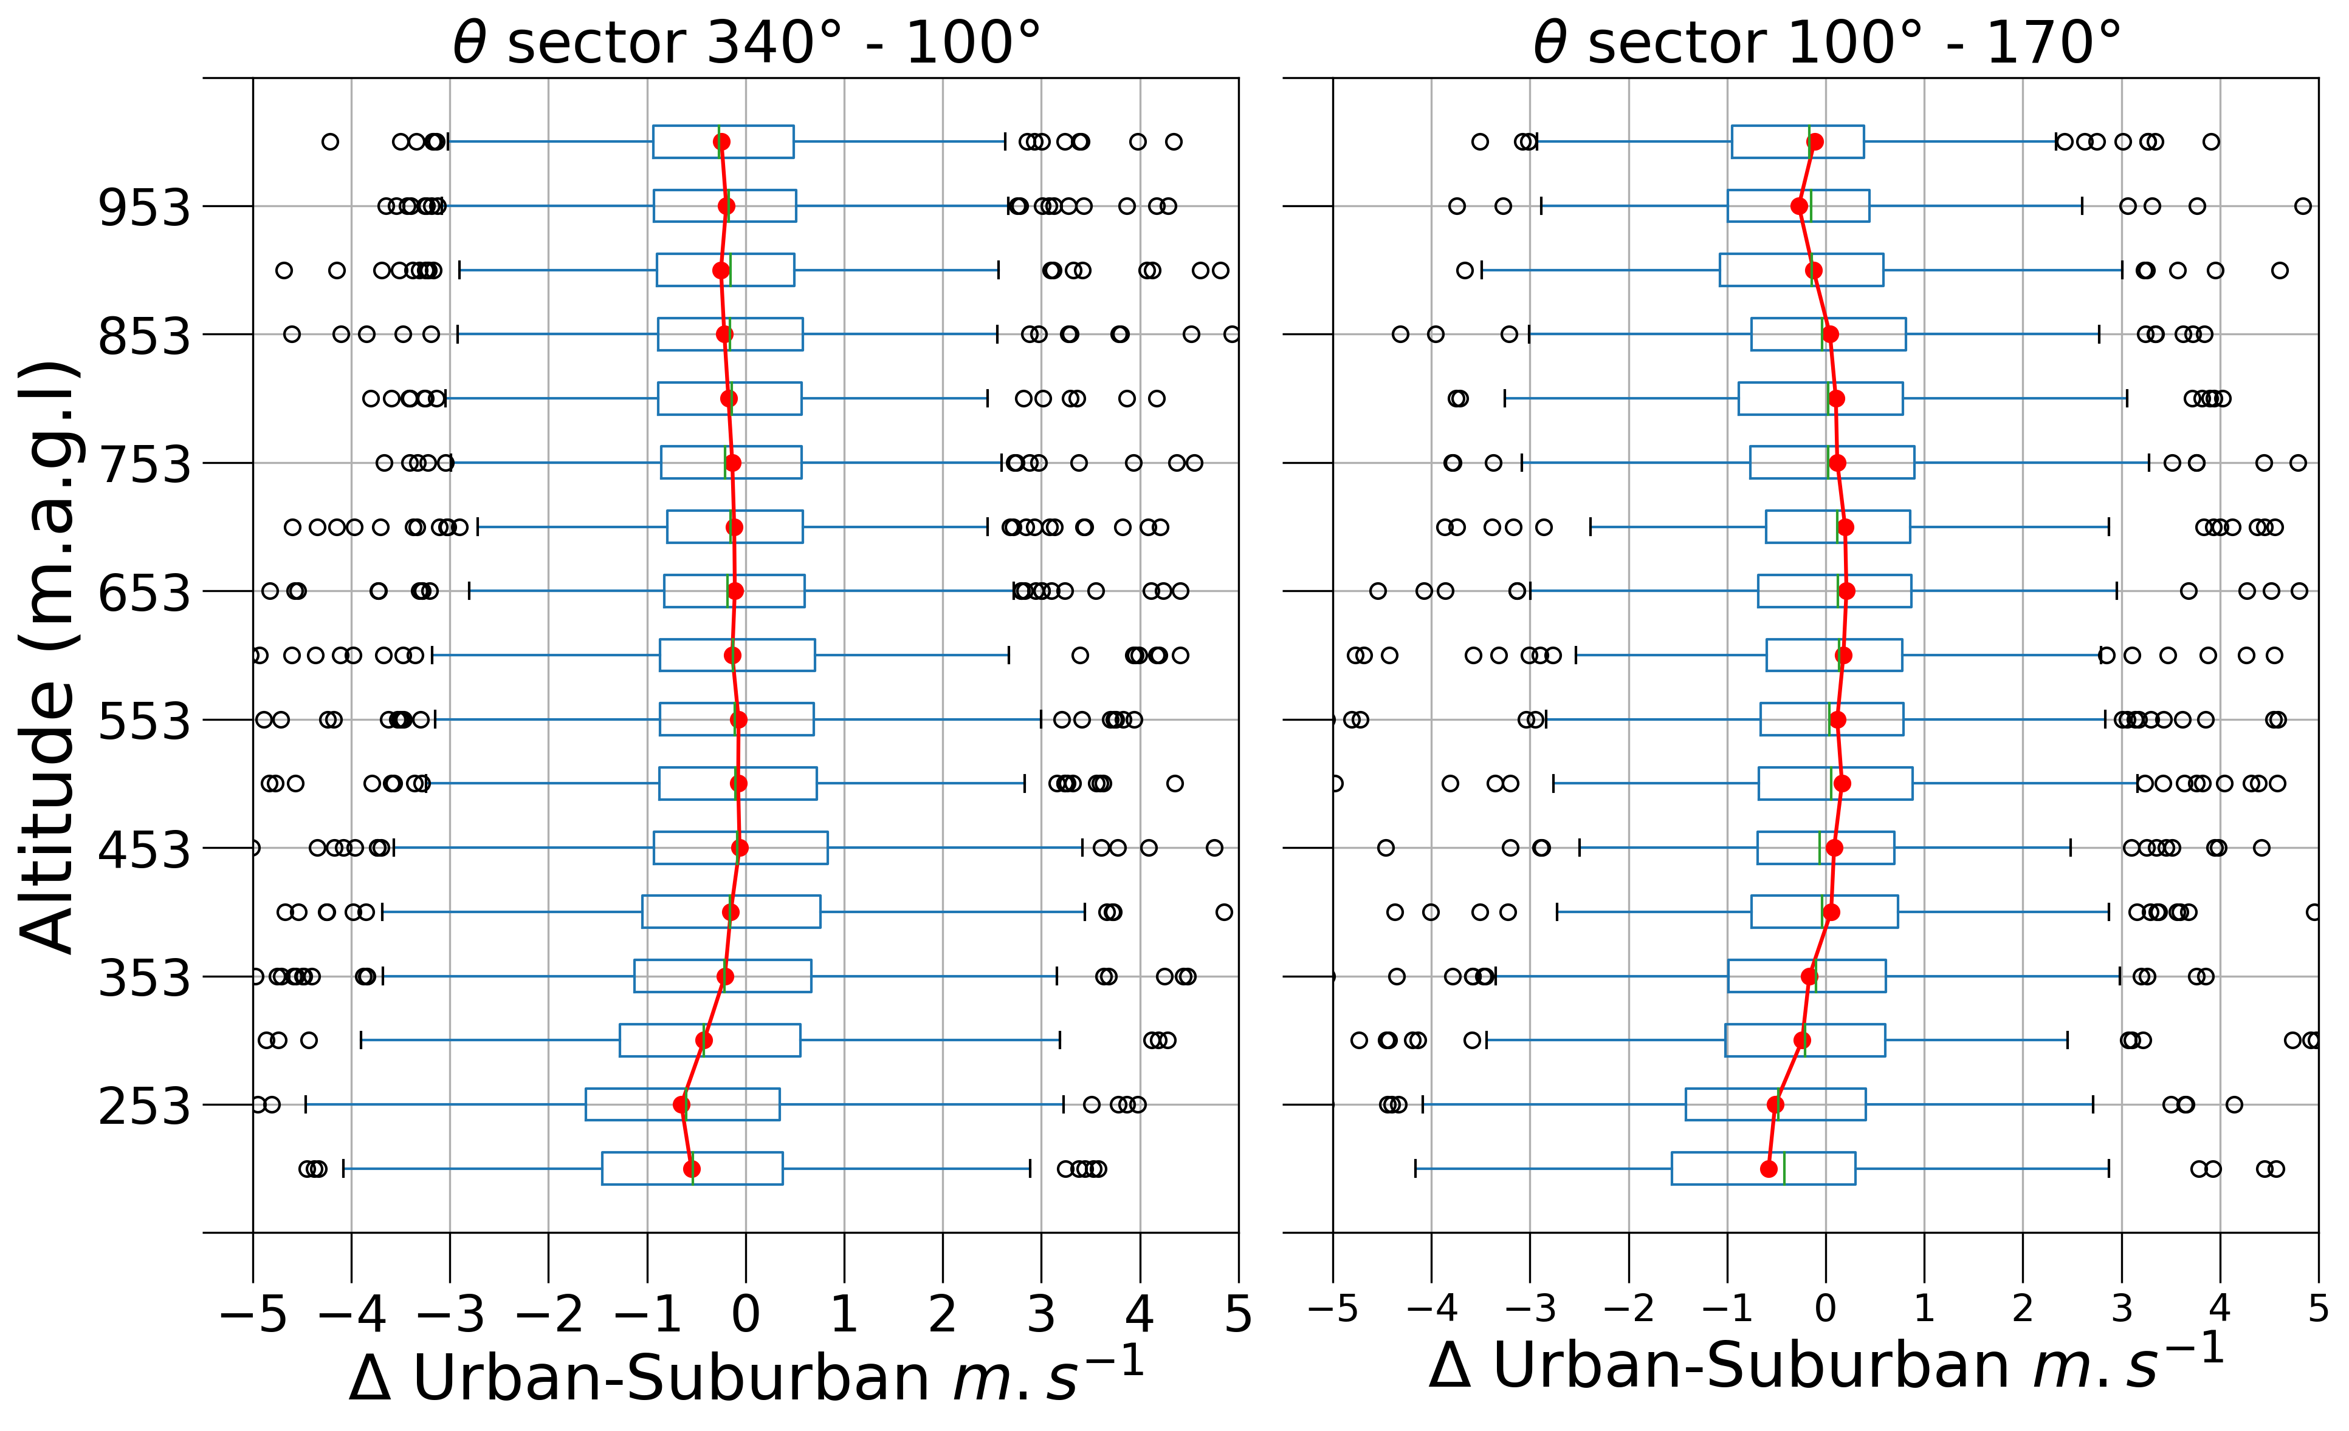
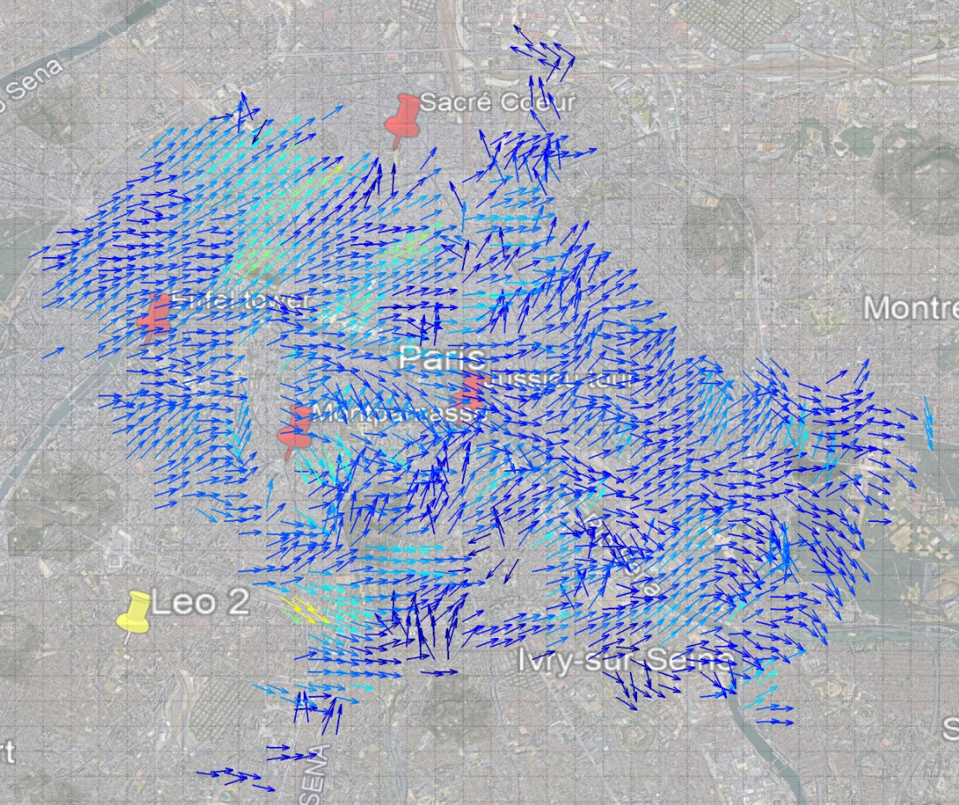
Wind profiles over the Paris area from Doppler Lidar
Jonnathan Cespedes, Simone Kotthaus, Ludovic Thobois, Martial Haeffelin
AS2.2 | EGU22-1471
SCAN ME
Urban
~3 months (2022-02-10 / 2022-04-31)
Suburban
Urban
270°-340°
ΔW.S = Urban - Suburban
100°-170°
Suburban
First observation above ground: 238 m (urban), 103 m (suburban)
No. samples 766
No. samples 681
Research Question:
What are the effects of the urban surface on the wind field?
Novel approach with scanning Doppler lidar
→ 3D wind field

