Slide 1



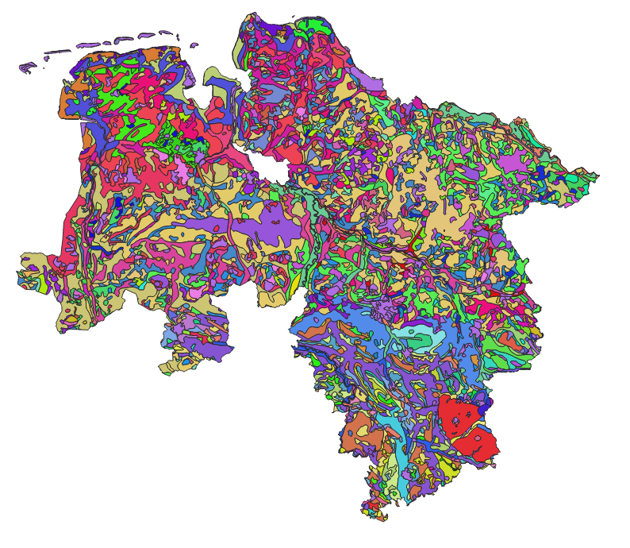
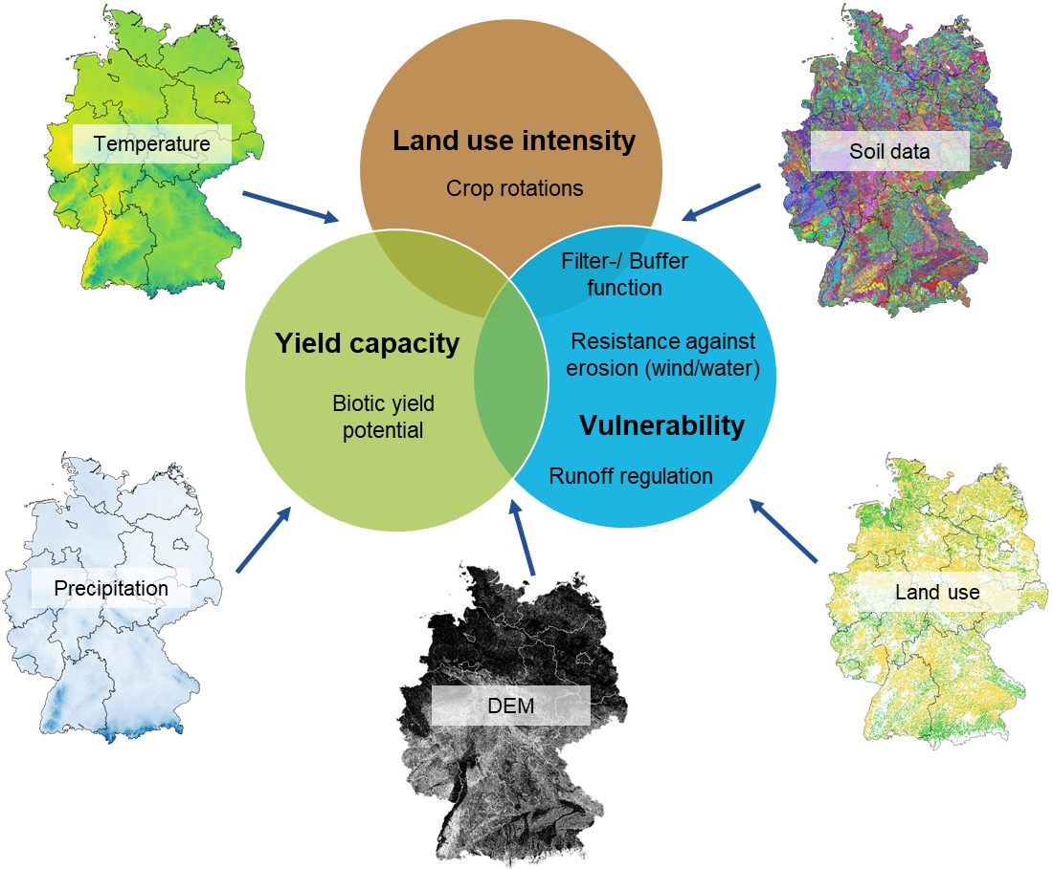
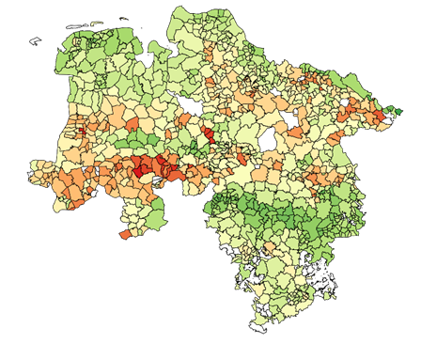
EGU22-11473
Investigating soil quality indicators of German soils under agriculture using soil information on different spatial scales
Annelie Säurich, Heike Gerighausen and Markus Möller

Slide 2
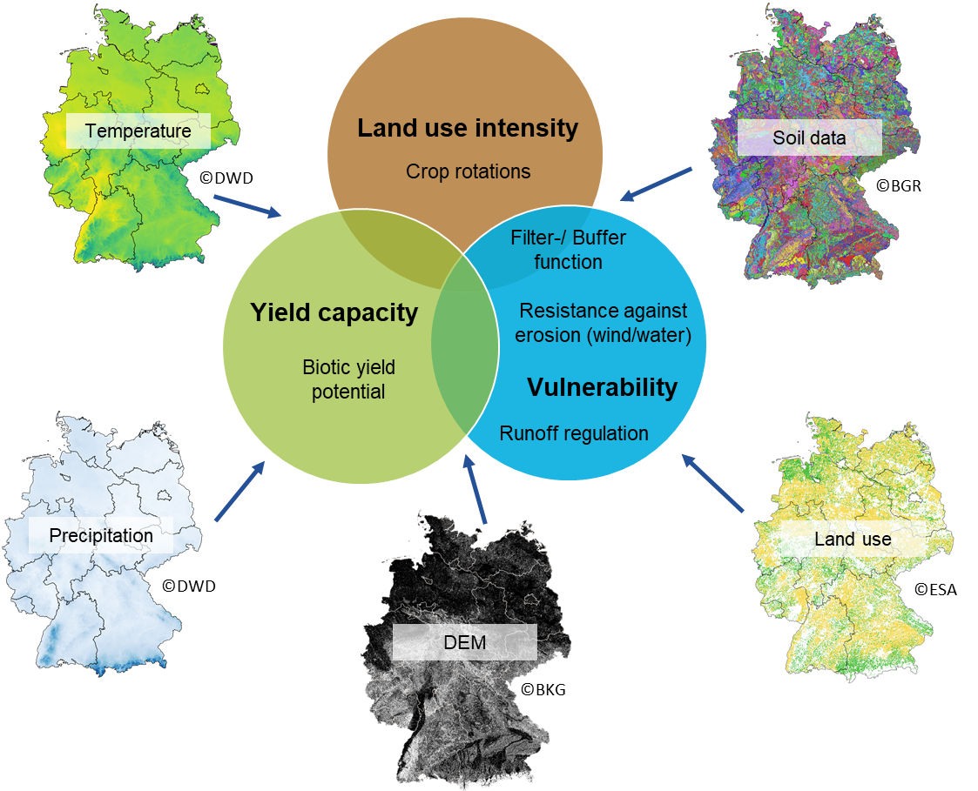
Scope of the SOIL-DE project
~56 ha d⁻¹ soil loss in Germany
Lack of details about location and soil quality
Recording of soil fertility and soil functions of agricultural soil and determination of soil loss
Adaptation and improvement of existing soil functions and soil indicators to assess yield capacity and vulnerability
Use of soil, climate, site, and remote sensing data (Sentinel-1/2) to infer current land use and intensity of use

Slide 3
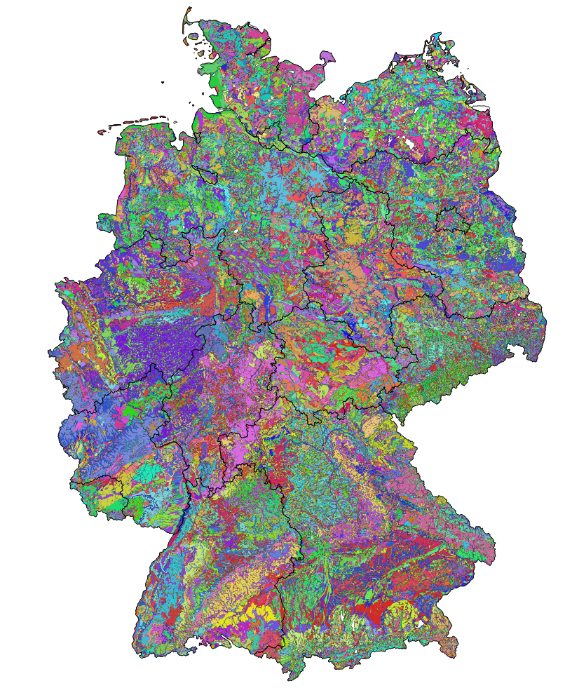
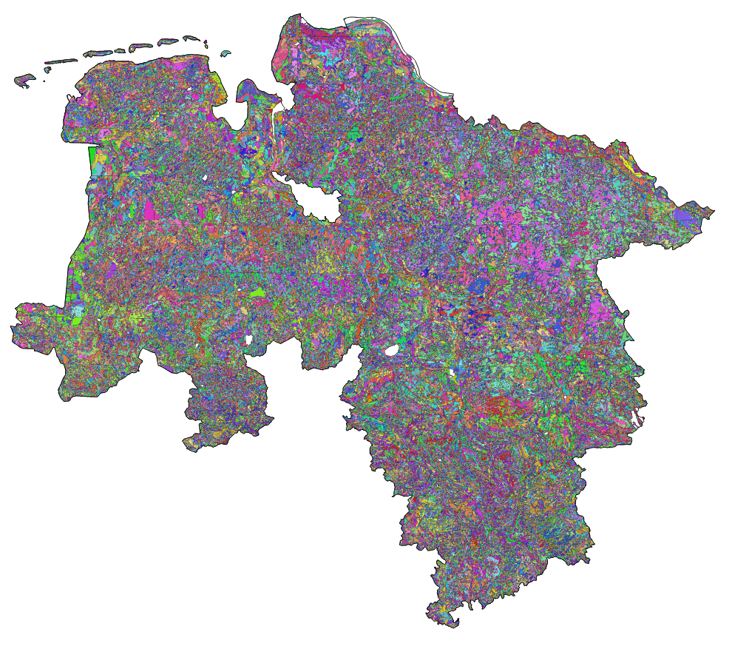
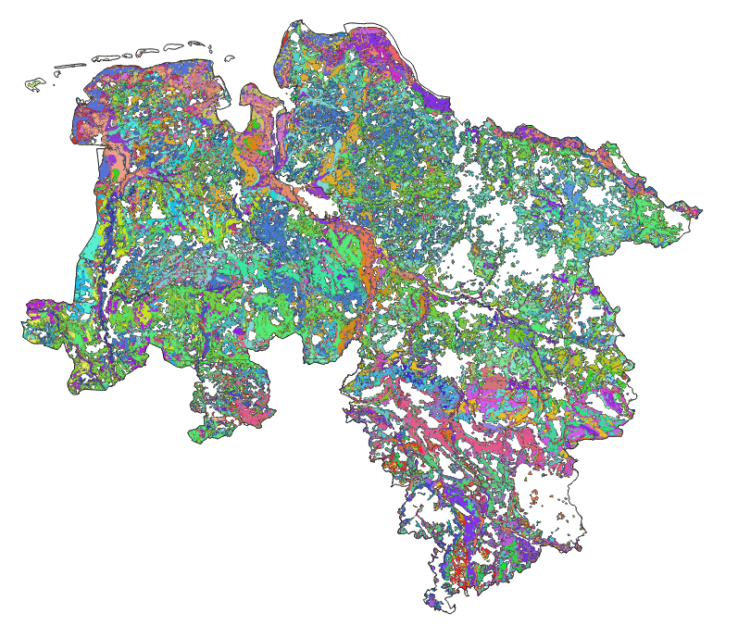
Differences in soil map scales
1:50,000
BK50
1:200,000
BÜK200
1:1,000,000
BÜK1000
vs.
vs.
©LBEG
©BGR
©BGR

Slide 4
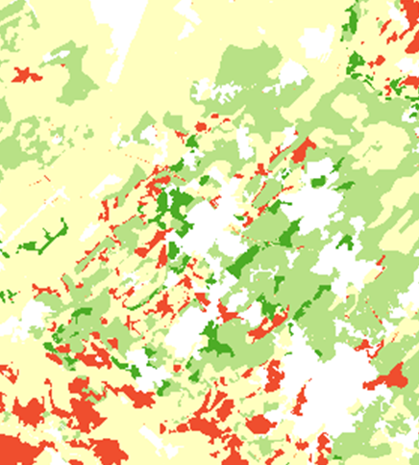
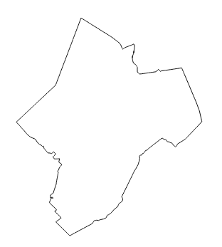
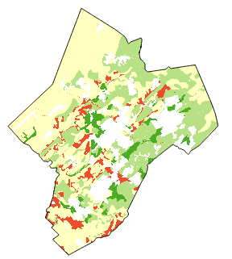
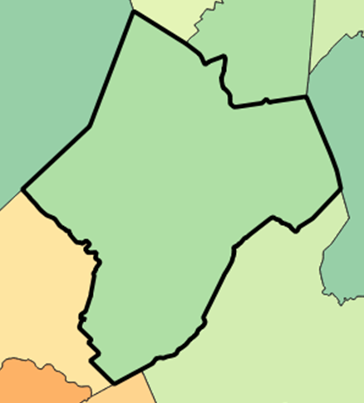
Differences in soil map scales
1:50,000
BK50
1:200,000
BÜK200
1:1,000,000
BÜK1000
vs.
vs.
©LBEG
©BGR
©BGR
Soil criteria
divided into comparison groups
Raster data
(10 m x 10 m)
Reference unit
(municipality)
polygones
Area share of every comparison group per reference unit
Calculation of comparison index*
(1 to 100)
* after Thiere et al. (1991) Arch. Acker-Pflanzenbau Bodenkd. 35 (3): 171-183, Berlin , Germany.

Slide 5
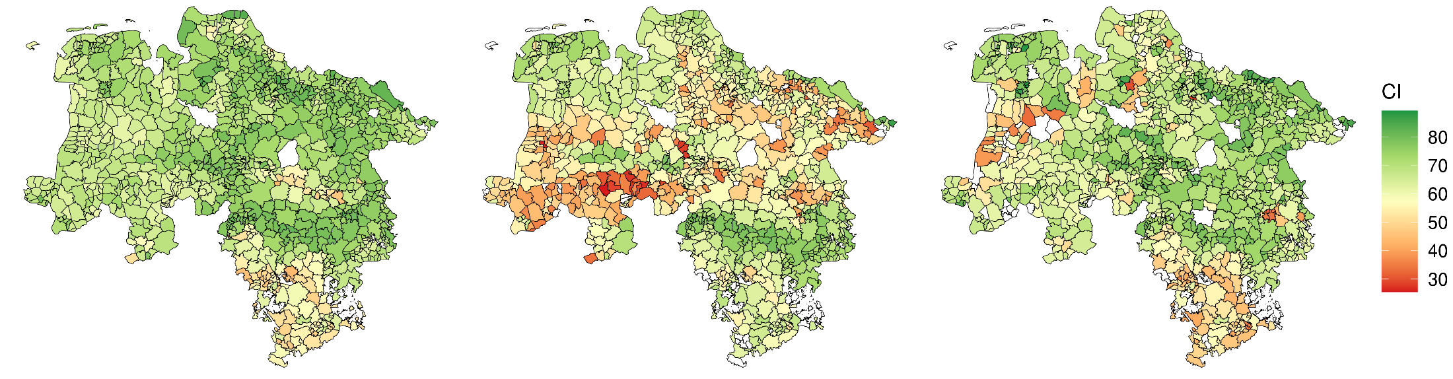
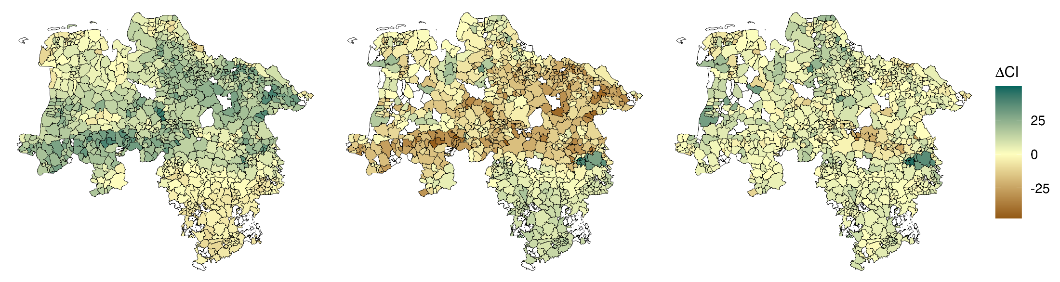
Biotic yield potential
BK50
BÜK200
BÜK1000
ΔBK50-BÜK200
ΔBÜK200-BÜK1000
ΔBK50-BÜK1000

Slide 6
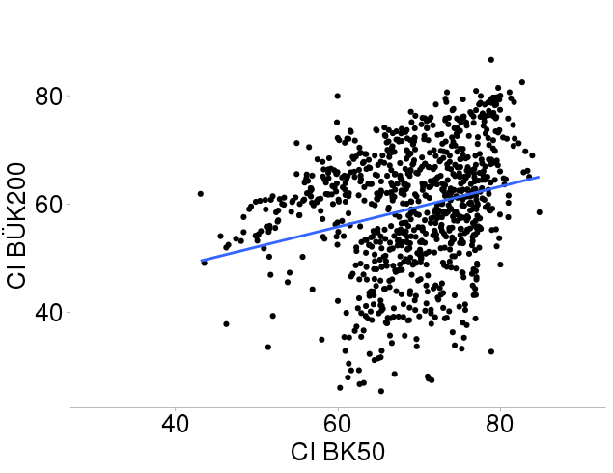
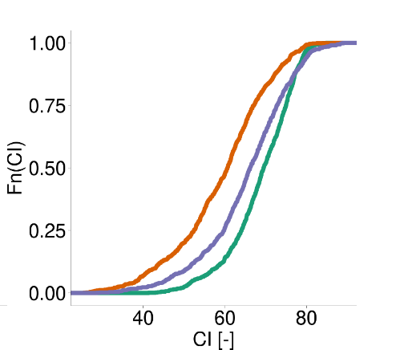
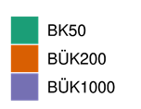
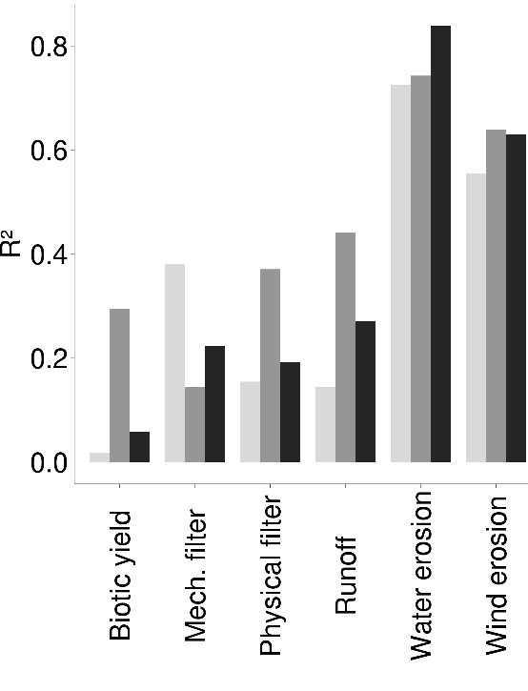

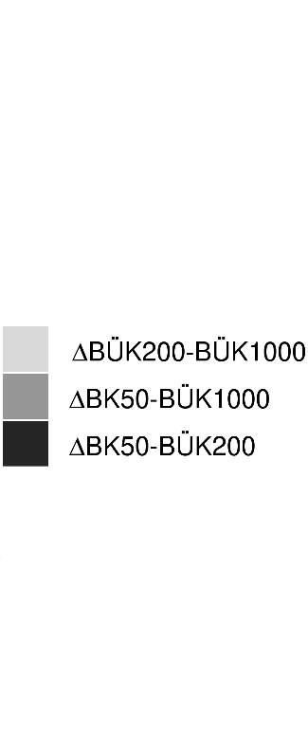
Differences between scales
Linear regression
eCDF
D = Δmax
similarity
similarity

Slide 7
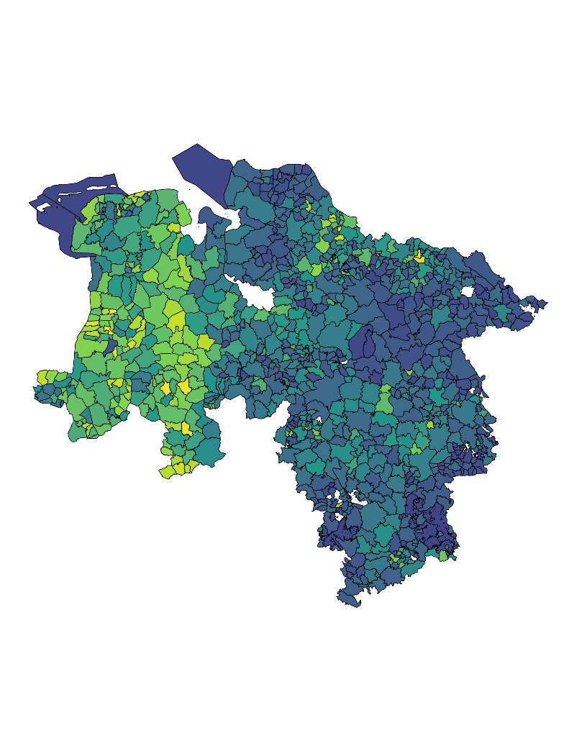
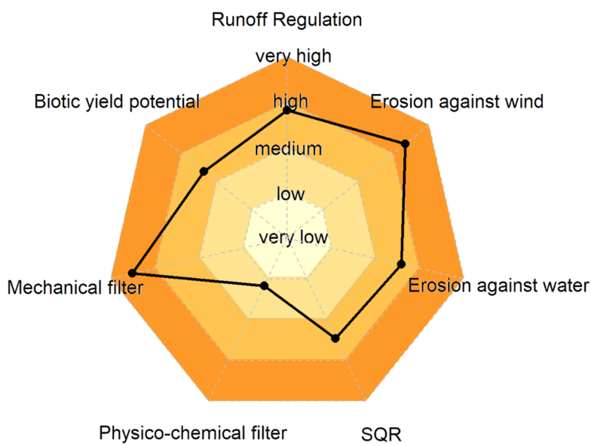

Teaser: soil loss
Soil loss quantity
Soil loss quality
[%]

Slide 8
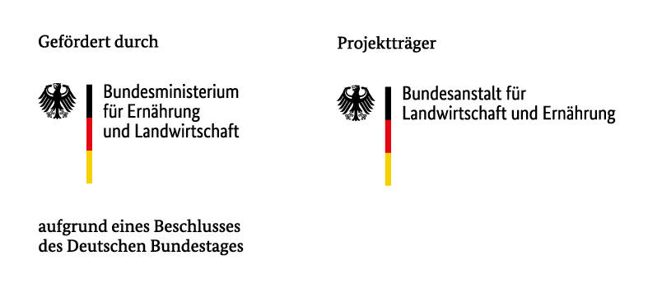




Teaser: soil loss
Soil loss quantity
Soil loss quality
[%]
Thank you for your attention.

