Slide 1




Deformation-facilitated melting of plagioclase
Sarah Incel, Marie Baïsset, Loïc Labrousse & Alexandre Schubnel

Slide 2
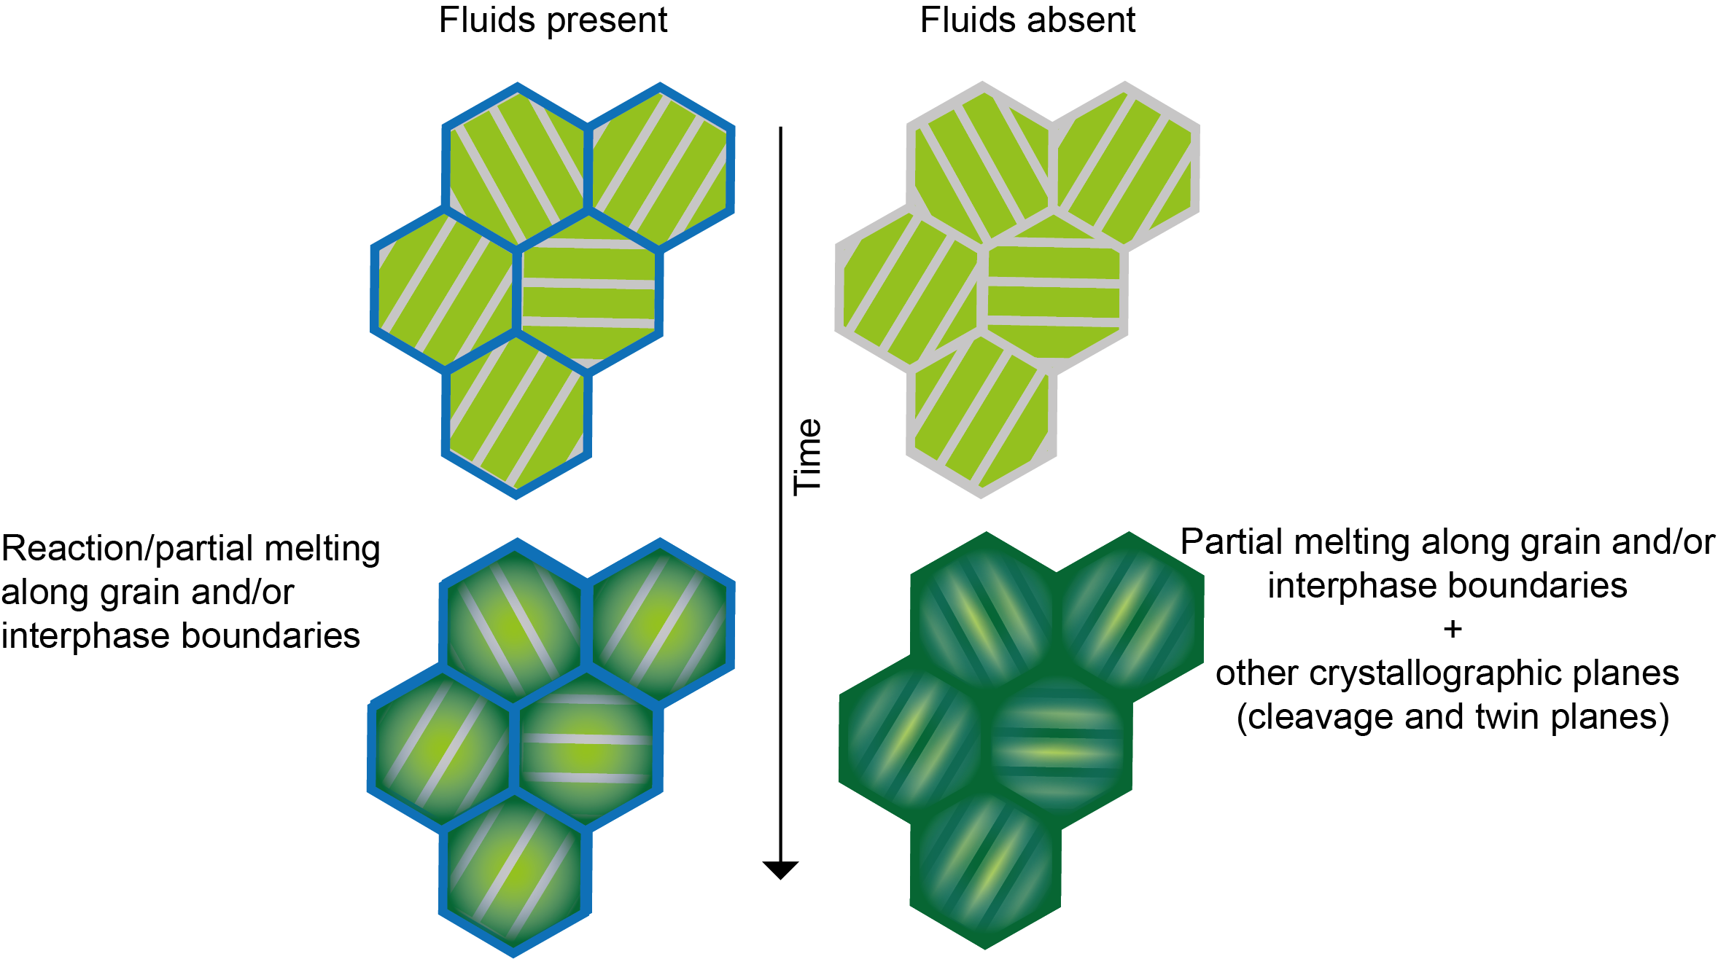
Introduction
EGU2022
Sarah Incel
Where do grains start to react/melt?
Tsuchiyama & Takahashi (1983):
Presence of fluids:
Along grain and interphase boundaries
Absence of fluids:
Along grain- and interphase boundaries
Crystallographic planes (cleavage planes,
twin boundaries)

Slide 3
Introduction
EGU2022
Sarah Incel
Why is it important?
The availability of interfaces for reaction and melting control the effective grain size of rocks
Important for deformation behaviour!

Slide 4
Materials & methods
EGU2022
Sarah Incel
Starting material:
Plagioclase (Bytownite) aggregates
Aggregate grain size <38 μm
Deformation experiments:
DDIA
Griggs
P= 2.5 GPa
T= 720 to 950 °C
Strain rate= 10⁻⁵ s⁻¹
P= 2.5 GPa
T= 700 °C; 900 °C
Strain rate= 10⁻⁵ s⁻¹ ; 10⁻⁶ s⁻¹

Slide 5
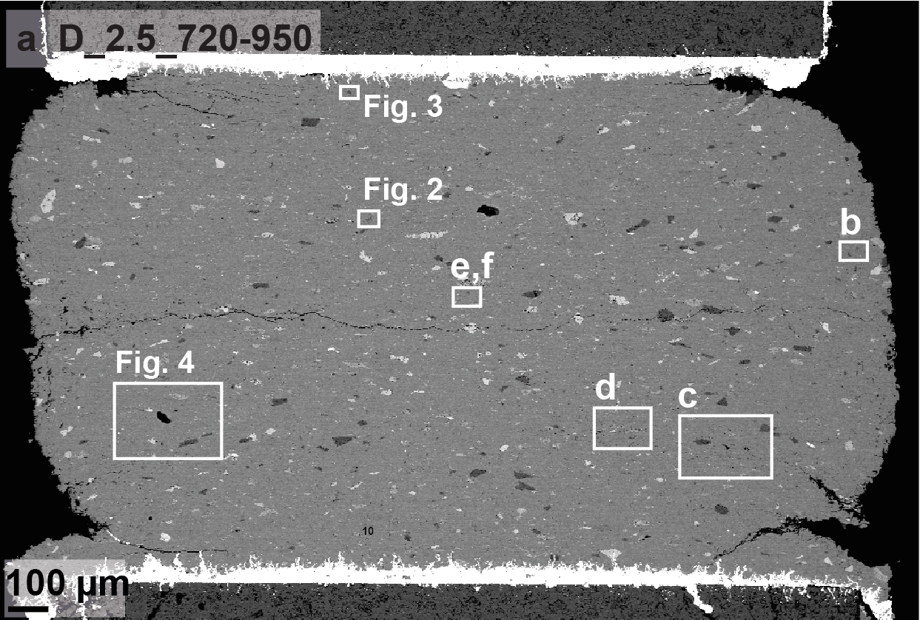
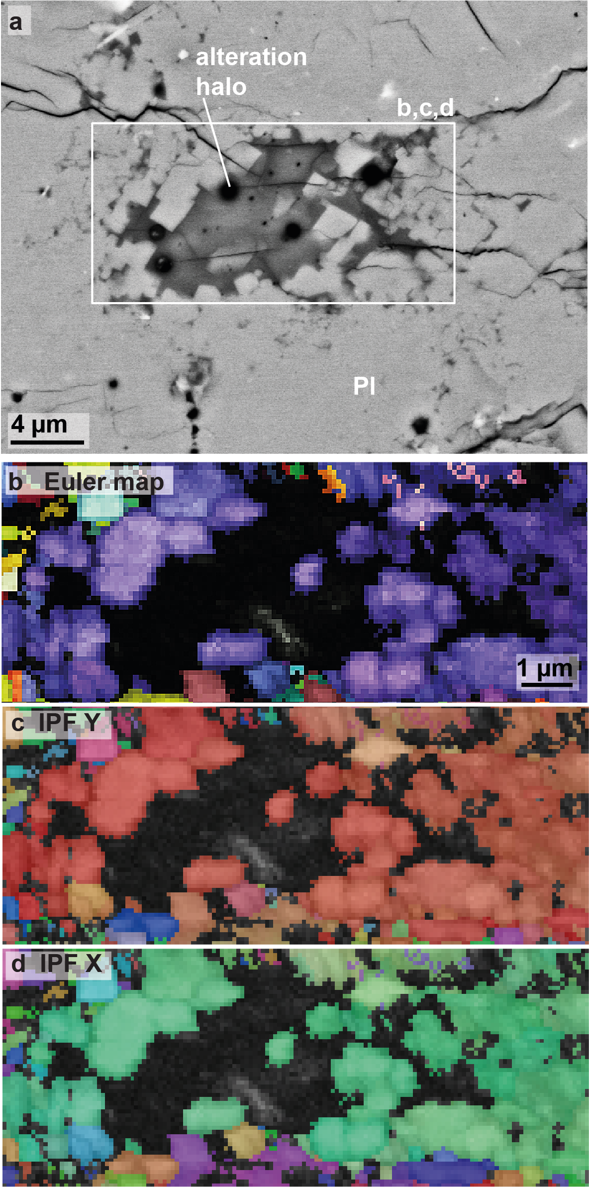
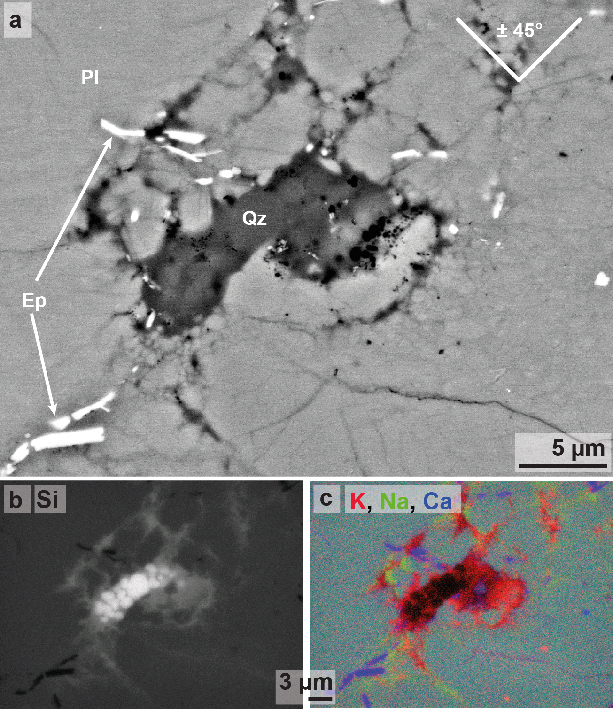
Results & discussion
EGU2022
Sarah Incel
Patches:
Often sharp edges oriented at approx. 45° towards direction of maximum compression
Vesicles and alteration haloes
very little grain rotation of the surrounding plagioclase → appear to form inside of plagioclase grains!
Non-indexed patch-filling material
Sometimes growth of sub-euhedral quartz within material rich in K
Incel et al. (under review in JMG)
→ Melt patches!

Slide 6
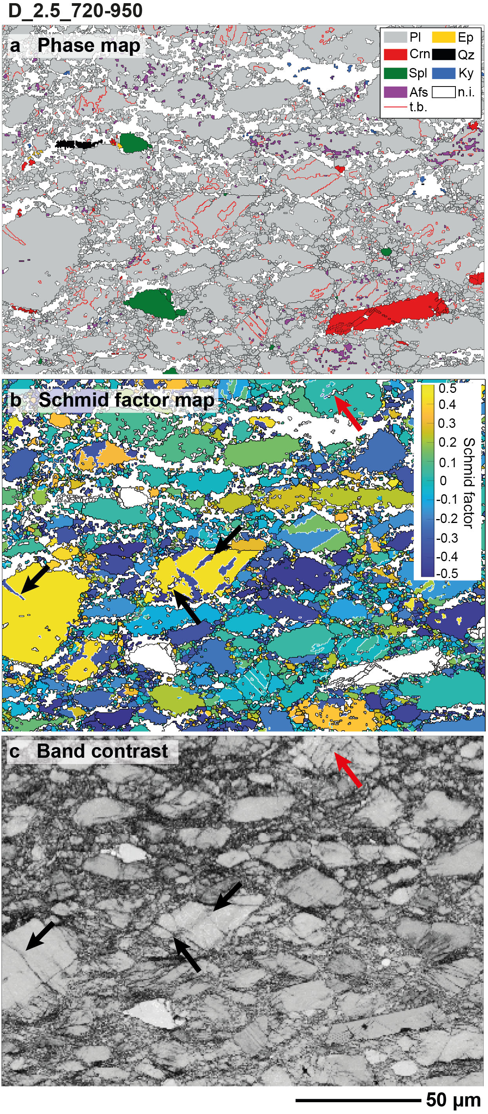
Results & discussion
EGU2022
Sarah Incel
Incel et al. (under review in JMG)
Newly formed deformation twins are all oriented at approx. 45° towards direction of maximum compression like melt patches
Deformation twins spatially associated with cracking

Slide 7
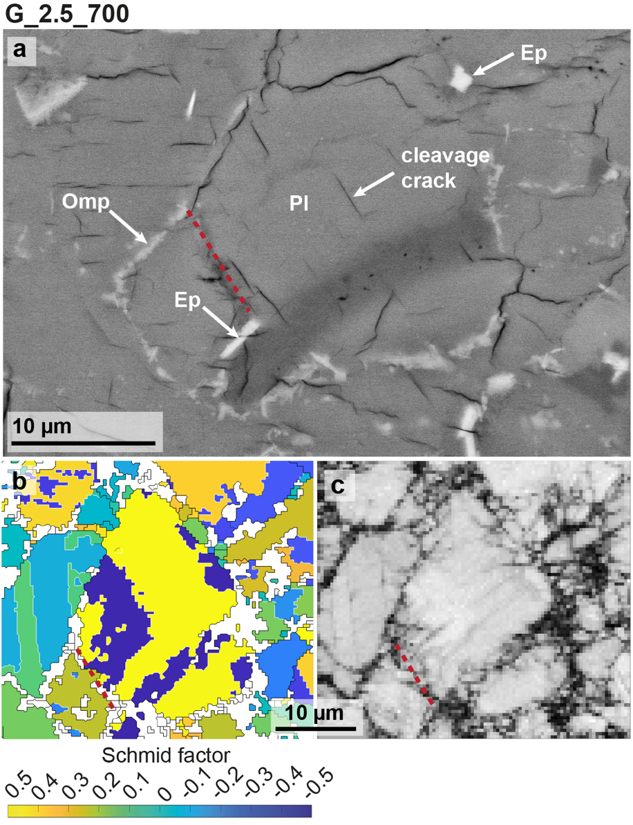
Results & discussion
EGU2022
Sarah Incel
Sample deformed at approx. 700 °C and 10⁻⁶ s⁻¹
Growth of omphacite and hydrous epidote around plagioclase grains
EBSD data: central grain favourably oriented to deform by twinning
Twin coincides with dark patch
non-indexed zone within twinned area that
is sensitive to electron beam (→ alteration haloes)
→ In both sample, we observe a close link between deformation and occurrence of amorphous material
Alteration
haloes
Incel et al. (under review in JMG)

Slide 8
Summary
EGU2022
Sarah Incel
Growth of hydrous epidote group minerals along grain boundaries, we know that fluids were present
→ wet melting
We observe also intracrystalline melting
→ Spatially associated with twinned and cracked regions
→ only observed for dry melting at 1300°C

Slide 9
Possible explanations
EGU2022
Sarah Incel
High defect density (+ temperature increase due to twinning shear)
Deformation twinning and cracking will locally increase the defect density
→ lower activation energy for melting
Rapid twinning shear can increase temperature locally
Melting inside of plagioclase will lead to local dilatancy and could further facilitate melting
→ would fit the ”fragmented” host plagioclase
Melting due to dilatancy during semi-brittle deformation
Previous study experimentally demonstrated that dilatancy due to cracking can lead to partial melting in alkali-feldspar (Negrini et al. 2014)
Both studies highlight the importance of semi-brittle deformation on the onset of partial melting in feldspar!

