Slide 1
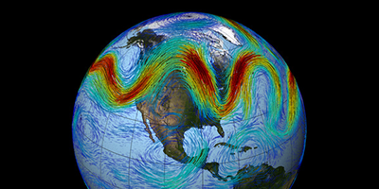



Response of the traveling planetary waves at low latitude middle atmosphere during September 2019 minor sudden stratospheric warming
Gourav Mitra (PRL, IITGN, INDIA)
EGU22-11510
27/05/2022
Collaborator: A. Guharay (PRL, INDIA)
P. P. Batista (INPE, BRAZIL)
R. A. Buriti (UFCG, BRAZIL)

Slide 2
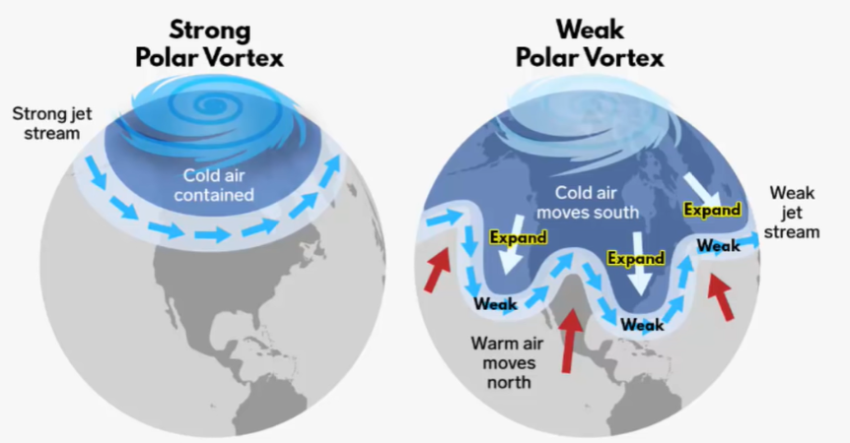
Introduction
Sudden stratospheric warming: an abrupt increase in polar stratospheric temperature by a few tens of kelvin in several days (Andrews et al., 1987).
Major and Minor warmings are two main categories of the SSW event.
Reversal of zonal mean temperature poleward of 60° is a signature of both major and minor event, but the reversal of zonal mean zonal wind at 60° latitude and 10 hPa pressure level is the characteristics of a major warming [Labitzke and Naujokat, 2000].
The occurrence of SSW is more frequent in the Northern hemisphere (NH) than in the Southern hemisphere (SH)
Few interesting studies on the impact of the 2019 SH SSW event affecting the global atmospheric system.
i. Noguchi et al. (2020): enhancement of convective activity in the tropics of the summer hemisphere
ii. Miyoshi and Yamazaki (2020): 6-day oscillation in the ionosphere
Credit: NOAA

Slide 3
Background dynamical conditions
Observational parameter
Horizontal winds (u,v): Meteor Radar, ECMWF reanalysis
Temperature: ECMWF reanalysis
ECMWF
Observational days from 1 August to 31 October 2019
Warming period (>25 K) day 253 to day 263 (Mcinturf 1978)
Westerly wind decelerates with no reversal (60°S, 10 hPa) Minor warming (Labitzke et al., 2005)
Reversal in ZMZW in upper stratosphere at 60°S High stratospheric warming (Savenkova et al., 2017).
Low latitude Stratospheric cooling and Mesospheric warming contrasting nature

Slide 4
Low-latitude planetary wave dynamics
Cachoeira Paulista (22.7°S, 45°W)
Cariri (7.4°S, 36.5°W)
Q16DW : 14-20 days
Q16DW prewarming days
Q6DW : 5-7 days
Q6DW around warming days
Q10DW: 9-12 days
Q10DW prewarming days
Meteor Radar
90 km
0.02 hPa ~ 80 km
ECMWF
1 hPa ~ 48 km
Q16DW is mostly found to be active at stratospheric heights during prewarming conditions, followed by the appearance of Q6DW at upper mesosphere during and after the warming days. Chandran et al. (2013)
10 hPa ~ 32 km
Day of year (2019)

Slide 5
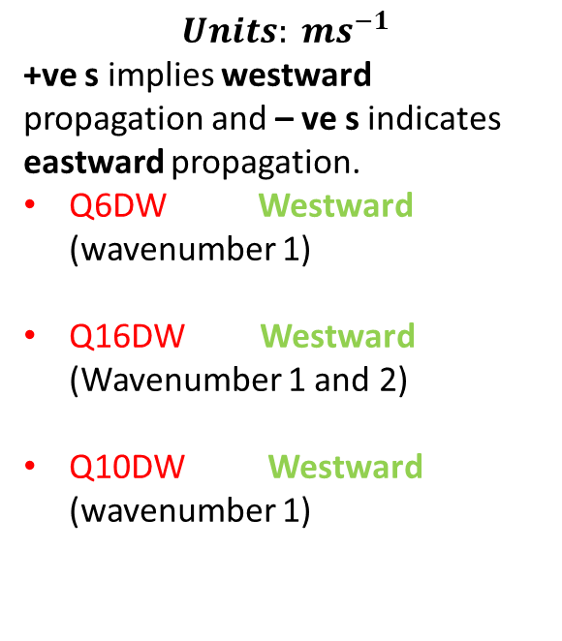

Major wave components at low latitudes
CP latitude (22.7 °S)
CA latitude (7.4 °S)
$$A\cos\left[2π \left(\frac{t}{ T} + s\frac{λ}{360}\right) – φ\right]$$
0.02 hPa ~ 80 km
$$Units: {ms}^{−1}$$
+ve s implies westward propagation and – ve s indicates eastward propagation.
Q6DW Westward (wavenumber 1)
Q16DW Westward (Wavenumber 1 and 2)
Q10DW Westward (wavenumber 1)
ECMWF
1 hPa ~ 48 km
10 hPa ~ 32 km
wavenumber

Slide 6
Wave propagation and forcing: Eliassen-Palm flux
F points in the direction of planetary wave propagation
D
F = { $f_{(φ)}$, F(z)} = {-$ρ_{o} a cos$ ϕ. ($\overline{v^{′}u′})$, f$ρ_{o} a cos$ ϕ. ($\frac{\overline{v′Θ′}}{\overline{Θ_{z}}}) \}$
$∇.F = \frac{1}{a cos φ}$ ( $F_{(φ)}$ $cos$ ϕ $)_{φ}$ + (F(z)$)_{z}$
Wave driving D = $\frac{1}{ρ_{o}a cos φ}$ $∇.F$ (Andrews et al., 1987)
The Eliassen-Palm (EP) flux diagnosis shows the propagation of PWs from high and mid to low latitudes during the warming
Maximum wave flux on the peak warming day, i.e. 18 September.
Wave activity decreases after warming days.

Slide 7
Summary
The present work portrays the PW dynamics in the middle atmosphere during a minor but impactful SSW event in September 2019 observed from two low latitude stations in the Brazilian sector. Based on the observed features
The present warming event can also be termed as high stratospheric warming.
The low latitude middle atmosphere shows contrasting character with respect to the high latitude, i.e. cooling in the stratosphere coincident with the high latitude warming and warming in the mesosphere concurrent with the high latitude cooling.
A strong Q16DW is mostly found to be present before the warming interval and weakens considerably after the warming episode. Another PW component, i.e., Q6DW is found in the mesosphere and MLT during the initial days of post warming phase.
A handful of travelling PW components, i.e., Q16DW, Q10DW, Q6DW and Q3DW are found during the observational period primarily correspond to the westward zonal wavenumber 1 and 2.
The EP flux reveals propagation of PWs from high and mid to low latitudes during the SSW event that maximises on the peak warming day, i.e.18 September.
Thank you

