Slide 1


A machine learning method for seismic signal monitoring: A contribution to the detection of the potential volcanic hazard on Etna, Italy Susanna Falsaperla, Horst Langer, Alfio Messina, and Salvatore Spampinato
Istituto Nazionale di Geofisica e Vulcanologia, Sezione di Catania, Osservatorio etneo, Catania, Italy (susanna.falsaperla@ingv.it)
EGU22-1151

Slide 2
Why this study?
The dynamics driving an eruption play a crucial role in the impact volcanic activity has on the community at large.
The interpretation of geophysical and geochemical changes heralding a volcanic unrest is a fundamental key to forecasting upcoming phenomena. However, the style and intensity of the eruption are difficult to predict, even in open-conduit volcanoes where eruptions can be relatively frequent.
This is the case of Etna, in Italy, one of the most active basaltic volcanoes in the world.
Seismic stations
Shaded relief of Etna updated at 2007 and modified after Gwinner et al. (2006).
EGU22-1151

Slide 3
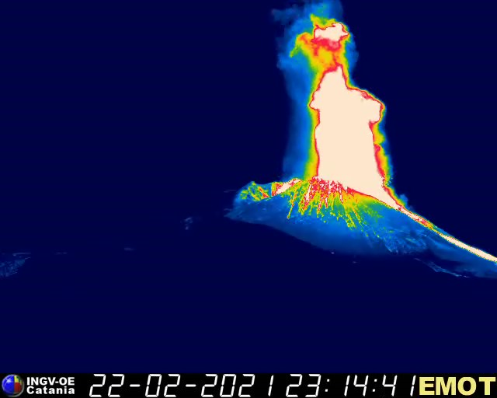

Why Etna?
In 2021, fifty-two lava fountains arose from its Southeast Crater accompanied by lava emissions and ash fallout, which disrupted air and road traffic in numerous Sicilian municipalities. Lava fountains are just one of the typical eruptive styles of Etna (e.g., Andronico et al., 2021). Strombolian activity and lava flows are also relatively frequent here, each with its own characteristics in terms of intensity and social impact.
EGU22-1151

Slide 4
Volcanic tremor and lava fountains
In this perspective, we refined a machine learning method encompassed in the multi-station warning system by Spampinato et al. (2019). The system flags alerts exploiting the spectral characteristics of the background signal, so-called volcanic tremor, continuously acquired by the stations of the Etna permanent seismic network.
Here, we offer a few examples of the challenges in the application of thresholds to forecast different levels of volcanic activity, from unrest to paroxysms.
F= lava fountain
?
start of the unrest
EGU22-1151

Slide 5
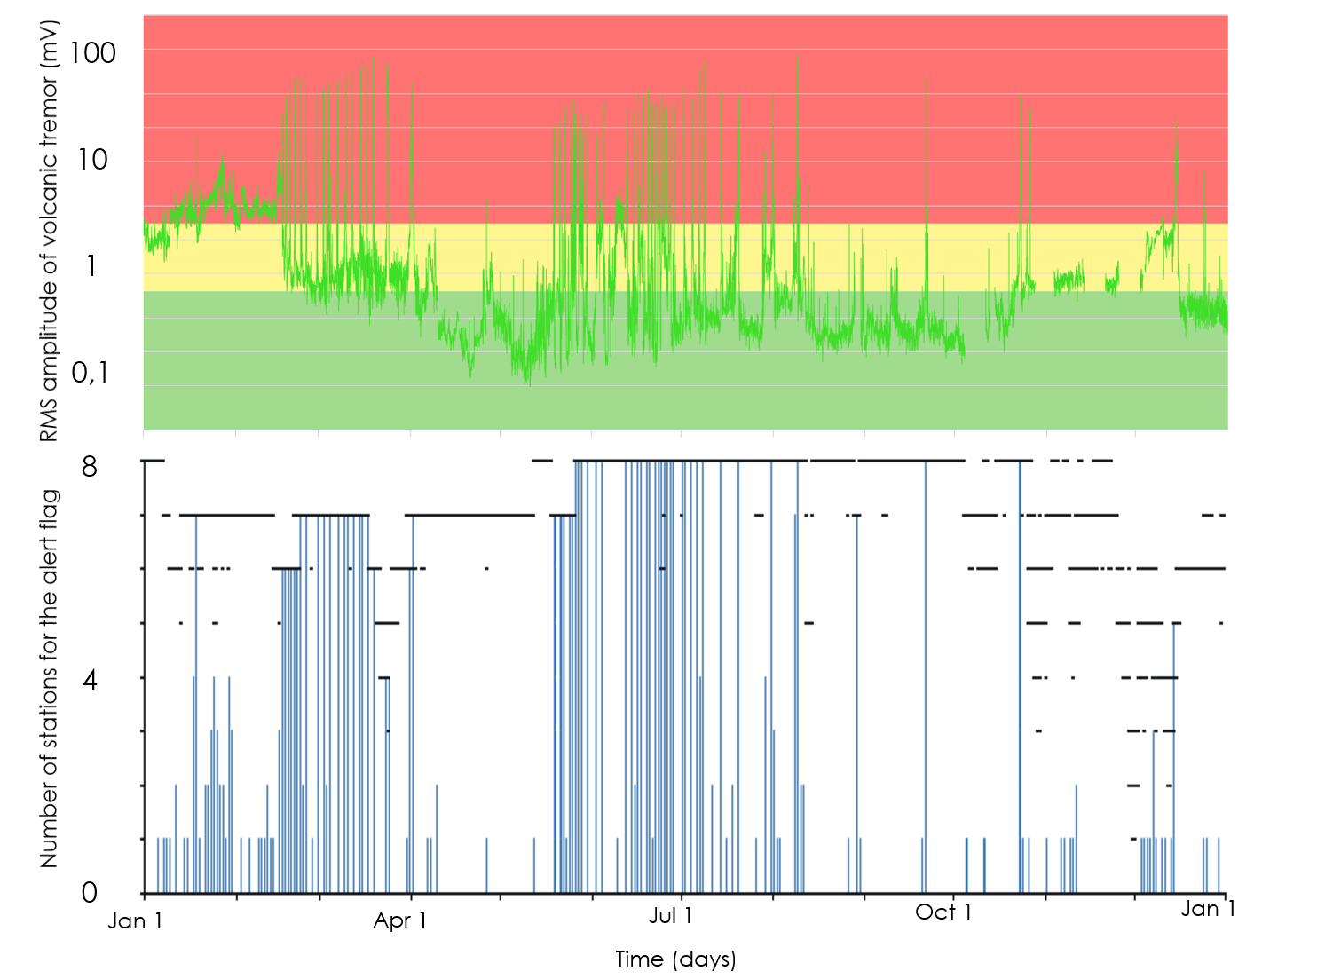
Warning in 2021: test of a threshold
The stronger the eruptive activity, the greater the number of alert flag stations.
EGU22-1151

Slide 6
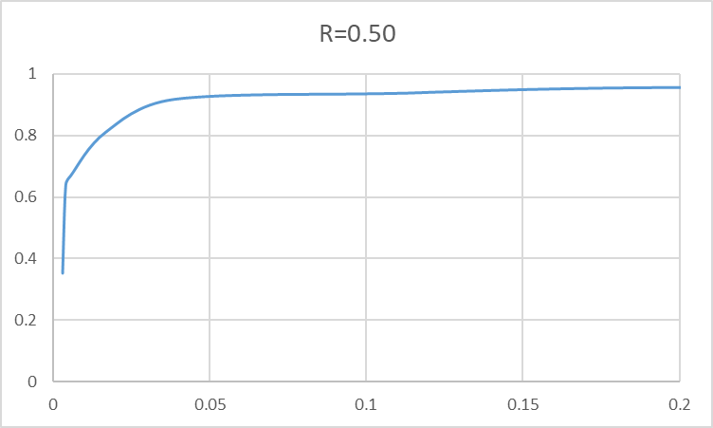
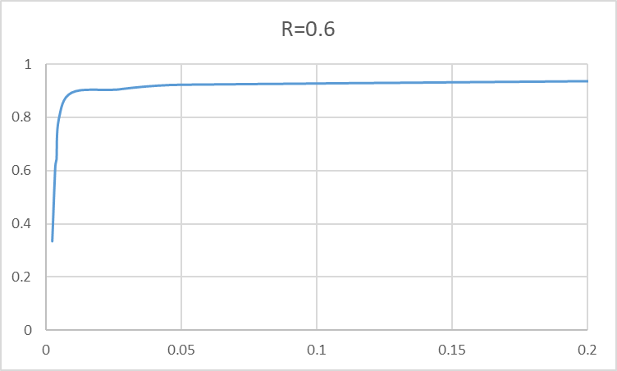
Evaluation of the performance
The so-called “Receiver Operation Characteristic” (ROC; Metz, 1978) curves allow us to establish rules for the identification of suitable criteria to evaluate the performance of our warning system, here based on the red (R) saturation of Kohonen maps (Kohonen, 2001).
This aim is achieved comparing the “true positives” (TP; events correctly flagged) with respect to “false positives” (FP; events flagged without having occurred).
TP 492
FP 469
(warning with at least four stations)
TP 481
FP 135
(warning with at least four stations)
EGU22-1151

Slide 7
Conclusions
Effettive analysis of high-dimensional data (volcanic tremor) using a multi-station warning system
Identification of changes heralding impending volcanic activity at Etna
Excellent performance of the warning system by using alert thresholds for the definition of different levels of activity, from unrest to paroxysms
Final choice of the thresholds and number of stations is a matter of discussion based on TP and FP.
EGU22-1151

Slide 8
Thank you!
Acknowledgments
This work was designed within the project IMPACT (A multidisciplinary Insight on the kinematics and dynamics of Magmatic Processes at Mt. Etna Aimed at identifying preCursor phenomena and developing early warning sysTems). IMPACT belongs to the Progetti Dipartimentali INGV [DIP7], https://progetti.ingv.it/index.php/it/progetti-dipartimentali/vulcani/impact#informazioni-sul-progetto. We are grateful to Emanuela De Beni for providing the modified shaded relief of Etna.
References
Andronico, D., Cannata, A., Di Grazia, G., Ferruccio Ferrari, F., The 1986–2021 paroxysmal episodes at the summit craters of Mt. Etna: Insights into volcano dynamics and hazard, Earth-Science Reviews, 220, 103686, https://doi.org/10.1016/j.earscirev.2021.103686, (2021).
Gwinner, K., Coltelli, M., Flohrera, J., Jaumanna, R., Matza, K.D., Marsella, M., Roatscha, T., Scholtena, F., and Trauthana, F., The HRSC-AX Mt. Etna Project: High-resolution Orthoimages and 1 m DEM at Regional Scale. In Proceedings of the ISPRS XXXVI, Paris, France, 4–6 July 2006. T05–23 (2006).
Kohonen, T., Self-organizing Maps, 3rd edition. Springer, Berlin, p 501 (2001).
Metz, C. E., Basic principles of ROC analysis. Sem. Nuc Med. 8, 283–298 (1978).
Spampinato, S., Langer, H., Messina, A., Falsaperla, S., Short term detection of volcanic unrest at Mt. Etna by means of a multi station warning system. Scientific Reports, 9:6506, https://doi.org/10.1038/s41598 019 42930 3 ; http://hdl.handle.net/2122/12914 (2019).
EGU22-1151

