Slide 1
Sub-Saharan Africa's international migration and sustainable development under climate change
Qirui Li
Cyrus Samimi
University of Bayreuth
Notes:
Abstract
Africa’s development problems are often visualized through the existence or lack of infrastructures of common good such as roads, hospitals and schools. Over the past decades, the development of infrastructures such as highways, standard gauge railways, oil and gas pipelines have been constitutive elements of transformational “visions” for many African countries. In East Africa, there are two key infrastructure projects express the admirable promise to place the region in the complex network of infrastructure geography, but also influence different scales of relations and struggles. Kenya’s LAPSSET and Uganda’s EACOP are the two projects. While the state-corporate rhetoric about these projects place their respective populations at the center of positive prospects, deeply seated socio-environmental concerns, among other factors have rendered their developments problematic. This presentation features the preliminary stages of developing Uganda’s crude-oil pipeline—the EACOP. It examines the trilateral struggles between the Ugandan state, the oil corporations and local communities along the pipeline corridor to legitimize the critical oil infrastructure. Low lying fears of and resistances against the infrastructure have compelled the state and the corporations to strategically “manufacture consent” among the communities to pave way for the commencement of the project. The paper is based on empirical field study conducted in five pipeline “right-of-way” districts (Hoima, Buliisa, Lwengo, Kyotera and Rakai) of Uganda.
Key words: Consent; EACOP; Oil, Uganda

Slide 2
Socio-ecological drivers of movements into and out of African Woodlands (2020-2024)
Objectives:
Interactions between population movements and environmental transformations and social-economic values
Practices of resource valorisation towards socio-ecological sustainability and mobility
https://www.africamultiple.uni-bayreuth.de/en/Research/1research-sections/mobilities/Spatio-temporal-variability/index.html
Notes:
There is apparent consensus that consent (in the context of large-scale project developments) is a problematic concept whose definition is far from being universal (World Bank, 2017). More generally, Consent alludes to an internationally recognized right of self-determination that has been enacted in several treaties and conventions (Hanna & Vanclay, 2013). In the field of extractives, consent is used in reference to best practice principles that insulate three core values: freedom value; time value and information value – often framed as Free Prior Informed Consent (FPIC) (IWGIA, 2017; IFC, 2012; Greenspan, 2014). FPIC became a globally recognized standard of operations for multinational corporations undertaking large-scale projects in remote parts of the world. The standard for consent is based on the three value principles of self-determination: adequately information; time to make/take a decision; opportunities for alternative choices before individuals/groups approve of or reject projects (Greenspan, 2014).
The fact that consent is triggered by (or within the context of) particular projects, and expected of the communities in whose midst such projects are undertaken makes it a practice based on modes of relations both within the self (biopolitics) and relations with other stakeholders. Taking the FPIC framework as a typical standard, consent ought to be seen from two angles: one angle is through the lens of neoliberal practice of “relations of freedom” bound by time of/and information flow. From this angle, arrival at consent totally follows the fundamental principles of right to self-determination. The other angle is one in which tensions arise between the communities and the state-corporate entities that seek to develop particular projects. Consent, under these circumstances are arrived at through some kind of “wars of subjectivity”—the struggle to reconfigure the interest (and also the conduct) of population (in this case, the affected communities) in projects that they would, otherwise, not agree to, or conditionalize the arrival at consent.
While agencies such as the International Financial Corporations (IFCs) demand that their clients adhere to the principles of FPIC in undertaking mega projects (World Bank, 2017), the very processes by which consent is achieved has not been adequately interrogated. The starting point to conceptualize this is to begin by seeing FPIC as a framework model for relations faceted by multiple considerations. By taking this direction, analytical spaces for examining the spaces and entangled practices that bring about consent open up. Therefore, we are enabled the possibility to see consent from sets of practices that we consider to be modes of relations—i.e. the very controversial questions relating to the core values of consent, namely: what consent is being sought for; the scope of free will (the extent of “freedom” there may be in the process of realizing consent); the timeframe within which this free will was exercised, and whether there were alternatives for choices to be made; How we can account for strategic misinformation, and so forth.
In attempt to delved into these important questions, I take a close look at consent to (im)mobility within the context of Uganda’s multi-billion-dollar project (the East African Crude Oil Pipeline – EACOP). Empirical evidence points towards two things: First, whereas the demand for consent to be freely based on adequate information, the freedom and adequacy of information remain nodes of contention. When individuals are faced with choice limitations and harsh alternatives, the modes of relations by which such consent comes into place would be in a problematic boundary between realms of free will and coercion. Second, there is misconception that the provision of information translates into consent. Little attention is often paid to the nature of the information, the manner in, and the conditions under which it is provided. Since consent depends largely on knowledge based on certain critical information, the potential for manipulative knowledge controversies are highly likely, in circumstances where the project may have exceedingly negative impacts to the consenting groups and individuals. Consent in the context of the EACOP has, therefore, been a manufactured mode of relation to which I will turn in section 5.

Slide 3
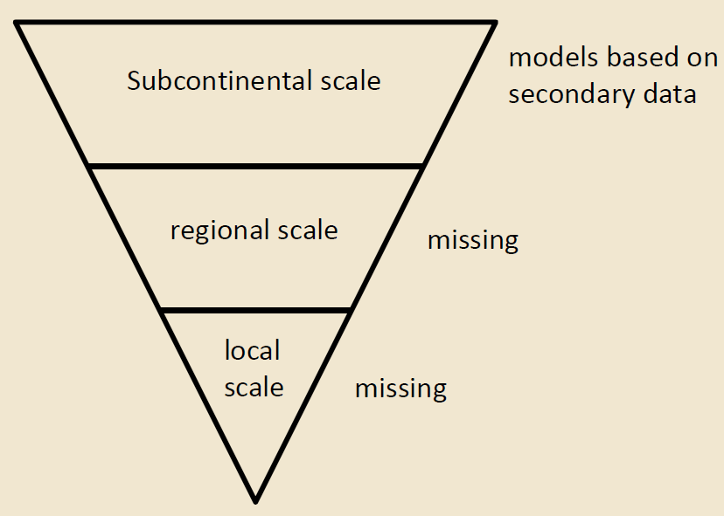


Socio-ecological drivers of movements into and out of African Woodlands (2020-2024)
Role of migration in the sustainability transition of socio-ecological systems
Environmental and socio-economic drivers
Causal effects on migration
Feedback effects of migration
Notes:
There is apparent consensus that consent (in the context of large-scale project developments) is a problematic concept whose definition is far from being universal (World Bank, 2017). More generally, Consent alludes to an internationally recognized right of self-determination that has been enacted in several treaties and conventions (Hanna & Vanclay, 2013). In the field of extractives, consent is used in reference to best practice principles that insulate three core values: freedom value; time value and information value – often framed as Free Prior Informed Consent (FPIC) (IWGIA, 2017; IFC, 2012; Greenspan, 2014). FPIC became a globally recognized standard of operations for multinational corporations undertaking large-scale projects in remote parts of the world. The standard for consent is based on the three value principles of self-determination: adequately information; time to make/take a decision; opportunities for alternative choices before individuals/groups approve of or reject projects (Greenspan, 2014).
The fact that consent is triggered by (or within the context of) particular projects, and expected of the communities in whose midst such projects are undertaken makes it a practice based on modes of relations both within the self (biopolitics) and relations with other stakeholders. Taking the FPIC framework as a typical standard, consent ought to be seen from two angles: one angle is through the lens of neoliberal practice of “relations of freedom” bound by time of/and information flow. From this angle, arrival at consent totally follows the fundamental principles of right to self-determination. The other angle is one in which tensions arise between the communities and the state-corporate entities that seek to develop particular projects. Consent, under these circumstances are arrived at through some kind of “wars of subjectivity”—the struggle to reconfigure the interest (and also the conduct) of population (in this case, the affected communities) in projects that they would, otherwise, not agree to, or conditionalize the arrival at consent.
While agencies such as the International Financial Corporations (IFCs) demand that their clients adhere to the principles of FPIC in undertaking mega projects (World Bank, 2017), the very processes by which consent is achieved has not been adequately interrogated. The starting point to conceptualize this is to begin by seeing FPIC as a framework model for relations faceted by multiple considerations. By taking this direction, analytical spaces for examining the spaces and entangled practices that bring about consent open up. Therefore, we are enabled the possibility to see consent from sets of practices that we consider to be modes of relations—i.e. the very controversial questions relating to the core values of consent, namely: what consent is being sought for; the scope of free will (the extent of “freedom” there may be in the process of realizing consent); the timeframe within which this free will was exercised, and whether there were alternatives for choices to be made; How we can account for strategic misinformation, and so forth.
In attempt to delved into these important questions, I take a close look at consent to (im)mobility within the context of Uganda’s multi-billion-dollar project (the East African Crude Oil Pipeline – EACOP). Empirical evidence points towards two things: First, whereas the demand for consent to be freely based on adequate information, the freedom and adequacy of information remain nodes of contention. When individuals are faced with choice limitations and harsh alternatives, the modes of relations by which such consent comes into place would be in a problematic boundary between realms of free will and coercion. Second, there is misconception that the provision of information translates into consent. Little attention is often paid to the nature of the information, the manner in, and the conditions under which it is provided. Since consent depends largely on knowledge based on certain critical information, the potential for manipulative knowledge controversies are highly likely, in circumstances where the project may have exceedingly negative impacts to the consenting groups and individuals. Consent in the context of the EACOP has, therefore, been a manufactured mode of relation to which I will turn in section 5.

Slide 4
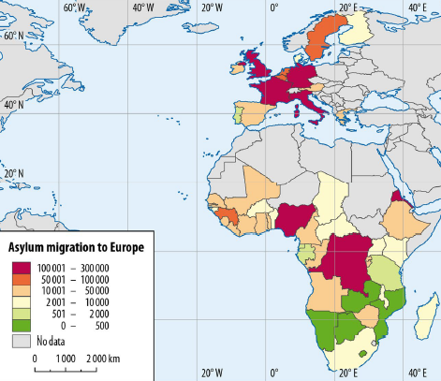
Subcontinental scale:
Secondary data
40 sub-Saharan African (SSA)
countries
14 European (EU-14) countries
1990-2020

Slide 5
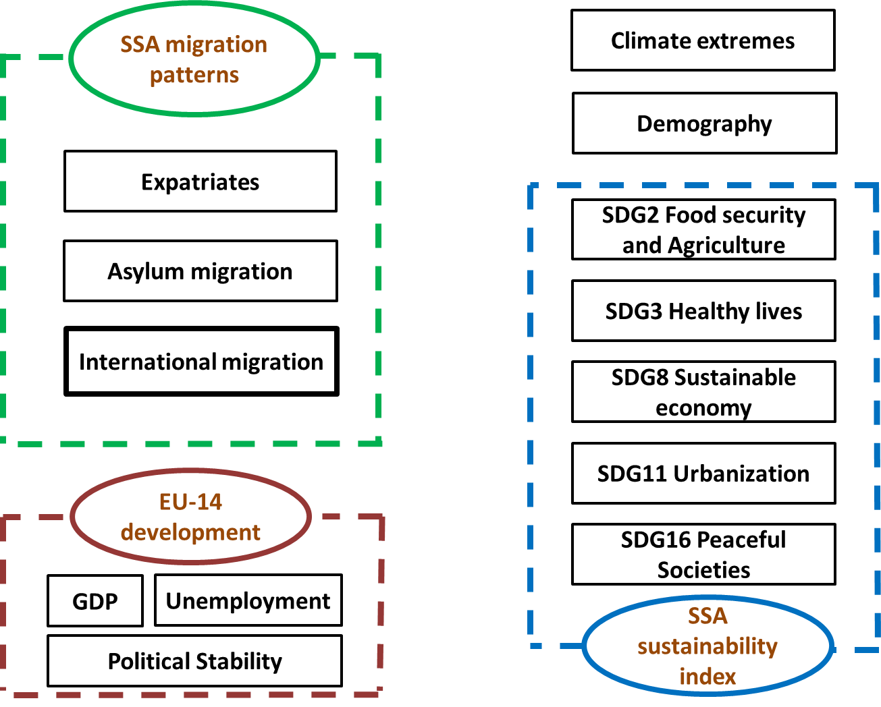
Data integration

Slide 6
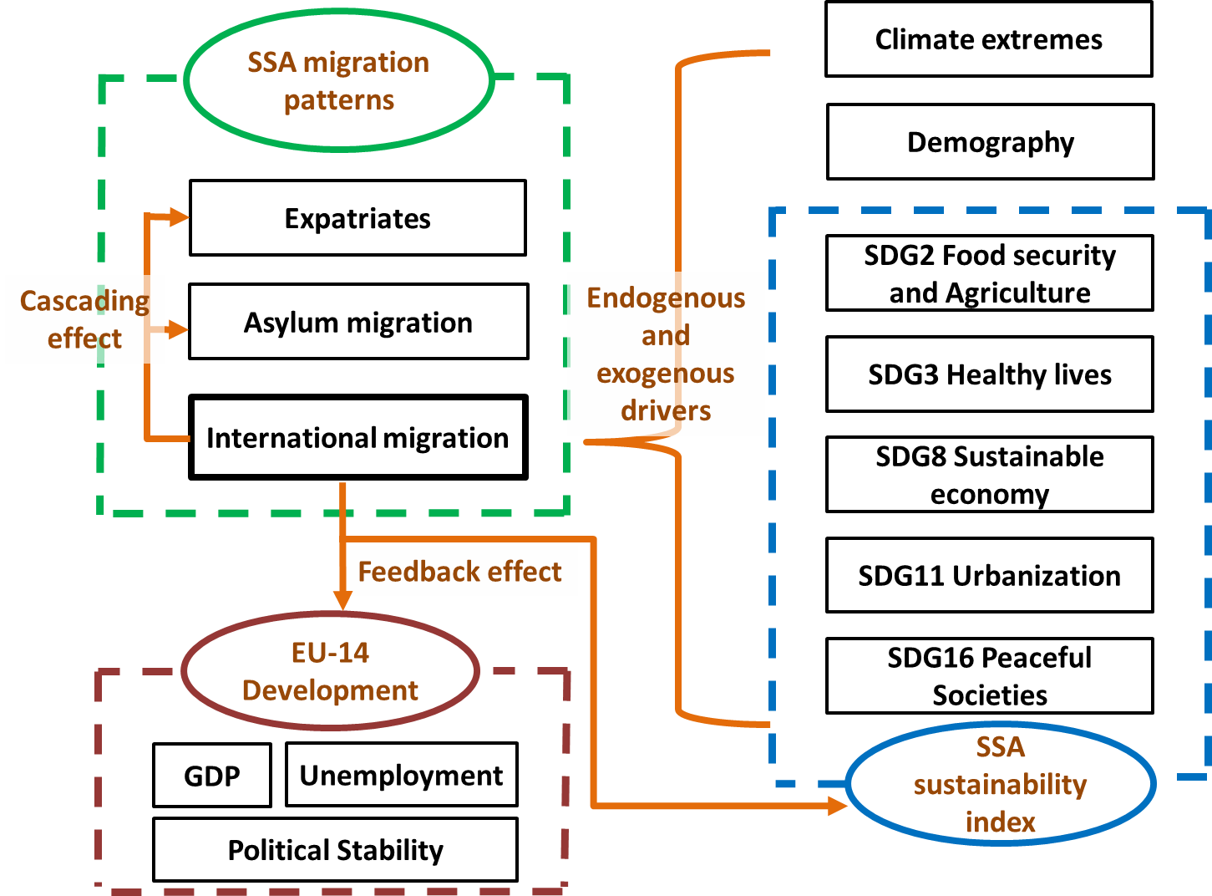
Modelling

Slide 7
Key findings
SSA international migration was primarily intra-SSA to low-income but high-population-density countries.
Along with increased sustainability scores, international migration declined, but emigration rose.
Climate extremes tend to affect migration and emigration but not universally. Dry extremes propelled migration, whereas wet extremes had an adverse effect.
SSA international migration was driven by food insecurity and political instability and violence.
SSA's international migration promoted asylum seeking to Europe, with the diversification of origin countries and a motive for economic wellbeing.
Large-scale international migration and asylum seeking constrained both EU and SSA's socio-economic development, e.g., political stability, GDP per capita and employment.
https://link.springer.com/article/10.1007/s11625-022-01116-z
Notes:
There is apparent consensus that consent (in the context of large-scale project developments) is a problematic concept whose definition is far from being universal (World Bank, 2017). More generally, Consent alludes to an internationally recognized right of self-determination that has been enacted in several treaties and conventions (Hanna & Vanclay, 2013). In the field of extractives, consent is used in reference to best practice principles that insulate three core values: freedom value; time value and information value – often framed as Free Prior Informed Consent (FPIC) (IWGIA, 2017; IFC, 2012; Greenspan, 2014). FPIC became a globally recognized standard of operations for multinational corporations undertaking large-scale projects in remote parts of the world. The standard for consent is based on the three value principles of self-determination: adequately information; time to make/take a decision; opportunities for alternative choices before individuals/groups approve of or reject projects (Greenspan, 2014).
The fact that consent is triggered by (or within the context of) particular projects, and expected of the communities in whose midst such projects are undertaken makes it a practice based on modes of relations both within the self (biopolitics) and relations with other stakeholders. Taking the FPIC framework as a typical standard, consent ought to be seen from two angles: one angle is through the lens of neoliberal practice of “relations of freedom” bound by time of/and information flow. From this angle, arrival at consent totally follows the fundamental principles of right to self-determination. The other angle is one in which tensions arise between the communities and the state-corporate entities that seek to develop particular projects. Consent, under these circumstances are arrived at through some kind of “wars of subjectivity”—the struggle to reconfigure the interest (and also the conduct) of population (in this case, the affected communities) in projects that they would, otherwise, not agree to, or conditionalize the arrival at consent.
While agencies such as the International Financial Corporations (IFCs) demand that their clients adhere to the principles of FPIC in undertaking mega projects (World Bank, 2017), the very processes by which consent is achieved has not been adequately interrogated. The starting point to conceptualize this is to begin by seeing FPIC as a framework model for relations faceted by multiple considerations. By taking this direction, analytical spaces for examining the spaces and entangled practices that bring about consent open up. Therefore, we are enabled the possibility to see consent from sets of practices that we consider to be modes of relations—i.e. the very controversial questions relating to the core values of consent, namely: what consent is being sought for; the scope of free will (the extent of “freedom” there may be in the process of realizing consent); the timeframe within which this free will was exercised, and whether there were alternatives for choices to be made; How we can account for strategic misinformation, and so forth.
In attempt to delved into these important questions, I take a close look at consent to (im)mobility within the context of Uganda’s multi-billion-dollar project (the East African Crude Oil Pipeline – EACOP). Empirical evidence points towards two things: First, whereas the demand for consent to be freely based on adequate information, the freedom and adequacy of information remain nodes of contention. When individuals are faced with choice limitations and harsh alternatives, the modes of relations by which such consent comes into place would be in a problematic boundary between realms of free will and coercion. Second, there is misconception that the provision of information translates into consent. Little attention is often paid to the nature of the information, the manner in, and the conditions under which it is provided. Since consent depends largely on knowledge based on certain critical information, the potential for manipulative knowledge controversies are highly likely, in circumstances where the project may have exceedingly negative impacts to the consenting groups and individuals. Consent in the context of the EACOP has, therefore, been a manufactured mode of relation to which I will turn in section 5.

Slide 8
Subcontinental scale:
Shortcomings:
Lack of quality data
Circular, internal and short term migration/mobility are not represented
Simulation and forecasting of various scenarios are missing
Notes:
There is apparent consensus that consent (in the context of large-scale project developments) is a problematic concept whose definition is far from being universal (World Bank, 2017). More generally, Consent alludes to an internationally recognized right of self-determination that has been enacted in several treaties and conventions (Hanna & Vanclay, 2013). In the field of extractives, consent is used in reference to best practice principles that insulate three core values: freedom value; time value and information value – often framed as Free Prior Informed Consent (FPIC) (IWGIA, 2017; IFC, 2012; Greenspan, 2014). FPIC became a globally recognized standard of operations for multinational corporations undertaking large-scale projects in remote parts of the world. The standard for consent is based on the three value principles of self-determination: adequately information; time to make/take a decision; opportunities for alternative choices before individuals/groups approve of or reject projects (Greenspan, 2014).
The fact that consent is triggered by (or within the context of) particular projects, and expected of the communities in whose midst such projects are undertaken makes it a practice based on modes of relations both within the self (biopolitics) and relations with other stakeholders. Taking the FPIC framework as a typical standard, consent ought to be seen from two angles: one angle is through the lens of neoliberal practice of “relations of freedom” bound by time of/and information flow. From this angle, arrival at consent totally follows the fundamental principles of right to self-determination. The other angle is one in which tensions arise between the communities and the state-corporate entities that seek to develop particular projects. Consent, under these circumstances are arrived at through some kind of “wars of subjectivity”—the struggle to reconfigure the interest (and also the conduct) of population (in this case, the affected communities) in projects that they would, otherwise, not agree to, or conditionalize the arrival at consent.
While agencies such as the International Financial Corporations (IFCs) demand that their clients adhere to the principles of FPIC in undertaking mega projects (World Bank, 2017), the very processes by which consent is achieved has not been adequately interrogated. The starting point to conceptualize this is to begin by seeing FPIC as a framework model for relations faceted by multiple considerations. By taking this direction, analytical spaces for examining the spaces and entangled practices that bring about consent open up. Therefore, we are enabled the possibility to see consent from sets of practices that we consider to be modes of relations—i.e. the very controversial questions relating to the core values of consent, namely: what consent is being sought for; the scope of free will (the extent of “freedom” there may be in the process of realizing consent); the timeframe within which this free will was exercised, and whether there were alternatives for choices to be made; How we can account for strategic misinformation, and so forth.
In attempt to delved into these important questions, I take a close look at consent to (im)mobility within the context of Uganda’s multi-billion-dollar project (the East African Crude Oil Pipeline – EACOP). Empirical evidence points towards two things: First, whereas the demand for consent to be freely based on adequate information, the freedom and adequacy of information remain nodes of contention. When individuals are faced with choice limitations and harsh alternatives, the modes of relations by which such consent comes into place would be in a problematic boundary between realms of free will and coercion. Second, there is misconception that the provision of information translates into consent. Little attention is often paid to the nature of the information, the manner in, and the conditions under which it is provided. Since consent depends largely on knowledge based on certain critical information, the potential for manipulative knowledge controversies are highly likely, in circumstances where the project may have exceedingly negative impacts to the consenting groups and individuals. Consent in the context of the EACOP has, therefore, been a manufactured mode of relation to which I will turn in section 5.

Slide 9
Regional scale:
Census data + Image data of Southern Africa
Hierarchical Bayesian Network
Food security assessment
→ Availability of quality data !!!
Meta analysis
Local scale: Rural Bushbuckridge, South Africa
Quantitative analysis
Household level: 500 household surveys from 2010 to 2021.
Village level: 12 selected villages + Image data on LUCCs
Qualitative analysis
Expert talk, group discussion, and participatory workshops
Notes:
There is apparent consensus that consent (in the context of large-scale project developments) is a problematic concept whose definition is far from being universal (World Bank, 2017). More generally, Consent alludes to an internationally recognized right of self-determination that has been enacted in several treaties and conventions (Hanna & Vanclay, 2013). In the field of extractives, consent is used in reference to best practice principles that insulate three core values: freedom value; time value and information value – often framed as Free Prior Informed Consent (FPIC) (IWGIA, 2017; IFC, 2012; Greenspan, 2014). FPIC became a globally recognized standard of operations for multinational corporations undertaking large-scale projects in remote parts of the world. The standard for consent is based on the three value principles of self-determination: adequately information; time to make/take a decision; opportunities for alternative choices before individuals/groups approve of or reject projects (Greenspan, 2014).
The fact that consent is triggered by (or within the context of) particular projects, and expected of the communities in whose midst such projects are undertaken makes it a practice based on modes of relations both within the self (biopolitics) and relations with other stakeholders. Taking the FPIC framework as a typical standard, consent ought to be seen from two angles: one angle is through the lens of neoliberal practice of “relations of freedom” bound by time of/and information flow. From this angle, arrival at consent totally follows the fundamental principles of right to self-determination. The other angle is one in which tensions arise between the communities and the state-corporate entities that seek to develop particular projects. Consent, under these circumstances are arrived at through some kind of “wars of subjectivity”—the struggle to reconfigure the interest (and also the conduct) of population (in this case, the affected communities) in projects that they would, otherwise, not agree to, or conditionalize the arrival at consent.
While agencies such as the International Financial Corporations (IFCs) demand that their clients adhere to the principles of FPIC in undertaking mega projects (World Bank, 2017), the very processes by which consent is achieved has not been adequately interrogated. The starting point to conceptualize this is to begin by seeing FPIC as a framework model for relations faceted by multiple considerations. By taking this direction, analytical spaces for examining the spaces and entangled practices that bring about consent open up. Therefore, we are enabled the possibility to see consent from sets of practices that we consider to be modes of relations—i.e. the very controversial questions relating to the core values of consent, namely: what consent is being sought for; the scope of free will (the extent of “freedom” there may be in the process of realizing consent); the timeframe within which this free will was exercised, and whether there were alternatives for choices to be made; How we can account for strategic misinformation, and so forth.
In attempt to delved into these important questions, I take a close look at consent to (im)mobility within the context of Uganda’s multi-billion-dollar project (the East African Crude Oil Pipeline – EACOP). Empirical evidence points towards two things: First, whereas the demand for consent to be freely based on adequate information, the freedom and adequacy of information remain nodes of contention. When individuals are faced with choice limitations and harsh alternatives, the modes of relations by which such consent comes into place would be in a problematic boundary between realms of free will and coercion. Second, there is misconception that the provision of information translates into consent. Little attention is often paid to the nature of the information, the manner in, and the conditions under which it is provided. Since consent depends largely on knowledge based on certain critical information, the potential for manipulative knowledge controversies are highly likely, in circumstances where the project may have exceedingly negative impacts to the consenting groups and individuals. Consent in the context of the EACOP has, therefore, been a manufactured mode of relation to which I will turn in section 5.

Slide 10
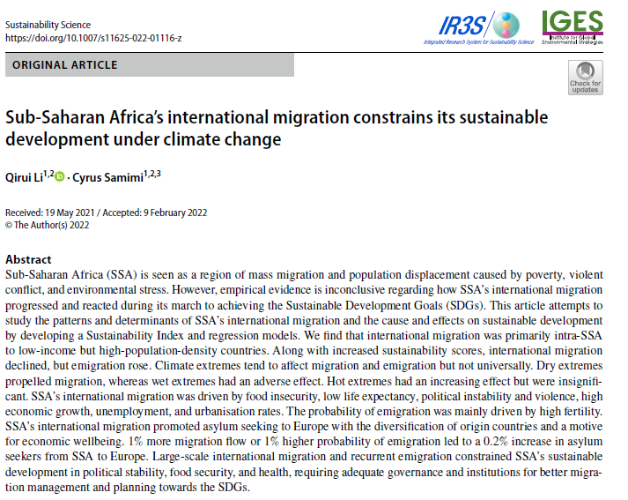

Email: qirui.li@uni-bayreuth.de /
leolee8612@gmail.com
ResearchGate:
https://link.springer.com/article/10.1007/s11625-022-01116-z

