Slide 1
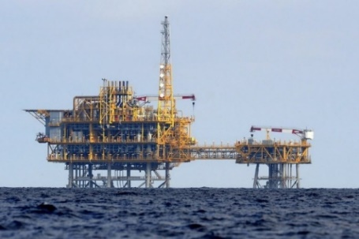



Triggering mechanisms of the induced seismicity at the Underground Gas Storage of Castor, Spain
Víctor Vilarrasa
victor.vilarrasa@idaea.csic.es
Silvia De Simone, Jesús Carrera, Antonio Villaseñor
EGU, 23-27 May, 2022

Slide 2
4.1
M
days
17
4-10
km

Slide 3
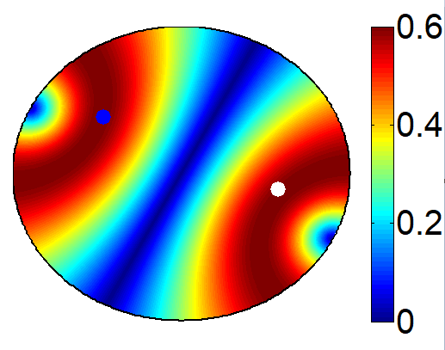
Castor platform
Mediterranean Sea
Injection wells
ΔP_{max}=0.8 MPa
2 km
Amposta Fault
Known and active, 1-km offset
Gas storage
4 km
How could gas injection at 1.7-km depth cause earthquakes several kilometers below with no hydraulic connection?
6 km
The induced earthquakes are aligned along a deep fault
8 km
Deep fault
Not mapped, critically stressed
Earthquakes
10 km

Slide 4
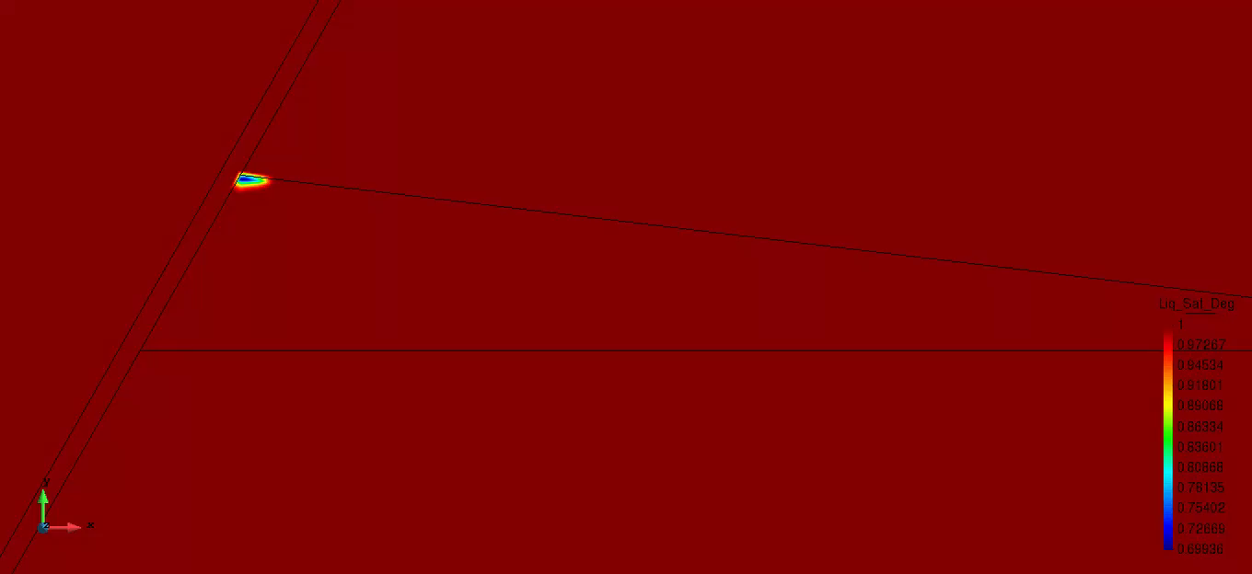
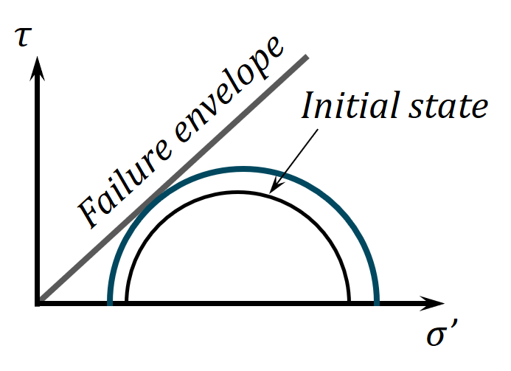
Gas injection accelerated the movement of the critically stressed Amposta fault, producing progressive aseismic slip
Vertical loading
During the 15 days of injection, the increase in pore pressure was the main cause of the Amposta fault movement
Horizontal unloading
Amposta fault
The gas continued to destabilize the Amposta fault after the stop of injection because its low density exerts a vertical buoyancy force

Slide 5
The slow, aseismic slip of the Amposta fault caused the movement of another, deeper fault that produced the earthquakes felt by the population
Injected gas
Amposta fault
Soft rocks, progressively deformed
Deep fault
The deep fault was destabilized by shear-slip stress transfer and transient slip-driven pore pressure changes
Stiff rocks, generate earthquakes when they break
Vilarrasa et al. (2021) GRL

Slide 6
Questions?
This project has received funding from the European Research Council (ERC) under the European Union’s Horizon 2020 research and innovation programme (grant agreement No 801809)
This presentation reflects only the author's view and the Agency and the Commission are not responsible for any use that may be made of the information it contains.

