Slide 1


DST
Department of Earth Sciences
DICUS
Department of Chemistry «Ugo Schiff»
The role of urban streams in the microplastics contamination scenario: the case study of the Mugnone Creek (Florence, Italy)
Dr. Alessio Monnanni
Session HS 7.3 24/05/2022

Slide 2
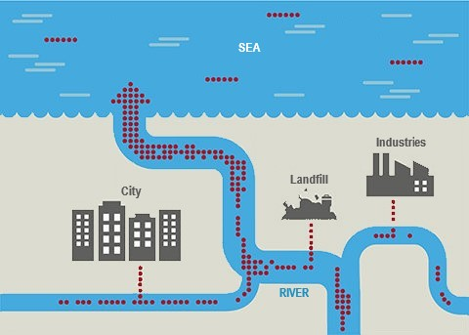
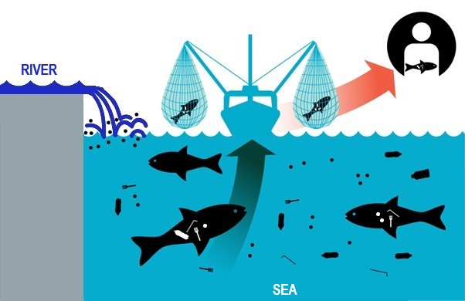
The role of rivers
80% of the Microplastics (MPs) found in the seas and oceans, come from continental freshwaters.
(Andrady, 2011)

Slide 3

Mugnone Creek
Mugnone Creek
Terzolle Creek
Arno River

Slide 4
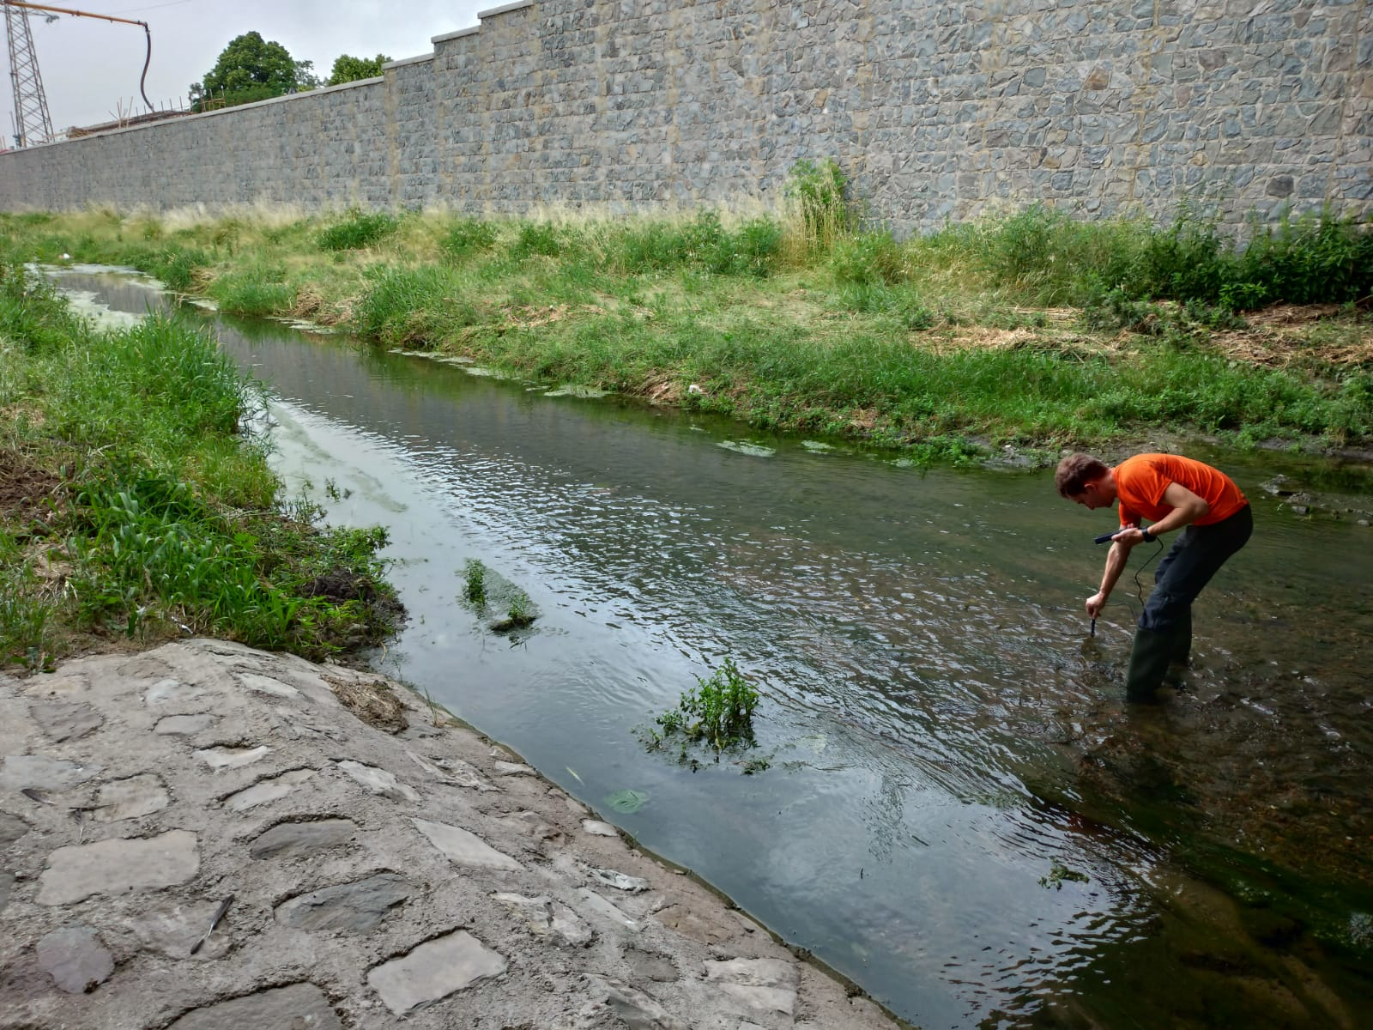
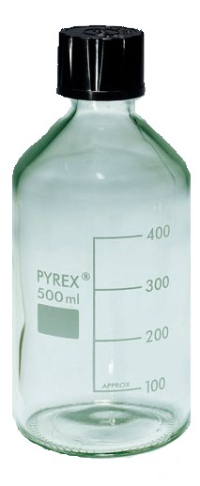
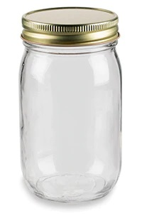
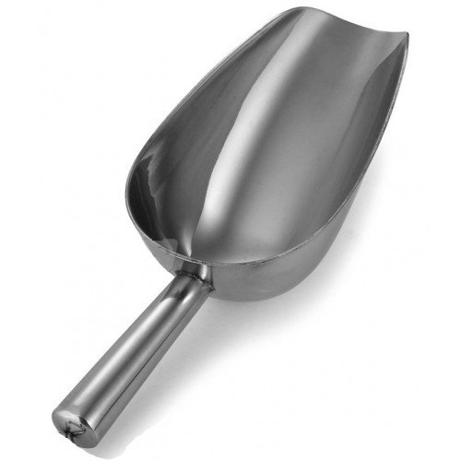
Sampling methods
WATER
SEDIMENT
(1-3 L pirex bottle)
(glass jar) + (aluminum shovel)

Slide 5
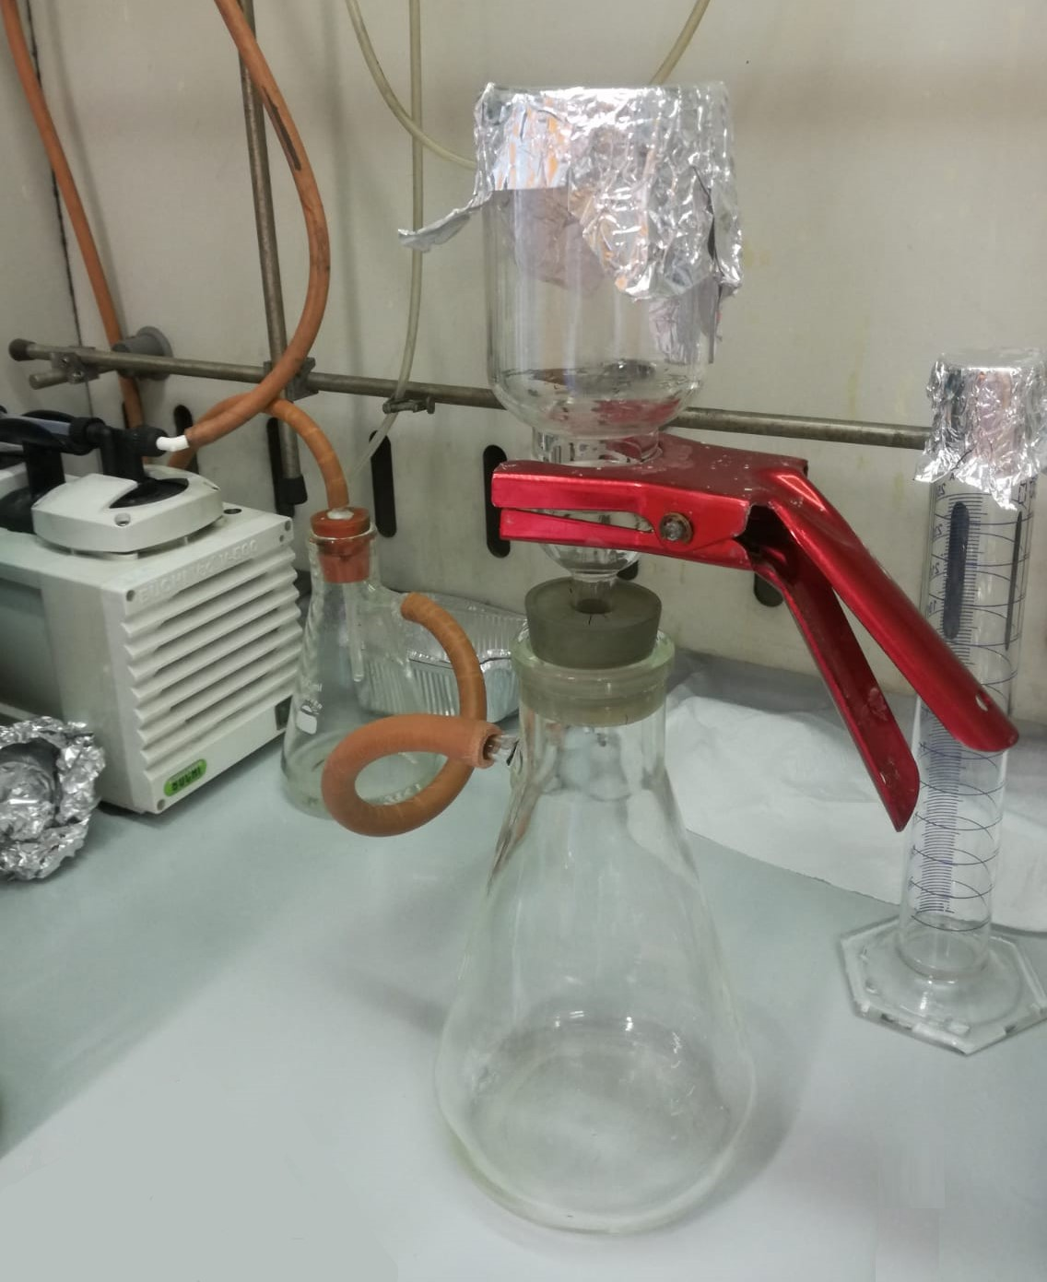
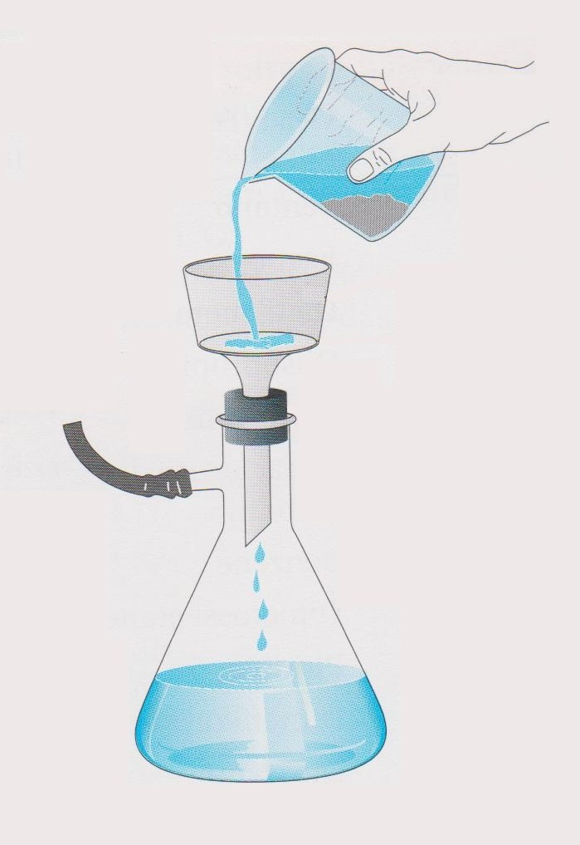
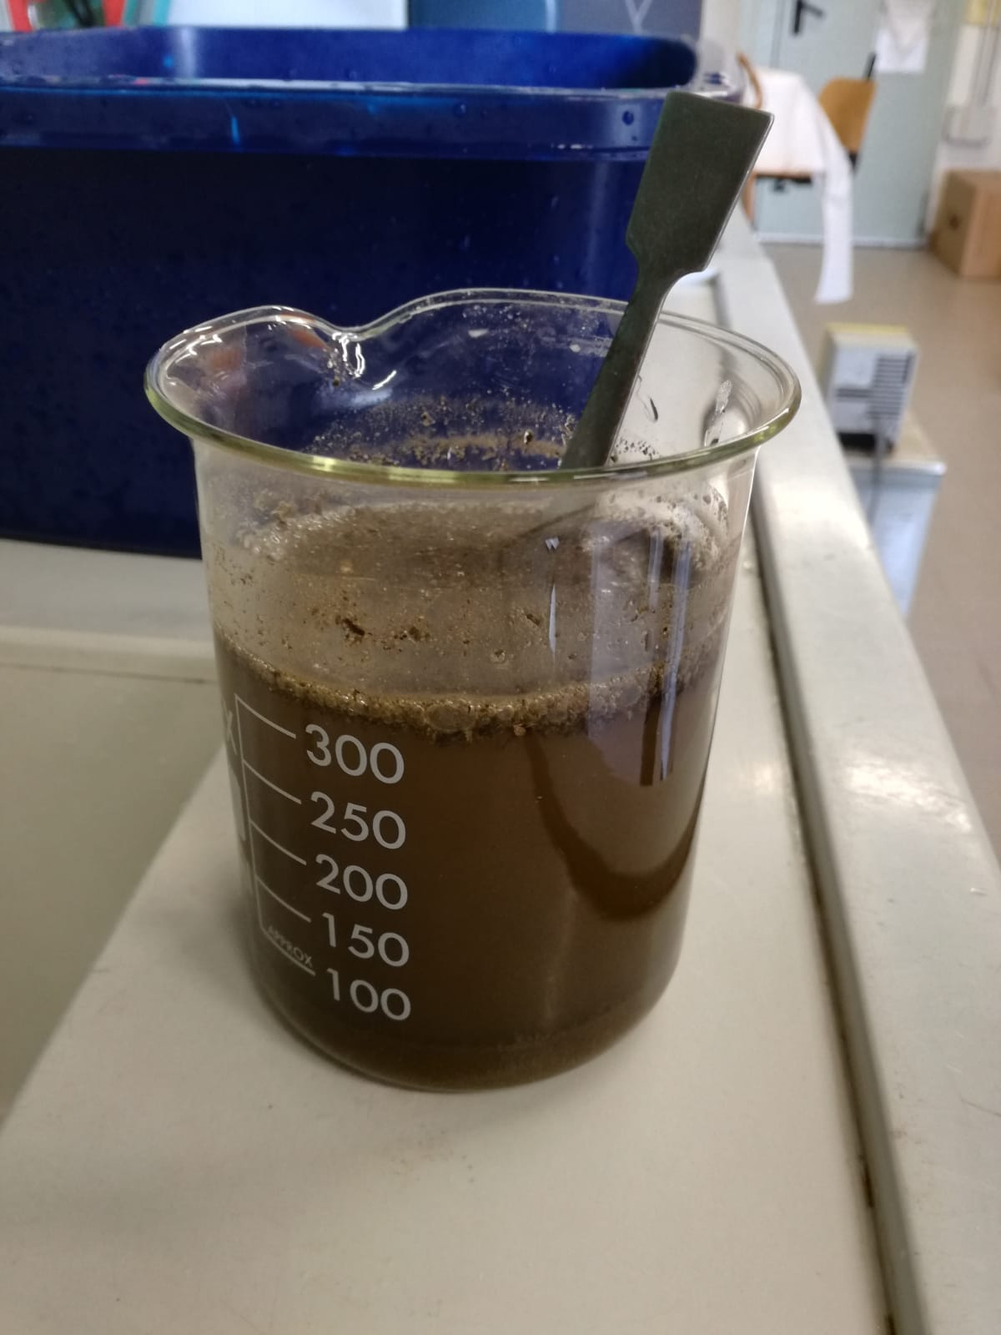
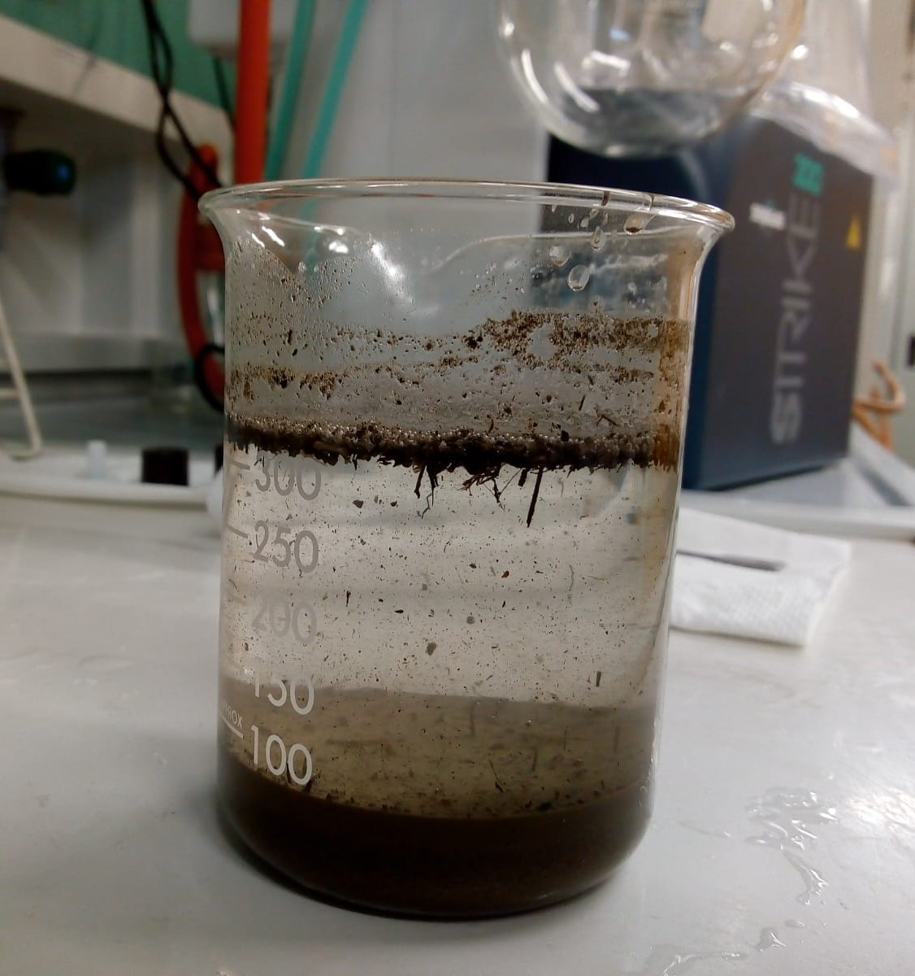
Extraction methods
WATER
MPs extraction by Filtration
SEDIMENT
MPs extraction
(1.6µm glass filters)
(Büchner filter system)
MPs extraction by Density Separation
Saturated brine solution (NaCl) ρ = 1,20 g/cm³
50 g of sediment + 300 ml of brine sol. mixing (3 min.)
Decanting (24 h)
Surnatant filtration
Digestion of filter (10 ml of H₂O₂ 15% vol.) for 48 h
(Decanting 24h)

Slide 6
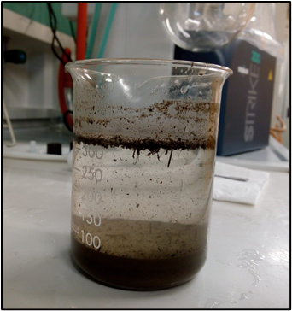
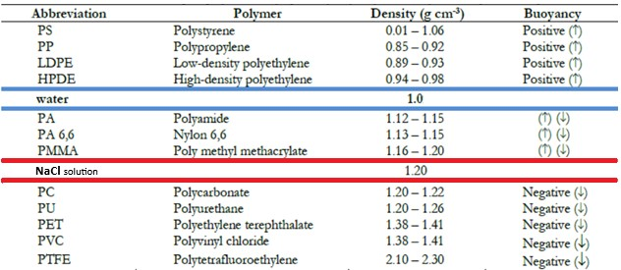
Density separation

Slide 7
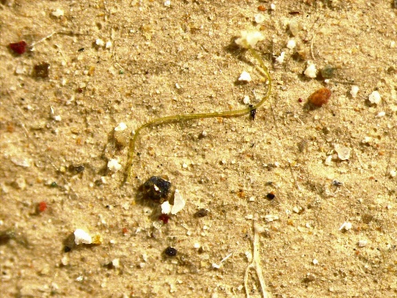
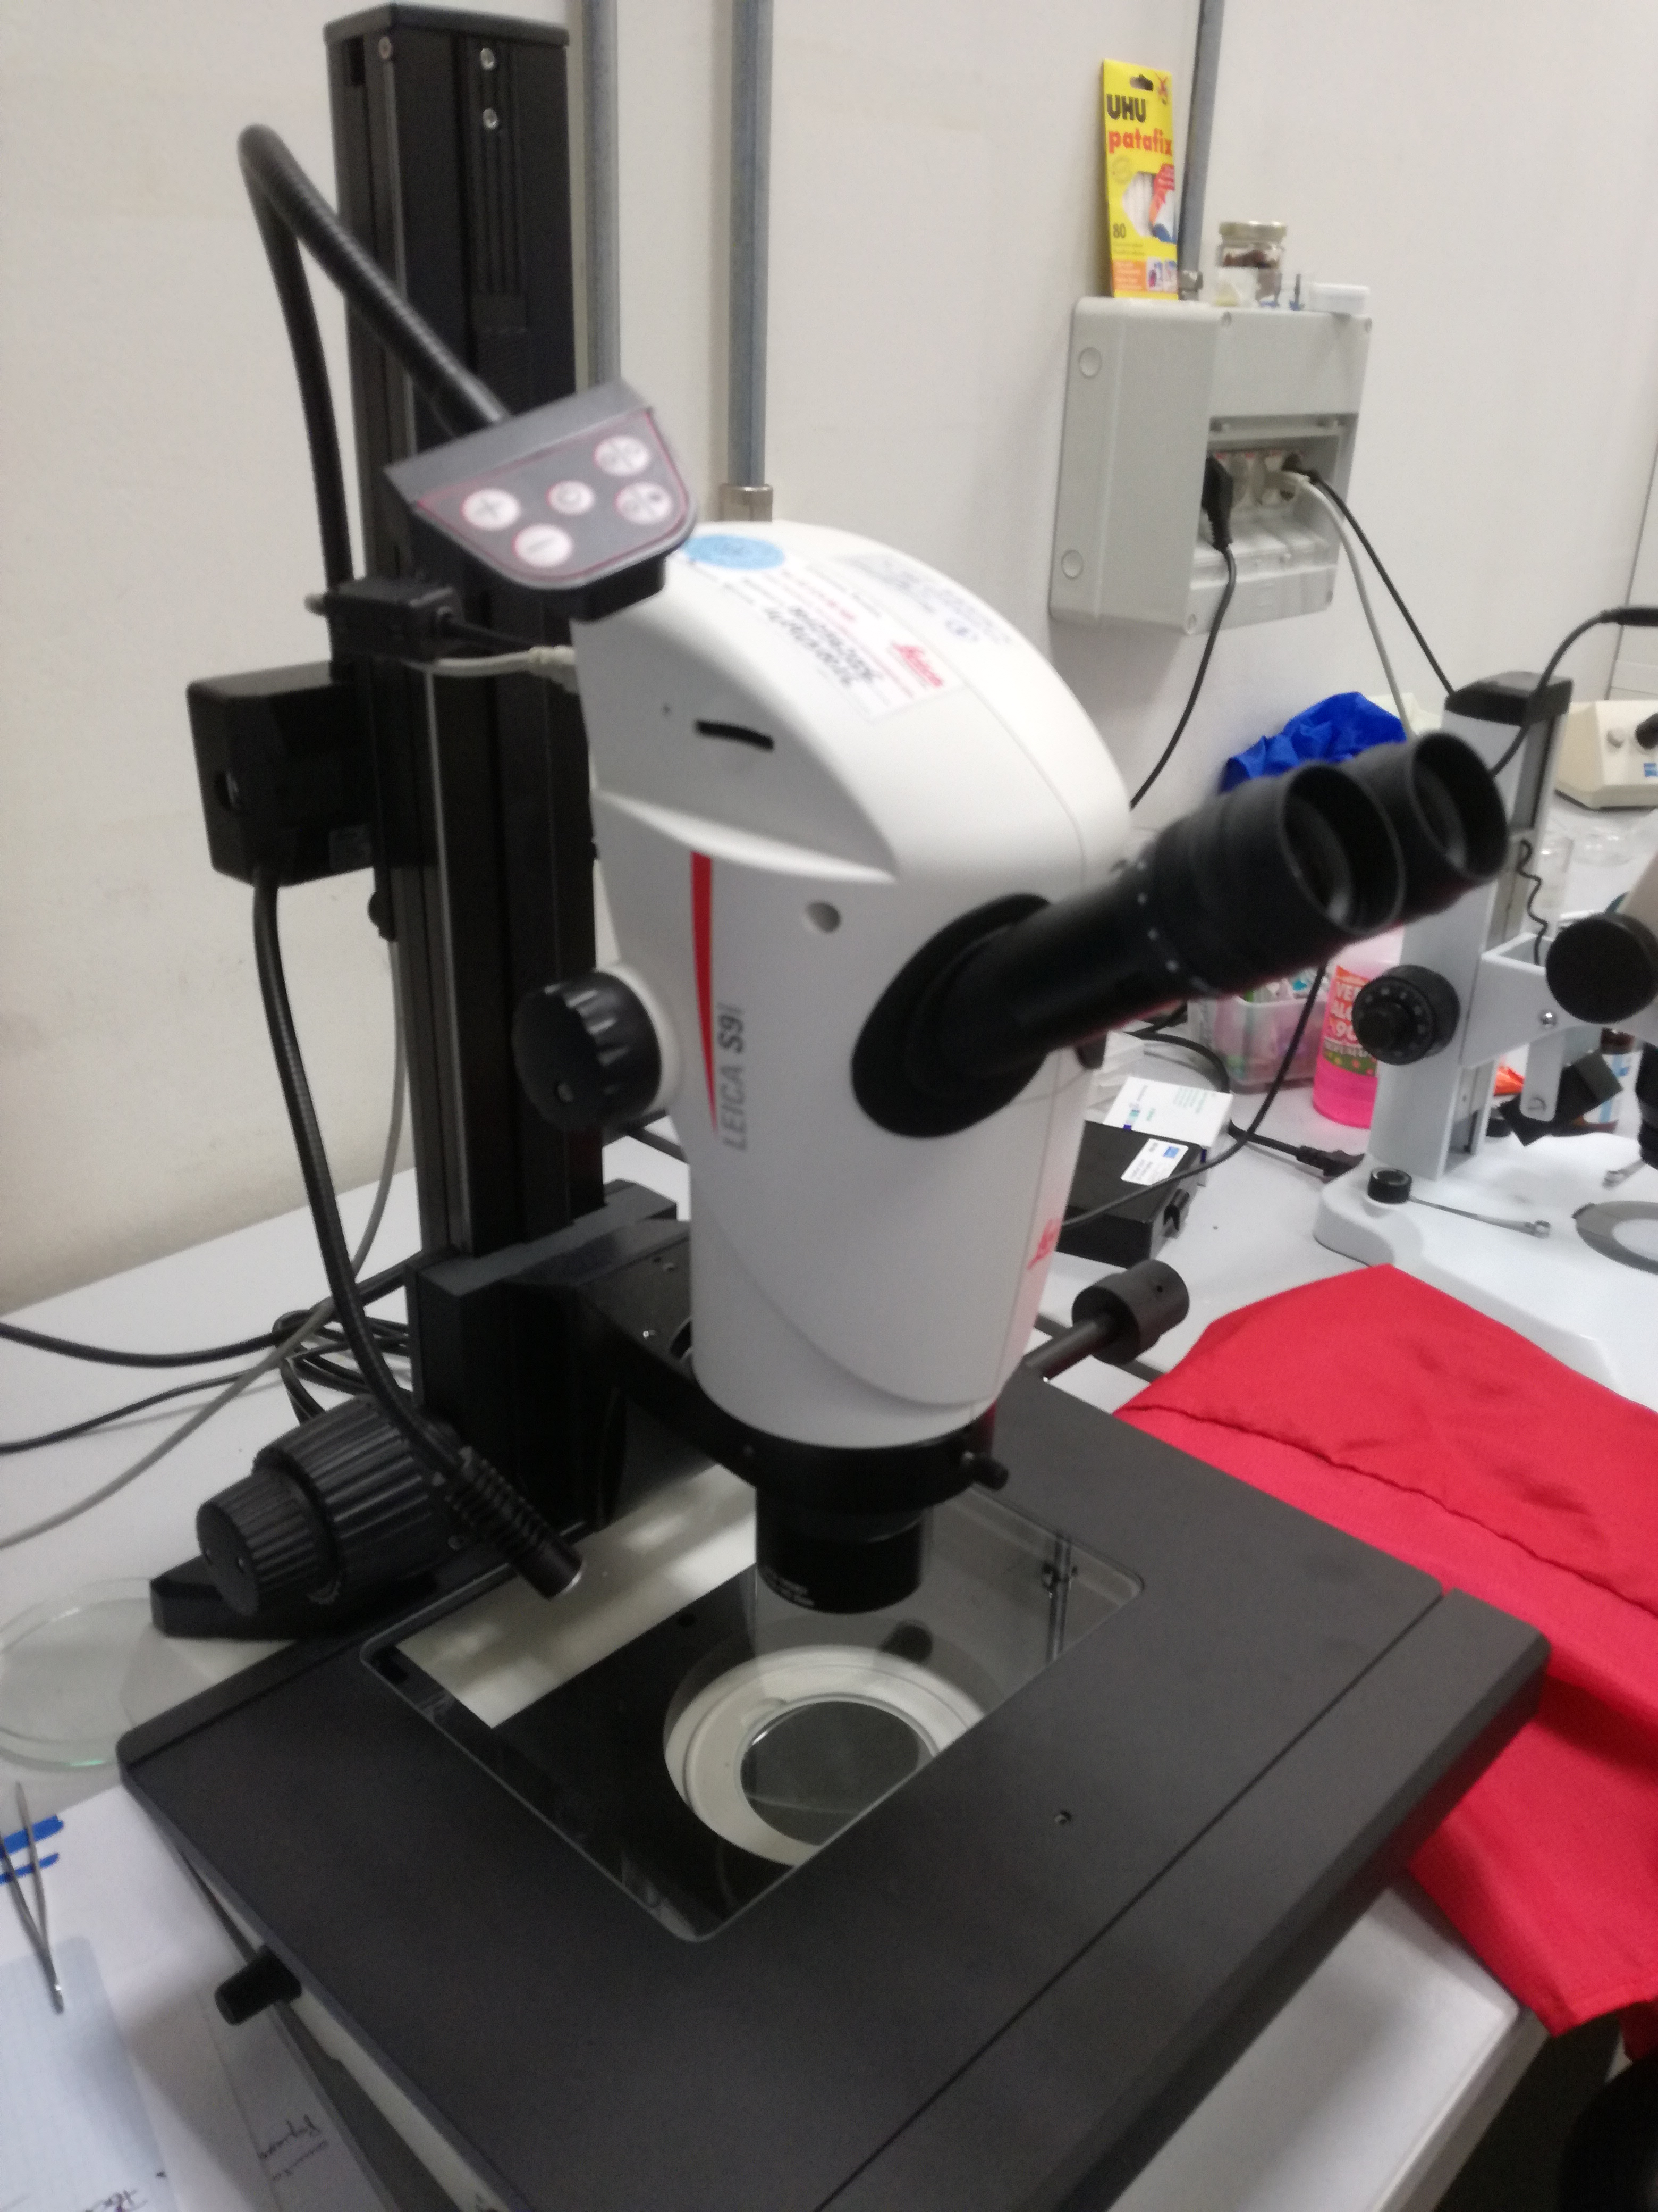
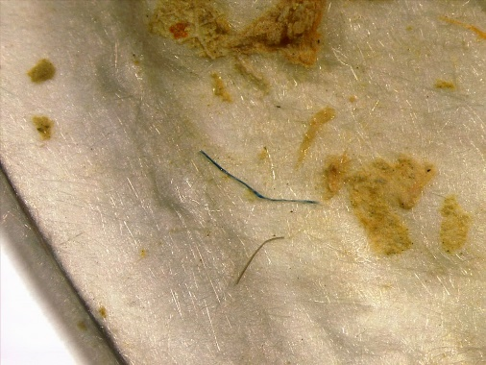
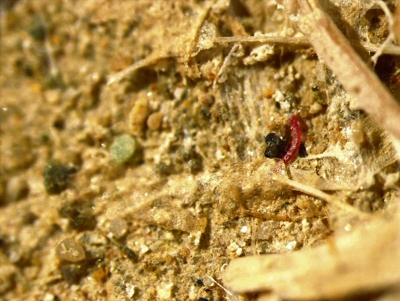
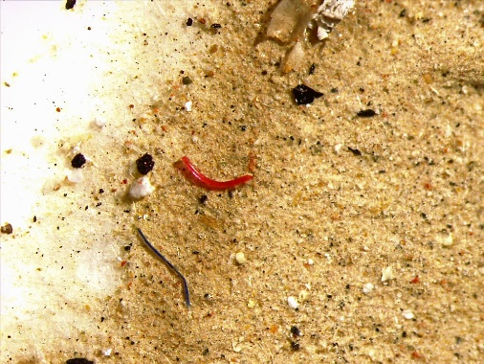
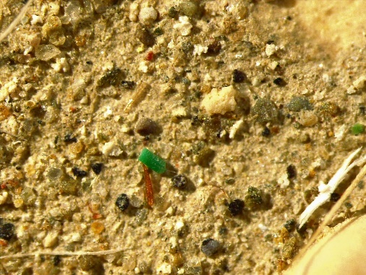
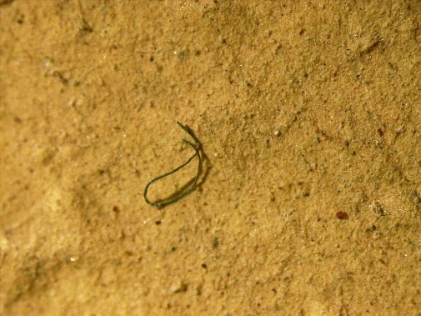
Analysis
Quantitative analysis
HD stereomicroscope "LEICA S9i"

Slide 8
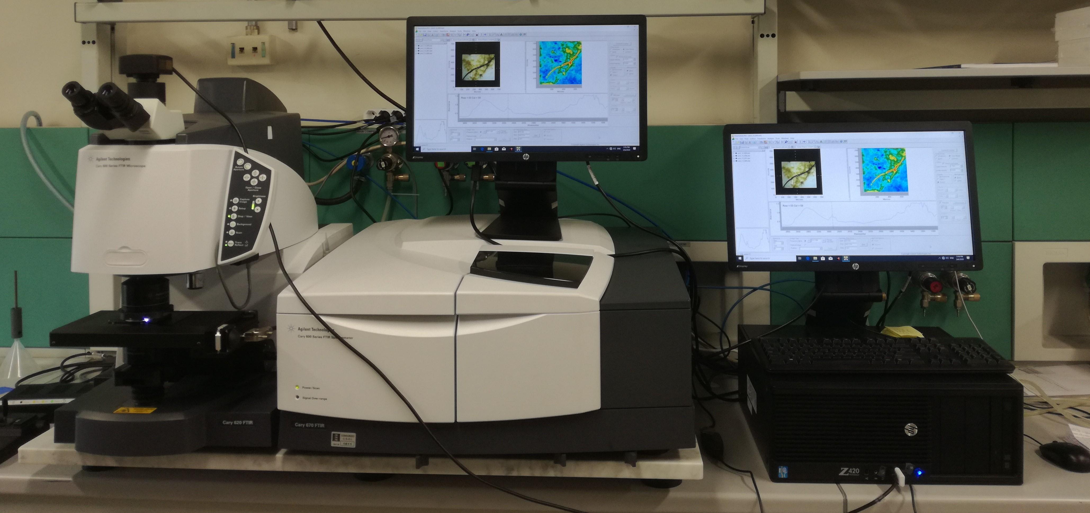
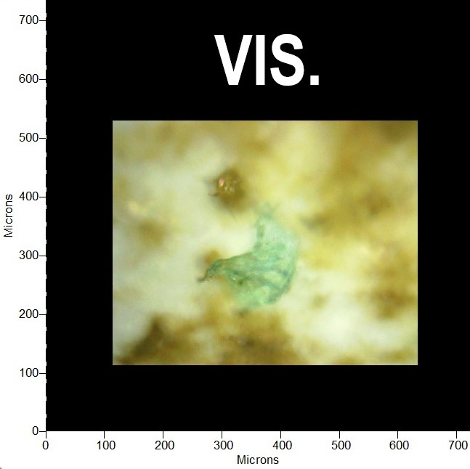
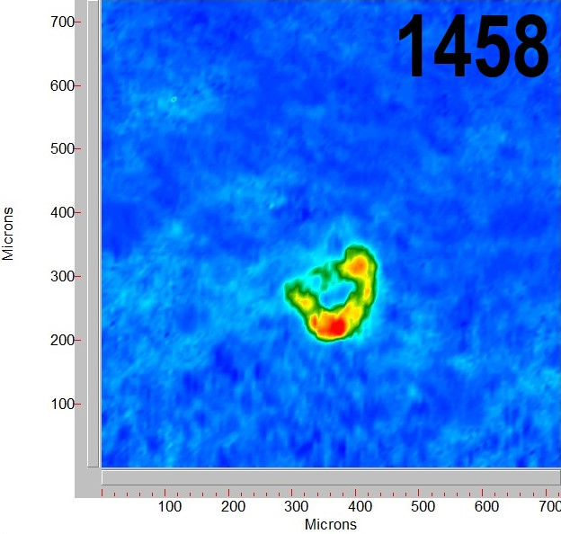
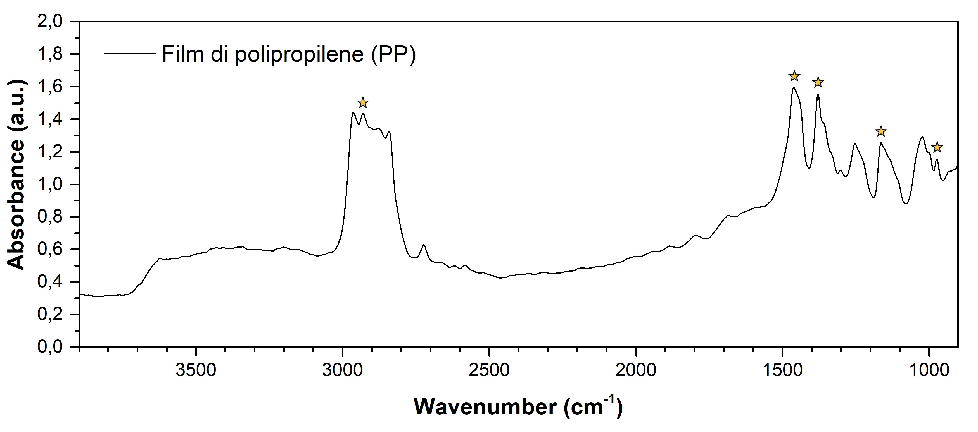
Analysis
Qualitative analysis
µ-FTIR "Cary 620-670 Agilent Technologies"

Slide 9

https://doi.org/10.5194/egusphere-egu22-11578
email: alessio.monnanni@unifi.it

