Slide 1
Plasmapause Surface Waves Triggered by Substorms
Yixin Hao^{1,2}, Qiugang Zong¹, Chao Yue¹, Xuzhi Zhou¹, Hui Zhang³, Zuyin Pu¹, and Yuri Shprits²
1. Institute of Space Physics and Applied Technology, Peking University, 100871, Beijing, China
2. Section 2.7 Space Physics and Space Weather, GFZ German Research Centre for Geosciences, Potsdam, Germany
^{3.} Physics Department and Geophysical Institute, University of Alaska Fairbanks, Fairbanks, USA

Slide 2
Surface Mode Waves in Magnetosphere
Surface mode MHD waves can be excited at the boundaries in terrestrial magnetosphere (magnetopause, plasmapause etc.).
Theory developed in 1970s [Chen and Hasegawa1974a&b], originally for ground-based magnetometer observations [Lanzerotti⁺1973].
Surface waves at magnetopause has been evidenced by in situ observations recently [Agapitov2009⁺, Archer2019⁺].

Slide 3
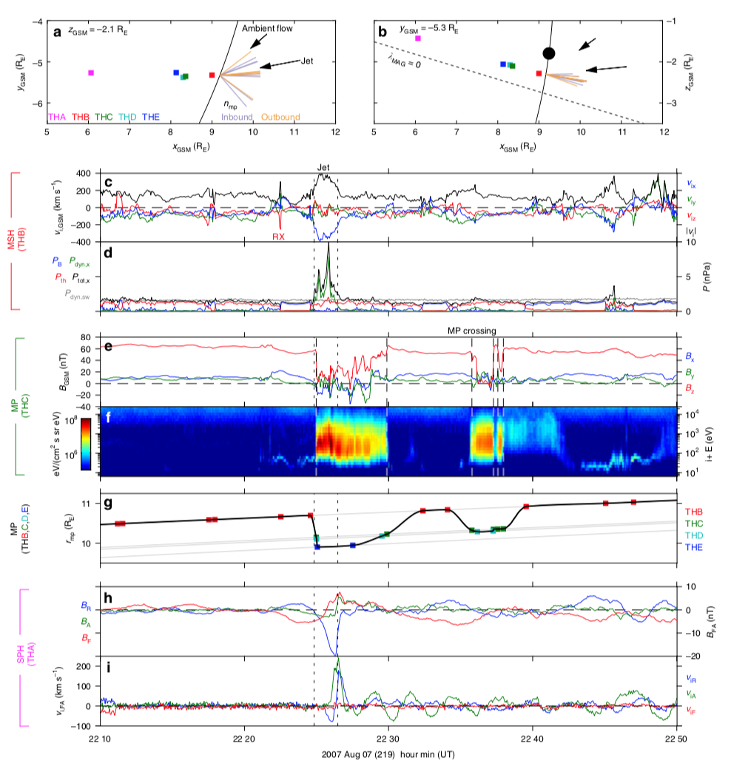
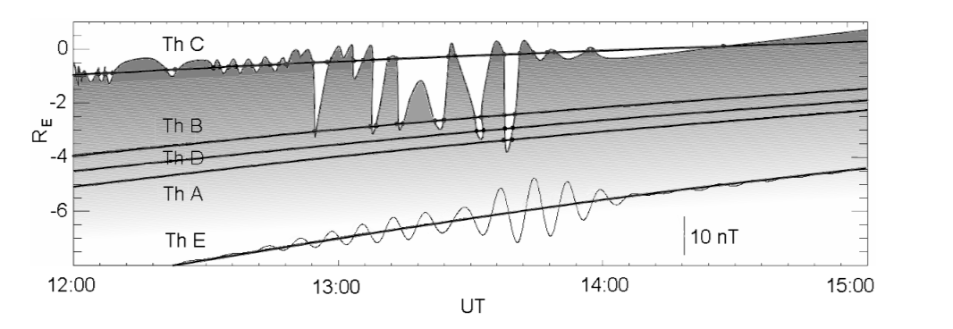
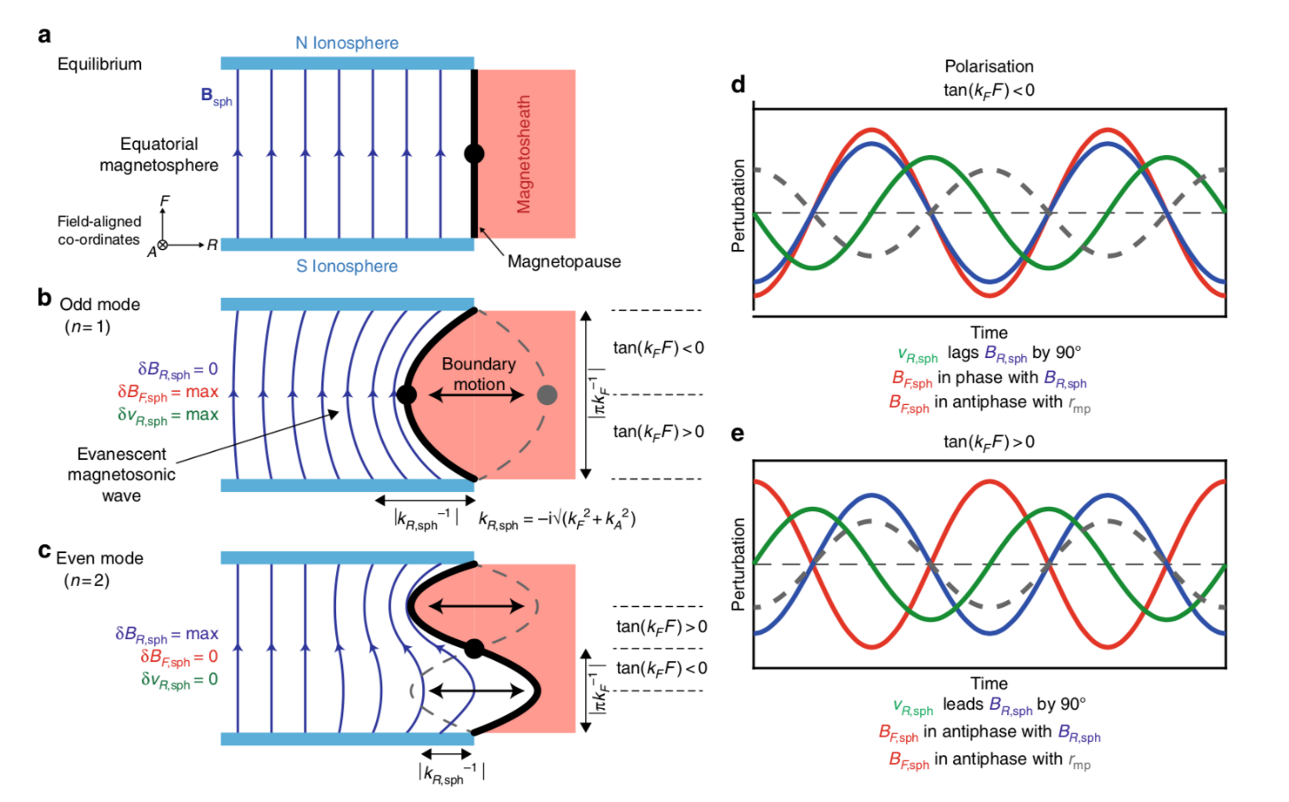
Magnetospheric Surface Mode Waves
[Agapitov⁺2008]:
Magnetopause surface wave drives field line resonance inside magnetophere.
[Archer⁺2019]:
Eigenmode of surface
wave at magnetopause has been diagnosed.

Slide 4
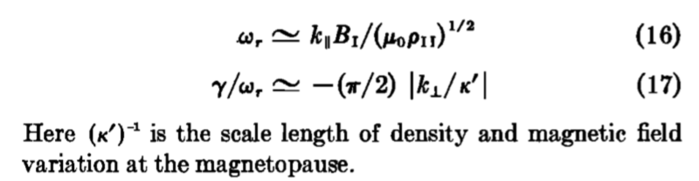
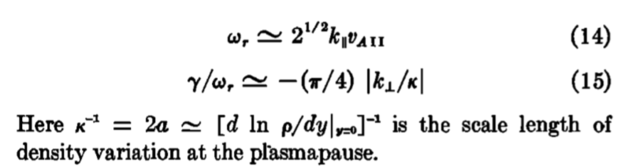
Magnetospheric Surface Mode Waves
At magnetopause: ρ_{outside}>>ρ_{inside}, B_{outside}²<<B_{inside}²
At plasmapause: ρ_{outside}<<ρ_{inside}, B_{outside}²≈B_{inside}²
From [Chen and Hasegawa 1974]

Slide 5
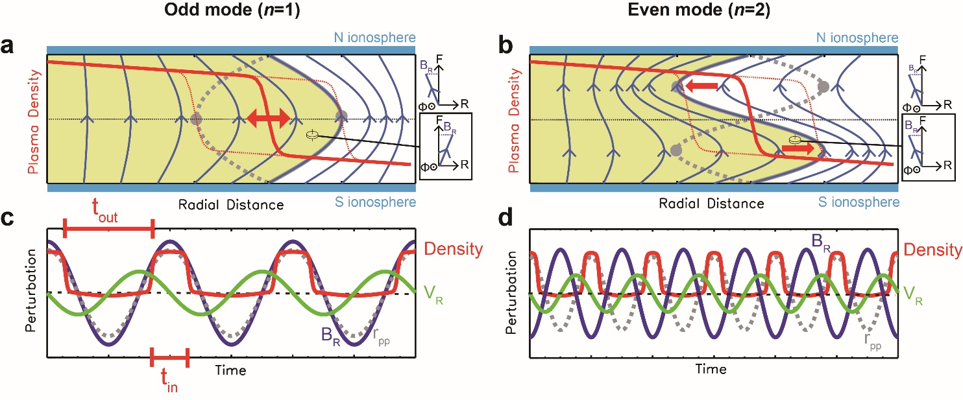
Α Sketch of Plasmapause Surface Eigenmode

Slide 6
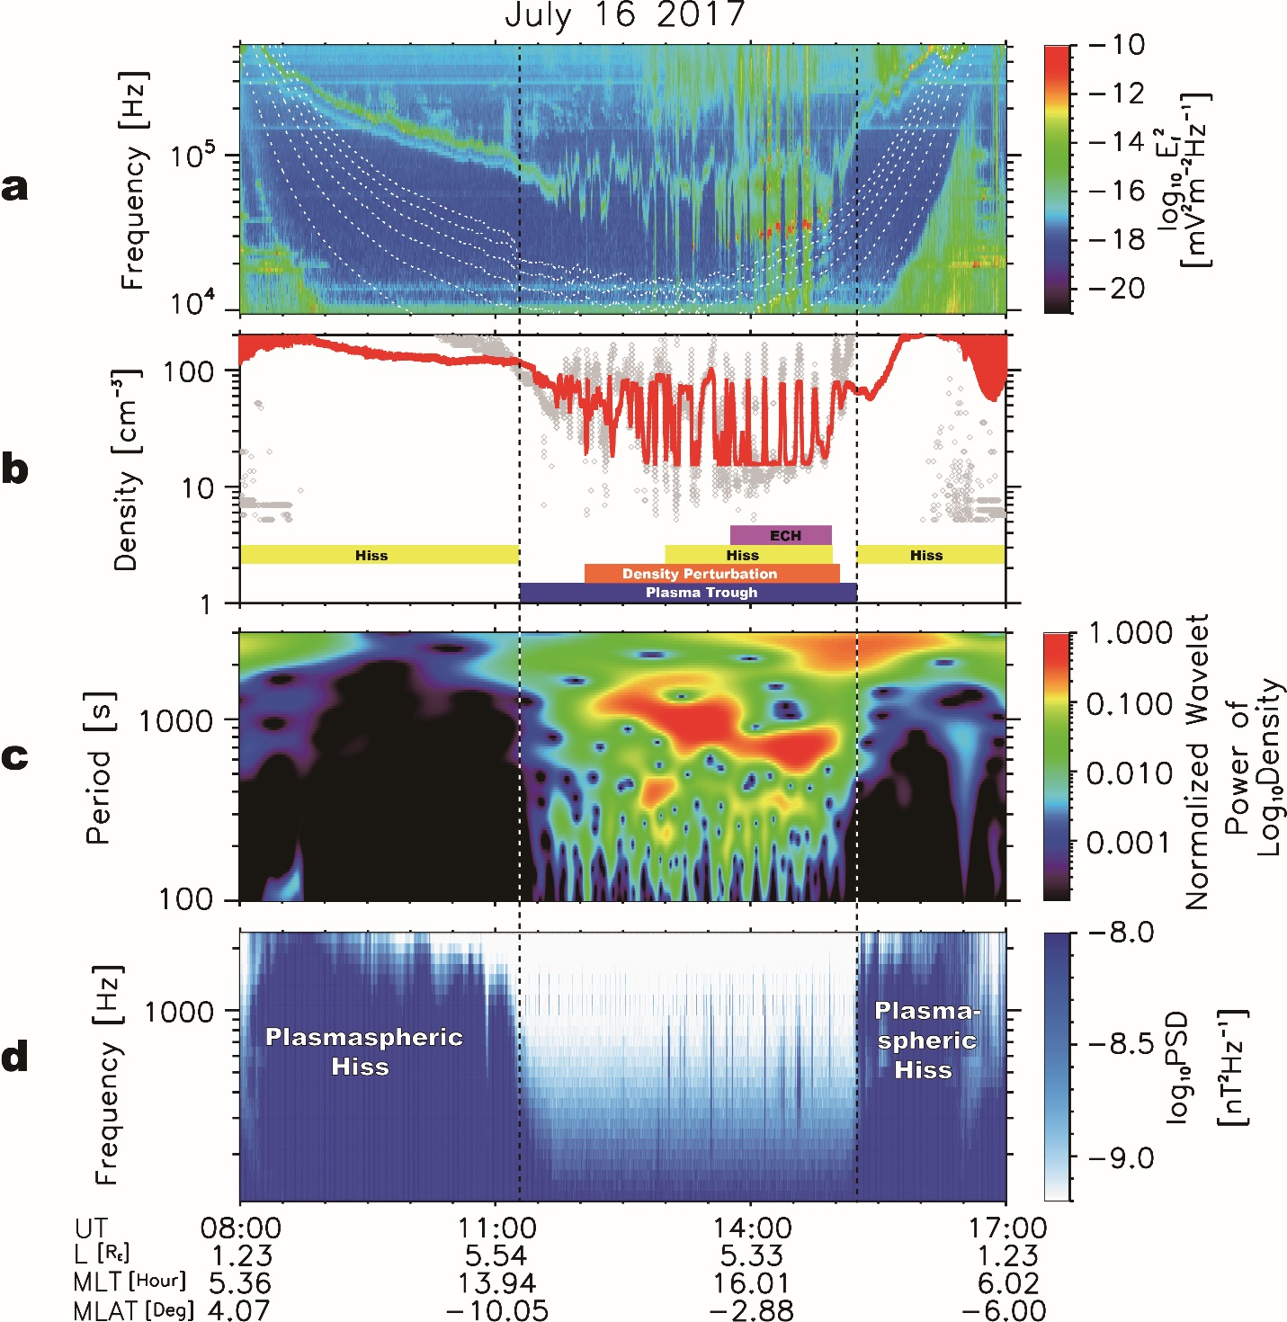
In situ observation of Plasmapause Surface Waves 1. Quasi periodic, toothcomb-like perturbation in plasma density in Trough, T~800s (Ps6 band); 2. Switching on/off wave activities at 100sHz and 10⁴~10⁵Hz.

Slide 7
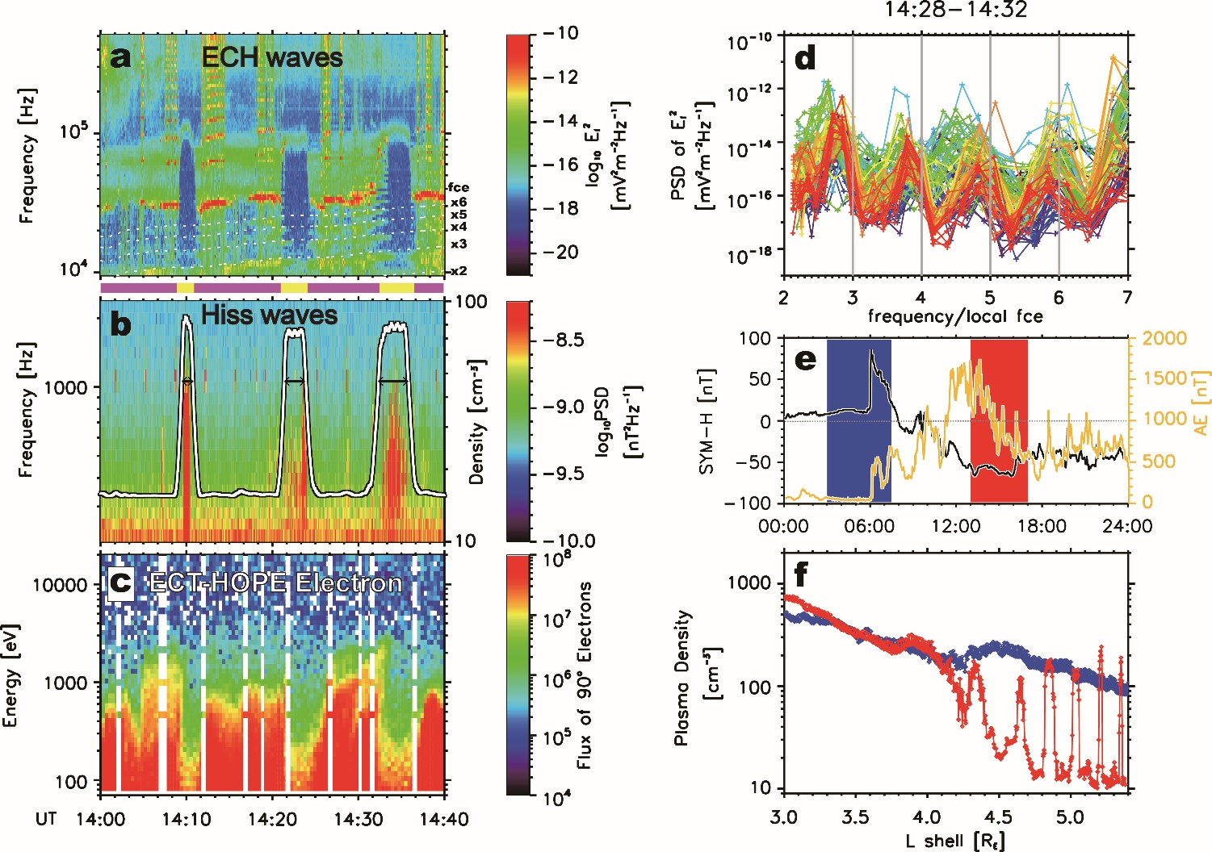
Hiss, ECH waves and density perturbations
Alternatively switching on/off ECH and hiss waves
Hiss waves: correlating high plasma density;
ECH waves: correlating to low plasma density and intense 100s eV electron flux;
Surface wave at plasmapause!

Slide 8
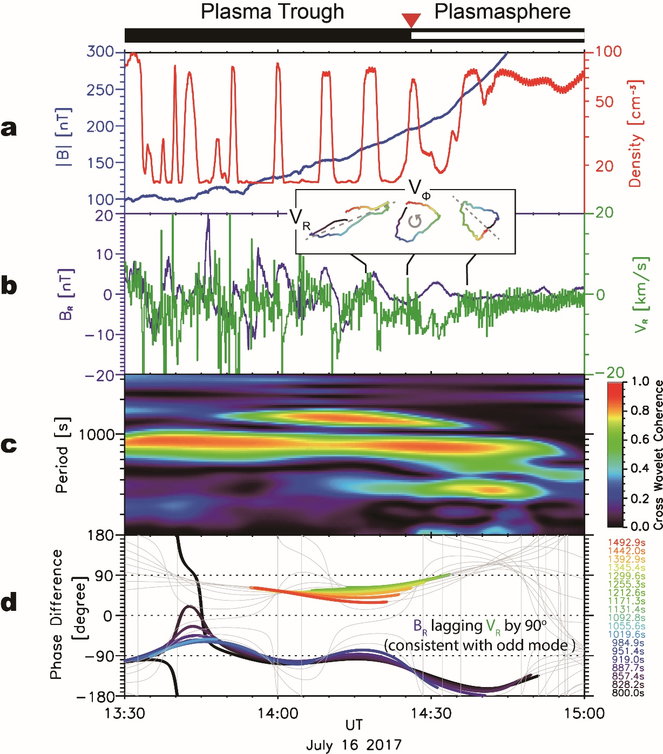
Diagnosing the eigenmode of plasmapause surface wave B_{R} lag V_{R} by 90º in southern hemisphere-> Odd mode, standing wave.

Slide 9
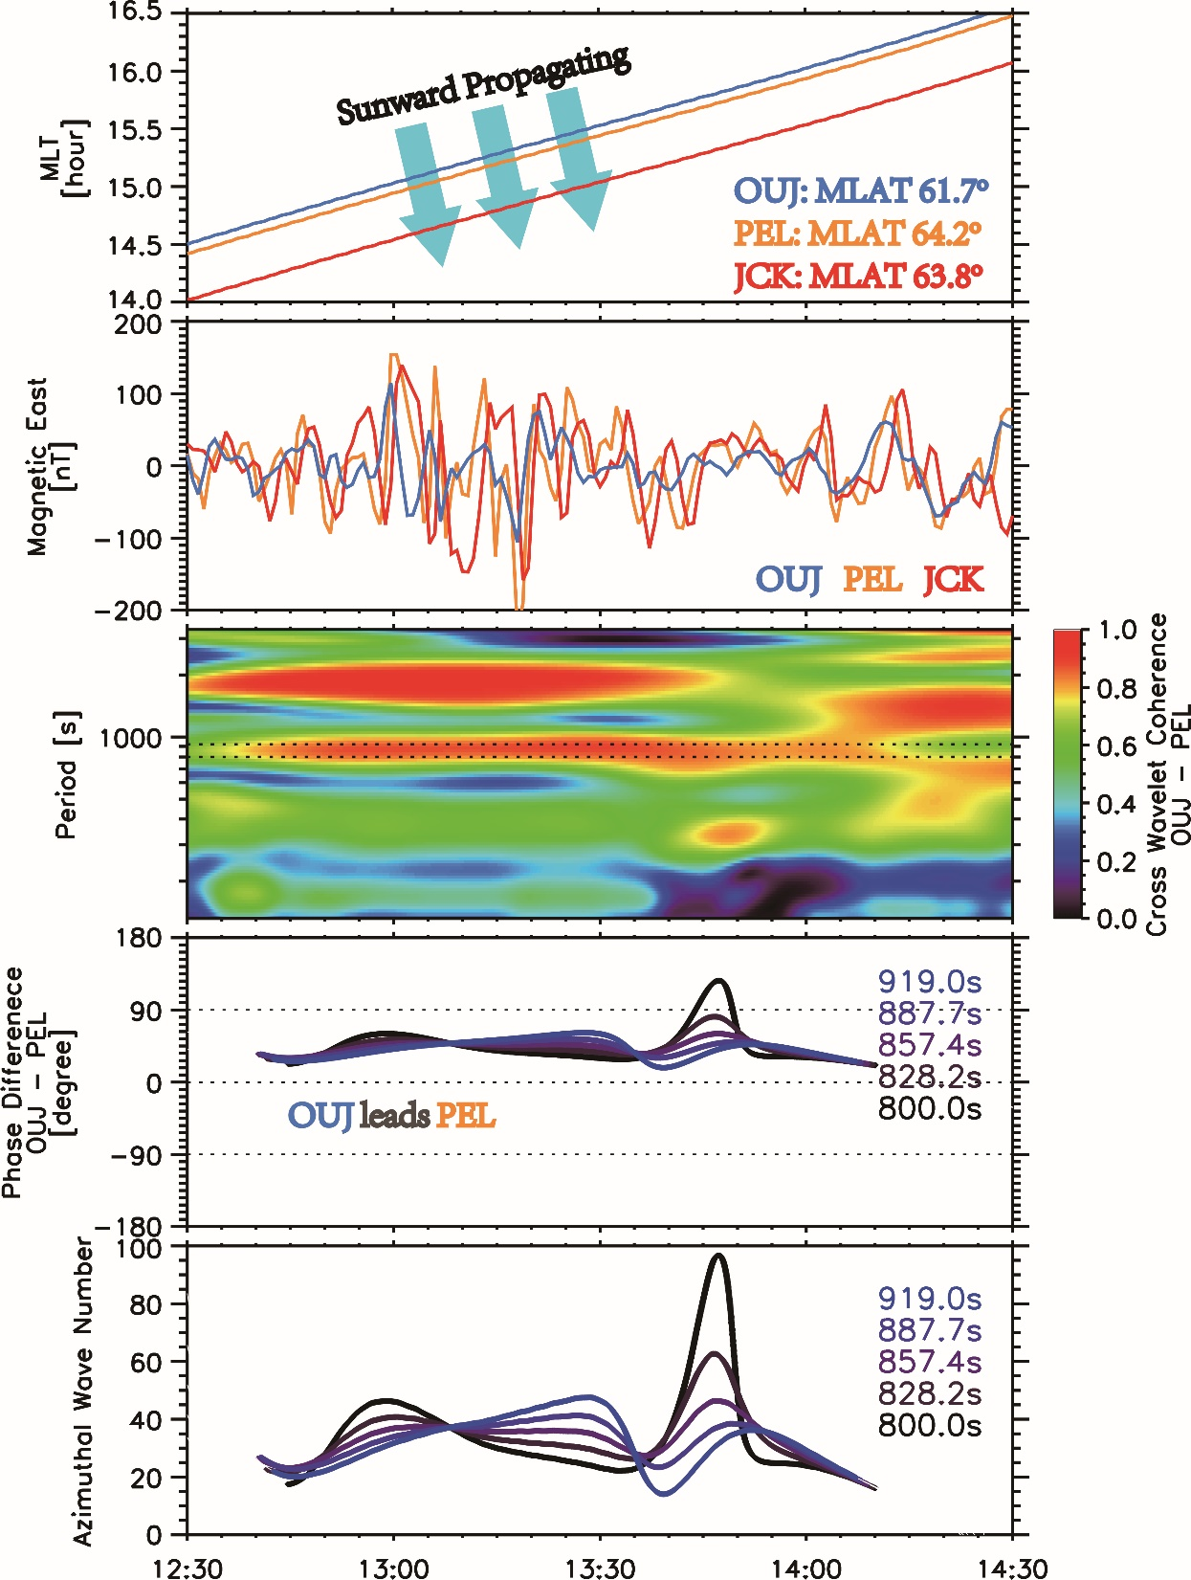
Possible trigger of plasmapause surface waves 1. IP shock? 2. K-H instability? 3. Substorm activities?

Slide 10
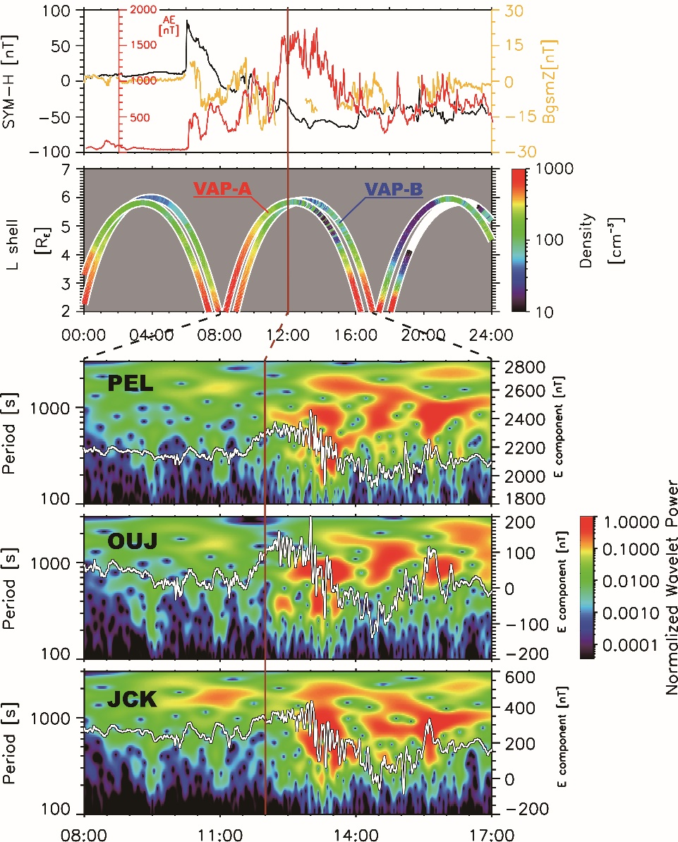
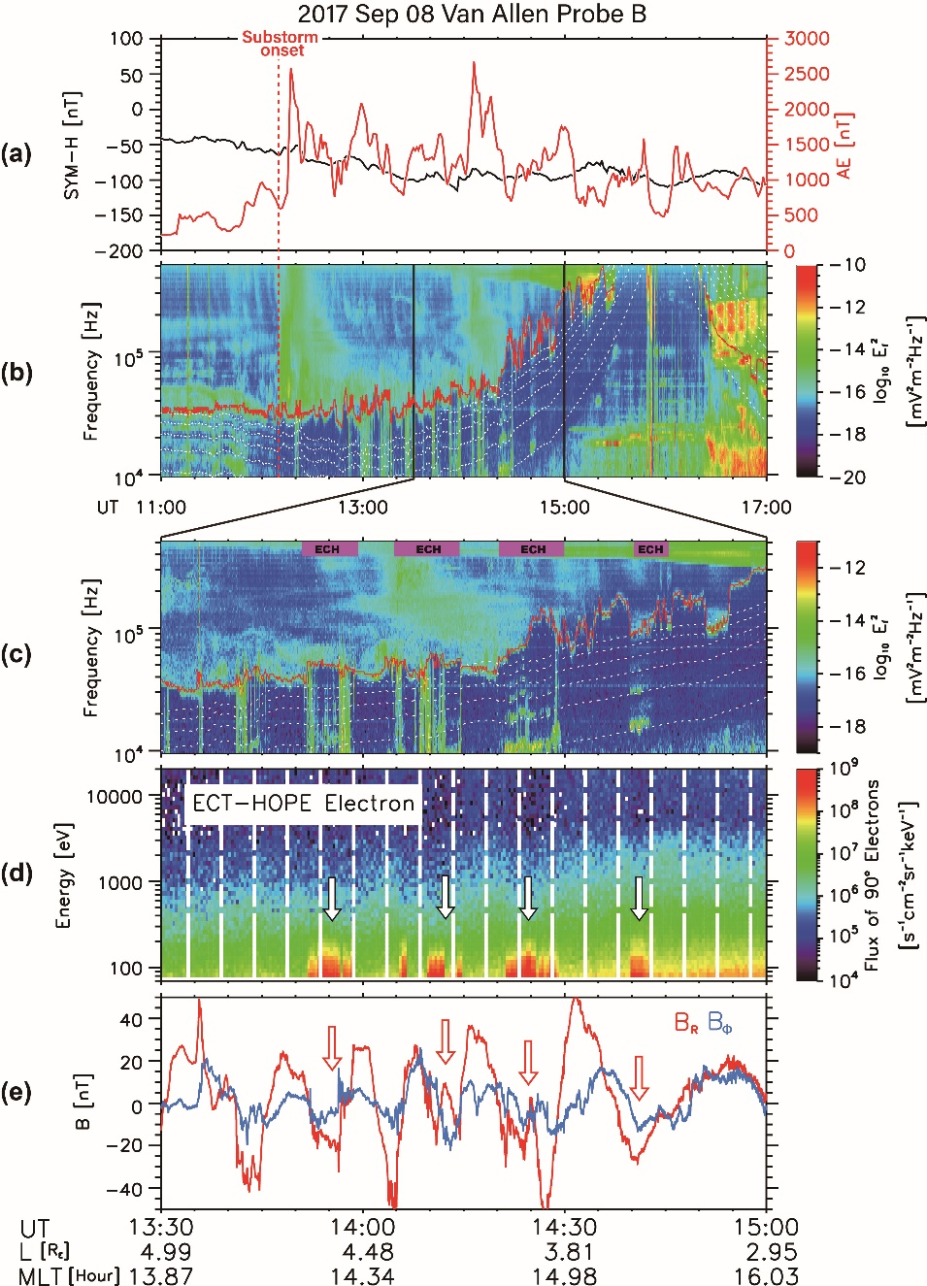
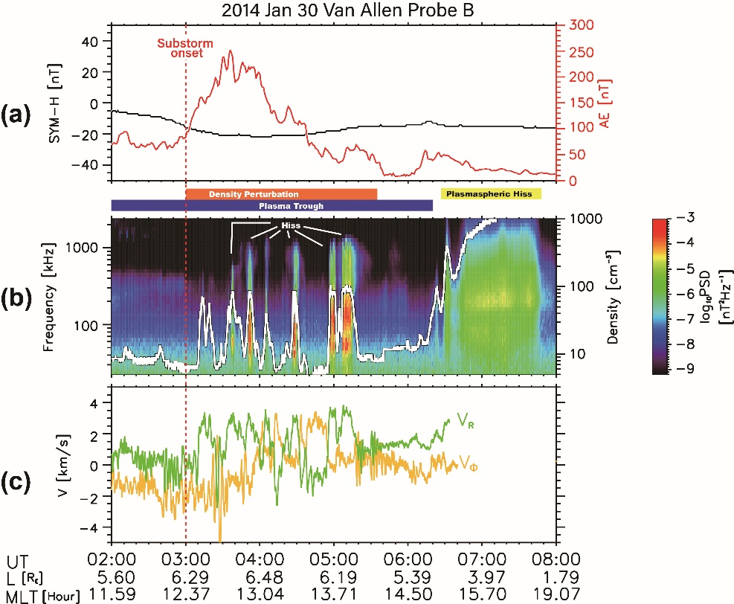
Possible trigger of plasmapause surface waves: Substorm activities

Slide 11
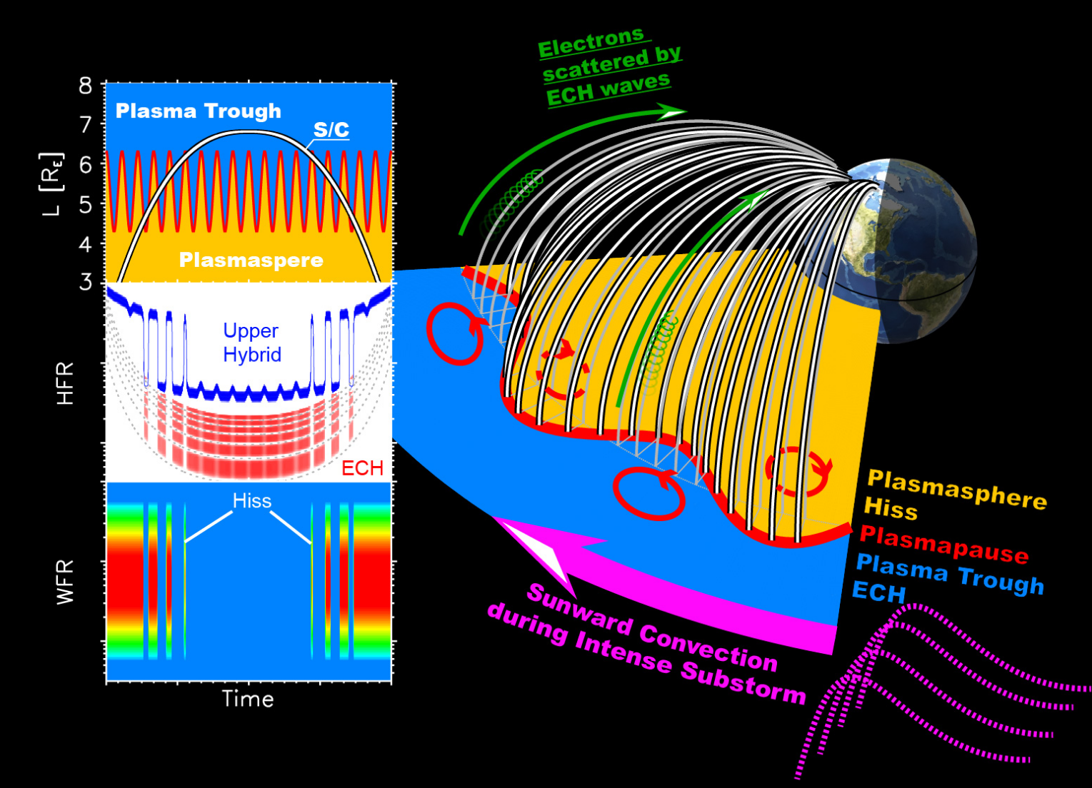
Plasmapause surface waves related with substorms: A possible scenario

Slide 12
Conclusions
Plasmapause surface waves could oscillate plasmapause and modulate hiss and ECH waves.
Plasmapause surface waves could be standing waves along the field line between southern and northern ionosphere.
Substorm activities might be the trigger of plasmapause surface wave activities.

