Slide 1


Longer dry and wet spells alter the stochasticity of microbial community assembly in grassland soils
Lingjuan Li, Gerrit Beemster, Simon Reynaert, Ivan Nijs, Kris Laukens, Han Asard, Olga Vinduskova, and Erik Verbruggen
Research Group of Plants and Ecosystems (PLECO), Department of Biology, University of Antwerp, Belgium
23/05/2022
Lingjuan.Li@uantwerpen.be

Slide 2

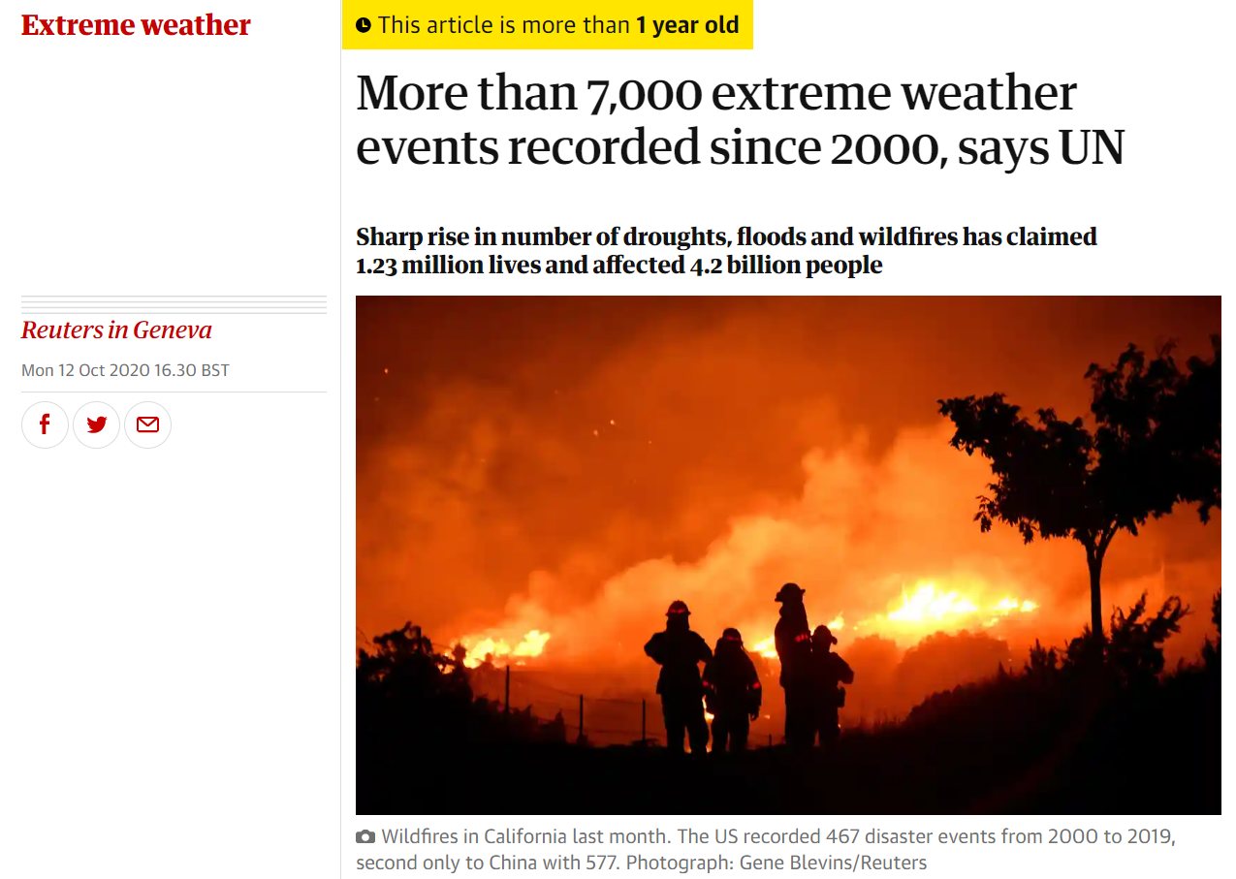
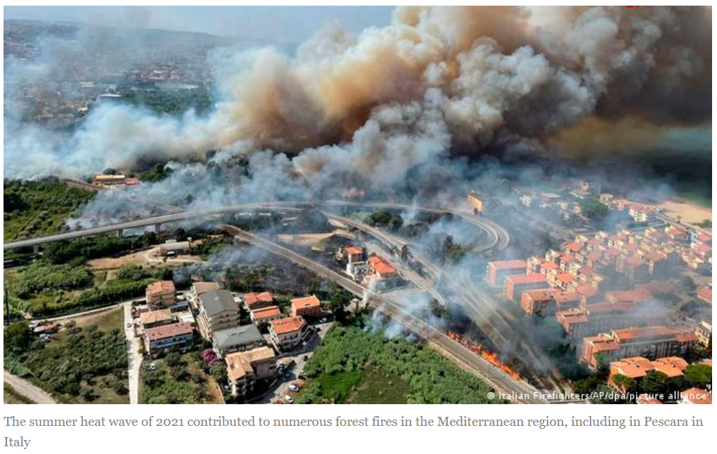

Background
Climate change is leading to simultaneously lengthening the duration of dry and wet periods (precipitation persistence).

Slide 3
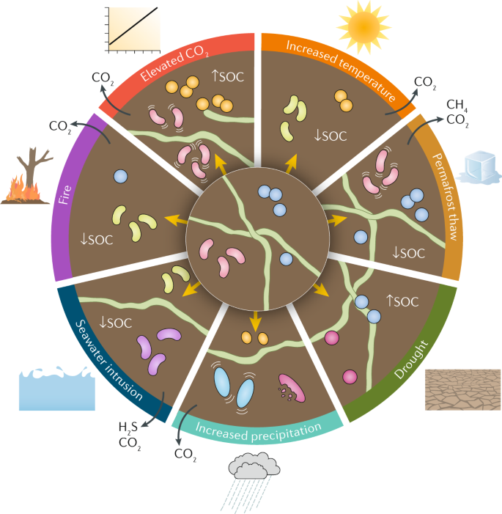






Background
Environmental filtering
Biotic interaction
Temperature
Deterministic processes
Moisture
pH
Random changes
Dispersal
Stochastic processes
Drift
Jansson et al. 2019
Precipitation persistence?

Slide 4
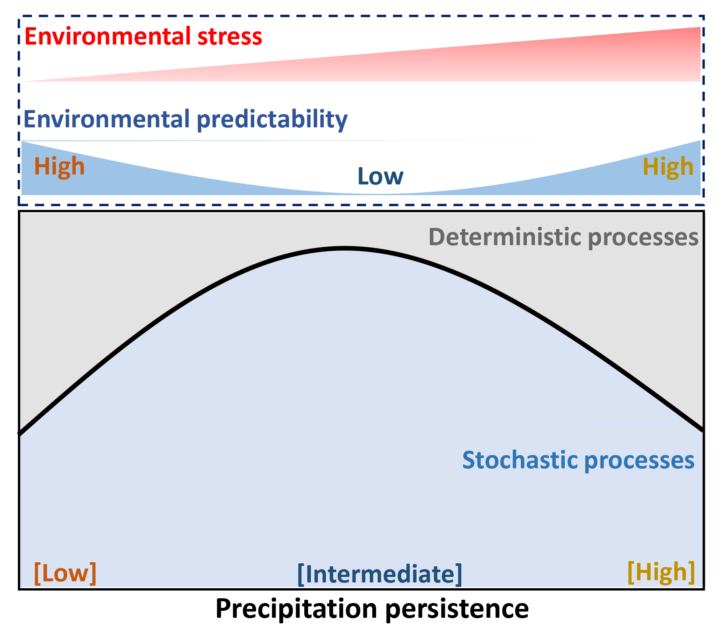
Hypotheses
Intermediate persistence
Frequent alternation
Random changes
Stochastic processes
Diversity
Connectivity
Unstable community

Slide 5
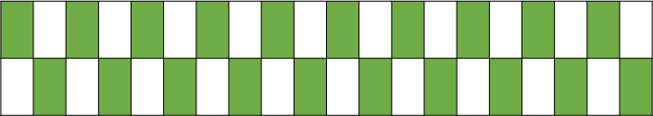
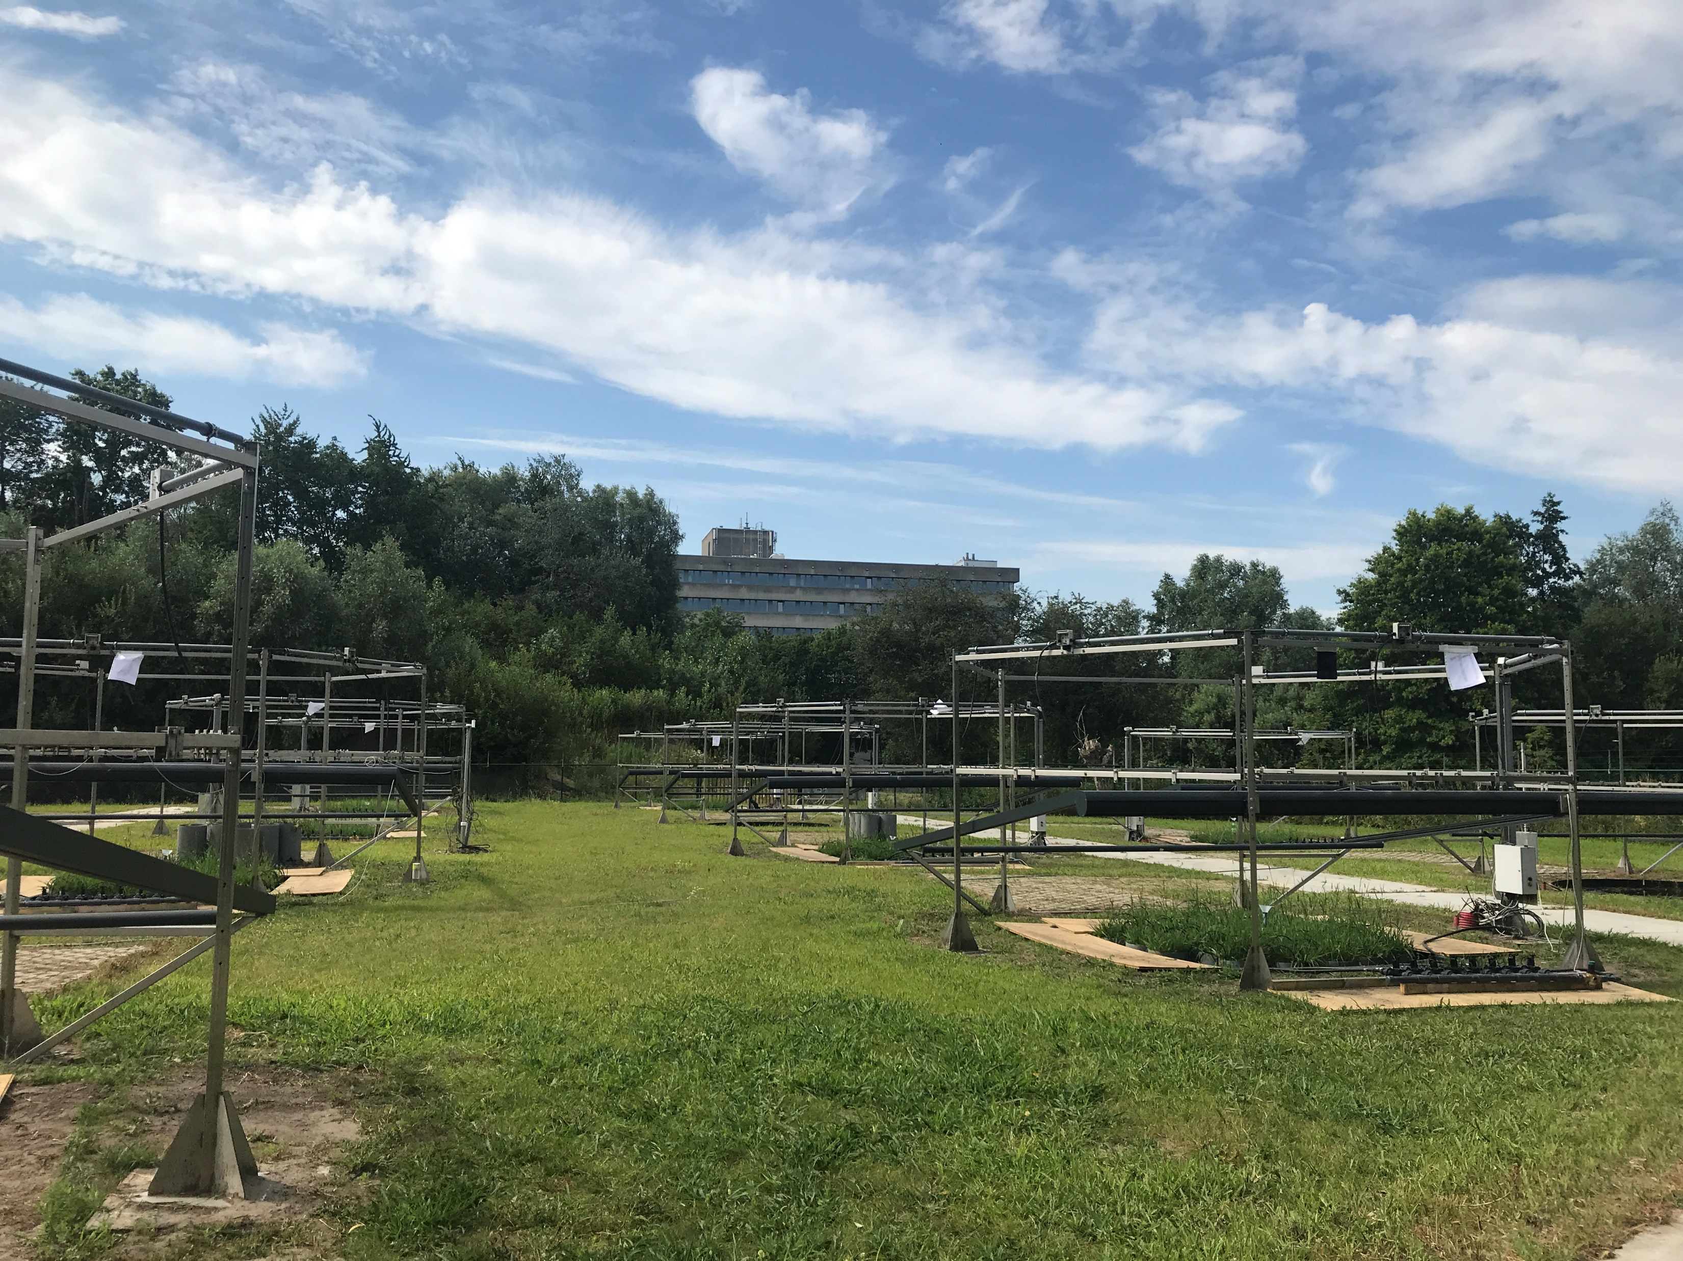
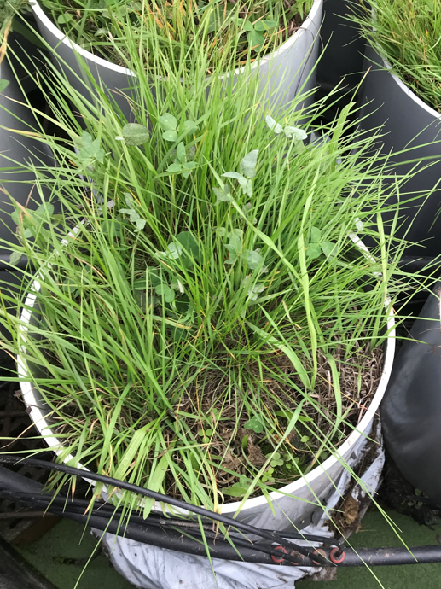
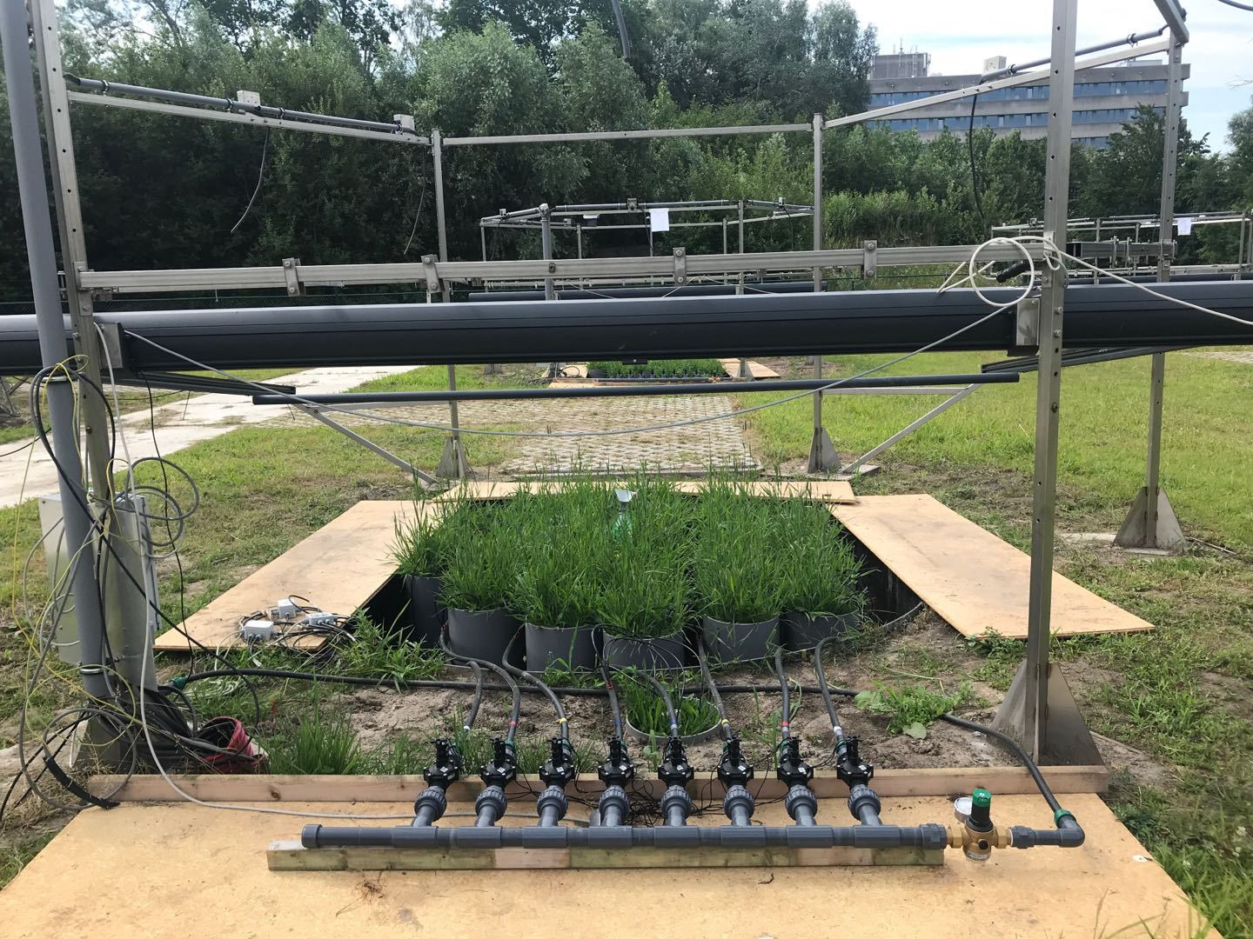
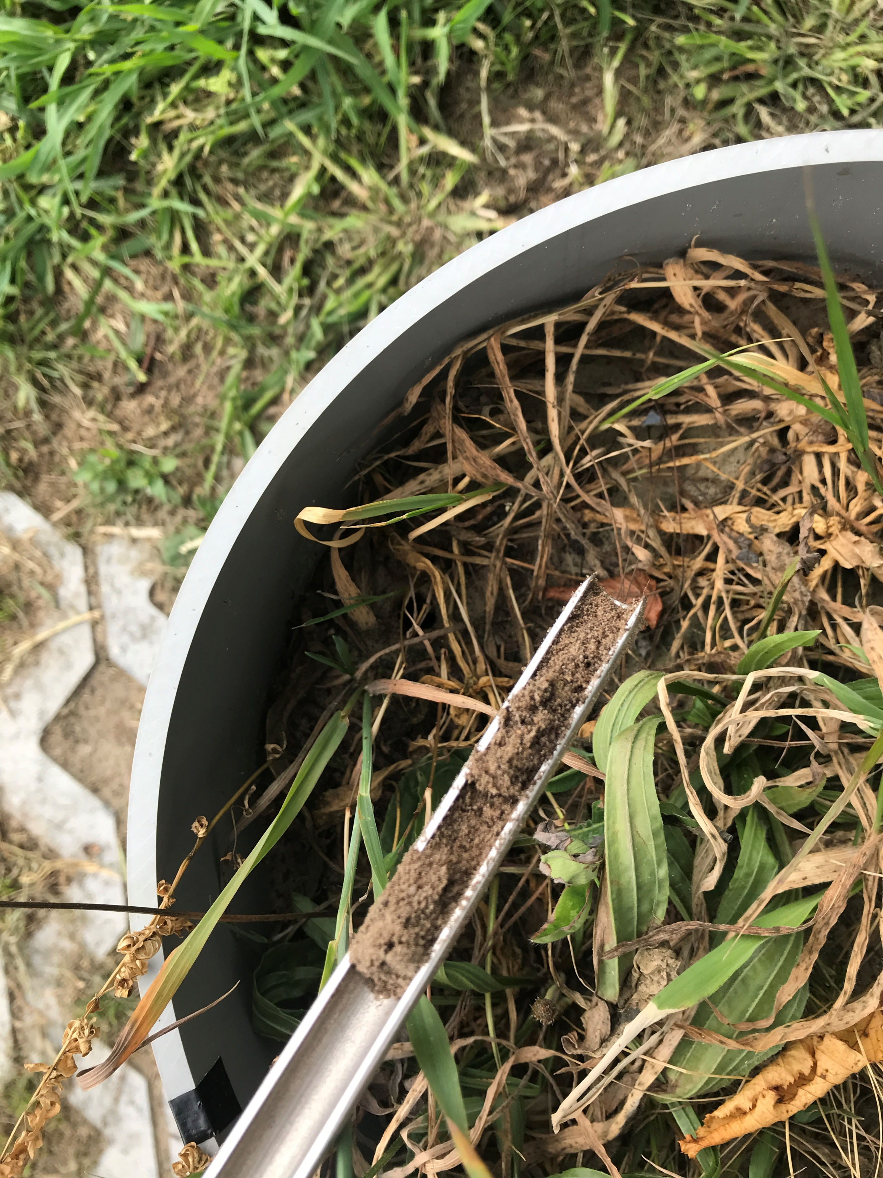
Experimental design
Jul 2019
120 days
Oct 2019
1, 3, 6, 10, 15, 20, 30, 60 days block duration
Wet start (DH) and Dry start (WH)
Keep the total precipitation amount consistent

Slide 6
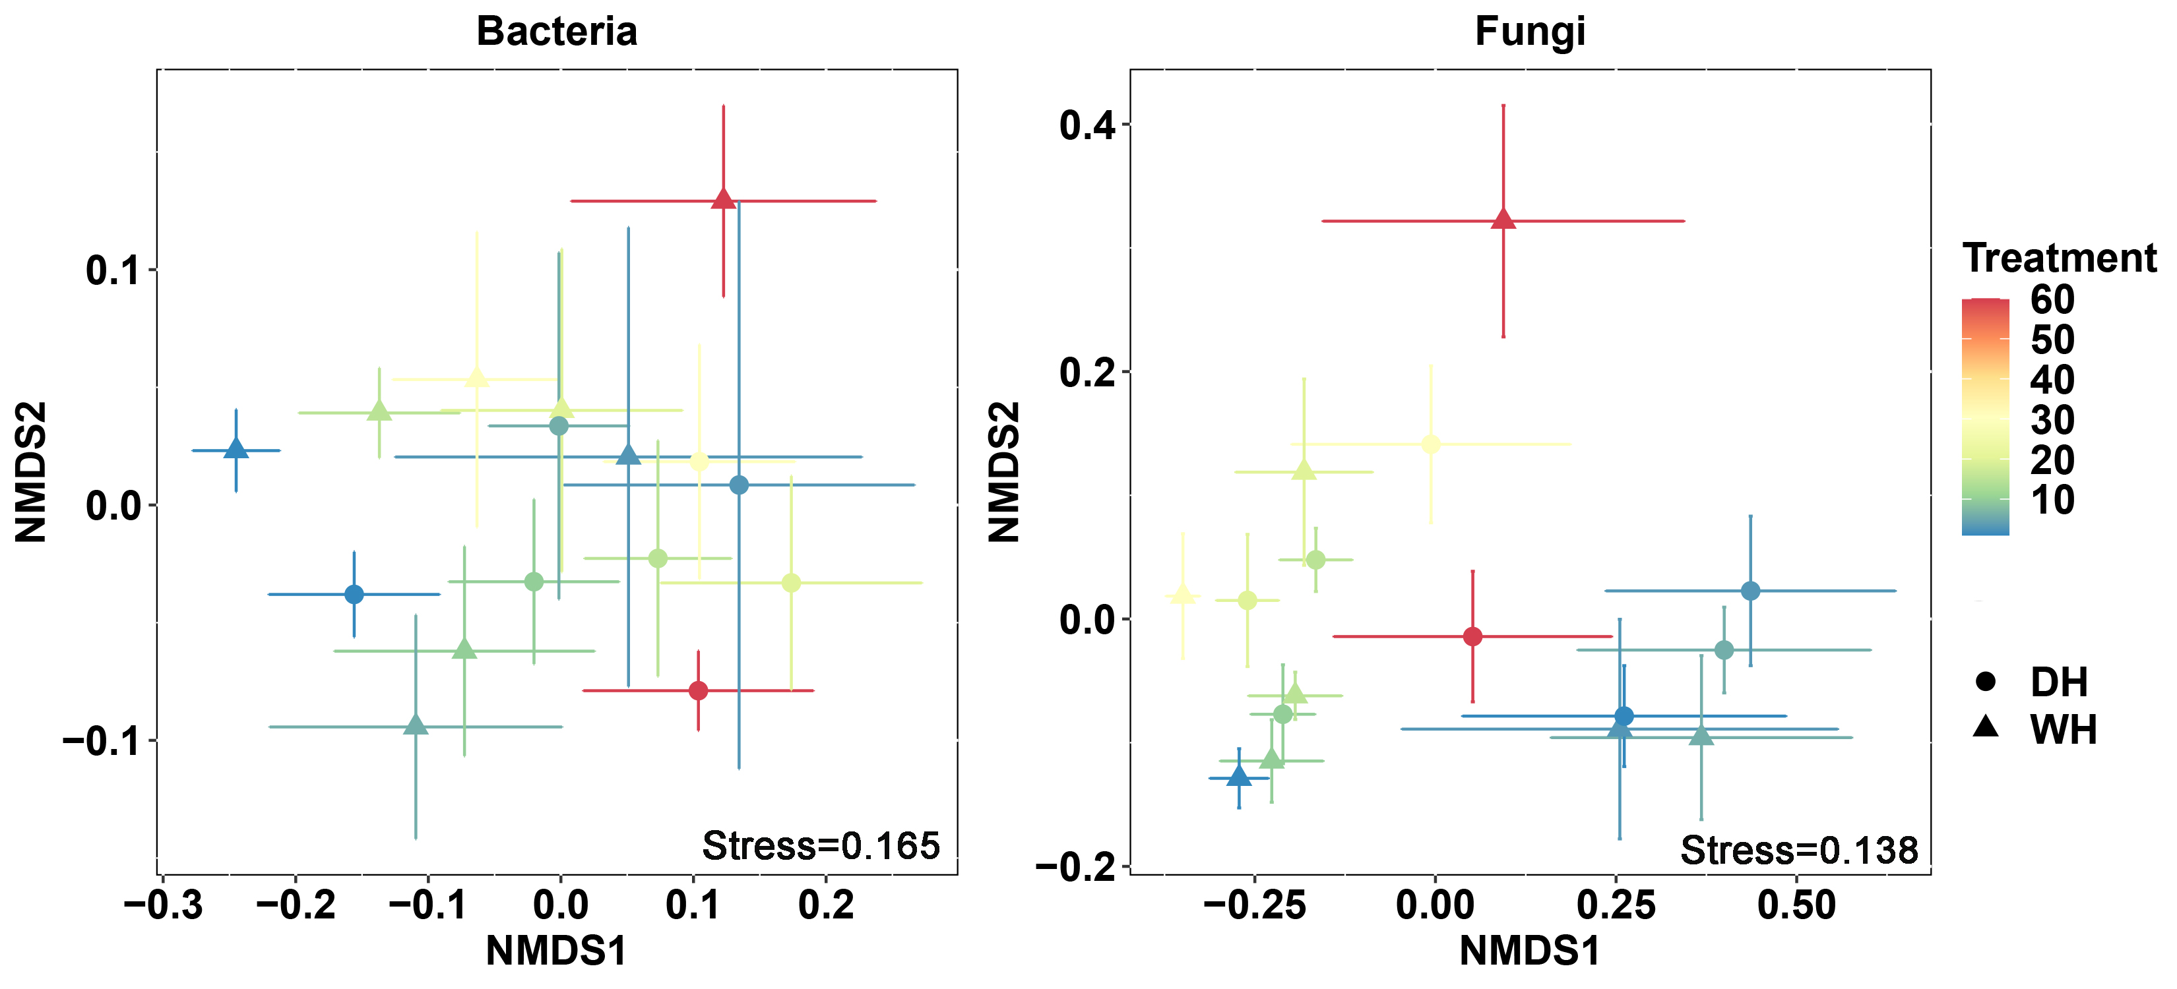
Results
Nonmetric multidimensional scaling ordinations of community on the Bray-Curtis dissimilarities. Points with error bars indicate the mean ± standard error of the six plots per treatment. DH indicates harvesting in the dry period and WH indicates harvesting in the wet period.

Slide 7
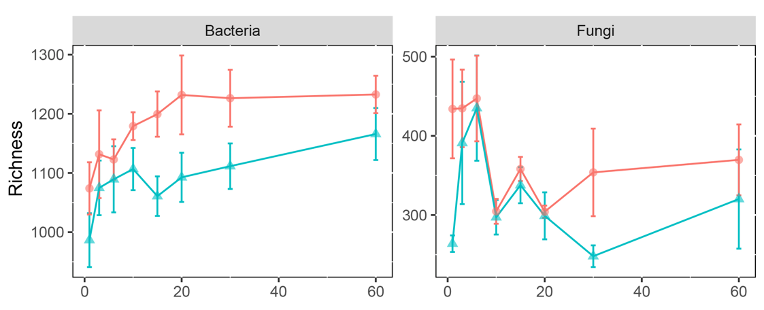

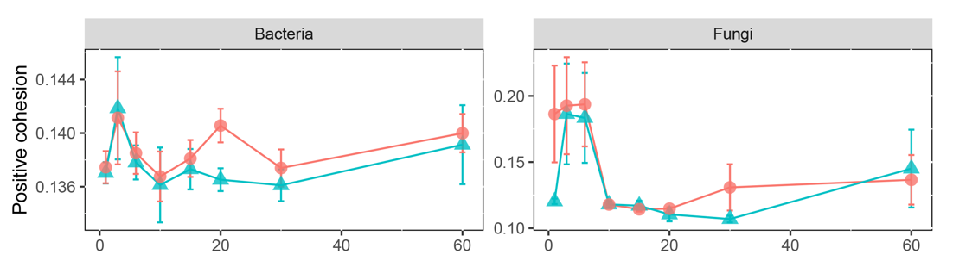
Results
Cohesion = Connectivity

Slide 8
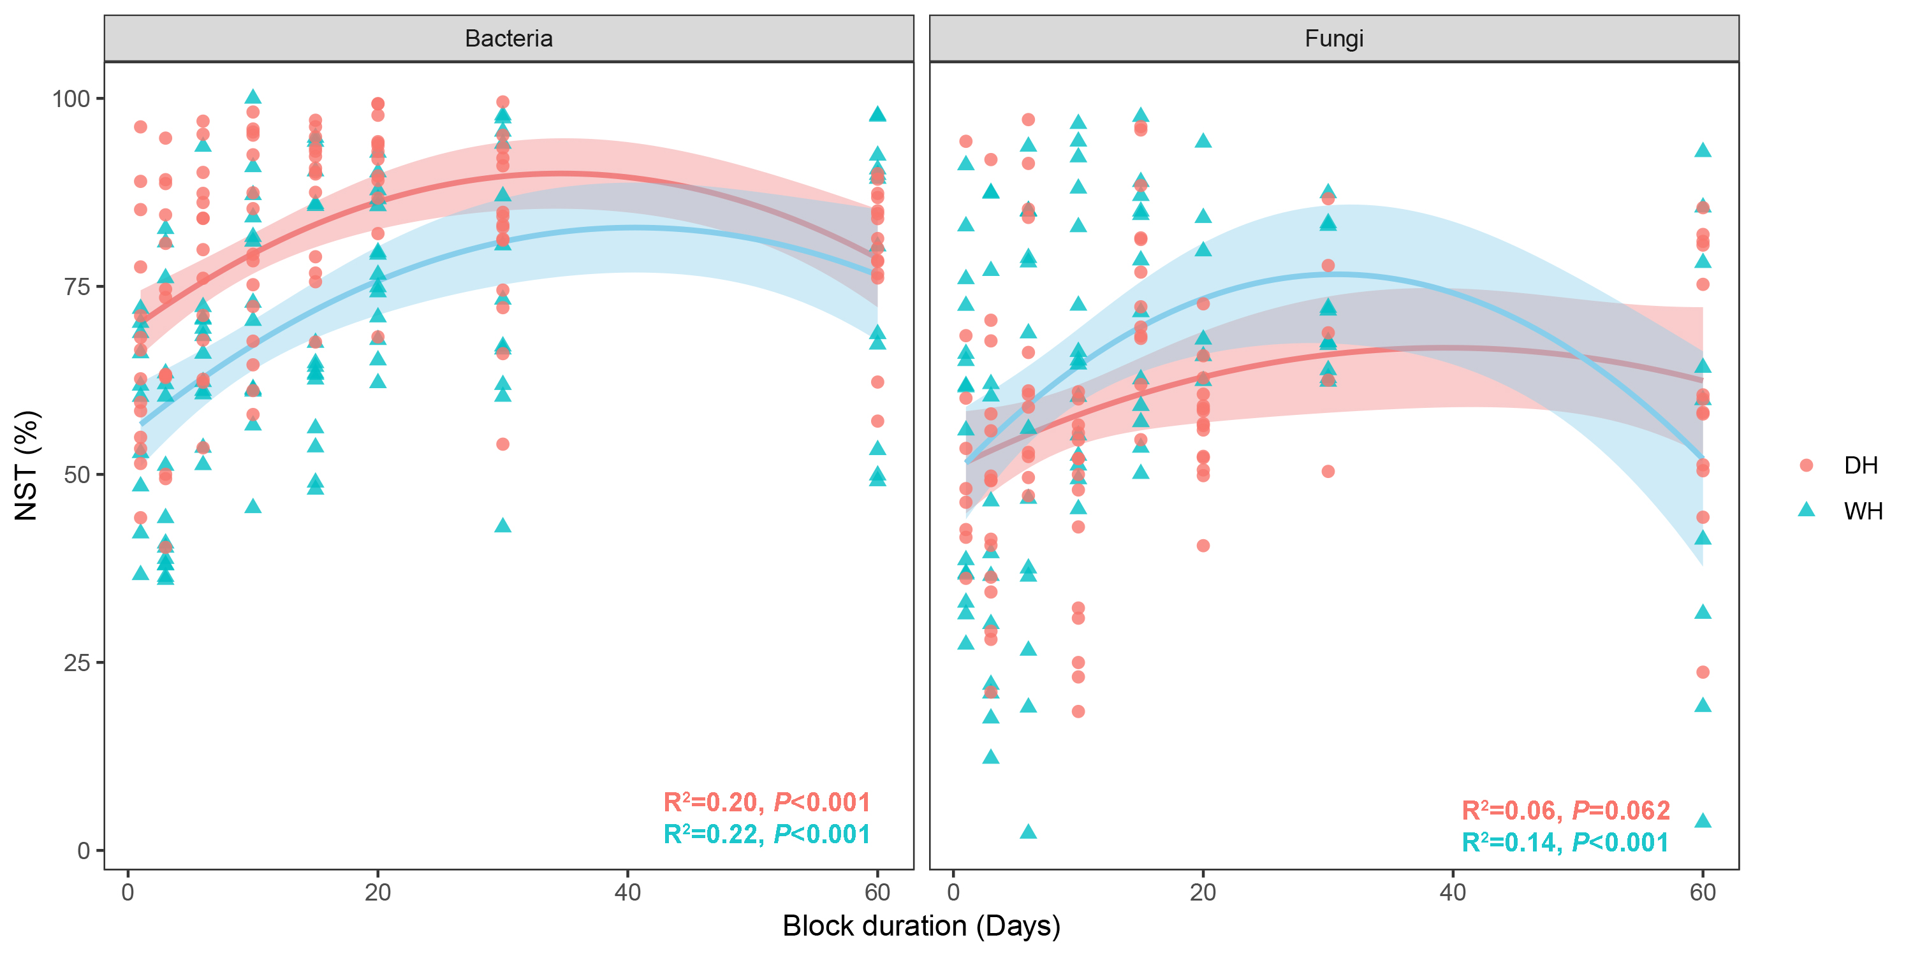
Results
NST (Normalized Stochasticity Ratio): to quantify ecological stochasticity under different situations in which deterministic factors drive the communities more similar or dissimilar than null expectation.

Slide 9
Results
Mantel test for Spearman’s correlations between microbial communities and variations in treatment, plant and edaphic factors.
 |  | Bacteria |  |  |  | Fungi
 | WH |  | DH |  | WH |  | DH
 | R | P | R | P | R | P | R | P
Treatment | 0.217 | 0.02 | 0.0448 | 0.299 | 0.3257 | 0.003 | 0.1648 | 0.045
Plant factors | 0.2469 | 0.02 | 0.0961 | 0.154 | 0.3167 | 0.005 | -0.0047 | 0.465
Edaphic factors | 0.2618 | 0.008 | -0.0720 | 0.835 | 0.4854 | 0.001 | 0.0801 | 0.129
Treatment indicates block duration. Plant factors include plant species richness and biomass. Edaphic factors include SWC, temperature, total nitrogen, total carbon, C/N ratio and pH. These factors are evaluated by Euclidian distance after standardization, and microbial communities are evaluated by Bray-Curtis distance.

Slide 10
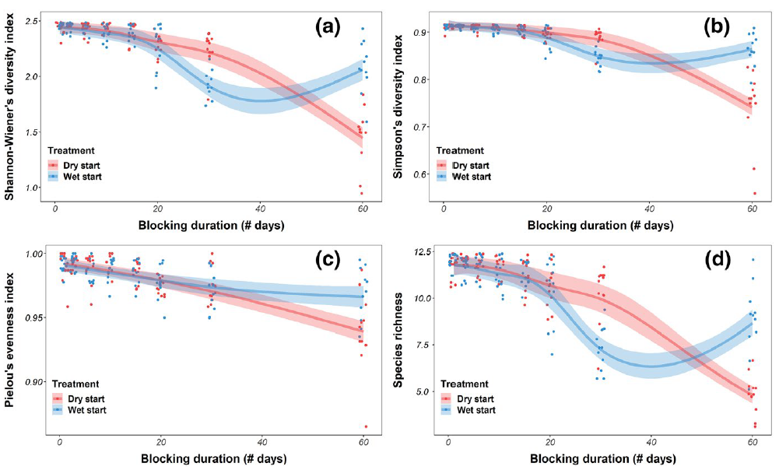
Plant response
Reynaert et.al, 2020

Slide 11
Summary:
Higher persistent precipitation reduces fungal diversity and connectivity but has little effect on bacterial communities.
Intermediate precipitation persistence leads to high stochasticity of microbial community assembly.
Increasing precipitation persistence leads to microbial communities being unstable and at risk.
Lingjuan.Li@uantwerpen.be

Slide 12




Thanks for your attention!
Lingjuan.Li@uantwerpen.be

