Slide 1




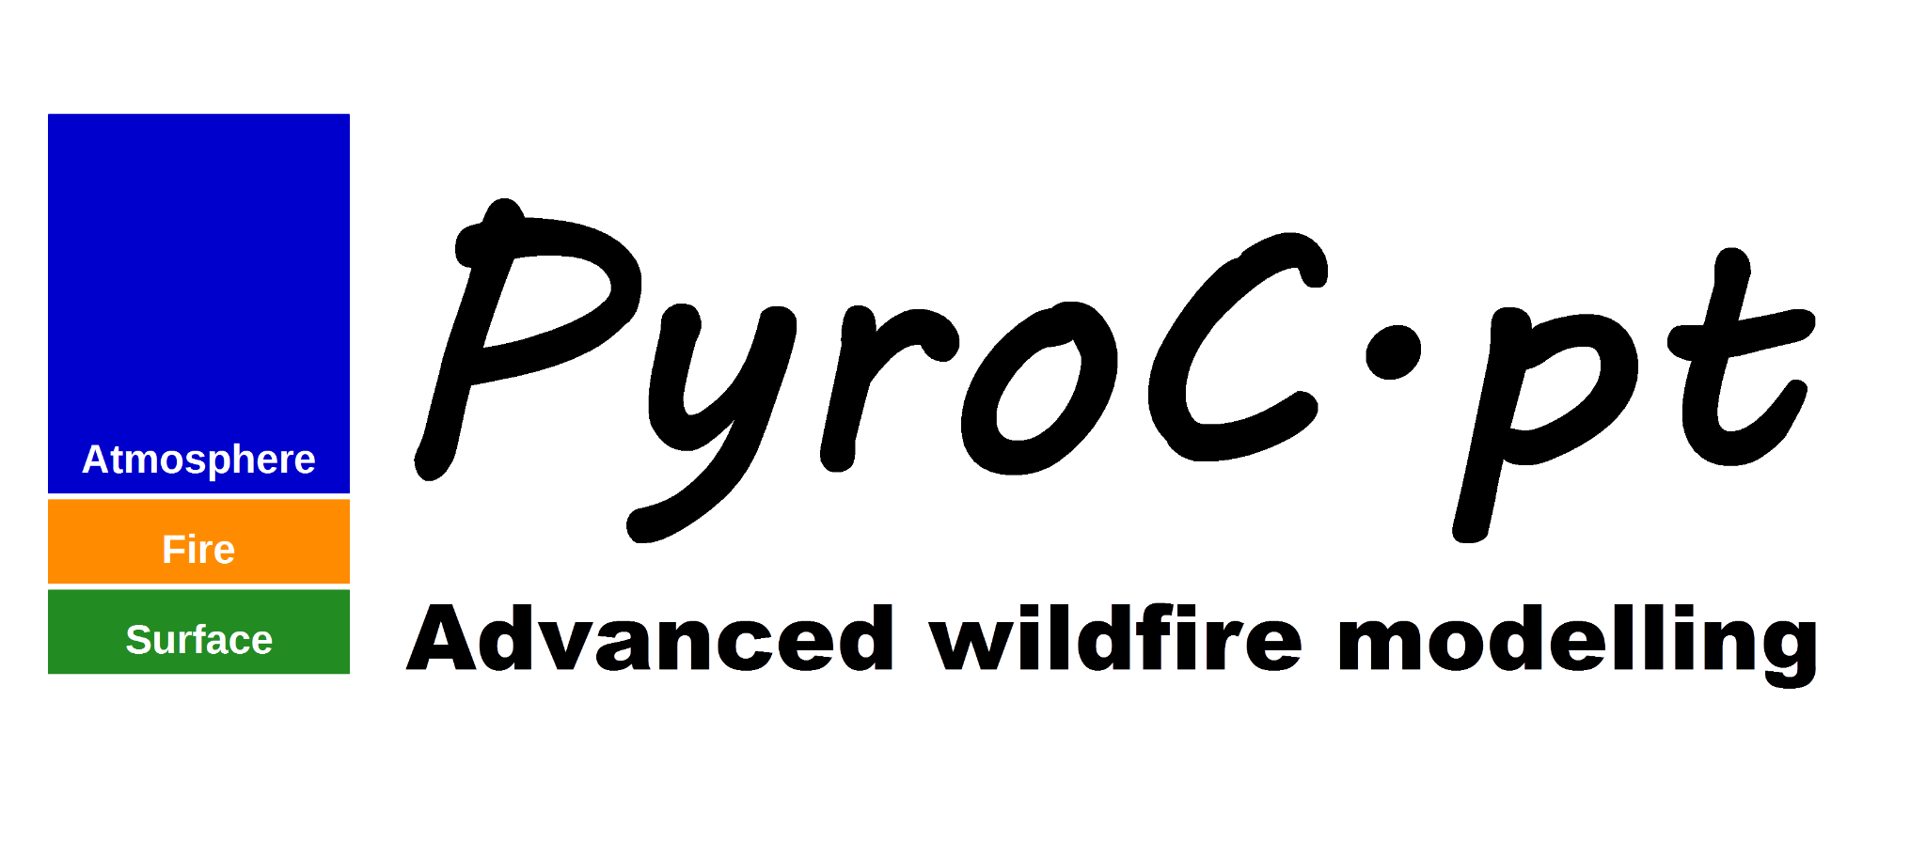


Fire weather risk analysis over Portugal in the last decades and their impacts over the atmosphere - The Monchique study case
Filippe L.M. Santos
Flavio T. Couto
Vanda Salgueiro
Miguel Potes
Maria João Costa
Daniele Bortoli
Rui Salgado

Slide 2
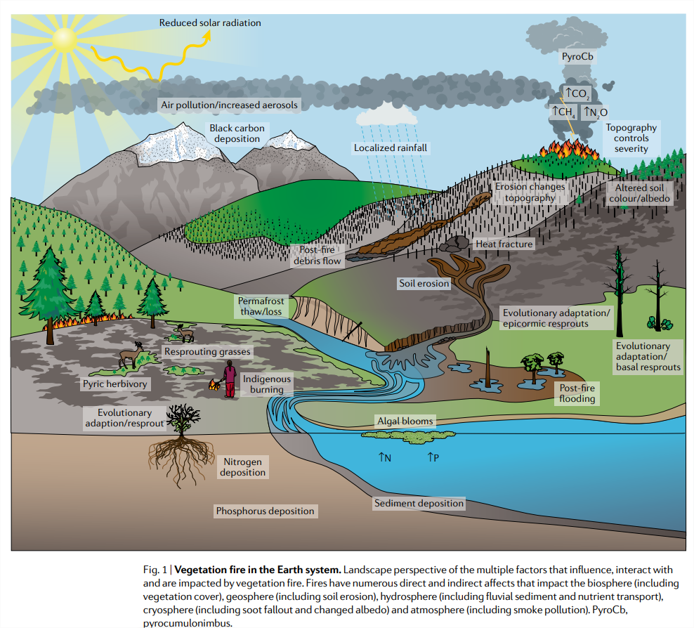
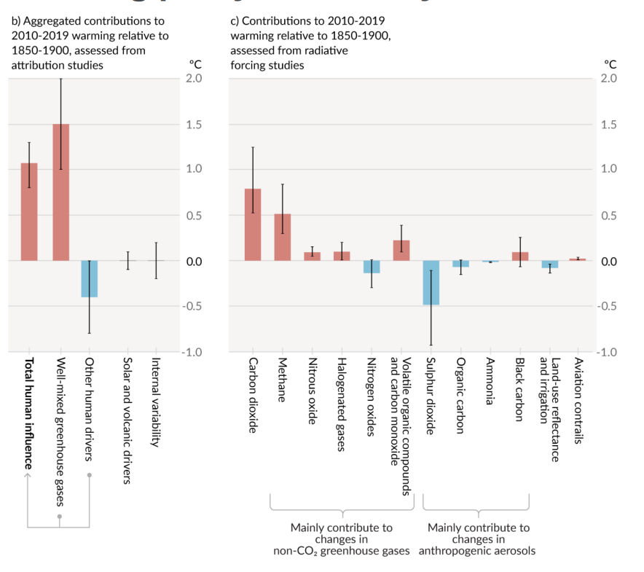
Wildfires climate impacts
IPCC AR6 2021
Source: Bowman, David M. J. S.; Kolden, Crystal A.; Abatzoglou, John T.; Johnston, Fay H.; van der Werf, Guido R.; Flannigan, Mike (2020). Vegetation fires in the Anthropocene. Nature Reviews Earth & Environment, (), –. doi:10.1038/s43017-020-0085-3

Slide 3
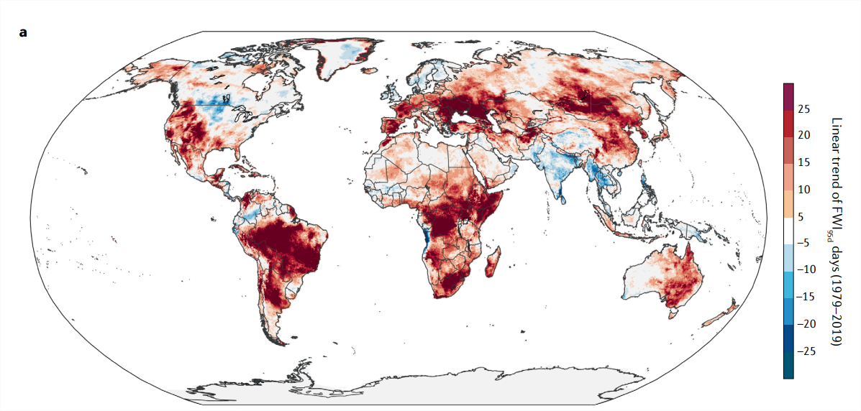
Objective
Fonte: Bowman, David M. J. S.; Kolden, Crystal A.; Abatzoglou, John T.; Johnston, Fay H.; van der Werf, Guido R.; Flannigan, Mike (2020). Vegetation fires in the Anthropocene. Nature Reviews Earth & Environment, (), –. doi:10.1038/s43017-020-0085-3
to investigate the fire risk evolution in Portugal over the last 40 years and the extreme wildfire emission impacts derived from remote sensing data.

Slide 4
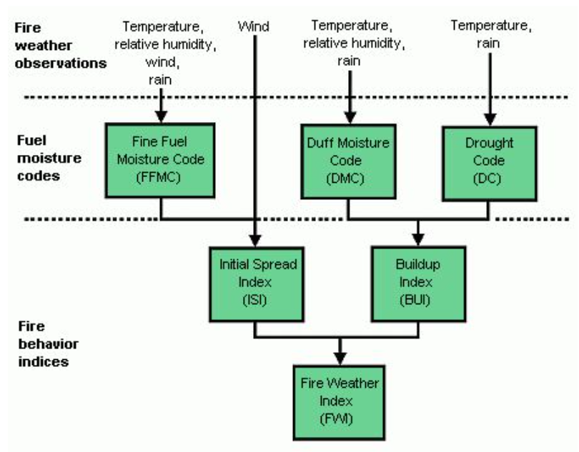
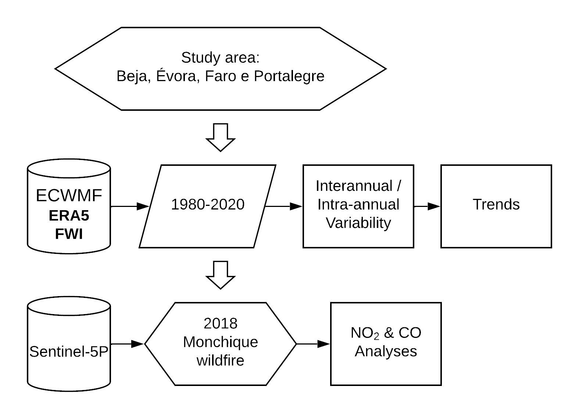
Methodology
Flowchart of this work.
Structure of the Canadian Forest Fire Weather Index (FWI) System
Source: https://confluence.ecmwf.int/display/CEMS/Fire+danger+indices+historical+data+from+the+Copernicus+
Emergency+Management+Service?preview=/239344103/239344106/Fire_In_CDS.pdf

Slide 5
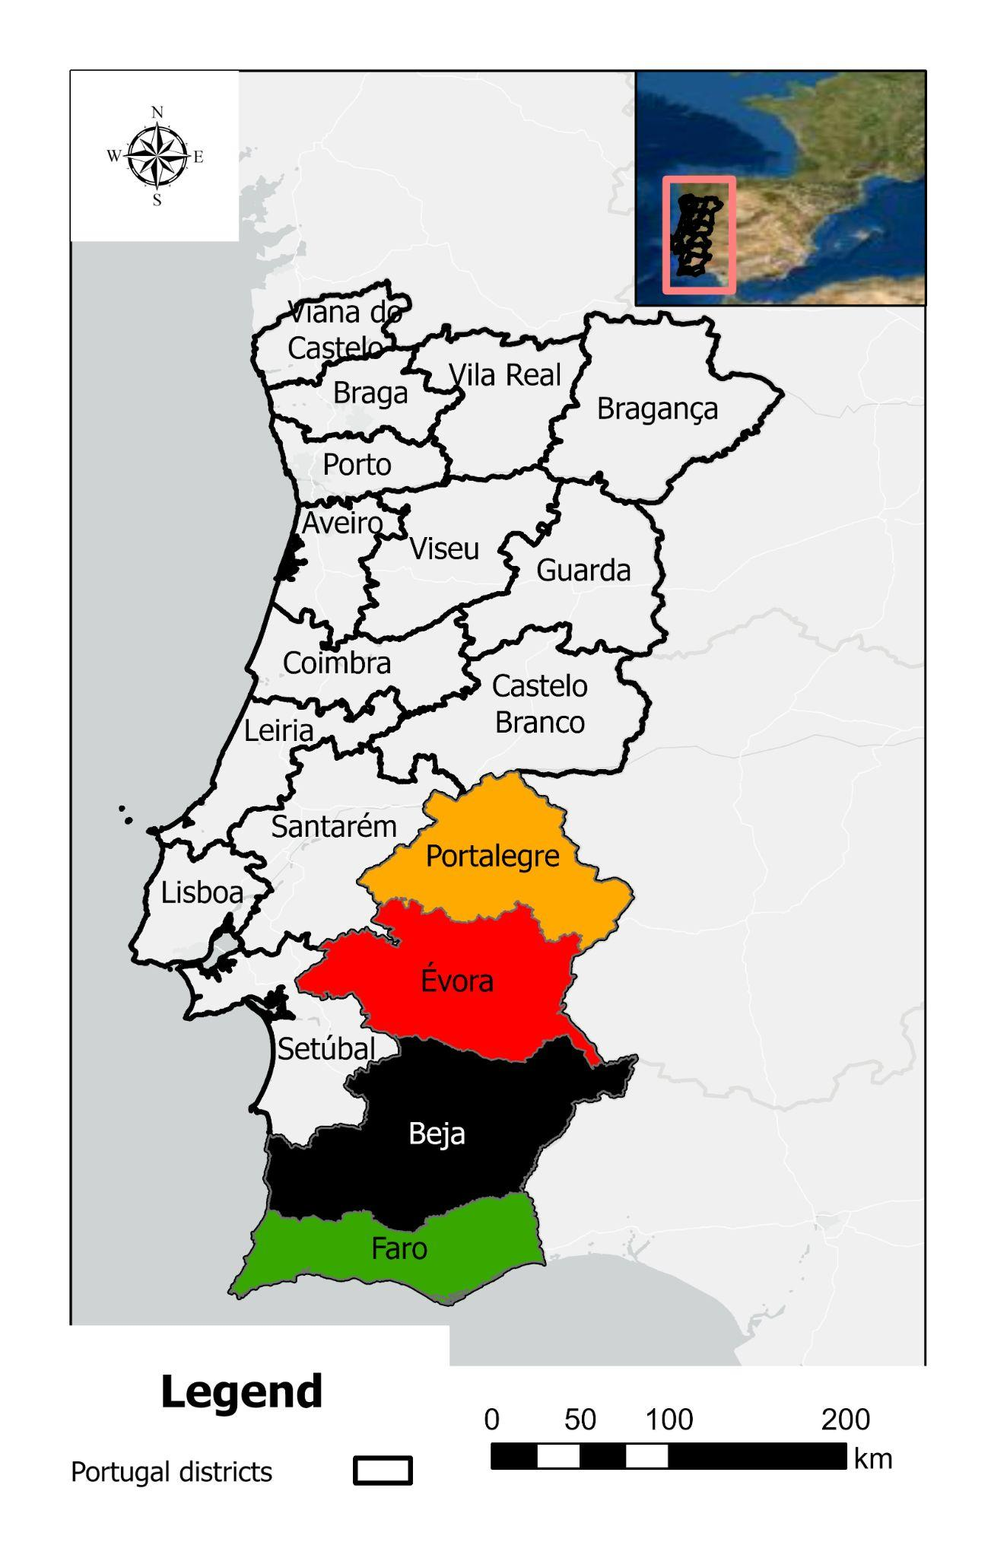
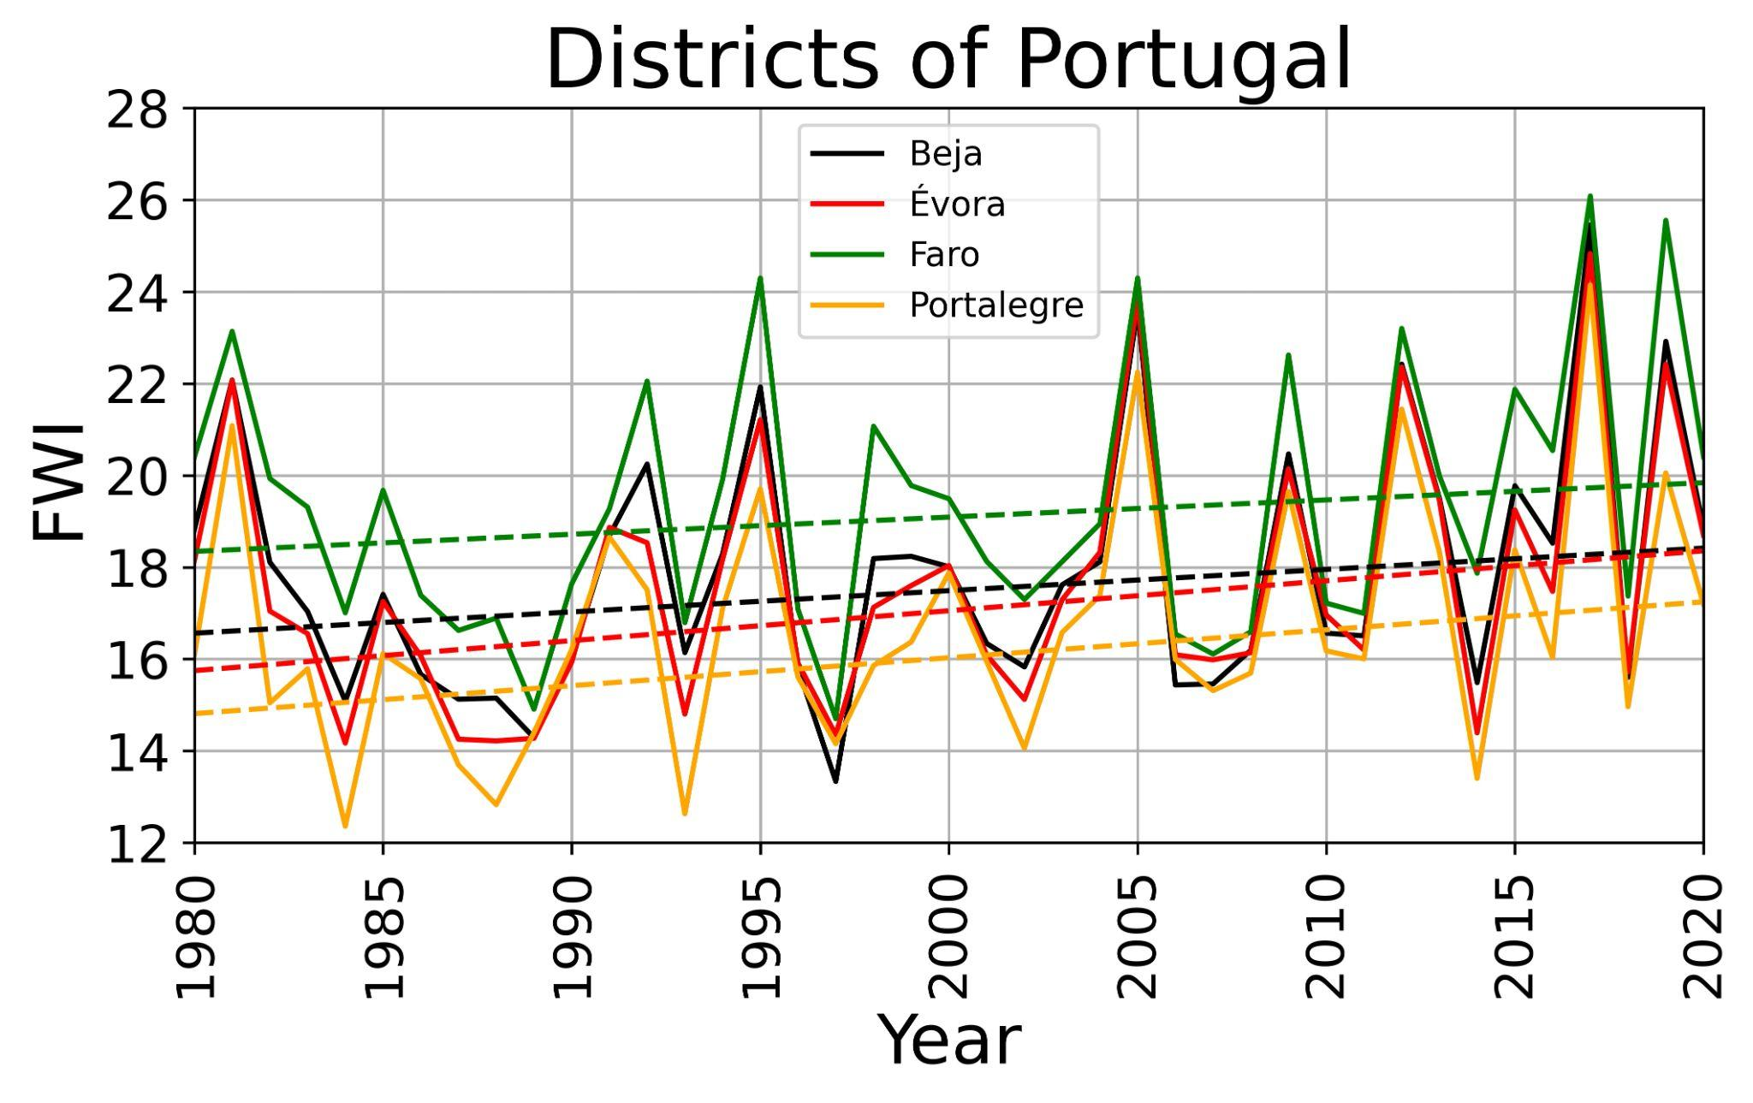
Results
Interannual variability

Slide 6
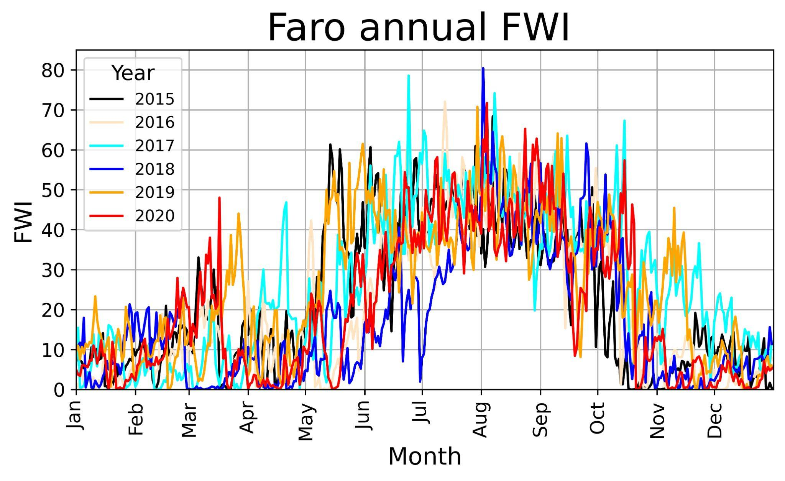
Results
Faro

Slide 7
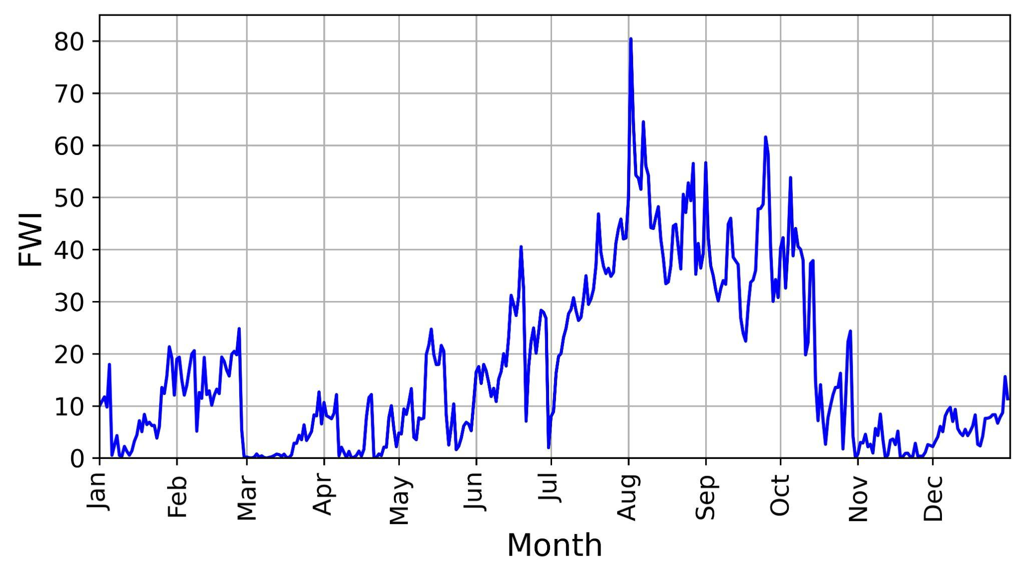
Results
Faro 2018

Slide 8
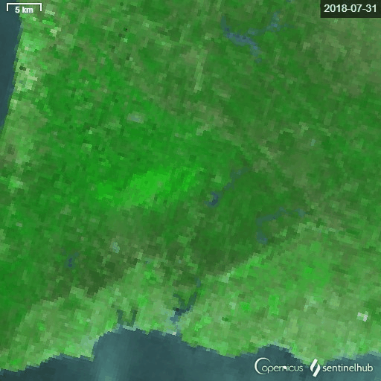
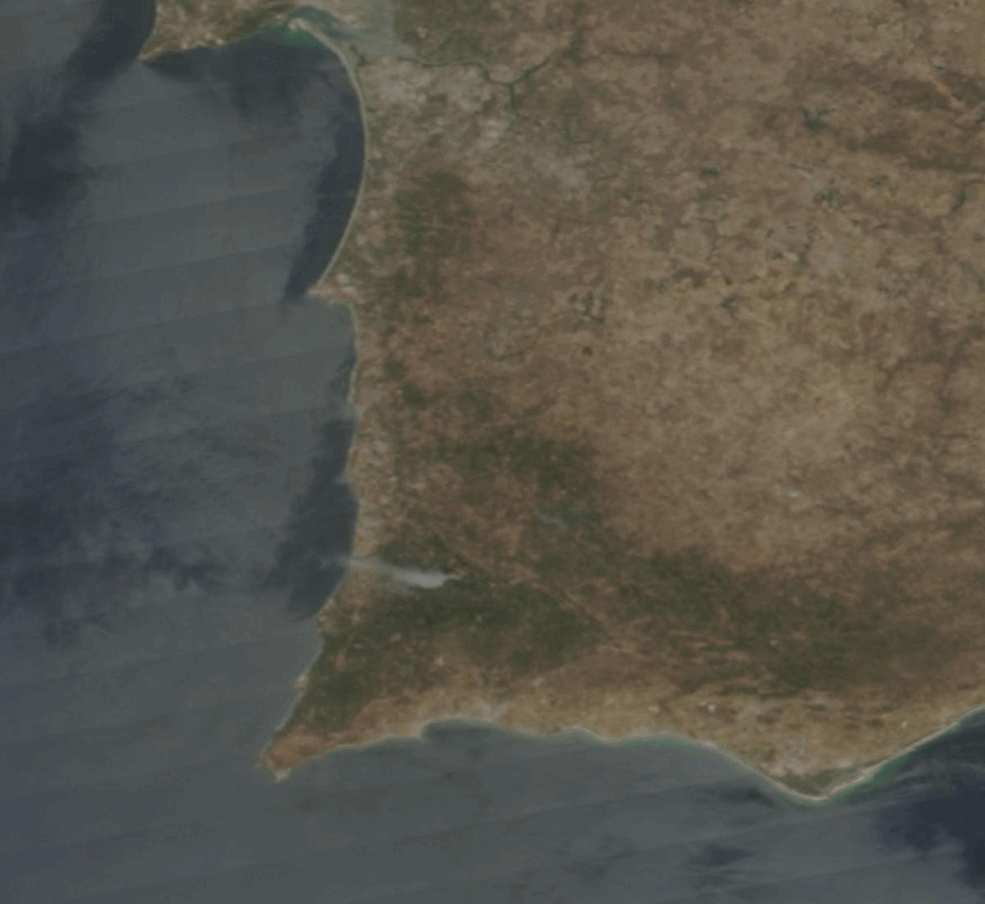
Results
Monchique
Sentinel-3
VIIRS

Slide 9
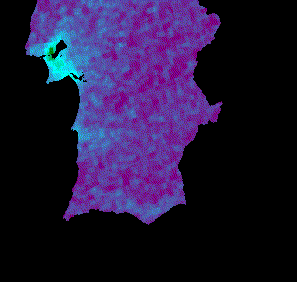
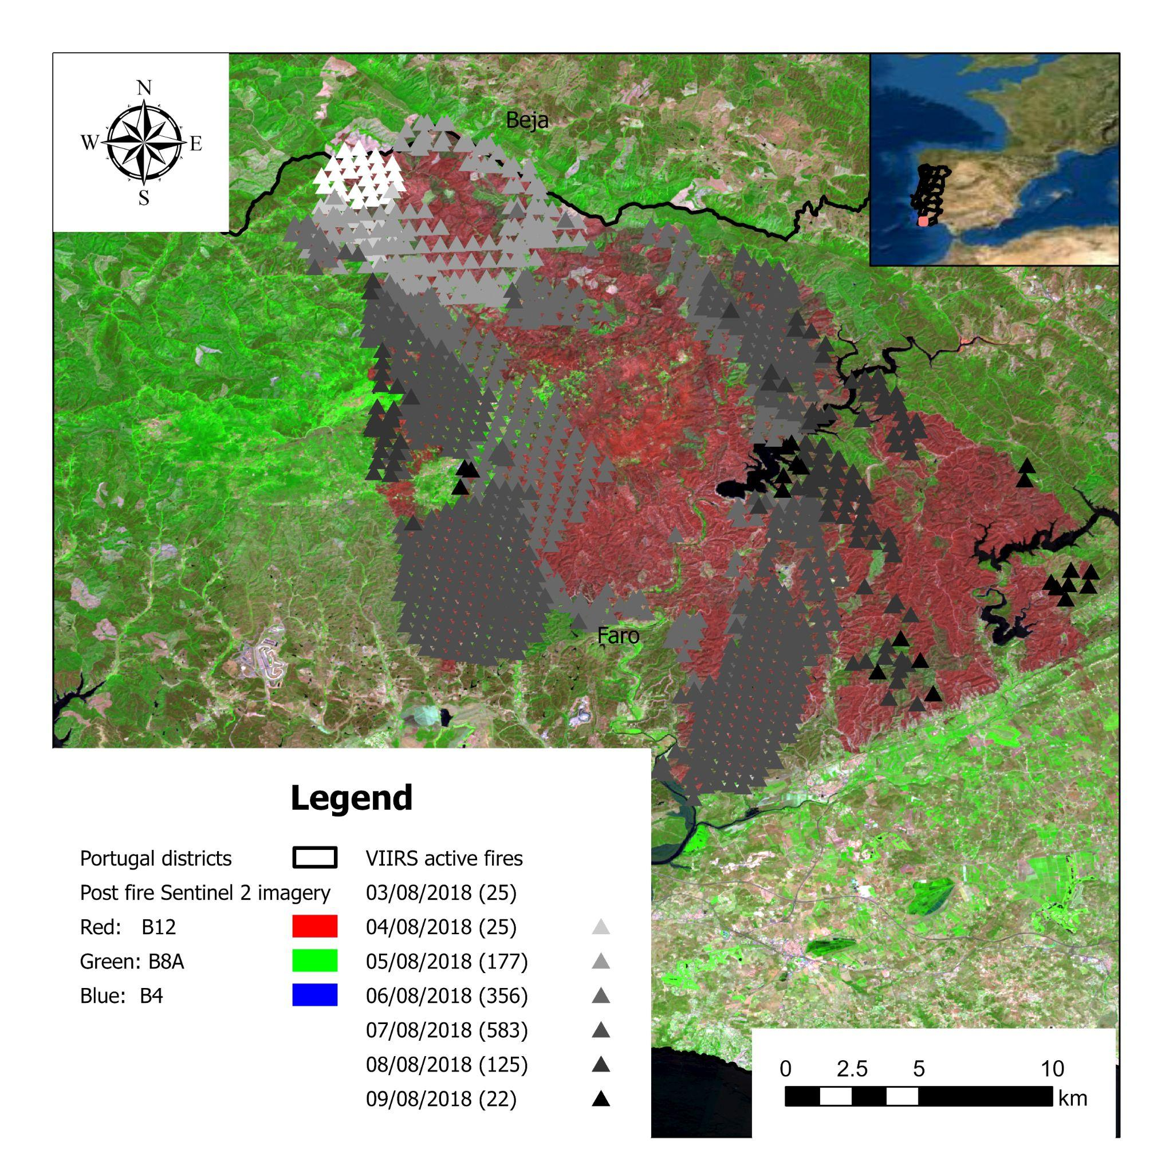
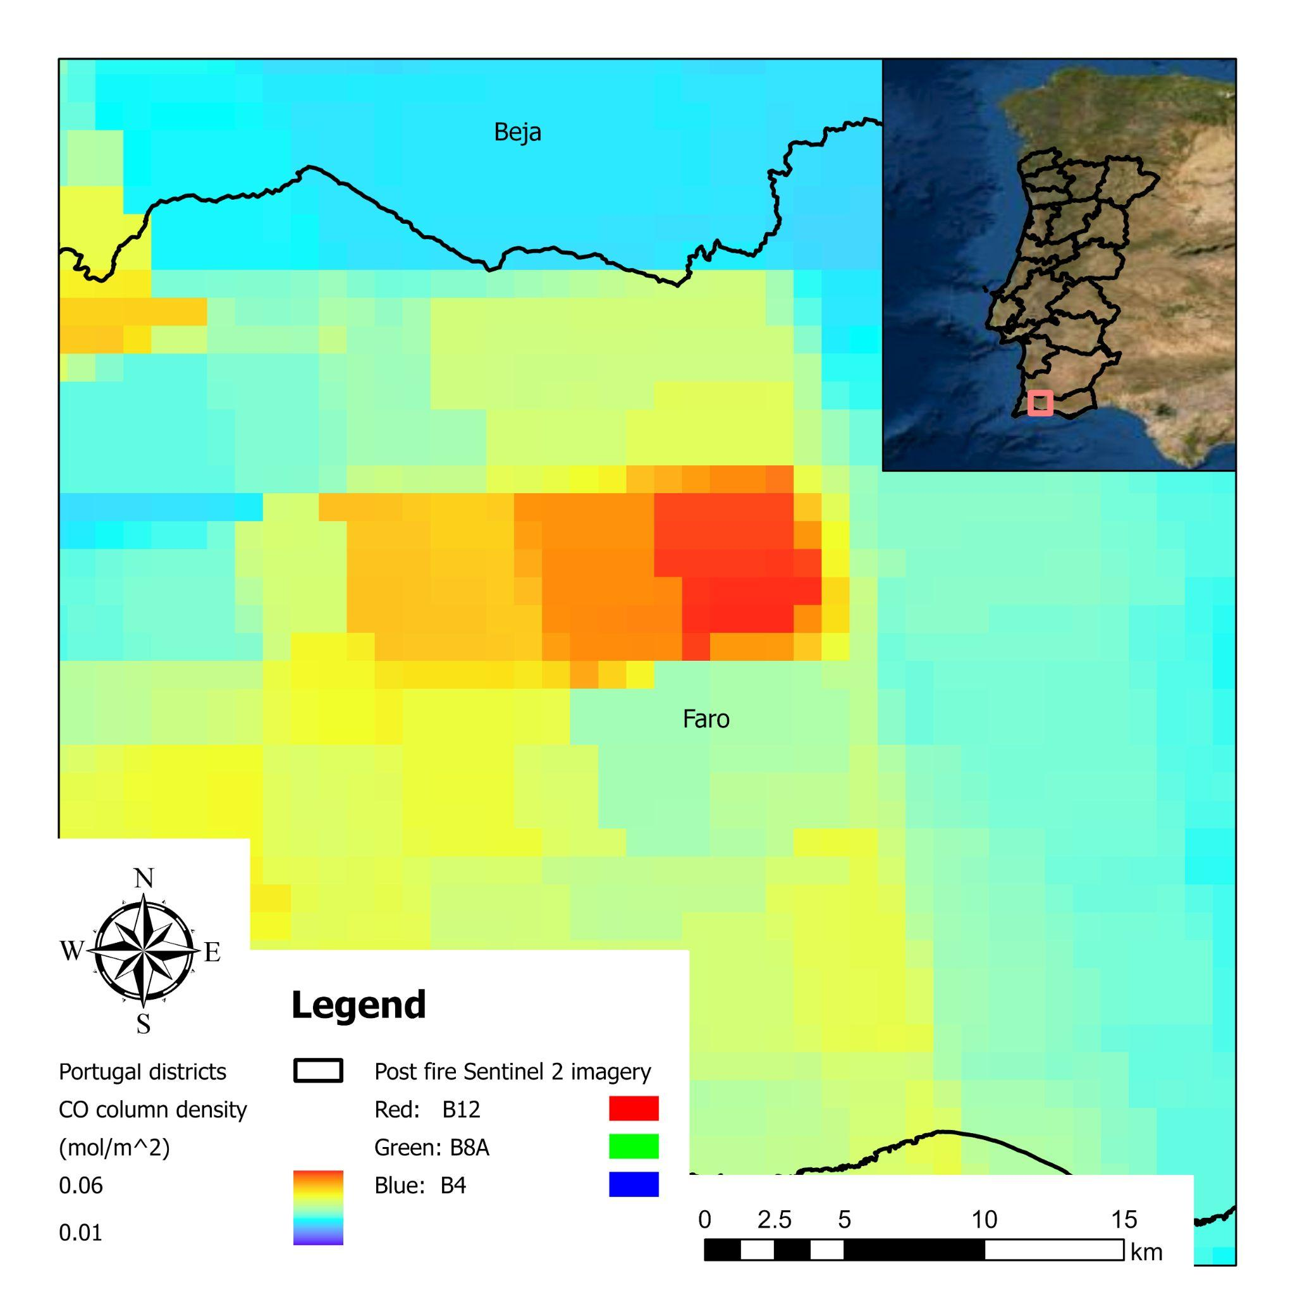
Results
Sentinel-5 NO₂ product
(01-10
Aug 2018)
2018-08-20
Sentinel-2
Sentinel-5 CO product

Slide 10
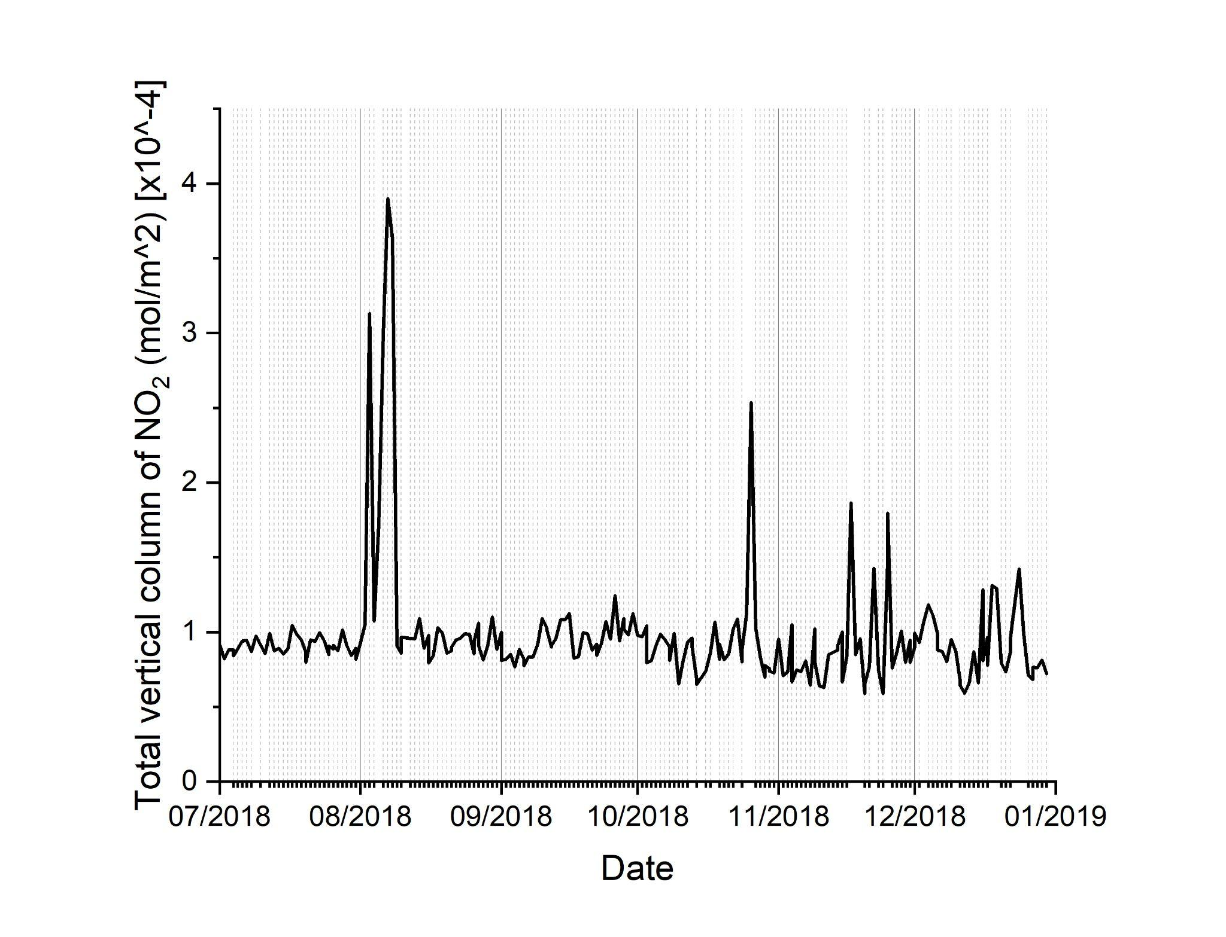
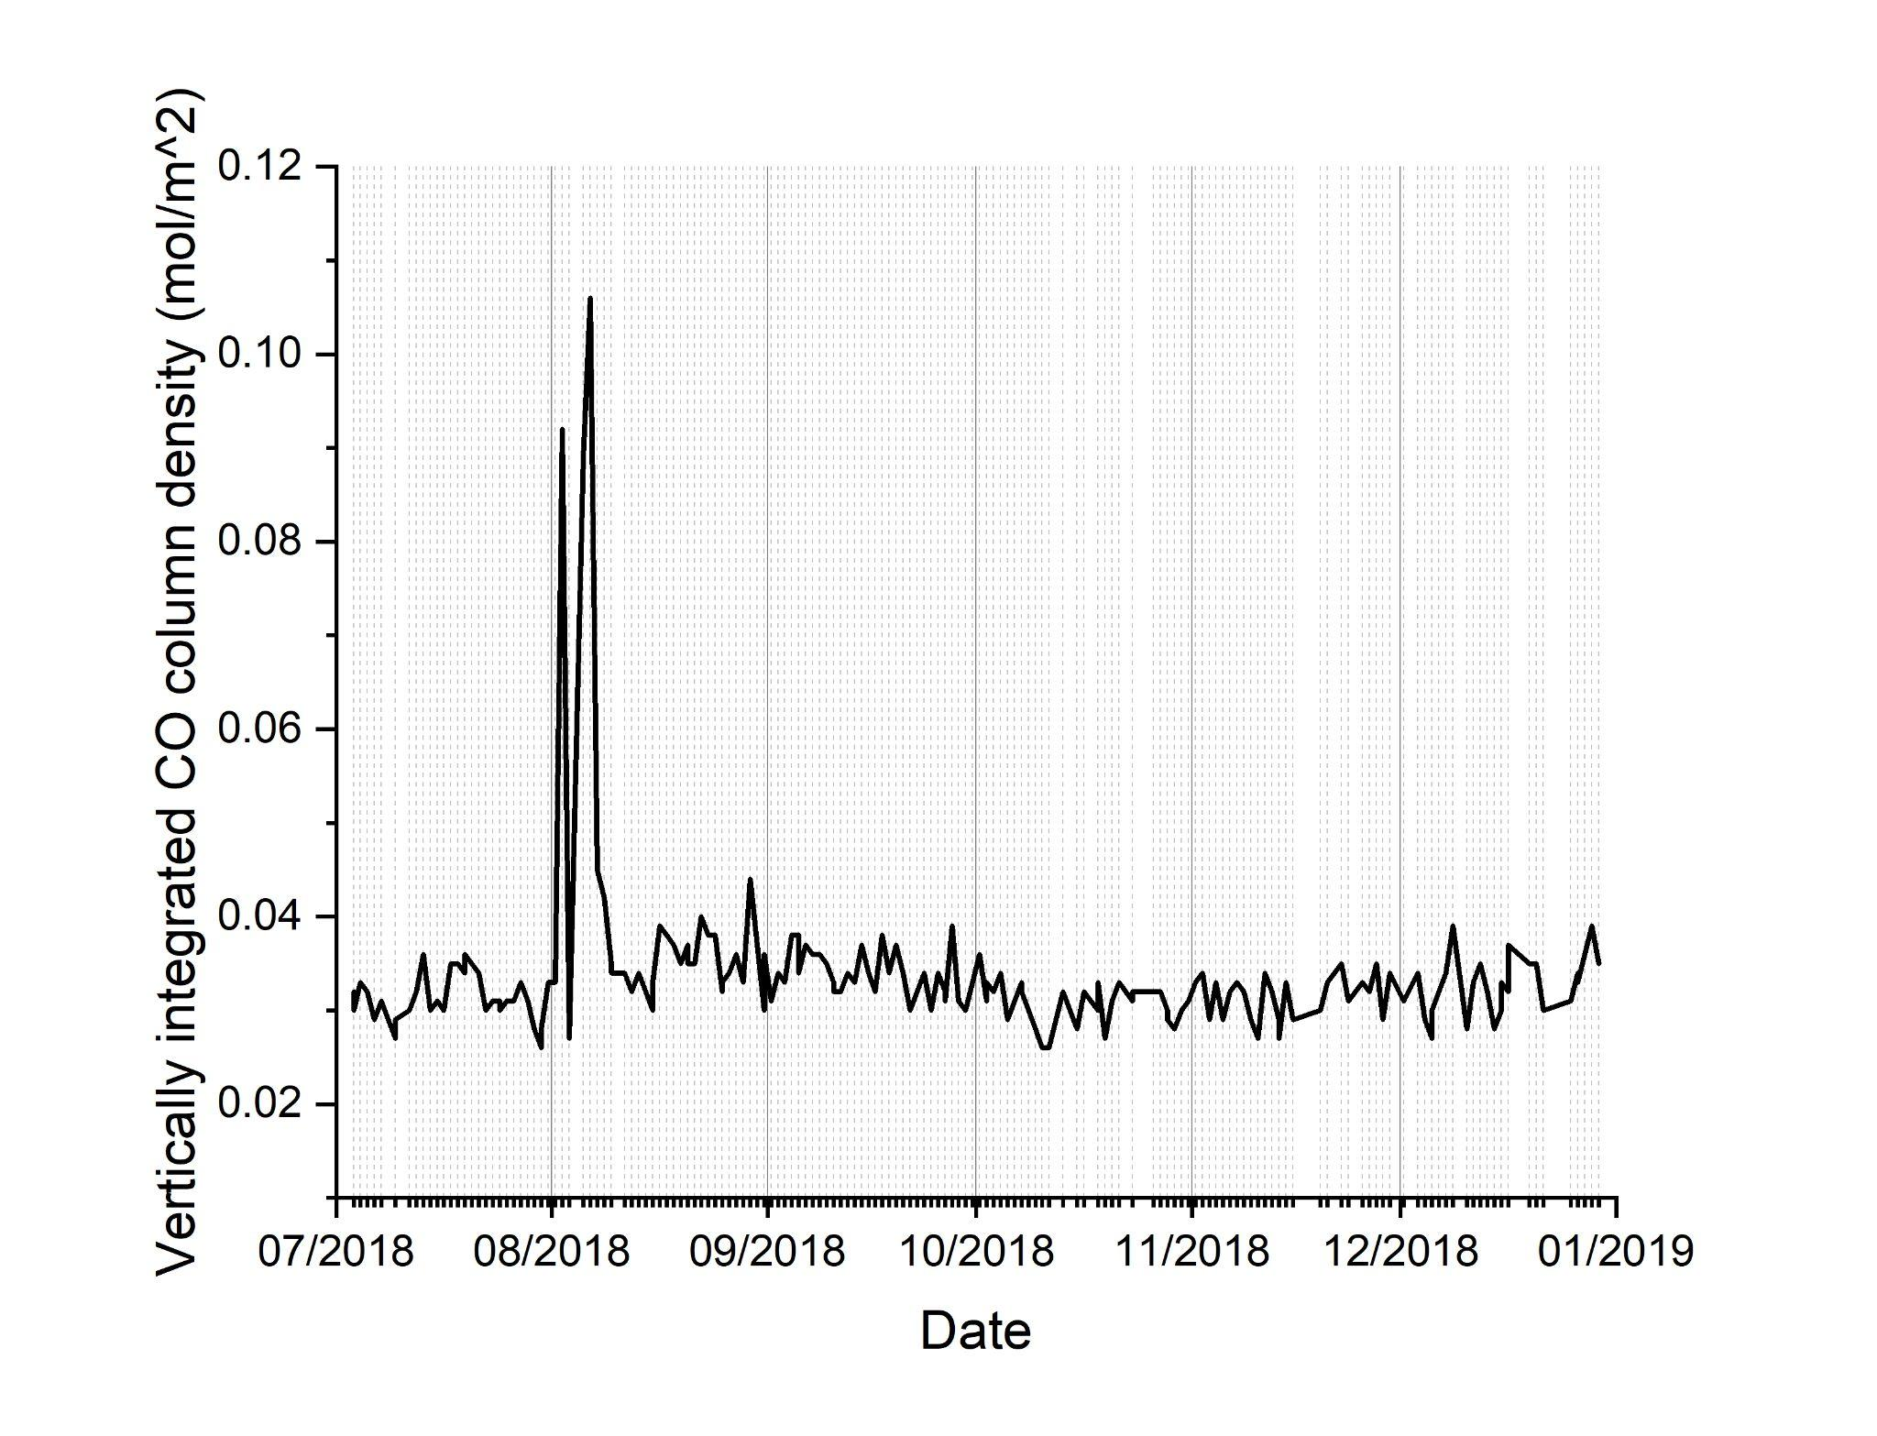
Results
NO₂
CO

Slide 11
Discussions
South Portugal has the FWI positive trend.
The Monchique wildfire was the most destructive in Portugal in 2018, with almost 27.000 ha burned.
Extreme wildfire events can release massive pollutants into the atmosphere.
The Sentinel-5 products help evaluate the fire emission evolution in extreme wildfire events.

Slide 12





Acknowledgements

Slide 13
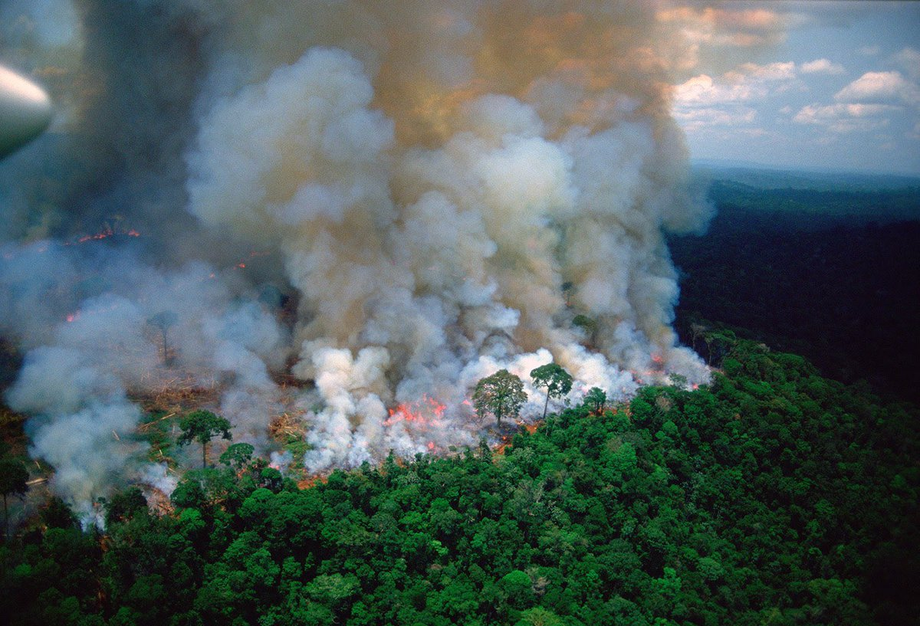
Thank you!
Questions?
Filippe Lemos Maia Santos
filippe.santos@uevora.pt
Source: https://www.ecohealthalliance.org/wp-content/uploads/2019/08/amazon-fire.jpeg

