Slide 1
Methodology for estimating the emission of radionuclides into the atmosphere from wildfires in the Chernobyl Exclusion Zone
Valentyn Protsak, Gennady Laptev, Oleg Voitsekhovych, Taras Ginchuk, Kyrylo Korychenskyi
Ukrainian Hydrometeorological Institute, Kiev, Ukraine
(protsak@uhmi.org.ua)

Slide 2
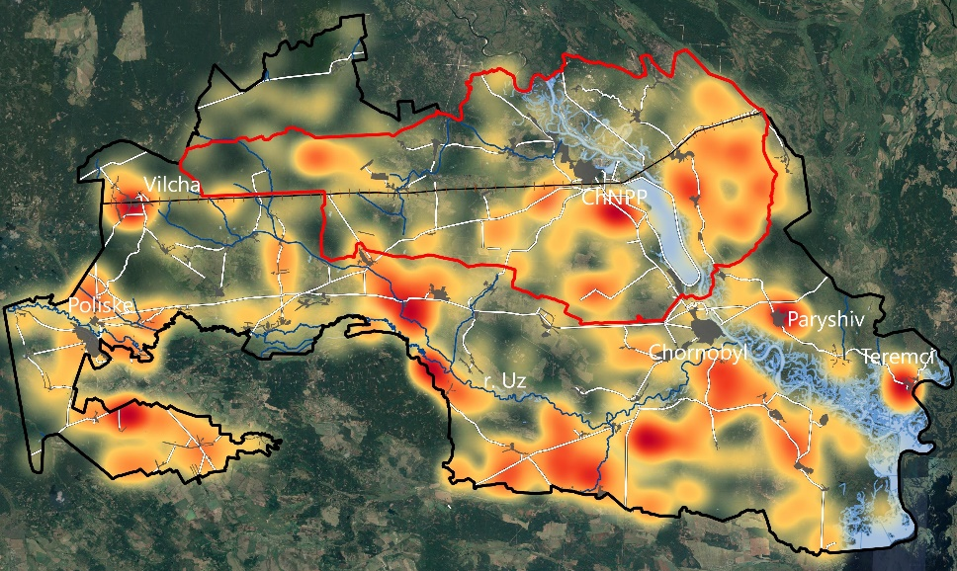
Statistics of wildfires on the territory of the CEZ for the period 1993-2020
Frequency distribution of wildfires in the CEZ by months.
Frequency distribution of wildfires by years in the Chornobyl Exclusion Zone.
Up to 100 or more wildfires cases can happen in the CEZ during a year.
More than 50% of all wildfires occur in the spring. April is the most fire-prone month.
Fires occur most often along the southern border of the CEZ,
along the floodplain of the Uzh River and near former settlements.
Frequency distribution of wildfire on the territory of the CEZ.

Slide 3
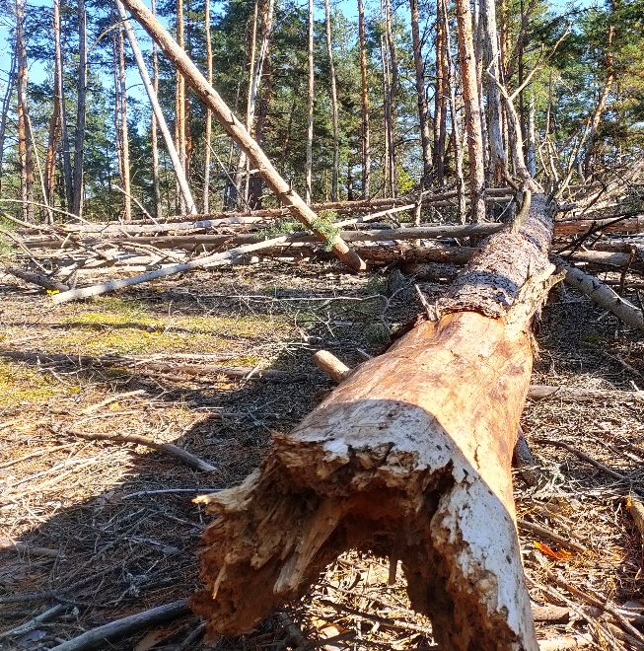
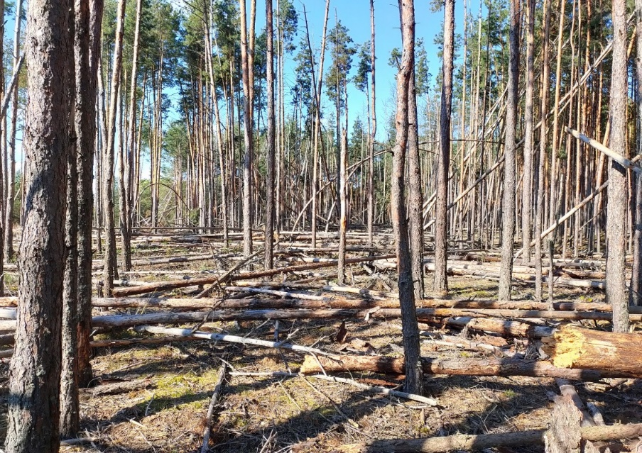
Main reasons leading to spread of wildfires in the CEZ
Lack of concept of forest management in the CEZ.
Uncontrolled vegetation growth of the lower layer of forests.
Distribution of forest pests (root sponge, bark beetle, etc.)
Significant number of fallen trees.
Extremely dry and windy climatic conditions in recent years. Several dry years preceded a major fire in April 2020.
Root sponge-damaged forest in the CEZ.

Slide 4
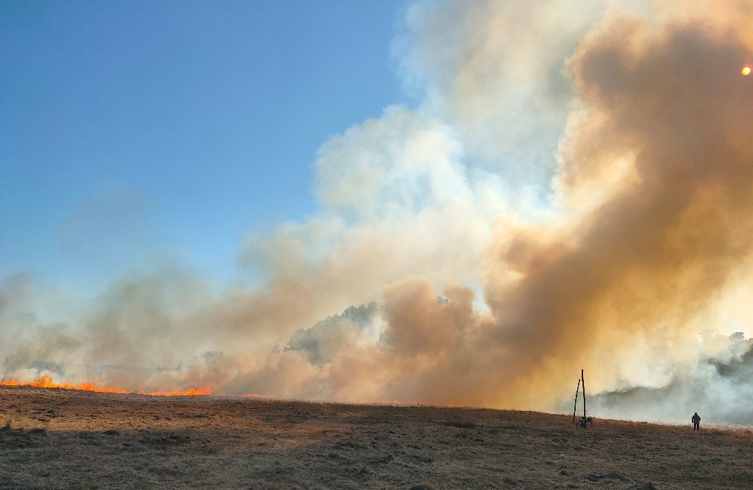
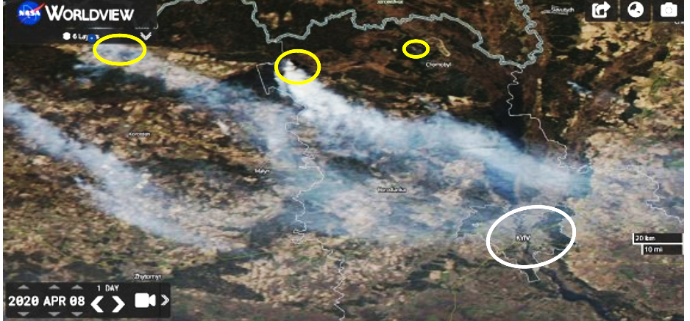
Danger of wildfires in the Chernobyl Exclusion Zone
Poor, sod-podzolic soils of the Ukrainian Polissya are favourable media to concentrate a significant part of ⁹⁰Sr and ¹³⁷Cs activity in plant biomass.
During fires, part of the radionuclides contained in combustible plant materials are released into the atmosphere with the products of combustion.
Biologically significant radionuclides as ⁹⁰Sr, ¹³⁷Cs, plutonium isotopes and ²⁴¹Am bound to fine aerosols in combustion products, can be transported with atmospheric masses over long distances. This may cause secondary radioactive fallout on remote territories and form an inhalation dose to the population.
Large-scale fires in the CEZ also create significant social and stress in society, especially in the absence of reliable information about the radiological consequences of fires in the CEZ for the population.
ChNPP
Kyiv

Slide 5
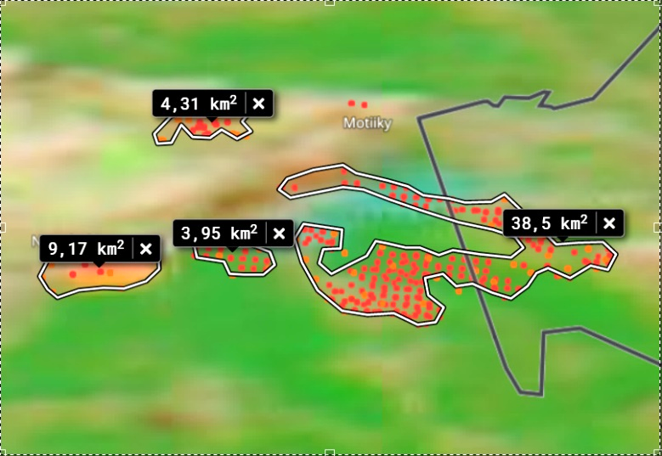
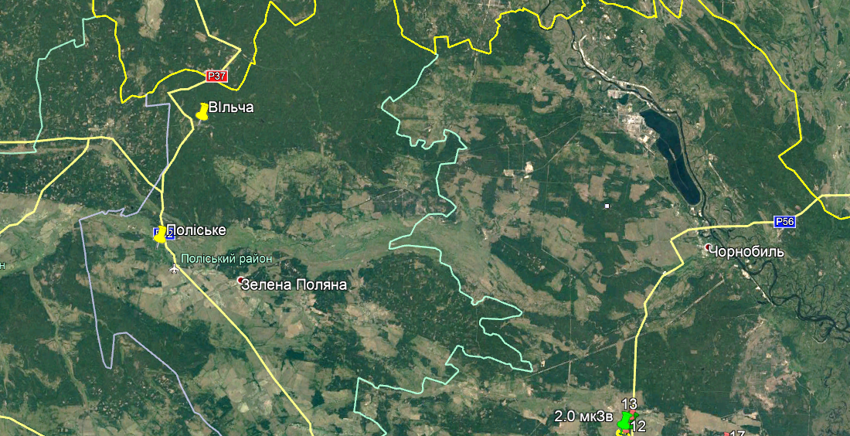
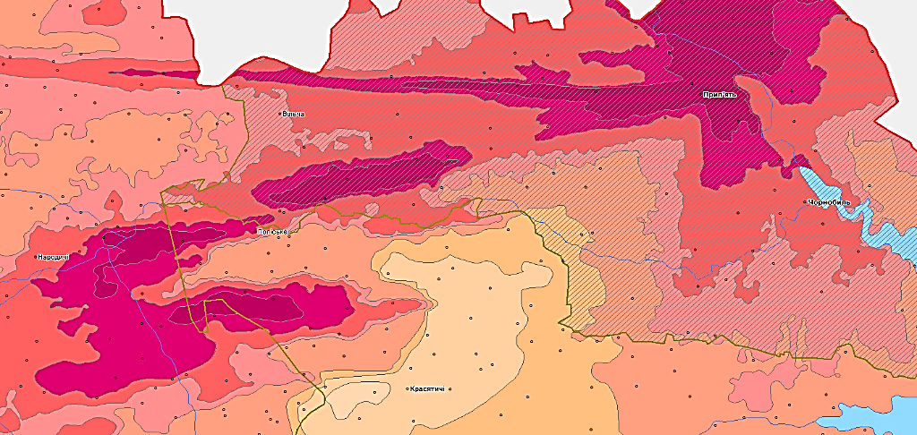
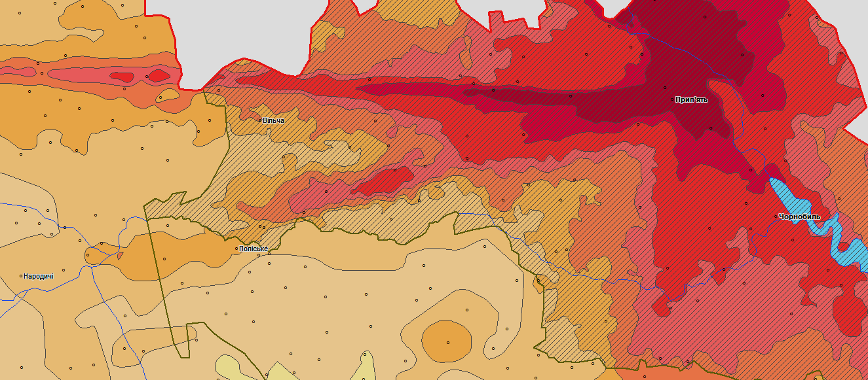
Methodology for estimating the emission of radionuclides into the atmosphere from wildfires in the Chernobyl Exclusion Zone
NASA Worldview
The algorithm for calculating the dynamics of emission radionuclide into the atmosphere from wildfires is based on the following data:
satellite date of NASA Worldview (to determine the position and area of the wildfire using thermopoint clusters);
map of landscape structure of the CEZ (to divide the fire area into forest and grassland polygons);
maps on radionuclide contamination density territory of the CEZ (to estimate the radionuclide inventory in forest and meadow biomass);
experimental date which relates the inventory of radionuclides in the main combustible components on meadow and forest areas (Bq/m²) with the density of soil contamination (Bq/m²);
data from evaluations of the radionuclide emission factors (EFs) in the combustion of radioactively contaminated biomass;
The analysis was carried out in a free and open source geographic information system QGIS.
Landscape structure
Contamination of ¹³⁷Cs
Contamination of ⁹⁰Sr

Slide 6
Calculation of radionuclide emissions into the atmosphere from wildfires in CEZ
Table 1 - Experimental coefficients (K), which relates the inventory of radionuclides in the main combustible components on meadow and forest areas (Bq/m²) with the density of soil contamination (Bq/m²)
А_{і}(Bq)=Ʃ(S_{n}(m²)·А^{i}_{n}(Bq/m²)·К^{і} ·EF^{і}),
where:
А_{і}(Bq) – activity of і-radionuclide emitted into the air during fire;
S_{n}(m²)– area of n- subpolygon affected by fire;
А^{i}_{n}(Bq/m²) – contamination deposition of the n-subpolygon by і-radionuclide;
К^{і} - coefficient linking i-th radionuclide reserves in fuel biomass depending on the cenosis and density of soil contamination with i-th radionuclide;
EF^{і} – emission factors (fraction of emission of і-radionuclide from fuel biomass to air during fire).
Radionuclide | K
 | Meadow | Forest
¹³⁷Cs | 0.015 | 0.11
⁹⁰Sr | 0.025 | 0.28
∑Pu | 0.01 | 0.03
²⁴¹Am | 0.01 | 0.03
Thus, the stock activity of radionuclides (A) in the combustible biomass on meadow and forest areas was calculated as:
A (Bq/m²) = K · A_{soil} (Bq/m²)

Slide 7
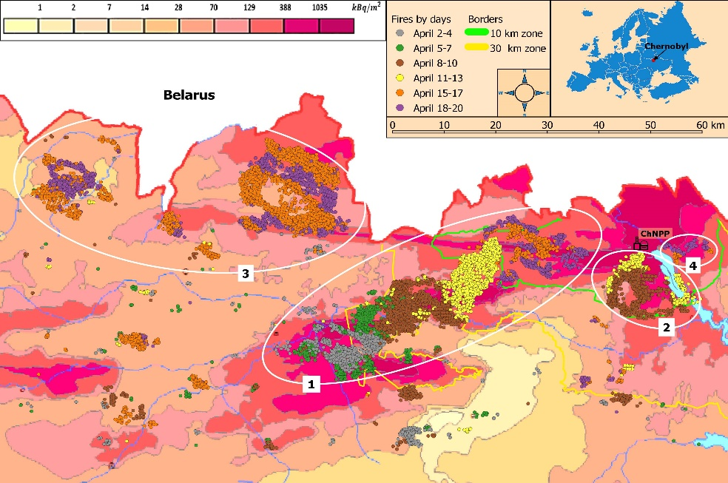
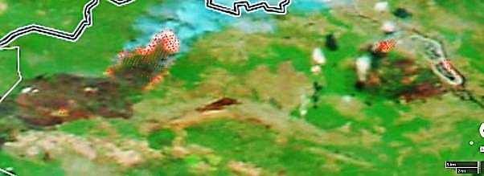
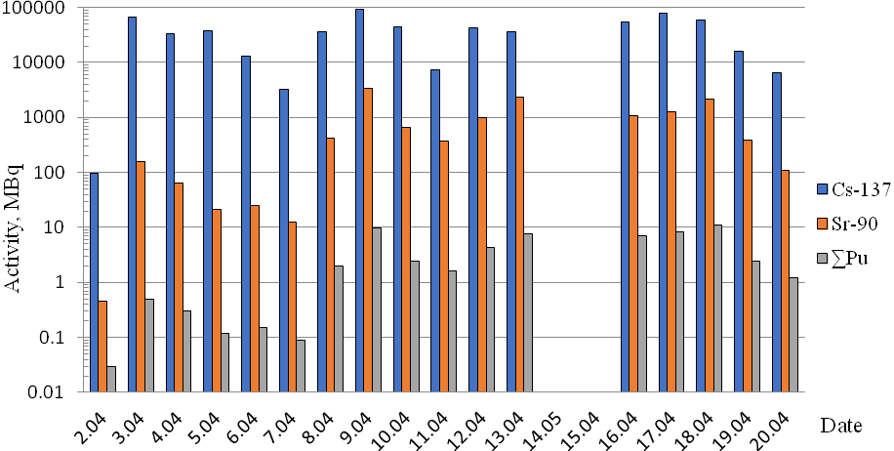
Source term analyses and estimates of the radionuclide emission into the atmosphere during the April fire 2020
13.04.2020
It is estimated that the total area of the April 2020 fire was about 870 km². Of these, about 425 km² is the territory of exclusion zone.
According to the obtained results, the total release of radionuclides in the smoke fraction that could be transferred over long distances is: ¹³⁷Cs – 630 GBq, ⁹⁰Sr – 13,5 GBq, ∑Pu - 59 MBq.
The obtained results are in good agreement with the inverse modeling data.
Daily dynamics of the total emission of radionuclides into the atmosphere from the April fire for the period 2.04-20.04.2020.

Slide 8
Thank you for your attention

