Slide 1
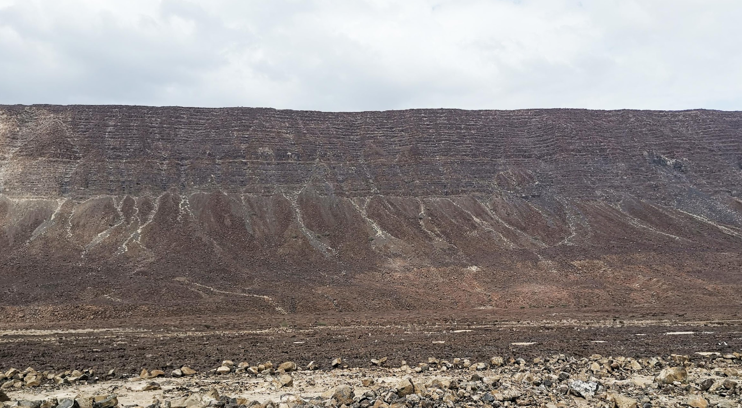



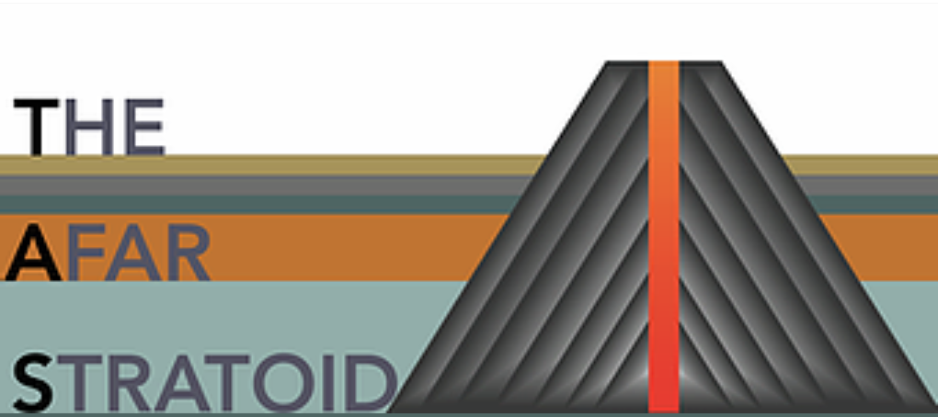

Stratoids flood basalt volcanism at the Afar rift: new insights from trace elements geochemistry
Gianmaria Tortelli*^{1,2}, Anna Gioncada ¹, Carolina Pagli ¹, Eleonora Braschi ³, Ermias Filfilu Gebru ^{4,5} and Derek Keir ^{2,6}
¹ Department of Earth Sciences , University of Pisa
² Department of Earth Sciences , University of Firenze
³ CNR, IGG, Firenze
⁴ Department of Geosciences, University of Fribourg
⁵ School of Earth Sciences, Addis Ababa University
⁶ School of Ocean and Earth Science, University of Southampton
Tortelli Gianmaria gianmaria.tortelli@unifi.it

Slide 2
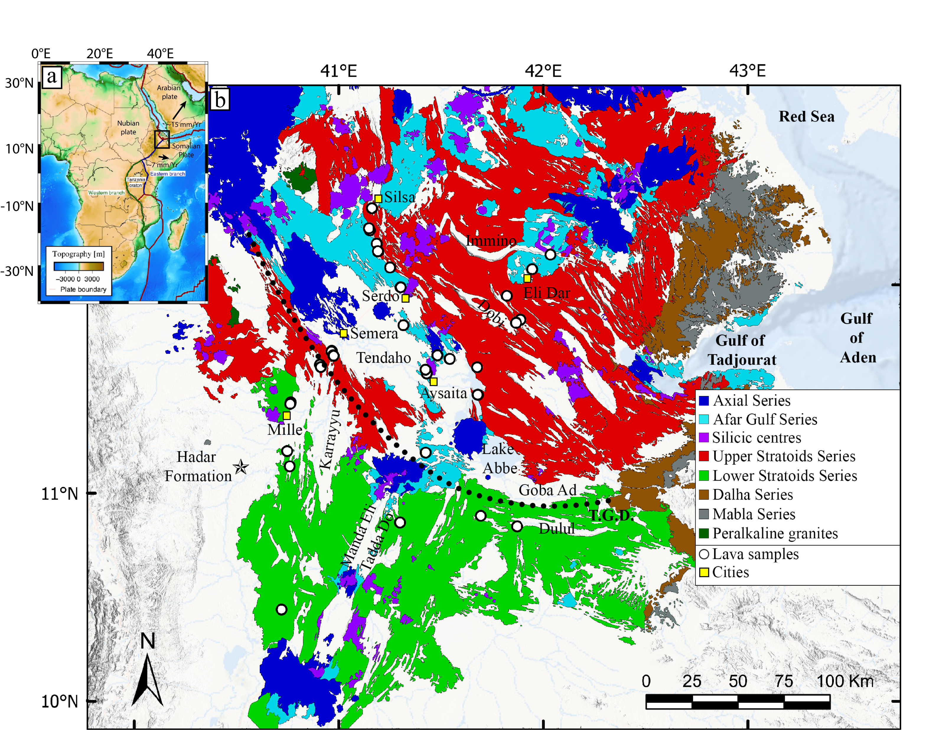
Geological background and aim
The Stratoid and Afar Gulf mafic products range from ~4.5 - 0.6 Ma over an area of ~55.000 km²
Based on age and morphology distinguished in: Lower Stratoids (4.5-2.6 Ma) Upper Stratoids (2.6-1.1 Ma) Central Afar Gulf (CAG) (1.1 - 0.6 Ma)
Transitional to subalkaline magmas
Mixture of Afar plume, depleted mantle, and sub-continental lithospheric mantle
Aim
Unravel the petrological and geochemical variations in order to interpret the evolution of the Red Sea rift branch
Tortelli et al. (G3, Under Review)

Slide 3
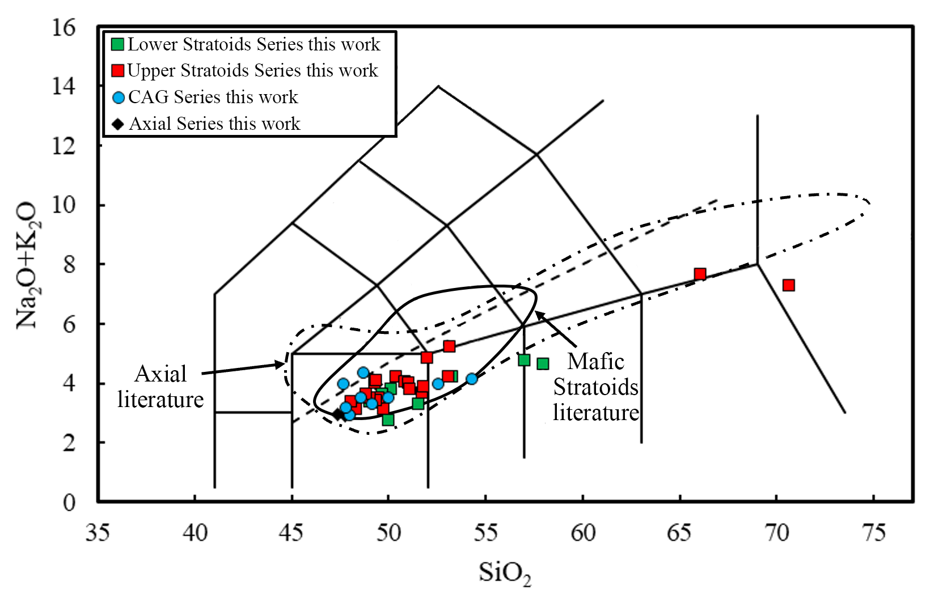
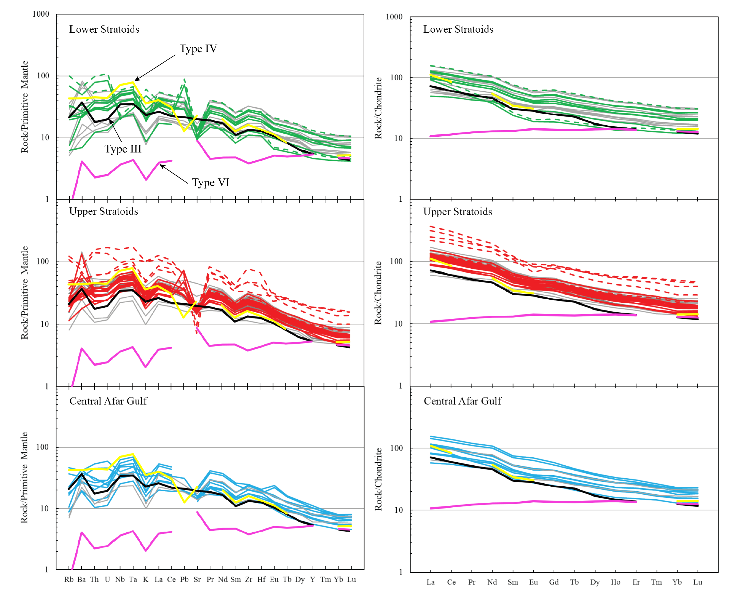
Results
Stratoids and CAG are subalkaline, with transitional to tholeiitic affinity
Enriched-MORB
Incipient lithosphere thinning according to type III and IV of Rooney (2020) classification
Amphibole in the mantle source
Tortelli et al. (G3, Under Review)

Slide 4
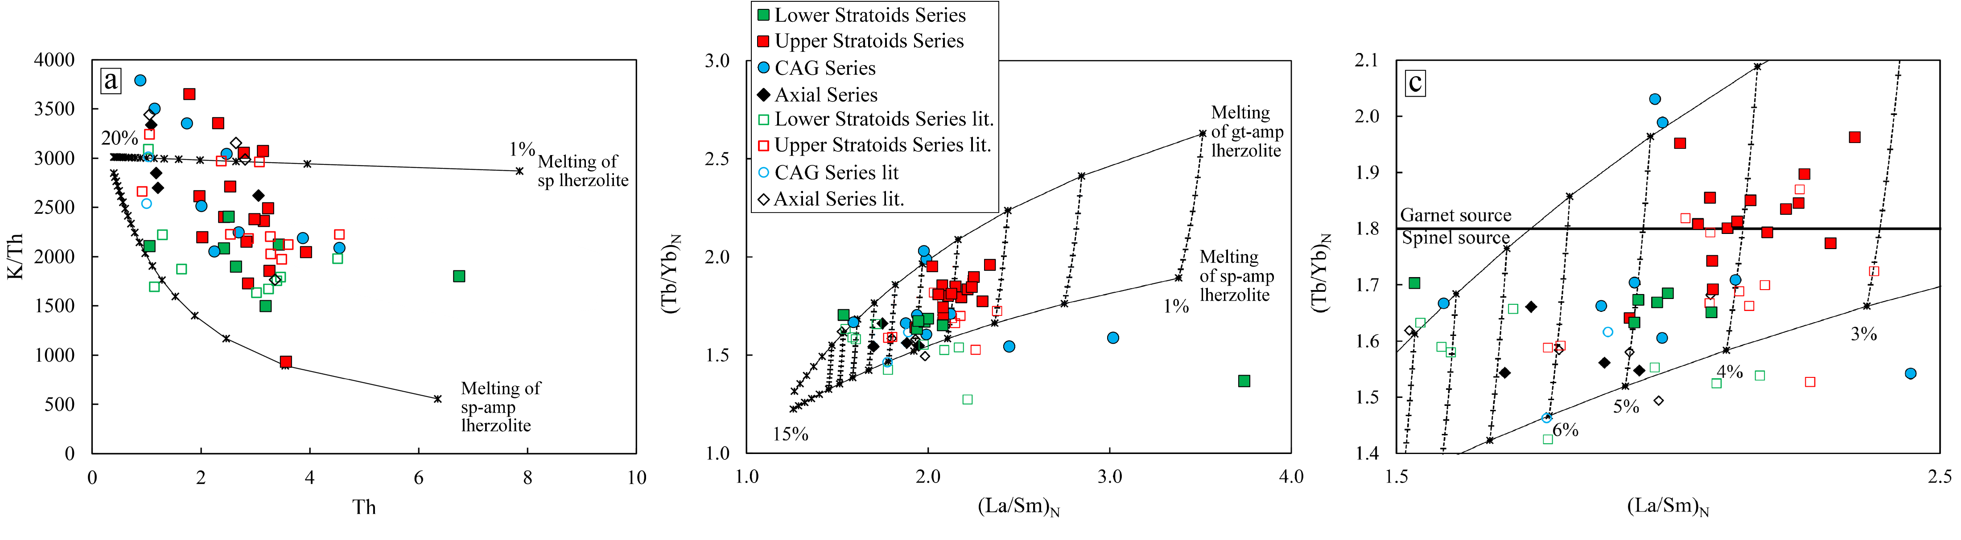
Tortelli et al. (G3, Under Review)
Lower Stratoids, Upper Stratoids and CAG: Residual amphibole in the mantle source
Upper Stratoids: ~4% partial melting 70-50% garnet-bearing mantle source
Lower Stratoids and CAG: ~5% partial melting 50-80% spinel-bearing mantle source
Amphibole metasomatism of the SCLM
Deeper melting column
Shallower melting column

Slide 5
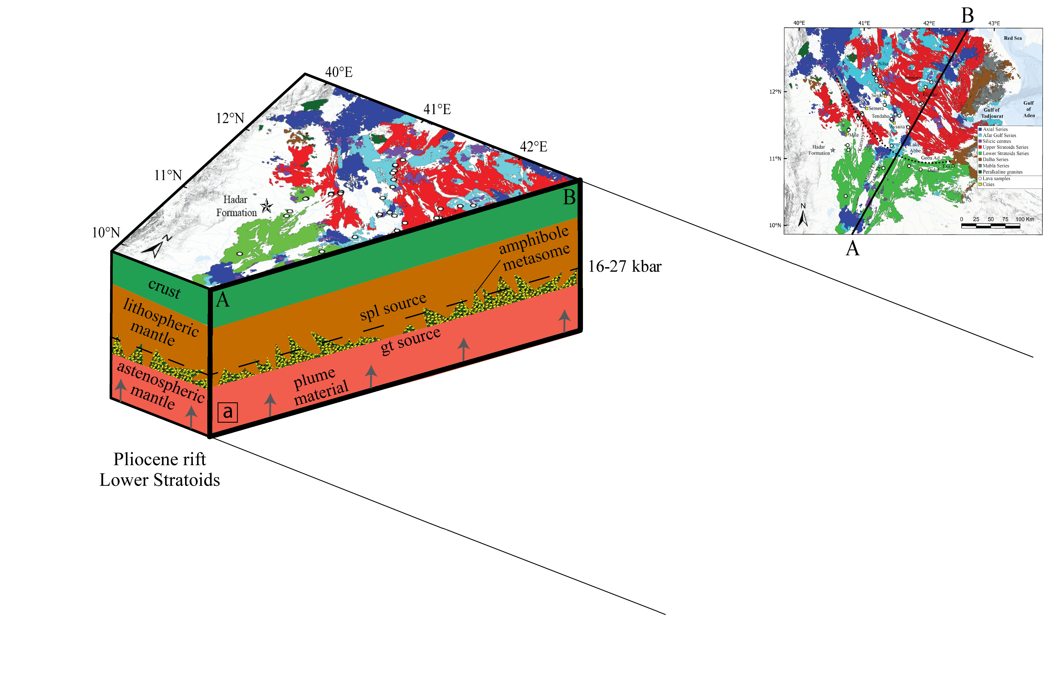
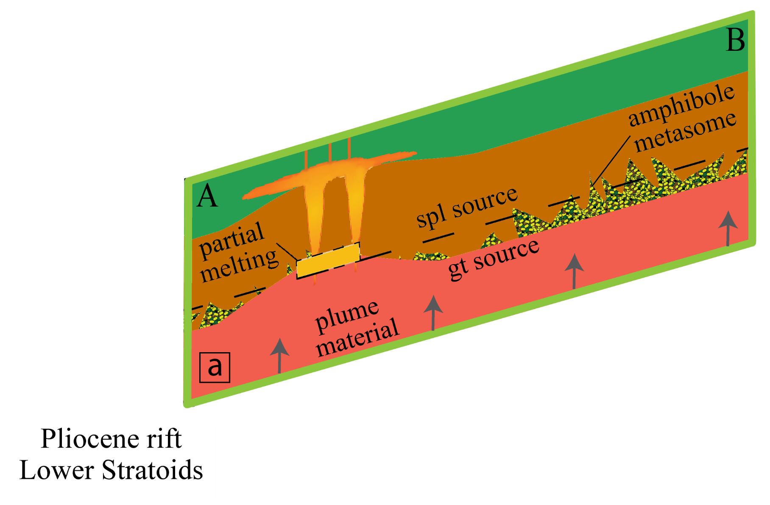
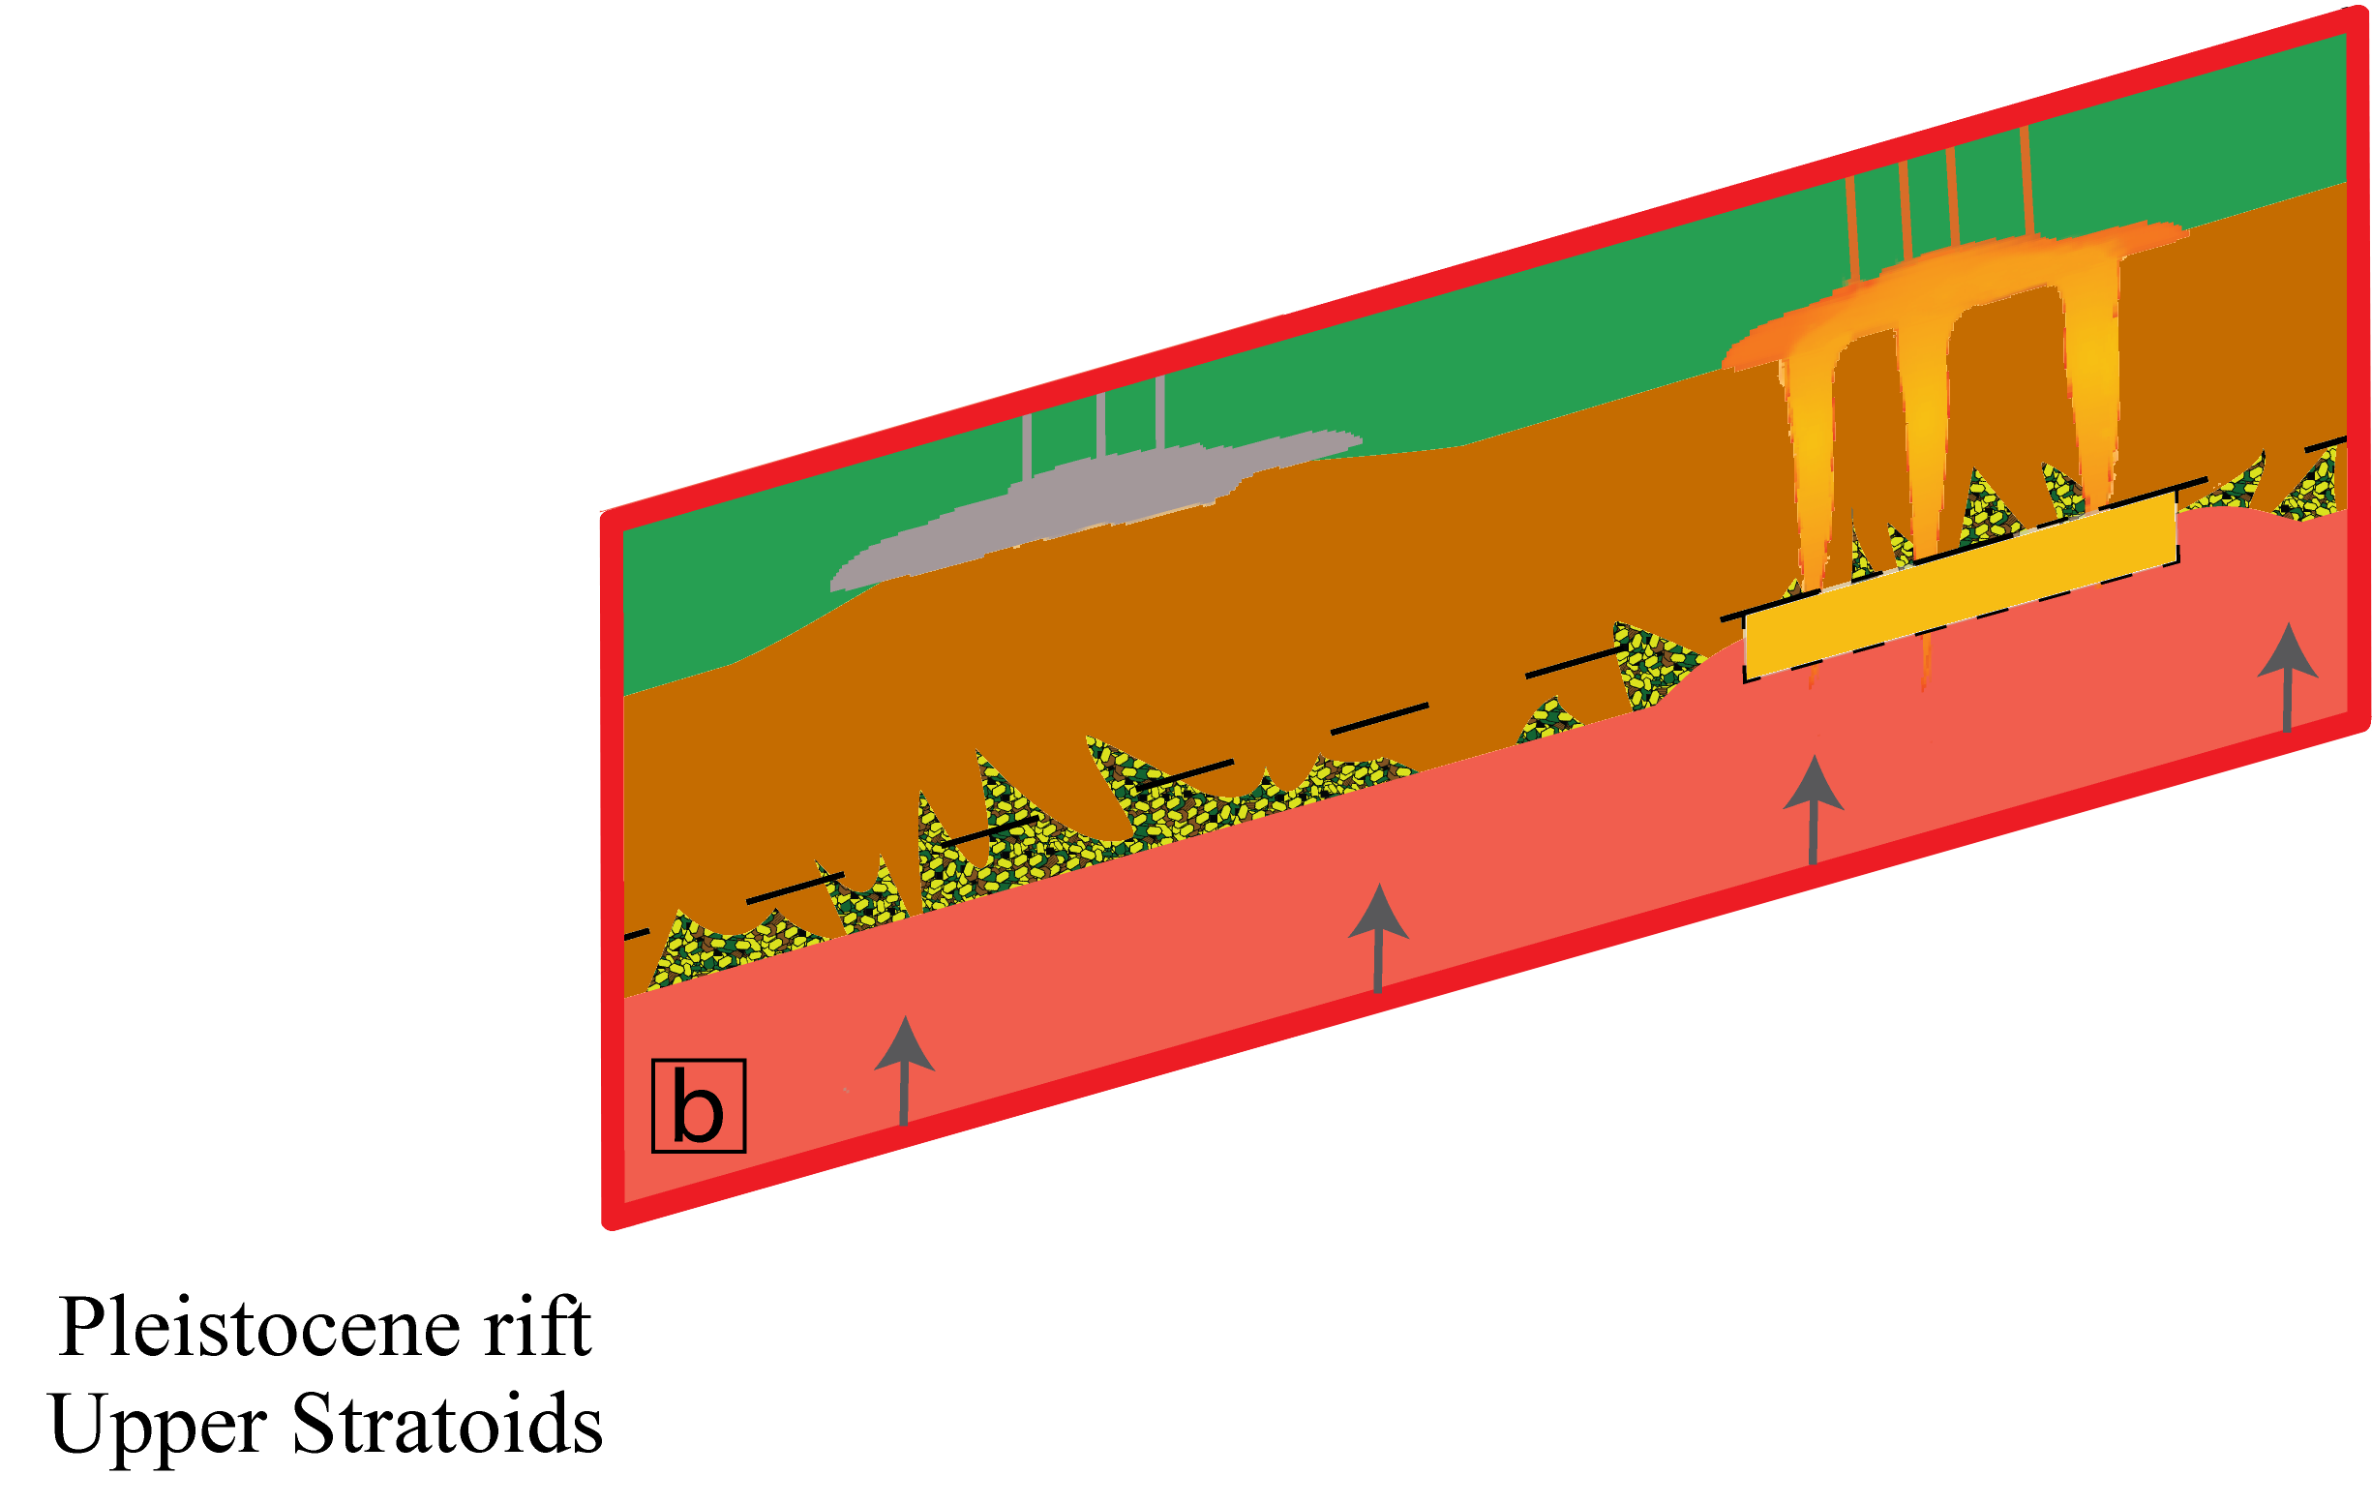
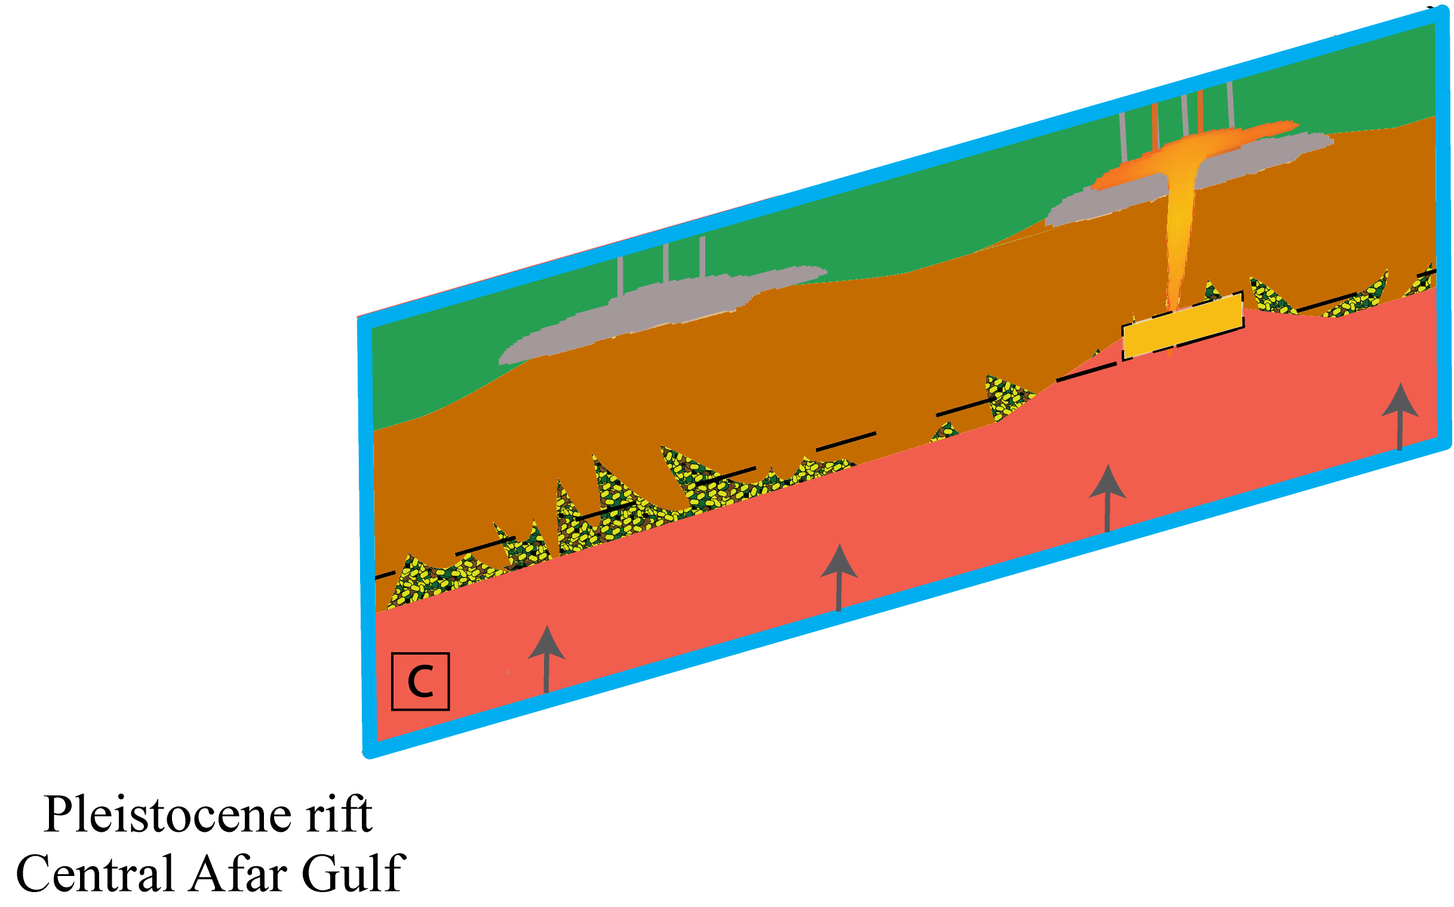
Conclusion
Amphibole-bearing SCLM
Pliocene rift (4.5-2.6 Ma) Lower Stratoids
Focalised strain in Southern Afar
Pleistocene rift (2.6-1.1 Ma) Upper Stratoids
No focalised strain in Central Afar
Pleistocene rift (1.1-0.6 Ma) Central Afar Gulf
Focalised strain in central Afar
Extensional processes can exert a fundamental control on the spatial and chemical variations of the recent flood basalt volcanism in Afar
Tortelli et al. (G3, Under Review)

Slide 6
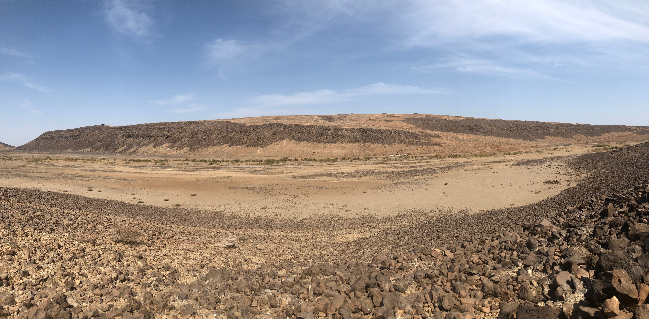
Thanks for your attention

Slide 8
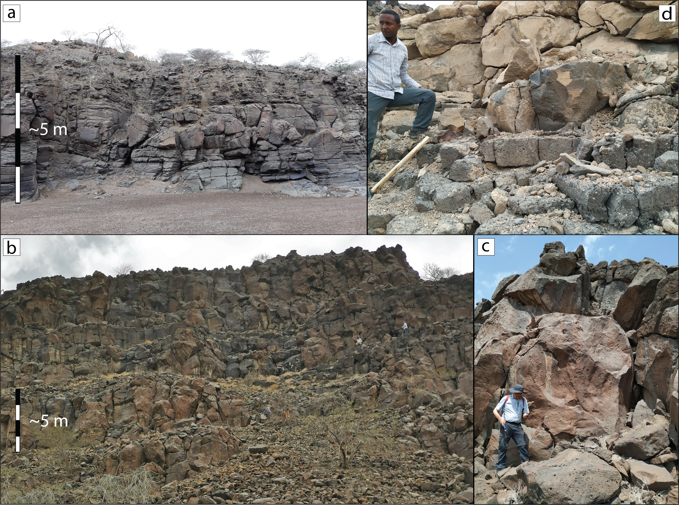

Slide 9
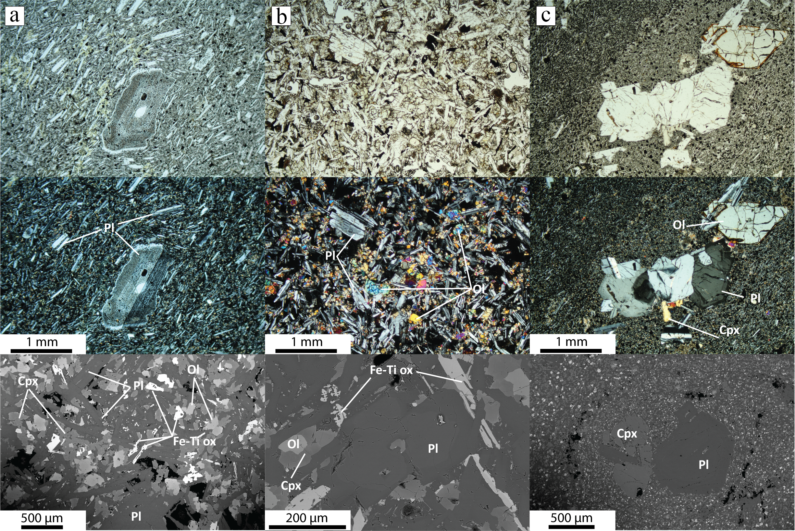

Slide 10
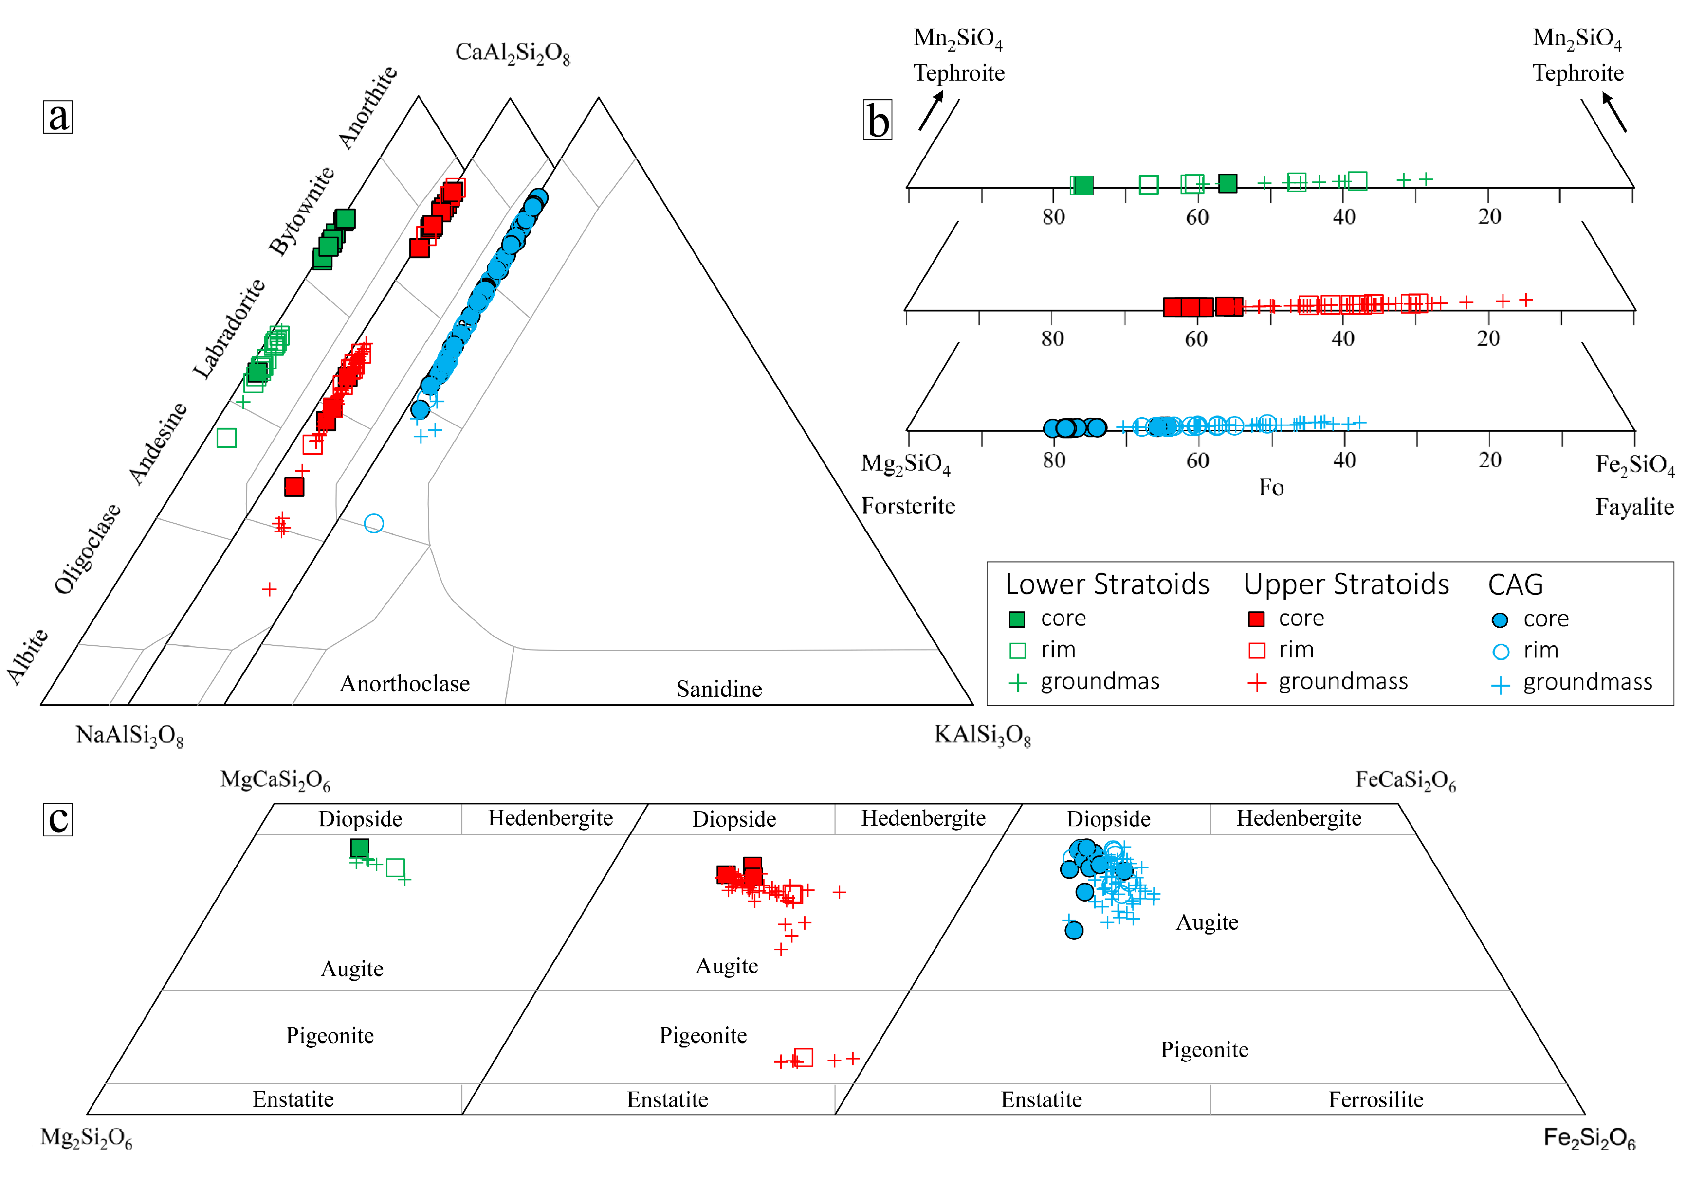

Slide 11
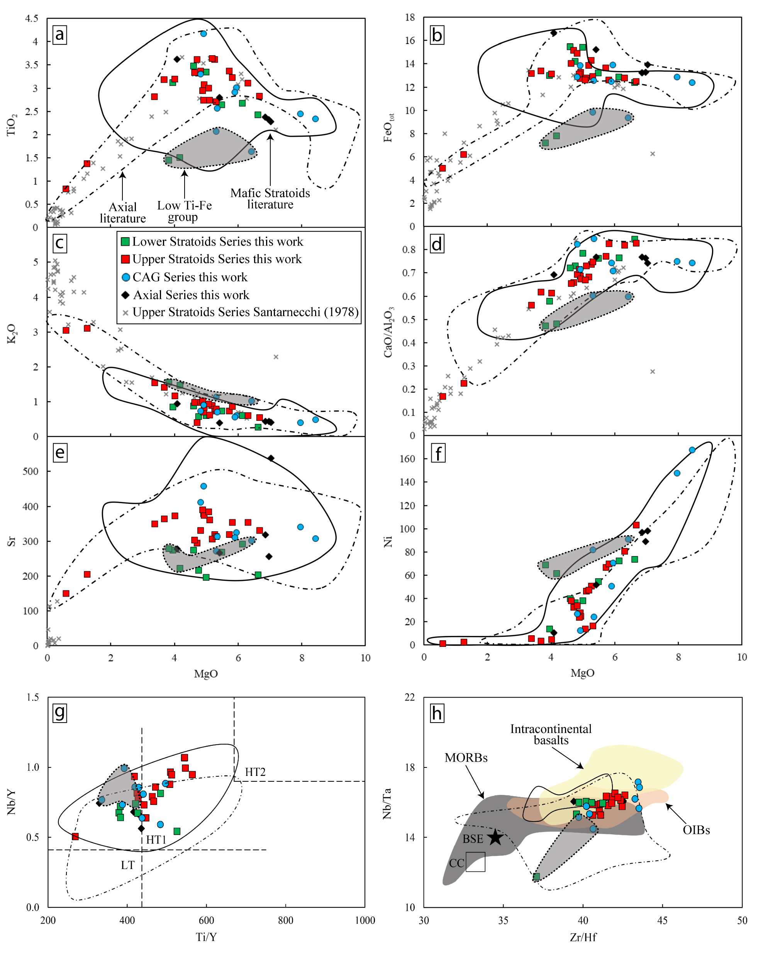
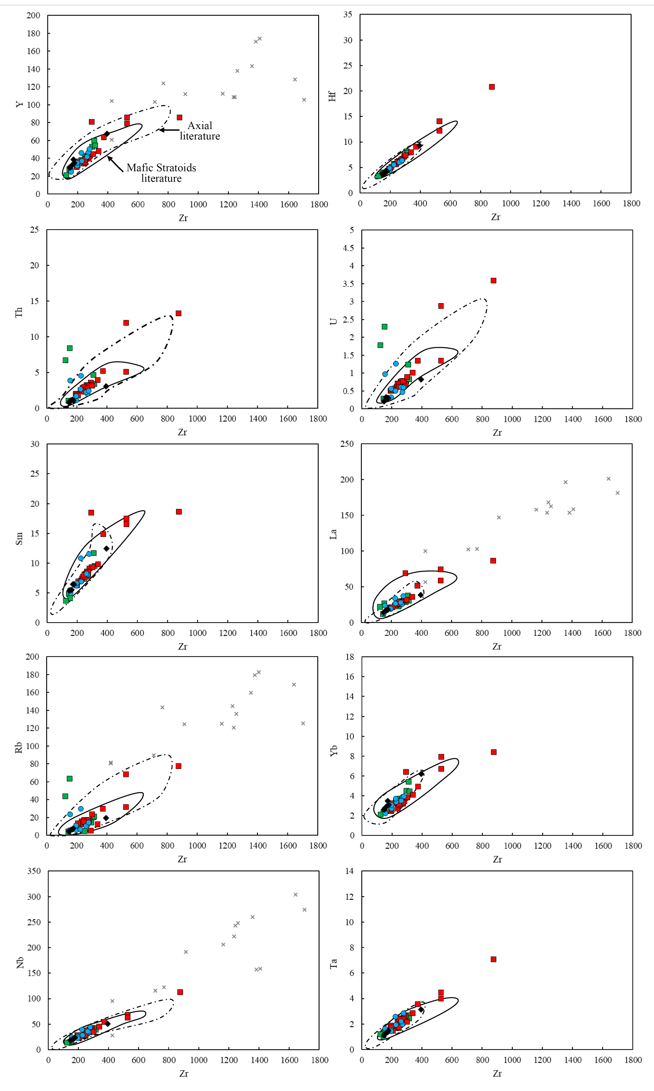

Slide 12
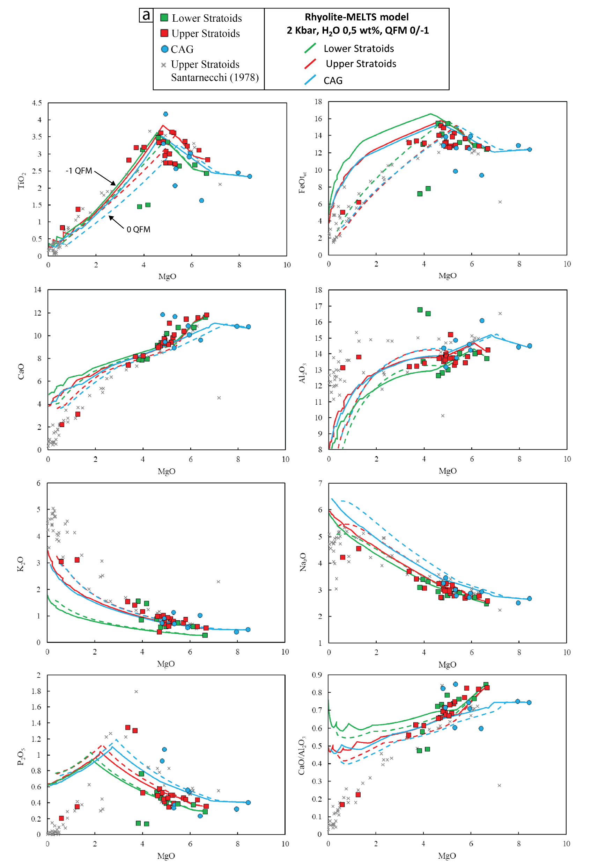
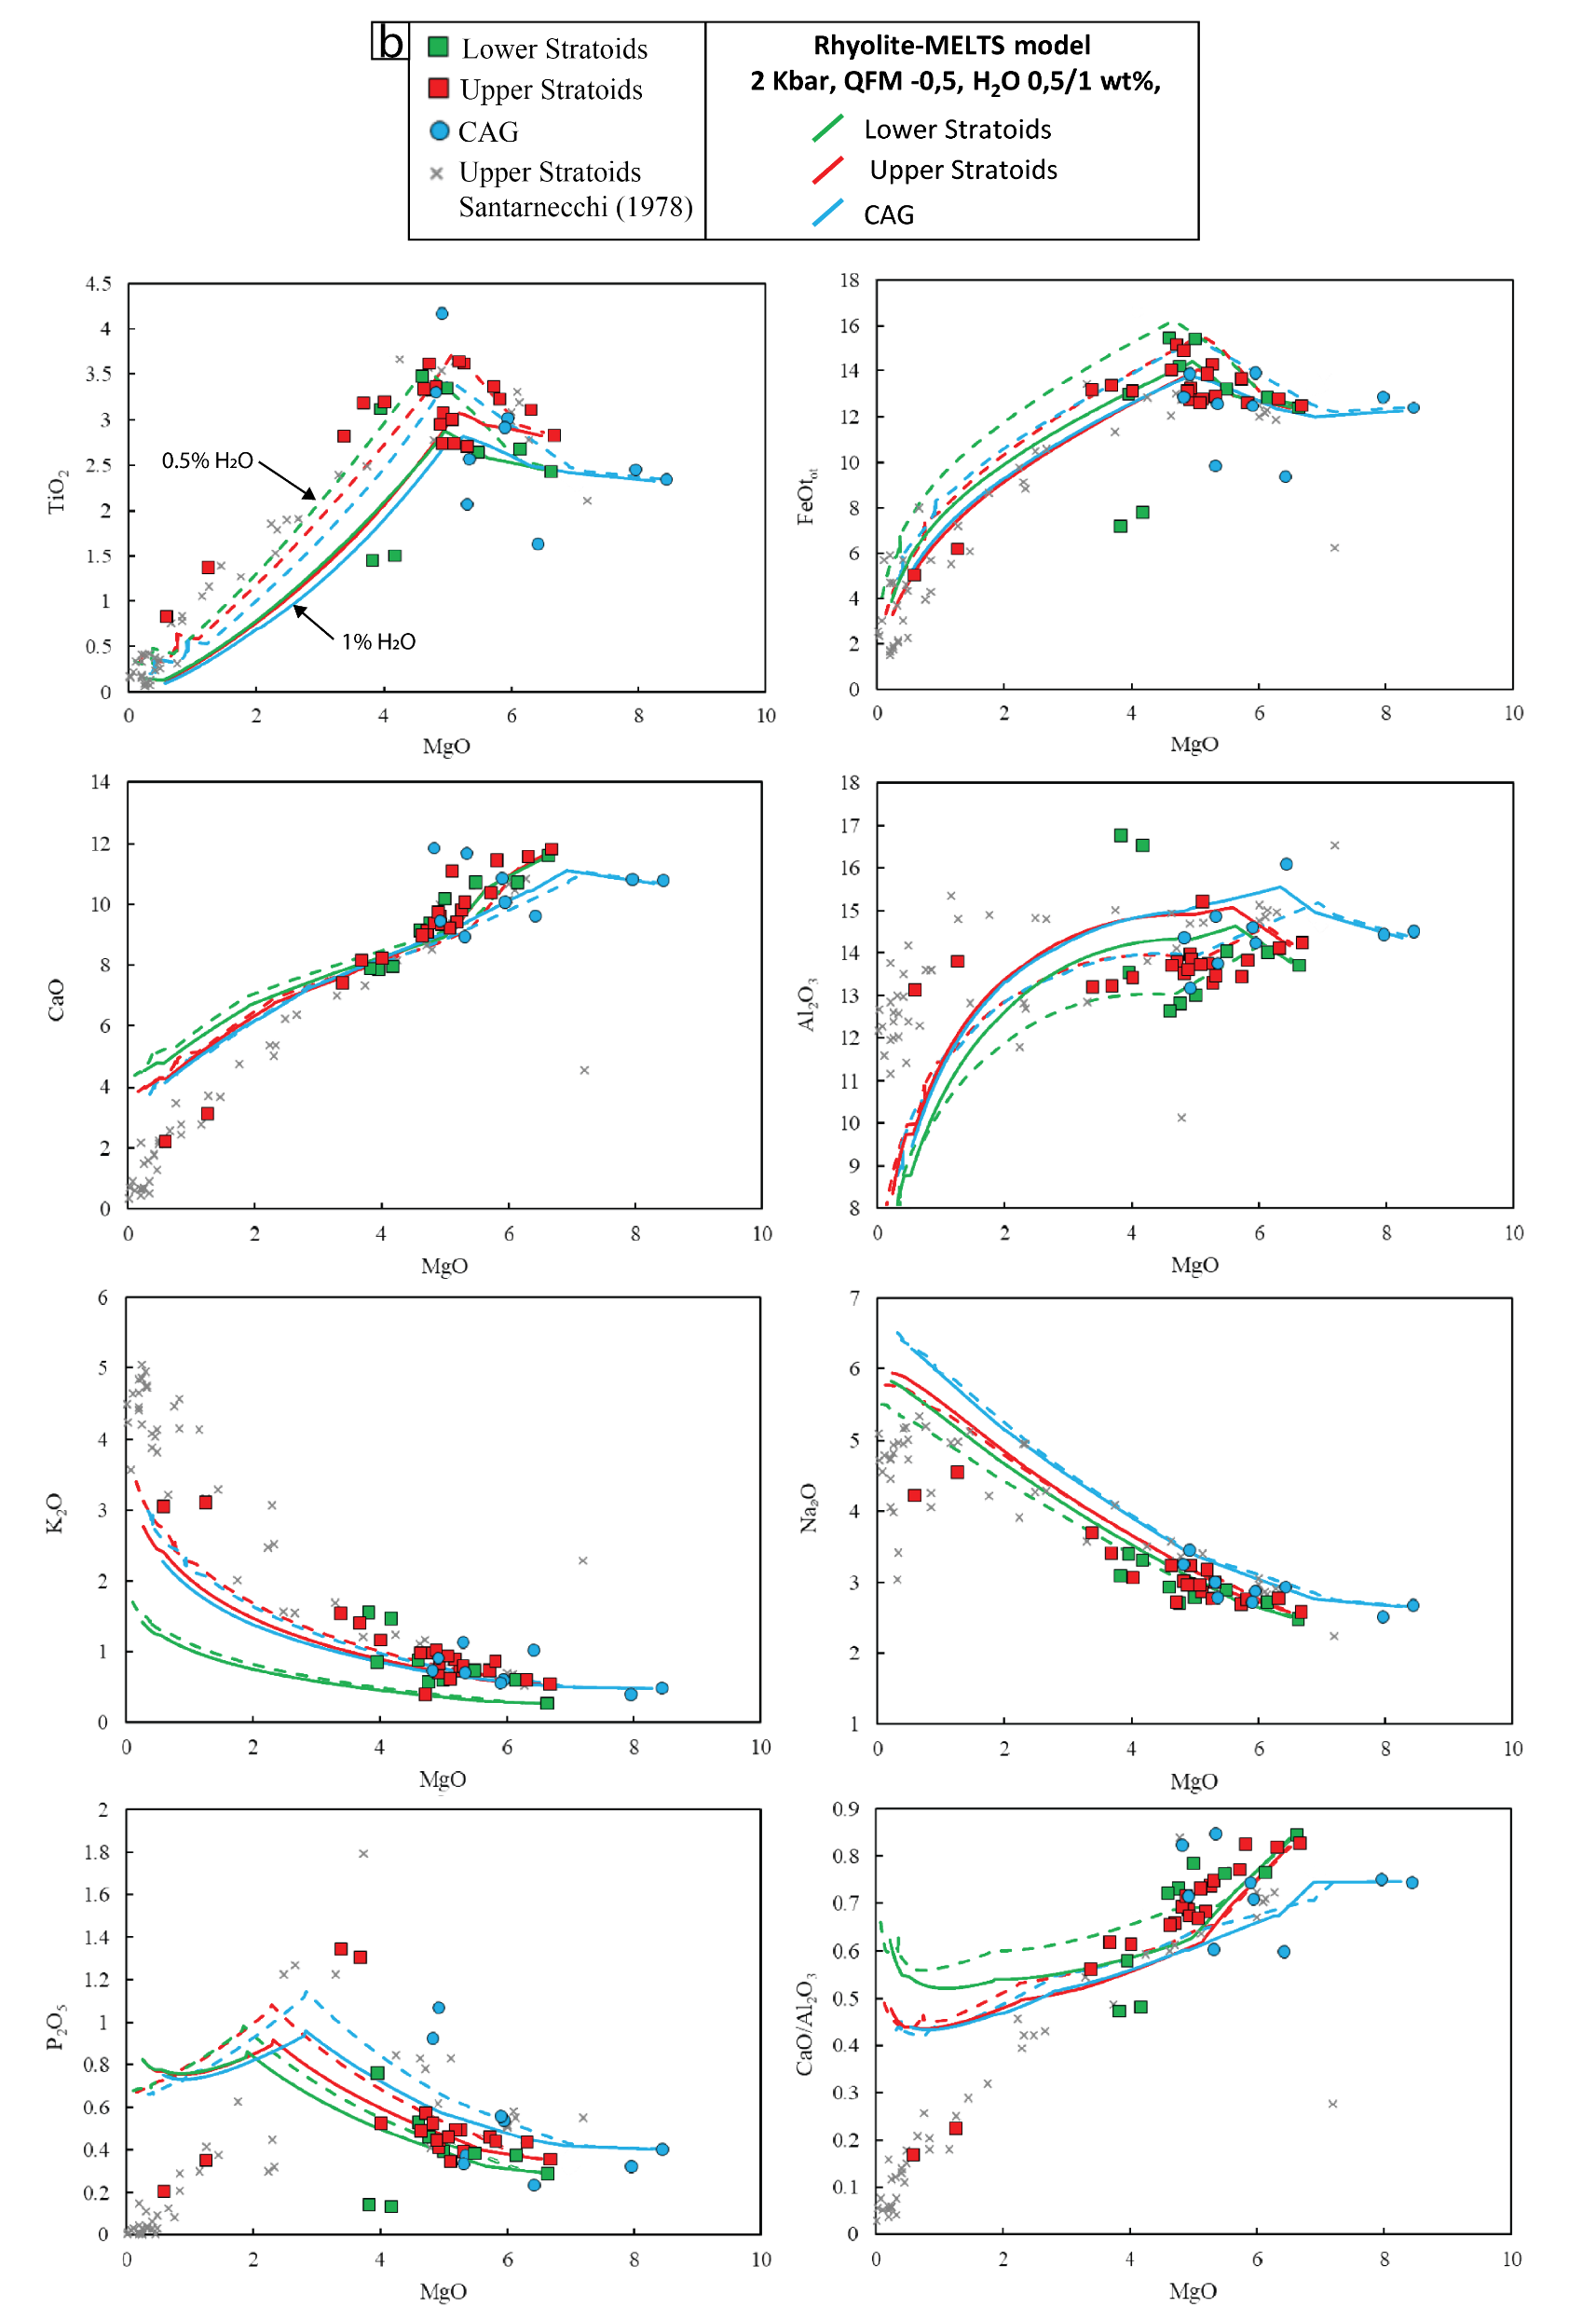
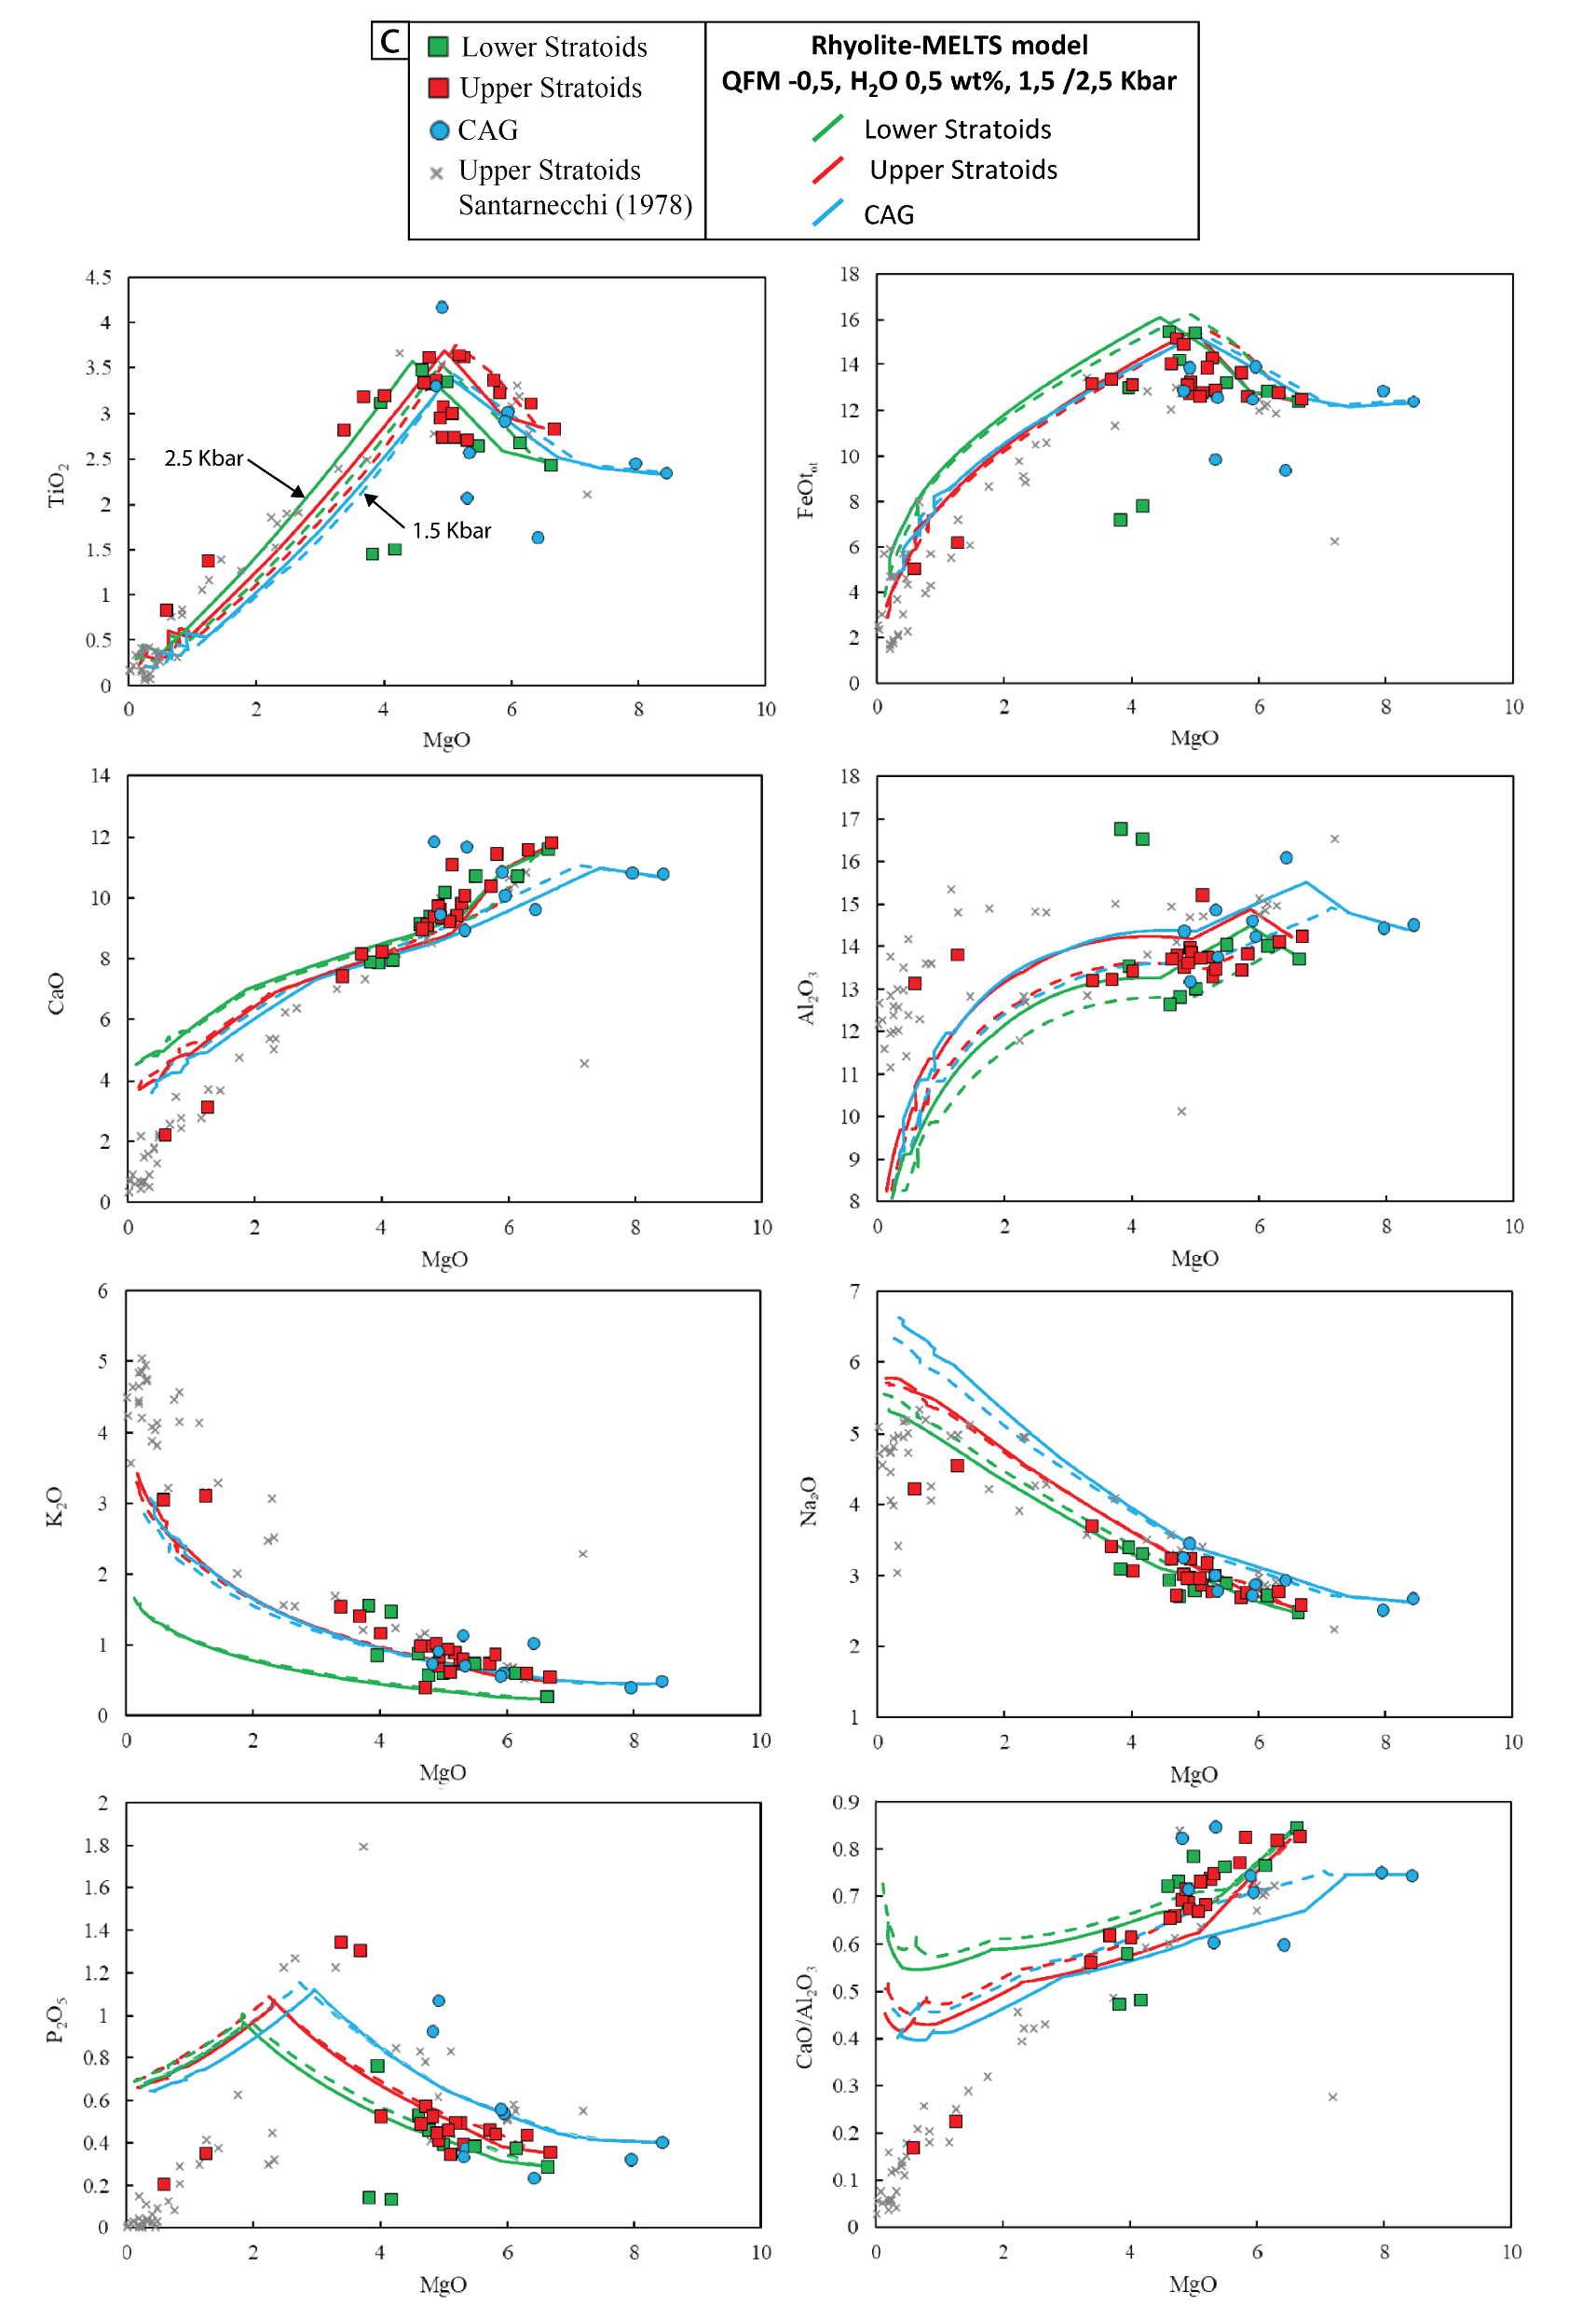

Slide 13
