Slide 1
Magnetosheath Jets at the Magnetopause
EGU 2022 – Display Materials
Adrian T LaMoury¹, Heli Hietala¹, Jonathan P Eastwood¹, Laura Vuorinen², and Ferdinand Plaschke³
¹Imperial College London, UK, ²University of Turku, Finland, ³TU Braunschweig, Germany

Slide 2
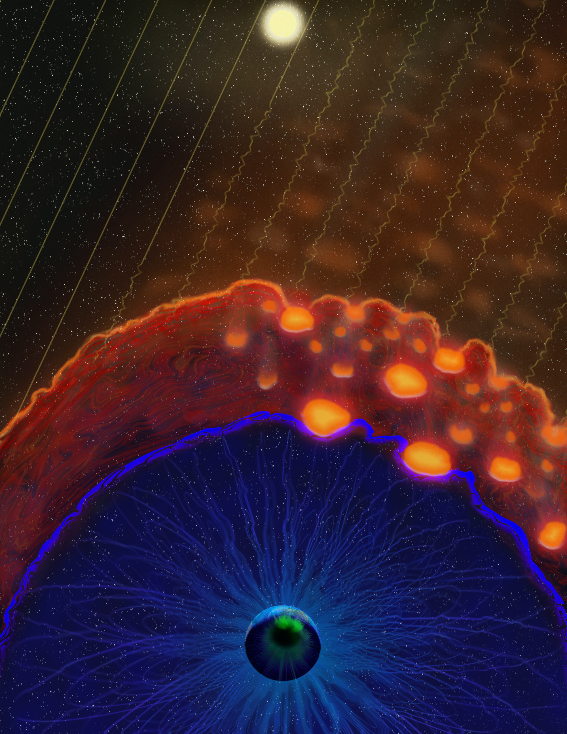
What are Magnetosheath Jets?
Large dynamic pressure pulses in Earth’s magnetosheath
Form at the bow shock and propagate Earthward
Can alter magnetospheric dynamics upon impacting the magnetopause
Most jets dissipate before reaching the magnetopause
Illustration by E. Masongsong

Slide 3
My PhD in Three Questions
How do the solar wind conditions control the number of jets reaching the magnetopause?
What are the properties of jets in the magnetosheath and how suitable are they for triggering magnetopause reconnection?
Does the magnetopause respond to jet impacts as expected?

Slide 4
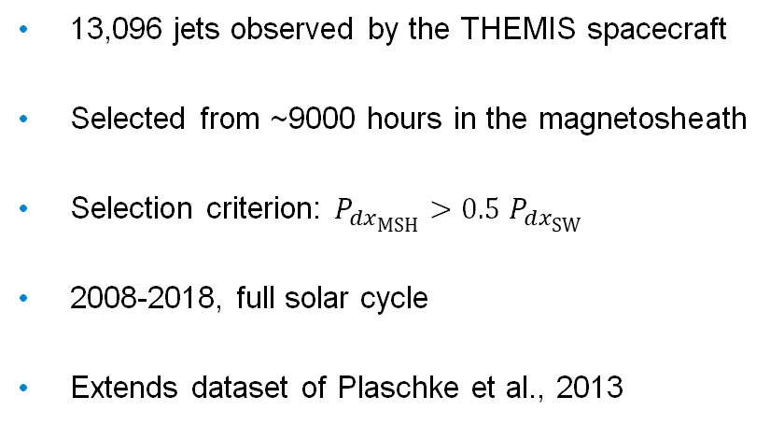
The Data Set
P_{dx}
[nPa]
B
[nT]
13,096 jets observed by the THEMIS spacecraft
Selected from ~9000 hours in the magnetosheath
Selection criterion: $P_{dx\text{MSH}}>0.5{ P}_{dx\text{SW}}$
2008-2018, full solar cycle
Extends dataset of Plaschke et al., 2013
density
[cm⁻³]
V_{i}
[km/s]
T_{i}
[eV]
ion energy flux [eV]

Slide 5
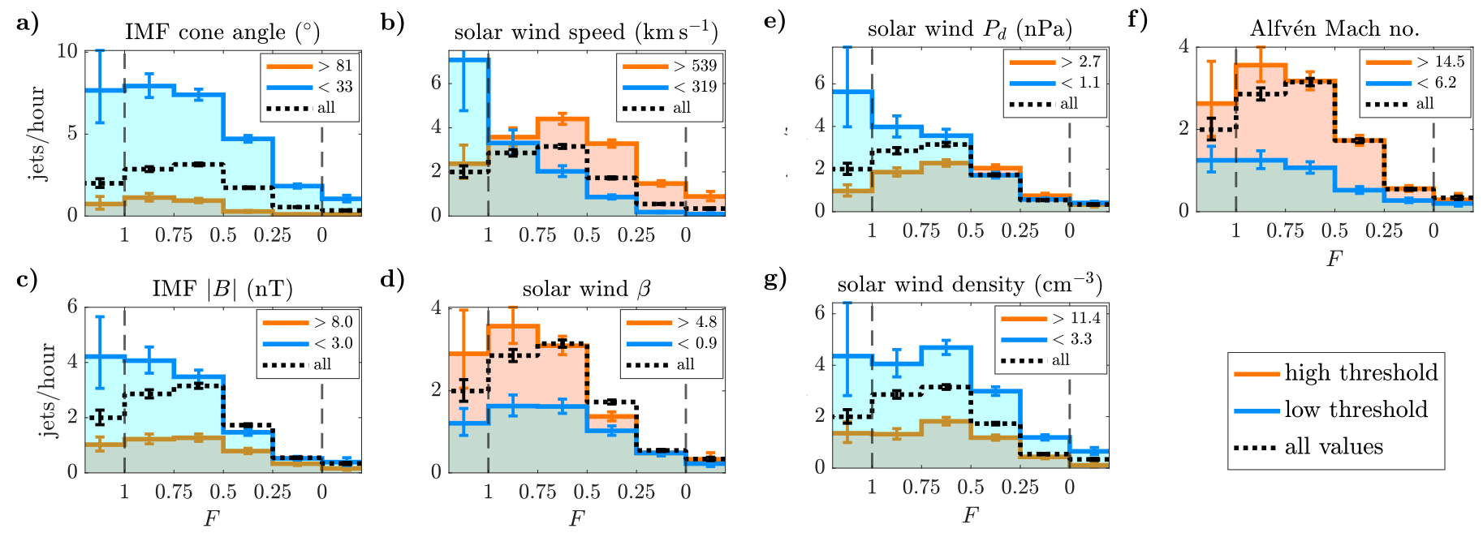
Solar Wind Control of Jets Reaching the Magnetopause
LaMoury et al., 2021

Slide 6
Implications
Formation and propagation effects are independent.
Jets are most likely to hit the magnetopause during fast-type solar wind.
May have interesting implications for solar wind transients, e.g. CMEs and SIRs.
We have made a step towards forecasting the rate of jet impacts purely from measurements of the upstream solar wind.
Next: Are jets likely to trigger reconnection at the magnetopause?

Slide 7
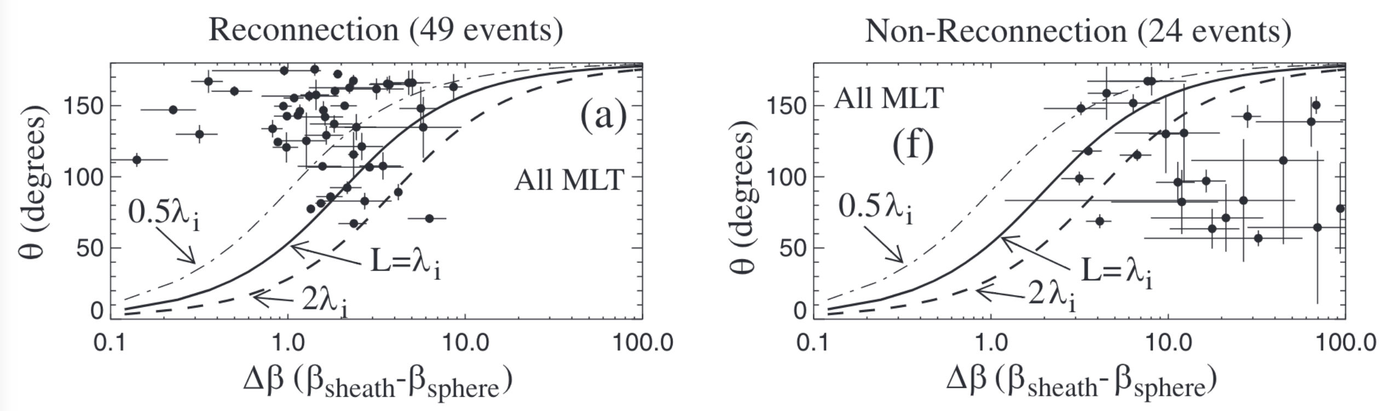
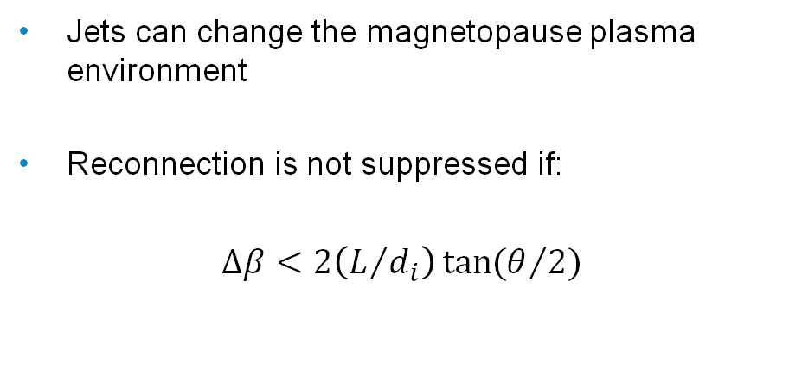
How Can Jets Trigger Reconnection?
Jets can change the magnetopause plasma environment
Reconnection is not suppressed if:
$∆β<2\left(L/{d_{i}}\right)\tan{(θ/{2)}}$
beta asymmetry
magnetic shear angle
Phan et al., 2013

Slide 8
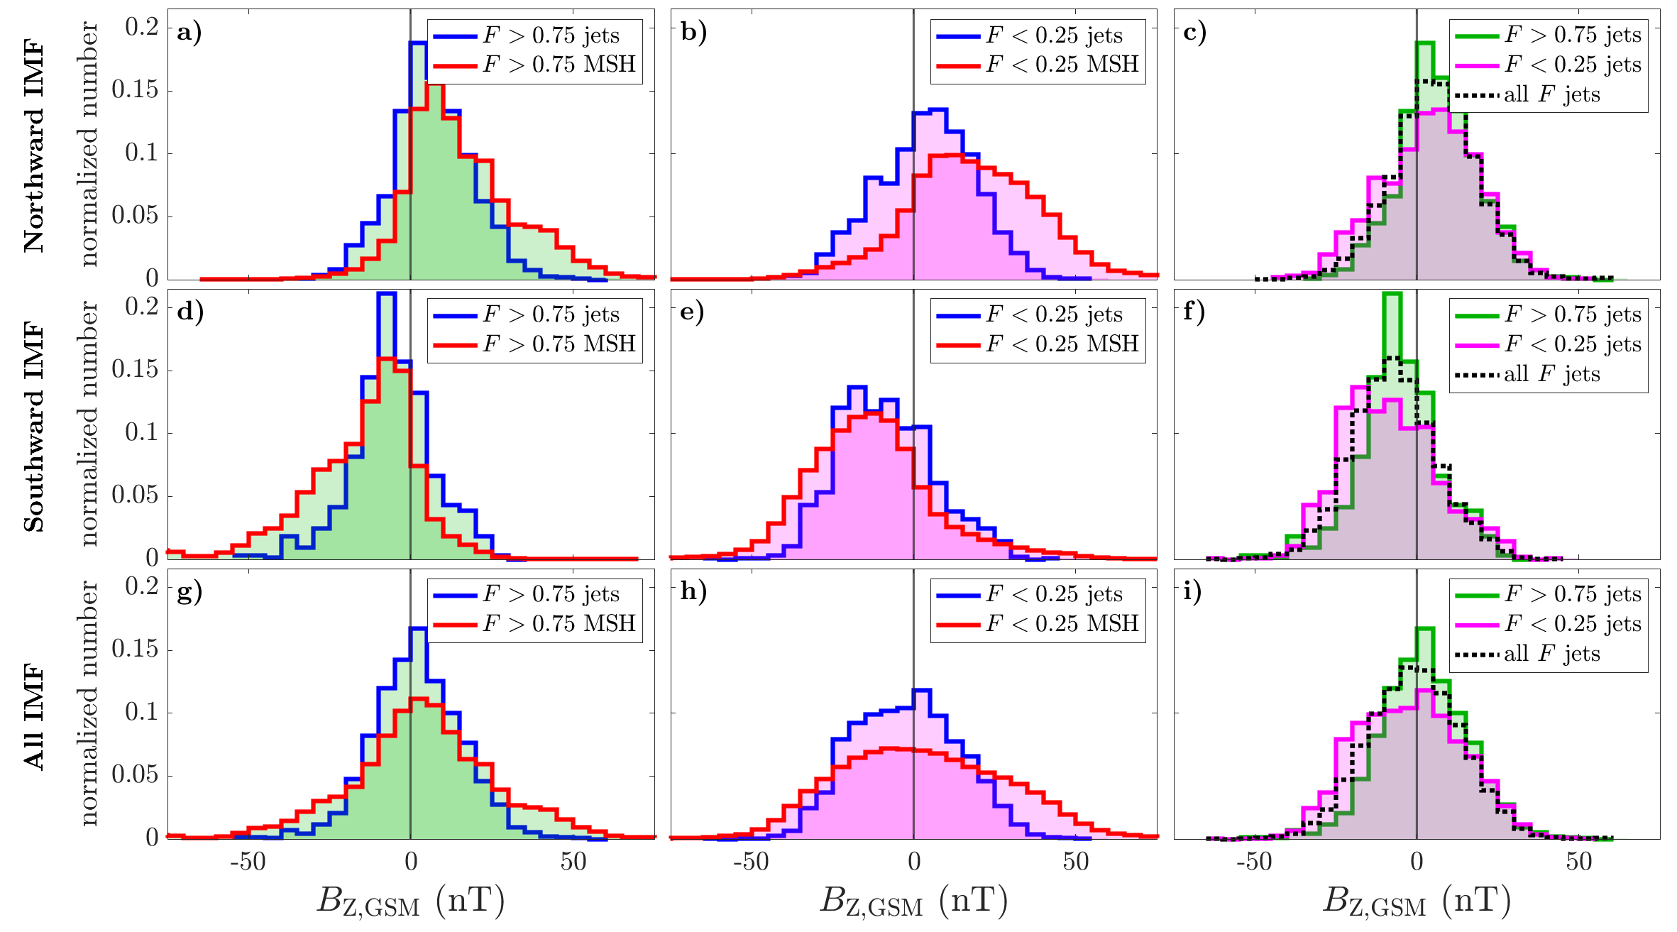
Jet B_{Z}
BS MP
Jets bring southward B_{z} to the magnetopause during northward IMF, more often than the non-jet magnetosheath
Jets may be able trigger reconnection

Slide 9
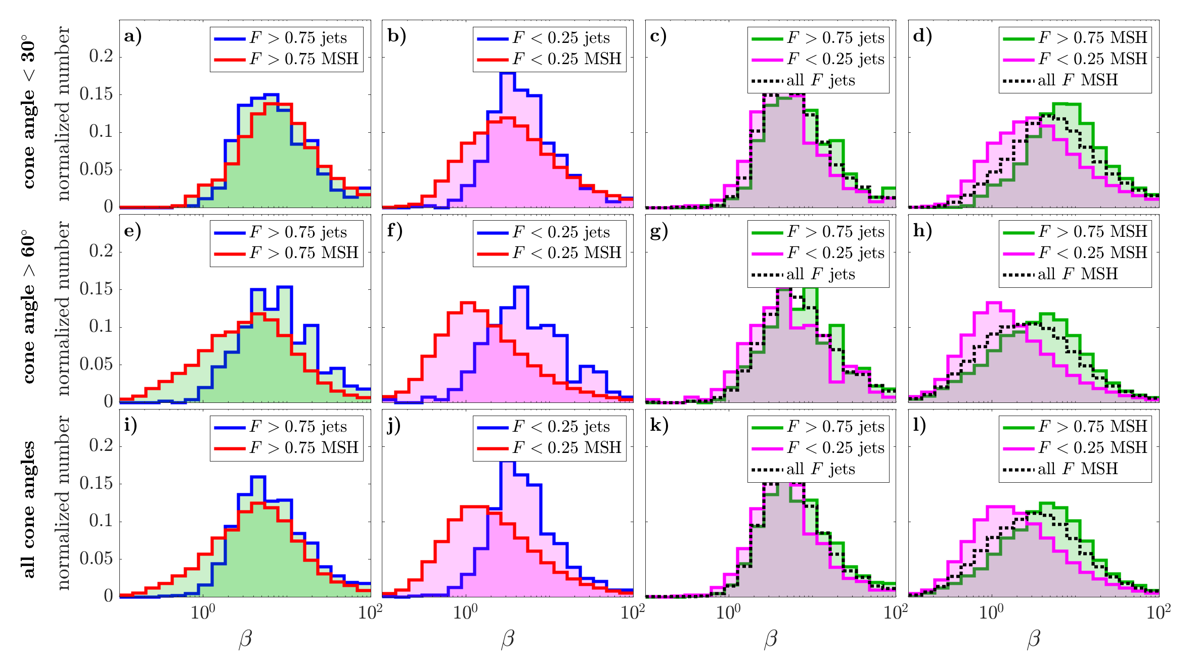
Plasma β
BS MP
Jet β at the magnetopause is typically higher than background
May make reconnection unfavourable

Slide 10
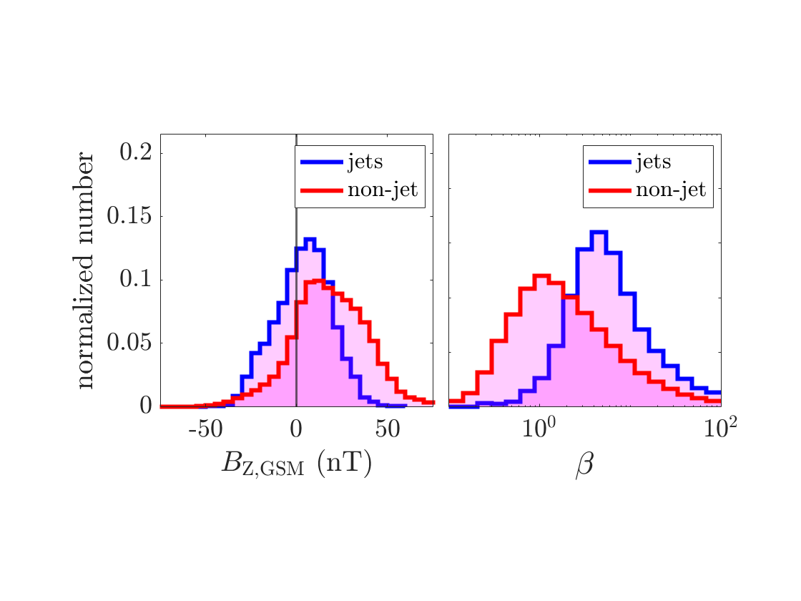
Competing Effects
Jets bring southward B_{Z} to the magnetopause more often than non-jet magnetosheath flow (Vuorinen et al., 2021) – good for reconnection
Jets bring higher β to the magnetopause than the normal magnetosheath flow – bad for reconnection
What is the overall effect on reconnection?

Slide 11
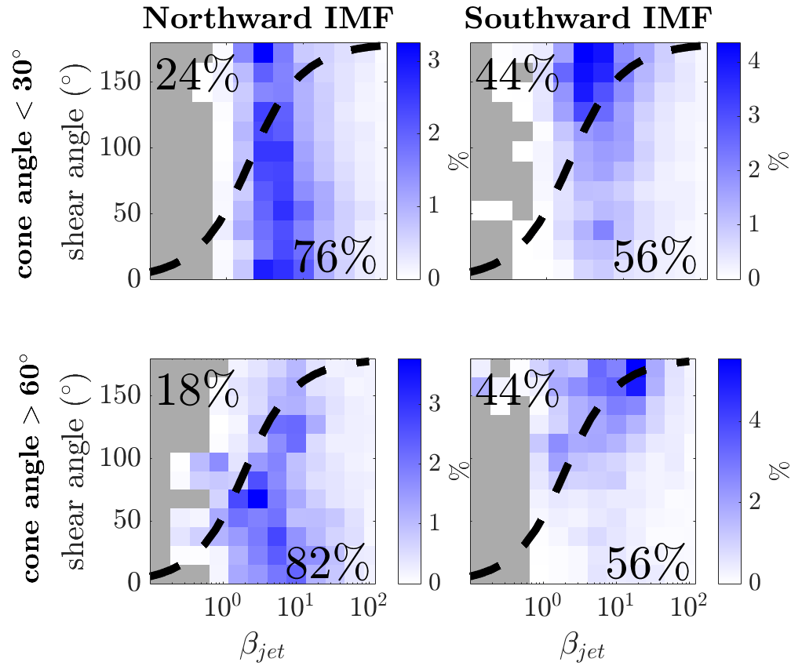
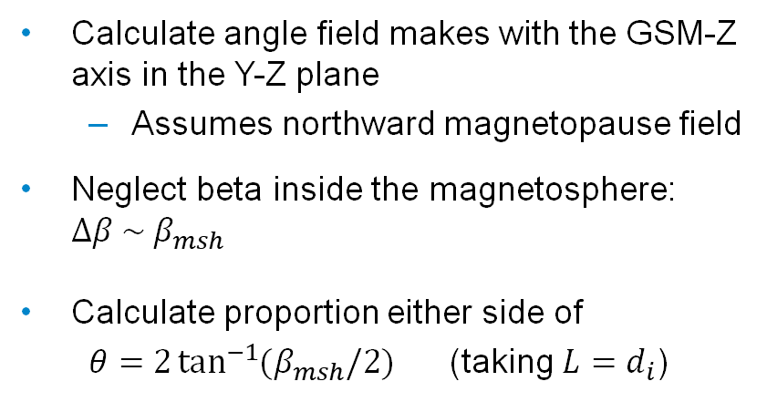
Magnetic Reconnection: β-Shear Dependence
Reconnection allowed
Calculate angle field makes with the GSM-Z axis in the Y-Z plane
  Assumes northward magnetopause field
Neglect beta inside the magnetosphere: $∆β \sim β_{msh}$
Calculate proportion either side of
$θ=2\tan^{−1}{(β_{msh}/2})$ (taking $L=d_{i}$)
Reconnection suppressed

Slide 12
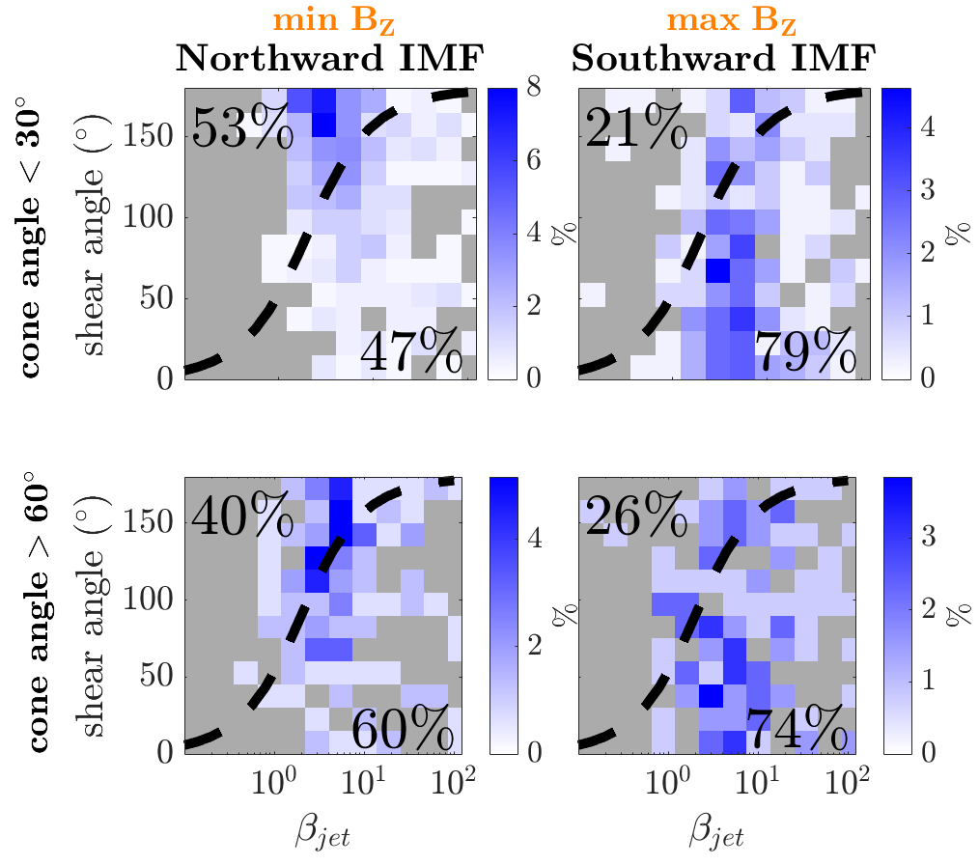
Extreme Cases
Moment of minimum Bz from each jet during northward IMF – jets most likely to trigger reconnection when it’s not typically expected
Moment of maximum Bz from each jet during southward IMF – jets most likely to suppress ongoing reconnection

Slide 13
Summary
Despite jet B_{Z} being generally favourable for reconnection, high jet beta means that the majority of jet plasma is unfavourable for reconnection
~50% of jets contain some reconnection-favourable plasma during northward IMF
~75% of jets contain some plasma that could suppress ongoing reconnection during southward IMF
Next: Does the magnetopause respond as expected?

Slide 14
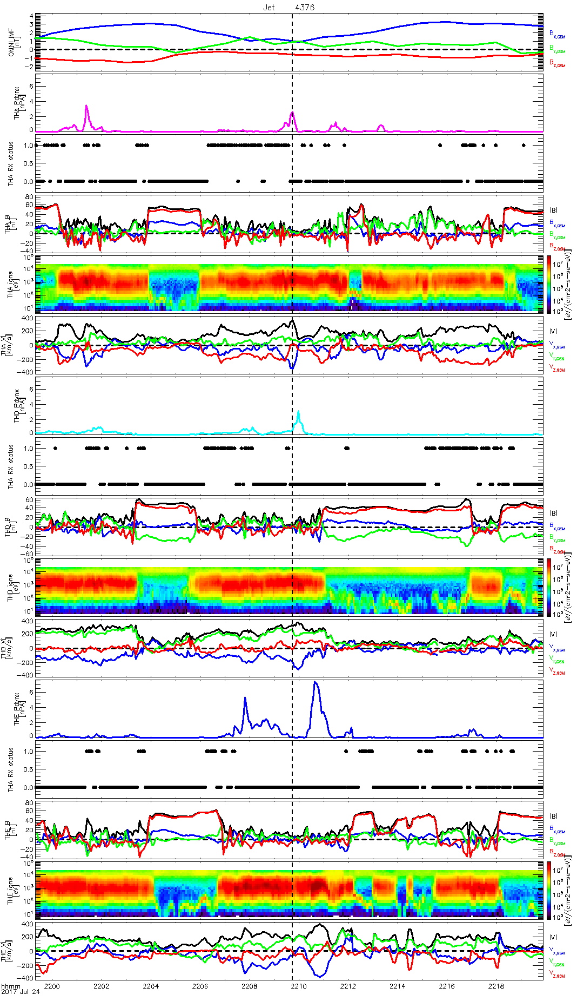
Future: How does the Magnetopause Respond?
Jets
Do we expect reconnection?
Magnetopause crossings
Find instances of jets impacting the magnetopause with nearby crossings
Build a series of case studies
Determine jet influence on reconnection and compare with expectation

