Slide 1
Modeling the Impact of Paleogeography on Cretaceous Ocean Deoxygenation
Nina M. Papadomanolaki,
Yannick Donnadieu, Marie Laugie, Anta-Clarisse Sarr, and Jean-Baptiste Ladant

Slide 2
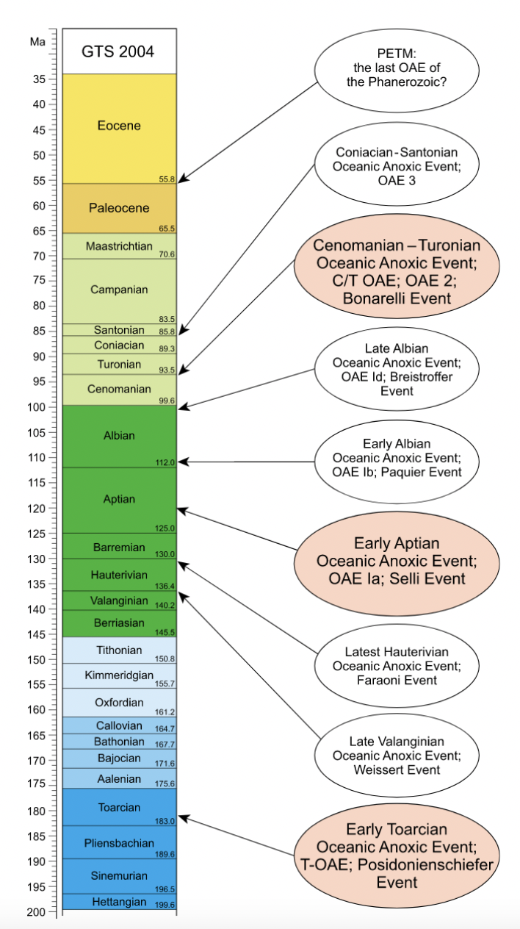
?
The Mesozoic Era was characterized by multiple deoxygenation events.
→ Did paleogeographic configuration precondition the ocean?
After Jenkyns, 2010
Notes:
During the Mesozoic Era shallow seas and parts of the open ocean experienced low to no oxygen conditions. These events generally occurred under greenhouse conditions, but some were more widespread than others. Since the Mesozoic, despite intervals with high CO2 still occuring, there is no evidence for similar events. The PETM may have been a failed OAE, with widespread but much less severe deoxygeation.
We want to know in how far the paleogeography and changes in circulation during specific timeperiods of the Mesozoic may have preconditioned the ocena for the occurrence of OAEs.

Slide 3
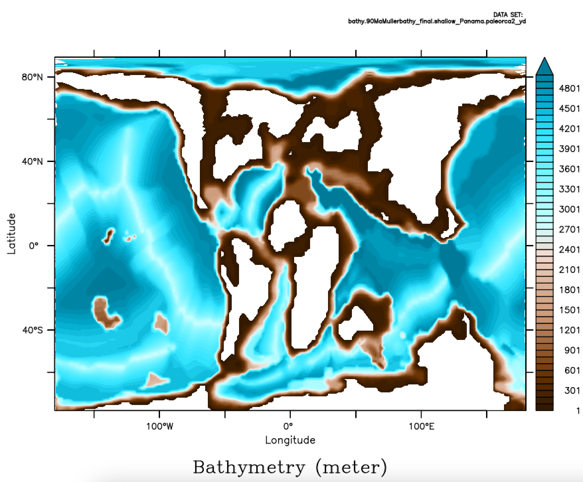
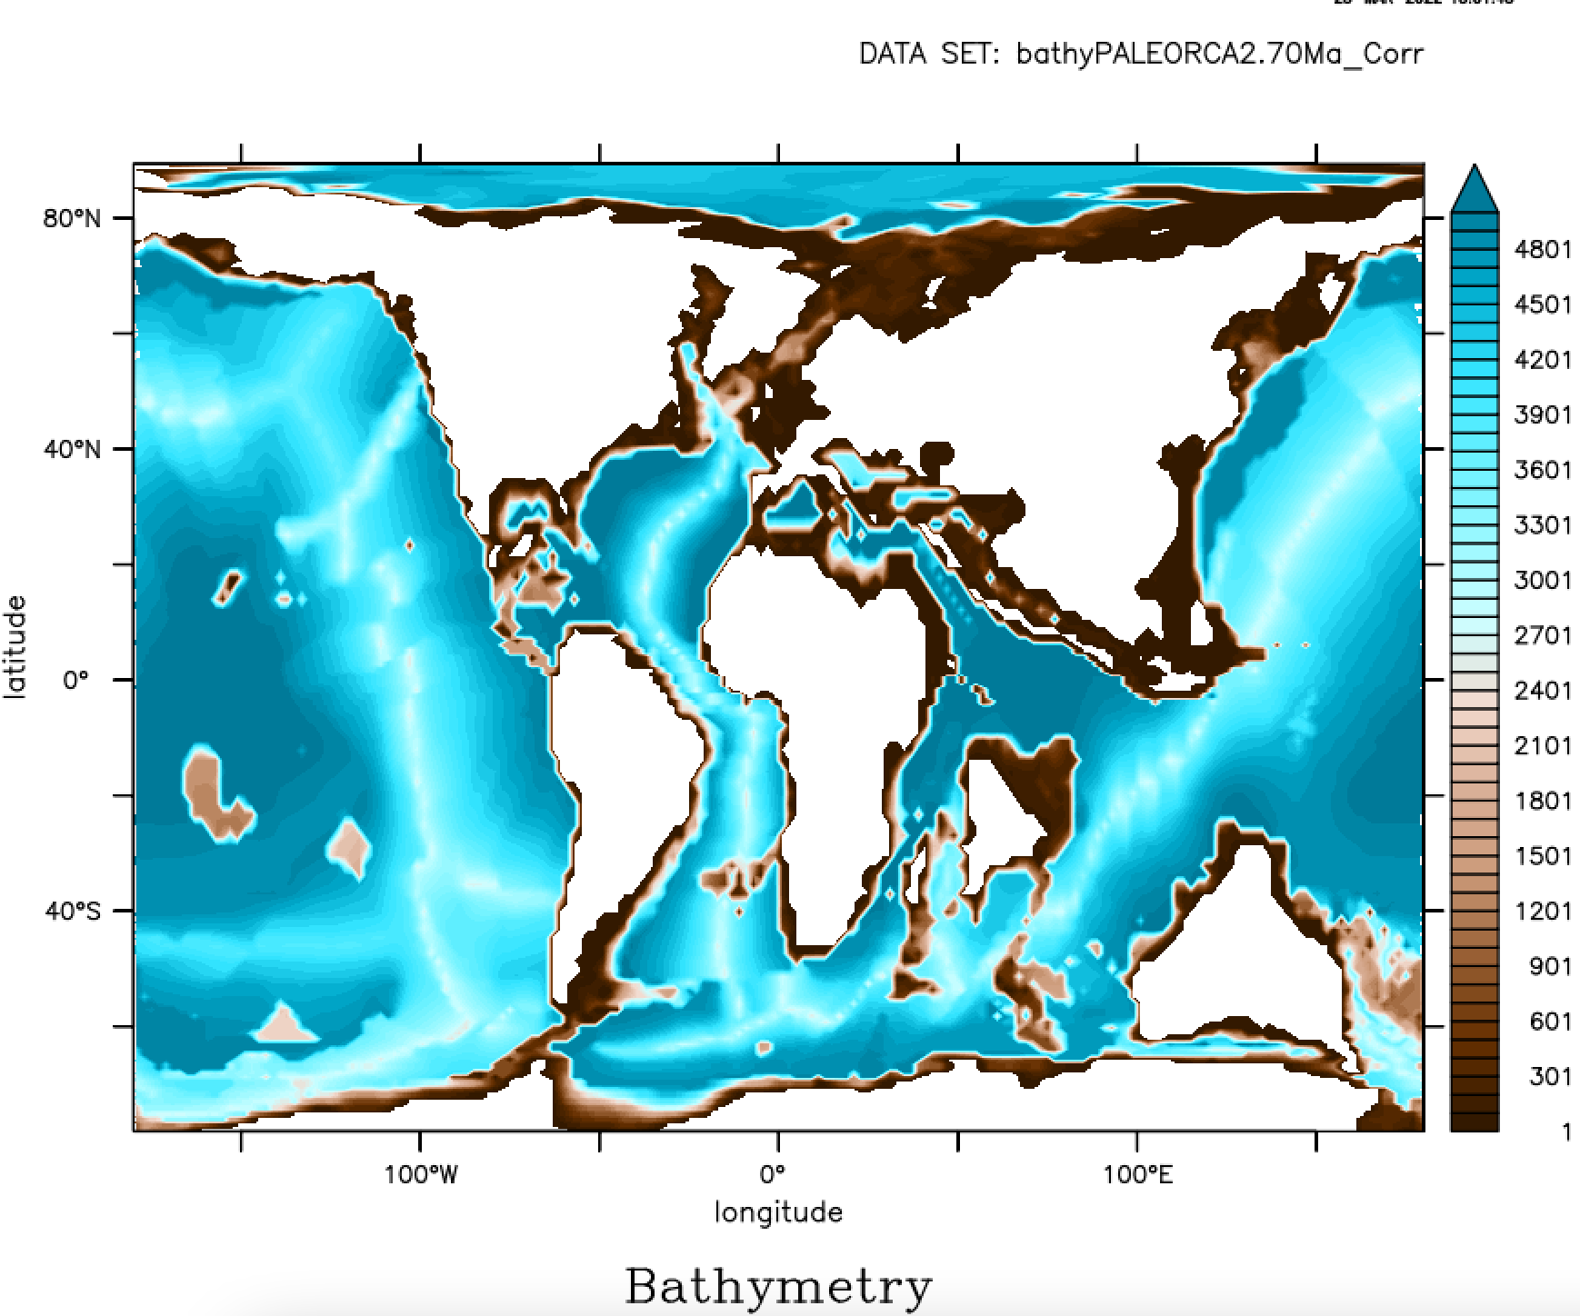
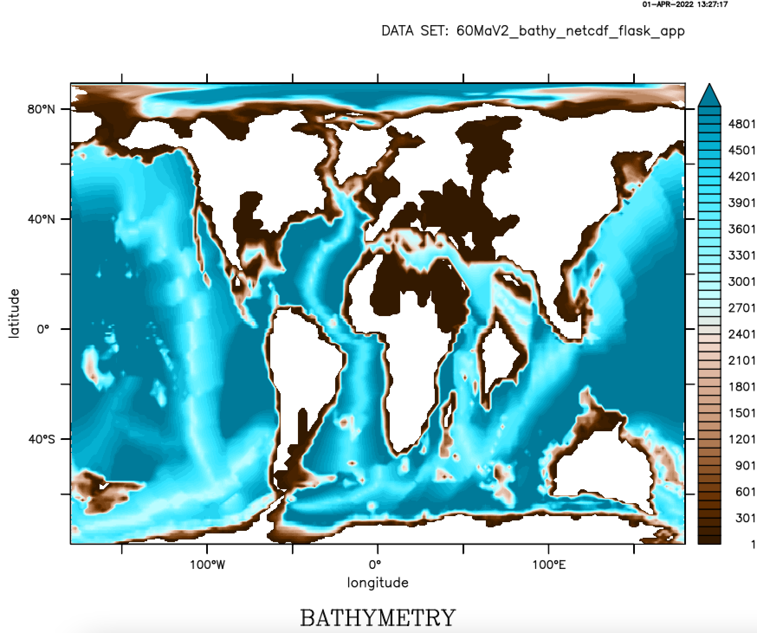
Paleogeographies (Scotese)
CENOMANIAN
MAASTRICHTIAN
PALEOCENE
90 Ma
70 Ma
60 Ma
(OAE2)
(PETM)
CO₂: 4x PI
CO₂: 4x PI
CO₂: 2x PI
Bathymetry
IPSL-CM5A2 with modern nutrient distribution
Notes:
Here we will focus on three geological intervals. The Cenomanian, which saw the occurrence of the most significant OAE, the Maastrichtian where there’s no real evidence for widespread deoxygenation pre impact. And the Paleocene which ended near the occurrence of the PETM, a potentially failed OAE. Our simulations were all performed with the IPSL-CM5A2 model with modern nutrient distributions. For the first two intervals I will show results for 4X PI CO2, for the Paleocene the results correspond to 2X PI. The Paleogeographic reconstructions are all by Scotese.

Slide 4
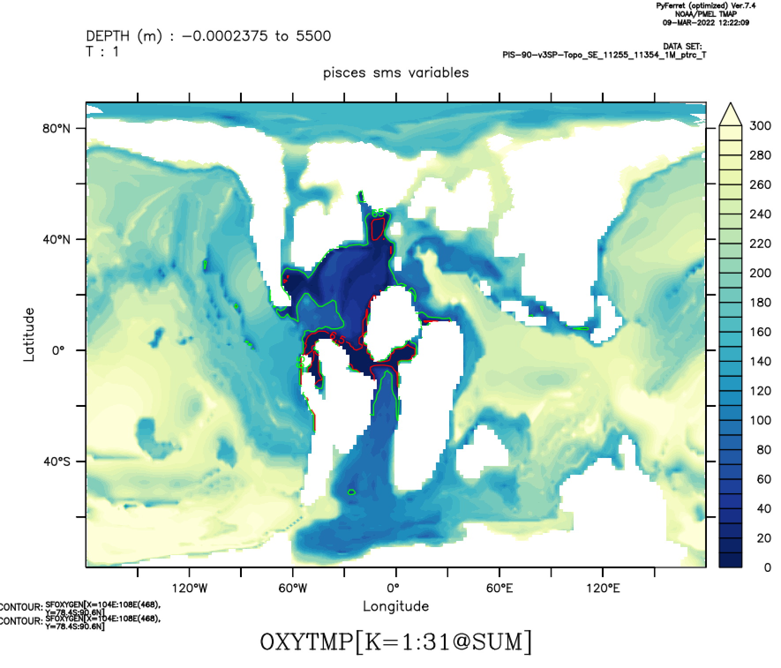
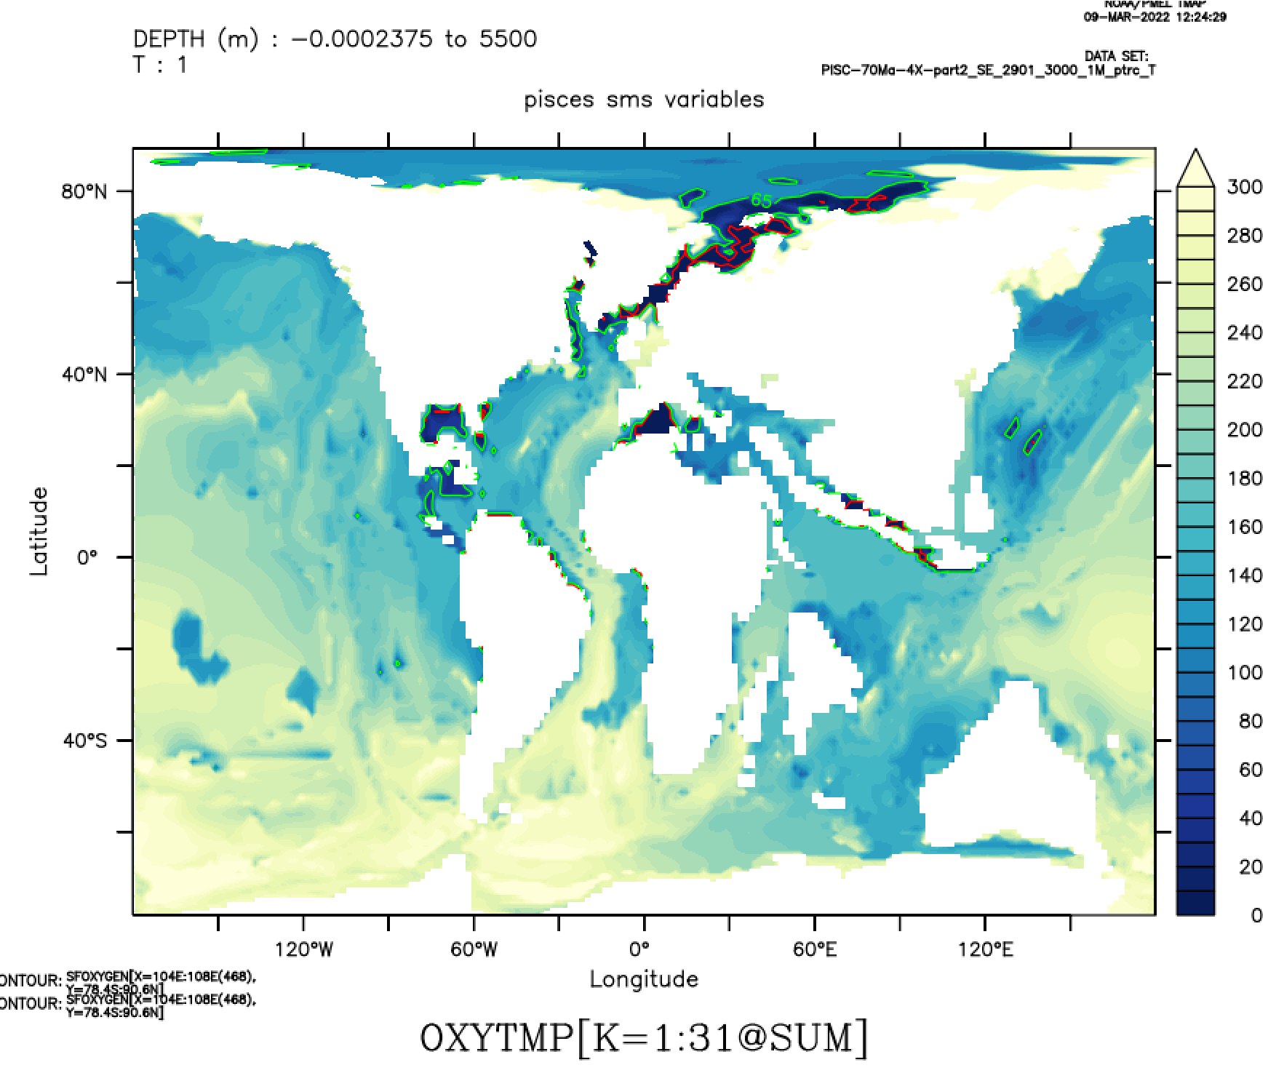
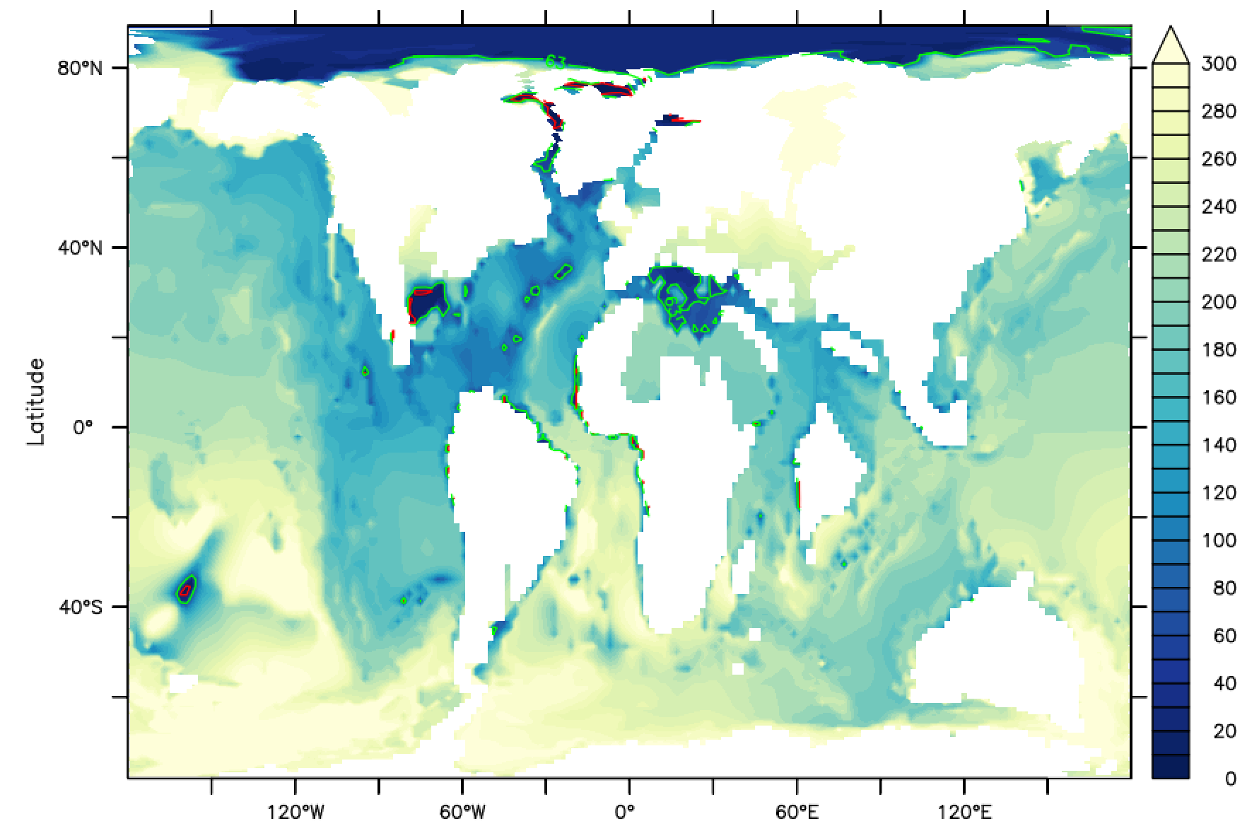
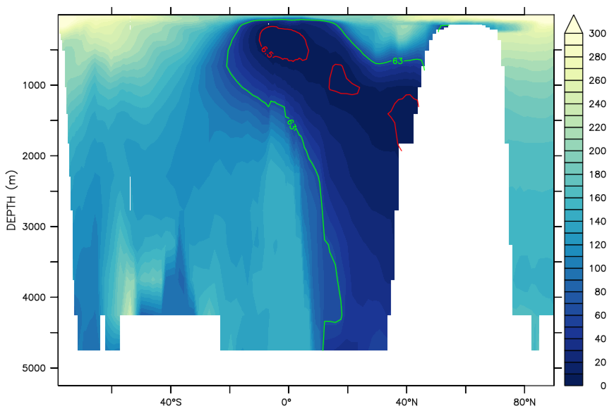
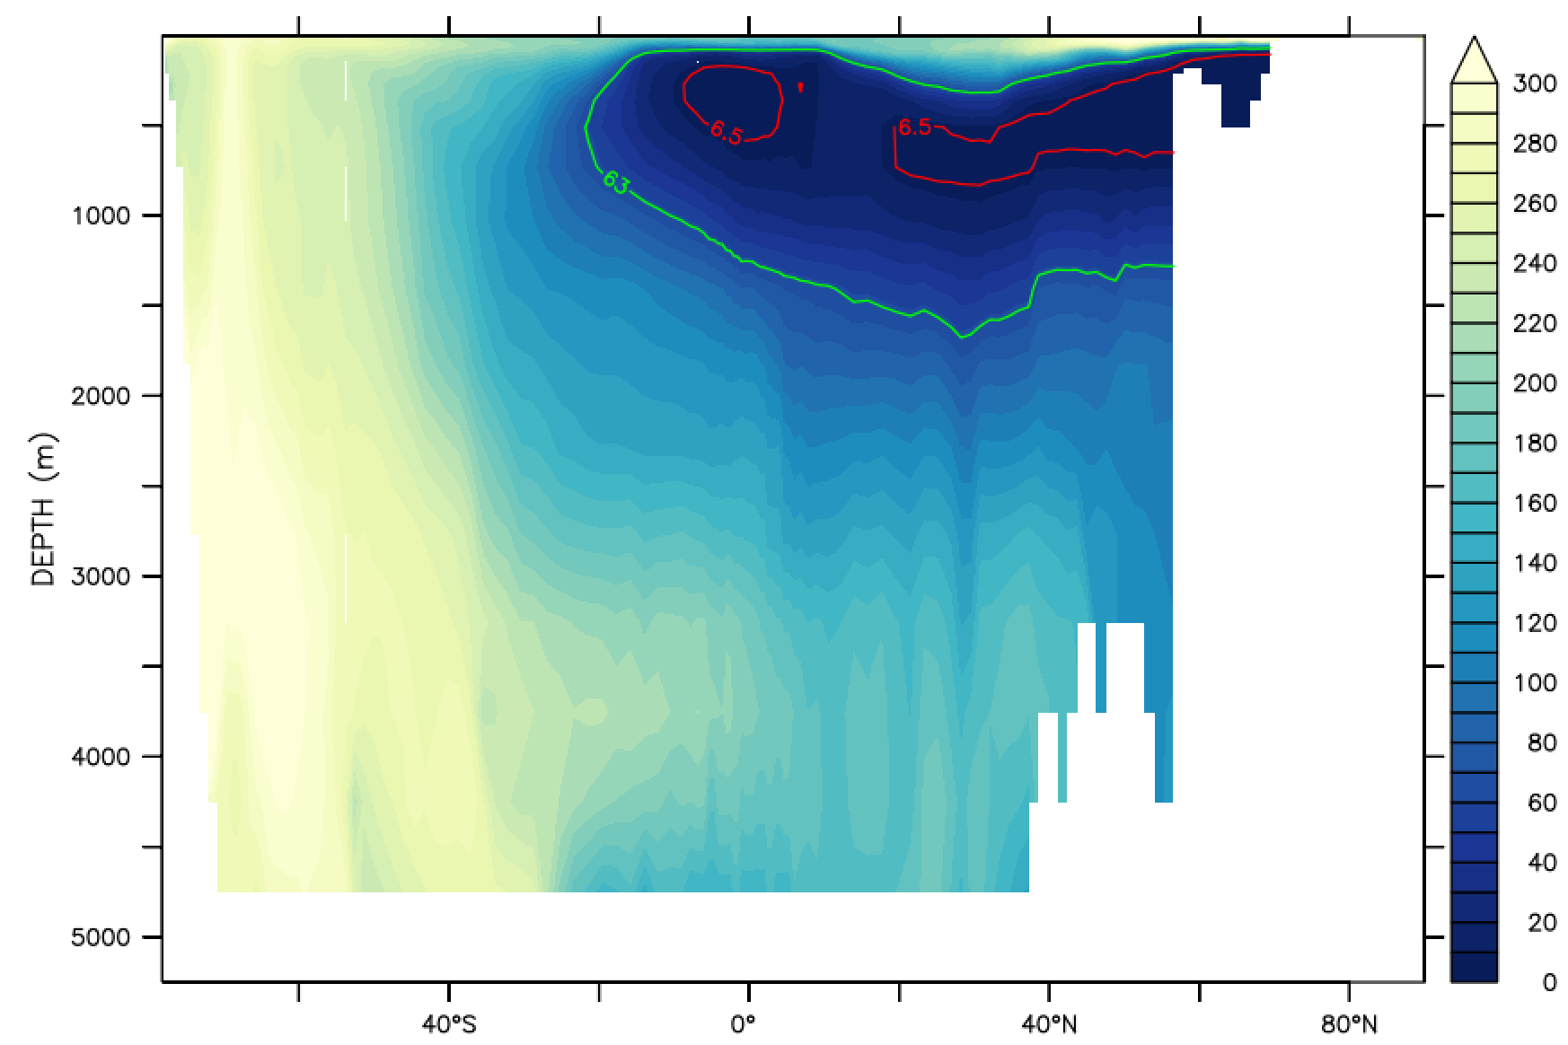
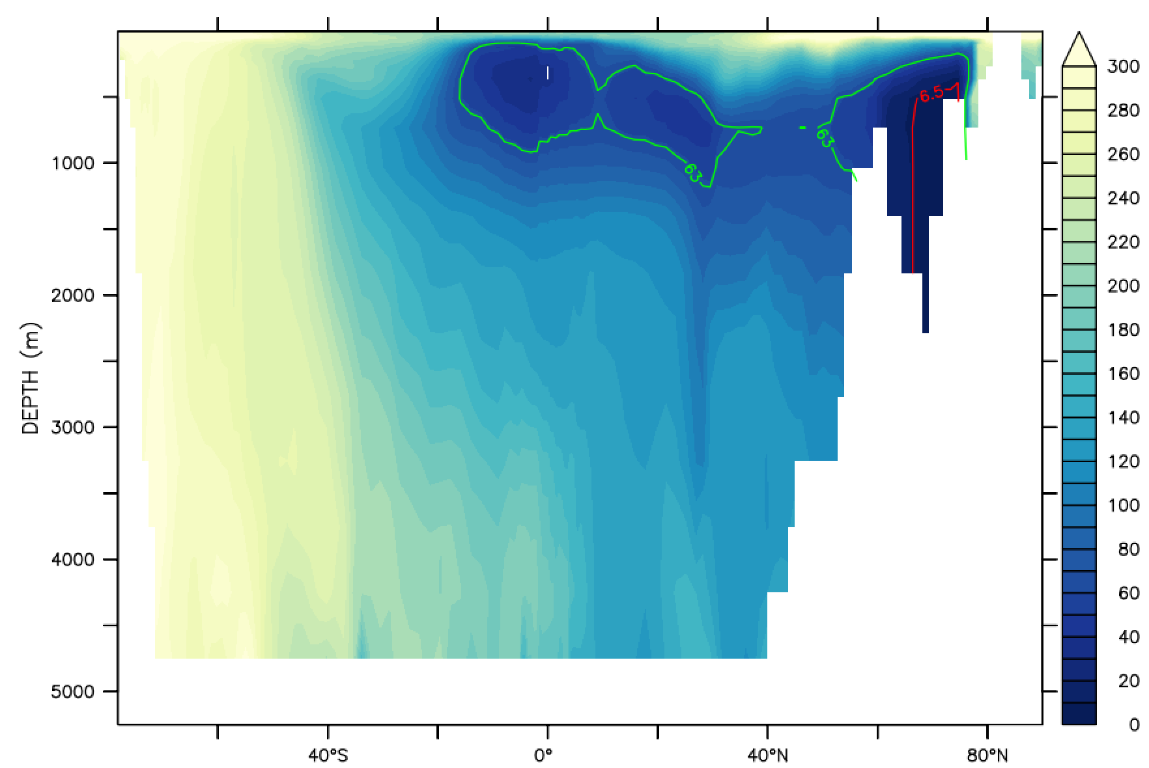
Deep Atlantic more oxygenated at 70Ma and 60Ma
CENOMANIAN
MAASTRICHTIAN
PALEOCENE
300 μΜ O₂
SEAFLOOR OXYGEN
Latitude
Latitude
Latitude
Longitude
0 μΜ O₂
Longitude
Longitude
ATLANTIC OXYGEN
Depth (m)
Depth (m)
Depth (m)
Latitude
Latitude
Latitude
6.5 μΜ O₂
62.5 μΜ O₂
Notes:
In our simulations, we see major differences in the oxygenation of the Atlantic, which I will focus on for this presentation, and the Arctic. At 90Ma most of the seafloor of the N. Atlantic and a large part of the watercolumn is hypoxic and especially around the shallow Equatorial gateway there are also anoxic sections. At 70Ma and 60Ma the hypoxic area gets progressively smaller and in both cases the seafloor is oxygenated.
We also see a major difference in S. Atlantic deep oxygenation and at 70Ma and 60Ma the high oxygen conditions appear to spread from a high oxygen region in the S. Ocean, suggesting deep water formation for these two timeslices.

Slide 5
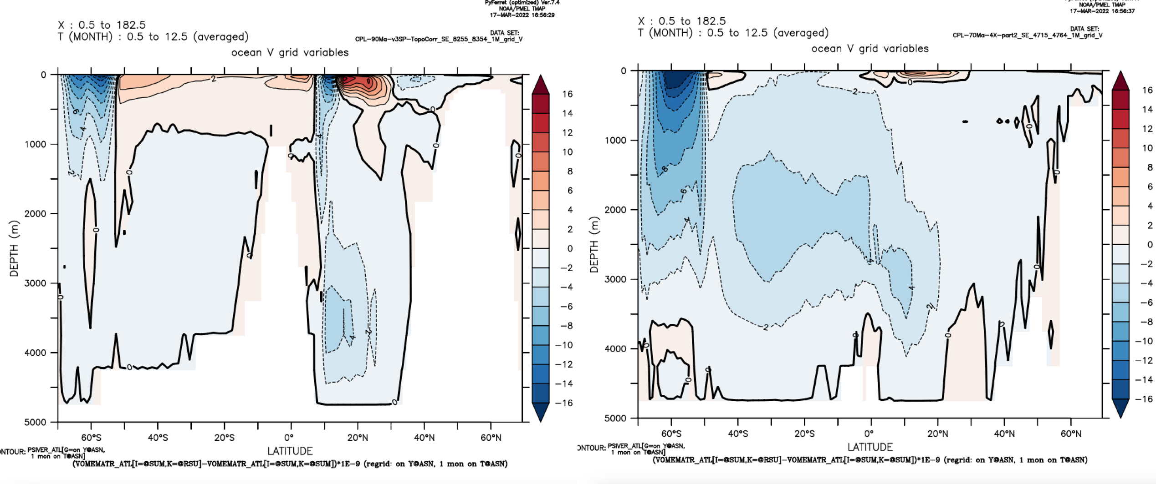
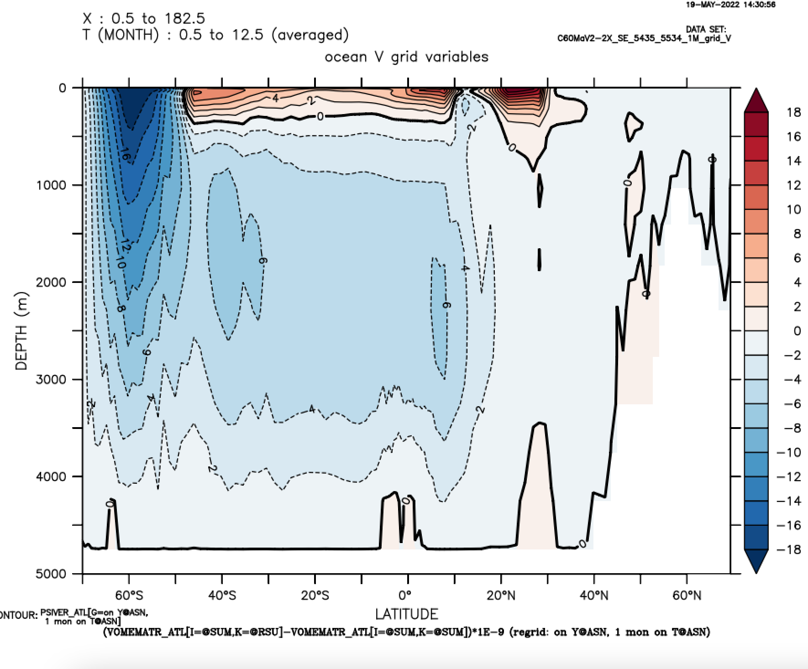
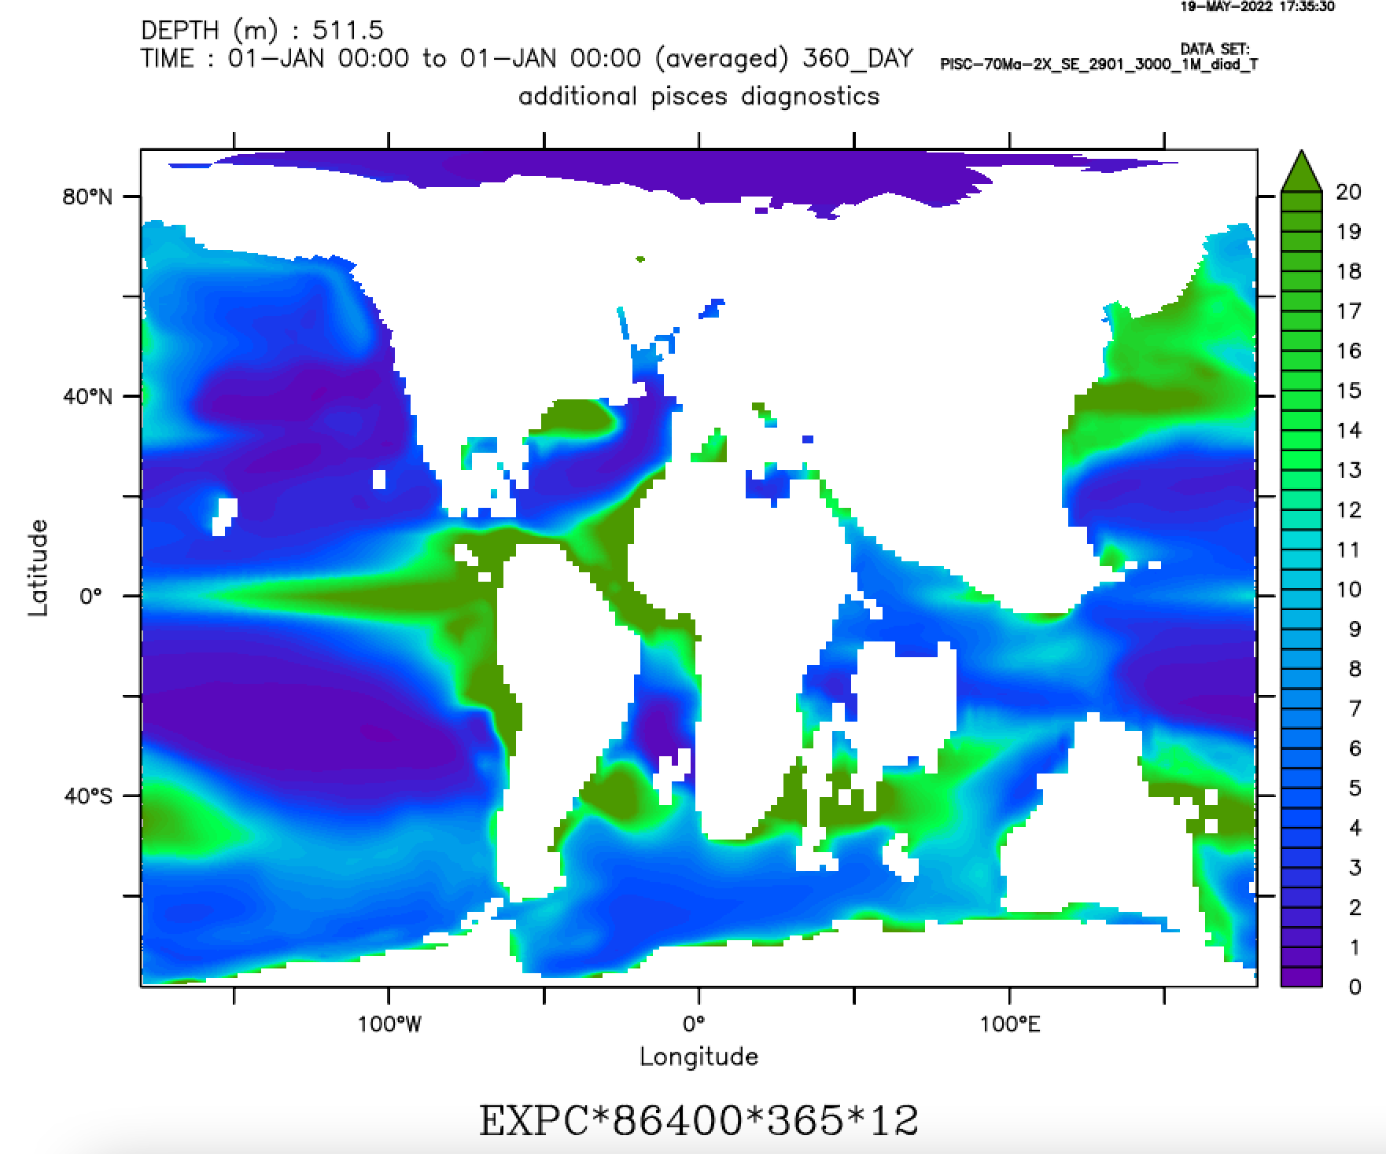
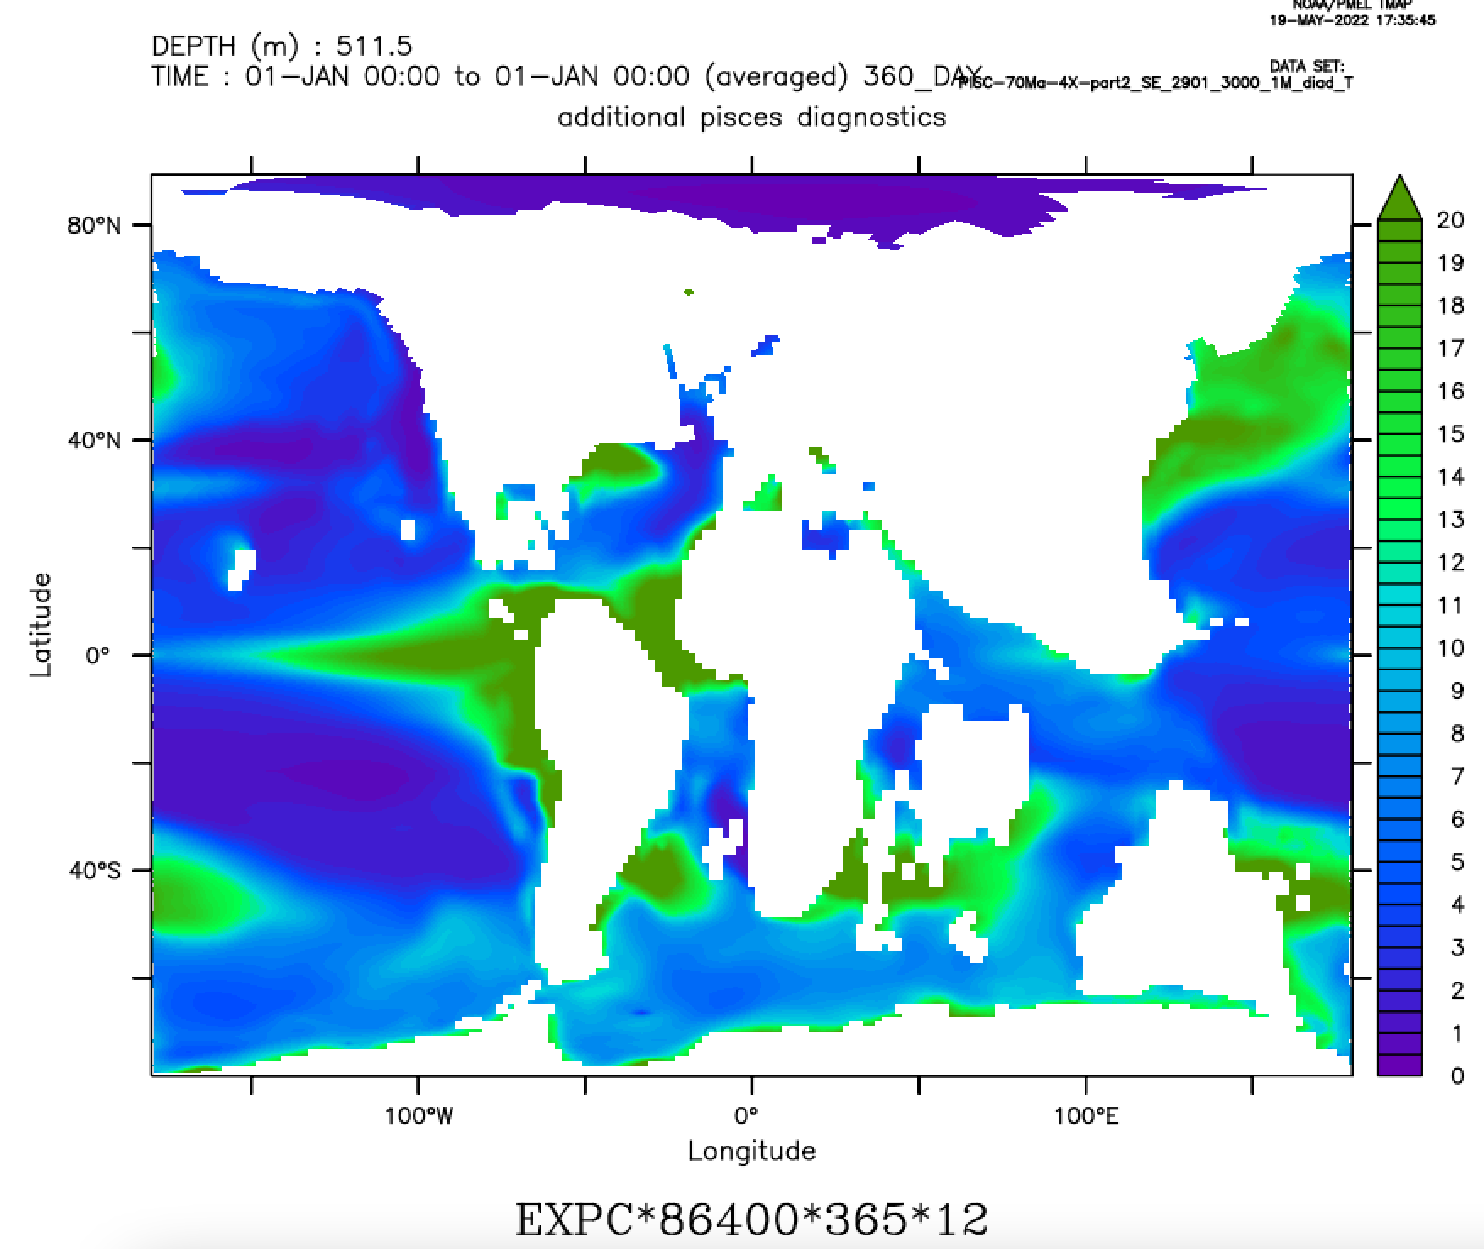
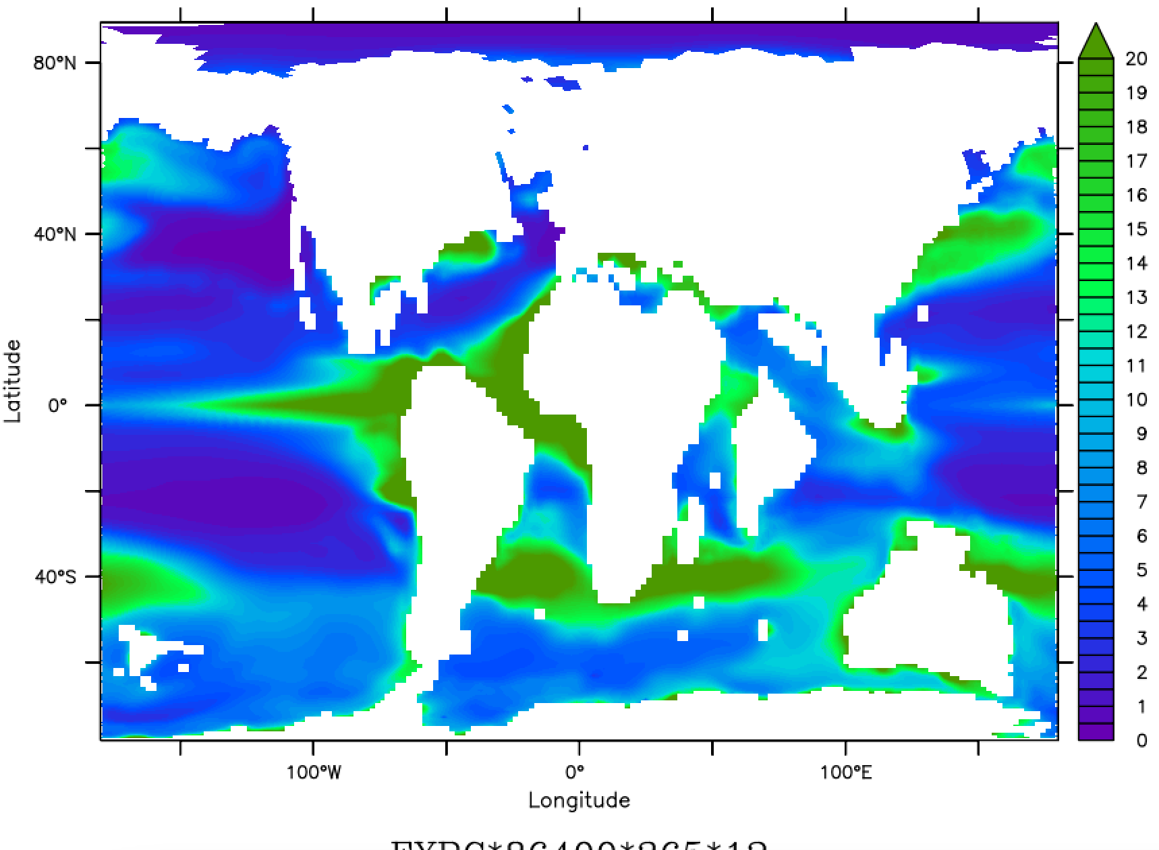
Atlantic deep water formation key to oxygenation
CENOMANIAN
MAASTRICHTIAN
PALEOCENE
16 Sv
ATLANTIC MER. OVERT.
Depth (m)
Depth (m)
Depth (m)
-16 Sv
Latitude
20 g C m⁻³ yr⁻¹
Latitude
Latitude
EXPORT PROD. 500m
Latitude
Latitude
Latitude
Longitude
0 g C m⁻³ yr⁻¹
Longitude
Longitude
Notes:
In the meridional overturning function for the Atlantic we can see there indeed appears to be a sinking cell in the Southern Atlantic at 70 and 60Ma. In both cases it reaches to 3000 or more meters depth, though it appears to be more vigorous at 60Ma.
Of course, circulation and deep water formation are not the only mechanisms that can force a decrease in oxygenation. Export and degradation of organic matter are an additional cause of low oxygen concentrations. However, the areas in question do not show large differences in export at 500m. Actually, parts of the Southern and also the North Atlantic have slightly higher export productivity at 70Ma, rather than at 90Ma where we saw the large hypoxic area. So while organc C degradation could definitely have contributed to decreasing o2 concentrations, the main differences in oxygenation were likely driven by differences in global circulation

Slide 6


Conclusions
Future research goals
Atlantic more oxygenated at 70Ma and 60Ma.
Deep water formation in S. Atlantic appears to be key driver of this difference.
Further work on circulation
Realistic nutrient modelling
Aptian?
Thank you for your attention!

