Slide 1


Monitoring Frost Heave and Thaw Settlement of Permafrost Using Timeseries InSAR Measurements
Yoon Taek Jung¹, Sang-Eun Park^{1,2}
¹Department of Geoinformation Engineering, Sejong University, Korea
²Department of Energy and Mineral Resources Engineering, Sejong University, Korea

Slide 2
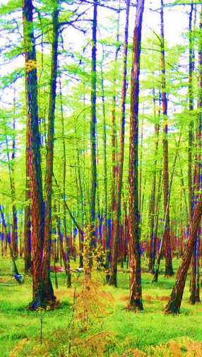
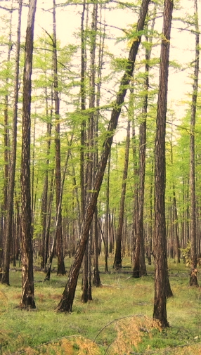
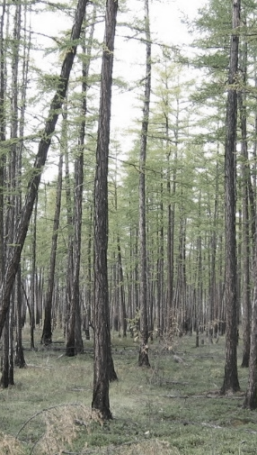
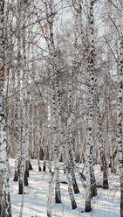
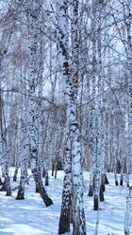
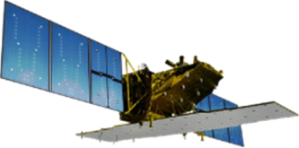
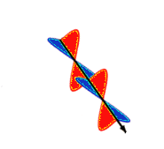
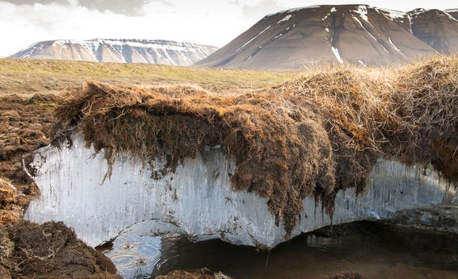


Introduction & Objective
Thaw
Freeze
Detection and Quantification of Frost heave over Permafrost region
$$∆z=0$$
Mid winter
Late winter
Summer
Fall
Early winter
Microwave
Remote Sensing
$$Depth$$
Frozen active layer
Thawed active layer
Permafrost
A layer above permafrost that freezes and thaws annually
permanently frozen ground in high latitudes
Active Layer
Permafrost
Permafrost melting in the arctic region of Svalbard, Norway.
Jeff Vanuga/Getty

Slide 3
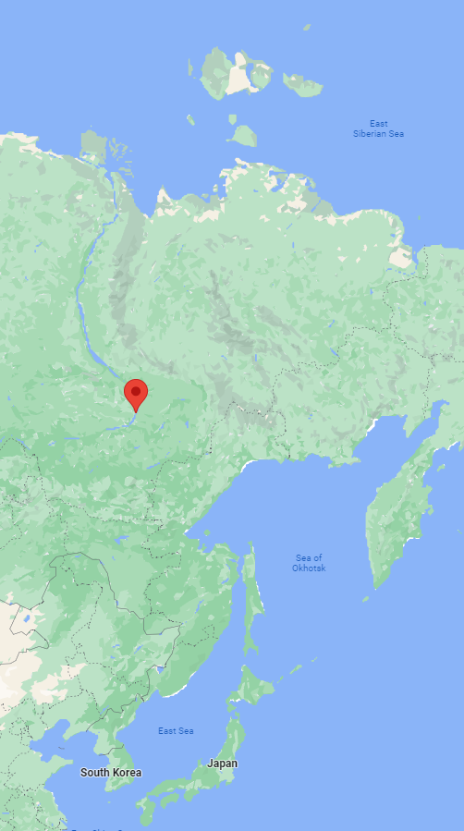
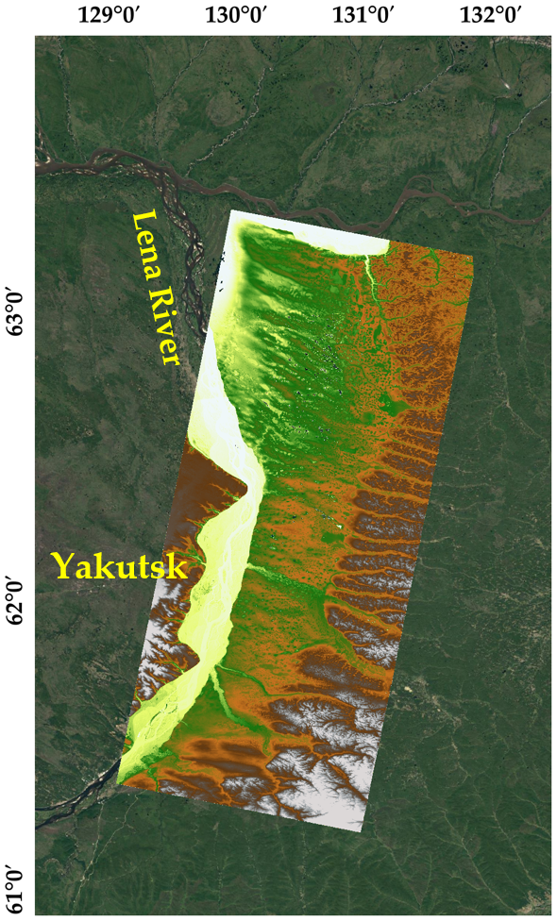
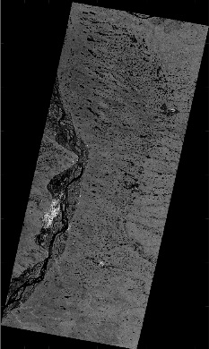
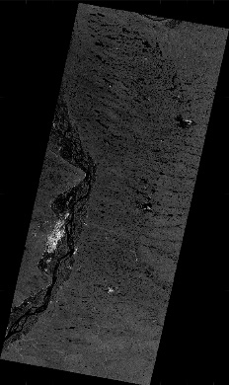
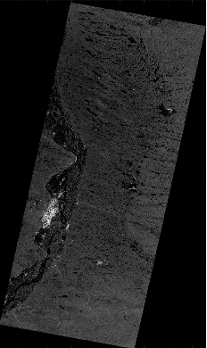
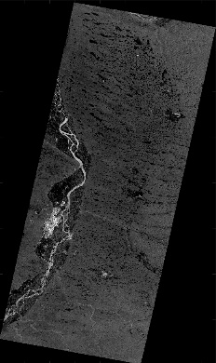
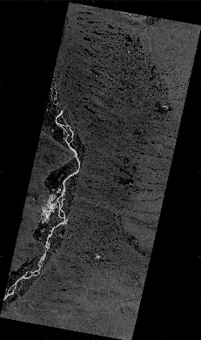
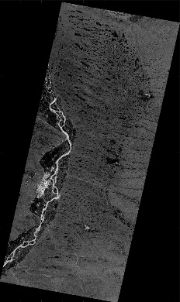
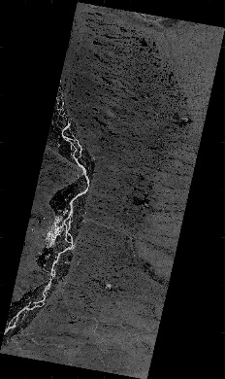
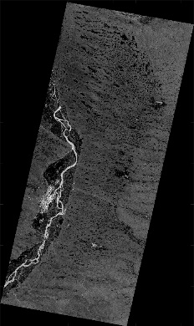
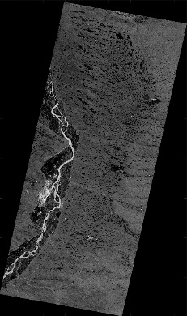
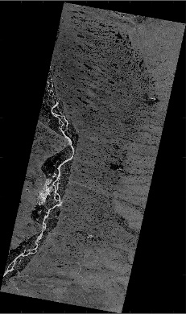

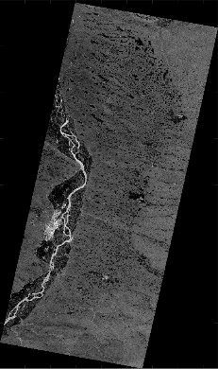
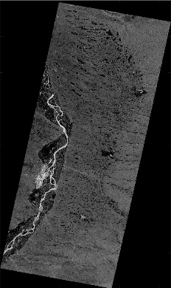

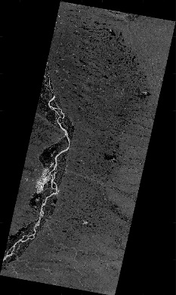
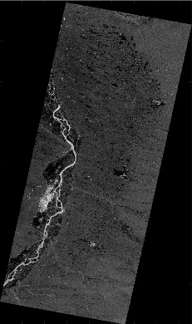
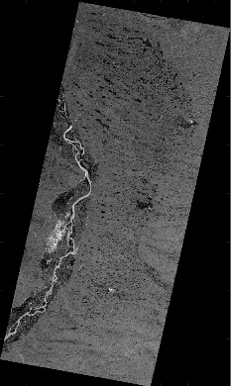
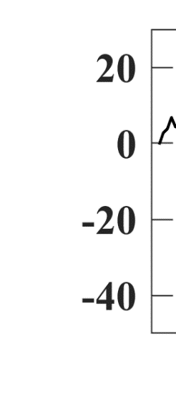
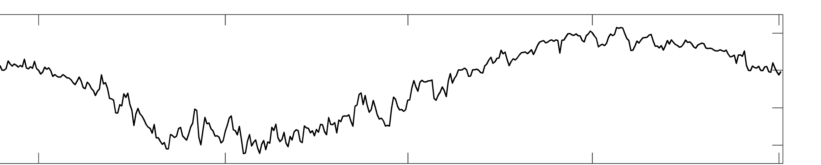

Study area & Dataset
Sentinel-1, 2018. 10.02 ~ 2019.04.12 (17 observations, 12-day repeat cycle)
Interferometric Wide swath mode, Descending
Freeze season
Arctic DEM
Eastern Siberia
thaw
Air temperature [˚C]
freeze
$$EMCWF Reanalysis v5 (ERA5)$$
18-10-01
19-01-01
19-04-01
19-07-01
19-10-01

Slide 4

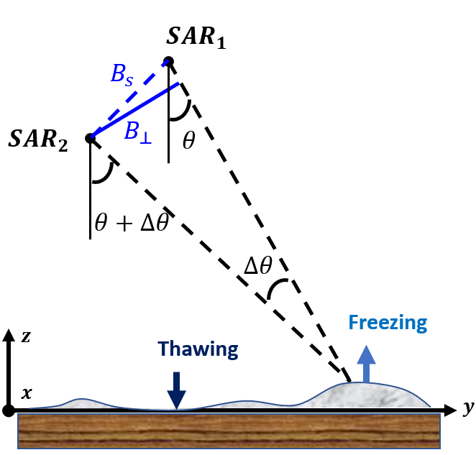

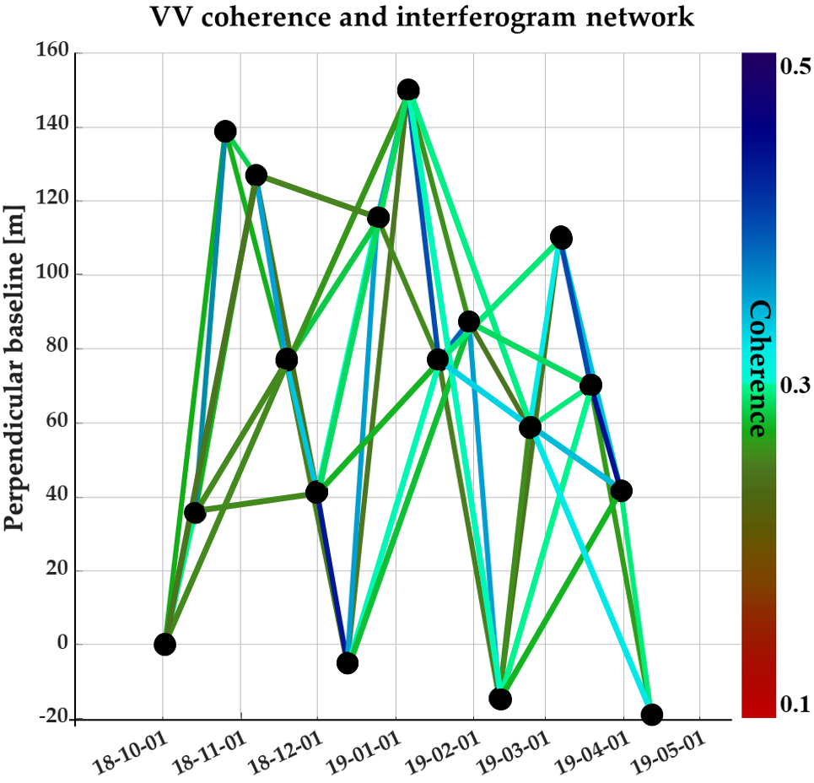
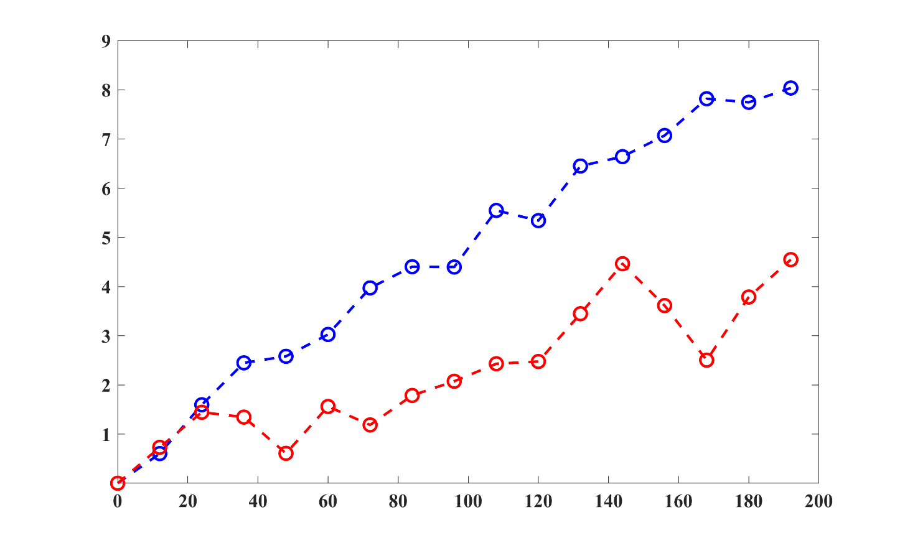






Interferometry SAR processing
Differential Interferometry SAR
$$S_{1}$$
PASS #1
PASS #2
$$S_{2}$$
Phase difference
Uplift
Subsidence
SBAS approach
$$⋮$$
$$δφ_{14}$$
⋮
$$δφ_{13}$$
Number of pairs
$$δφ_{12}$$
Before inversion & correction
After inversion & correction
Times series images of Unwrapped Differential Phase

Slide 5
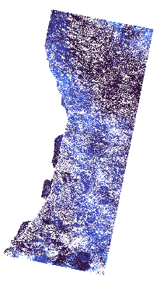
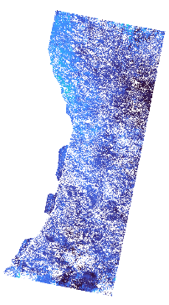
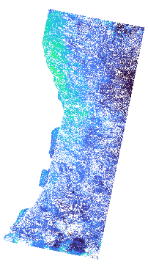
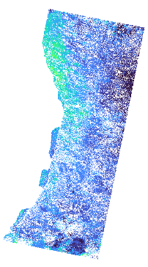
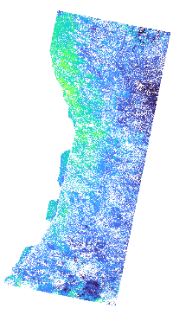
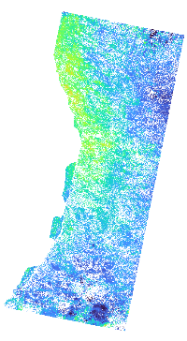
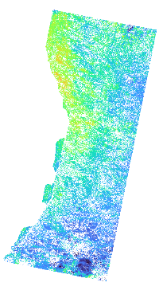
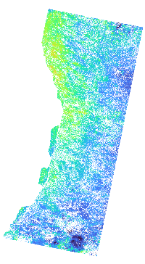
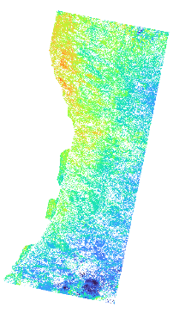
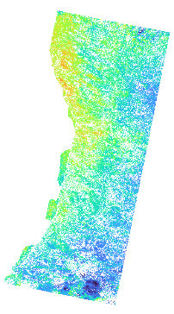
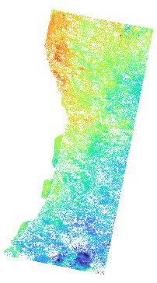
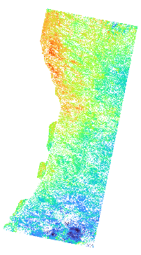
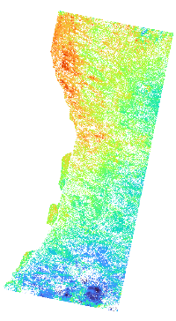
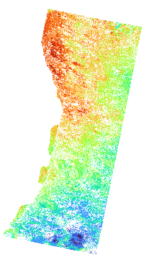
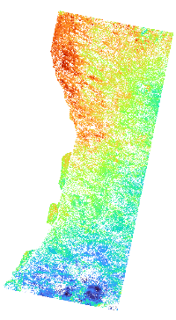
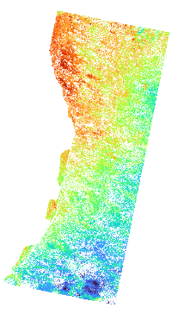
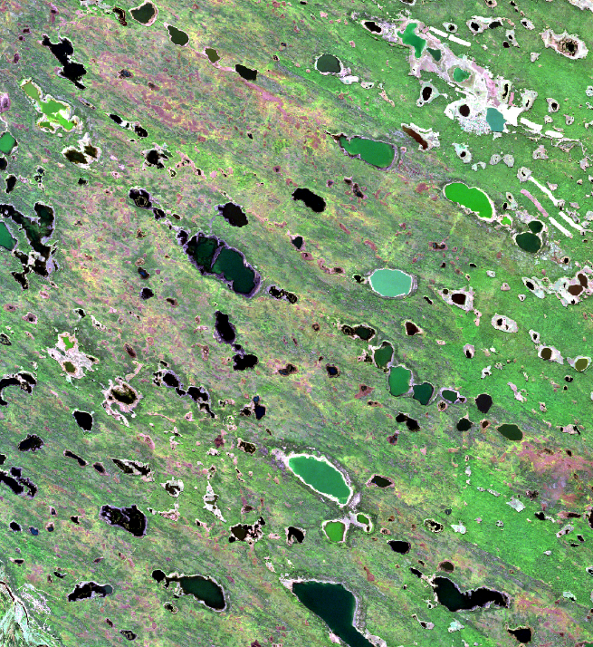
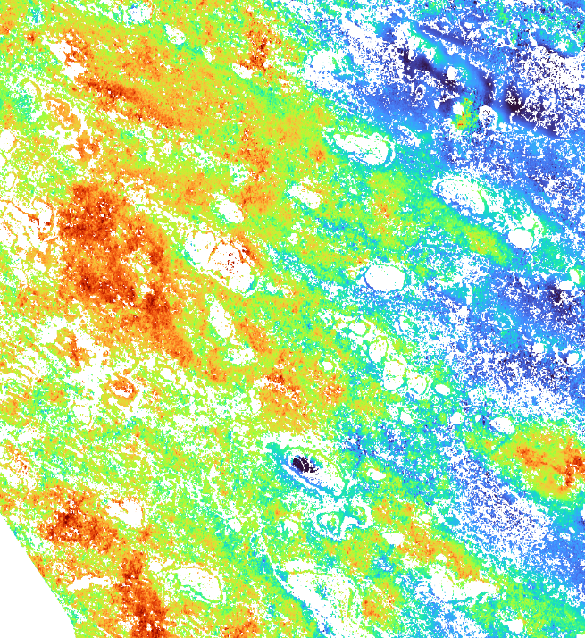
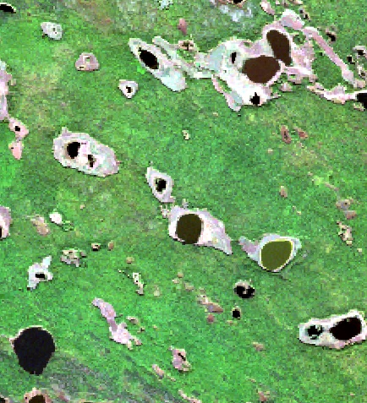
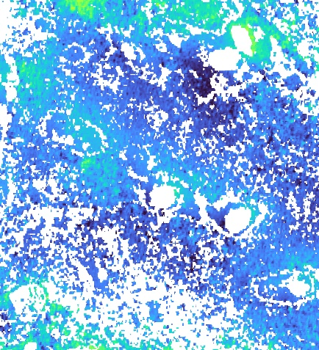











Estimated Time series Displacement
Beginning of Freezing season
0
LOS displacement [cm]
8
End of Freezing season
12
days
24
days
36
days
48
days
60
days
72
days
84
days
96
days
108
days
120
days
132
days
144
days
156
days
168
days
180
days
192
days
Final displacement ( related to Thickness of Active Layer )
A
B
A
B
2018-09-14
(Sentinel-2)
4
LOS displacement [cm]
8
Active Layer
Thickness
Water
Active Layer
Thickness
Grassland
Sparse forest
Thickness of active layer is different wrt the land cover types
Amount of Uplift by frost heave is different depending on the land cover types
Birch forest
Larch forest
SVM classification

Slide 6















Segmented Linear Fitting
Temporal displacement ( related to vertical distribution of ICE-rich active layer )
8
6
Cumulative displacement
$$δ$$
$$∆δ_{3}$$
Temporal displacement
Surface
$$∆δ_{2}$$
Displacement [cm]
$$∆δ_{1}$$
4
Frozen active layer
Frozen active layer
Frozen active layer
2
Upper
Thawed active layer
Middle
Thawed active layer
Thawed active layer
0
Lower
Segmented Linear with 3 layers
Permafrost
Permafrost
Permafrost
Permafrost
8
Fitted parameters
Slope of each layer
Displacement of each layer
Days of break point
6
99 days
7.35 cm
35 days
Fully frozen
Active layer
Displacement [cm]
36 days
0$.0292{cm}/{day}$
4
2
0$.0433{cm}/{day}$
0
0$.0799{cm}/{day}$
0
12
24
36
48
60
72
84
96
108
120
132
144
156
168
180
192
Cumulative days from 1st acquisition
Segmented Slope
Segmented Displacement
Day of break point
Slope of each layer $[{cm}/{day}]$
LOS displacement [cm]
Cumulative days of each breakpoint
0
0.06
0
3
20
60
70
135
160
185

Slide 7





Results – the Yukechi alas area
Alas
Alas
Displacement [cm]
0
0.5
1
1.5
2
2.5
3
3.5
4
0
1st Layer
2nd Layer
3rd Layer
Yedoma
Yedoma
50
Fully Frozen
Google earth
Sites from [Windirsch et al., 2015]
188 m
220 m
100
150
Alas
Yedoma
200
Cumulative Day
( ≈ Depth )
Different
Active Layer Thickness
YED
ALAS

Slide 8




















Results – ecosystem changes
Sparse forest expanding
1st Slope
2nd Slope
3rd Slope
2018-09-14 (S2)
Upper layer
Lower layer
2019-09-12 (S2)
←Frost heave→
0
0.085
0
0.045
0
0.045
Water shrinking
←Frost heave→
No changes
Low frost heave→

Slide 9


Conclusion
Conducted a study to estimate the displacement in permafrost regions during the winter season based on C-band SAR data.
It is revealed that time series displacement in permafrost region provides information about vertical distribution of ice-rich active layer.
Time series displacement during freezing season seems to be related to ecosystem changes even in a short period of time.
Work in progress
Expansion of study areas.
Analyzing longer period than a short period as long as the level of the interferometric coherences maintains stable.

Slide 10
Thank you

