Slide 1


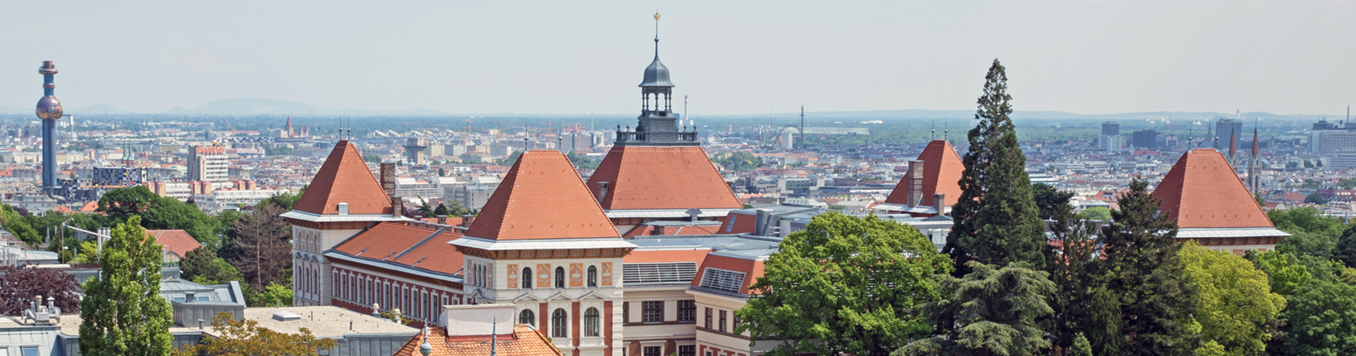

A mid-20th century estimate of global vegetation carbon stocks based on inventory statistics
Bhan, M., Meyfroidt, P., Matej, S., Erb, K-H., Gingrich, S.
(currently under review); Journal of Land Use Science
maybeEcosystems

Slide 2
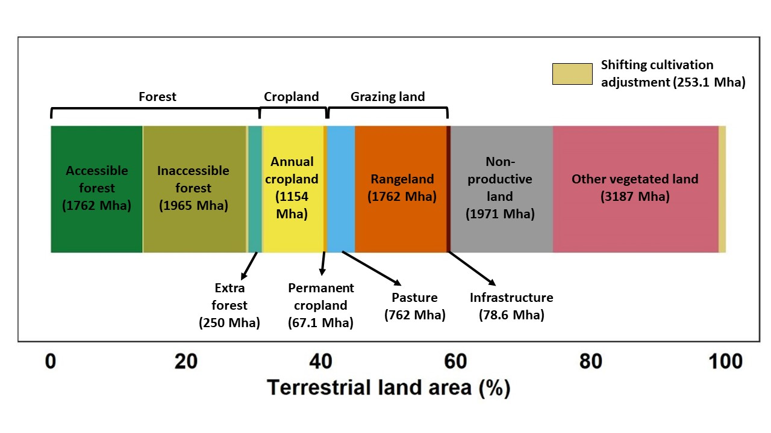
Bringing together existing knowledge on land use and biomass carbon densities
Land use reconstruction using different FAO-based datasets for that timeperiod
+
carbon densities of different land use types (from inventories/ previous studies)
=
biomass carbon stocks estimates (above + below-ground)

Slide 3
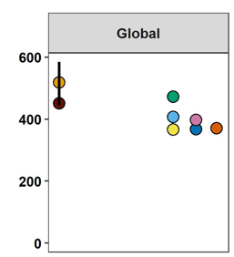
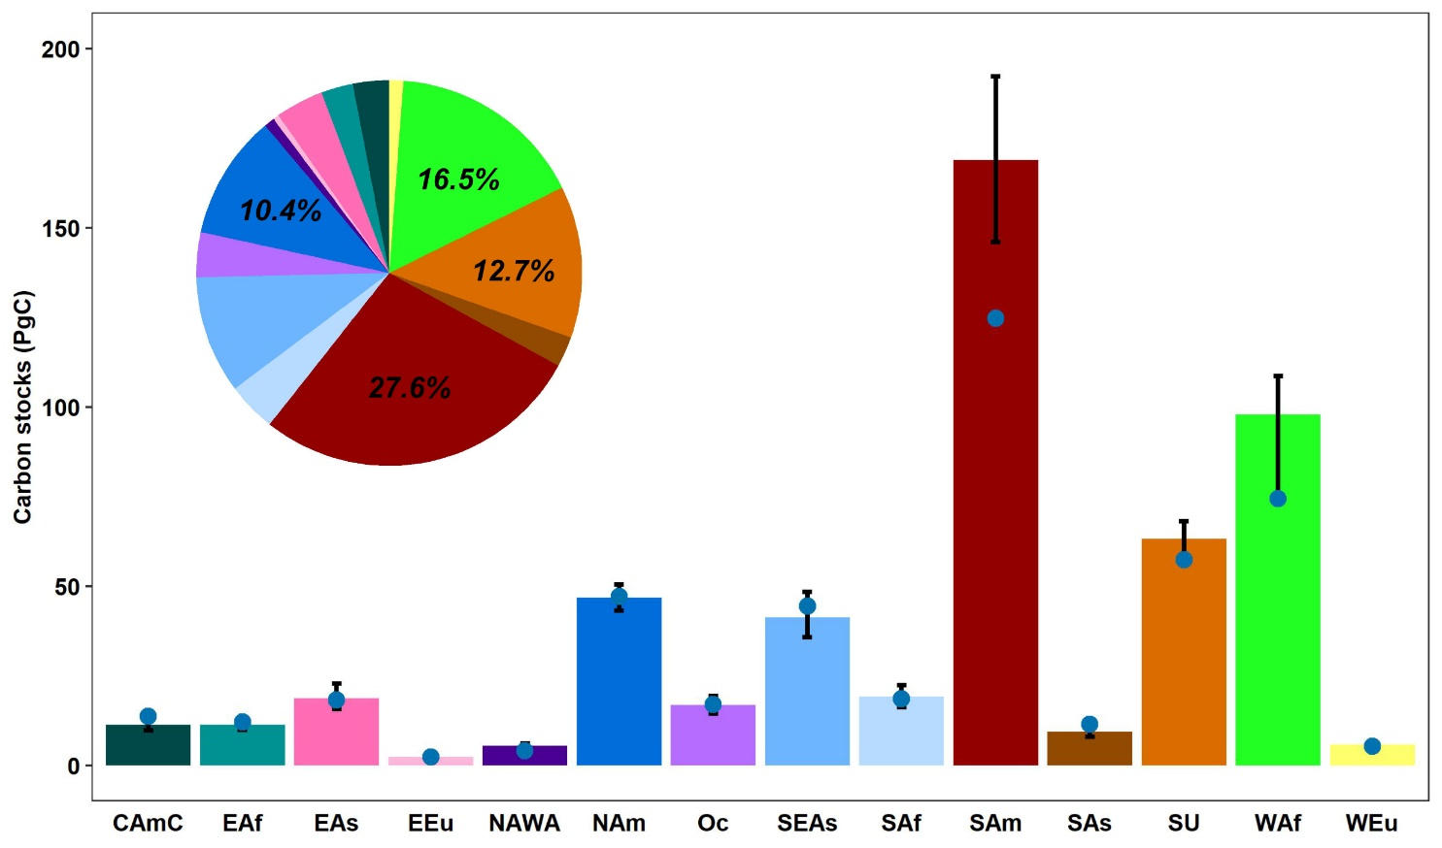
A robust estimate to compare the past with the present
Carbon stocks (PgC)
1950
2000
2010
2019
Global best-guess = 450.7 PgC
Scenario-based approach;
Median = 518.3 PgC
Inner quartiles = 443.9 – 584.6 PgC
Sub-continental distribution

Slide 4
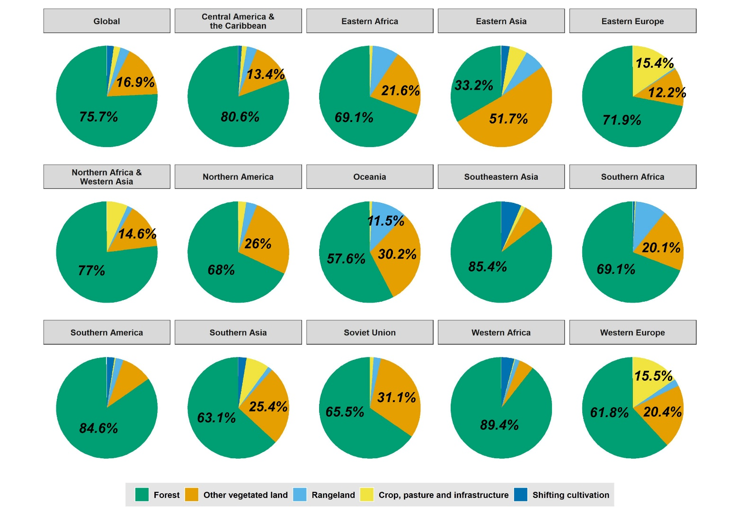
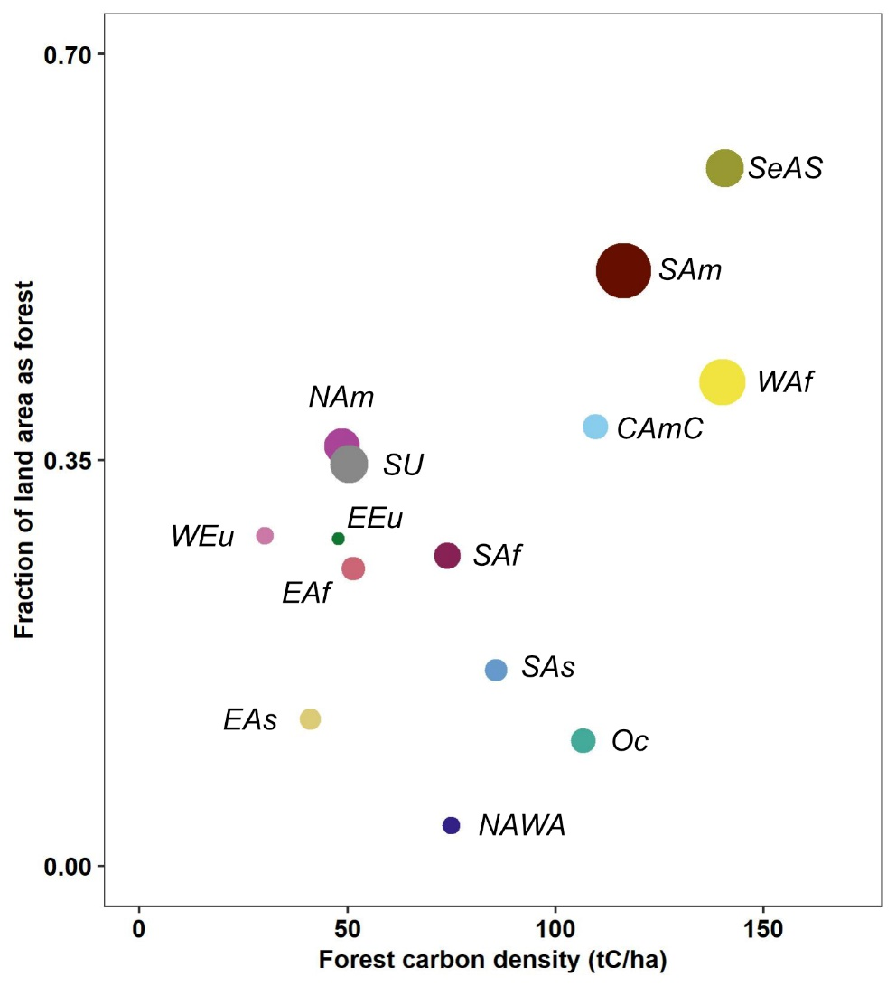
Forests were (and are) the storehouses of biomass carbon
Tropics!
The contribution of forests differ across subcontinents
...and is an outcome of both forest extent and carbon density

Slide 5
Thank you!
I look forward to questions here and over coffee!
Email: manan.bhan@boku.ac.at
Twitter: @maybeEcosystems

