Slide 1






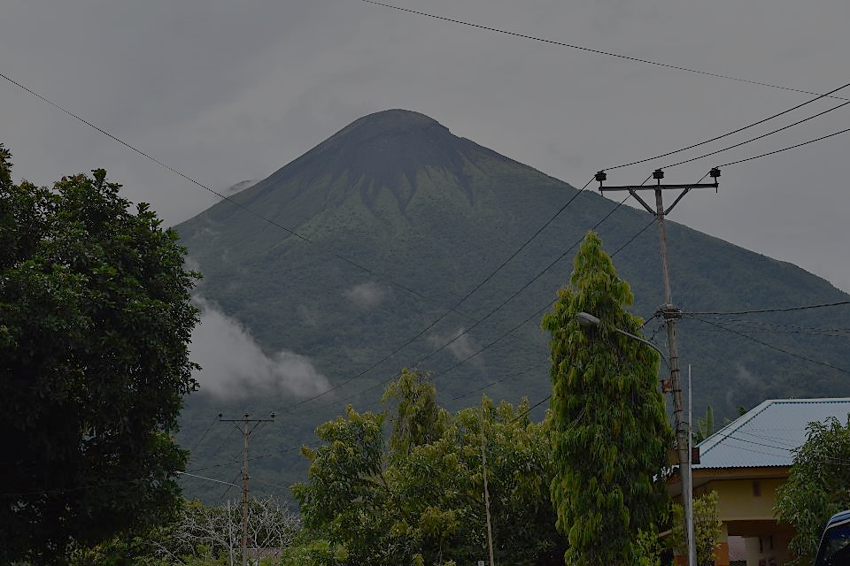
Adding your title
EGU22-11688
Session NH3.1 – Debris flows: advances on mechanics, controlling factors, monitoring, modelling and risk management
Thursday, 26 May 2022, 13:27 CEST
Numerical modelling of the potential for landslide-induced tsunamis, Mount Gamalama, Indonesia
Saaduddin^{1,3}, Jurgen Neuberg¹, Mark Thomas¹, Jon Hill²
¹⁾Institute of Geophysics and Tectonic, School of Earth and Environment, University of Leeds, Leeds, UK
²⁾Department of Environment and Geography, University of York, York, UK
³⁾Department of Geophysics, Faculty of Mathematics and Natural Sciences, Hasanuddin University, Makassar, Indonesia

Slide 2
Outline:
Background
The Potential Gamalama Landslides
The Potential Gamalama Tsunami model

Slide 3
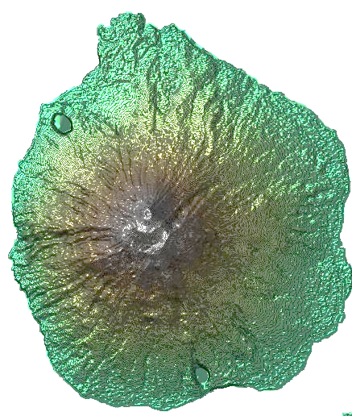
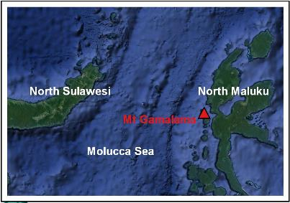
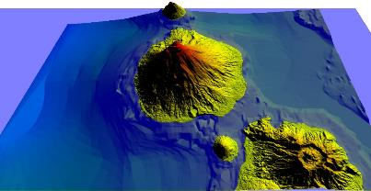
Background
Mount Gamalama is a volcanic island in Indonesia which has a history of tsunami generation in 1604, 1840 and 1871 (Hamzah et al., 2000; Paris et al., 2014).

Slide 4
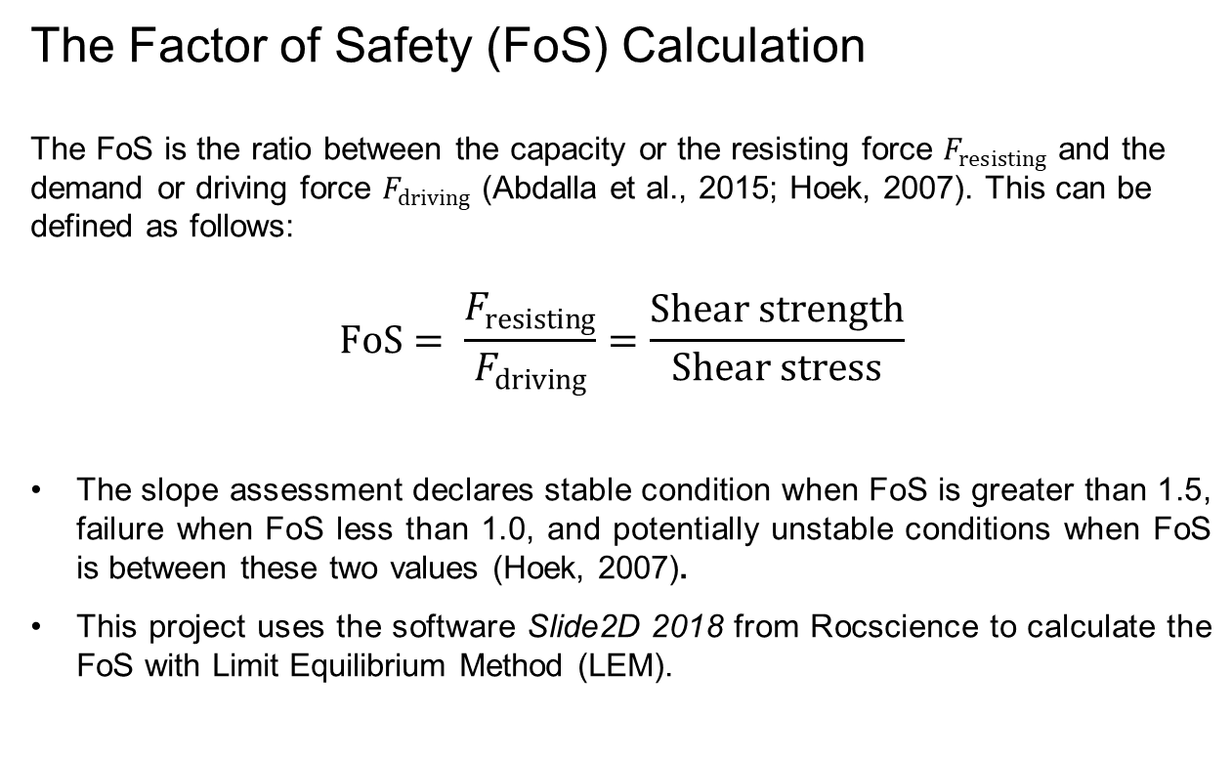
Text sizes and hierarchy
The Gamalama Potential Landslides
The Factor of Safety (FoS) Calculation
The FoS is the ratio between the capacity or the resisting force $F_{resisting}$ and the demand or driving force $F_{driving}$ (Abdalla et al., 2015; Hoek, 2007). This can be defined as follows:
$$FoS= \frac{F_{resisting}}{F_{driving}}=\frac{Shear strength}{Shear stress}$$
The slope assessment declares stable condition when FoS is greater than 1.5, failure when FoS less than 1.0, and potentially unstable conditions when FoS is between these two values (Hoek, 2007).
This project uses the software Slide2D 2018 from Rocscience to calculate the FoS with Limit Equilibrium Method (LEM).

Slide 5
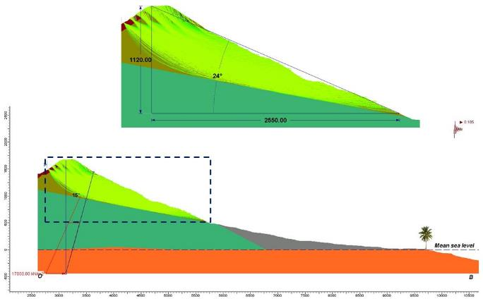
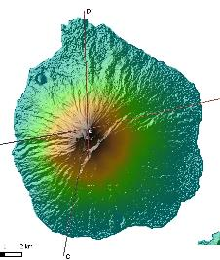
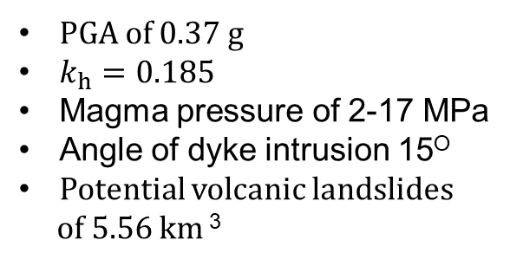
Text sizes and hierarchy
The Gamalama Potential Landslides
PGA of 0.37 g
$k_{h}=0.185$
Magma pressure of 2-17 MPa
Angle of dyke intrusion 15^{O}
Potential volcanic landslides
of 5.56 km ³
Light green area shows the
geometry of the potential
Landslides.

Slide 6
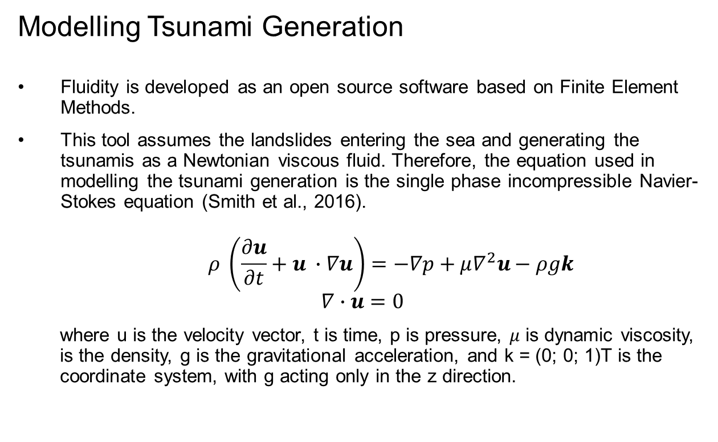
Text sizes and hierarchy
The Gamalama Potential Tsunamis
Modelling Tsunami Generation
Fluidity is developed as an open source software based on Finite Element Methods.
This tool assumes the landslides entering the sea and generating the tsunamis as a Newtonian viscous fluid. Therefore, the equation used in modelling the tsunami generation is the single phase incompressible Navier-Stokes equation (Smith et al., 2016).
$$ρ \left(\frac{∂u}{∂t}+u ∙∇u\right)=−∇p+μ∇^{2}u−ρgk$$
$$∇∙u=0$$
where u is the velocity vector, t is time, p is pressure, $μ$ is dynamic viscosity, is the density, g is the gravitational acceleration, and k = (0; 0; 1)T is the coordinate system, with g acting only in the z direction.

Slide 7
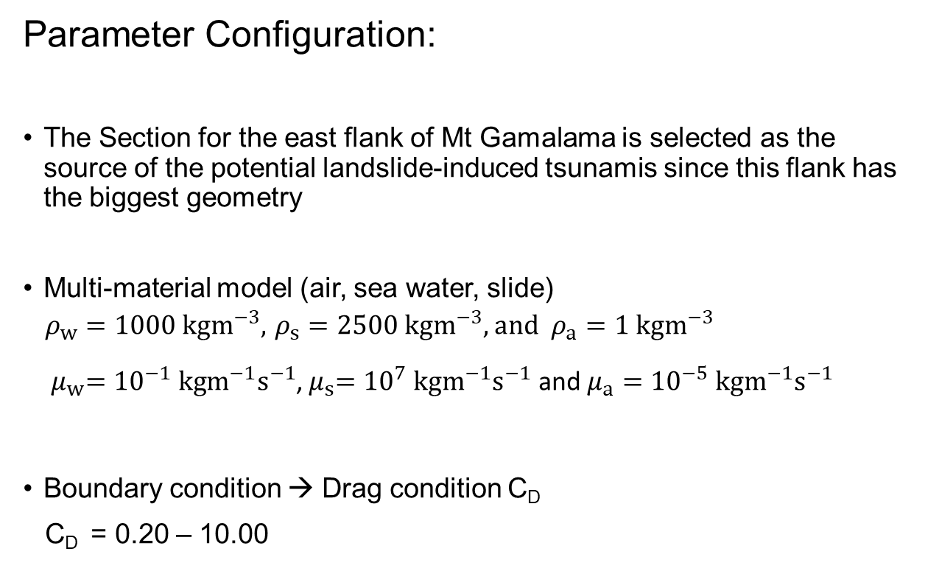
Text sizes and hierarchy
The Gamalama Potential Tsunamis
Parameter Configuration:
The Section for the east flank of Mt Gamalama is selected as the source of the potential landslide-induced tsunamis since this flank has the biggest geometry
Multi-material model (air, sea water, slide)
$ρ_{w}=1000 kgm^{−3}, { ρ}_{s} =2500 kgm^{−3},$ and $ρ_{a}=1 kgm^{−3}$
${ μ}_{w}={10}^{−1} kgm^{−1}s^{−1}$,${ μ}_{s}={10}^{7} kgm^{−1}s^{−1}$ and$μ_{a}={10}^{−5} kgm^{−1}s^{−1}$
Boundary condition → Drag condition C_{D}
C_{D} = 0.20 – 10.00

Slide 8
Text sizes and hierarchy
t = 0 s
t = 140 s
t = 160 s
t = 200 s
t = 240 s
t = 300 s

Slide 9
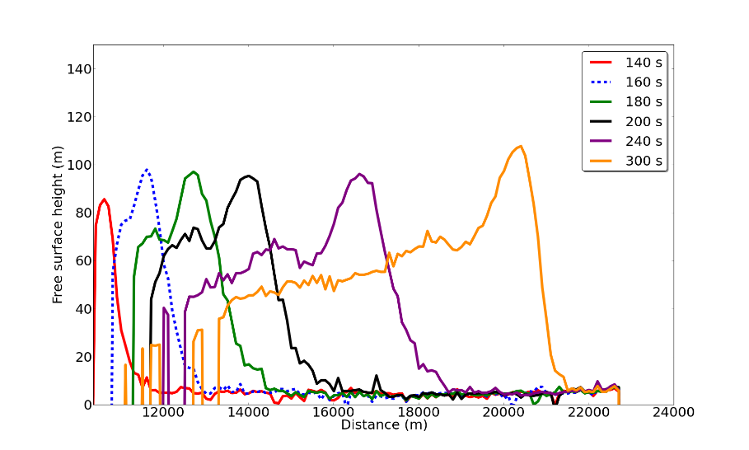
Text sizes and hierarchy
The Gamalama Potential Tsunamis
Evolution of tsunami wave height through time

Slide 10
Conclusions:
A volcanic landslide of 5.56 km³ is a realistic opportunity
The subaerial mass failure takes around 2 to 6 minutes to enter the sea and can generate an initial wave of heights ranging from 35 m to 110 m.
The waves can reach Halmahera island in 6-10 minutes
This needs to be planned for and managed

Slide 11
Thank You
Terima Kasih

