Slide 1




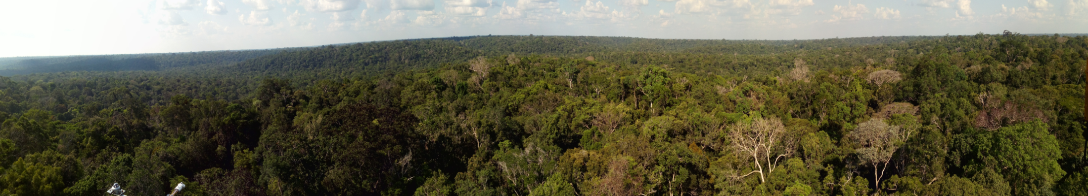
Tropical forest CH₄ budget:
the importance of local hotspots
Hella van Asperen^{1,2}, Thorsten Warneke², Alessandro Carioca de Araújo^{3,4}, Bruce Rider⁵, Sávio Ferreira⁵, João Rafael Alves-Oliveira⁶, Leonardo Ramos de Oliveira³, Thiago de Lima Xavier³, Marta de Oliveira Sá³, Paulo Ricardo Teixeira³, Elaine Pires⁵, Veber Sousa de Moura³, Shujiro Komiya¹ , Santiago Botia¹, Sam Jones¹, Jošt Lavrič¹ , Susan Trumbore¹, and Justus Notholt²
1 Max Planck Institute for Biogeochemistry (MPI-BGC), Hans-Knoell-Straße 10, 07745 Jena, Germany
2 University of Bremen, Institute of Environmental Physics (IUP), Remote Sensing, Bremen, Germany
3 Instituto Nacional de Pesquisas da Amazônia (INPA), Large Scale Biosphere-Atmosphere Experiment in Amazonia (LBA), Manaus, Brazil
4 Brazilian Agricultural Research Corporation (EMBRAPA), Embrapa Amazônia Oriental, Belém, Brazil
5 Instituto Nacional de Pesquisas da Amazônia (INPA), Coordenação de Dinâmica Ambiental (CDAM), Manaus, Brazil
6 Coordenação de Pesquisas em Entomologia (CPEN), Instituto Nacional de Pesquisas da Amazônia (INPA), Manaus, Brazil

Slide 2
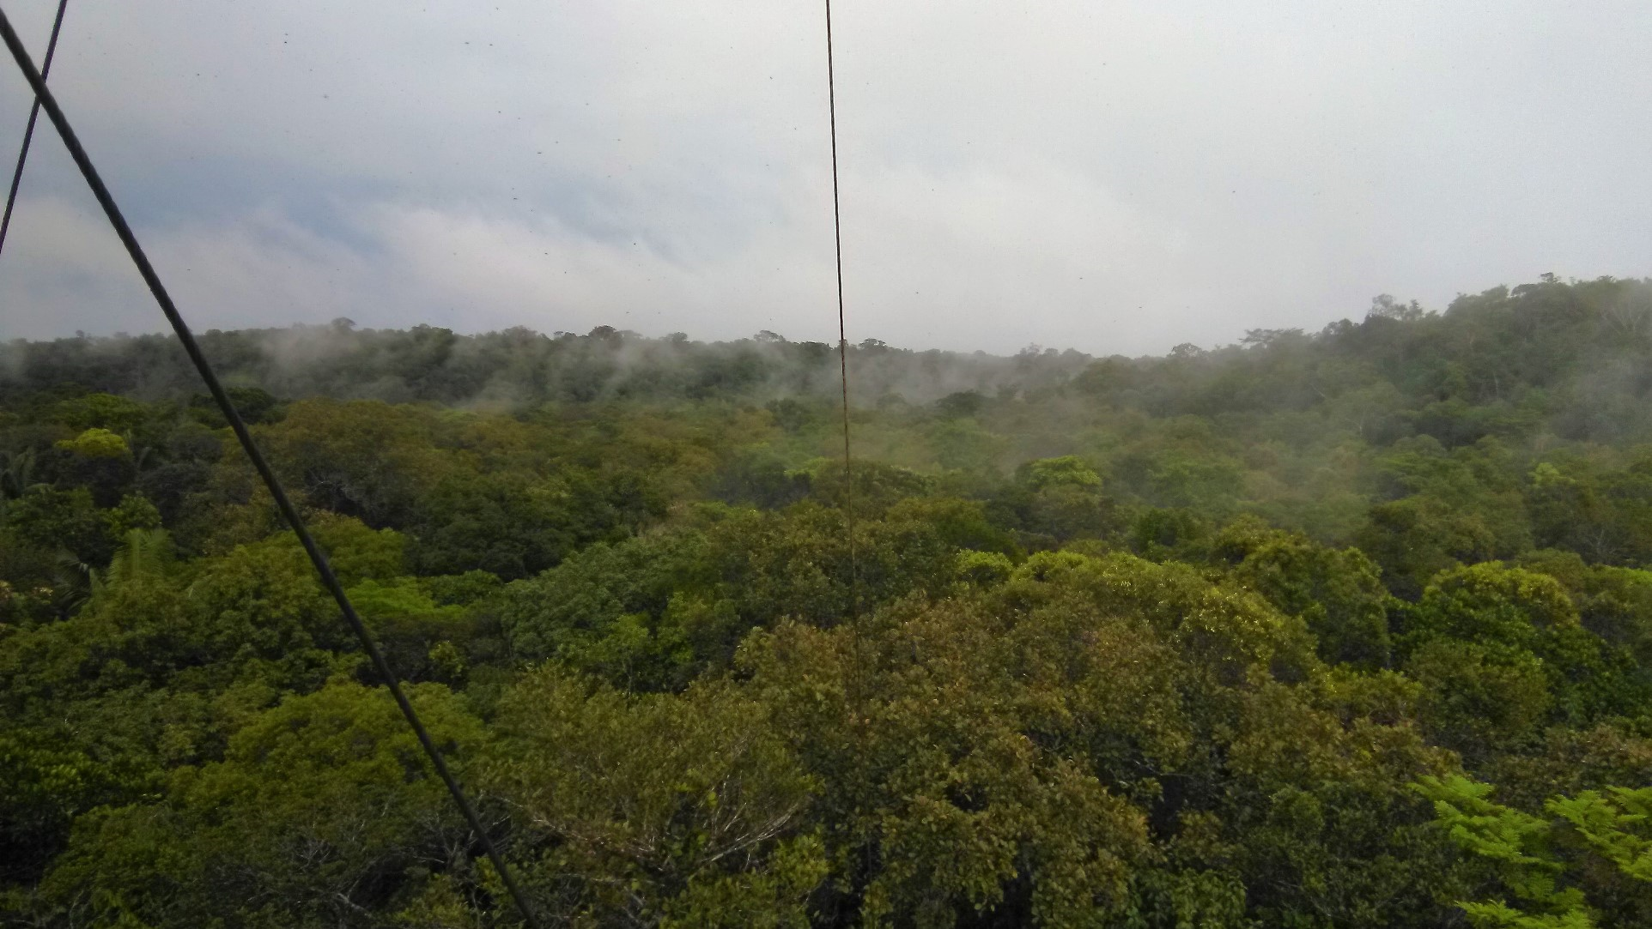
Tropical forest CH₄
Natural sources of methane are still not well understood and quantified.
The Amazon rainforest is expected to be a significant source of methane, but in situ CH₄ flux measurements are rare.
By combining different instruments and measurement techniques, we aimed to identify the different CH₄ sources and sinks in the ecosystem, and tried to estimate the overal net CH₄ flux.
Fig 1: View from the B34 valley tower, at fieldsite ZF2
Introduction - Soil CH₄ flux - Termite (mound) CH₄ flux - Ecosystem CH₄ flux - Ecosystem CH₄ budget

Slide 3
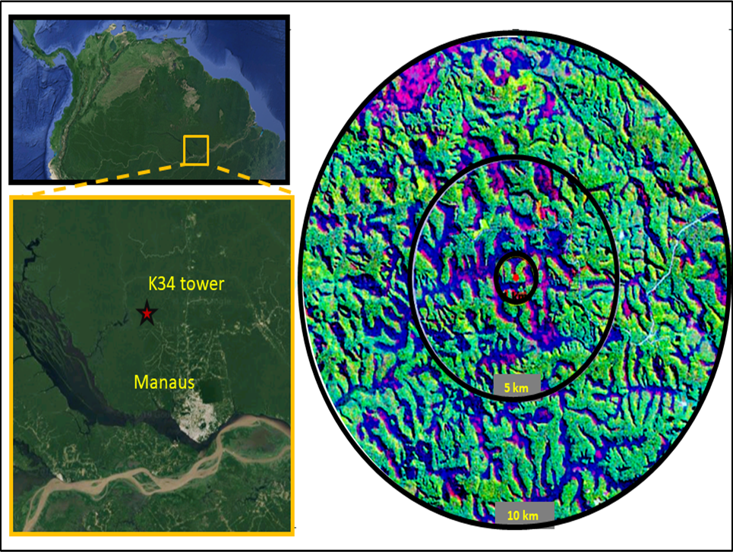
Field site & Instruments
Fieldsite ZF2 (LBA, INPA) is located 60 km northwest of Manaus (Brazil), in the middle of the Amazon rainforest (Fig. 2). The area consists of plateaus and waterlogged valleys. The 50m high K34 tower, located on the plateau, is a micrometeorological tower, providing environmental
and flux (CO₂ and H₂O) data.
Two additional instruments were added to the K34-tower (2018-2021):
A Spectronus FTIR-analyzer (CO₂, CH₄, CO, N₂O and δ¹³CO₂);
  continuously measures concentrations at 5, 15, 36 and/or 51 m;
  measures bag samples from soil and termite flux chamber measurements, and bag samples from nighttime valley air.
a Los Gatos ultraportable analyzer (CO₂ and CH₄)
  Nighttime valley tower (B34) profile measurements;
  Flux chamber measurements on soil, tree stems, water, and termite mounds;
  Termite incubations experiments.
Fig 2: the location of the K34 tower at fieldsite ZF2, 60 km northwest of Manaus
Introduction - Soil CH₄ flux - Termite (mound) CH₄ flux - Ecosystem CH₄ flux - Ecosystem CH₄ budget

Slide 4
Ecosystem CH₄ budget
Soil flux measurements
Termite (mound) flux measurements
Tower (total ecosystem) flux measurements
Slide 5-8
Slide 9-13
Slide 14-16
Ecosystem CH₄ budget
Slide 17-20
Tropical forest CH₄budget:
the importance of local hotspots
Introduction - Soil CH₄ flux - Termite (mound) CH₄ flux - Ecosystem CH₄ flux - Ecosystem CH₄ budget

Slide 5
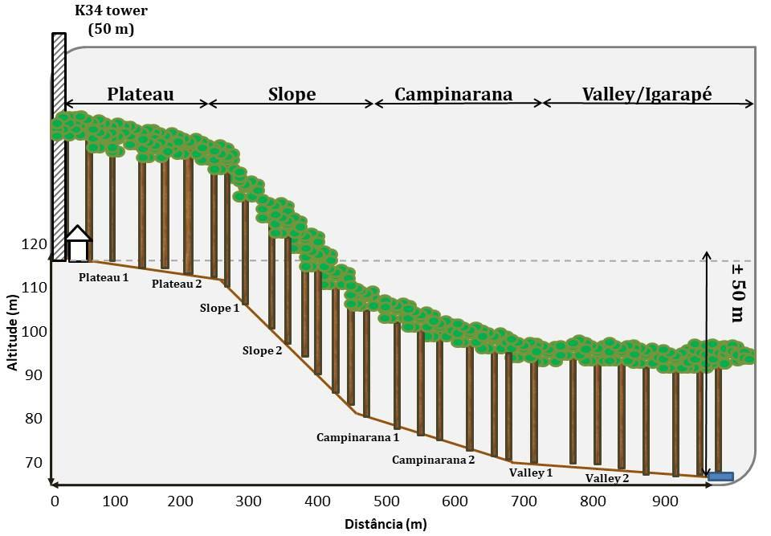
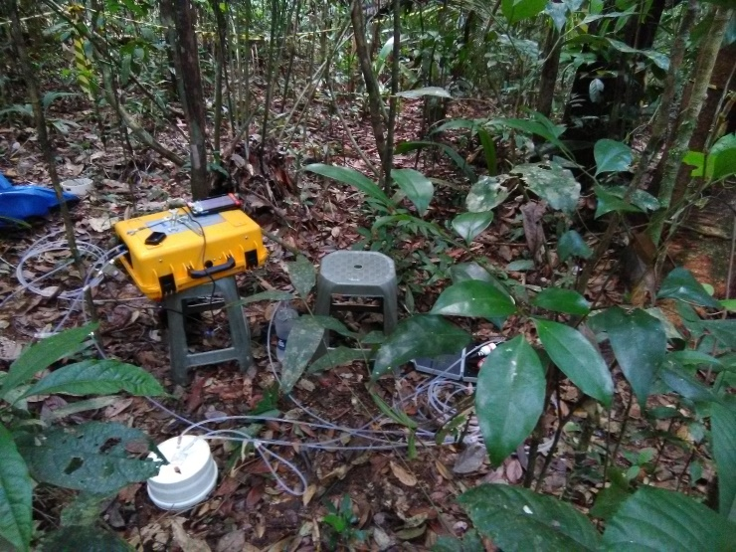
Soil flux CH₄ measurements
40 soil collars were installed at 8 topographical locations (Fig. 3b).
CO₂ and CH₄ fluxes were measured by use of the Los Gatos analyzer, connected to a portable flow-through flux chamber (4.7 L, Fig. 3a).
Fig 3a: Picture of the Los Gatos analyzer, measuring the soil flux chamber
Fig 3b: Overview of the topography of the transect, with the 8 soil flux locations indicated.
5
Introduction - Soil CH₄ flux - Termite (mound) CH₄ flux - Ecosystem CH₄ flux - Ecosystem CH₄ budget

Slide 6
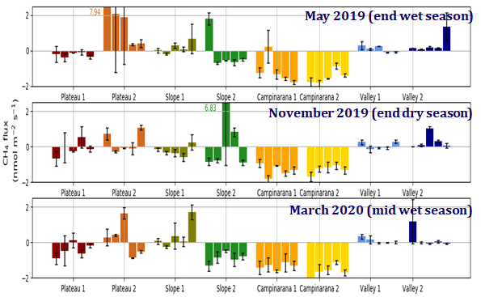
Soil flux CH₄ measurements
Fig 4: Soil CH₄ fluxes measured in the different seasons: upper figure is wet season (May 2019), middle figure is dry season (November 2019), and lower figure is wet season (March 2020). Every bar stands for the average of the 3 measurements.
6
Introduction - Soil CH₄ flux - Termite (mound) CH₄ flux - Ecosystem CH₄ flux - Ecosystem CH₄ budget

Slide 7
Soil flux CH₄ measurements
*ar
 | Area* | Wet season 2019 |  | Dry season 2019 |  | Wet season 2020
 |  | Median | Mean | Median | Mean | Median | Mean
Plateau 1 | 0.26 | -0.21 | -0.22 | -0.24 | -0.12 | -0.38 | -0.42
Plateau 2 |  | 0.41 | 2.53 | -0.06 | 0.26 | 0.33 | 0.19
Slope 1 | 0.31 | 0.09 | 0.18 | -0.28 | -0.25 | -0.04 | 0.38
Slope 2 |  | -0.54 | -0.12 | -0.61 | 1.02 | -0.84 | -0.89
Campinarana 1 | 0.43 | -1.47 | -1.14 | -1.19 | -1.34 | -1.54 | -1.35
Campinarana 2 |  | -1.54 | -1.48 | -1.34 | -1.31 | -1.67 | -1.72
Valley 1 |  | 0.12 | 0.13 | -0.03 | 0.05 | 0.01 | 0.09
Valley 2 |  | 0.14 | 0.42 | 0.17 | 0.29 | -0.03 | 0.21
Area weighted average |  | -0.339 nmol m⁻² s⁻¹ | 0.085 nmol m⁻² s⁻¹ | -0.435 nmol m⁻² s⁻¹ | -0.109 nmol m⁻² s⁻¹ | -0.490 nmol m⁻² s⁻¹ | -0.405 nmol m⁻² s⁻¹
*area is based on Zanchi et al. 2014
7
Introduction - Soil CH₄ flux - Termite (mound) CH₄ flux - Ecosystem CH₄ flux - Ecosystem CH₄ budget

Slide 8
Soil flux CH₄ measurements
Valley was a small but consistent source of CH₄, while the neighboring sandy campinarana was a strong CH₄ sink.
While the slope and the plateau overall show CH₄ uptake, also some strong CH₄ emissions were observed, varying over small scale, and varying over the different seasons. As a result of the high spatial variability, the mean and median flux per location differ strongly.
Based on the medians of the 3 season, an area-weighted average soil ecosystem flux of -0.5 to -0.3 nmol m⁻² s⁻¹ was estimated, indicating that the soil in this ecosystem is a net sink of CH₄.
8
Introduction - Soil CH₄ flux - Termite (mound) CH₄ flux - Ecosystem CH₄ flux - Ecosystem CH₄ budget

Slide 9
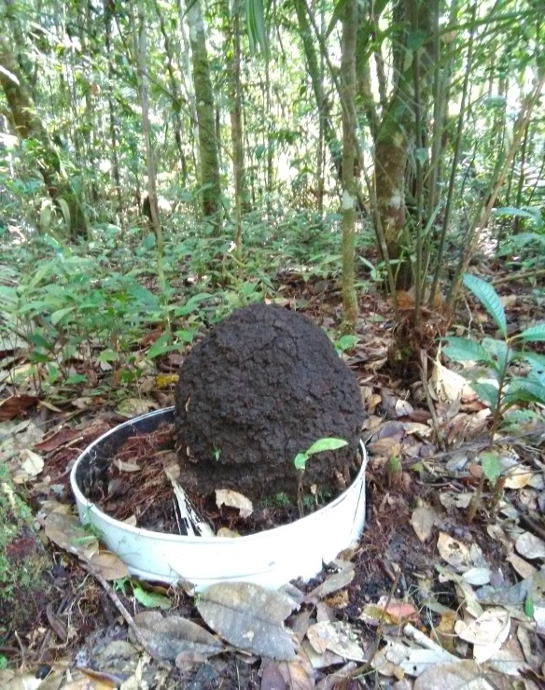
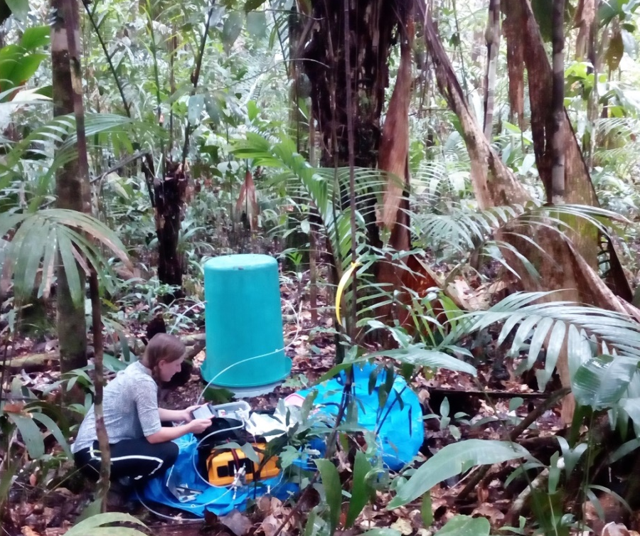
Termite mound CH₄ fluxes
What are the CH₄ emissions of termite mounds?
5 mound of the species Neocapritermes brasiliensis were selected for termite mound measurements
Emission were measured by placing a large bucket over the mound, and measuring the CH₄ increase in the bucket by use of the portable Los Gatos analyzer
Fig 5: A termite mound of the species ‘Neocapritermes brasiliensis’. A special soil collar was designed to fit around the mound so that the flux chamber could be installed without leaks.
More details about this part can be found in van Asperen et al. (2021)
9
Introduction - Soil CH₄ flux - Termite (mound) CH₄ flux - Ecosystem CH₄ flux - Ecosystem CH₄ budget

Slide 10
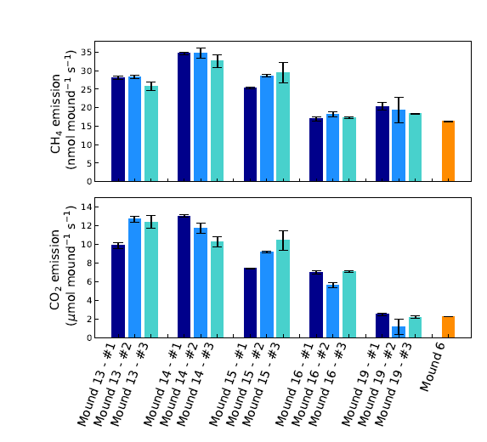
Termite mound CH₄ fluxes
What are the CH₄ emissions of termite mounds?
Fig 6: Termite mounds of the species ‘Neocapritermes Brasiliensis’ were found to be hotspots of CH₄, with on average fluxes of 25.2 nmol mound per second. Mound 6 is a termite mound of a different species.
More details about this part can be found in van Asperen et al. (2021)
10
Introduction - Soil CH₄ flux - Termite (mound) CH₄ flux - Ecosystem CH₄ flux - Ecosystem CH₄ budget

Slide 11
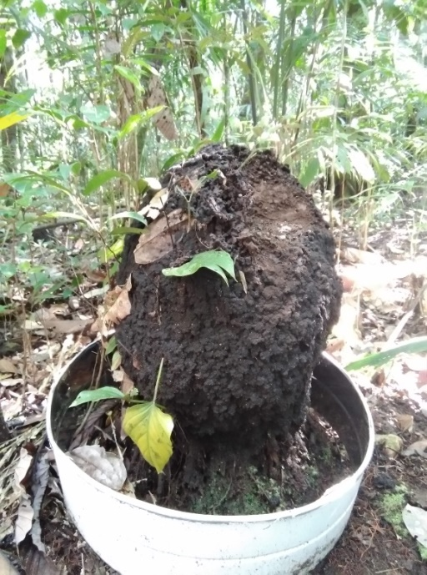
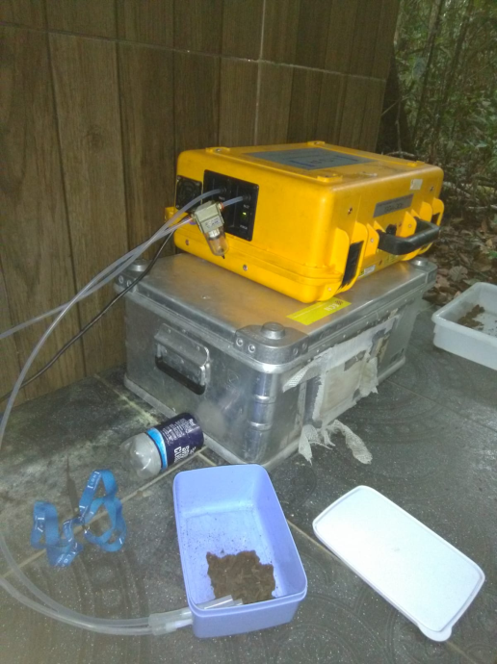
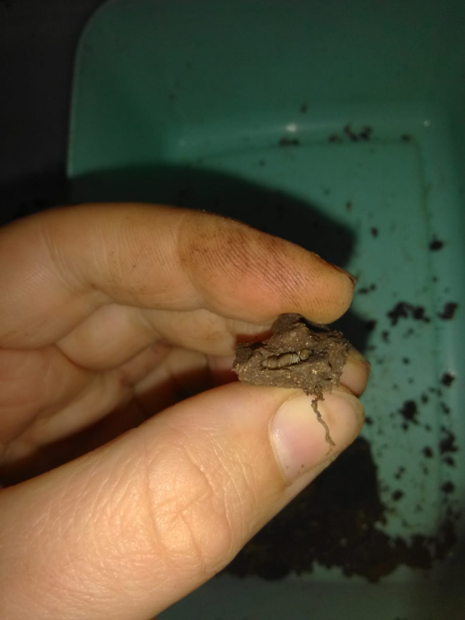

Individual termite CH₄ fluxes
What is the CH₄ emission per termite?
1
2
3
Sample piece
from
termite mound
Measure small pieces in mini chamber
Break open
mound
material
Count
all
termites
Fig 7: A piece of termite mound was sampled, and placed in a mini incubation chamber. After an emission measurement of 10 minutes, the mound material was broken open, and termites were counted.
More details about this part can be found in van Asperen et al. (2021)
11
Introduction - Soil CH₄ flux - Termite (mound) CH₄ flux - Ecosystem CH₄ flux - Ecosystem CH₄ budget

Slide 12
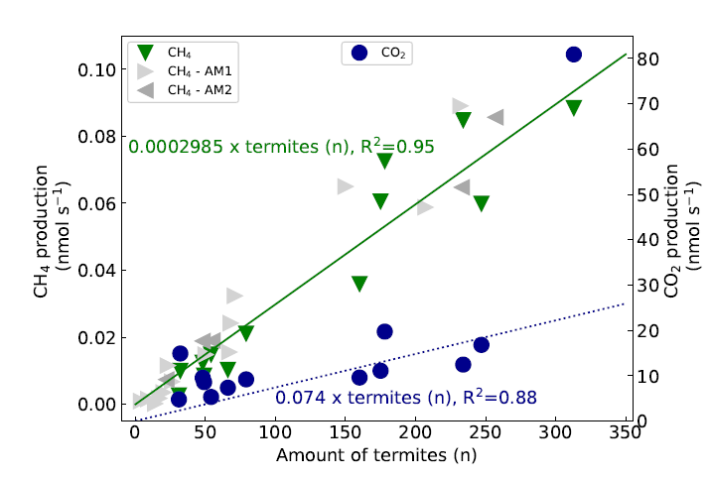
Individual termite CH₄ fluxes
What is the CH₄ emission per termite?
Fig 8: A termite emission factor of 0.0002985 nmol termite⁻¹ s⁻¹ (0.35 μmol g_{termite}⁻¹ h⁻¹) was determined, which is twice as high as the previously found value for the Amazon by Martius et al. (1993).
More details about this part can be found in van Asperen et al. (2021)
12
Introduction - Soil CH₄ flux - Termite (mound) CH₄ flux - Ecosystem CH₄ flux - Ecosystem CH₄ budget

Slide 13
Termite CH₄ on ecosystem scale
what is the role of termites in the ecosystem?
Mound density values from local studies were used to upscale to ecosystem scale
This estimate neglects termite activity outside mounds, and is therefore lower-bound
Average mound emission:
25.2 nmol CH₄ nest⁻¹ s⁻¹
Mound density: 60-280 nests ha⁻¹
Ecosystem termite emission:
0.15-0.71 nmol CH₄ m⁻² s⁻¹
Estimated termite biomass for tropical rainforest (11 g_{termite} m⁻²) were combined with the termite emission factor
Termite emission factor:
0.0002985 nmol CH₄ termite⁻¹ s⁻¹
Termite weight: 3.07 mg termite⁻¹
Ecosystem termite emission:
1.1 nmol CH₄ m⁻² s⁻¹
Termite biomass: 11 g m⁻²
More details about this part can be found in van Asperen et al. (2021)
13
Introduction - Soil CH₄ flux - Termite (mound) CH₄ flux - Ecosystem CH₄ flux - Ecosystem CH₄ budget

Slide 14

Tower (total ecosystem) CH₄ flux
The Spectronus FTIR analyzer continously (every 30 min) measured the concentrations of vertical profile of CO₂, CH₄, CO, N₂O and δ¹³CO₂, at the heights 5, 15, 36 and/or 51 m (canopy height ~28 m) from 2018 to 2021;
The Los Gatos analyzer measured the nighttime vertical profile of CO₂ and CH₄ during 3 one-week campaigns at the valley tower B34, at the heights 2,5,10,18,25 and 40 m (canopy height ~20m). These campaigns took place in May 2019 (end wet season), November 2019 (end dry season) and March 2020 (wet season).
Tower profile data can be used to estimate the CH₄ flux: at night, if the atmosphere is stable, forest respiration leads to a gradual CO₂ accumulation in the forest so that 'dCO₂/dz‘ (vertical gradient) is positive. If the CH₄ concentrations also show a concentration increase over height, a CH₄ source can be expected, and the CH₄ emission can be estimated as follows (Carmo et al. 2006):
  $$PCH4=PCO2\frac{{dCH4}/{dz}}{{dCO2}/{dz}}$$
14
Introduction - Soil CH₄ flux - Termite (mound) CH₄ flux - Ecosystem CH₄ flux - Ecosystem CH₄ budget

Slide 15
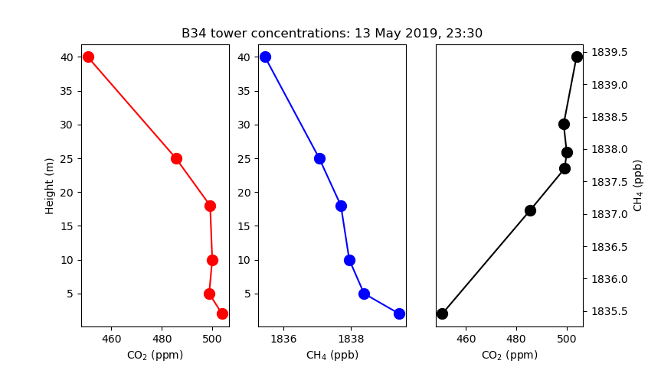
Tower (total ecosystem) CH₄ flux
(dCH₄/dz)/(dCO₂/dz) is estimated by correlating the CH₄ and CO₂ concentration data of a minimum of 3 heights each half hour (R²>0.95). Ratios was calculated for every 30 min for the plateau tower (K34) as well as for the valley tower (B34) for nighttime hours (20h-5h).
Ratios were also calculated for N₂O and CO, but are not shown in this presentation.
  PCO₂ is planned to be calculated as ‘Storage flux + Eddy Covariance flux’. For these preliminary results, the ecosystem respiration value of Chambers et al. (2004) of 7.8 µmol m⁻² s⁻¹ is taken, which was estimated for this ecosystem specifically.
Fig 9: The CO₂ (left panel) and CH₄ profile (middle panel) during one night in the dry season at the valley tower B34, as measured by the Los Gatos portable instrument. The right panel shows the CO₂ vs the CH₄ concentrations.
15
Introduction - Soil CH₄ flux - Termite (mound) CH₄ flux - Ecosystem CH₄ flux - Ecosystem CH₄ budget

Slide 16
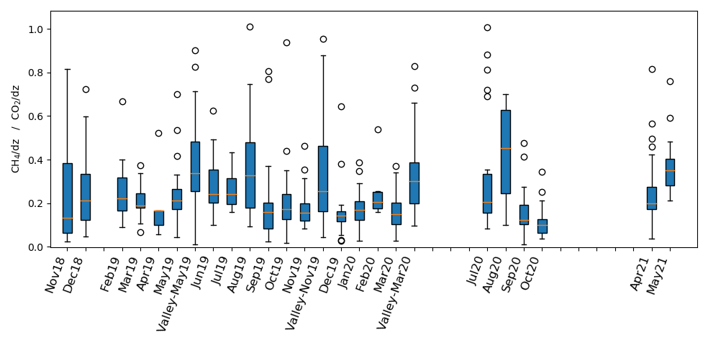
Tower (total ecosystem) CH₄ flux
The figure shows the ratios, grouped per month. All 30 min-ratios were filtered for R²>0.95 and dCH₄/dz>0 and dCO₂/dz>0.
Plateau ratios vary strongly, but the average ratio ranges between 0.1 and 0.4.
The valley profile measurements (red squares) indicate a higher ratio (>0.3).
Based on these preliminary analyses, the following CH₄ emission can be estimated:
7.8* (0.1-0.4)=0.8-3.4 µmol CH₄ m⁻² s⁻¹
16
Introduction - Soil CH₄ flux - Termite (mound) CH₄ flux - Ecosystem CH₄ flux - Ecosystem CH₄ budget

Slide 17
Estimated ecosystem CH₄ budget
  Soil fluxes - median based estimate -0.5 to -0.3 nmol m⁻² s⁻¹
  Soil fluxes - mean based estimate -0.4 to 0.1 nmol m⁻² s⁻¹
  Contribution of soil fluxes -0.5 to 0.1 nmol m⁻² s⁻¹
  Termite mound fluxes ~0.5 nmol m⁻² s⁻¹
  General termite emission 1.1 nmol m⁻² s⁻¹
  Contribution of termite emission 0.5-1.1 nmol m⁻² s⁻¹
  (Plateau) ecosystem CH₄ flux 0.8-3.4 nmol m⁻² s⁻¹
  CH₄ emission estimated by previous study (Querino et al. 2011) 1.0 nmol m⁻² s⁻¹
17
Introduction - Soil CH₄ flux - Termite (mound) CH₄ flux - Ecosystem CH₄ flux - Ecosystem CH₄ budget

Slide 18
Estimated ecosystem CH₄ budget
  Soil fluxes indicate an overall CH₄ uptake, but also showed a large spatial variability, and the presence of (temporary) emission hotspots (Fig 4).
  Termite mound measurements showed that mounds can be strong local emitters, serving as CH₄ hotspots in its surrounding (Fig 6).
  Considering the estimated ecosystem emission (0.8-3.4 nmol m⁻² s⁻¹), there are likely more hotspots in the ecosystem, in the form of active (anaerobic) soil spots, termite nests, rotting wood and water emissions.
18
Introduction - Soil CH₄ flux - Termite (mound) CH₄ flux - Ecosystem CH₄ flux - Ecosystem CH₄ budget

Slide 19
Estimated ecosystem CH₄ budget
  Several additional experiments have been performed at the fieldsite to study and quantity these hotspots, which are not shown in this presentation:
    Floating chamber and tree flux measurements;
    Ebullition bubble detection experiment, wherein CH₄ concentrations were measured continuously just above the water surface (50 cm);
    Nighttime valley concentration measurements, wherein CH₄ was measured in the valley, adjacent to the valley stream;
    Spatial variability experiment on the plateau, wherein 8 inlets (0.5m height) were continuously measured for CH₄ concentrations.
19
Introduction - Soil CH₄ flux - Termite (mound) CH₄ flux - Ecosystem CH₄ flux - Ecosystem CH₄ budget

Slide 20
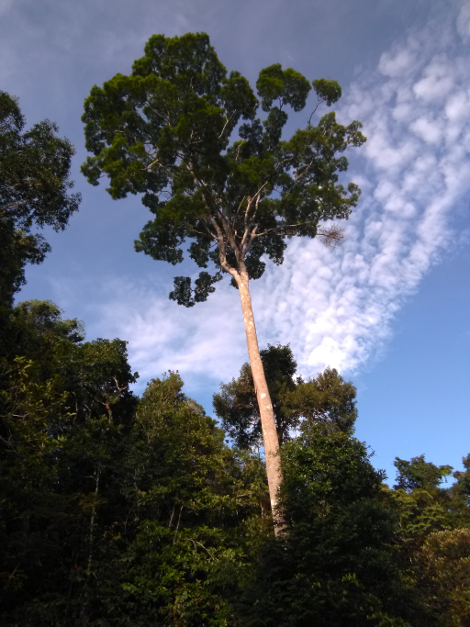
Conclusion
By combining different instruments and set ups, different components of the CH₄ budget of the ecosystem could be studied.
In this presentation, just a selection of the measurements was shown.
Overall, it is expected that hotspots, such as termite mounds, dead wood, or active soil spots, play an important role in the ecosystems CH₄ budget.
20
Introduction - Soil CH₄ flux - Termite (mound) CH₄ flux - Ecosystem CH₄ flux - Ecosystem CH₄ budget

Slide 21
References
Carmo, J. B. D., Keller, M., Dias, J. D., Camargo, P. B. D., & Crill, P. (2006). A source of methane from upland forests in the Brazilian Amazon. Geophysical Research Letters, 33(4).
Chambers, J. Q., Tribuzy, E. S., Toledo, L. C., Crispim, B. F., Higuchi, N., Santos, J. D., ... & Trumbore, S. E. (2004). Respiration from a tropical forest ecosystem: partitioning of sources and low carbon use efficiency. Ecological Applications, 14(sp4), 72-88.
Querino, C. A. S., Smeets, C. J. P. P., Vigano, I., Holzinger, R., Moura, V., Gatti, L. V., ... & Röckmann, T. (2011). Methane flux, vertical gradient and mixing ratio measurements in a tropical forest. Atmospheric chemistry and physics, 11(15), 7943-7953.
van Asperen, H., Alves-Oliveira, J. R., Warneke, T., Forsberg, B., de Araújo, A. C., & Notholt, J. (2021). The role of termite CH 4 emissions on the ecosystem scale: a case study in the Amazon rainforest. Biogeosciences, 18(8), 2609-2625.
Zanchi, F. B., Meesters, A. G., Kruijt, B., Kesselmeier, J., Luizão, F. J., & Dolman, A. J. (2014). Soil CO₂ exchange in seven pristine Amazonian rain forest sites in relation to soil temperature. Agricultural and Forest Meteorology, 192, 96-107.
For any questions, please feel free to write me:
Hella van Asperen
hasperen@bgc-jena.mpg.de
Introduction - Soil CH₄ flux - Termite (mound) CH₄ flux - Ecosystem CH₄ flux - Ecosystem CH₄ budget

Slide 22
Acknowledgements
We are grateful for the support of the DFG, which supported this research by providing an individual research grant (grant no. 352322796)
We are thankful for the support of the crew of the experimental field site ZF2, the research station managed by the INPA-LBA (National Institute for Amazonian Research (INPA), The Large-Scale Biosphere-Atmosphere Research Program in Amazonia (LBA)). We would also like to express our gratitude to the staff of LBA for providing logistics, advice, and support during
different phases of this research.
Introduction - Soil CH₄ flux - Termite (mound) CH₄ flux - Ecosystem CH₄ flux - Ecosystem CH₄ budget

