Slide 1




Recent and future intense fire seasons in the Mediterranean basin:
the increasing role of droughts and heatwaves
Ricardo Trigo, Marco Turco, Sonia Jerez, Pedro Sousa, Ana Russo and Julien Ruffault
May 2022 EGU General Assembly 2022

Slide 2
Turco et al (2017)
1985-2011
EFFIS
(a) Maximum significant correlation between detrended log(BA) and SPEI (b) length of the period (3, 6 and 12 months)

Slide 3
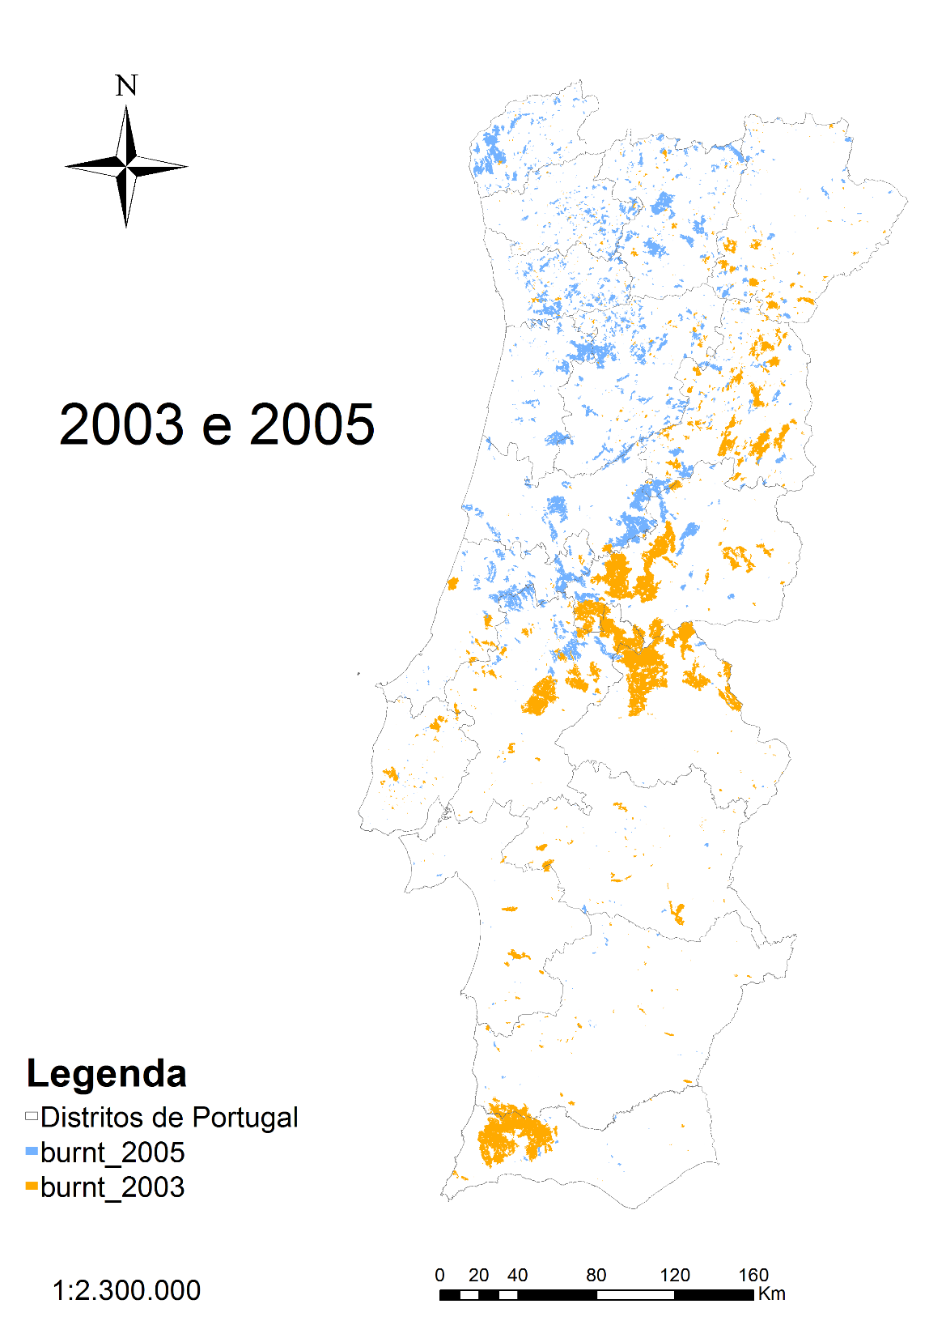
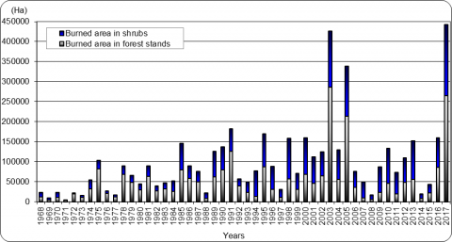
Annual burned area in Portugal since 1980 (peaks in 2003 2005 2017)
2005 fires induced by Winter-spring Drought
2003 fires induced by HW
2003 fires induced by HW

Slide 4
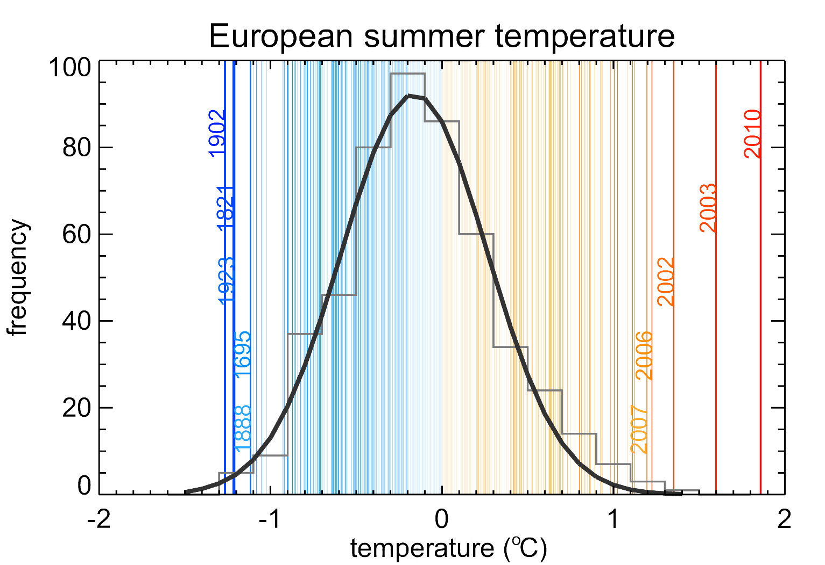
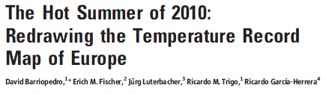
The impact of summer 2003 and 2010 mega-heatwaves in Europe
Barriopedro et al. (2011, SCIENCE)
Notes:
Statistical frequency distribution of European ([35ºN, 70ºN], [25ºW, 40ºE]) summer land temperature anomalies (ºC, relative to the 1970-1999 period) for the 1500-2010 period (vertical lines). The five warmest and coldest summers are highlighted. Grey bars represent the distribution for the 1500-2002 period (11) with a Gaussian fit in black. Data for the 2003-2010 period are from (23). The bottom panel shows the running decadal frequency of extreme summers, defined as those with temperature above the 95th percentile of the 1500-2002 distribution. A 10-yr smoothing is applied. Dotted line shows the 95th percentile of the distribution of maximum decadal values that would be expected by random chance (15).

Slide 5
The impact of summer 2018 and 2019 heatwaves in Europe
2018
2019
(Sousa et al, 2019)
(New French Record) 44,1ºC (2003)
46ºC (2019)

Slide 6
The impact of summer 2018 and 2019 heatwaves in Europe
(Sousa et al, 2020)

Slide 7
(Ruffault et al, 2020)

Slide 8

Takeaway messages
1) In Mediterranean-type climates, the frequency and amplitude of extreme events (Drought – Heat waves – Fires) are rising significantly and increasingly driven by Climate Change.
2) The Mediterranean region is bound to see a higher risk of Hot-Drought and Heatwave type of fires in the next decades as RCMs show that both types are predicted to become more frequent under Climate Change.
This work was supported by national funds through FCT (Fundação para a Ciência e a Tecnologia, Portugal) under project FIRECAST (PCIF/GRF/0204/2017). M.T. is supported by the Spanish Ministry of Science, Innovation and Universities - Spanish State Research Agency and the European Regional Development Fund through the PREDFIRE projects (RTI2018-099711-J-I00, MCI/AEI/FEDER, EU) and the Ramón y Cajal grant (RYC2019-027115-I). S.J. thanks the Spanish Ministry of Science, Innovation and Universities - Agencia Estatal de Investigación and the European Regional Development Fund for the support received through the EASE project (RTI2018 100870 A I00).

