Slide 1

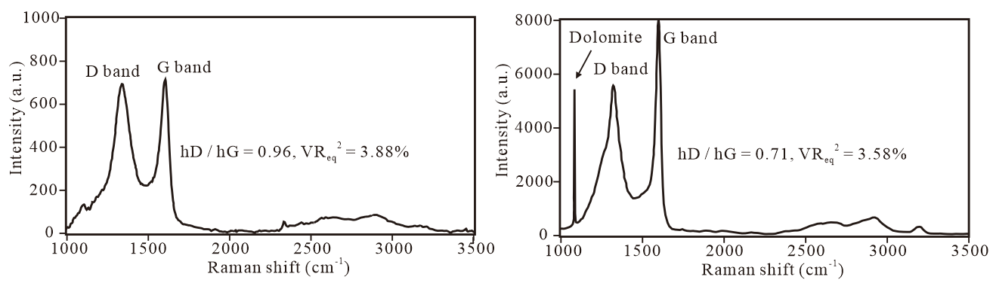
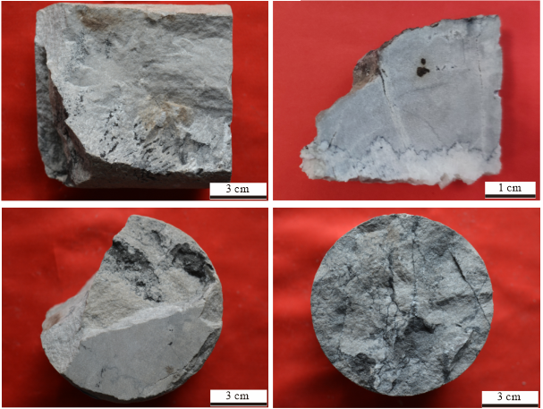
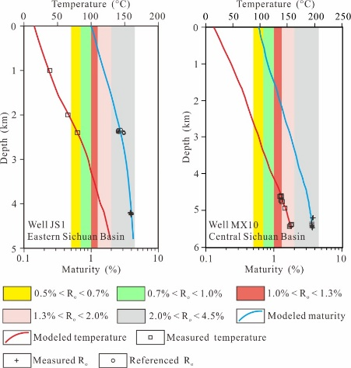
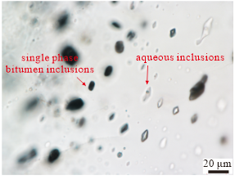
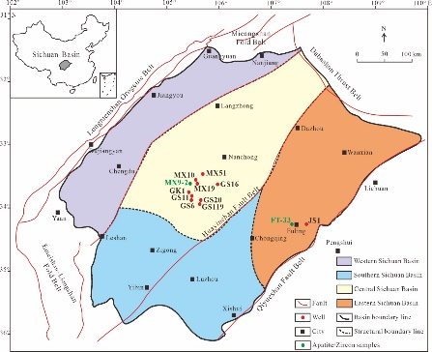
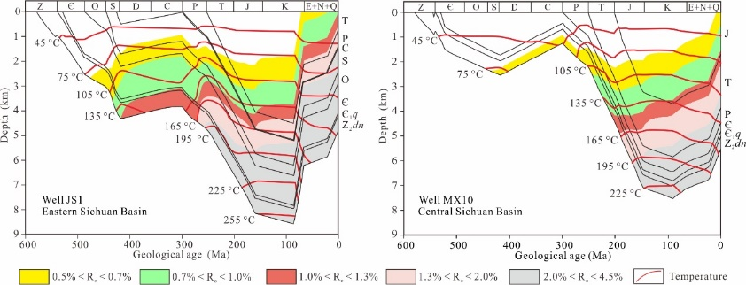
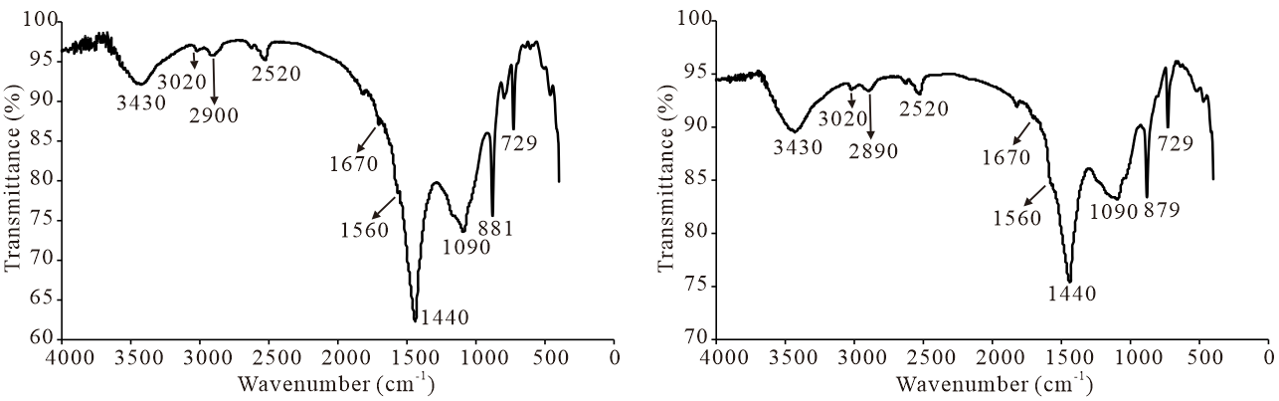
Maturity assessment of solid bitumen in the Sinian carbonate reservoirs of the eastern and central Sichuan Basin, China:
insights from FTIR and Raman spectroscopy analyses
Jiaxu Chen and Xiaowen Guo
Introduction
and Raman spectroscopy analysis.
Wells MX10 and JS1 were selected to simulate the burial and thermal history of Sinian reservoirs in the central and eastern Sichuan Basin utilizing the BasinMod 1-D software.
of the central Sichuan Basin vary from 3.54% to 3.64% (Fig. 5).
Maturity assessment of solid bitumen is significant for the construction of the thermal evolution history of Sinian carbonate reservoirs in the eastern and central Sichuan Basin because of the absence of vitrinite. Optical characteristics, thermal maturity levels, and geochemical compositions of solid bitumen in the central Sichuan Basin have been extensively studied, yet its thermal maturity remains controversial. The application of solid bitumen reflectance plays an important role in assessing thermal maturity due to the intensified exploitation of deep carbonate hydrocarbon systems in the central Sichuan Basin. However, it is difficult to interpret the reflectance values of solid bitumen debris in the Sinian carbonate reservoirs according to the established empirical thresholds because of their extensive values (0.12%–9.35%) which are not common in ordinary reservoirs. Therefore, the thermal maturity levels of solid bitumen are very difficult to accurately evaluate by solid bitumen reflectance.
Thermal maturity of solid bitumen
Based on detailed observation of core samples and thin sections, solid bitumen was identified within intercrystalline pores, intercrystalline dissolution pores, karst caves, fractures, and stylolites in the Sinian reservoir of the Sichuan Basin (Fig. 2). Single-phase bitumen inclusions were observed in the Sinian reservoir of the central Sichuan Basin (Fig. 3).
The FTIR spectrums of solid bitumen are characterized by depleted aliphatic carbon and C=O group, and enrichment of aromatic carbon, which indicates that the VR_{eq} values of solid bitumen in the Sichuan Basin exceed at least 1.3%. (Fig. 4).
The calculated VR_{eq} values of solid bitumen inferred by Raman spectroscopy analysis are 3.8%–4.09% and 3.51%–3.77% in the eastern and central Sichuan Basin, respectively (Fig. 5). The calculated VR_{eq} values of bitumen inclusions
Fig. 5 Raman spectrums of solid bitumen and bitumen inclusions in the Sichuan Basin.
Thermal evolution history of Sinian reservoirs
Modeled temperatures and R_{o} values concur with the measured temperatures and R_{o} values, implying that the burial and thermal history models are suitable for the eastern and central Sichuan Basin (Fig. 6). The thermal evolution history of Sinian reservoirs in the eastern and central Sichuan Basin can be divided into two heating–cooling stages. At the end of the second heating stage, that is, the Late Cretaceous, the Sinian reservoir reached the highest temperature of 250 °C in the eastern Sichuan Basin and 225 °C in the central Sichuan Basin (Fig. 7).
Objective
The objectives of this study are to: (1) evaluate the thermal maturity of solid bitumen in the Sinian carbonate reservoirs of the eastern and central Sichuan Basin by FTIR spectroscopy and Raman spectroscopy; (2) reconstruct the thermal history of the Sinian carbonate reservoirs in the eastern and central Sichuan Basin.
Fig. 2 Photographs showing the occurrence of solid bitumen in the Sinian reservoirs of the Sichuan Basin.
Geological settings
The Sichuan Basin, located in the southwest of China, is a superimposed petroliferous basin that developed on the Precambrian basement of the Yangtze Craton, covering an area of 1.8 × 10⁵ km²(Fig. 1). The basin can be divided into four secondary structural units, including the western Sichuan Basin, the southern Sichuan Basin, the central Sichuan Basin, and the eastern Sichuan Basin. The Sinian dolomites in the Sichuan Basin constitute high-quality reservoirs in which natural gas and solid bitumen were found.
Fig. 6 Depth profiles of modeled and measured temperatures and Ro values in wells JS1 and MX10.
Fig. 3 Photograph of bitumen inclusions in the Sinian reservoir of the central Sichuan Basin.
Fig. 1 Geological map of the Sichuan Basin, showing main structural units and well locations.
Methods
Thermal maturity of solid bitumen was evaluated by FTIR spectroscopy
Fig. 4 FTIR spectrums of solid bitumen in the Sichuan Basin.
Fig. 7 Burial and thermal history of wells JS1 and MX10 in the Sichuan Basin.

