Slide 1
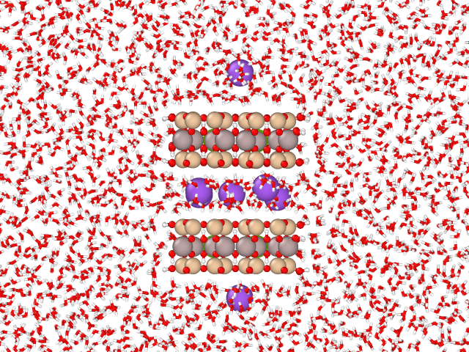
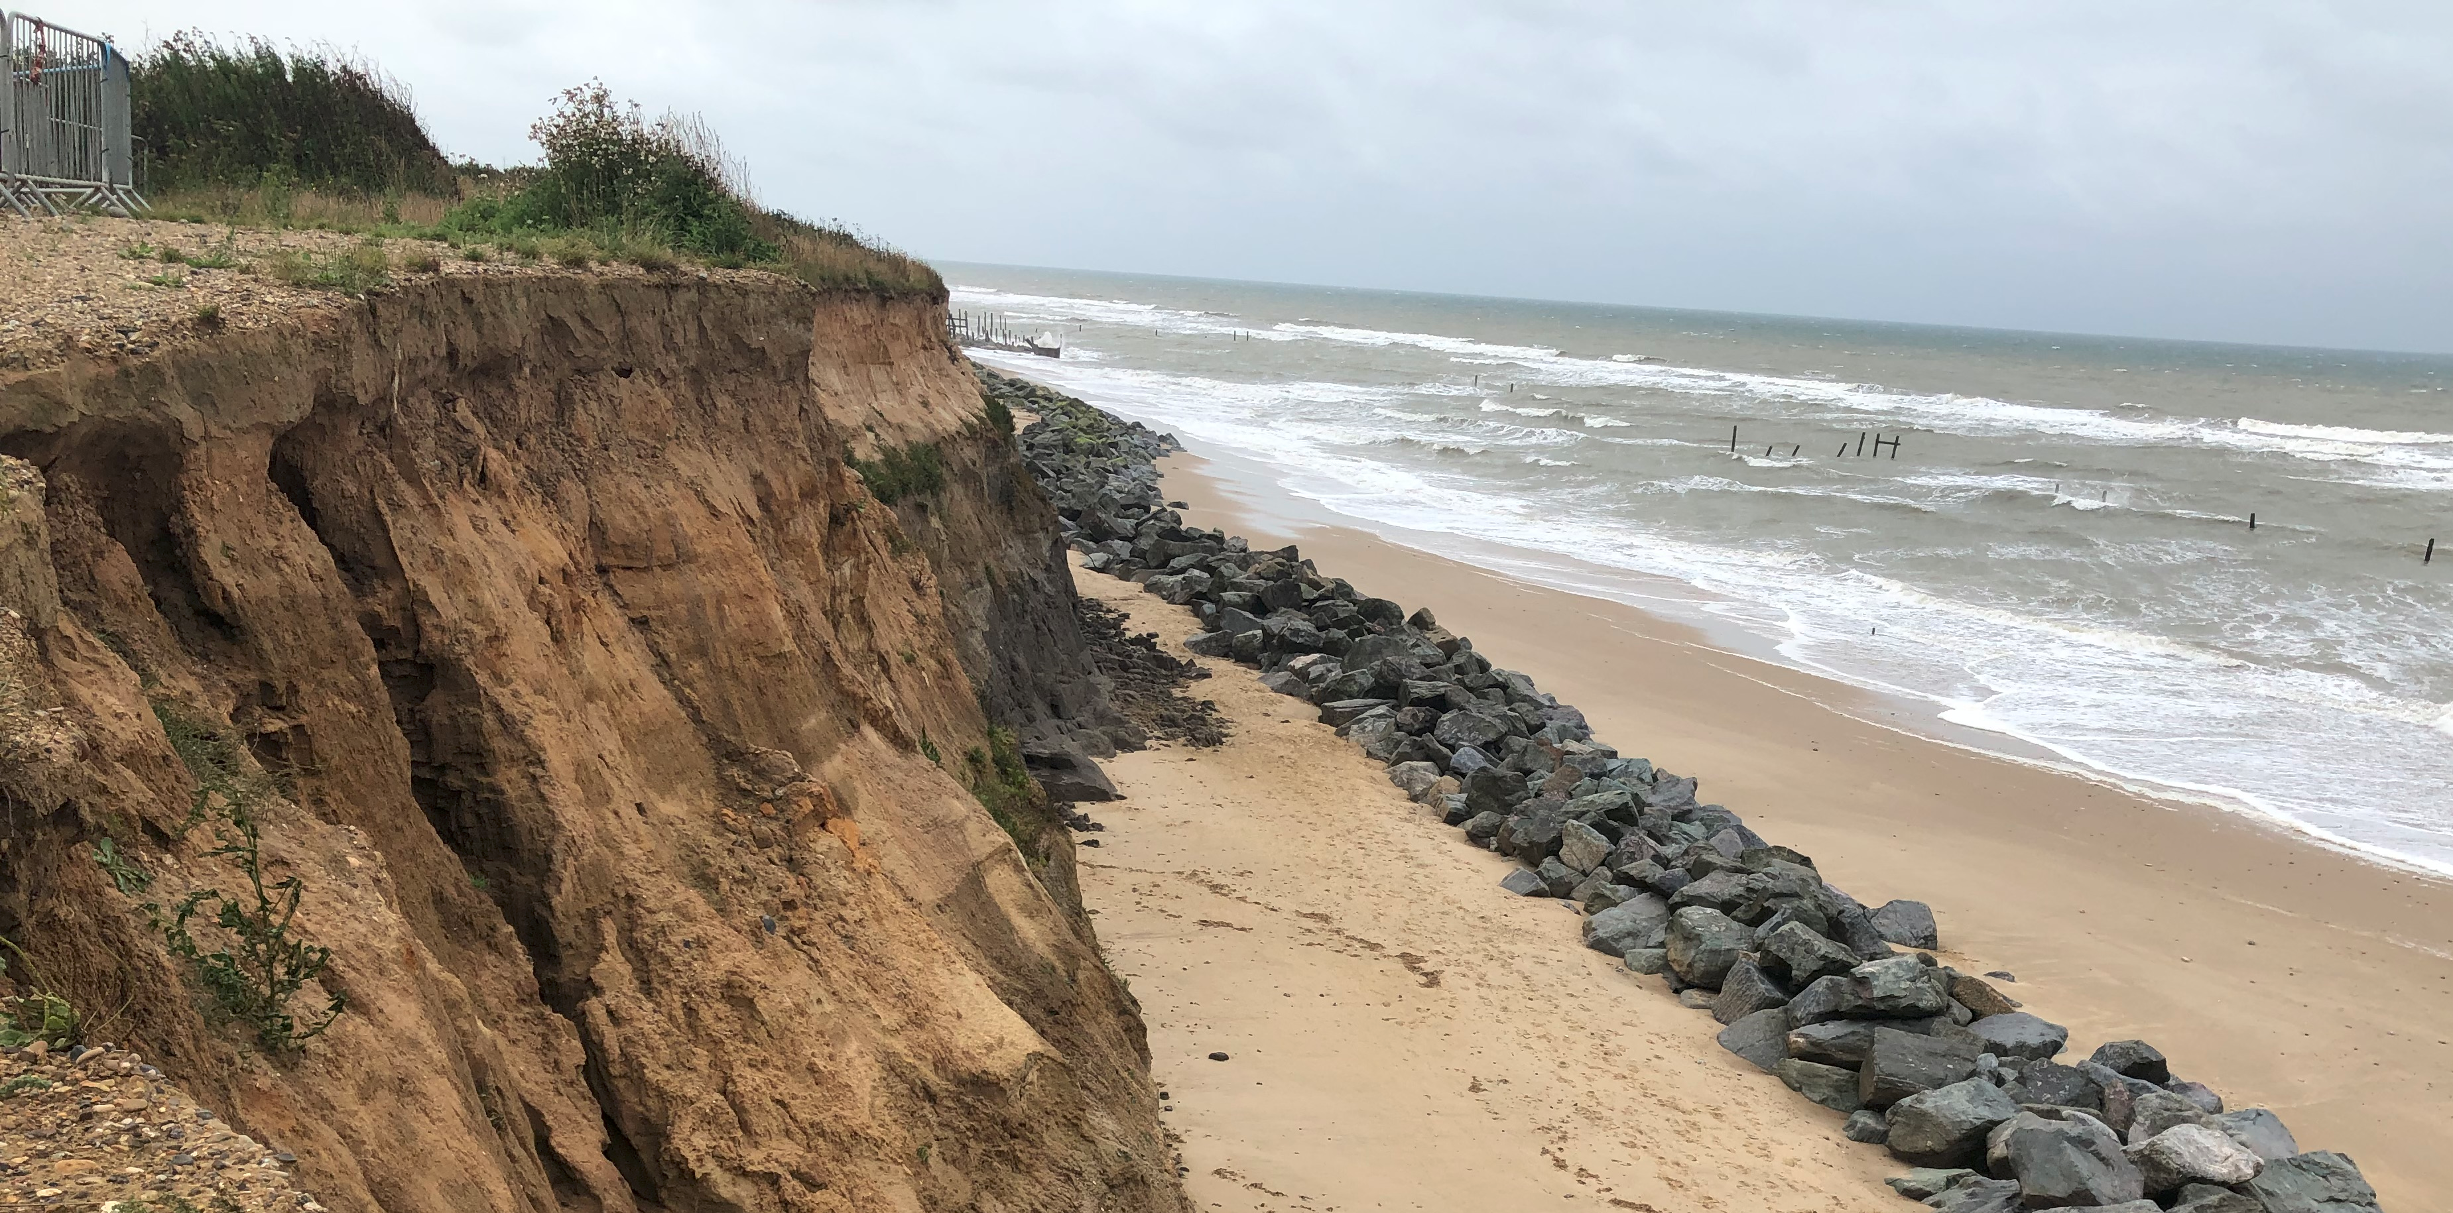



Modelling short-range interaction of clay particles to improve erodibility prediction
W.L. Chenª, R. Grabowskiª S. Goel^{b,c,d}
ªSchool of Water, Energy and Environment, Cranfield University; ^{b}School of Engineering, London South Bank University; ^{c}University of Petroleum and Energy Studies, Dehradun 248007, India; ^{d}Indian Institute of Technology Guwahati, Guwahati 781039, India.
Notes:
Hello, welcome to my presentation, my name is wenlong chen, I am working in Cranfield University as a research fellow. In this talk, I am going to share out latest research on using molecular dynamics simulation to model the short-range interaction of clay particles, an to improve the prediction of erodibility with our model. I would like to thank my co-authors, Dr Robert Grabowski and professor Saurav Goel from London south bank university. As well as the financial support from EPSRC and the university.

Slide 2
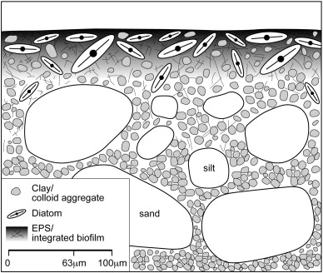
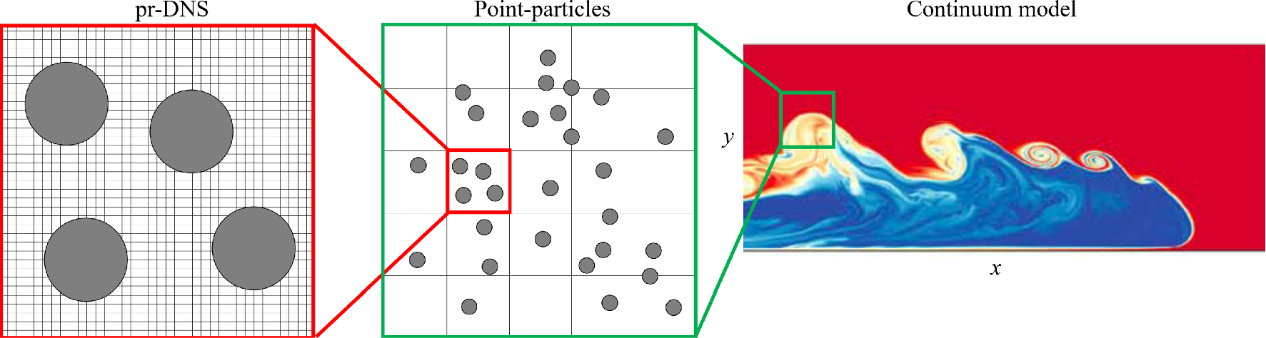

Research goal and motivation
Modelling short-range interaction of clay particles to improve erodibility prediction
Notes:
Sediment erosion affects many engineering problems, such as the water quality, pollutant transport, land deformation, bank failure or coastal erosion. Such large-scale engineering problems are normally solved using continuum model. However, as pointed out by recent studies on sediment transport, an accurate continuum model should based on point resolved sediment dynamics. Where inter-particle interaction is crucial in predicting the movement of sediment. Now lets look into the mixture of cohesive sediment. The fine composition of the mixture, especially the finest composition, clay, are in fact the dominant component providing attraction within the mixture. Clay featured with small size, negative charge and plate like shape. It is very active both physically and chemically. Owing to these features, clay provides the most adhesion and cohesion to the cohesive sediment, and is very important for the stability of the mixture.

Slide 3
Research goal and motivation
Sediment erodibility is a crucial property of sediment affecting many problems, i.e., pollutant transport, land deformation, bank failure and coastal erosion.
Clay: size < 2µm, negative charge, plate shape, physical-chemical active, provides adhesion and cohesion, and determines the stability of cohesive sediment.
No universal formula for the prediction of sediment erodibility.
Quantification the inter-particle interaction is essential (Vowinckel 2021).
We aim to use molecular dynamics to quantify inter-particle forces for clay of different charge.
Modelling short-range interaction of clay particles to improve erodibility prediction
Notes:
Sediment erosion affects many engineering problems, such as the water quality, pollutant transport, land deformation, bank failure or coastal erosion. Such large-scale engineering problems are normally solved using continuum model. However, as pointed out by recent studies on sediment transport, an accurate continuum model should based on point resolved sediment dynamics. Where inter-particle interaction is crucial in predicting the movement of sediment. Now lets look into the mixture of cohesive sediment. The fine composition of the mixture, especially the finest composition, clay, are in fact the dominant component providing attraction within the mixture. Clay featured with small size, negative charge and plate like shape. It is very active both physically and chemically. Owing to these features, clay provides the most adhesion and cohesion to the cohesive sediment, and is very important for the stability of the mixture. Numerous studies looked into the interactions between clay particles with both experimental and numerical methods, but results remains as empirical. Which led to the fact that there is no universal formula for the prediction of sediment erodibility. In this study, we would like to build up from the bottom, using molecular dynamics to quantify inter-particle forces for clay particles. The variation of clay charge was also considered.

Slide 4
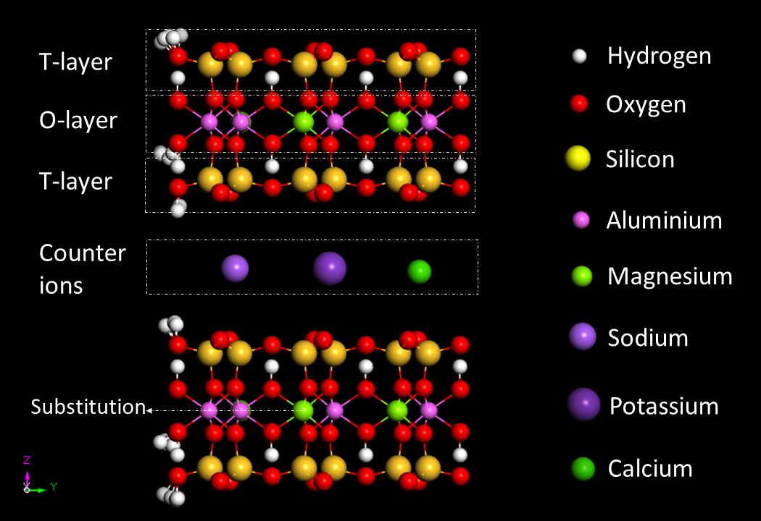

Method: montmorillonite (MMT) structure
MMT plate has a typical T-O-T layered structure.
Substitution of O-Al (3+) with Mg (2+) leads to negative charge in the center.
Positively charged cations, i.e. Na (+), in the interlayer space balance the charge.
$$δ$$
Modelling short-range interaction of clay particles to improve erodibility prediction
Notes:
Here is an example of clay structure. Clay is featured with numerous plate layers stack together. Here we look at montmorillonite, which has such sandwidch structure in each layer, for instance, with two surface tetrahedral layers and one interior octahedral layers. The substitution of o-layer Aluminium with Magnesium then leads to negative charge of the particle, owing to their valence difference. Various number of substitution then leads to different layer charge. Which requires positively charged cations to balance the charge. Cations can be mono valent, such as sodium and potassium or bivalent like calcium. The distance between two layers, here denoted as delta, and is recorded as an indicator for the swelling state of clays.

Slide 5
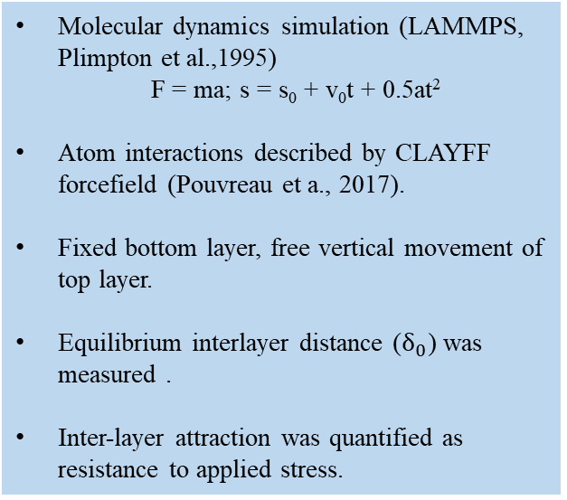
Method: molecular dynamics simulation
Molecular dynamics simulation (LAMMPS, Plimpton et al.,1995)
F = ma; s = s₀ + v₀t + 0.5at²
Atom interactions described by CLAYFF forcefield (Pouvreau et a., 2017).
Fixed bottom layer, free vertical movement of top layer.
Equilibrium interlayer distance ($δ_{0}$) was measured .
Inter-layer attraction was quantified as resistance to applied stress.
Water
Na⁺
Clay layer
Modelling short-range interaction of clay particles to improve erodibility prediction
Notes:
We are using lammps software to perform the molecular dynamics simulation, which uses newton’s second law to predict the trajectory of atoms. The force/interaction between atoms are described with the CLAYFF force field. As you can see from the right figure, a two layer particle was used, the white and red sticks indicate the water molecules, and the disperse purple balls are resolved sodium atoms. Throughout the simulation, the bottom layer was fixed, whereas the top layer was free to move vertically. The inter-layer attraction was quantified as resistance to applied stress.

Slide 6
Results: equilibrate of clay in water
Unstable structure for Na-MMT carrying -0.375 e/unit, -0.5 e/unit and -0.625 e/unit.
Stable structure for Na-MMT with -0.125, -0.25 and -0.75 e/unit, but at different distance, i.e., thickness of 1/2 water layer (1/2W) for low/high charge.
Step wise 1W-2W swell and osmotic swell are reproduced for Na-MMT (Chen et al., 2022).
Modelling short-range interaction of clay particles to improve erodibility prediction
Notes:
clay of various charge were placed in water box and equilibrate over time. the top layer was fixed for the 1st ns at a distance of 2 A, and relaxed afterwards. in the figure, the x axis is time and y axis is interlayer distance. as you can see from the figure, clay of various charge shows distincting behavior. with low charge, for instance panel a and b, the clay stabilized at a distance around 3 A, which is the thickness of 1 water layer. with mediate charge, clay swells to a distance over 12 A. this is known as osmotic swell in soil dynamics. swelling clay has no resistance towards external stress and is not stable. with high charge, like it shown in panel f, clay stabilized at around 6 A, which is equivalent to the thickness of 2 water layer.
the jump from 1W-2W state is rather swift, like a step-wise, this is a phenomenon known as christalline swell, and was simulated for the first time in our study. the mechanism underneath christalline swell and osmotic swell could be found on our latest publication on ACS omega.

Slide 7
Results: pull resistance analysis
F_{p}
Modelling short-range interaction of clay particles to improve erodibility prediction
Notes:
to quantify the attraction in between clay layers, we performed a so called pull resistance analysis on those stable clay particles. the final state of stable clay from previous simulation was used. we apply pull stress on the top layer, and incrementally increased the stress until the top layer was dragged away from the bottom layer. the maximum stress the structure could withstand is then captured and used to represent clay attraction.

Slide 8
Results: pull resistance analysis of stable Na-MMTs
The maximum F_{p} obtained in the pull resistance analysis was normalized over the basal surface of the particle to obtain P_{res,p}.
Greater resistance at lower charge (-0.125 e/unit).
Resistance correlates inversely with a inter-layer equilibrium distance (1W vs 2W).
Modelling short-range interaction of clay particles to improve erodibility prediction
Notes:
Results are present in this figure, for each clay, a number of pull tests were performed, the averaged value were plotted, with bar indicating the standard deviation. note that the clay with mediate charge has no resistance. the greatest resistance was found for clay of lowest charge. The resistance is inversely correlates with the interlayer equilibrium distance. as clay with bigger interlayer distance exhibits lower resistance.

Slide 9
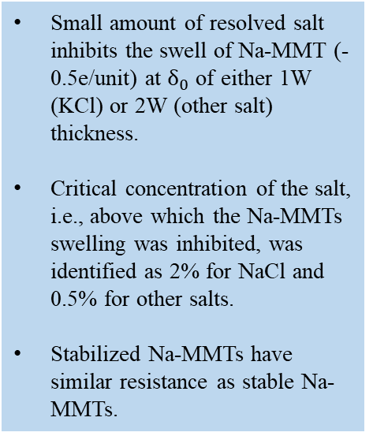
Results: inhibition of salt on clay swell
Small amount of resolved salt inhibits the swell of Na-MMT (-0.5e/unit) at $δ_{0}$ of either 1W (KCl) or 2W (other salt) thickness.
Critical concentration of the salt, i.e., above which the Na-MMTs swelling was inhibited, was identified as 2% for NaCl and 0.5% for other salts.
Stabilized Na-MMTs have similar resistance as stable Na-MMTs.
Modelling short-range interaction of clay particles to improve erodibility prediction
Notes:
we also investigated the effect of salt on the swelling clays, for sodium based mot carrying 0.5 e/unit negative charge, we add salt of various type and concentration into the water box. in general, adding salt effectively inhibit the osmotic swelling of the particle but the requirement of salt concentration differs for various salt. in the top panel we can see the equilibrium interlayer distance of clay in salted water. osmotic swelling was observed for water with sodium chloride concentration lower than 2%, whereas with other salt, only 0.5% of salt was needed to stop the osmotic swelling. note that, with potassium chloride, the clay stabilizes at 1W thickness. as a result, the strength of clay was greatly improved. with other salt, stabilized clay has similar resistance as those of stable clay in water.

Slide 10
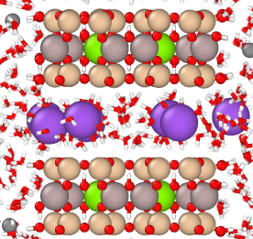
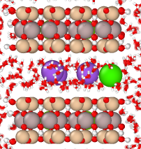
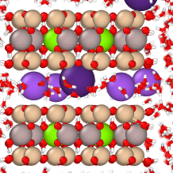
Results: inhibition of salt on clay swell
2% NaCl
1% CaCl₂
1% KCl
Resolved NaCl in water increased the interlayer Na cations, while resolved CaCl₂ and KCl replaced interlayer Na with Ca or K.
Modelling short-range interaction of clay particles to improve erodibility prediction
Notes:
the stabilizing mechanism of various salt differs, as the figure shows, with 2% NaCl, increased number of cations were observed, whereas with other salts, the Na Cation was replaced with other more stable cations.

Slide 11
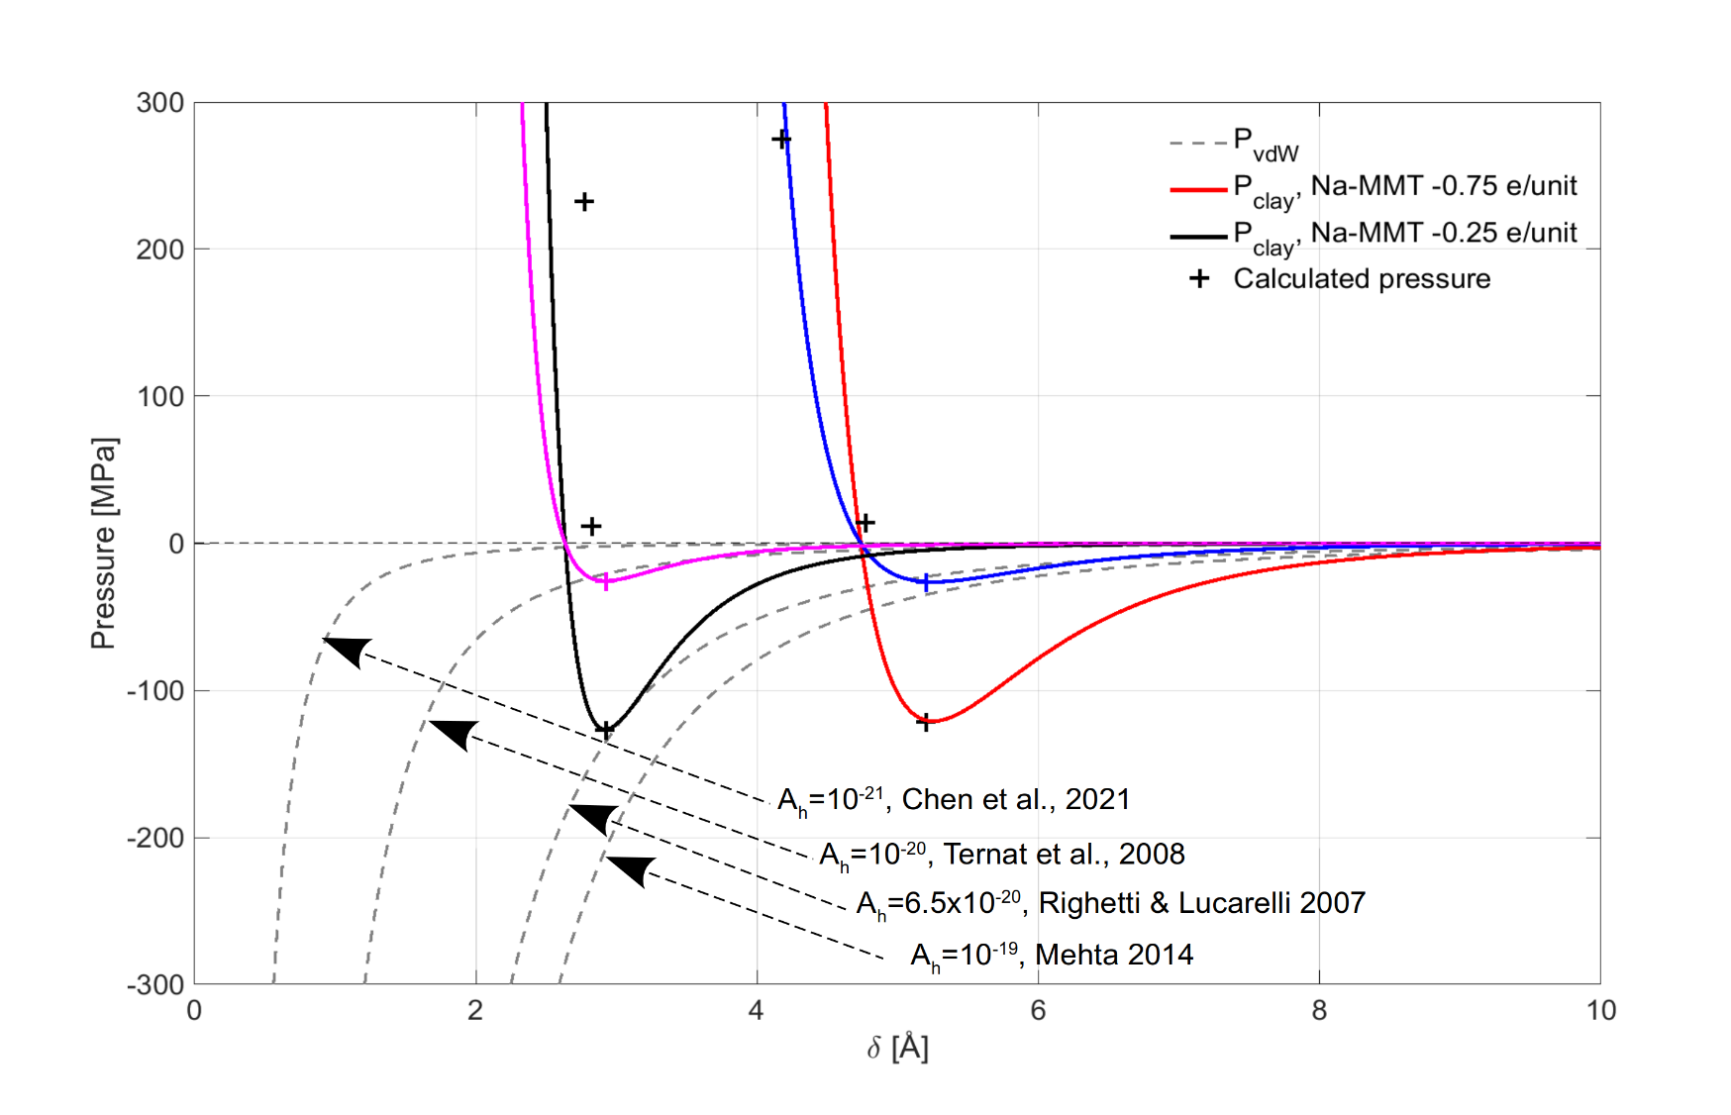
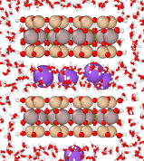
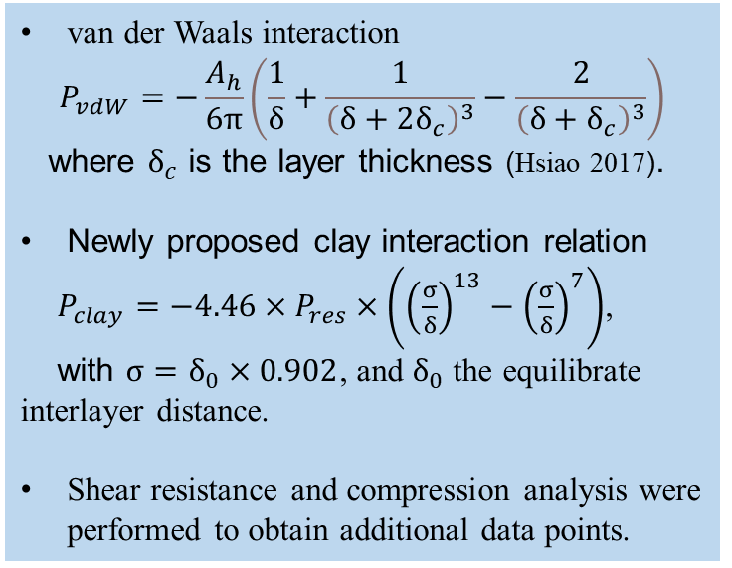
Results: clay interaction
van der Waals interaction
$$P_{vdW}=−\frac{A_{h}}{6π}\left(\frac{1}{δ}+\frac{1}{{\left(δ+2δ_{c}\right)}^{3}}−\frac{2}{{\left(δ+δ_{c}\right)}^{3}}\right)$$
where $δ_{c}$ is the layer thickness (Hsiao 2017).
Newly proposed clay interaction relation
$P_{clay}=−4.46×P_{res}×\left({\left(\frac{σ}{δ}\right)}^{13}−{\left(\frac{σ}{δ}\right)}^{7}\right)$,
with $σ=δ_{0}×0.902$, and $δ_{0}$ the equilibrate interlayer distance.
Shear resistance and compression analysis were performed to obtain additional data points.
F_{c}
Modelling short-range interaction of clay particles to improve erodibility prediction
Notes:
with molecular dynamics simulation, we are now able to quantify the resistance of stable clay particles in either pure water or salted environment. we would like to use our result to improve the prediction of sediment erodibility. in sediment transport, an often used theory to describe clay attraction was the van der Waals interaction. it predicts exponentially decreasing attraction over the inter-particle distance as you can find in the dashed curves where hamaker constant was used to account for variations in the clay minerals, water chemistry. The hammer constant was empirically obtained due to the lack of accurate calculation, and various value were suggested. furthermore, the van der Waals attraction predicts a closely attached combination between clay particles, which contradicts our finding of an equilibrate interlayer distance. Here we proposed a new relationship to describe clay interaction that takes the shape of the solid curves. It is inspired from the lenaard-jones potential. Two parameters linking to interlayer distance and resistance were used in the relation. Note that the negative and positive pressure in the figure indicates attraction and repulsion in between clay particles. Where the repulsion at distance short than the equilibrium distance was obtained by press analysis. The proposed relation captures both the attraction and repulsion of clay particles. The blue and purple cross indicate the shear resistance of clay particles.

Slide 12
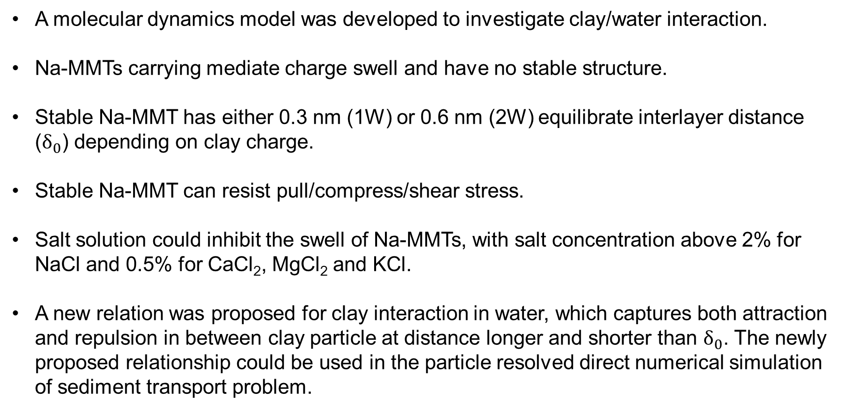
Conclusion
A molecular dynamics model was developed to investigate clay/water interaction.
Na-MMTs carrying mediate charge swell and have no stable structure.
Stable Na-MMT has either 0.3 nm (1W) or 0.6 nm (2W) equilibrate interlayer distance ($δ_{0}$) depending on clay charge.
Stable Na-MMT can resist pull/compress/shear stress.
Salt solution could inhibit the swell of Na-MMTs, with salt concentration above 2% for NaCl and 0.5% for CaCl₂, MgCl₂ and KCl.
A new relation was proposed for clay interaction in water, which captures both attraction and repulsion in between clay particle at distance longer and shorter than $δ_{0}$. The newly proposed relationship could be used in the particle resolved direct numerical simulation of sediment transport problem.
Modelling short-range interaction of clay particles to improve erodibility prediction
Notes:
In conclusion. We developed a molecular dynamics method to investigate nano-scale clay water interaction and to quantify the strength of clay particle.
….
Additional studies on other clays such as beidellde and kaolinite as well as other counter ions were performed, we hope to present these findings in a research paper in the coming month.
Thank you for your attention and we welcome suggestions/comments/communications in any form.

Slide 13
Reference
Israelachvili, J. N., & Pashley, R. M. (1983). Molecular layering of water at surfaces and origin of repulsive hydration forces. Nature, 306(5940), 249–250. https://doi.org/10.1038/306249a0
Hsiao, Y. W., & Hedström, M. (2017). Swelling Pressure in Systems with Na-Montmorillonite and Neutral Surfaces: A Molecular Dynamics Study. Journal of Physical Chemistry C, 121(47), 26414–26423. https://doi.org/10.1021/acs.jpcc.7b09496
Vowinckel, B. (2021). Incorporating grain-scale processes in macroscopic sediment transport models: A review and perspectives for environmental and geophysical applications. Acta Mechanica, 232(6), 2023–2050. https://doi.org/10.1007/s00707-021-02951-4
Chen, W. L., Grabowski, R. C., & Goel, S. (2022). Clay Swelling: Role of Cations in Stabilizing/Destabilizing Mechanisms. ACS Omega, 7(4), 3185–3191. https://doi.org/10.1021/acsomega.1c04384
Chen, D., Zheng, J., Zhang, C., Guan, D., Li, Y., & Wang, Y. (2021). Critical Shear Stress for Erosion of Sand-Mud Mixtures and Pure Mud. Frontiers in Marine Science, 8(October), 1–19. https://doi.org/10.3389/fmars.2021.713039
Plimpton, S. Fast Parallel Algorithms for Short-Range Molecular Dynamics. Journal of Computational Physics 1995, 117 (1), 1–19. https://doi.org/https://doi.org/10.1006/jcph.1995.1039.
Pouvreau, M.; Greathouse, J. A.; Cygan, R. T.; Kalinichev, A. G. Structure of Hydrated Gibbsite and Brucite Edge Surfaces: DFT Results and Further Development of the ClayFF Classical Force Field with Metal-O-H Angle Bending Terms. Journal of Physical Chemistry C 2017, 121 (27), 14757–14771. https://doi.org/10.1021/acs.jpcc.7b05362.
Modelling short-range interaction of clay particles to improve erodibility prediction
Notes:
The simulation results are present here. We looked into clay of various charge, therefore requires different number of sodiums to balance the charge, 2, 4, 6, 12 etc. and also potassium and calcium as balancing cations. The x axis is time and the vertical axis the d-space, which denotes the distance between layers. Lets first look at the sudden jumps of d-space. In panel f, the d-space stays for around 15 ns at 12.5 A and suddenly jumps to 15 A in less than 0.2 ns. Such step-wise increase is also known as crystalline swell. Lets take a close look at this process.

