Slide 1


The channel source hypothesis: Empirical evidence for in-channel sourcing of solutes to explain hysteresis in a headwater mountain stream
Adam S. Ward
Steve M. Wondzell
Hydrological Processes, 2022
bit.ly/ChannelSourceHypothesis

Slide 2
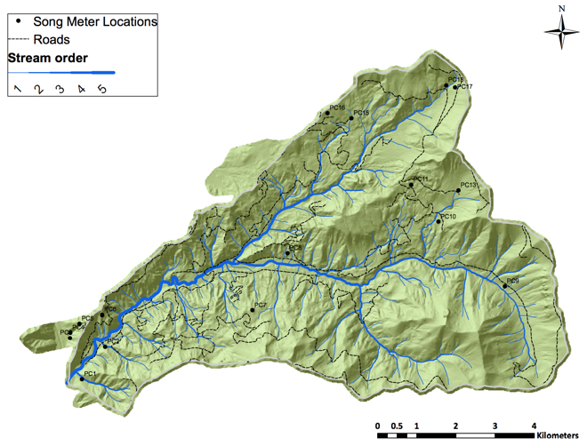
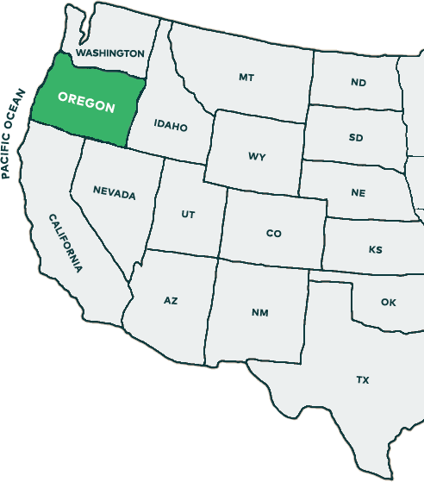
Field campaign: WS01 at the HJ Andrews Experimental Forest
Hydrological Processes, 2022
bit.ly/ChannelSourceHypothesis

Slide 3
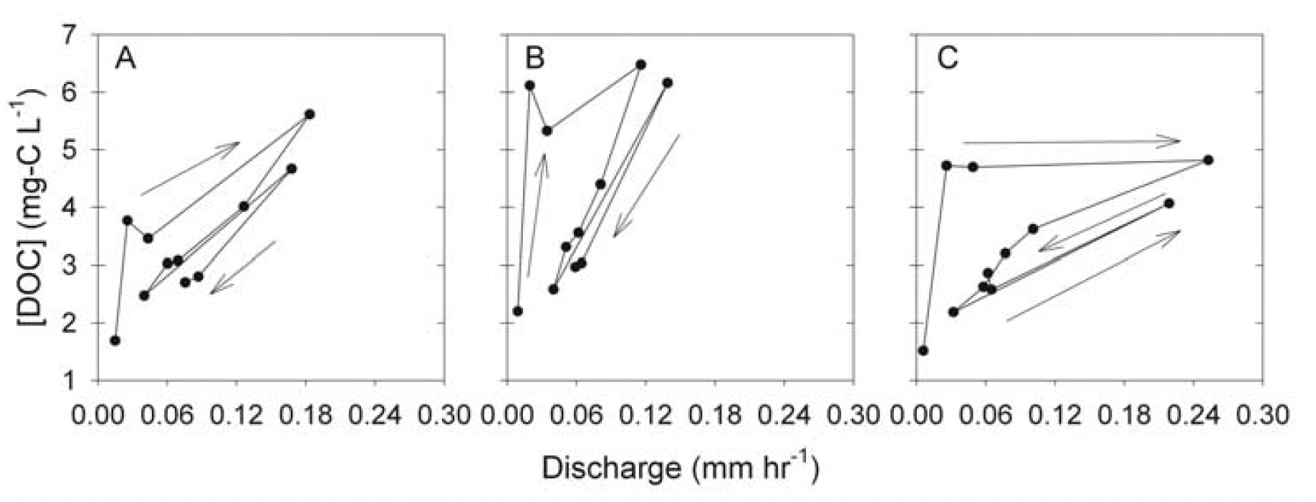
Initial objective: Confirm past observations & mechanism for DOC
Clockwise Hysteresis for DOC
→ Translatory flow displaces
DOC-rich riparian water
Hood et al., JRG, 2004
Outlet-only measurements → Inferred mechanism in our study basin
Hydrological Processes, 2022
bit.ly/ChannelSourceHypothesis

Slide 4
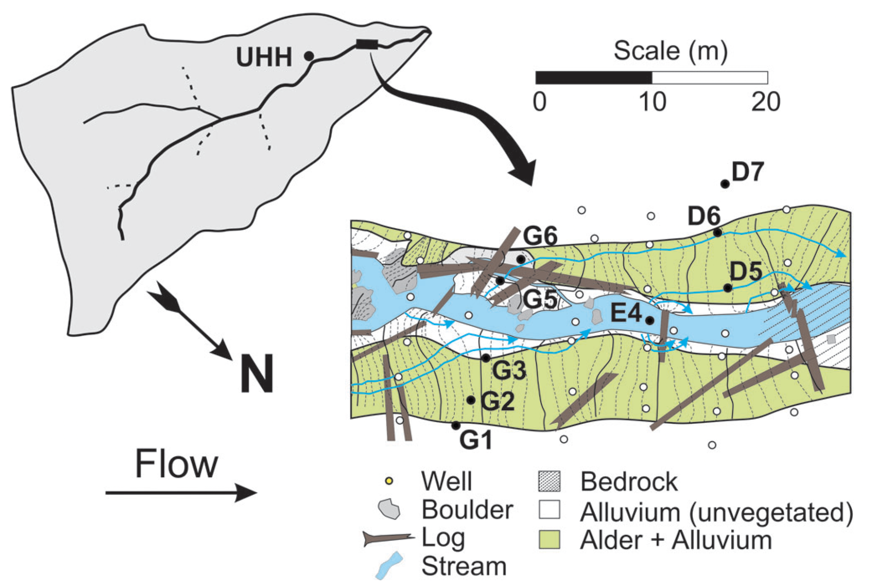
Field campaign: WS01 at the HJ Andrews Experimental Forest
Key observations:
Q
Chemistry
Stream
Hyporheic & riparian wells
Hillslope subsurface flow
Saprolite flow
Hydrological Processes, 2022
bit.ly/ChannelSourceHypothesis

Slide 5
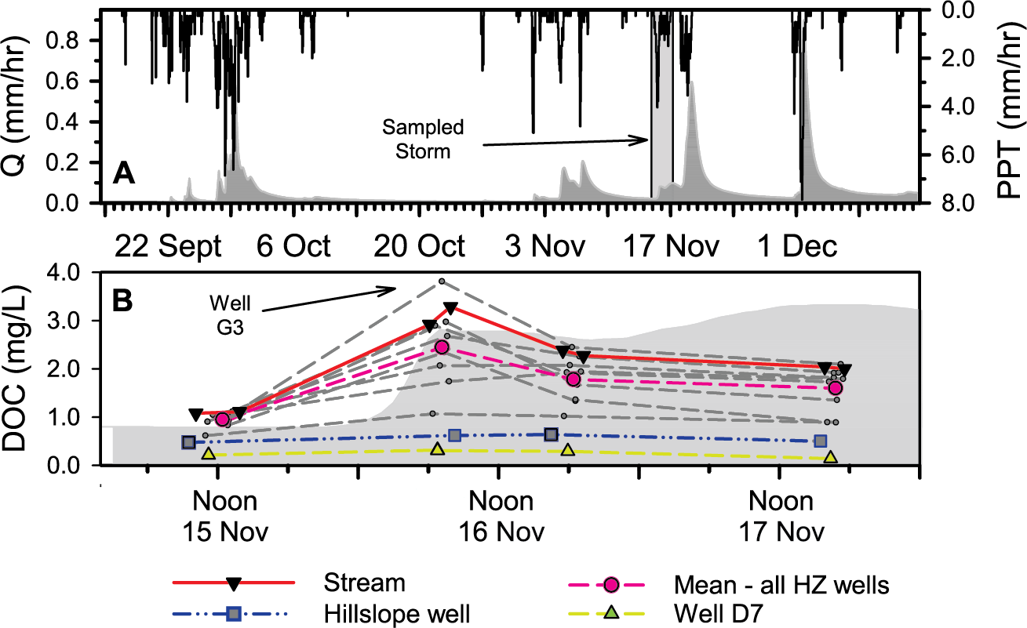
Field campaign: WS01 at the HJ Andrews Experimental Forest
We have: Clockwise hysteresis (early storm = rapid, high C)
But cannot find riparian sources invoked in past studies
…so what is happening in our basin?
Hydrological Processes, 2022
bit.ly/ChannelSourceHypothesis
Stream
Mean of riparian & hyporheic
Hillslope Runoff
Saprolite / Fracture Flow

Slide 6
9 previously published mechanisms for DOC: 1. Hortonian (infiltration excess) Overland Flow
Hydrological Basis | DOC Requirements
Infiltration excess overland flow generation Evidence: Flow generation mechanism never observed nor reported at our study site. | DOC source along land surface mobilized by runoff Evidence: Not measured.
Hydrological Processes, 2022
bit.ly/ChannelSourceHypothesis
Horton, 1933

Slide 7
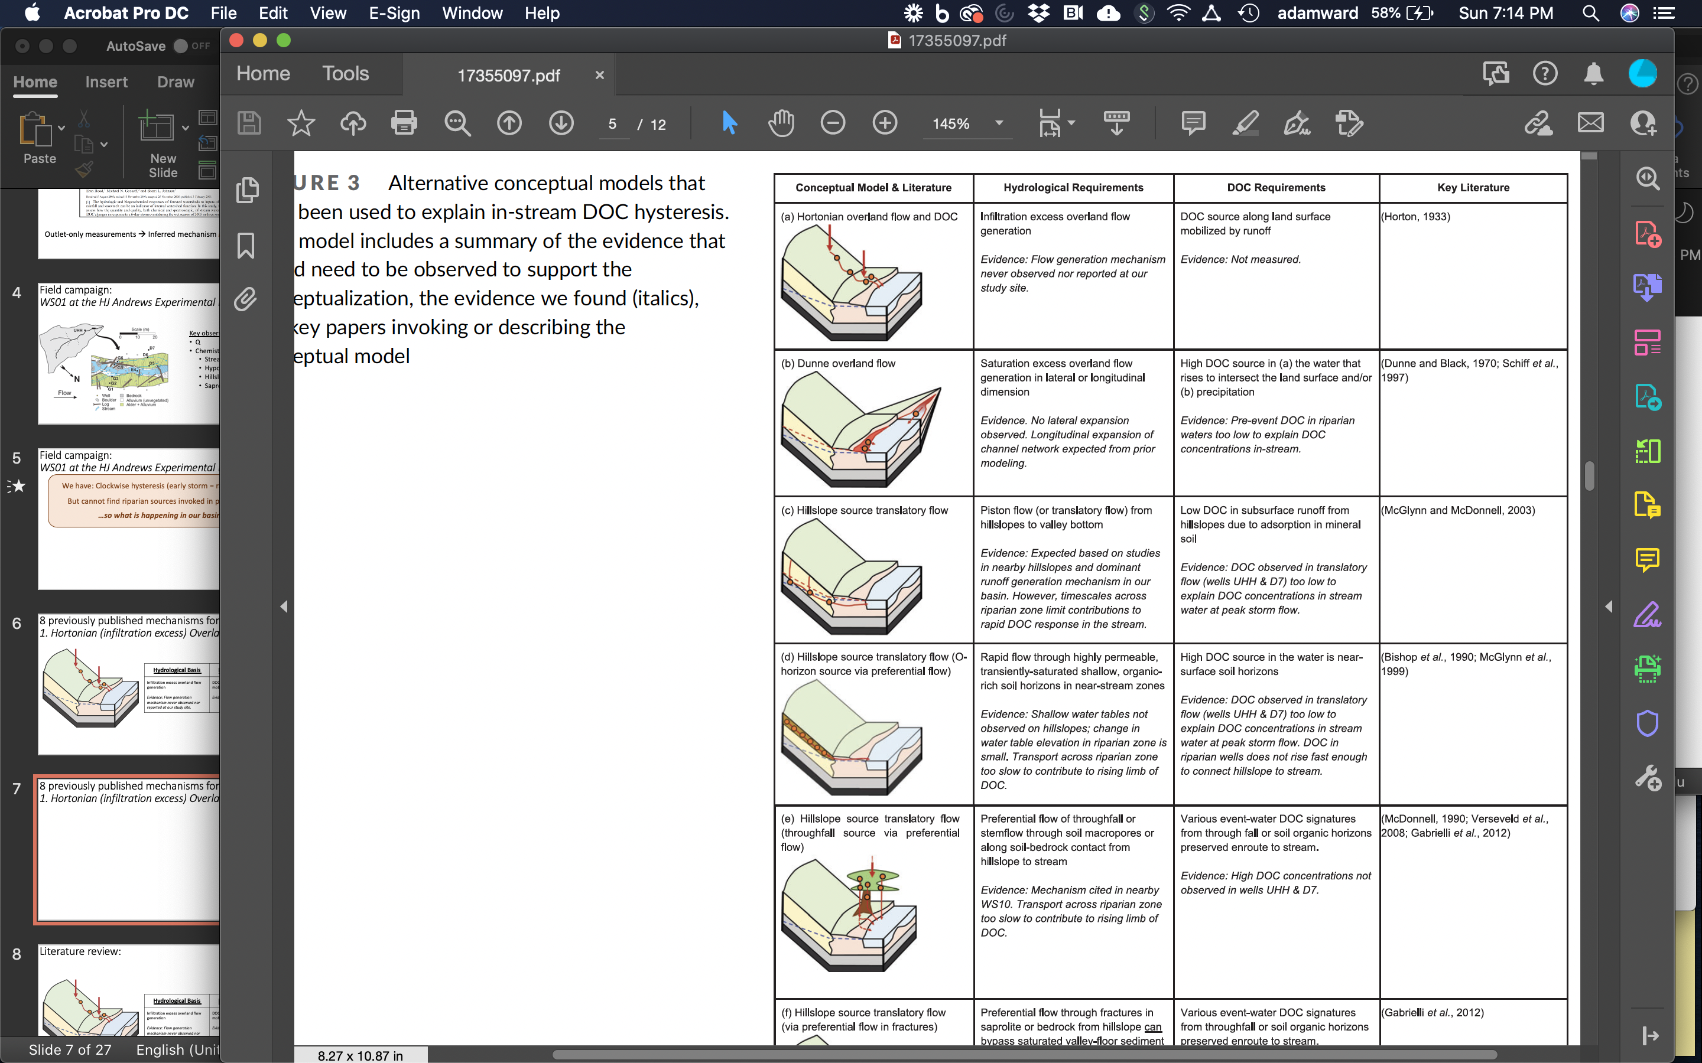
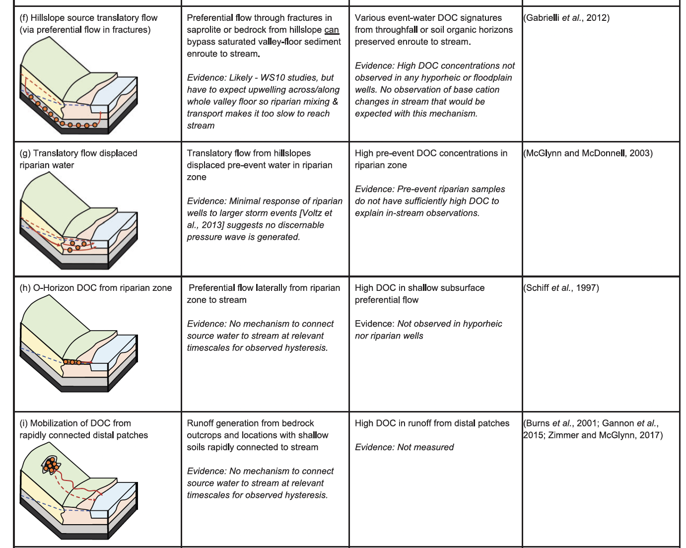
9 previously published mechanisms for DOC: (see evidence, literature in manuscript)
We falsify the hypotheses of each pre-existing conceptual model for DOC hysteresis.

Slide 8
A simpler, alternative explanation: The Channel Source Hypothesis
DECOUPLE sources of
water and DOC
Hydrological Basis | DOC Requirements
Hydrological response generates high flow in stream channel Evidence: observed in-channel hydrograph regardless of runoff generation mechanism(s) | Mobilization of DOC from in-channel leafpacks Evidence: Large store of in-channel leaf litter, seasonally high DOC at start of rainy season.
Meyer and Tate, 1983;
Meyer et al., 1998;
Buffam et al., 2001
Hydrological Processes, 2022
bit.ly/ChannelSourceHypothesis

Slide 9
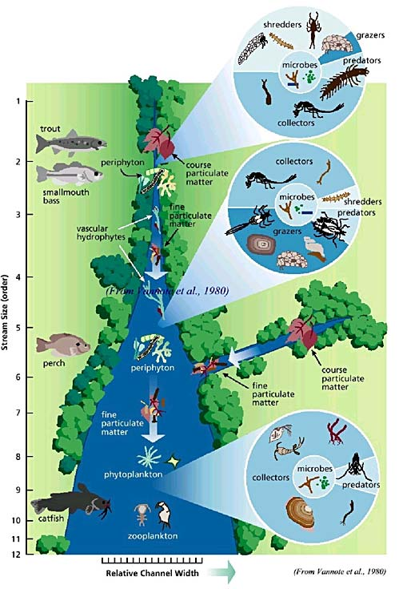
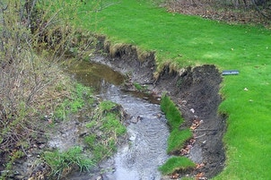
Other disciplines allow for channel sources…
Hydrological Processes, 2022
bit.ly/ChannelSourceHypothesis

Slide 10
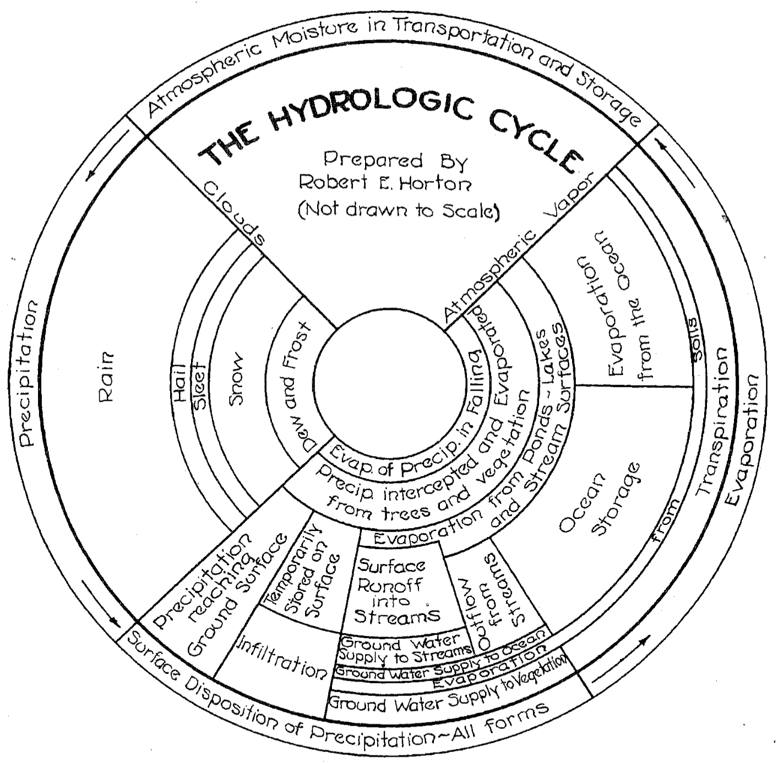
…so why don’t hydrologists?
The stream doesn’t generate significant runoff
Solute loads are classically associated with fluxes of water
Consequently, hydrologists have not considered sources of solute independent from of sources of water
Hydrological Processes, 2022
bit.ly/ChannelSourceHypothesis
Horton (1931)

Slide 11
Conclusions.
Careful reviews of the literature → conflicting conceptual models
The streambed is a significant and persistent source of DOC (per the stream ecosystem community) and sediment (geomorph.), but seldom considered by hydrologists
Disciplinary perspectives shape the way in-stream DOC sources are considered, with an existing body of work reflecting stark differences in their interests.
DOC as an indicator of hydrological sources vs. object of study
In-channel hysteresis and DOC dynamics may be explained by a host of potential mechanisms.
Observations in the catchment (not just at the outlet) are requisite to differentiate between them
Time to end our 28+ year (since Hornberger, 1994?) tradition
Hydrological Processes, 2022
bit.ly/ChannelSourceHypothesis

Slide 12
Hydrological Processes, 2022
bit.ly/ChannelSourceHypothesis

Slide 13
The following slides were not presented, but are shared here as relevant, related material

Slide 14
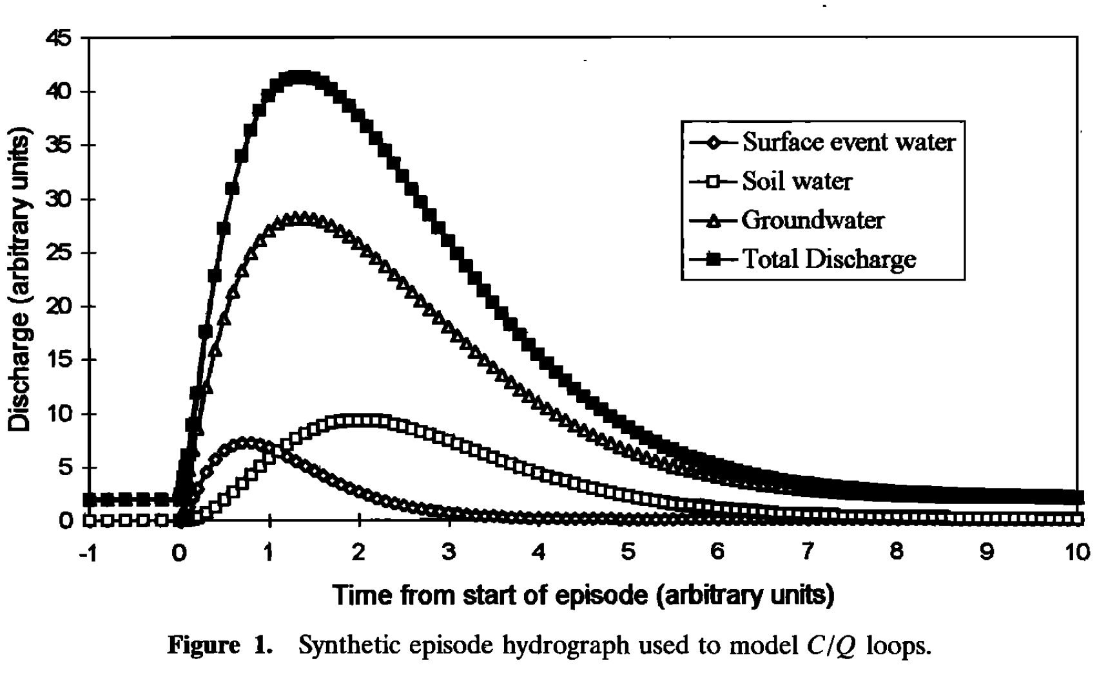
Concentration-discharge relationships results from mixing sources of water and solutes.
Surface Event Water
Soil Water
Groundwater
What happens if C_{surface} ≠ C_{soil} ≠ C_{groundwater} ?
Evans and Davies, 1998, WRR

Slide 15
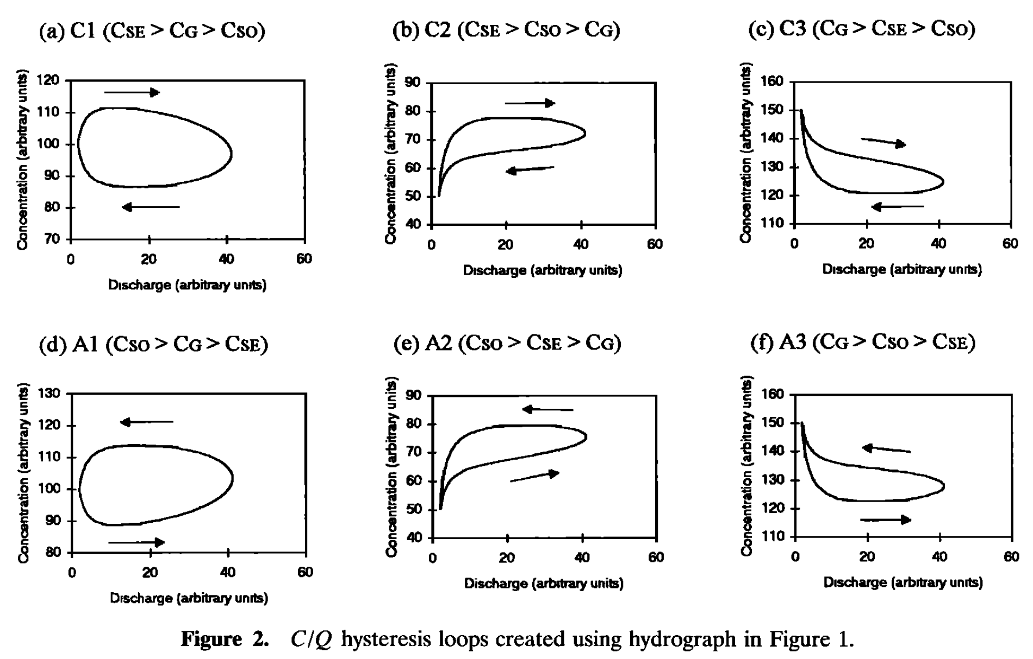
Concentration-discharge relationships result from mixing sources of water and solutes.
C_{Surface} > C_{Soil} > C_{Groundwater}
Key elements for clockwise hysteresis:
Early runoff has high concentration
Later runoff has lower concentration
Evans and Davies, 1998, WRR

Slide 16
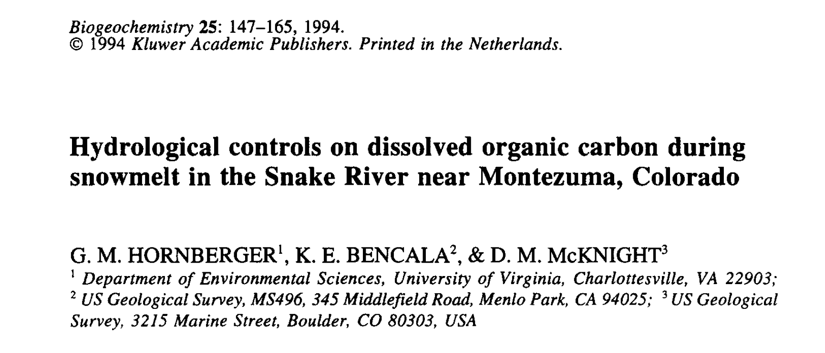
27+ years of inferring process from the basin outlet
Hornberger et al., 1994, Biogeochemistry

Slide 17
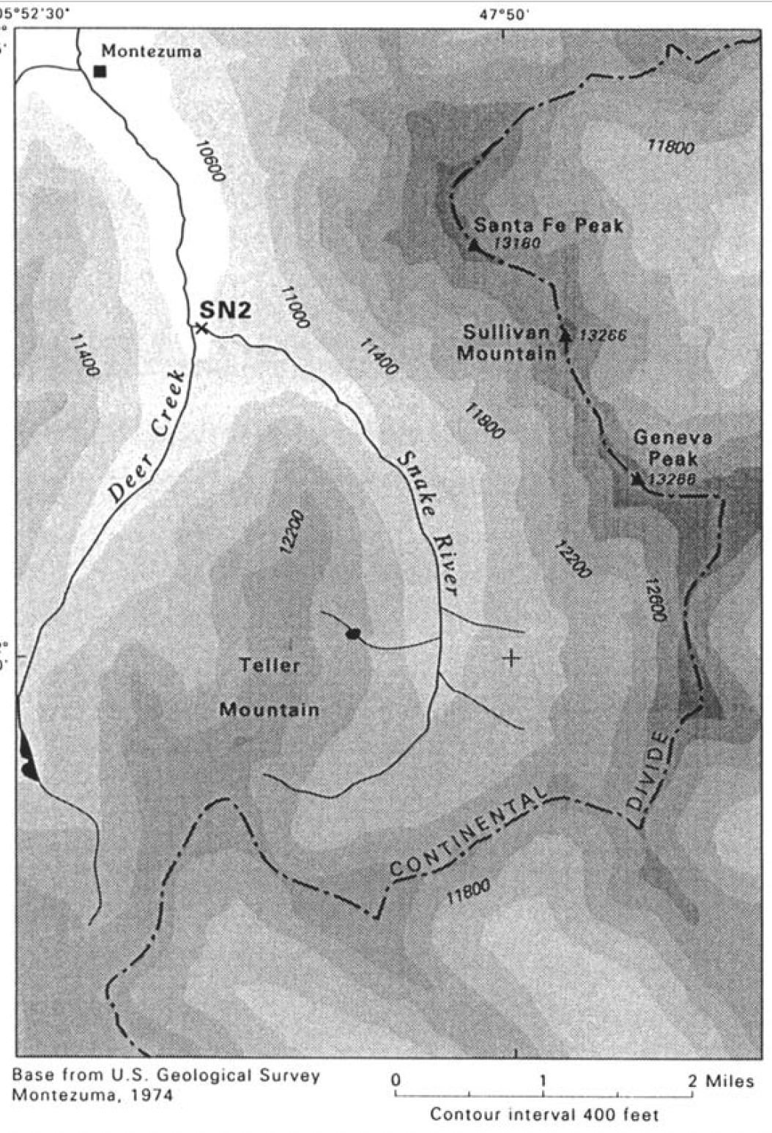
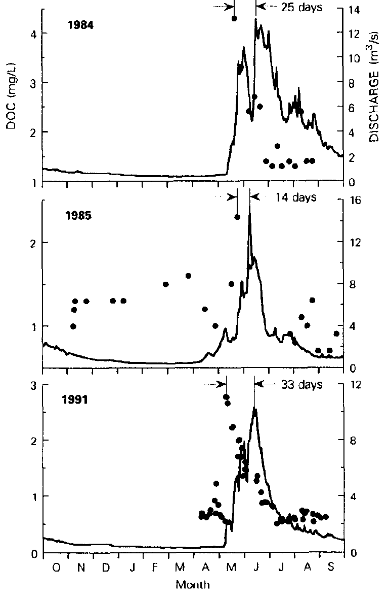
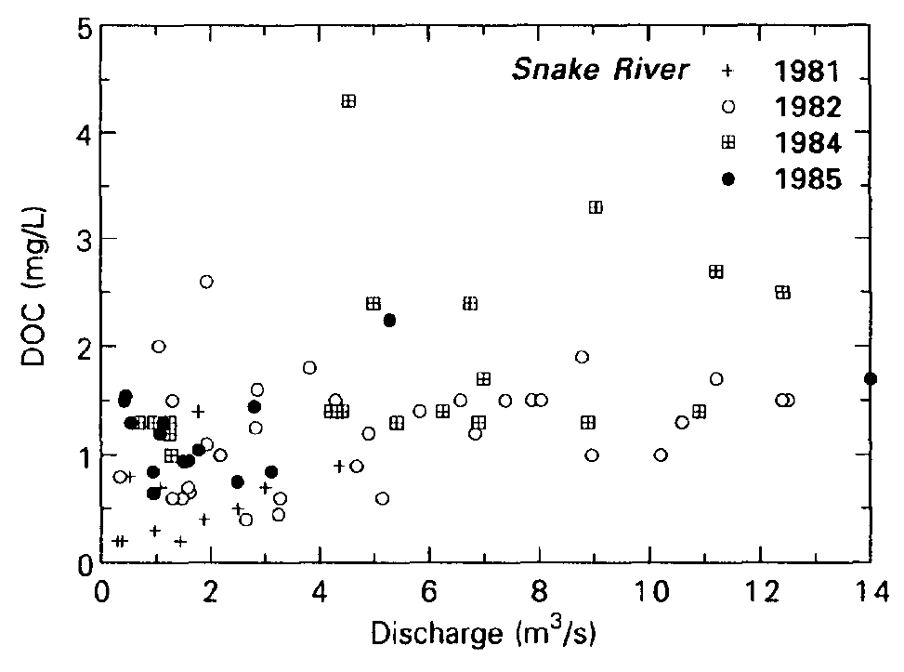
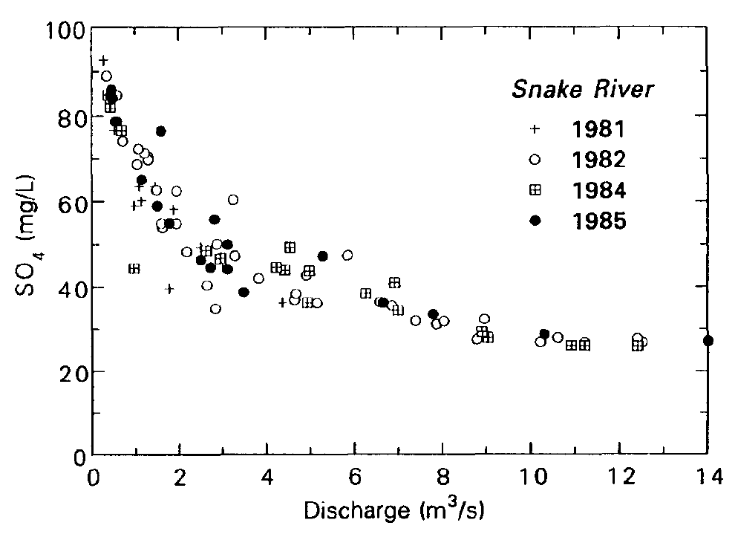
27+ years of inferring process from the basin outlet
1. Pick a place to observe
2. Measure Q(t) & C(t) at outlet
3. Plot & interpret C(t) vs. Q(t)
‘complex sources’
‘simple dilution’
Hornberger et al., 1994, Biogeochemistry

Slide 18
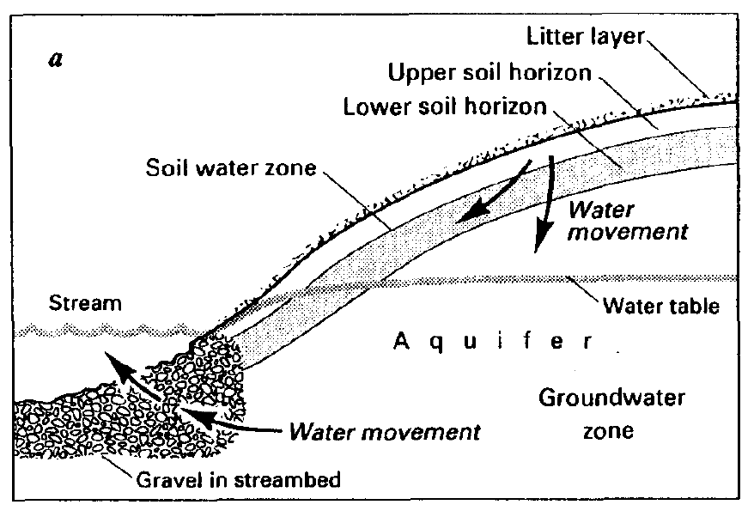
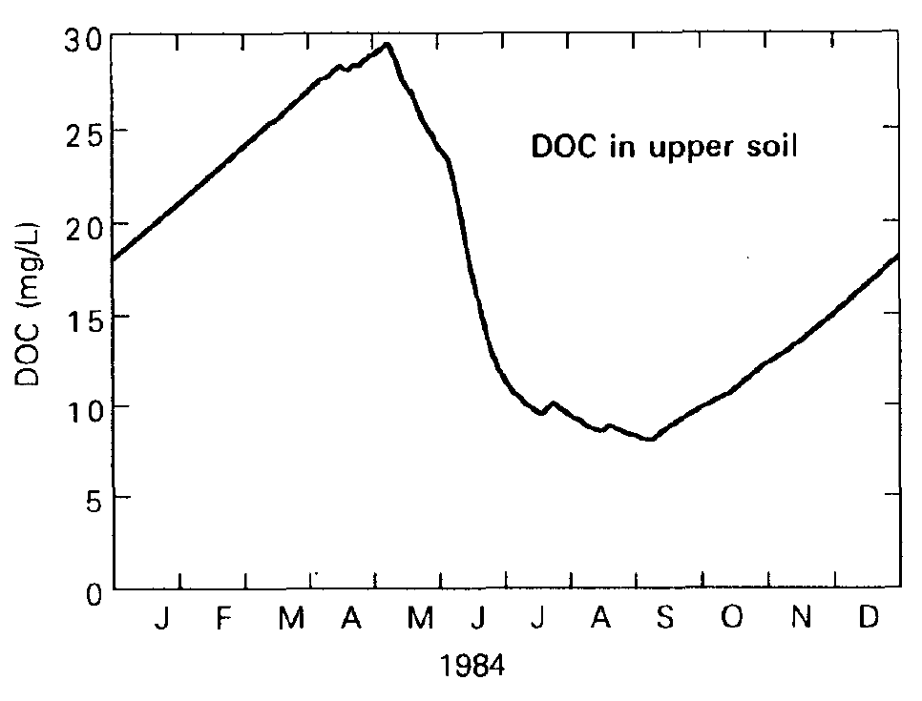
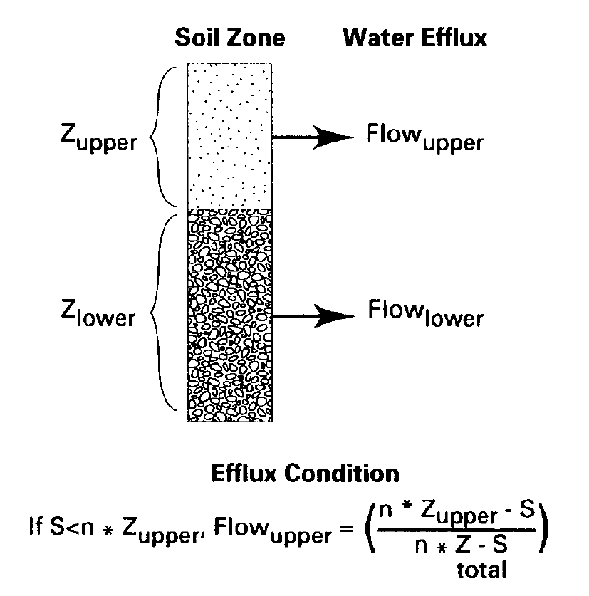
Hydrologists explain
Conceptual / Perceptual Model
Predictions that can be validated
Mathematical Models
simulated
Back to the field
Hornberger et al., 1994, Biogeochemistry

