Slide 1
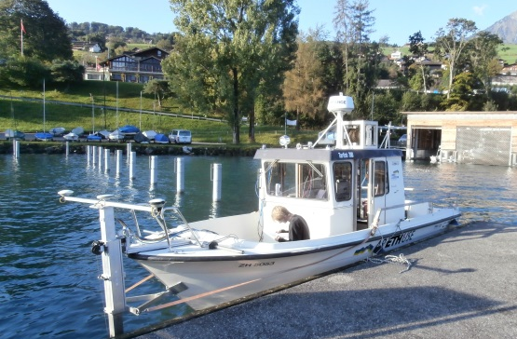
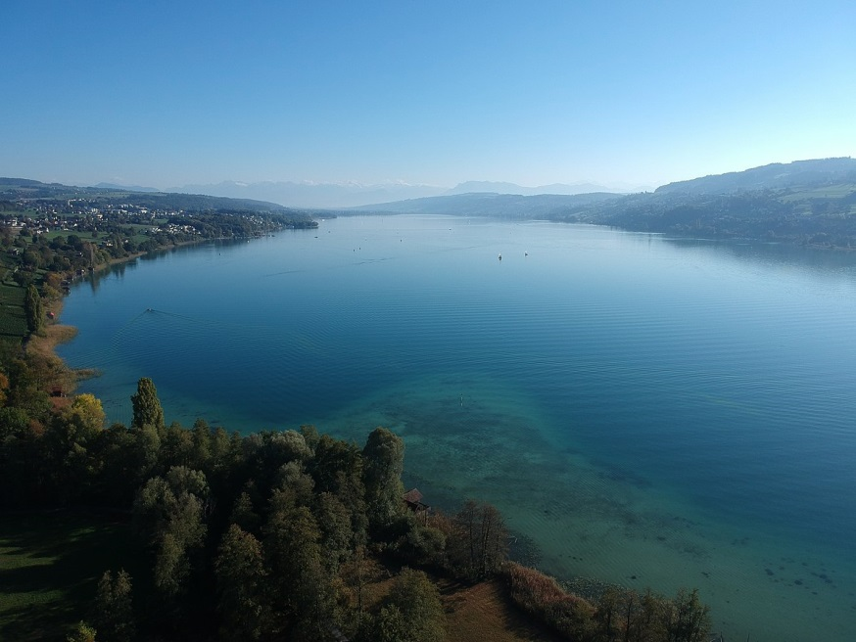
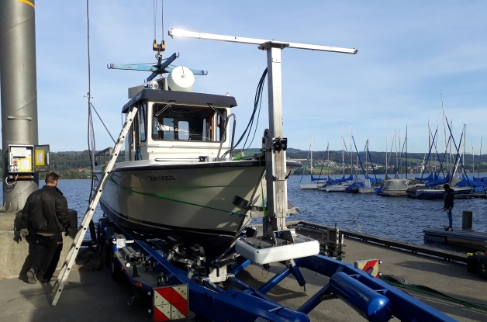
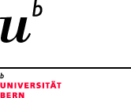



Deltaic mass-movement trigger analysis in Lake Hallwil (Switzerland)
Stefano Fabbri^{1,2} and Katrina Kremer^{1,3}
¹ Institute of Geological Sciences and Oeschger Centre of Climate Change Research, University of Bern, Switzerland
² Currently: Laboratoire EDYTEM, Université Savoie Mont Blanc, France
³ Swiss Seismological Service, Dept. of Earth Sciences, ETH Zürich, Switzerland
stefano.fabbri@geo.unibe.ch

Slide 2


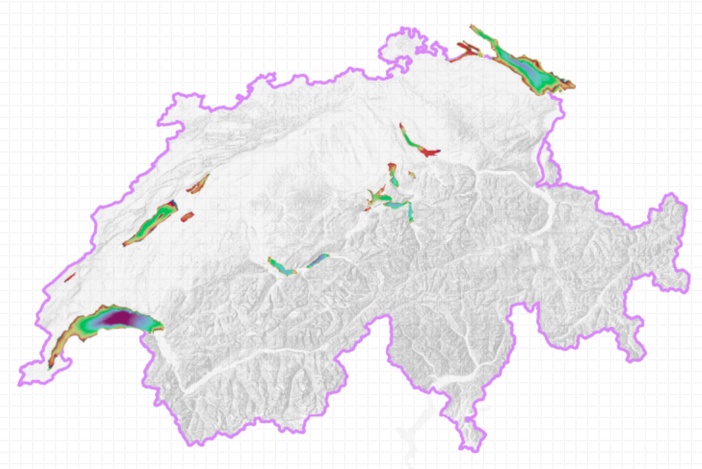
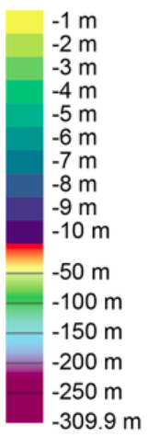
Bathymetry Overview of Switzerland
Based on avg. lake
water level

Slide 3

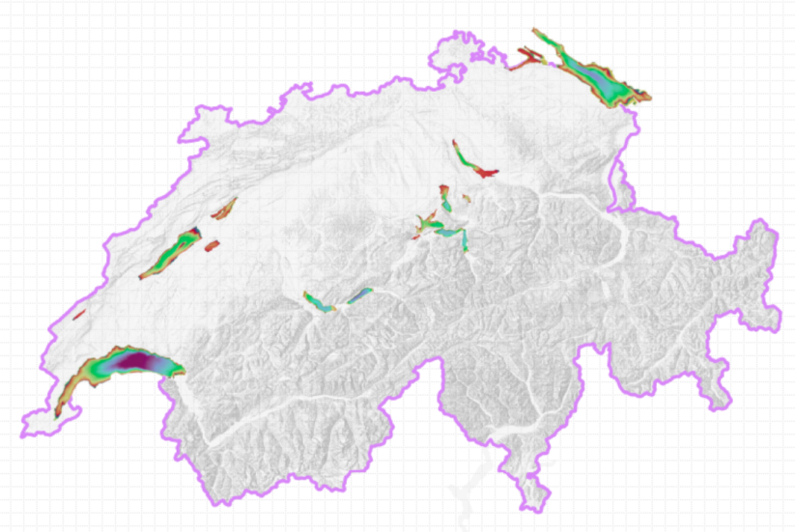
Bathymetry Overview of Switzerland
Seismically triggered mass movements (e.g. EQ)
Climatically triggered mass movements (e.g. floods)
Rockfall-triggered mass movements
Spontaneously triggered mass movements (no apparent trigger)
Typical deltaic mass movement related questions are:
Where do slope failures in deltas (delta collapses) occur?
What sediment types are responsible for delta failures?
What type of failure exist and how do they occur?
What type of deposit is produced?
Notes:
563 AD rockfall-triggered Rhône delta failure

Slide 4
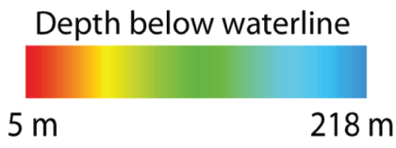
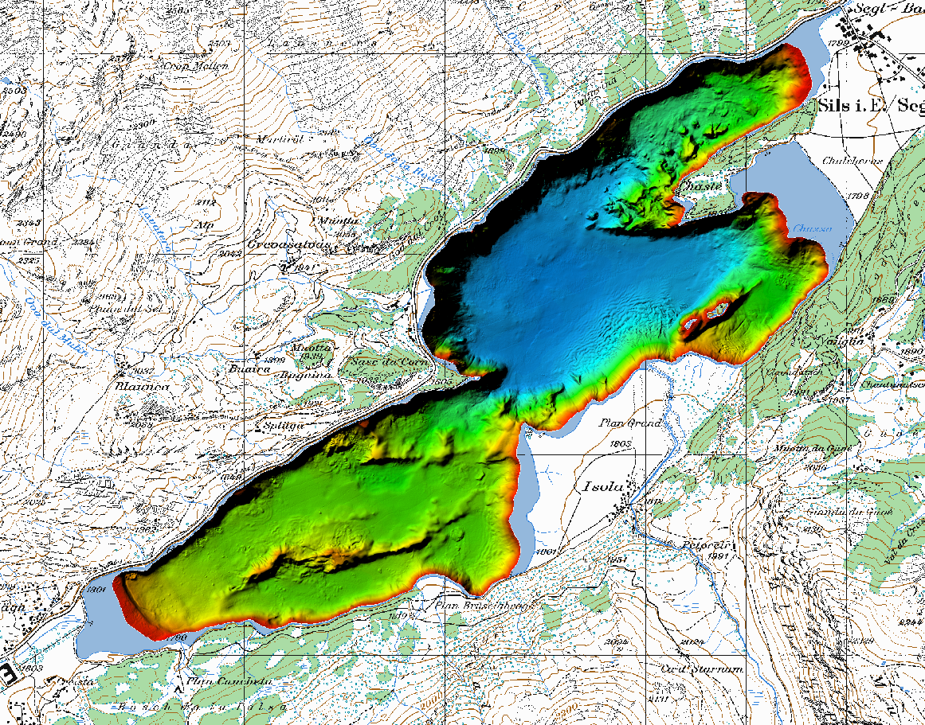
Seismically triggered mass movements
Case 1: Inner Alpine Lake
Lake Sils (Engadin) – Isola Delta Collapse (548–797 cal CE)
Tsunamigenic delta collapse and its associated
tsunami deposits in and around Lake Sils (CH)
Isola Delta (Fabbri et al., in prep.)
2 m 70.5 m
2 km
Notes:
multiple coevally triggered mass movements deposited along the same horizon within a restricted basin and in different lakes are strong evidence for an earthquake-triggered collapse

Slide 5
Seismically triggered mass movements
Case 1: Inner Alpine Lake
Lake Sils (Engadin) – Isola Delta Collapse (548–797 cal CE)
Tsunamigenic delta collapse and its associated
tsunami deposits in and around Lake Sils (CH)
Isola Delta (Fabbri et al., in prep.)
2 m 70.5 m
Multiple subaquatic mass movements in nearby Lake Silvaplana (Bellwald 2012 in Kremer et al. 2017)
Contemporaneously (~ 530 CE; Fanetti et al. 2008) large mass-movement deposit in Lake Como (60 km south)
multiple coevally triggered mass movements deposited along the same horizon within a restricted basin and in different lakes
-> earthquake-triggered collapse
2 km
Notes:
multiple coevally triggered mass movements deposited along the same horizon within a restricted basin and in different lakes are strong evidence for an earthquake-triggered collapse

Slide 6
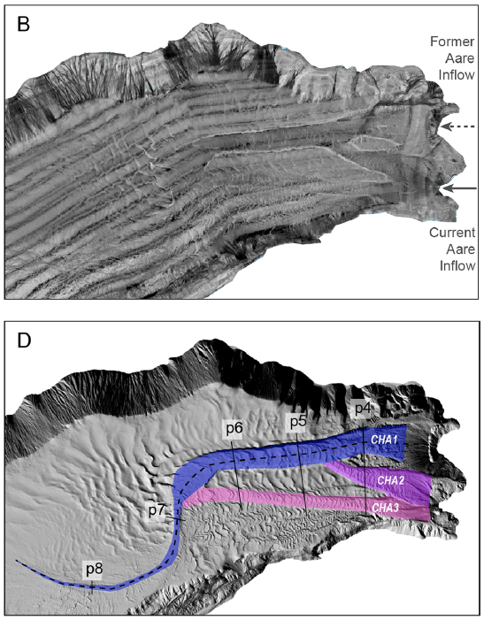
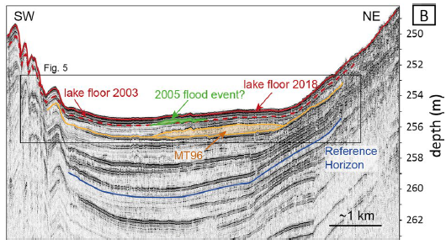
Spontaneously triggered mass movements
Case 2: Alpine Lake
Lake Brienz, Aare Delta (Bernese Alps) – 1996 CE
No clear signature of slope failure
Aare Delta
(Fabbri et al., 2021)
Notes:
multiple coevally triggered mass movements deposited along the same horizon within a restricted basin and in different lakes are strong evidence for an earthquake-triggered collapse

Slide 7

Unknown trigger at Hallwil
Case 3: Peri-Alpine Lake
Lake Hallwil (Lucern Area) –
Deltaic Mass Movements

Slide 8
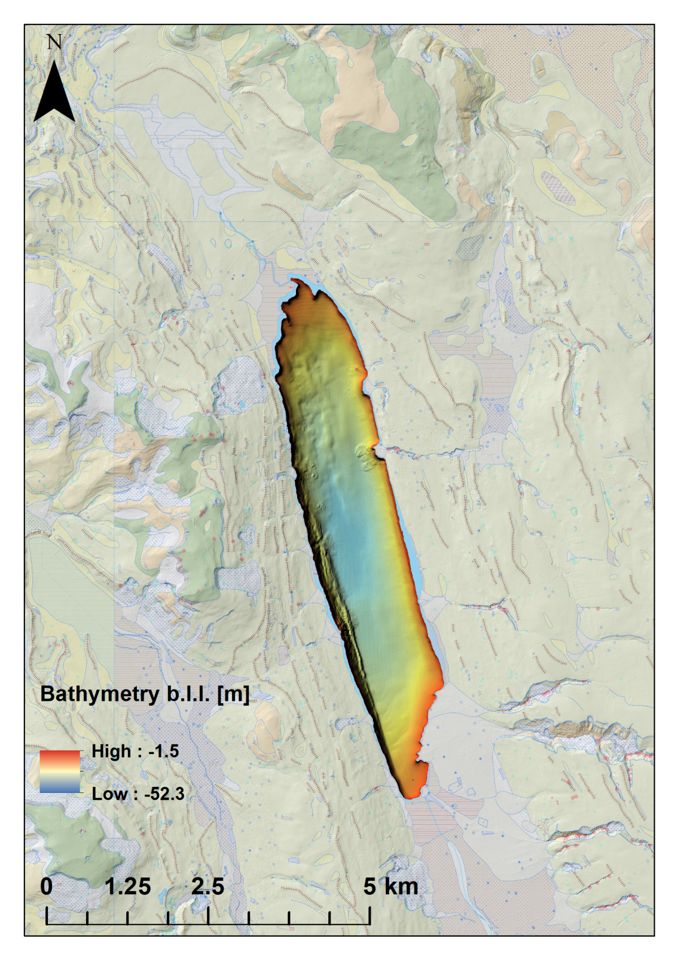
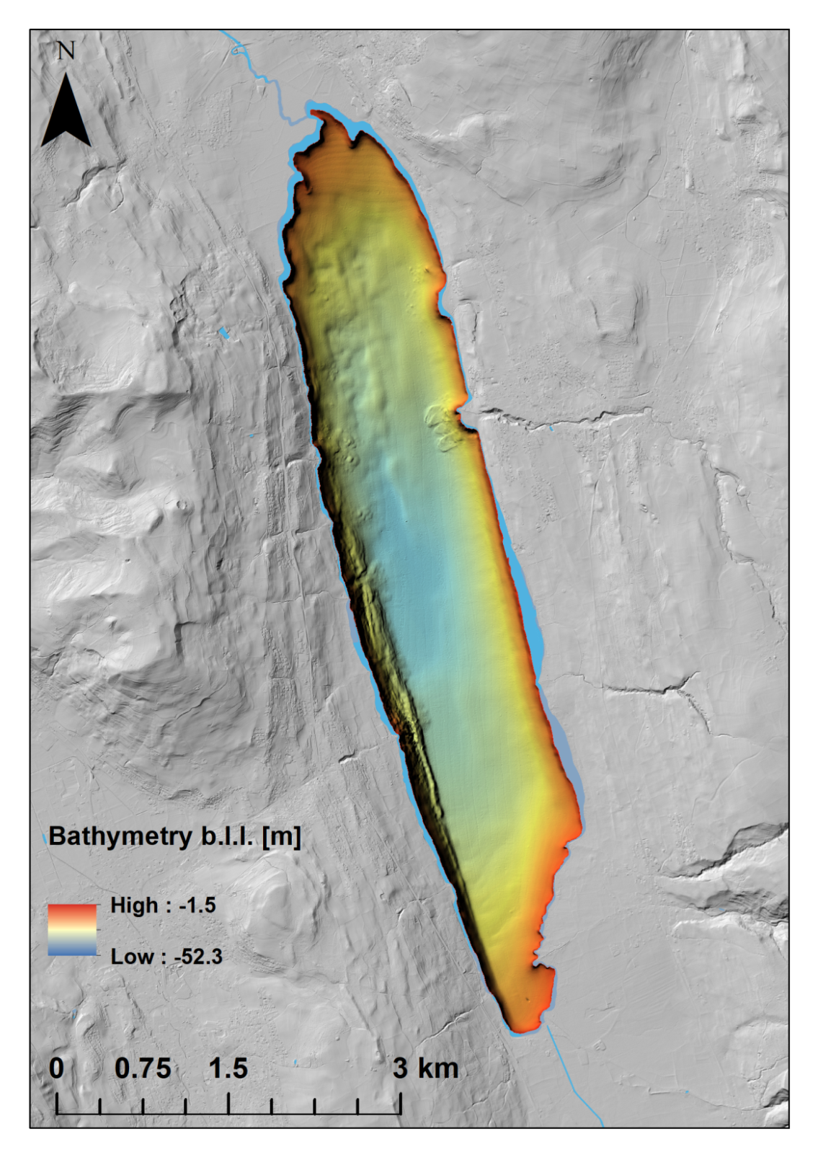
Lake Hallwil Bathymetry (Dorfbach Delta)

Slide 9
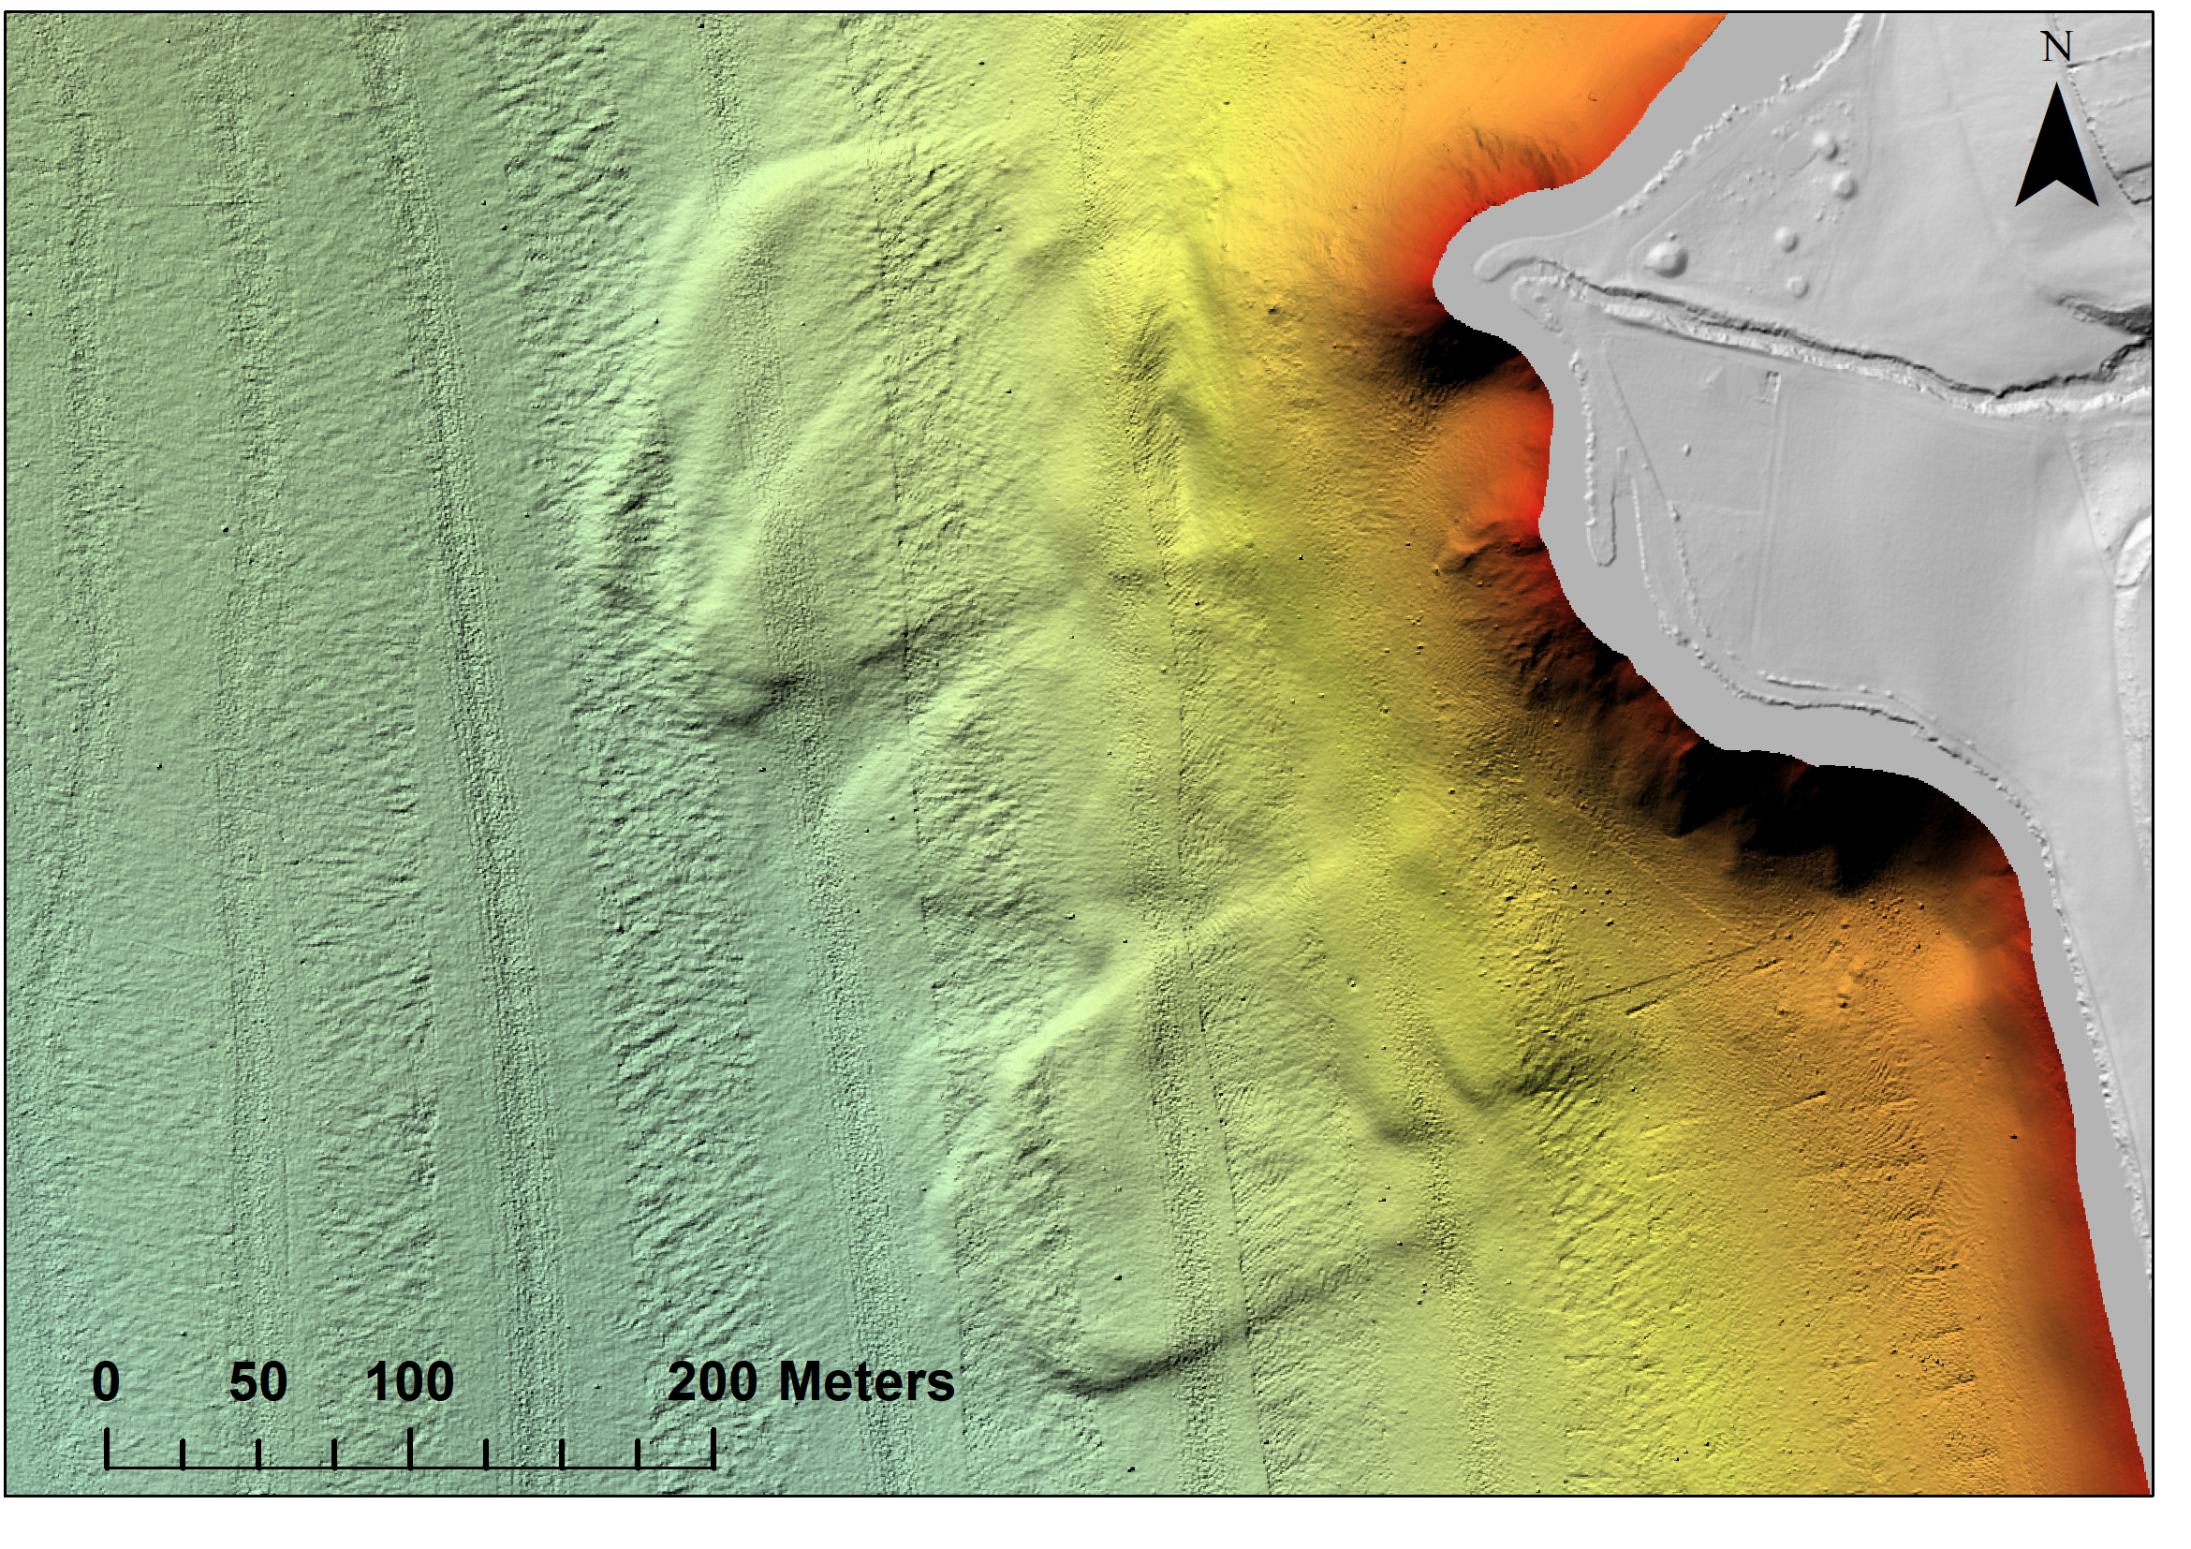
Mutiple deltaic mass movements

Slide 10
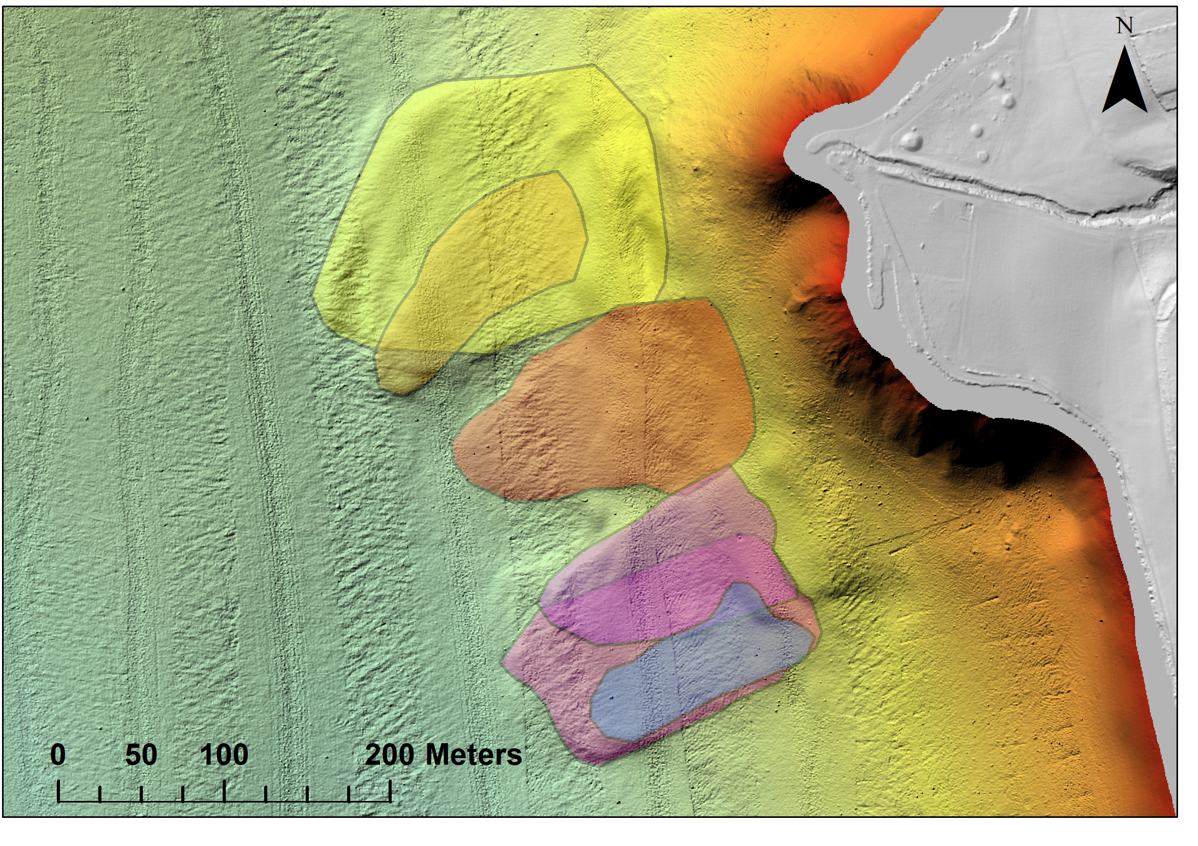
Mutiple deltaic mass movements
Area
1) 28’700 m²
2) 8’450 m²
3) 15’950 m²
4) 15’950 m²
5) 10’200 m²
6’090 m²
Relative Age
1
2
3
Young
5
6
2
5
4
6
3
1
4
old

Slide 11
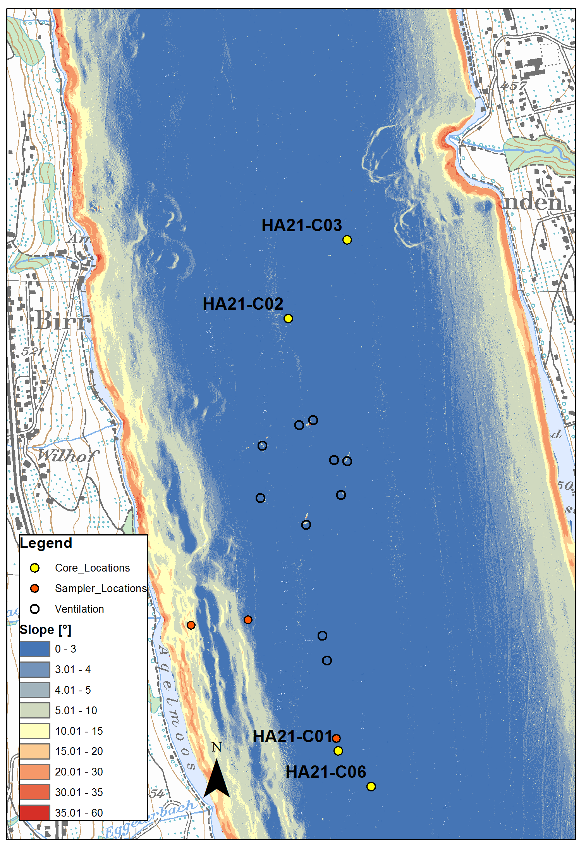

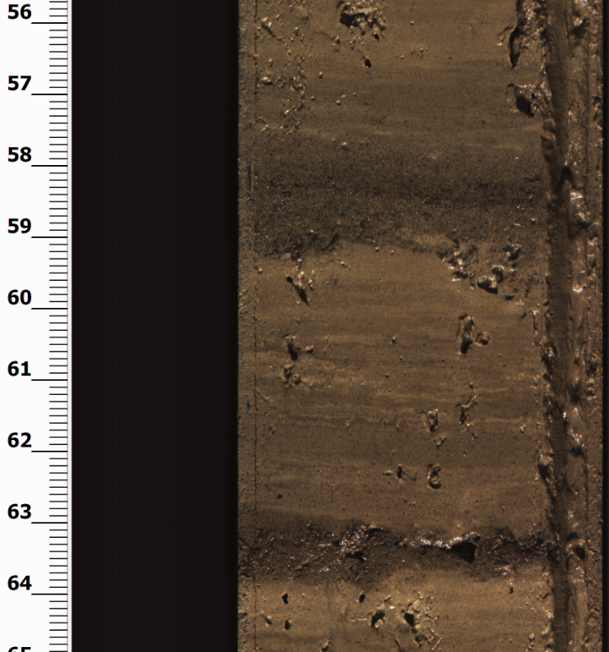
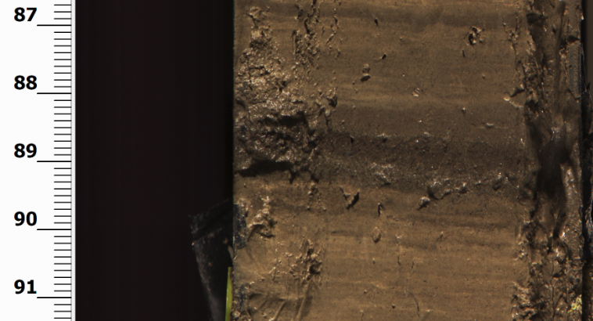
Slope Map & Coring Locations
HAL21-C03
Sandy layer with
erosive base and
fining upwards
Sandy layer with
erosive base and
fining upwards
Sandy layer and
fining upwards
Notes:
This Is ongoing work
We took a series of cores for detailed trigger analysis

Slide 12
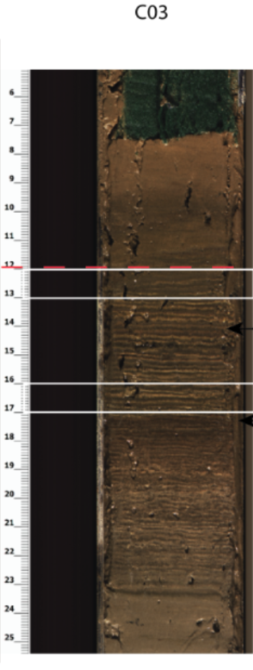
Slope Map & Coring Locations
HAL21-C03
Presumed start of
ventilation (1986)
¹³⁷Cs peak at 12-13 cm
-> 1986
¹³⁷Cs peak at 16-17 cm
-> 1963
Varve counting
Info:
1986 for Tchernobyl accident
1963 atmospheric nuclear testing
Notes:
This Is ongoing work
We took a series of cores for detailed trigger analysis

Slide 13

Slope Map & Coring Locations
Outlook:
Short Cores taken (dating, MSCL, grain size, stratigraphy)
Trigger analysis
3.5 kHz seismic lines planned
CT images of cores
Also see:
Notes:
This Is ongoing work
We took a series of cores for detailed trigger analysis

Slide 14
Appendix

Slide 15
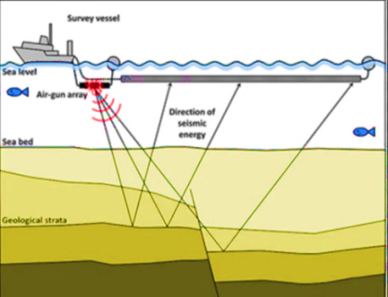
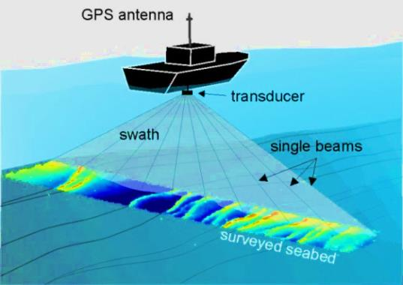
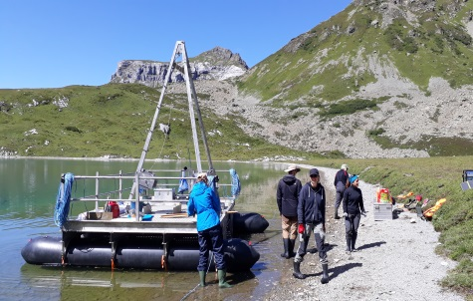
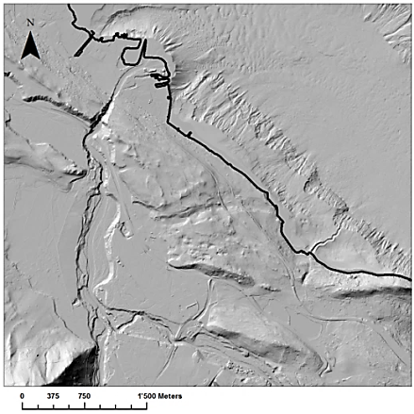
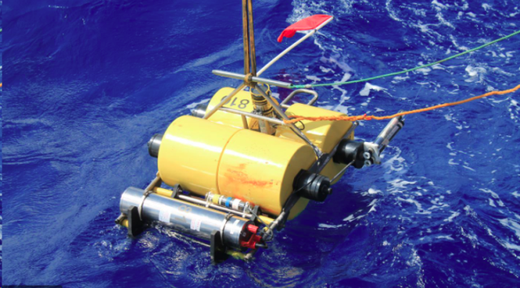
Methods for deltaic mass movement trigger analysis
Multichannel/single reflection seismics
Combining amphibious geomorphology with subsurface geophysical
and geological data
Coring
Multibeam bathymetry (4D)
Geomorphology
ADCP & OBS

Slide 16
Rockfall-triggered mass movements
Case 2: Alpine Lake
Lake Thun (Bernese Alps) –
the signature of impact waves
Case 1: Inner Alpine Lake
Lake Sils (Engadin)
Tsunamigenic delta collapse and its associated
tsunami deposits in and around Lake Sils (CH)

Slide 17
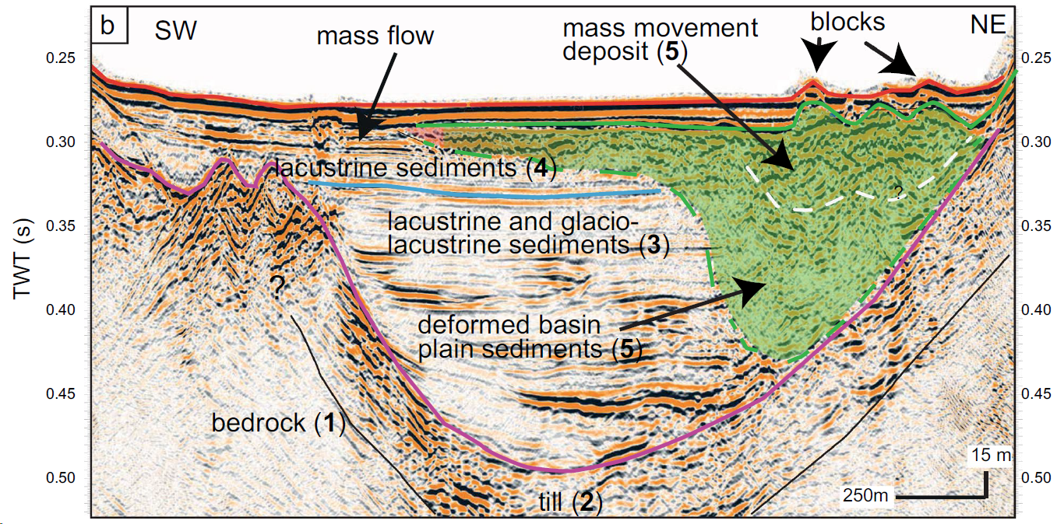
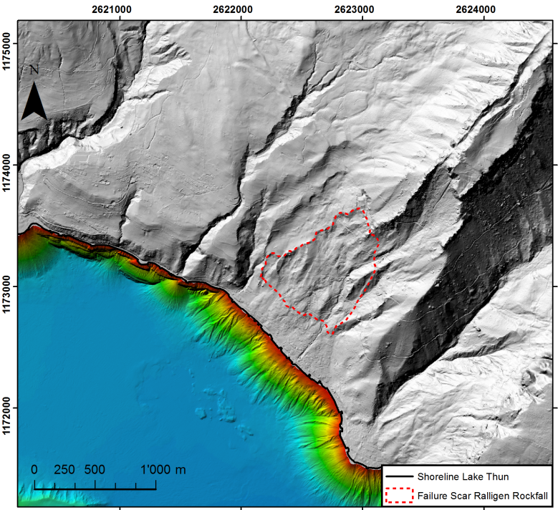
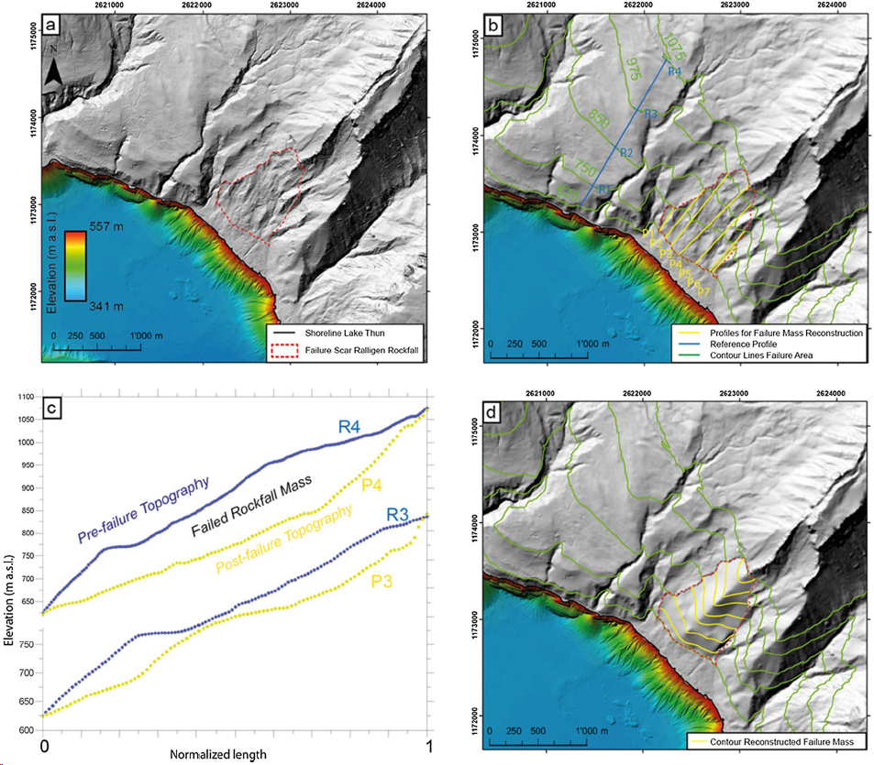
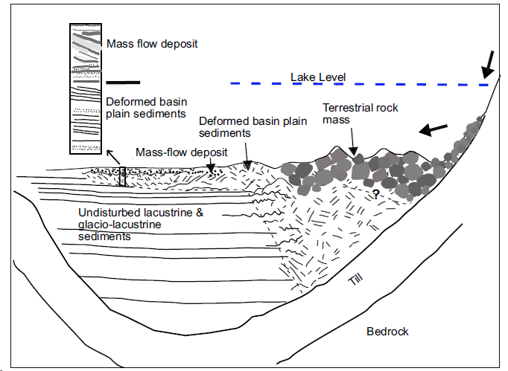
Kremer et al. (2022): Traces of a prehistoric and potentially tsunamigenic mass movement in the sediments of Lake Thun (Switzerland)
TWT [s]

Slide 18
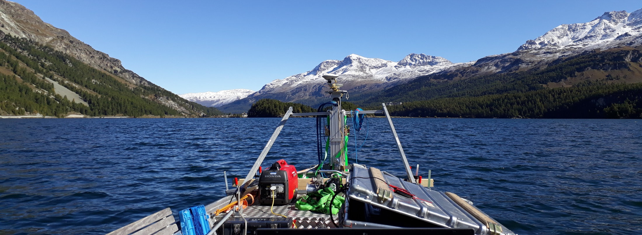
Seismically triggered mass movements
Case 1: Inner Alpine Lake
Lake Sils (Engadin)
Tsunamigenic delta collapse and its associated
tsunami deposits in and around Lake Sils (CH)

Slide 19
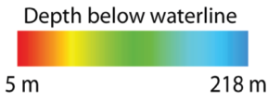
Tsunamigenic delta collapse and its associated
tsunami deposits in and around Lake Sils (CH)
-> Delta collapse (548–797 cal CE)
Lake Sils Multibeam Bathymetry
2 m 70.5 m
Isola Delta
Unpublished data
2 km
Notes:
The timing of the Isola Delta collapse
(548–797 cal CE) coincides, within the resolution of the radiocarbon dating method, with
multiple subaquatic mass movements identified on reflection seismic data and sediment
cores in nearby Lake Silvaplana at 571–650 cal CE (Bellwald 2012 in Kremer et al. 2017).
Moreover, a large mass-movement deposit was identified in Lake Como 60 km to the south
and dated to ~ 530 CE (Fanetti et al. 2008). Such multiple coevally triggered mass movements
deposited along the same horizon within a restricted basin and in different lakes
are strong evidence for an earthquake-triggered collapse

Slide 20
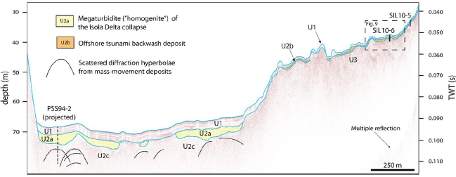
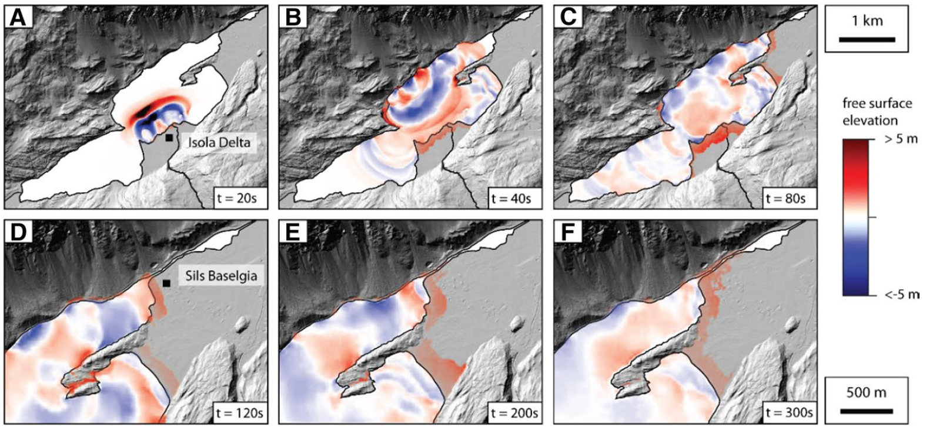
Tsunami-wave modelling
Nigg et al. (2021): A tsunamigenic delta collapse and its associated tsunami deposits in and around Lake Sils, Switzerland
Notes:
A large subaqueous delta collapse emplaced a mass-movement deposit with a maximum thickness of more than 6 m and a total estimated minimum volume of 6.5 × 106 m3 in the Central Basin of Lake Sils around 548–797 cal CE (Blass et al. 2005
These waves inundated the alluvial plain at Sils Baselgia with a maximum run-up of 2–3 m up to 200 m inland with initial flow velocities of up to ~ 5 m s−1.

Slide 21
Rockfall-triggered mass movements
Case 2: Alpine Lake
Lake Thun (Bernese Alps) – ~2500 cal yrs BP
the signature of impact waves
Ralligen Rockfall deposits
2 m 217 m
(Kremer et al., 2022)
Notes:
multiple coevally triggered mass movements deposited along the same horizon within a restricted basin and in different lakes are strong evidence for an earthquake-triggered collapse

Slide 22

Rockfall-triggered mass movements
Case 2: Alpine Lake
Lake Thun (Bernese Alps) – ~2500 cal yrs BP
the signature of impact waves
Ralligen Rockfall deposits
2 m 217 m
Rockfall deposits in the basin
Deformed underlying sediments
Signature of impact wave
(Kremer et al., 2022)
Notes:
multiple coevally triggered mass movements deposited along the same horizon within a restricted basin and in different lakes are strong evidence for an earthquake-triggered collapse

