Slide 1



GIS-based Aquifer Thermal Energy Storage (ATES) systems potential assessment in Spain
Adela Ramos Escudero
Martin Bloemendal
May 23th 2022

Slide 2
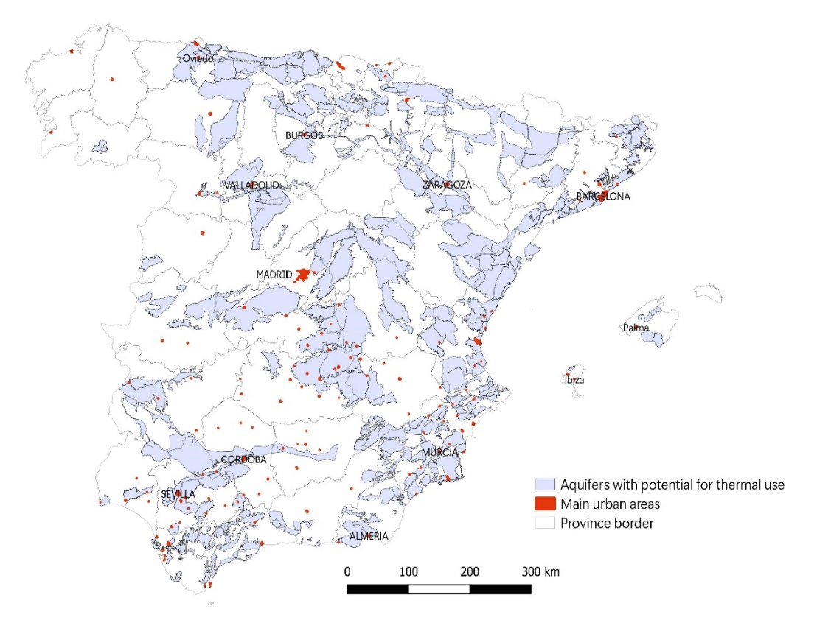
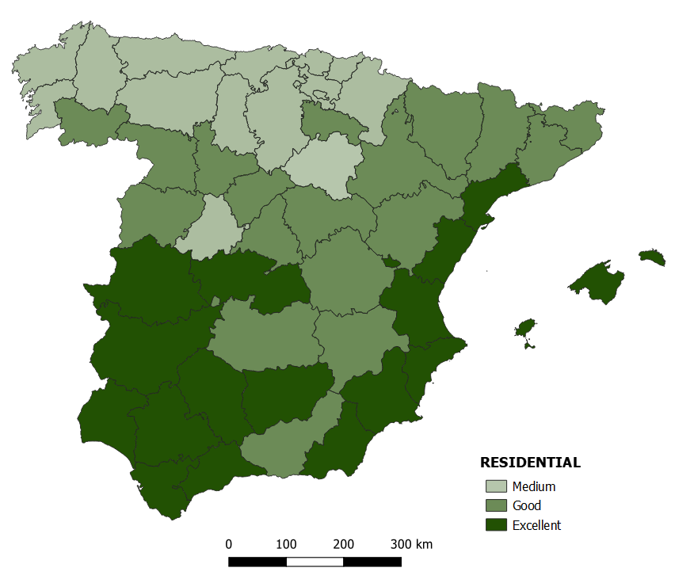
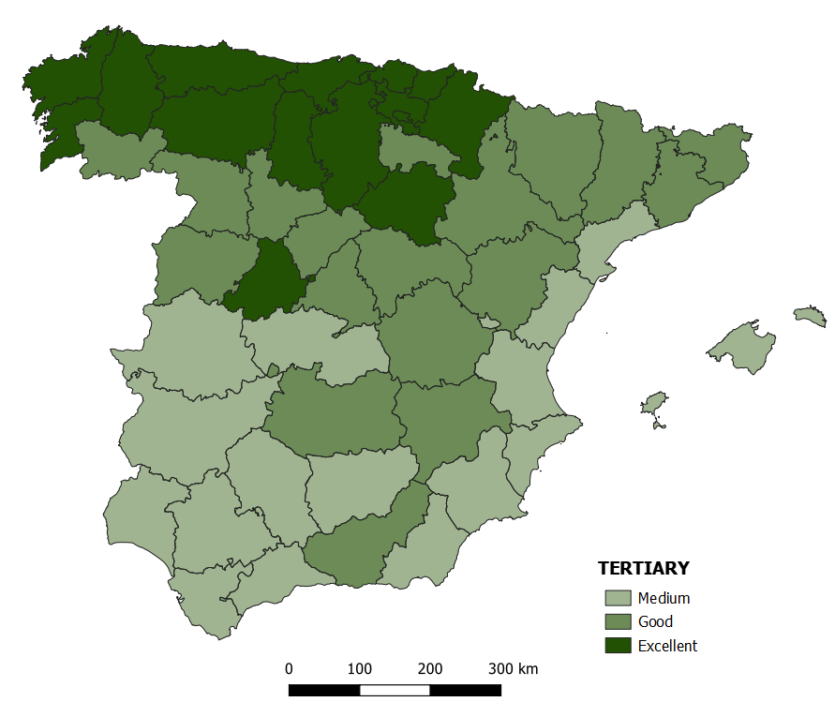
ATES potential areas identification.
1
1.1 - Hydrogeological conditions
Aquifers with potential for thermal use:
High permeability aquifers (fissured and fractured)
Acceptable depth
1.2 - Climatic conditions
Balance heating and cooling needs based on climatic zones.
Residential & Tertiary sector
38%
Total Surface
VALENCIA
Geothermal energy potential evaluation report. PER 2011-202. Institute for the Diversification and save of energy. Spain.

Slide 3
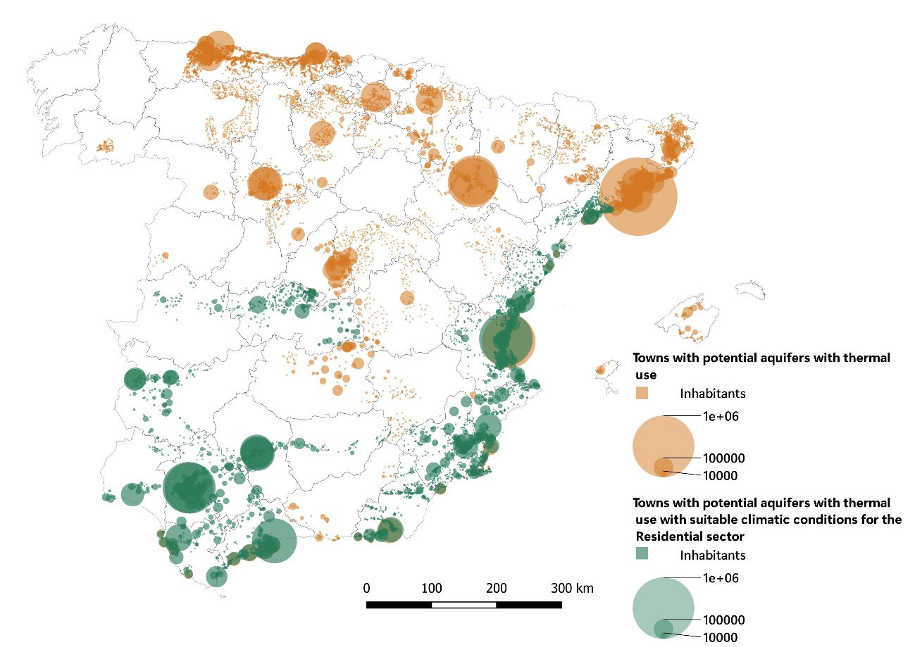
ATES market potential.
2
Potential aquifers vs population
in towns (>1,500 inhabitants per km²)
Aquifers with thermal use
Towns with pot. aquifers
26%
Total population living in pot. areas
53%
Residential sector
Towns with excellent conditions
13%
Total population in Spain
28%

Slide 4
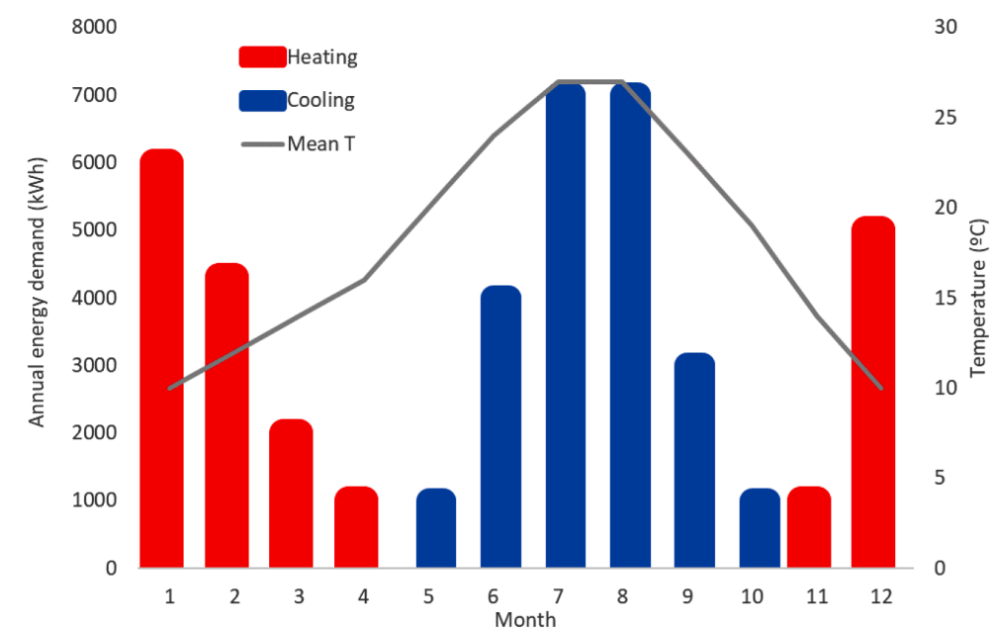
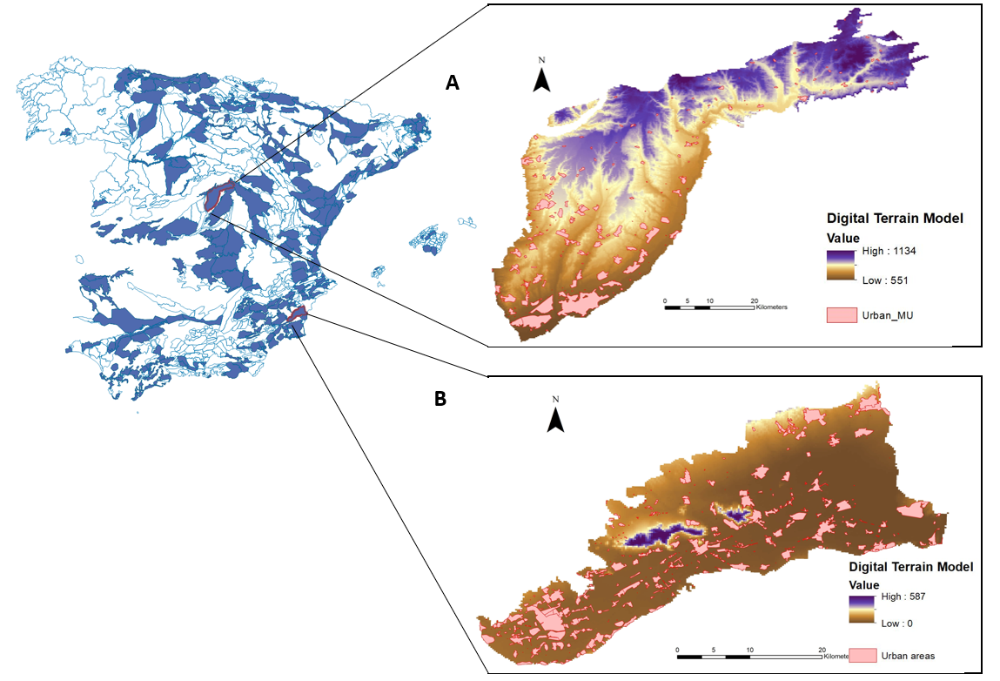
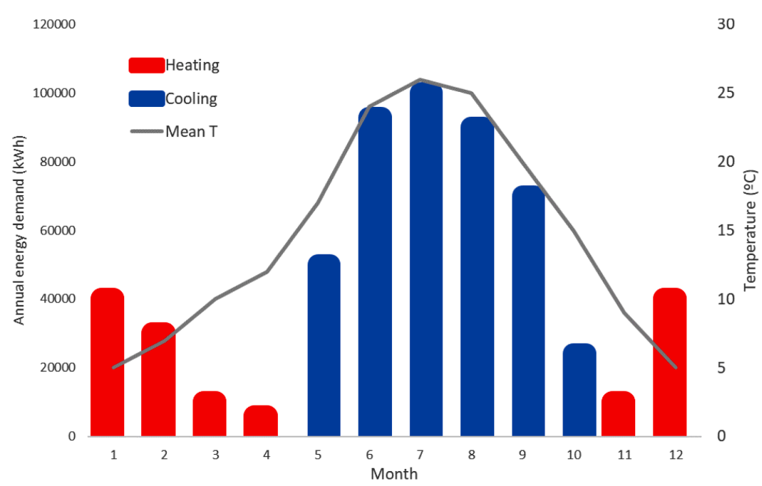
Feasibility study.
3
Two case studies selected:
For Residential and Tertiary
Hydrogeological parameters:
Water quality (<50 meters)
Water freshness, avoid salinization
Groundwater flow. Low velocities.
Parameter | Unit | Tertiary | Residential
Surface | m² | 10,000 | 2,000
Heating capacity | kW | 54 | 6
Heating energy demand | MWh | 140 | 19.4
Cooling capacity | kW | 400 | 50
Cooling energy demand | MWh | 420 | 20
Bloemendal, M., & Hartog, N. (2018). Combining climatic and geo-hydrological preconditions as a method to determine world potential for aquifer thermal energy storage

Slide 5
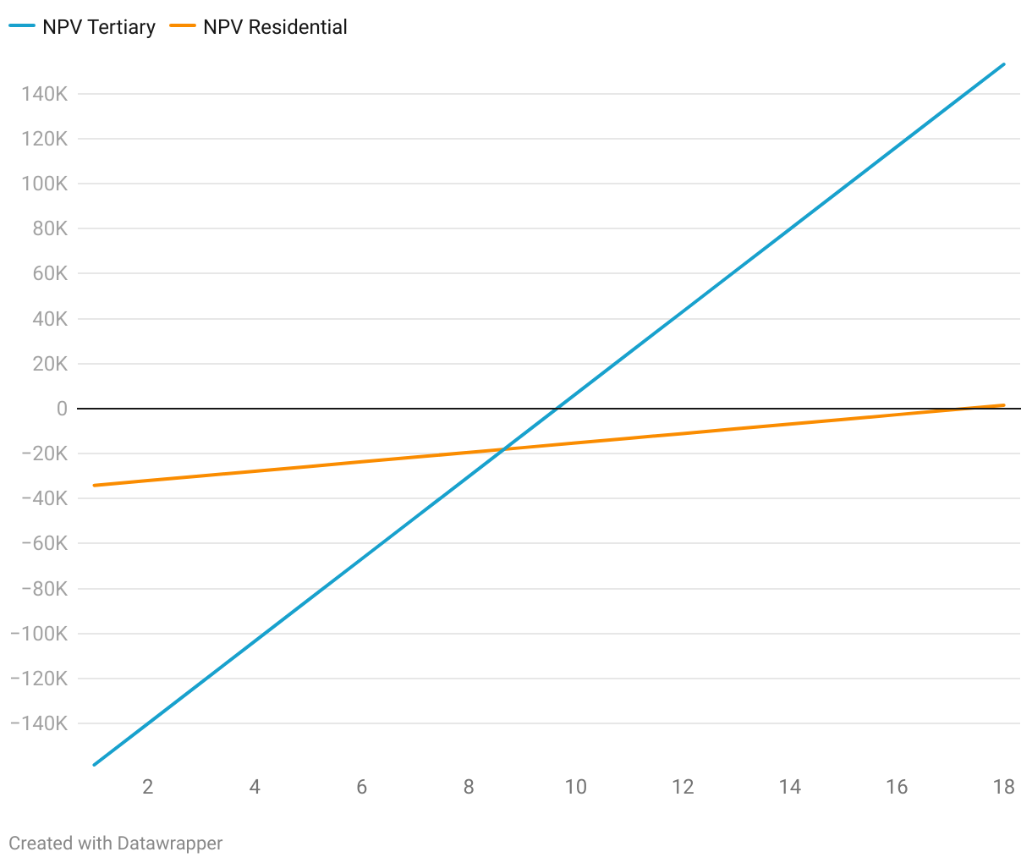
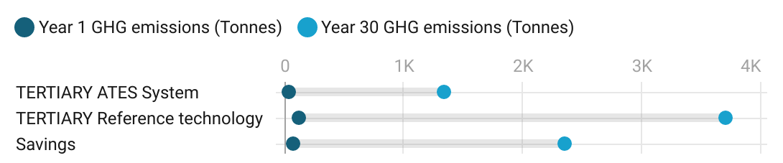
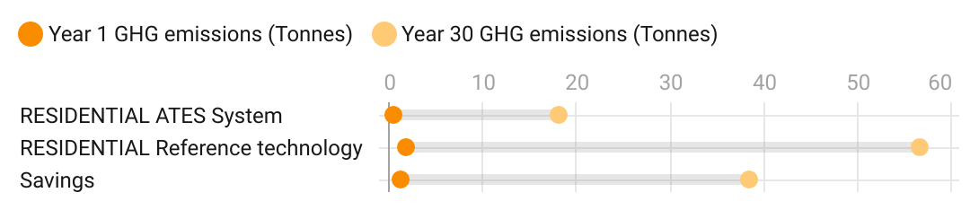
Economic and GHG reduction potential.
4
Payback Period
Greenhouse Gas Emissions savings
10 years
6,503 €
18 years
1,483 €
63%
68%

Slide 6
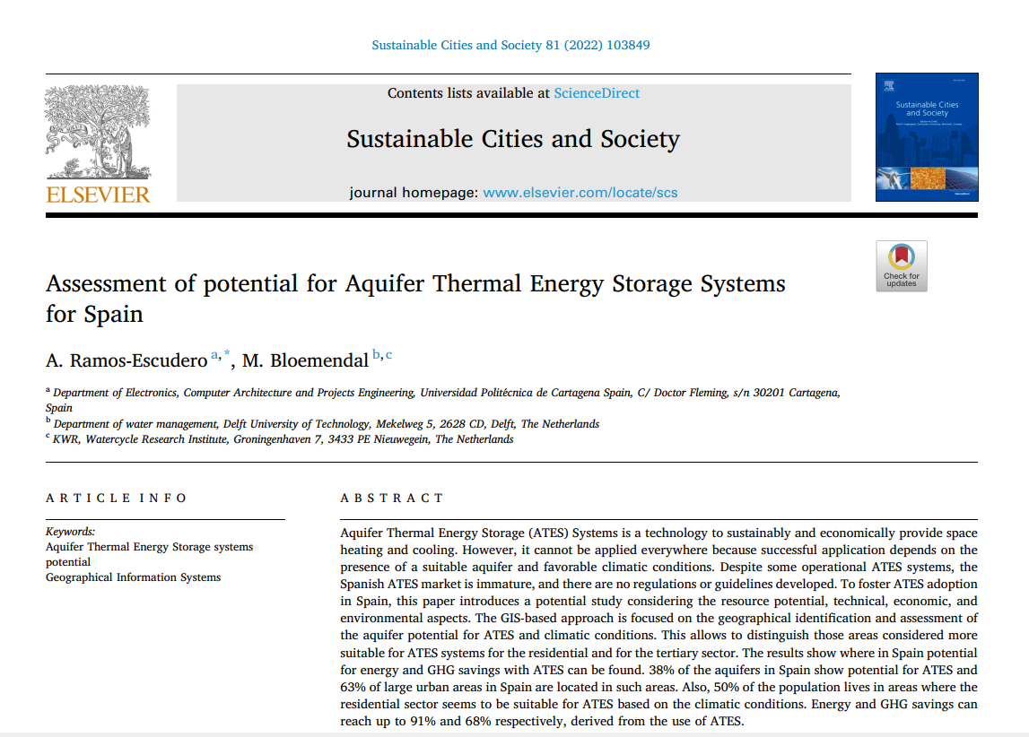
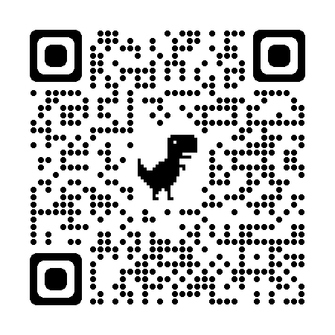
Thank you very much! adela.ramos@upct.es

