Slide 1

Machine Learning Model to Reproduce Nature-Based Solution for Flood and Drought Mitigation
EGU General Assembly 2022
HS3.3 Spatio-temporal and/or (geo)statistical analysis of hydrological events, floods, extremes, and related hazards
Kabita Gautam¹, Gerald Corzo¹, Shreedhar Maskey¹, Dimitri Solomatine¹
1 IHE Delft Institute for Water Education, 2611AX, Delft, The Netherlands
25 May 2022

Slide 2
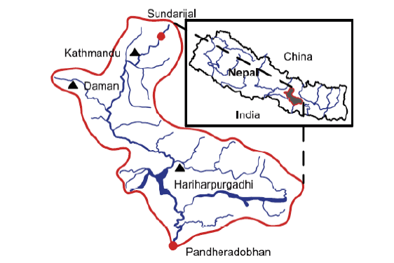
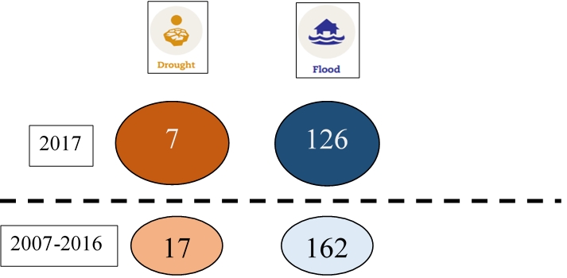
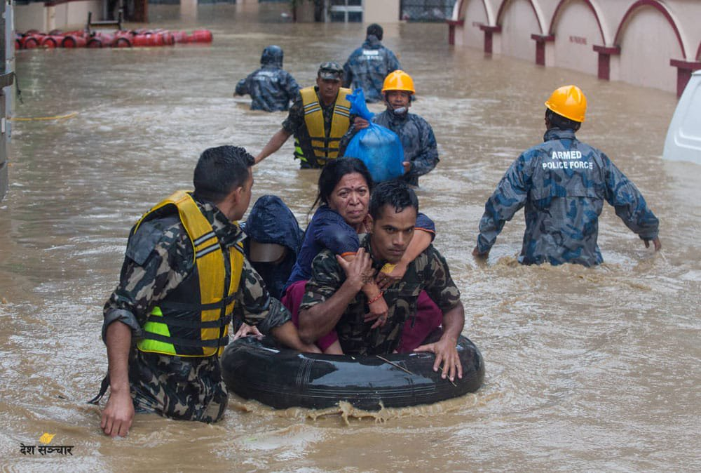
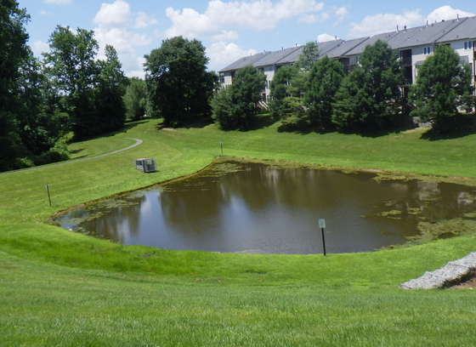
Background
Bagmati River Basin of Nepal
2019
Fig: Bagmati River basin
(Source: Kayastha, 2014)
Number of Flood and Drought Occurrences worldwide in 2017 compared to 2007-2016 (UCL et al., 2017)
https://www.spotlightnepal.com/2019/07/12/water-level-bagmati-river-and-its-tributaries-above-danger-mark/
Sustainable solutions- Nature-Based Solution (NBS)
Understanding of how to model NBS is limited
Machine Learning (ML) approach can be useful for replicating such complex system
Pond as NBS
Floods most common natural disasters
Droughts not widely studied, few papers published indicate the occurrence of droughts of different intensity
https://www.howardcountymd.gov/public-works/stormwater-management-facilities

Slide 3
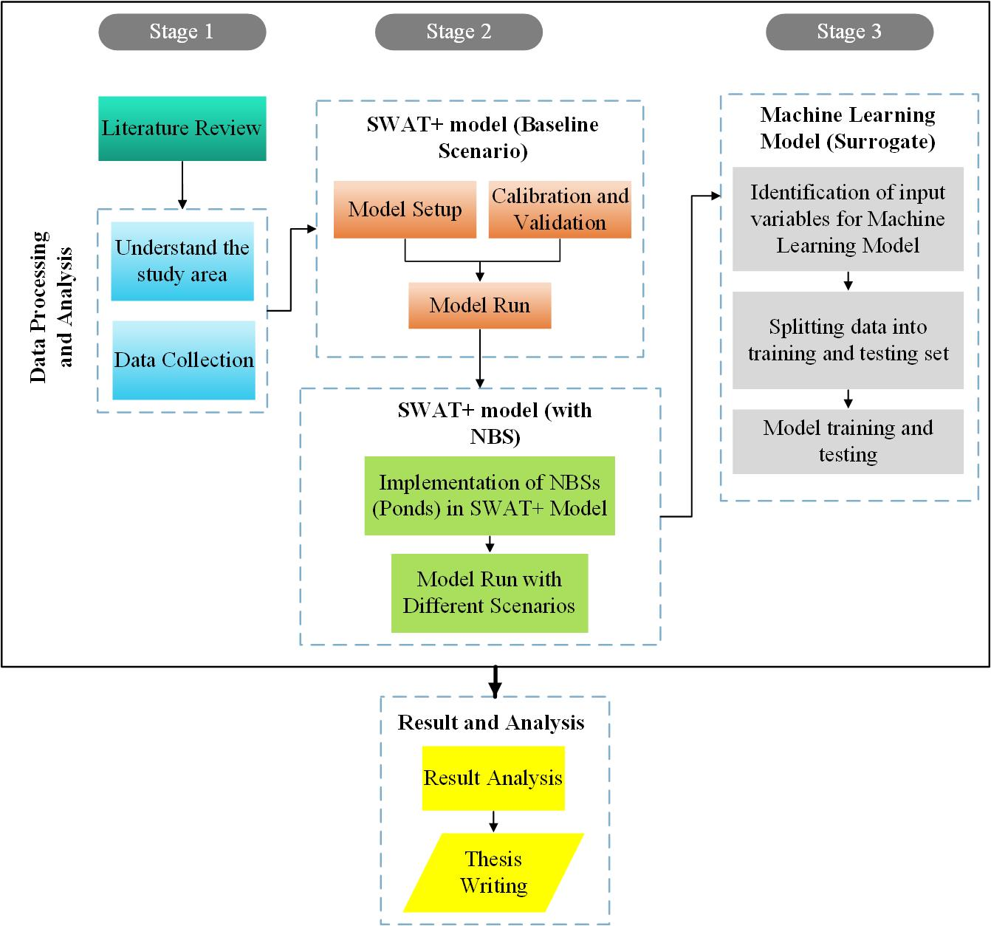
Research Methodology
Machine Learning model
SWAT+ Output for Agricultural HRUs
Correlation Analysis-Pearson Correlation Coefficient
Decision Tree (Regression Tree) and Random Forest (RF)

Slide 4
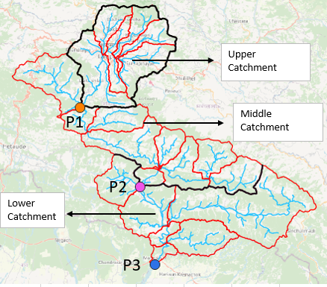
Scenarios for Ponds (Agricultural HRUs)
Scenario U: Ponds in Upper catchment
Scenario M: Ponds in Middle catchment
Scenario L: Ponds in Lower catchment
Scenario UM: Ponds in Upper+Middle catchment
Scenario ML: Ponds in Middle+Lower catchment
Scenario UML: Ponds in Upper+Middle+Lower catchment
U
M
L

Slide 5
Results
SWAT+ model (with NBS compared to the baseline model)

Slide 6
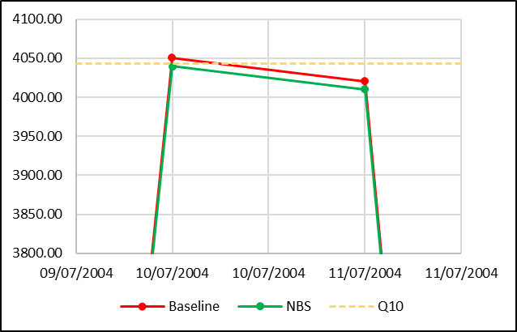
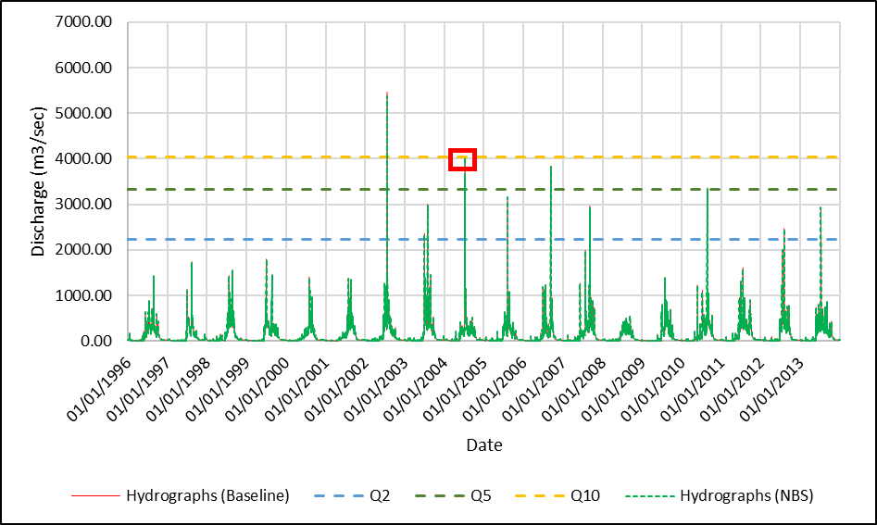
Flood Peak Analysis
Analyzed at the main outlet (P3)
Higher impact with the increase in the intervention area and proximity
Not so effective for higher return period range
Return period (yrs) | Number of Peaks (Baseline) | Number of Reduced Peaks
 |  | Scenarios
 |  | U | M | L | UM | ML | UML
Q2-Q5 | 6 | 2 | 4 | 3 | 5 | 6 | 6
Q5-Q10 | 2 | 0 | 1 | 2 | 2 | 2 | 2
>Q10 | 2 | 0 | 1 | 1 | 1 | 1 | 1
Total | 10 | 2 | 6 | 6 | 8 | 9 | 9
Maximum Reduction (m3/sec) |  | 10 | 10 | 10 | 10 | 20 | 20

Slide 7
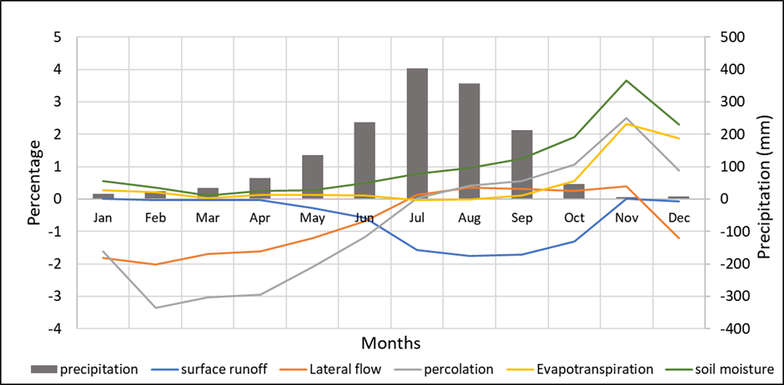
Drought Analysis (Hydrological)
Location | Baseline | Scenarios
 |  | U | M | L | UM | ML | UML
P1 | 150 | 152 | 150 | 150 | 152 | 150 | 152
P2 | 177 | 177 | 176 | 177 | 178 | 176 | 178
P3 | 185 | 183 | 185 | 181 | 184 | 182 | 181
Total | 512 | 512 | 511 | 508 | 514 | 508 | 511
Mixed results for either a rise in event, a decrease in it or no change
Monthly mean of the variation of water balance components (Upper Catchment)
Decrease in surface runoff in the monsoon season helps in the reduction of flood events
Soil retains more water during the rainy season (June-September) compared to the baseline scenario, improves the drought situation in the immediate dry months.

Slide 8
Results (Machine Learning model-Random Forest and Regression Tree)

Slide 9
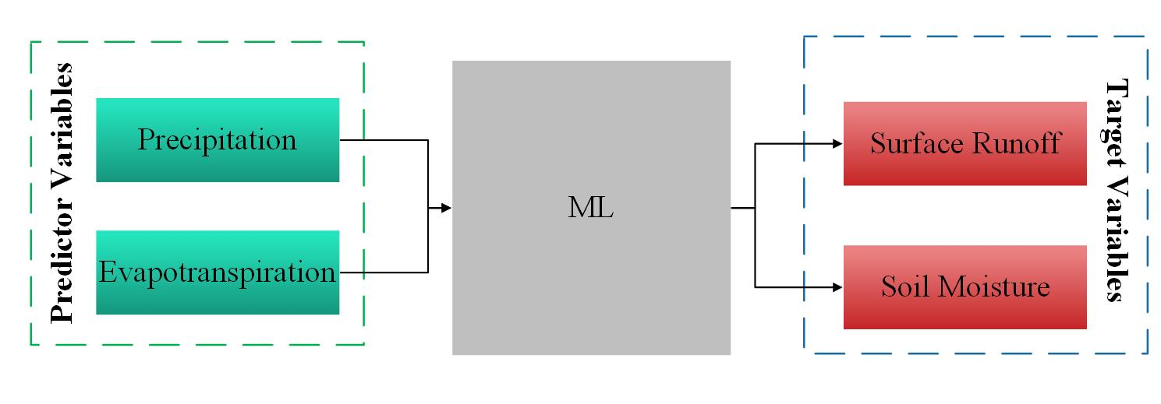
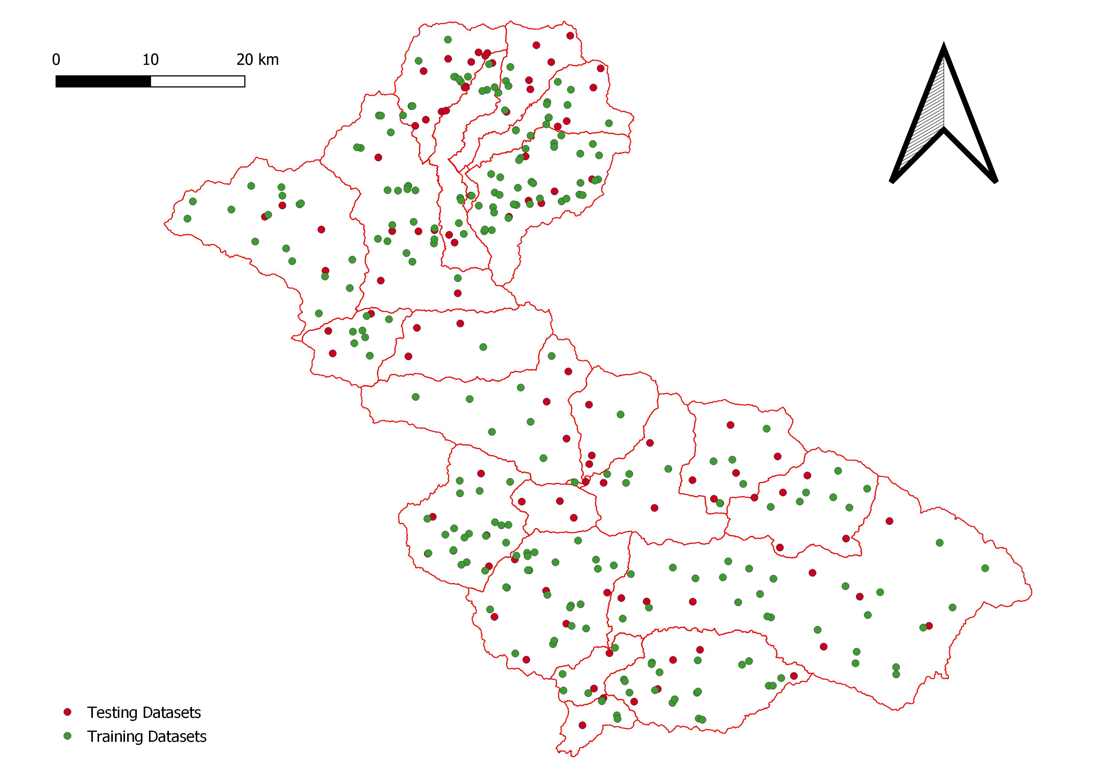
Selection of Inputs
Training and Testing Sets
Distribution throughout the Catchment
(235 HRUs for training 100 HRUs for testing)

Slide 10
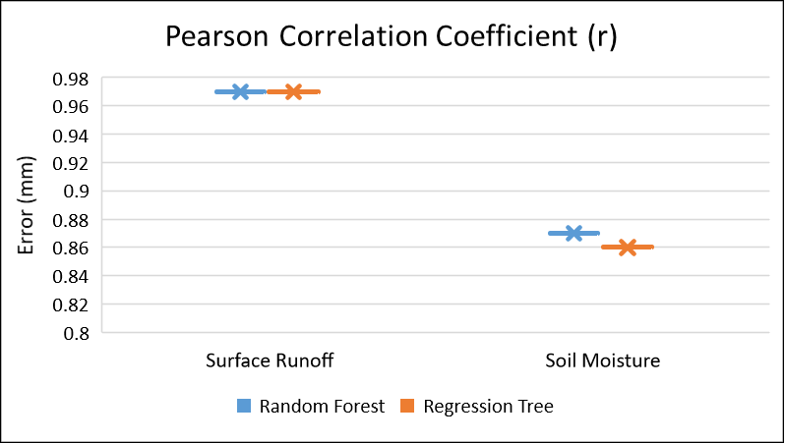
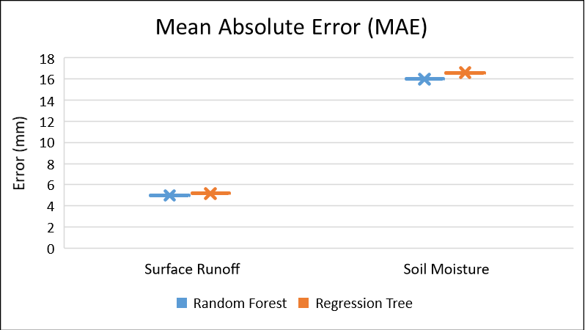
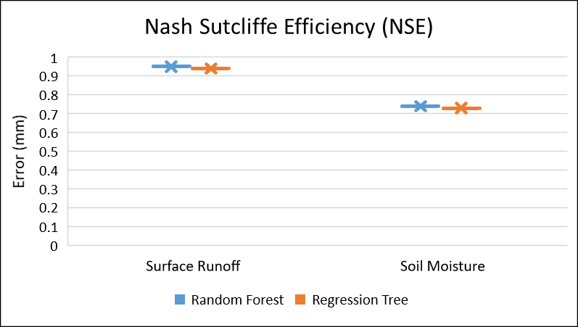
Statistical Performance Analysis
(Random Forest and Regression Tree)
Prediction for Surface Runoff better
Random Forest superior

Slide 11
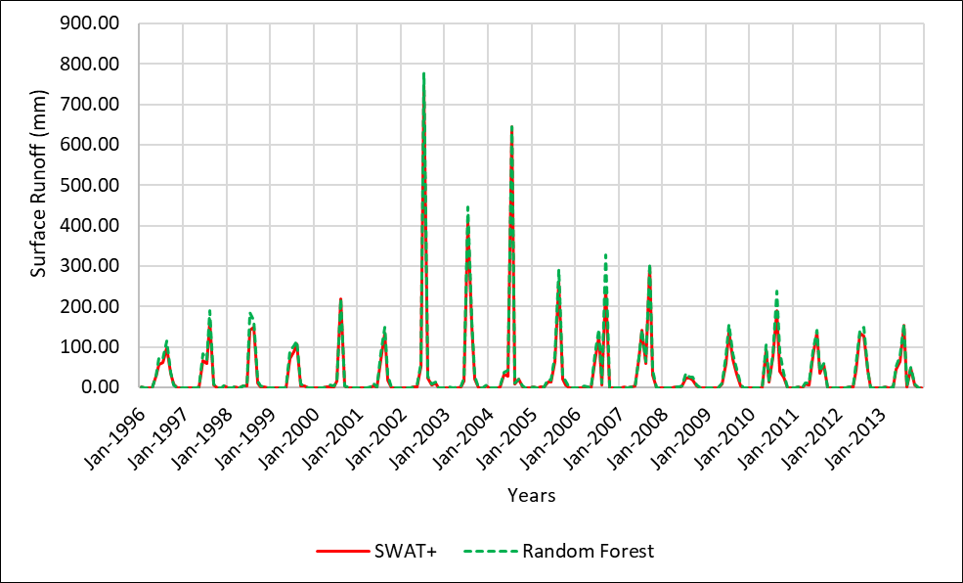
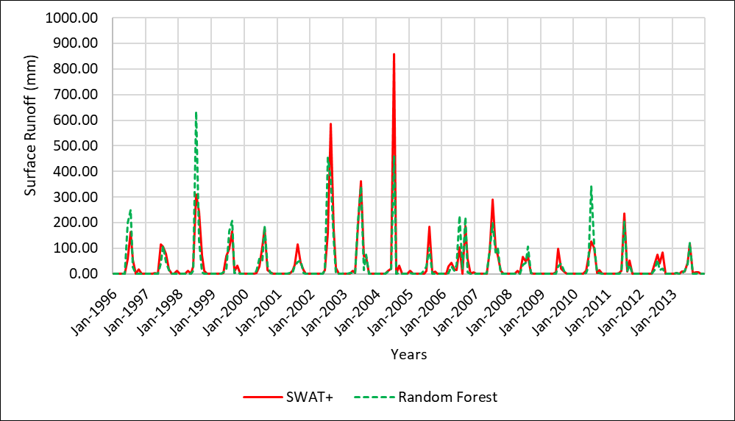
Time Series Analysis (Surface Runoff)
Only Random Forest considered for this analysis as it showed comparatively better performance than regression tree
Time series graph given by SWAT+ and Random Forest for surface runoff
HRU 1718
HRU 2246
Good consistency, minor variance, slightly overpredicted peaks
Mixed peak prediction, captures the trend of variation

Slide 12
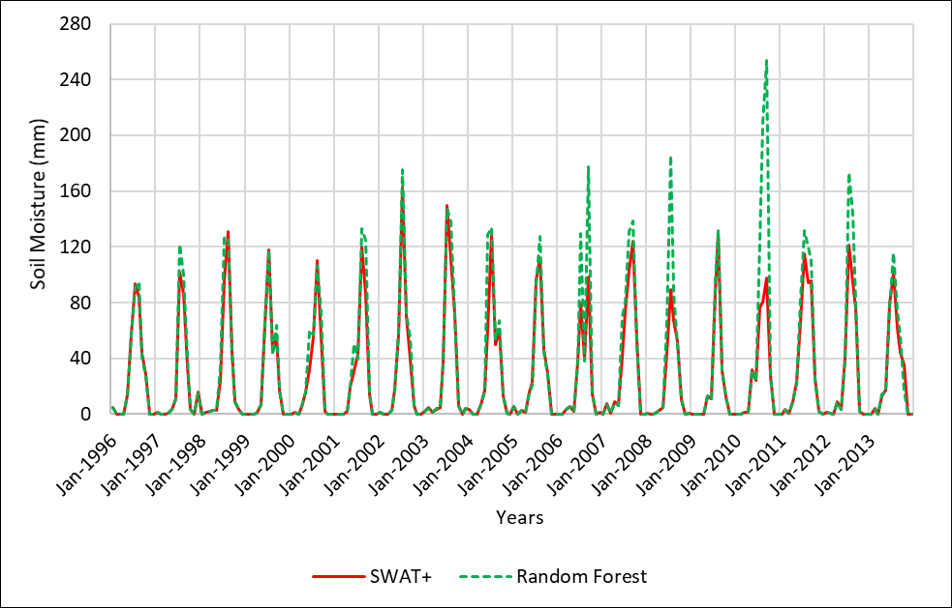
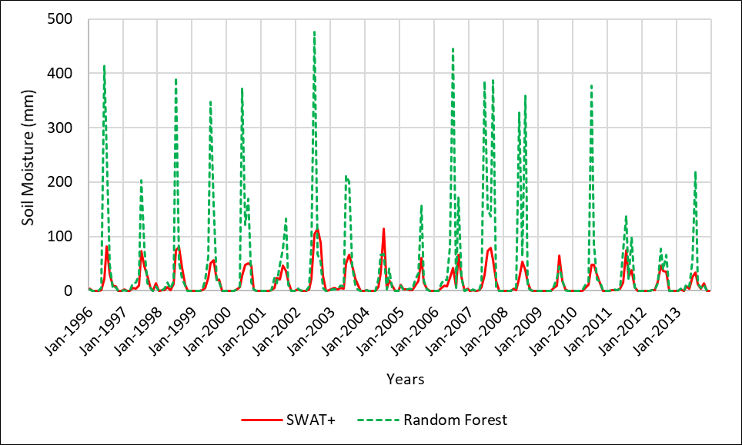
Time Series Analysis (Soil Moisture)
Time series graph given by SWAT+ and Random Forest for soil moisture
HRU 1718
HRU 2246
Fair fit until 2005, overpredicts the peak values in the later years, trend of the variation captured well
Significantly overestimates the peak values in all years
May overlook the monthly drought conditions

Slide 13
Conclusion
As a surrogate, Machine Learning model has a good potential to represent NBS such as ponds however, further research and analysis is necessary to establish ML as a popular tool in this area.
  Ponds have the potential to attenuate both flood and drought to a certain degree
  They have a local effect, effectiveness increases with an increase in the area of intervention
  Performance of ML models in the prediction of surface runoff in HRU level high- surface runoff or excess runoff closely related to precipitation-one of the inputs to ML, soil moisture could not be modelled as effectively- further research needed to develop a justified conclusion

Slide 14
References
Dhital YP, Kayastha RB (2013) Frequency analysis, causes and impacts of flooding in the Bagmati River Basin, Nepal. Journal of Flood Risk Management 6: 253-260 DOI https://doi.org/10.1111/jfr3.12013
Ruangpan L, Vojinovic Z, Di Sabatino S, Leo LS, Capobianco V, Oen AMP, McClain ME, Lopez-Gunn E (2020) Nature-based solutions for hydro-meteorological risk reduction: a state-of-the-art review of the research area. Nat Hazards Earth Syst Sci 20: 243-270 DOI 10.5194/nhess-20-243-2020
UCL, CRED, USAID (2017) Natural Disasters 2017

Slide 15
Thank You
Questions??

