Slide 1



A way-out from the maze of mid Miocene Sphaeroidinellopsis (planktonic Foraminifera)
Alessio Fabbrini, Zamininga I., Ezard T. & Wade B.
25/05/2022 Vienna

Slide 2
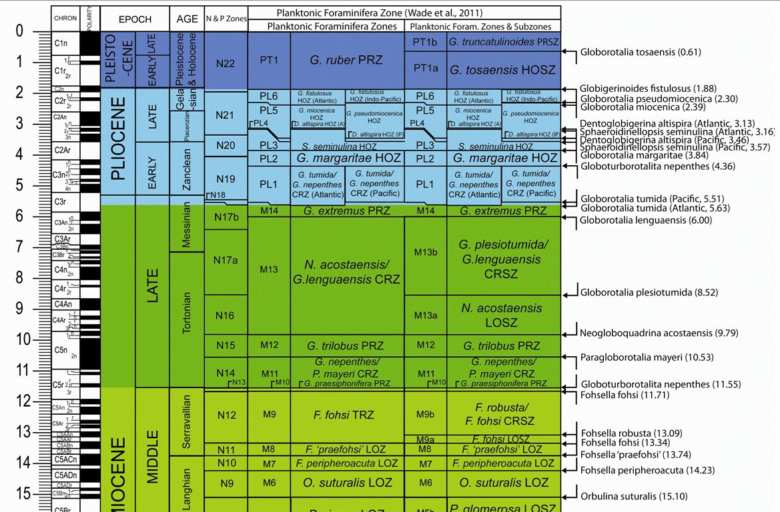
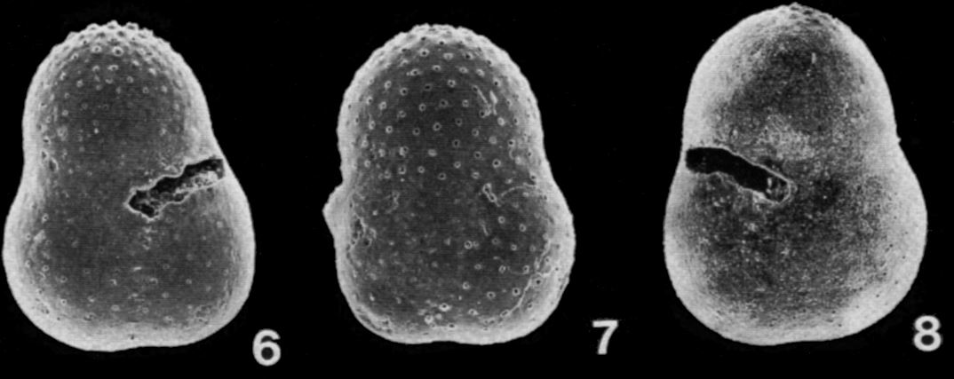
Why Taxonomy?
Biostratigraphy
Ss seminulina
MIOCENE

Slide 3
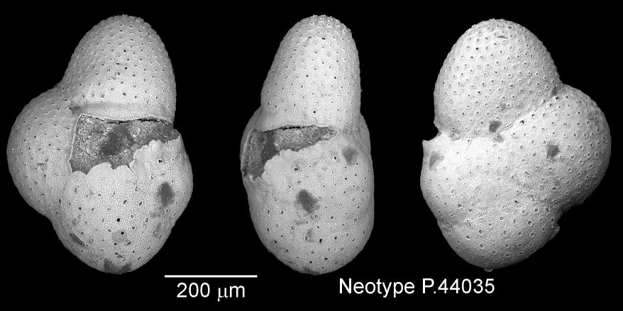
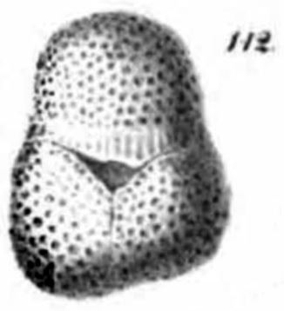
What is S. Seminulina?
Schwager 1866, Neotype Banner & Blow 1960
Biozone M4-PL3
3 chambers (+ cortex)
Holotype

Slide 4
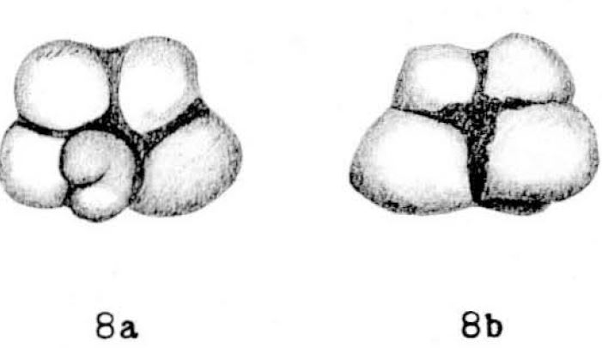
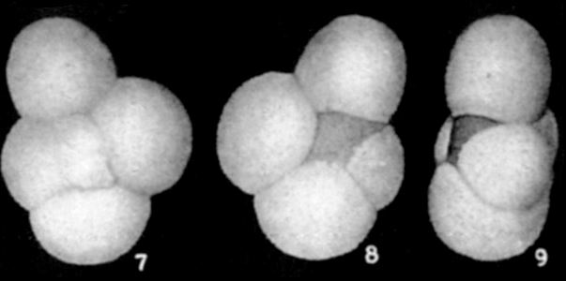
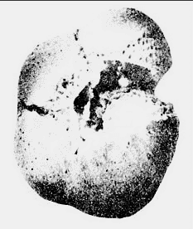
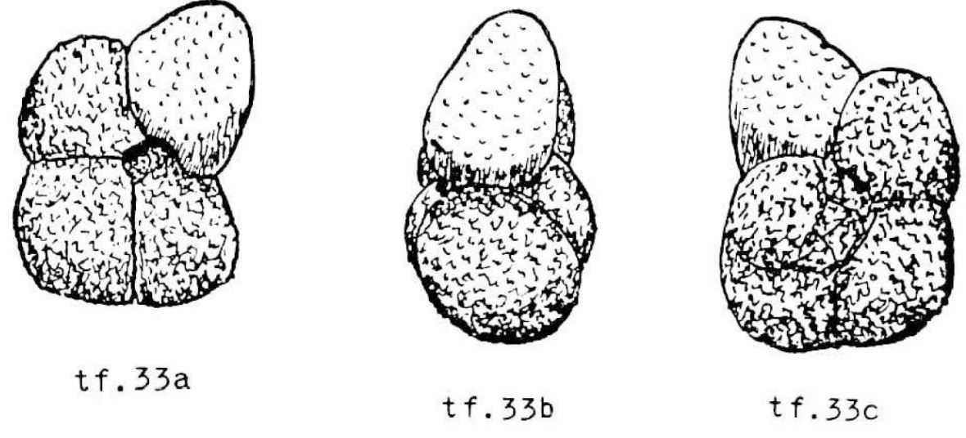
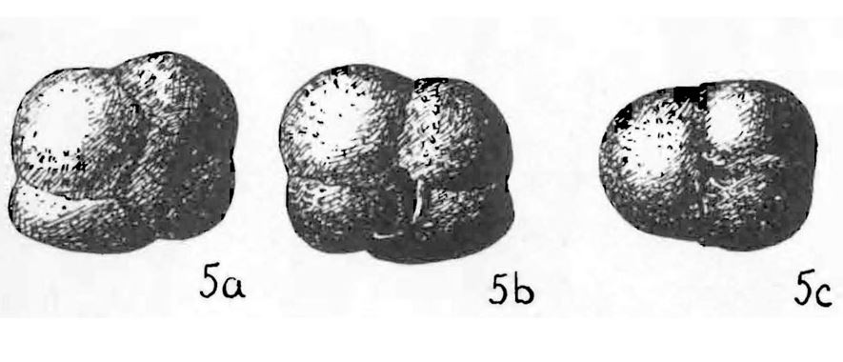
A real maze….
Ss multiloba
Ss kochi
???
Ss hancocki
Ss grimsdalei
Ss rutschi

Slide 5
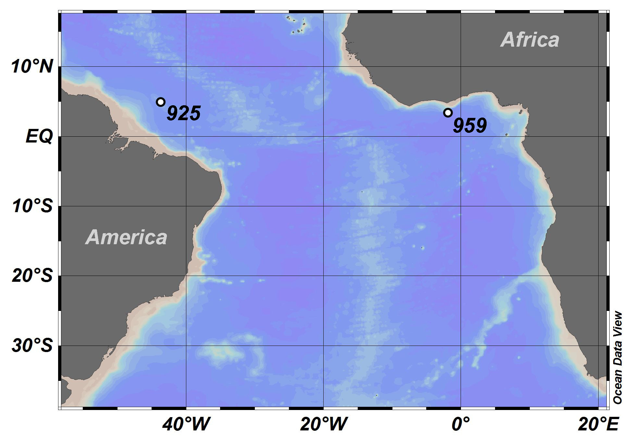
Locations
Leg 154-Ceara Rise
3041 m water depth
Leg 159-Deep Ivorian Basin
2090 m water depth
Fabbrini et al. (2021)

Slide 6
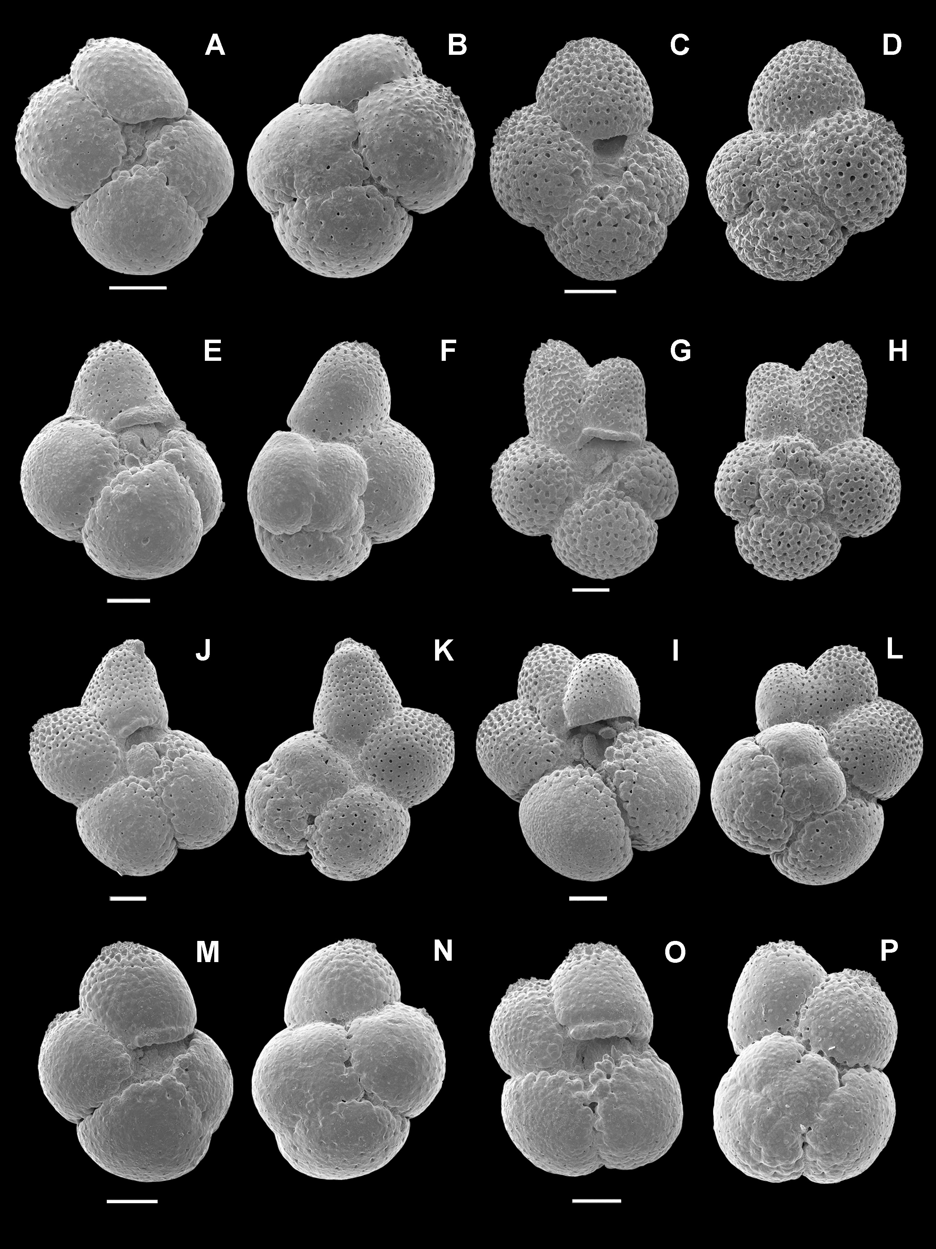
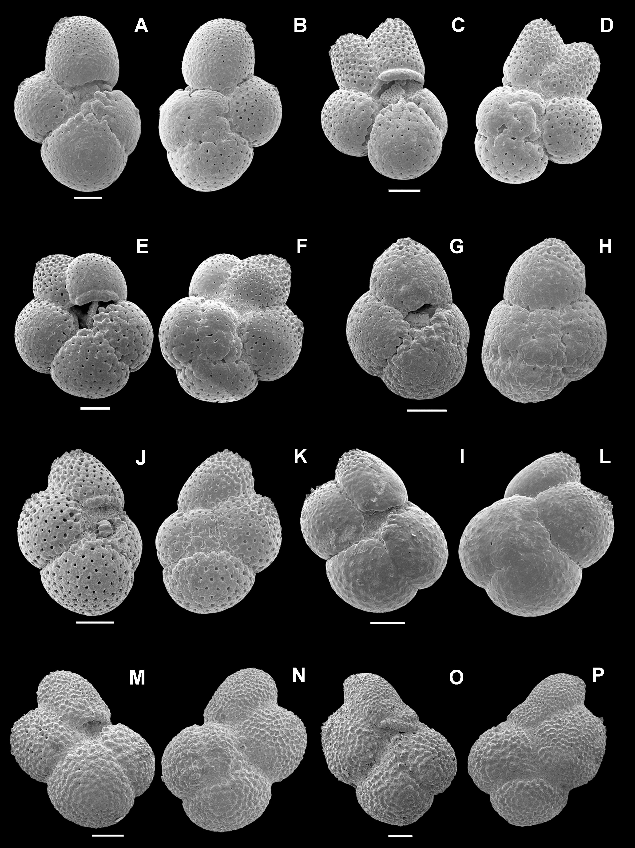
results
Ss kochi
Caudri 1934
M6-PL1
Cortex (0-90%)
> 3 ½ chambers
Fabbrini et al. (2021)

Slide 7
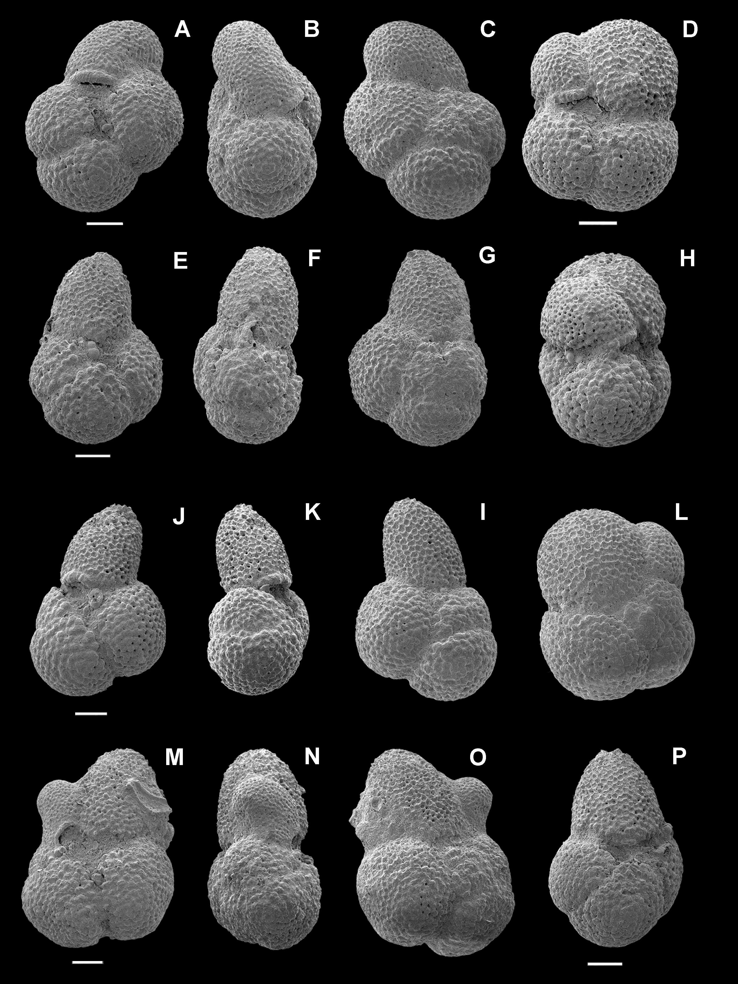
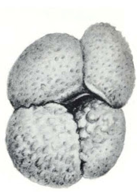
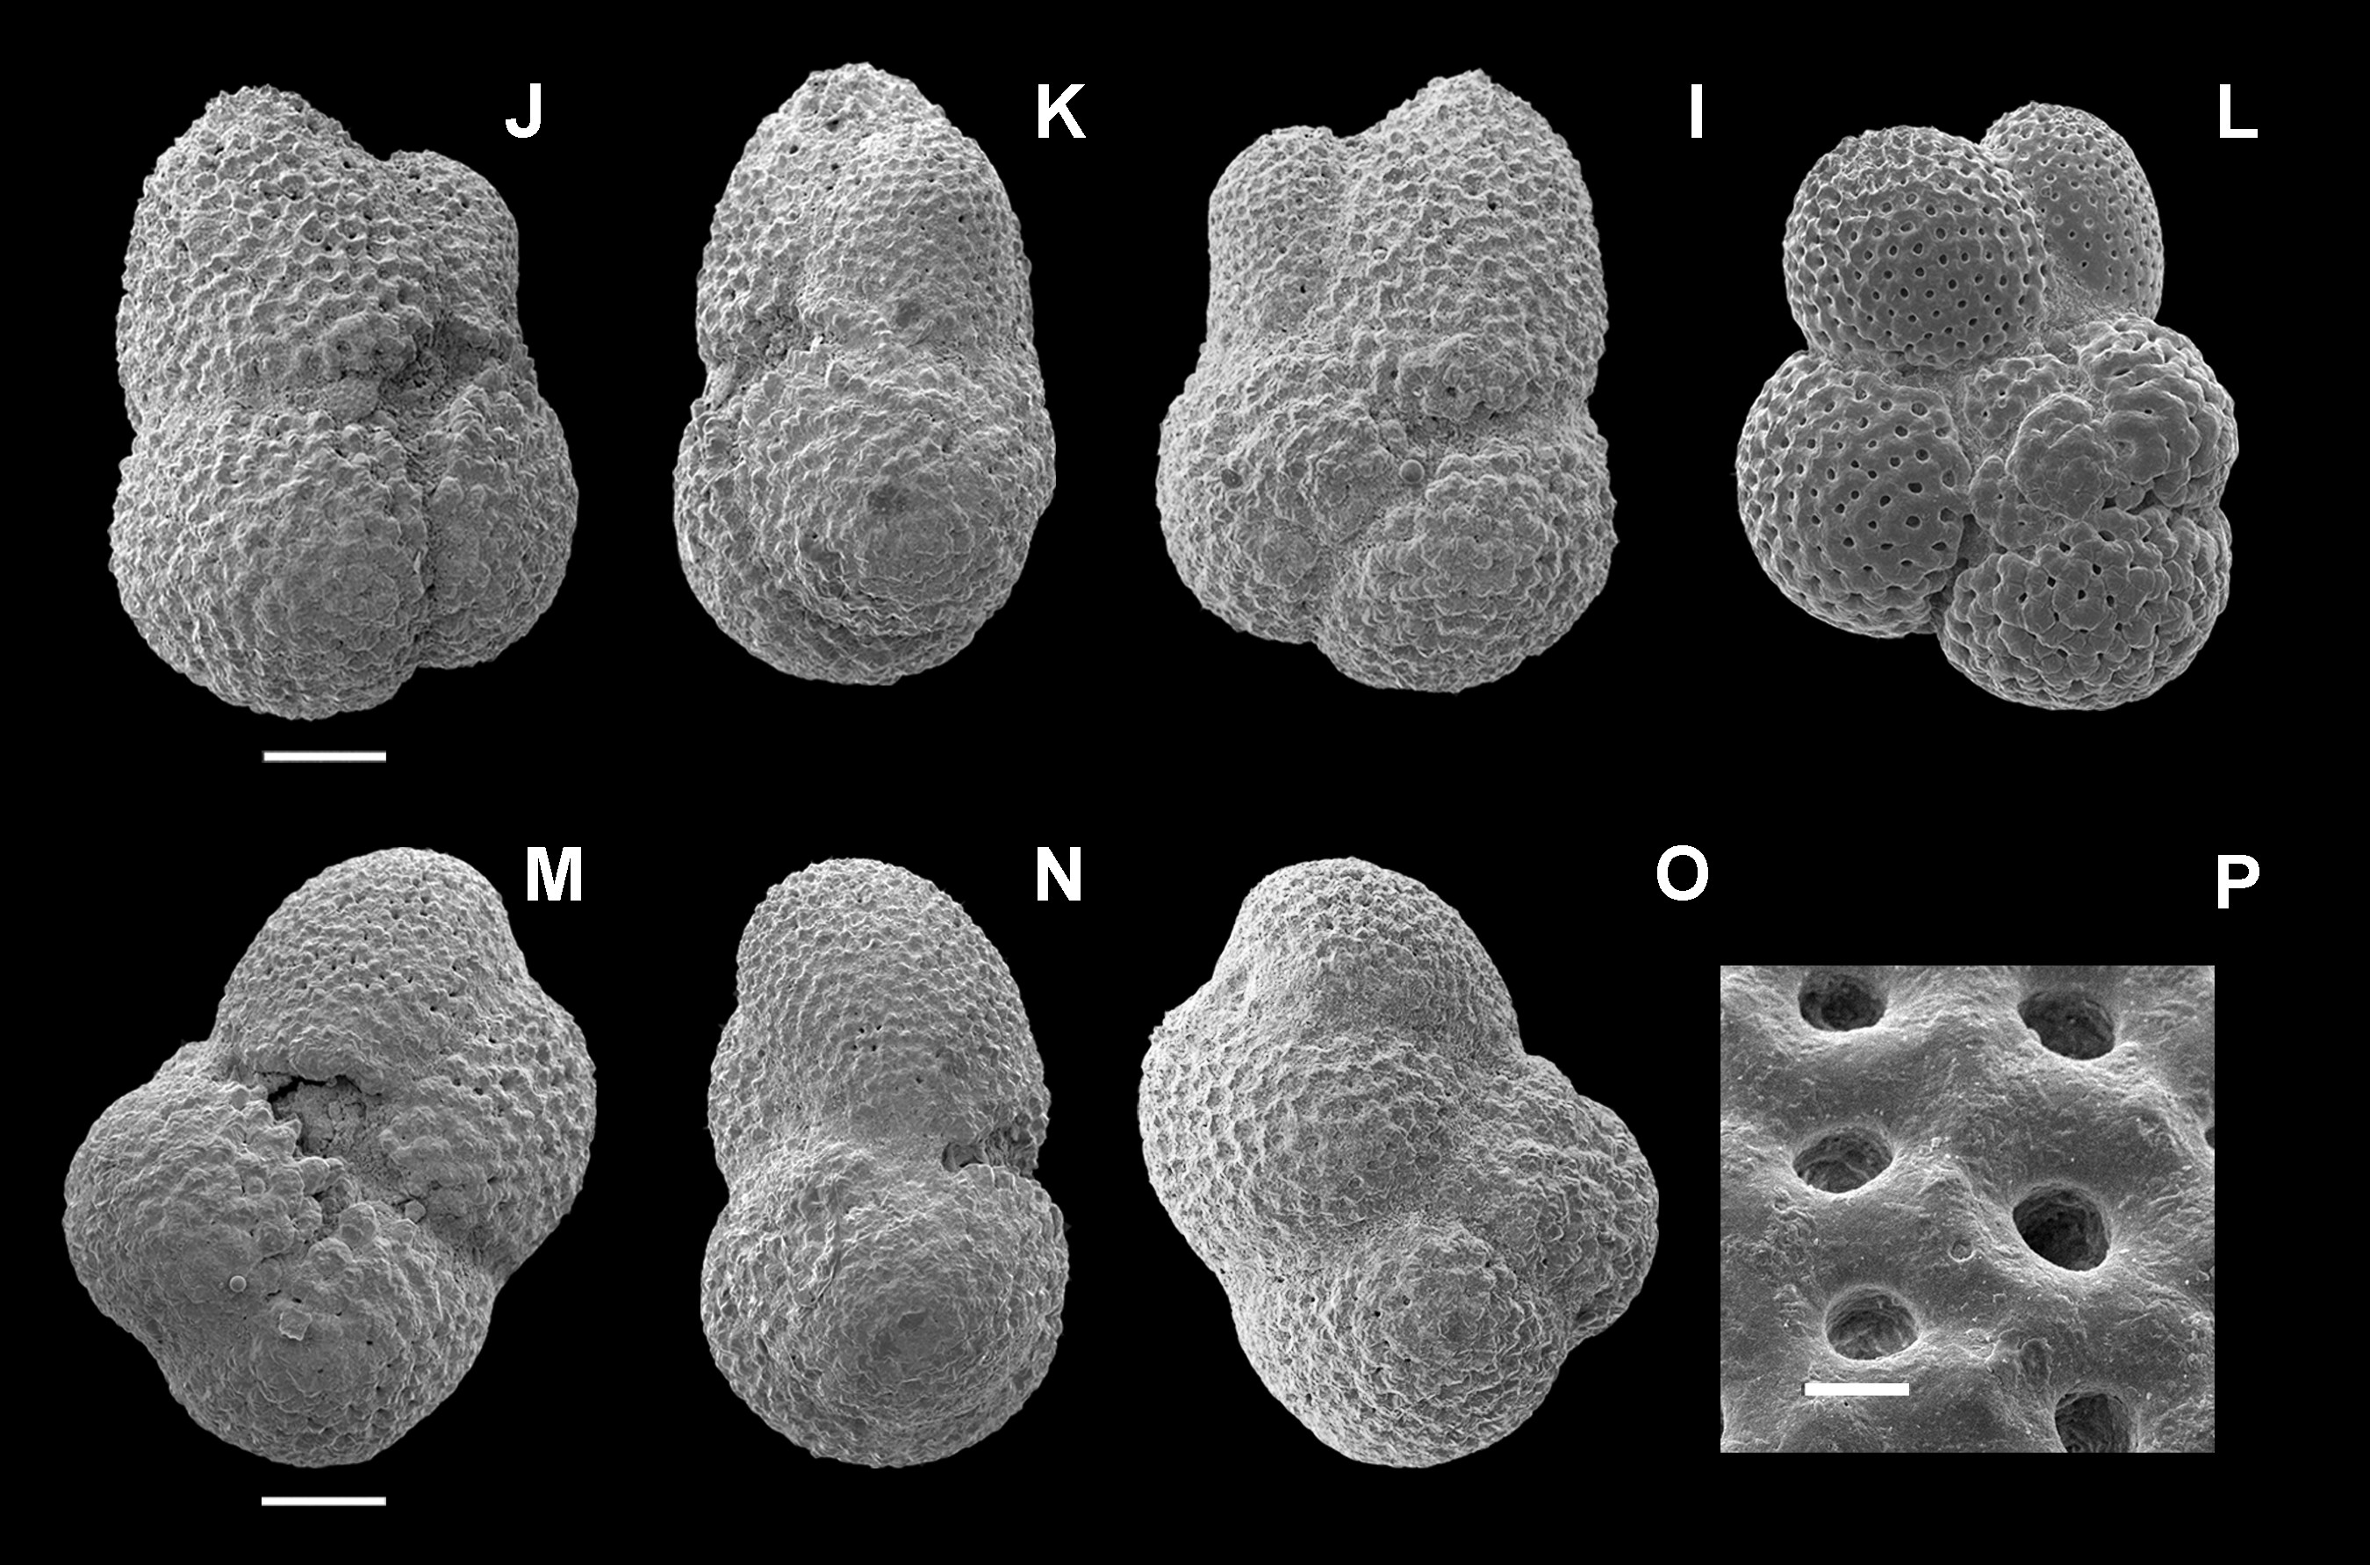
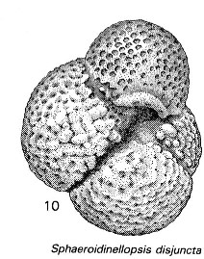
transition
Fabbrini et al. (2021)

Slide 8
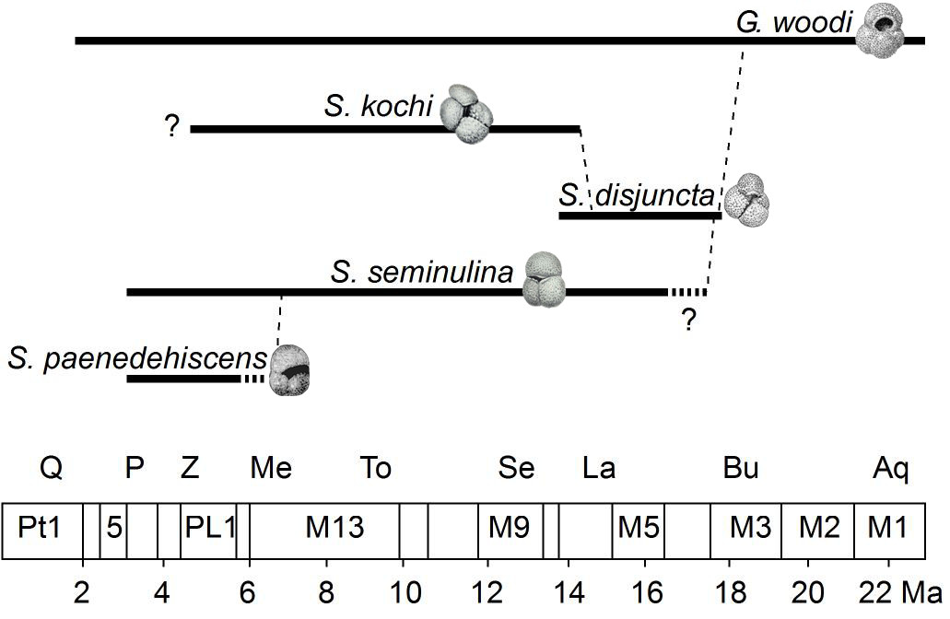
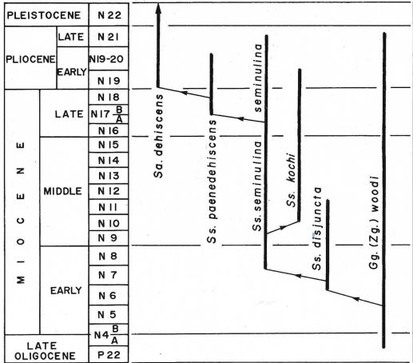
Conclusions: A new phylogeny
Kennett & Srinivasan (1983)
Fabbrini et al. (2021)

Slide 9

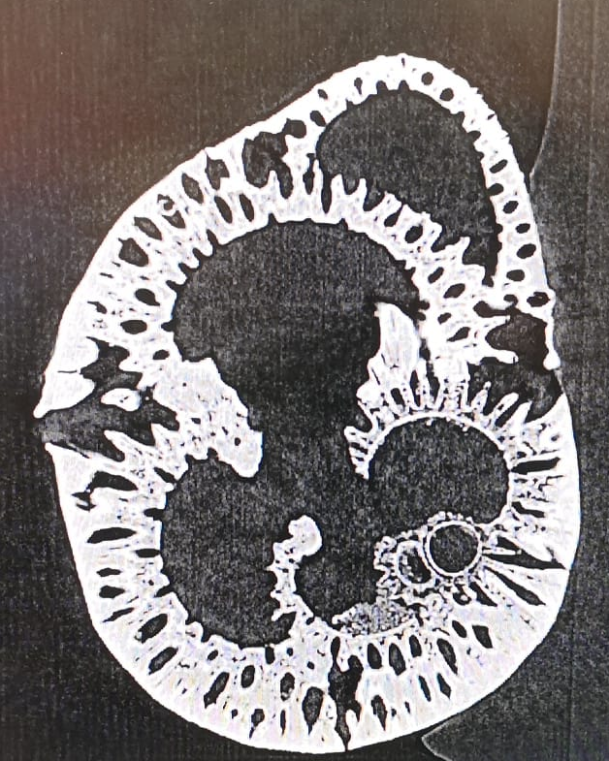
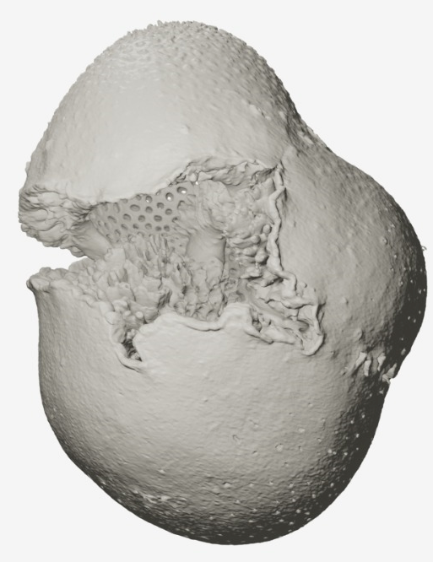
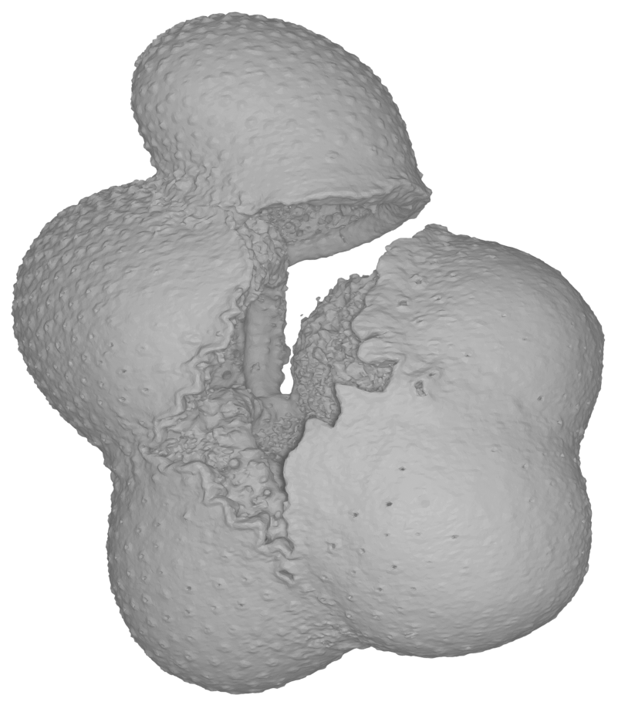
What’s next?
Fabbrini et al. (in prep)

Slide 10
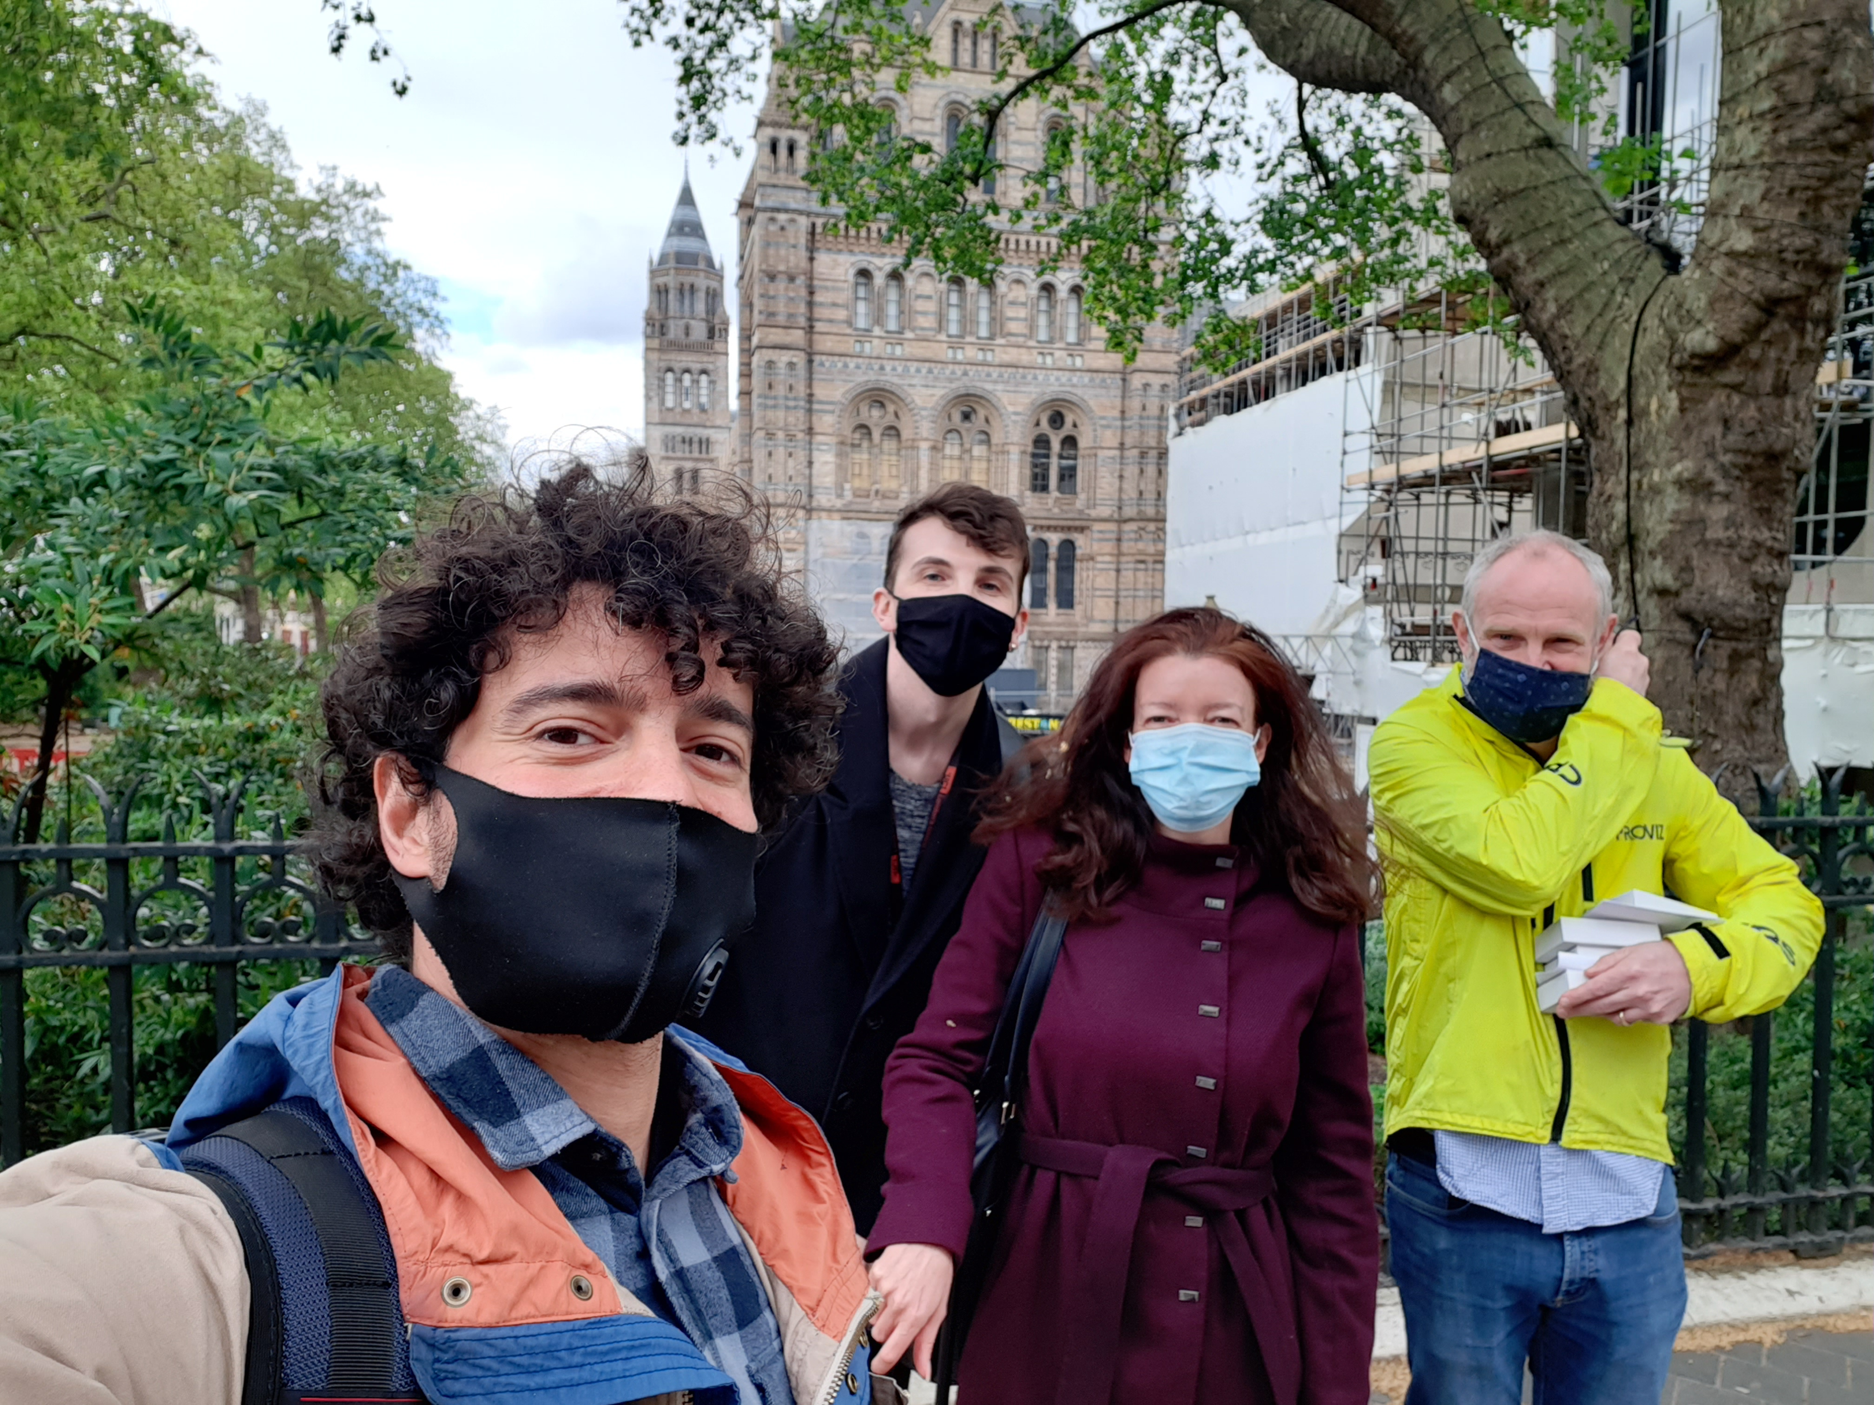
Grazie!

Slide 11
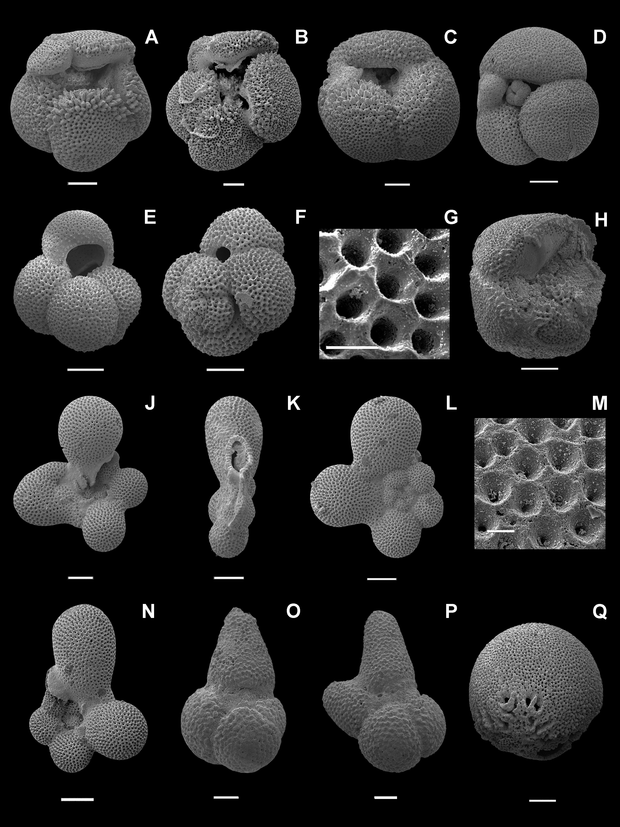
The Assemblage

