Slide 1
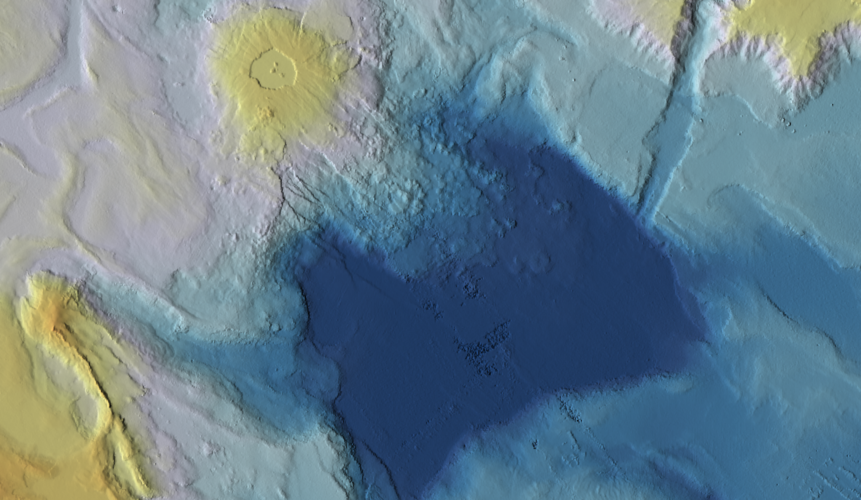




Geomorphology of the Mabahiss Deep area, Northern Red Sea: New insights from high-resolution multibeam bathymetric mapping
M. Fittipaldi¹ (margherita.fittipaldi@kaust.edu.sa)
D. Trippanera¹, N. Augustin², F. M. van der Zwan¹, L. Parisi¹,
A. Petrovic¹, D. Metz³ and S. Jónsson¹
1
2
3

Slide 2
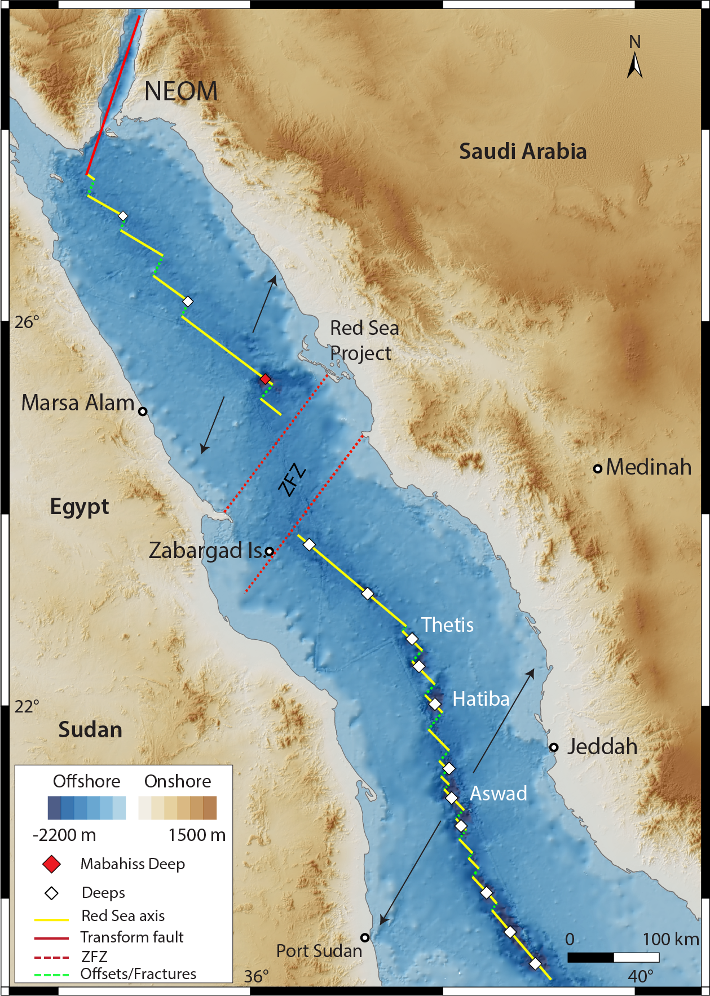
The Red Sea Rift (RSR) and the Zabargad Fracture Zone (ZFZ)
Problems?
→ZFZ : 60 km offset in the North
Evaporites cover : massive evaporites deposits along the entire rift
majority of the cover in the northern Red Sea
→ Axis structure: - North: rare deeps, poorly defined axis
- Centre: frequent deeps with oceanic crust
- South: continuous axial valley
How is the RSR axis structure to the north of ZFZ? Is rifting continuing north?
Focus?
MABAHISS DEEP AREA
Modified after Viltres et al. 2022

Slide 3
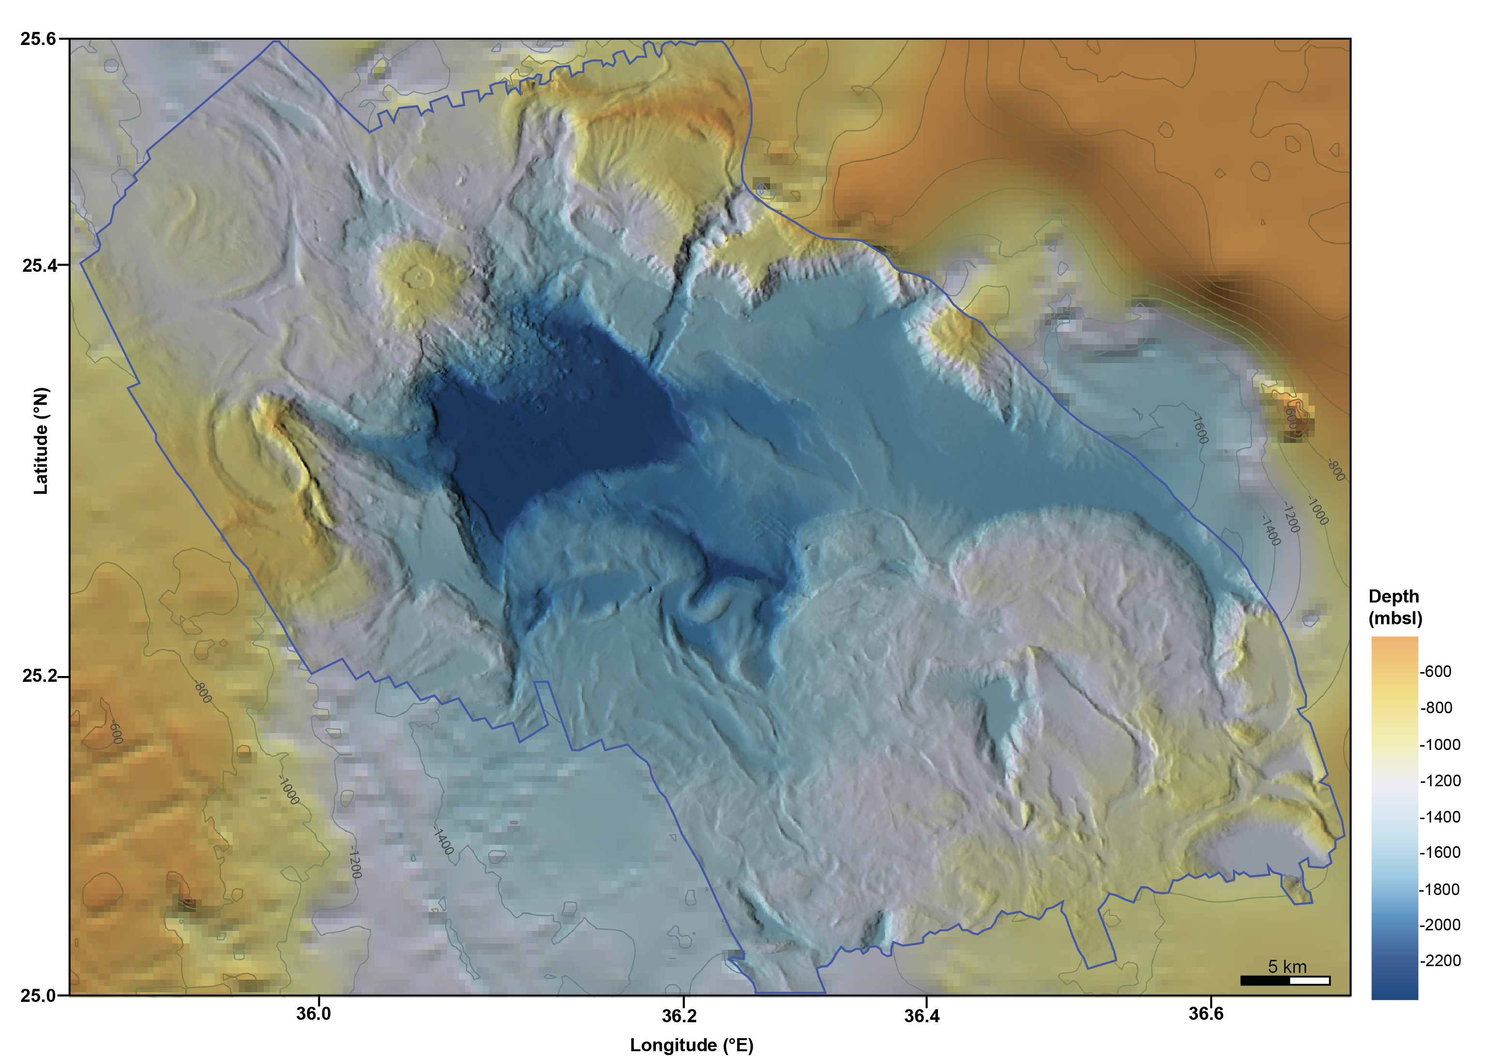
Structural and geomorphological map
→We compiled a geomorphological and structural map showing the main features of the Mabahiss Deep area from the multibeam bathymetric data
MD

Slide 4
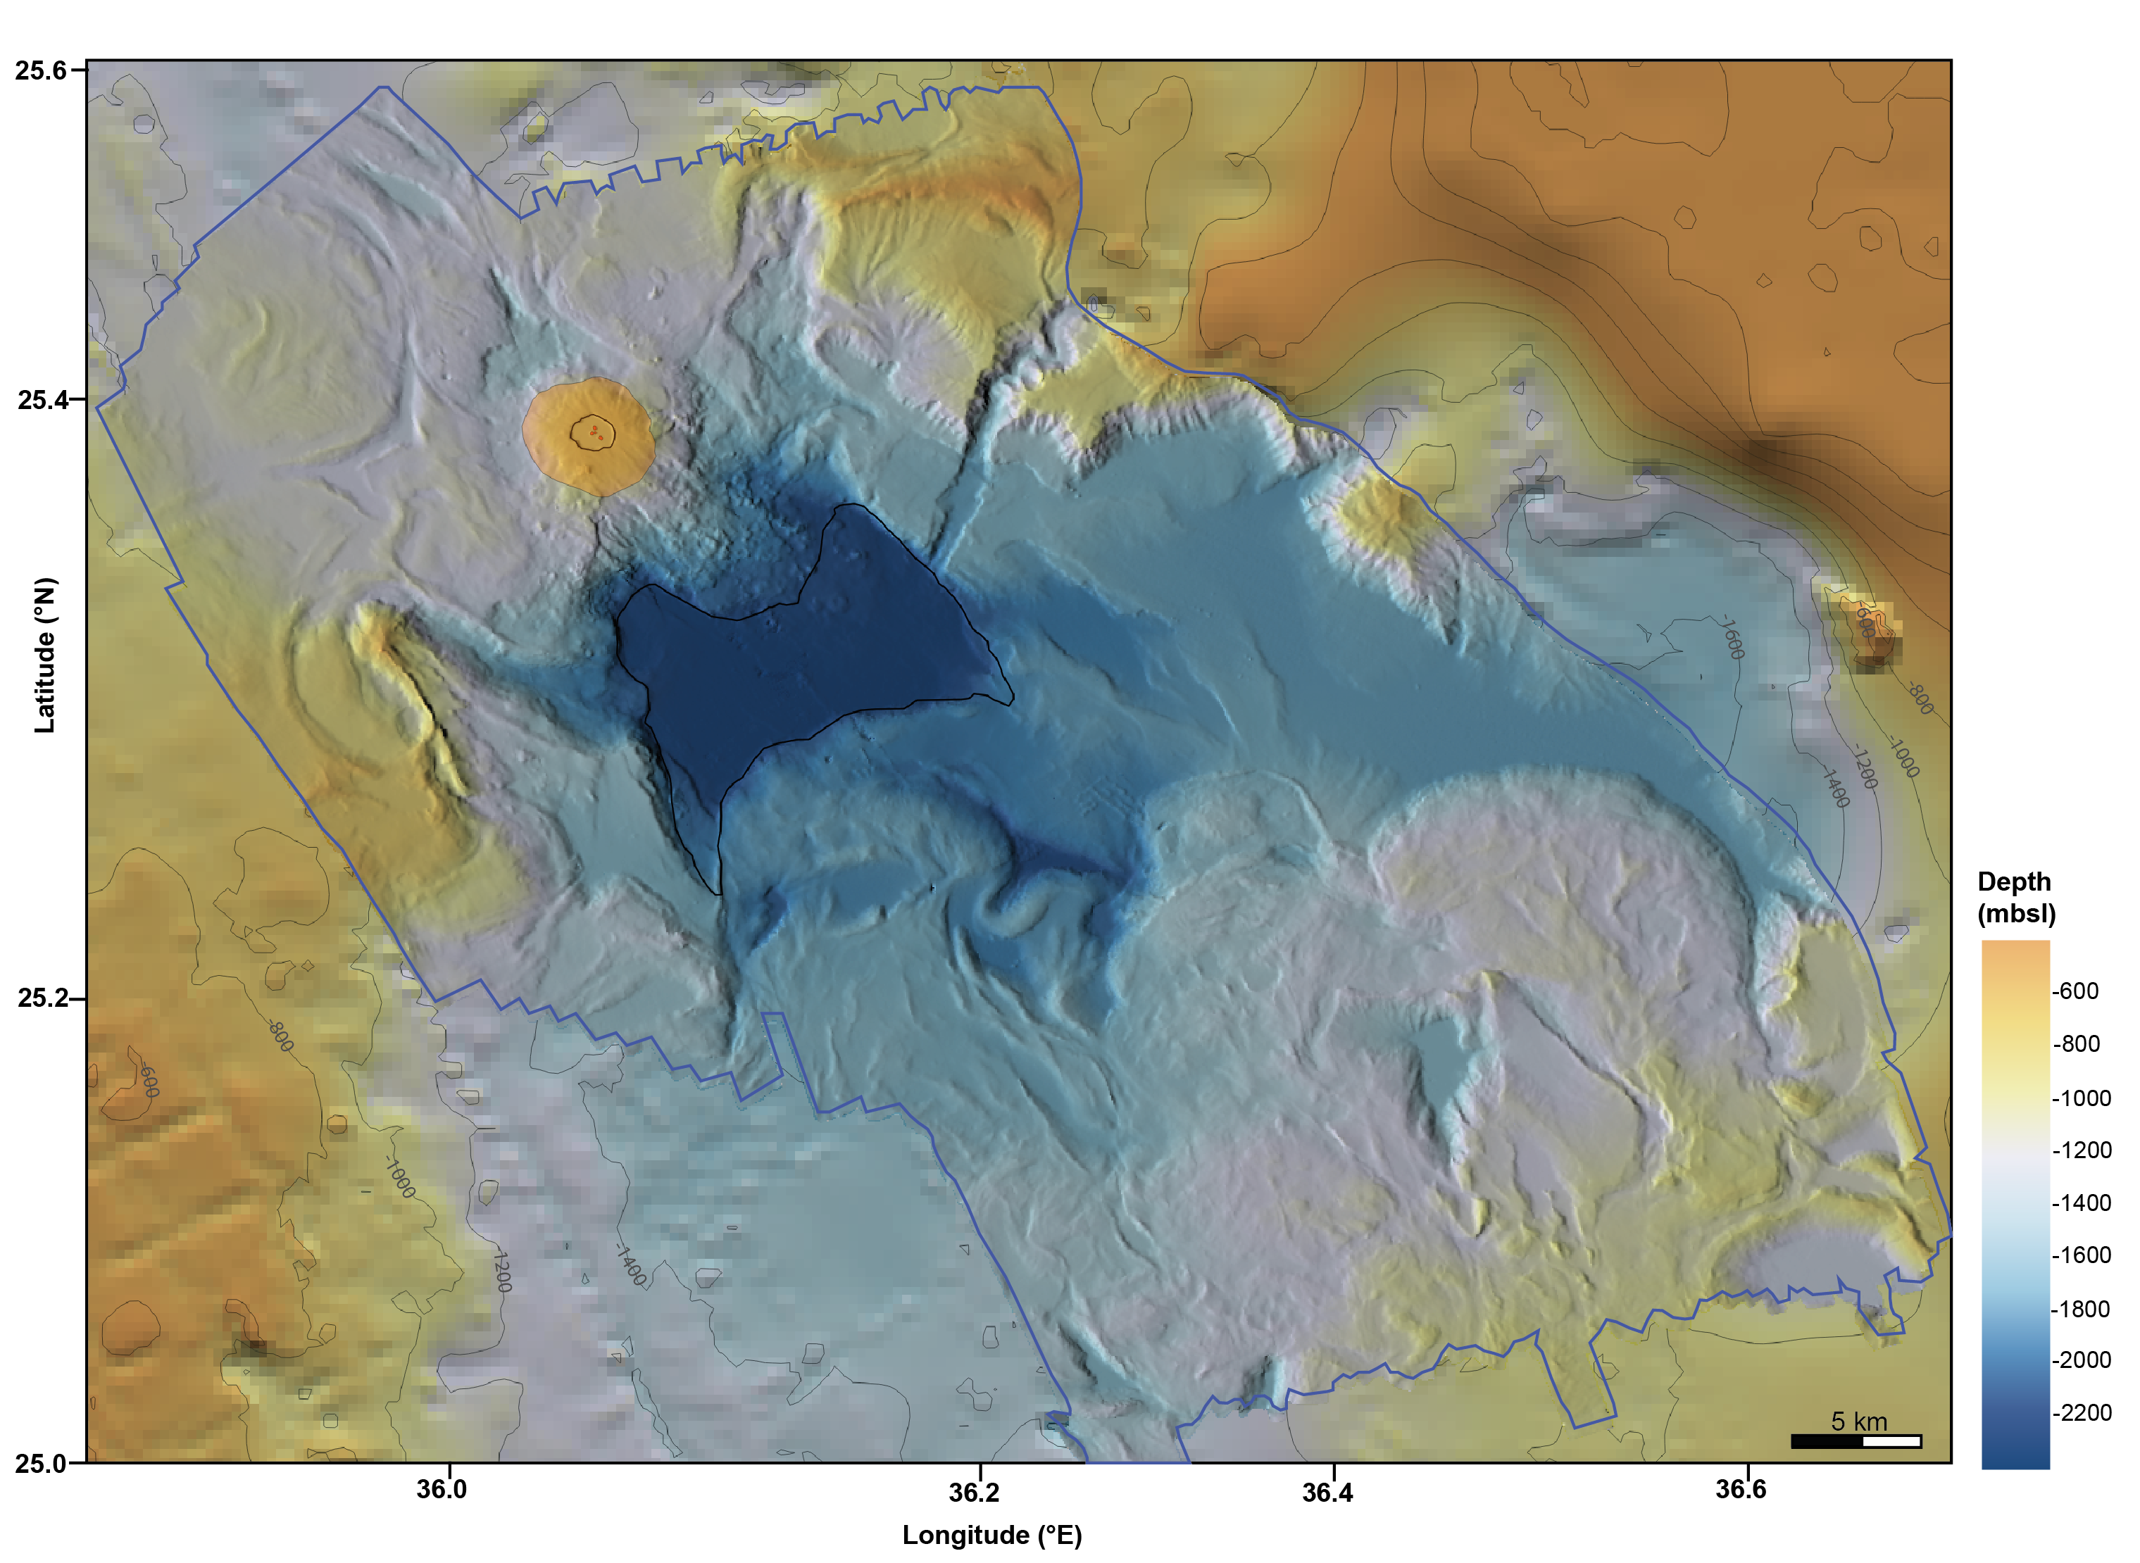
Structural and geomorphological map
→ Two prominent morphological features : Mabahiss Deep and Mabahiss Mons
LEGEND
Mabahiss volcano
Mabahiss Deep
Intracalderic cones
Caldera rim
MD

Slide 5
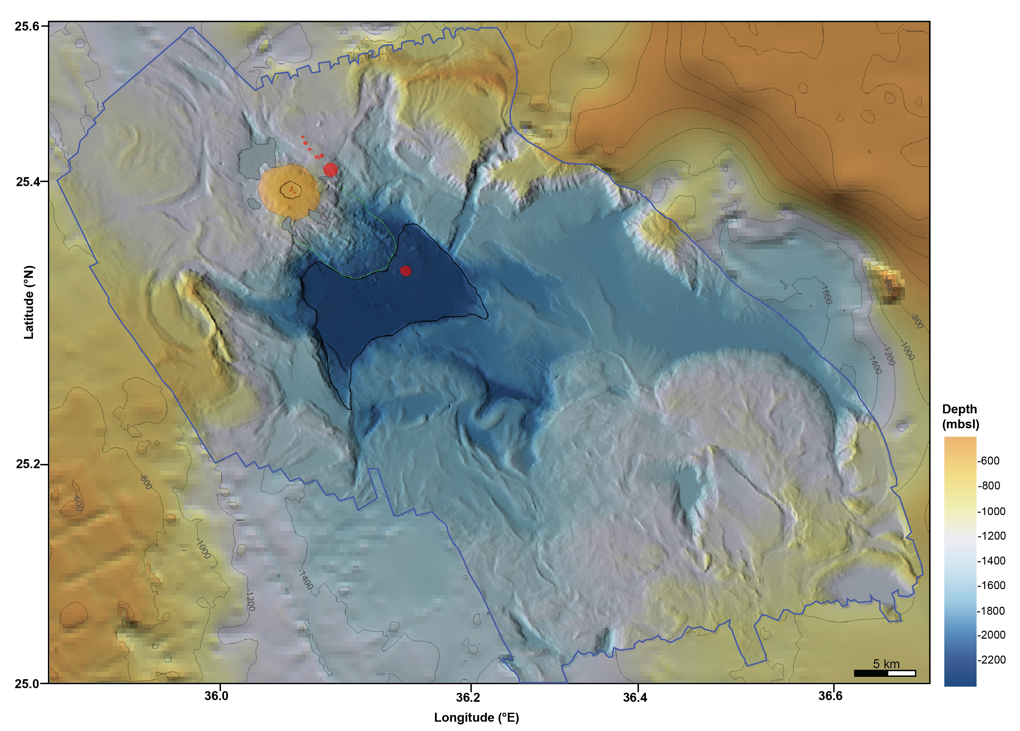
Structural and geomorphological map
→ Presence of several volcanic cones, lava flows and hummocky deposit
LEGEND
Mabahiss volcano
Mabahiss Deep
Intracalderic cones
Caldera rim
Volcanic cones
MD
Lava flows
Hummocky deposit

Slide 6

Structural and geomorphological map
→ Normal faults trending NNW-SSE and radial fractures on the volcano’s flanks
LEGEND
Mabahiss volcano
Mabahiss Deep
Intracalderic cones
Caldera rim
Volcanic cones
MD
Lava flows
Hummocky deposit
Normal faults
Radial fractures
Uncertain faults

Slide 7

Structural and geomorphological map
→ Salt flows covering the 50% of the study area
LEGEND
Mabahiss volcano
Mabahiss Deep
Intracalderic cones
Caldera rim
Volcanic cones
MD
Lava flows
Hummocky deposit
Normal faults
Radial fractures
Uncertain faults
Salt flows front
Salt flows direction

Slide 8
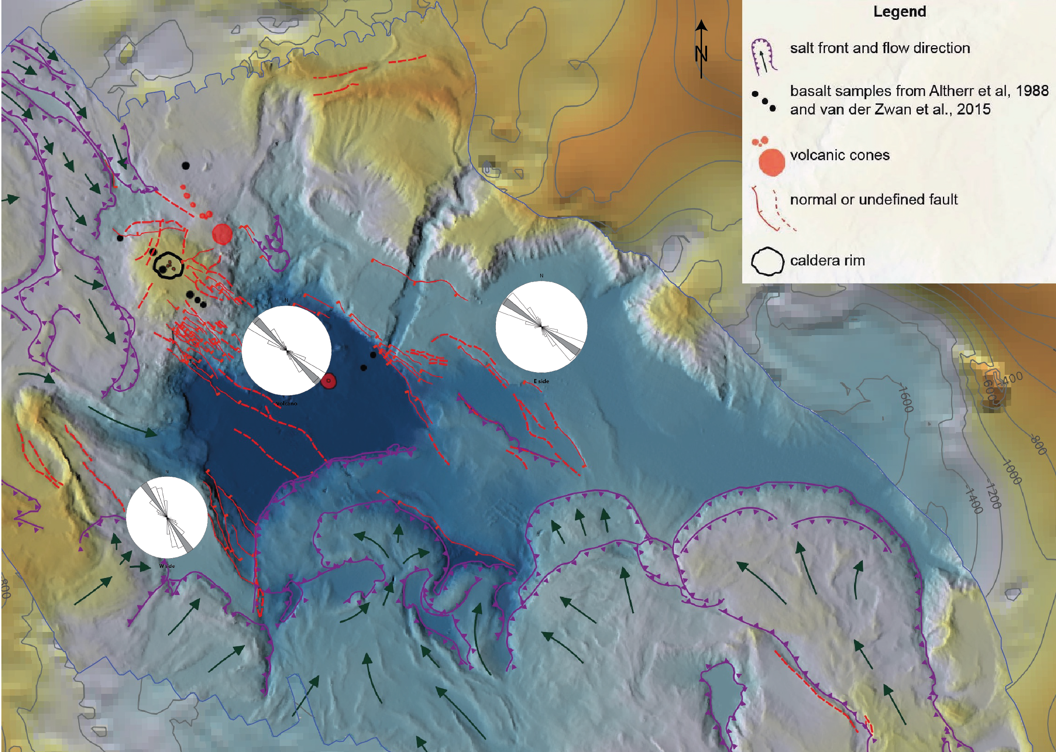
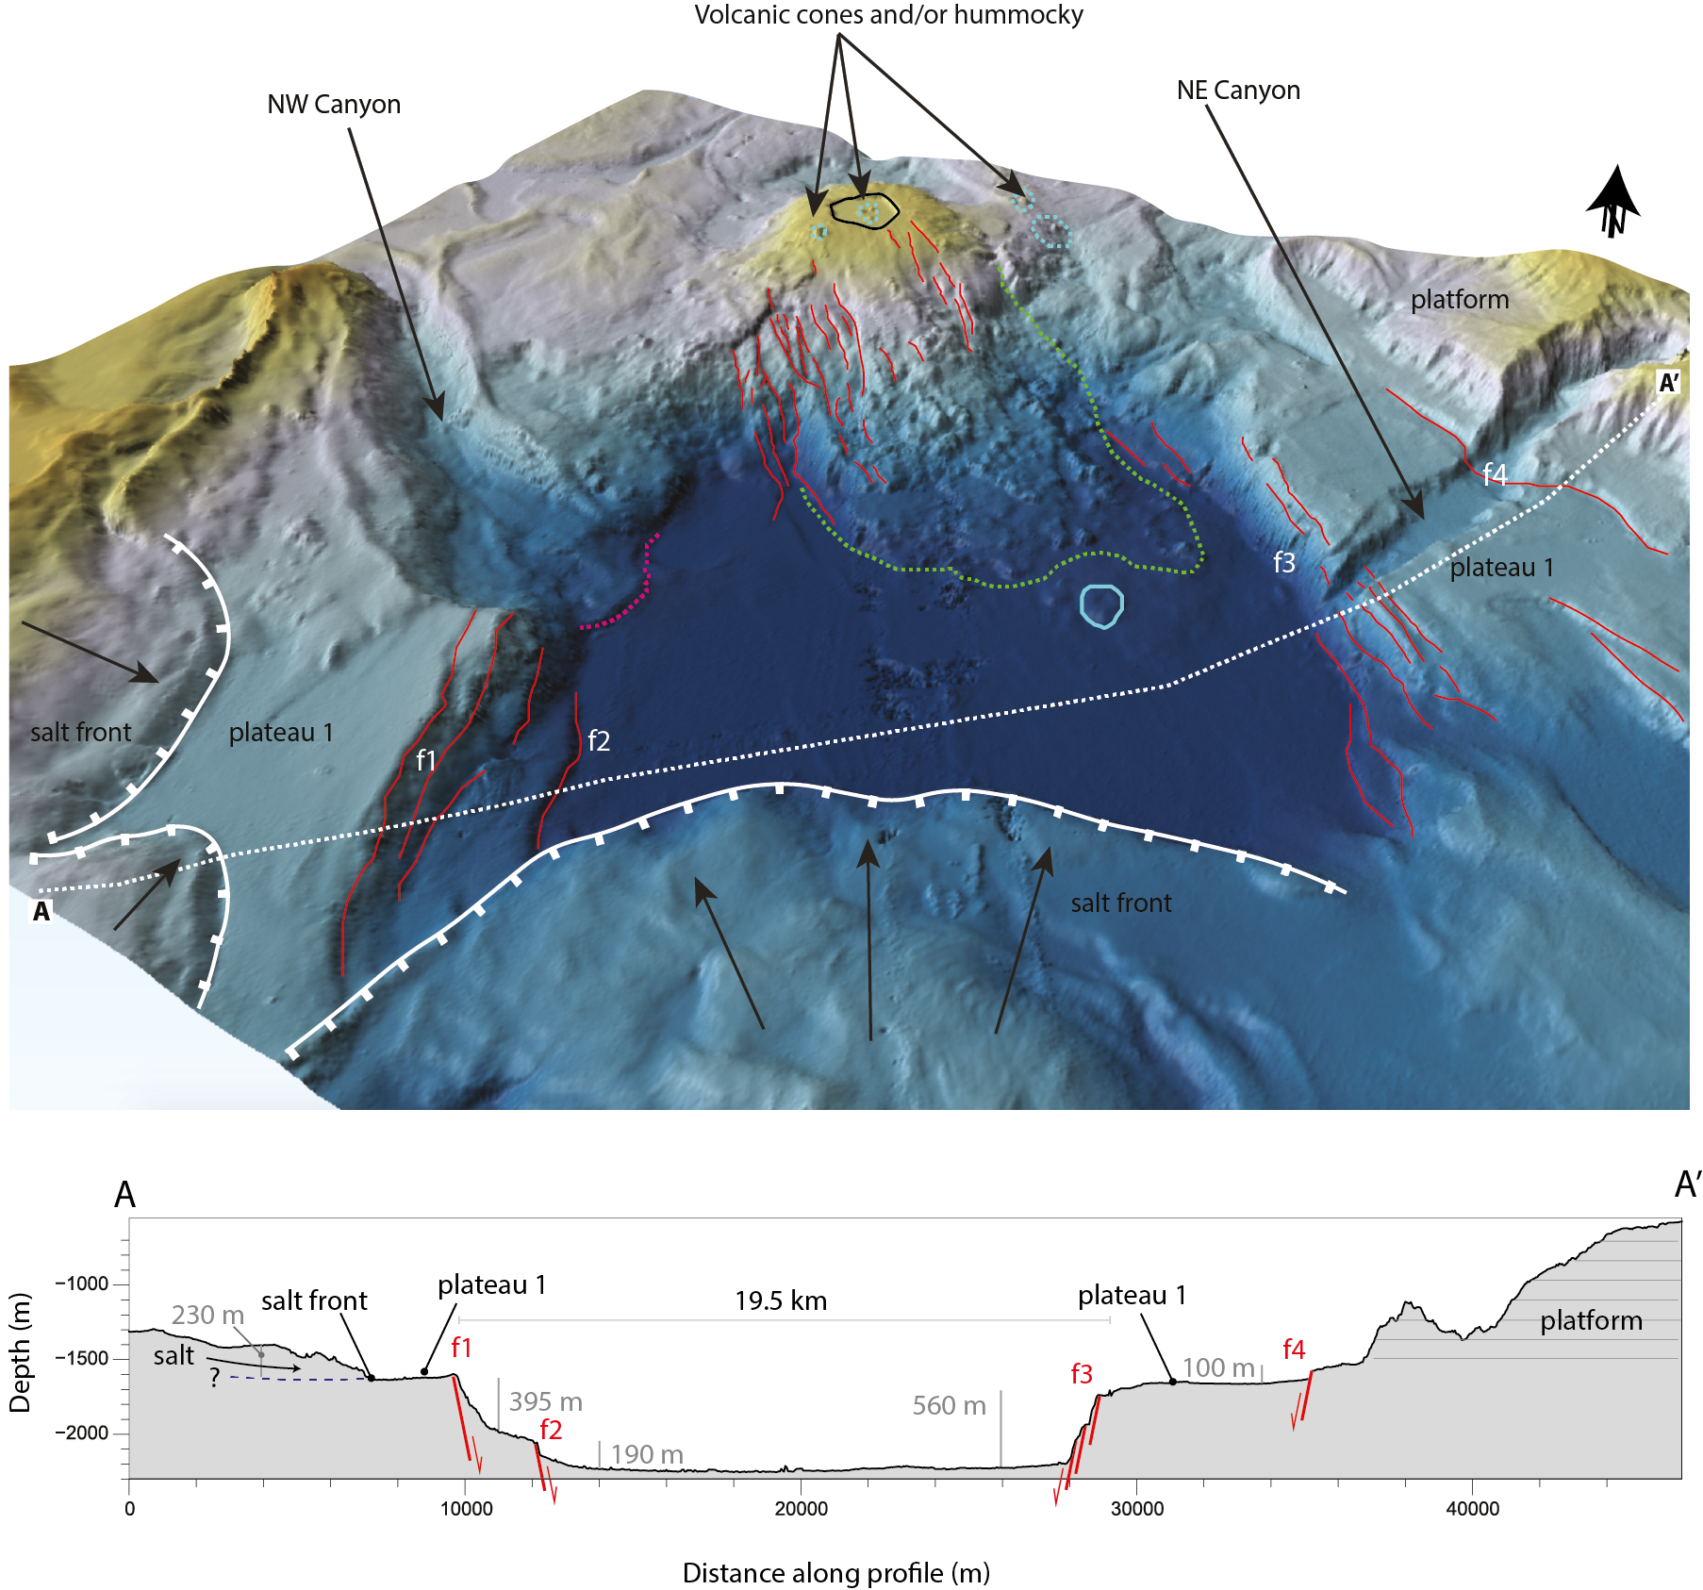
Mabahiss Deep
15 km in the NE-SW direction
9 km in the NW-SE direction
Maximum depth of ~2360 m
Graben-like structure

Slide 9
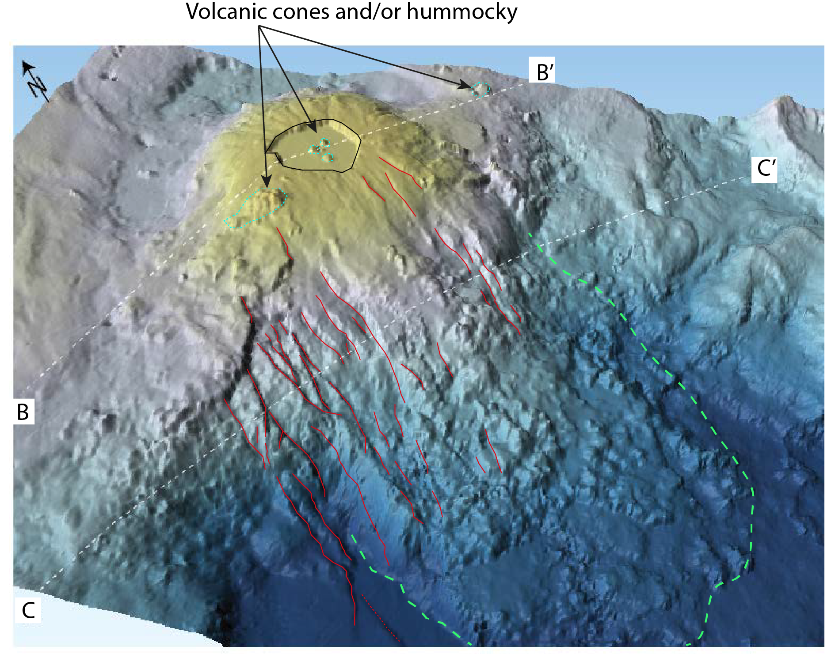
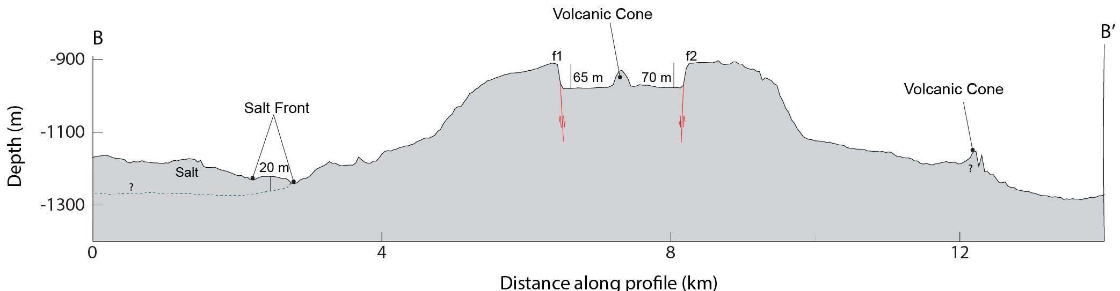
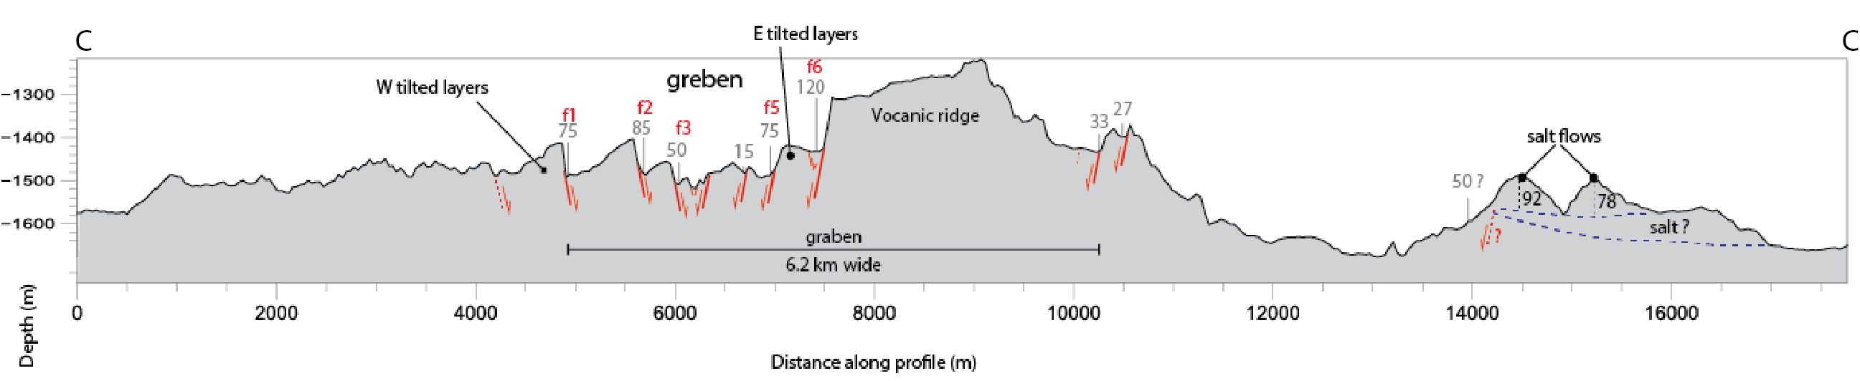
Mabahiss Volcano
8 km long diameter
Average height of 356 m
1.8 km wide circular caldera
Southern flank is dissected by several normal faults
Presence of MORB basalts

Slide 10
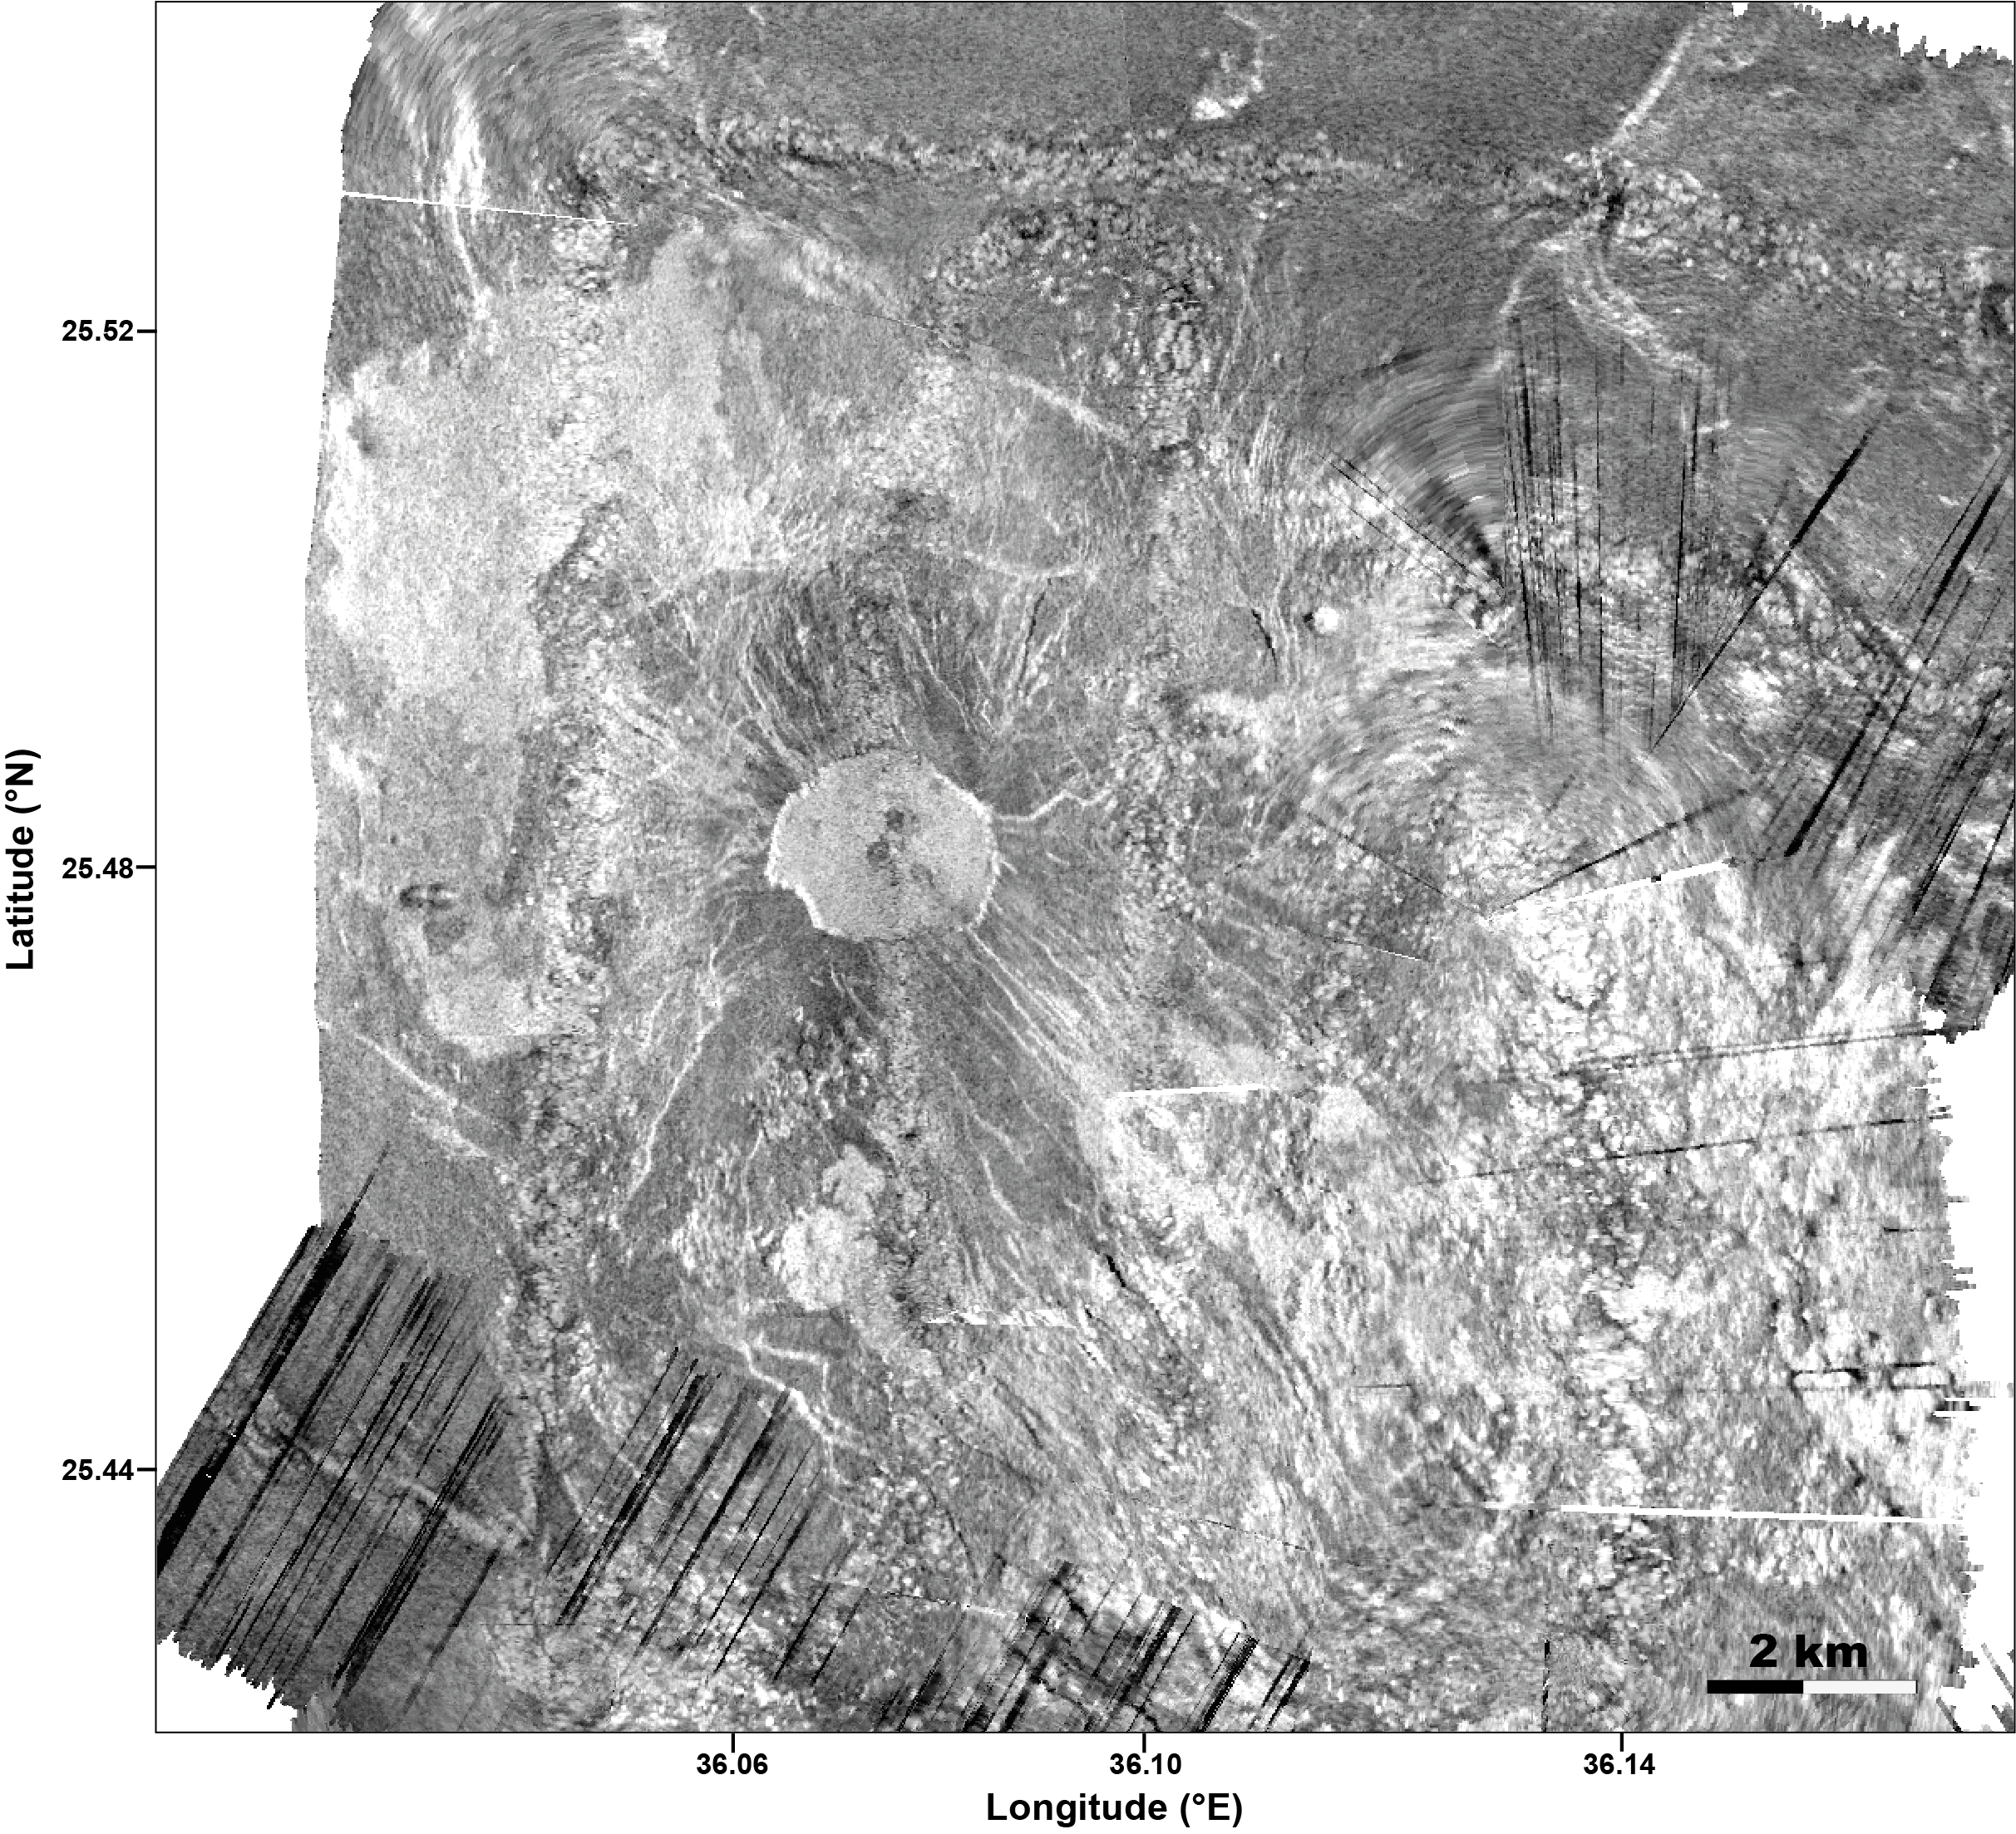
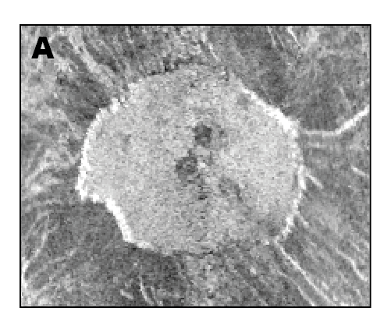
Mabahiss Volcano
A

Slide 11
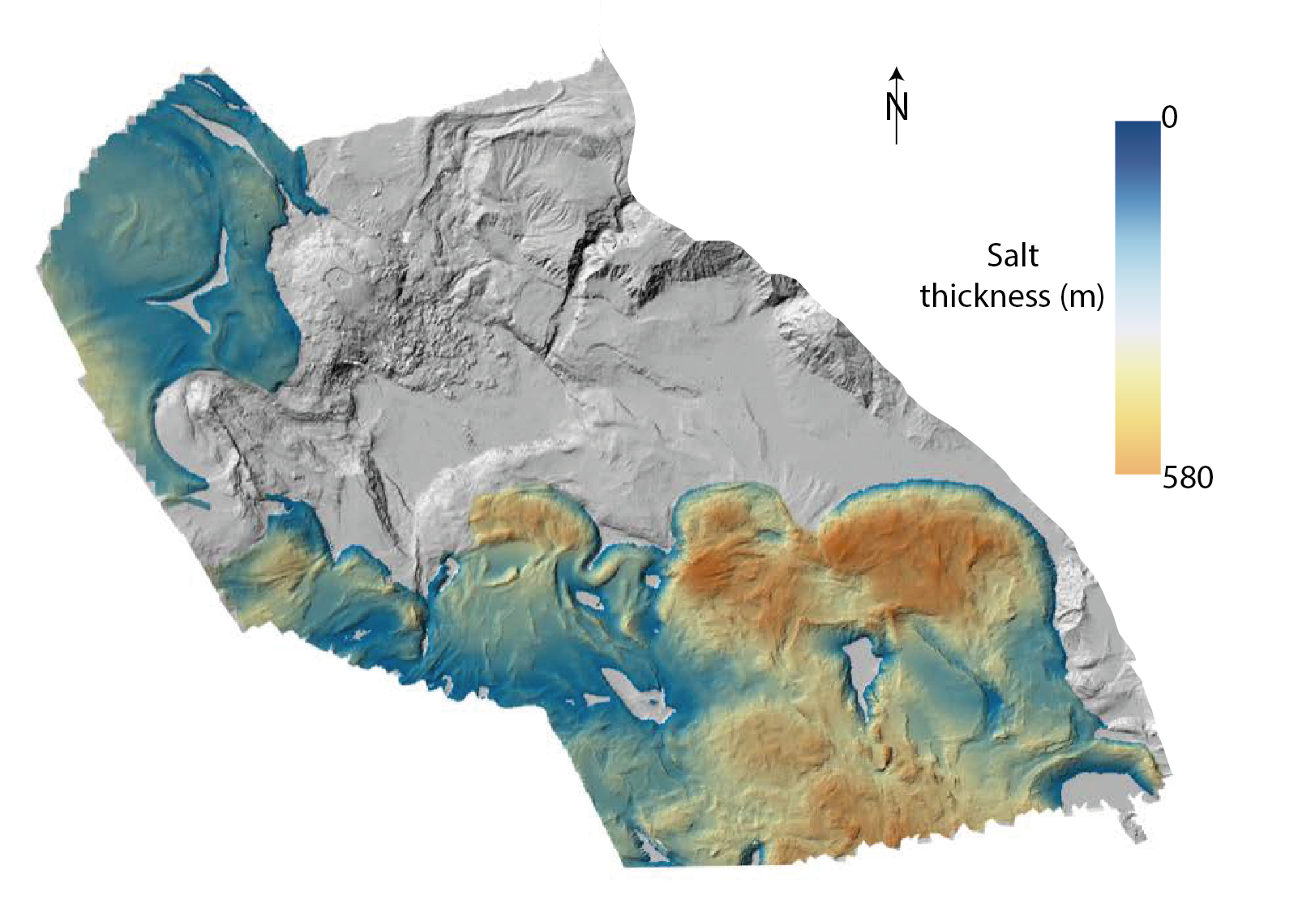
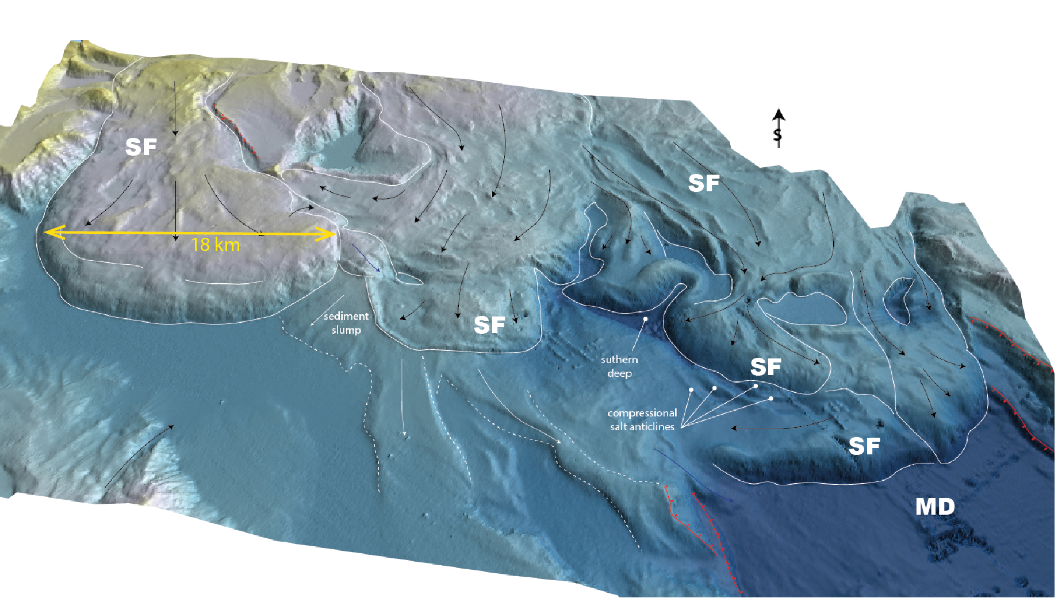
Salt Flows
The maximum thickness reached is 580 m
Salt covers over 50% of the surveyed area
A
A’

Slide 12
Conclusions
Our study provides a new high-resolution bathymetric map for the Mabahiss area
Mabahiss area is characterized by:
NW-SE trending graben-like structures →fitting the general RSR trend and useful to constrain the position of the RSR axis north of ZFZ
Presence of oceanic MORB basalts → oceanic rifting continues to the north
Presence of salt flow→ importance of the salt tectonic in the Red Sea
Mabahiss area show typical features found at other (ultra-)slow-spreading ridges:
magma focusing on the segment centers, rift-like morphology
No clear evidences of a transform fault:
the link between Mabahiss and the ZFZ remains unclear

Slide 13
THANK YOU

