Slide 1
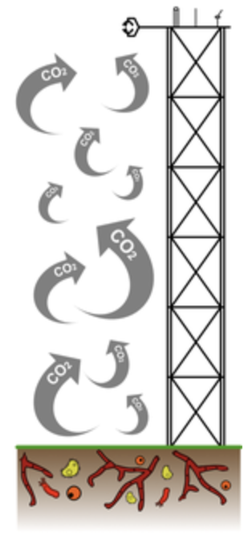
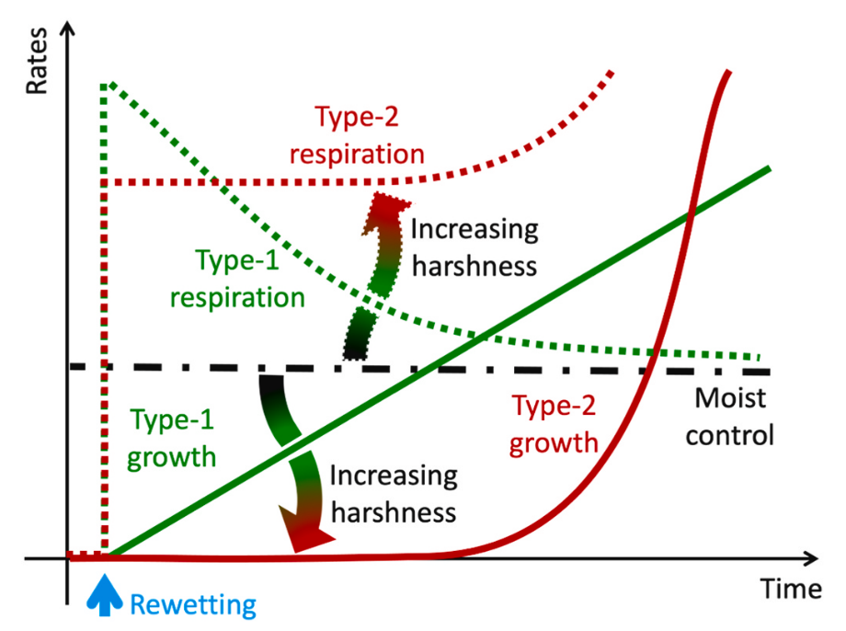
Mechanisms controlling the emission and stabilization of carbon during soil drying-rewetting
Albert C. Brangarí ^{1,2}, Stefano Manzoni ^{3,4}, and Johannes Rousk ¹
¹ Microbial Ecology, Department of Biology, Lund University, Lund, Sweden
² Centre for Environmental and Climate Research, Lund University, Lund, Sweden
³ Department of Physical Geography, Stockholm University, Stockholm, Sweden
⁴ Bolin Centre for Climate Research, Stockholm University, Stockholm, Sweden
@AlbertBrangari

Slide 2
Recent empirical evidence: two types of response to drying-rewetting
‘Type-2’ respiration
‘Type-1’ respiration
‘Type-1’ growth
Respiration rates
Growth rates
‘Type-2’ growth
Moist control
Moist control
Rewetting
Time
Rewetting
Time
[e.g., Göransson et al. (2013), Meisner et al. (2013, 2017), Slessarev et al., (2020)]

Slide 3
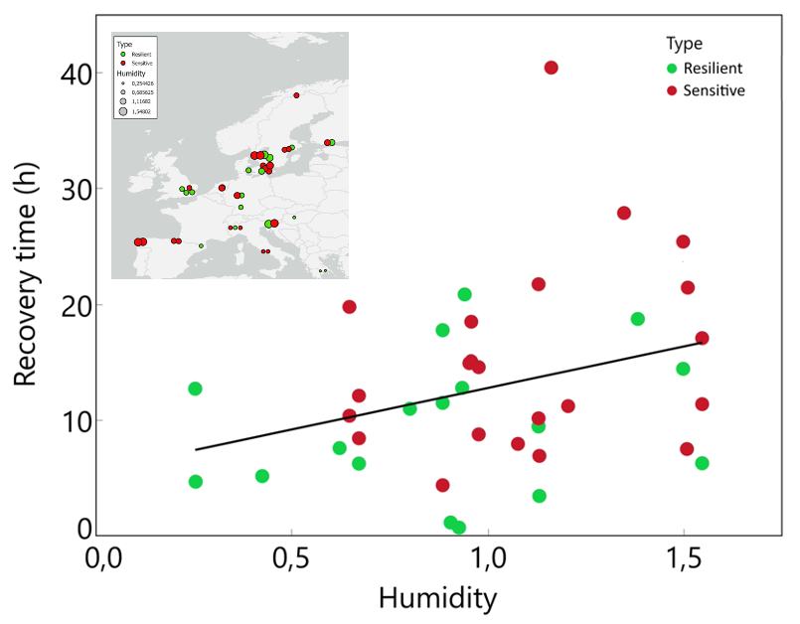
Recent empirical evidence: two types of response to drying-rewetting
Type 2 respiration
Type 2 respiration
Type 1
Type 2
Type 1 respiration
Type 1 respiration
Rates
Respiration rates
Growth rates
Moist control
Moist control
Moist control
Type 1 growth
Type 1 growth
Type 2 growth
Type 2 growth
Time
Rewetting
Time
Dry
Time
Wet
Rewetting
Rewetting
[Winterfeldt, 2020)]
Disconnected growth and respiration?
Mechanisms behind type 1? And type 2?
Role of climate?

Slide 4
But what about the type 1 and type 2 responses?
Respiration
Respiration
(osmoregulation)
Production of OS
Release
Decay
OSMOLYTES
OSMOLYTES
Respiration (biomass synthesis)
Respiration (dormancy)
Respiration (CR mineralization)
Decay
ACTIVE CELLS
Dormancy
DORMANT CELLS
Litter input
Osmolysis
Growth
Biomass synthesis
Uptake
CELL RESIDUES
ENZYMES
DOC
Decomposition
(+ disruption)
POC
Decay
Decay
Recycling
[Brangarí et al., 2021]

Slide 5
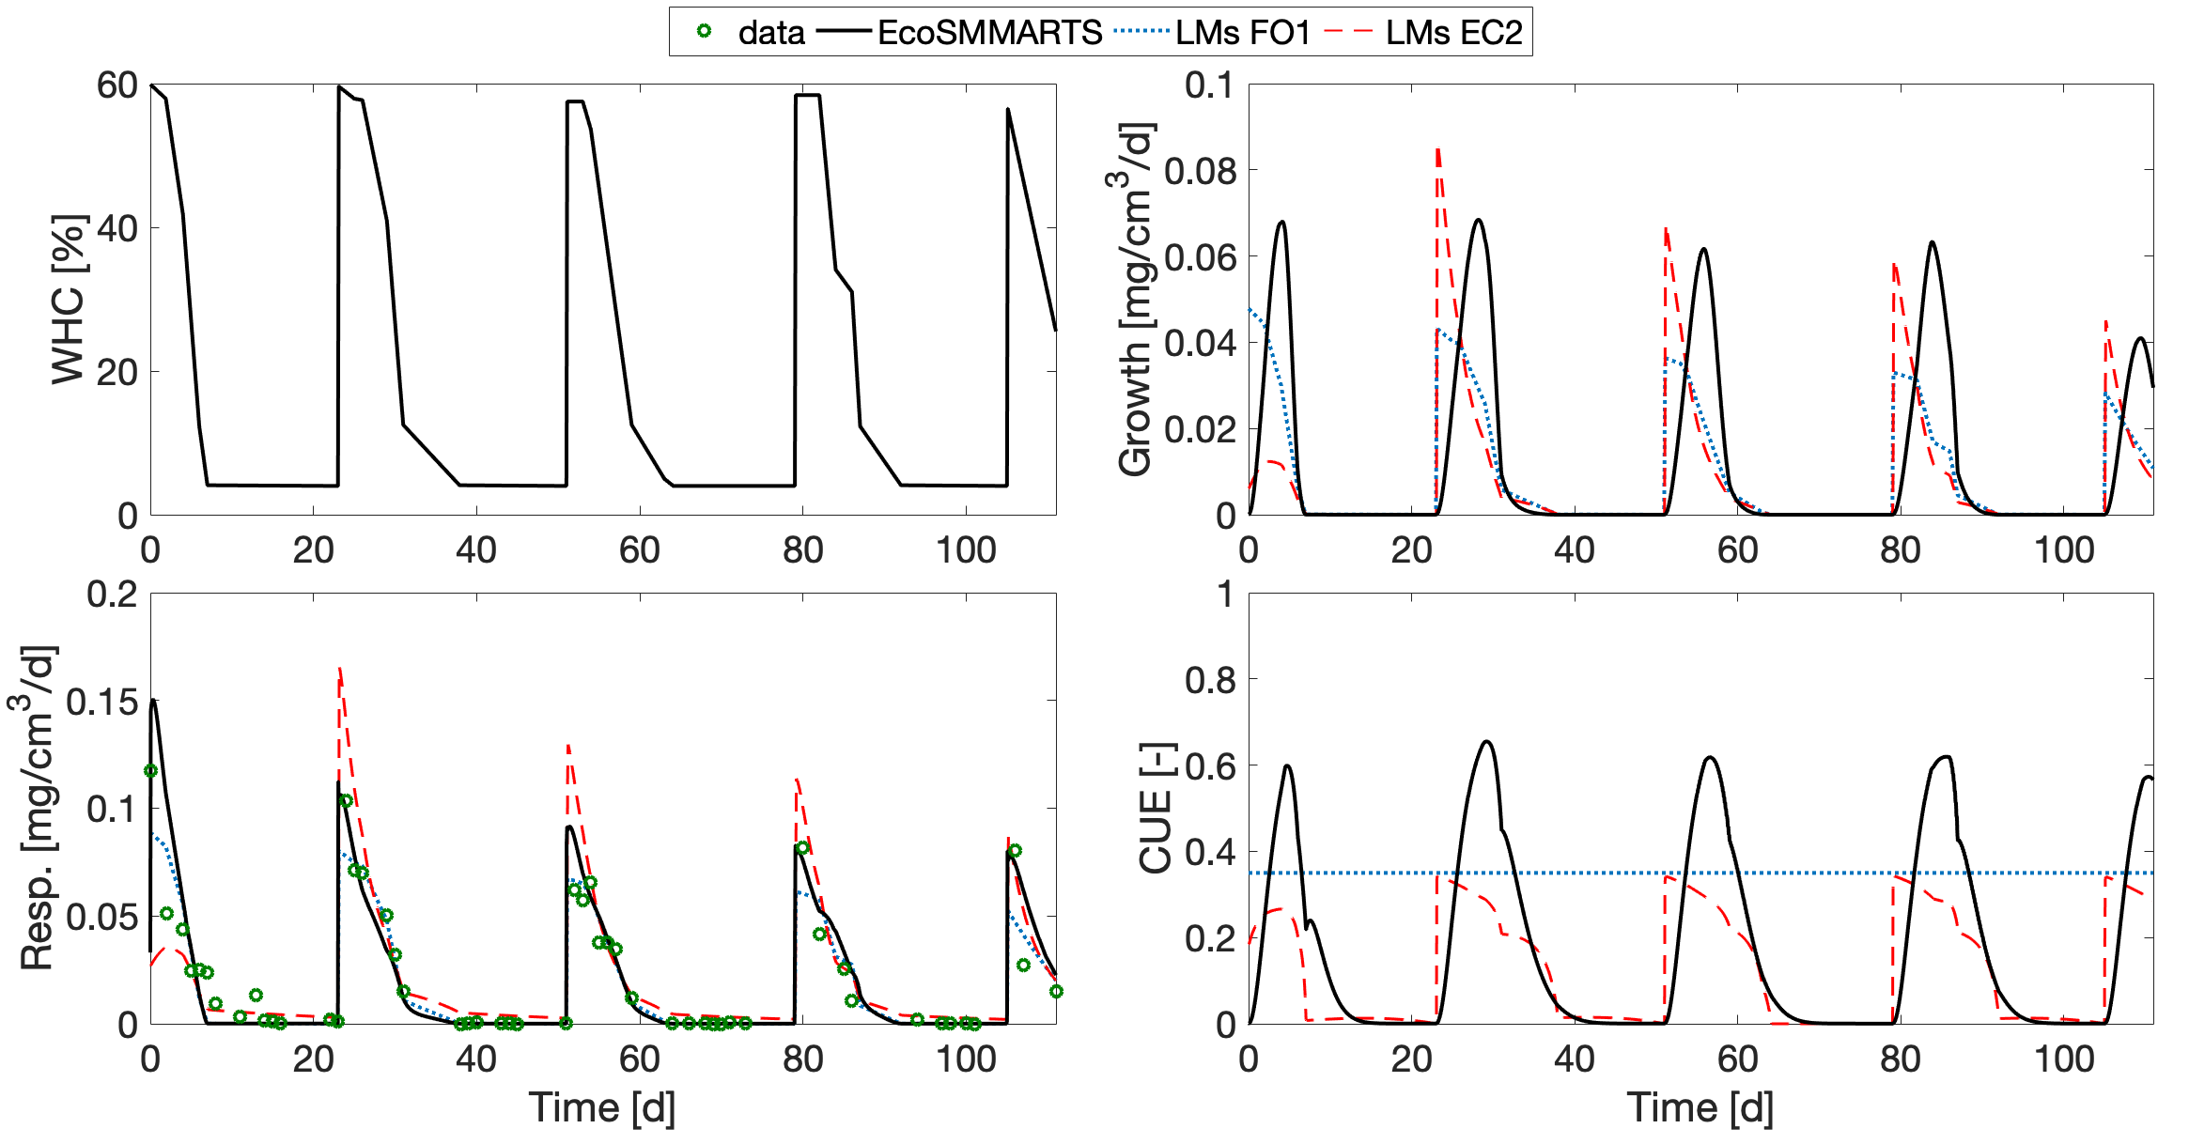
Dynamics under cycles of drying-rewetting
Only EcoSMMARTS reproduces delayed growth
Reproducing the experiment in Miller et al. (2005)
Comparison with models by Lawrence et al. (2009) [LMs]
All models capture respiration peaks
SMMARTS results in a very low CUE after RW
[Brangarí et al., 2020]

Slide 6
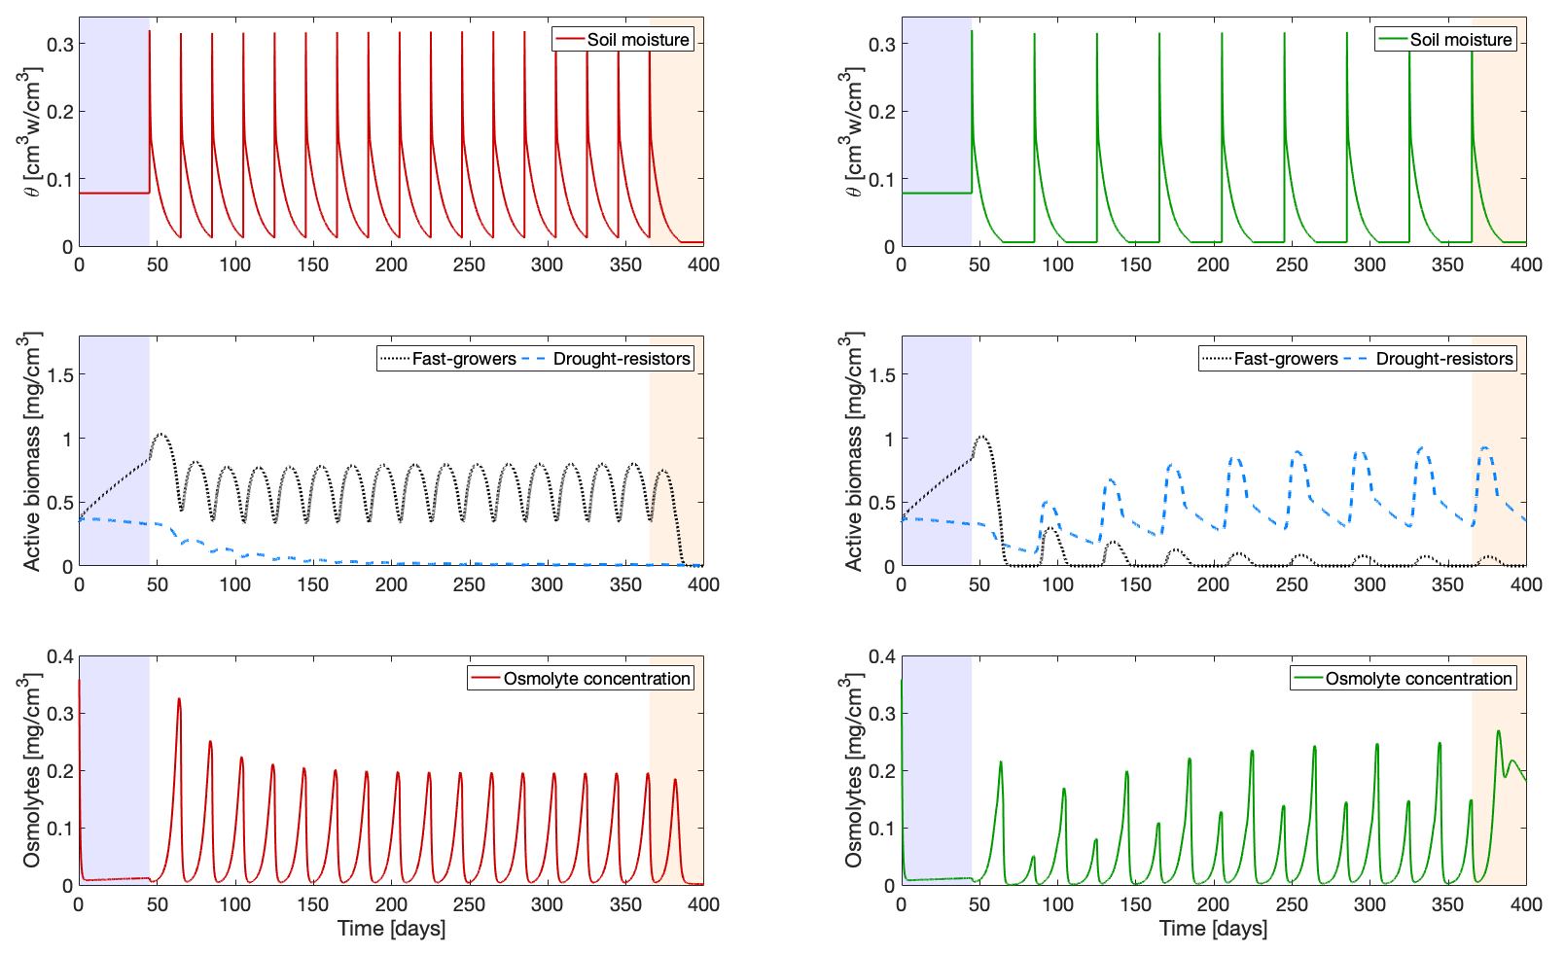
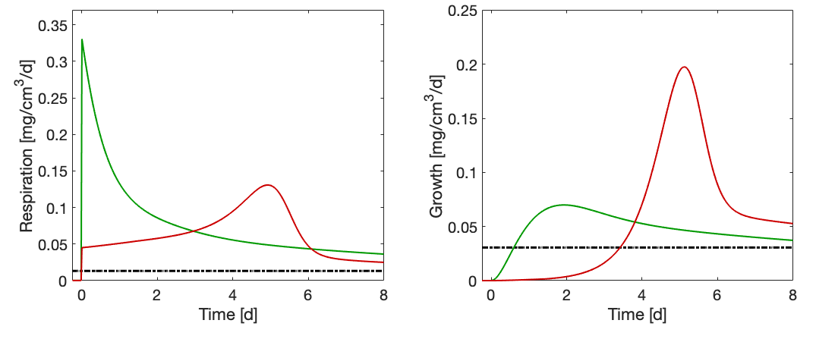
Simulations of microbial adaptation to soil moisture history
“DRY” CLIMATE
“WET” CLIMATE
Time [d]
Time [d]
History of soil moisture variations shapes the structure of the microbial community and its physiology
Communities regularly exposed to severe conditions adapted to stress and perceive last drying as mild
Type-2
Type-1
Communities not exposed to moderate environments perceive last drying as harsh
Type-2
Type-1
Community structure and physiology determines the characteristics of the responses to RW

Slide 7

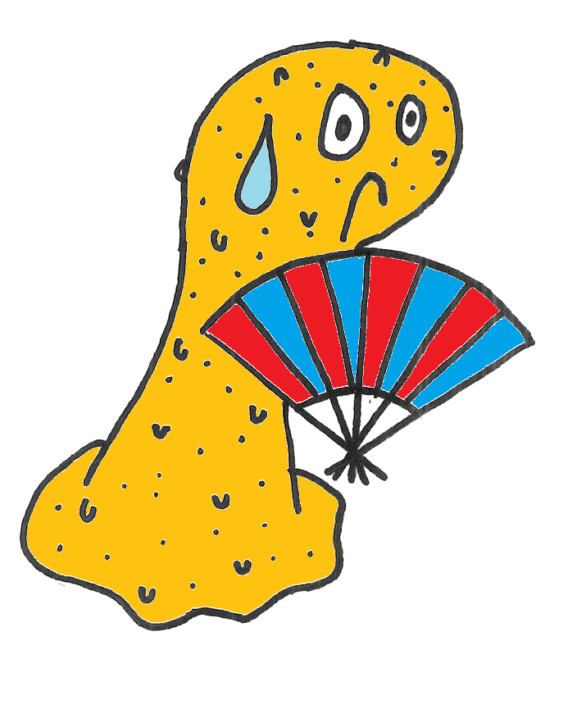
Process-based soil microbial model: EcoSMMARTS
Biomass synthesis
Osmoregulation
“DRY” CLIMATE
OSMOLYTES
OSMOLYTES
ACTIVE CELLS
Fast growers
Drought resistors
DORMANT CELLS
Fast growers
Drought resistors
Growth
CELL RESIDUES
ENZYMES
DOC
POC

Slide 8



Process-based soil microbial model: EcoSMMARTS
C mineralization by cell residues
“WET” CLIMATE
OSMOLYTES
OSMOLYTES
ACTIVE CELLS
Fast growers
Drought resistors
DORMANT CELLS
Fast growers
Drought resistors
Growth
CELL RESIDUES
ENZYMES
DOC
POC

Slide 9

Take home message…
And thanks !!!

