Slide 1


Everything you always wanted to know about b-value*
(*but were afraid to ask)
Taroni M., Zhuang J., Selva J., Marzocchi W.

Slide 2
Outline:
The Gutenberg-Richter law
Weighted likelihood estimation of the b-value
B-value estimation with multiple completeness thresholds
Conclusions

Slide 3
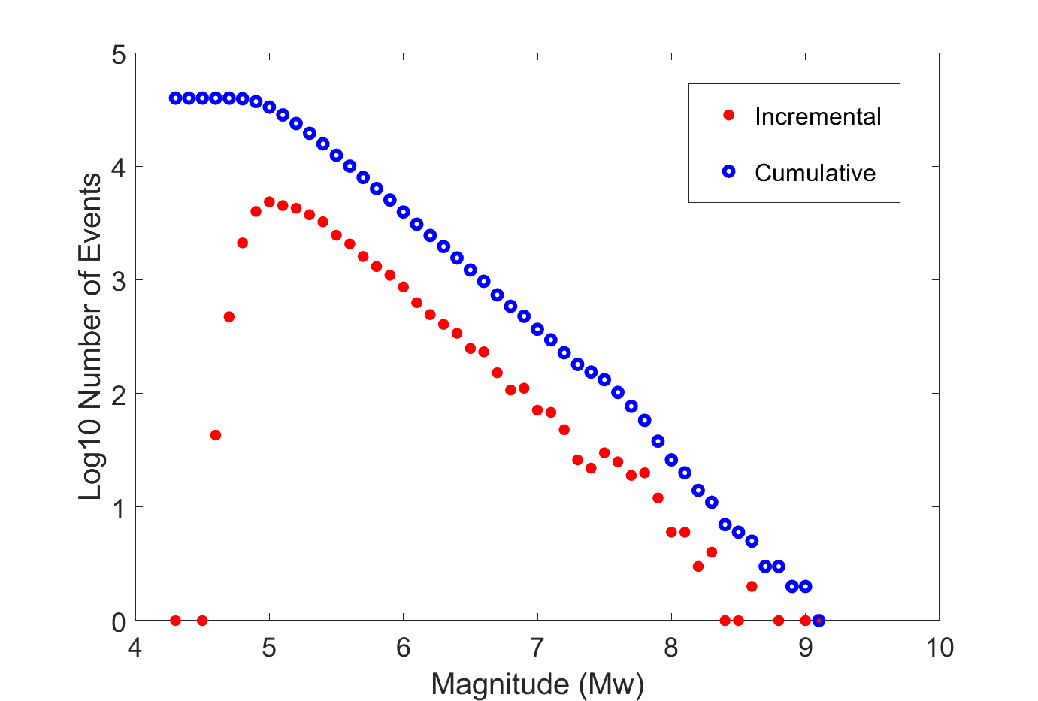
The Gutenberg-Richter law
Example from
Global CMT catalog

Slide 4
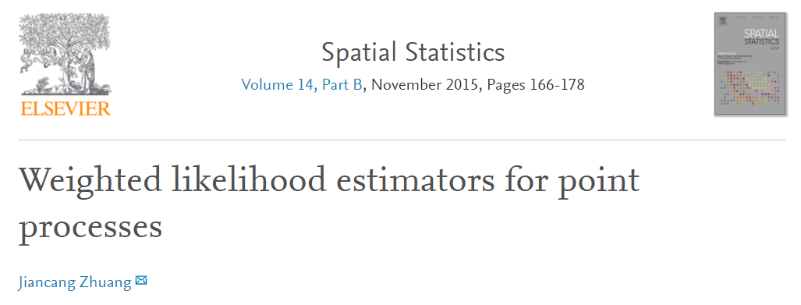

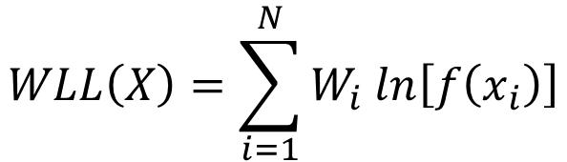
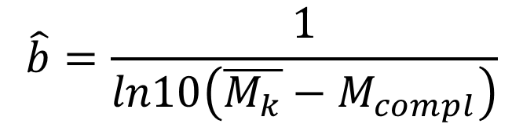
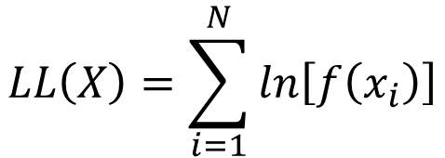
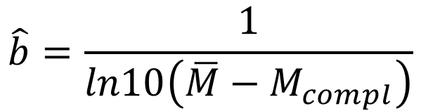
Weighted likelihood estimation of the b-value
$$LL\left(X\right)=\sum_{i=1}^{N}{ln\left[f\left(x_{i}\right)\right]}$$
$$\hat{b}=\frac{1}{ln10\left(\overline{M}−M_{compl}\right)}$$
mean
$$WLL\left(X\right)=\sum_{i=1}^{N}{W_{i} ln\left[f\left(x_{i}\right)\right]}$$
$$\hat{b}=\frac{1}{ln10\left(\overline{M_{k}}−M_{compl}\right)}$$
weighted
mean

Slide 5
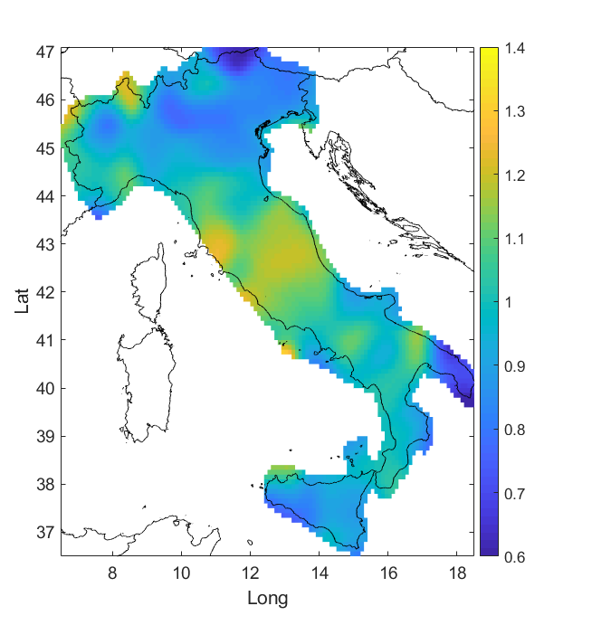
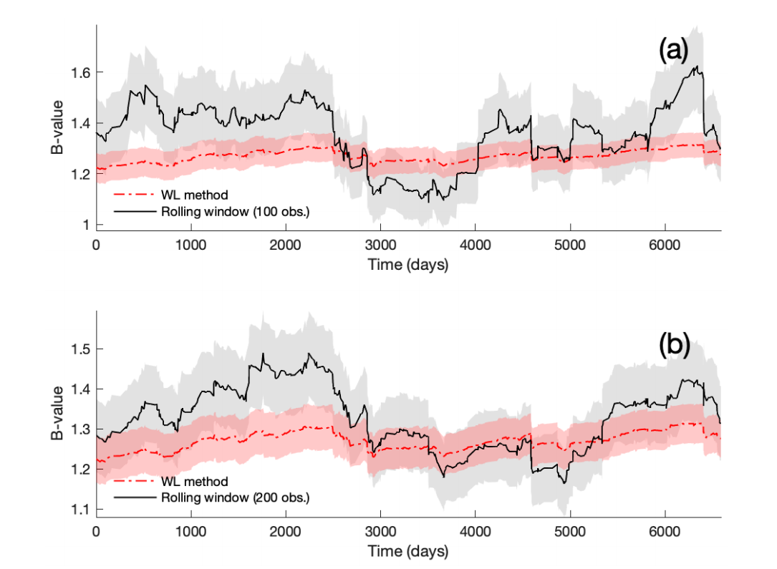
Weighted likelihood estimation of the b-value
B-value
Spatial b-value estimation
Temporal b-value estimation

Slide 6
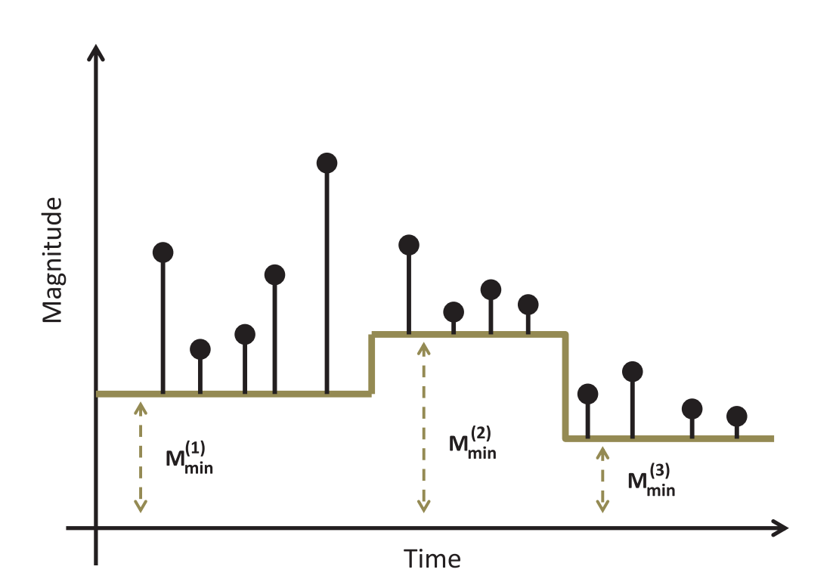

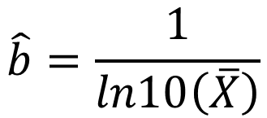
B-value estimation with multiple completeness thresholds
$$X_{i}=M_{i}−M_{min}^{(i)}$$
$$\hat{b}=\frac{1}{ln10\left(\overline{X}\right)}$$

Slide 7

B-value estimation with multiple completeness thresholds
Tapered GR
B-value

Slide 8
Conclusions
Weighted likelihood estimation avoids subjective choices in the spatial and temporal b-value studies
Using multiple completeness thresholds seismologists can significantly increase the amount of available data (e.g. during seismic sequences)

