Slide 1

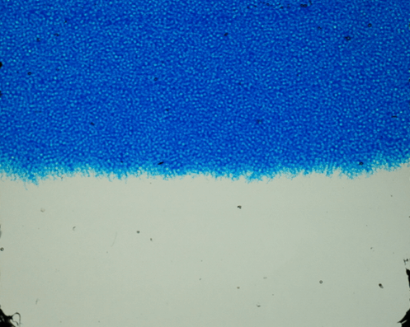



Experimental study of miscible Rayleigh-Taylor convection in a granular porous medium
Shabina Ashraf, Jayabrata Dhar, François Nadal, Patrice Meunier & Yves Méheust
23-27 May, 2022

Slide 2
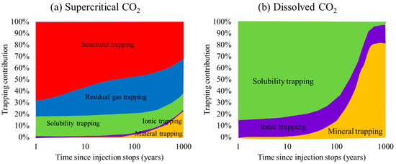
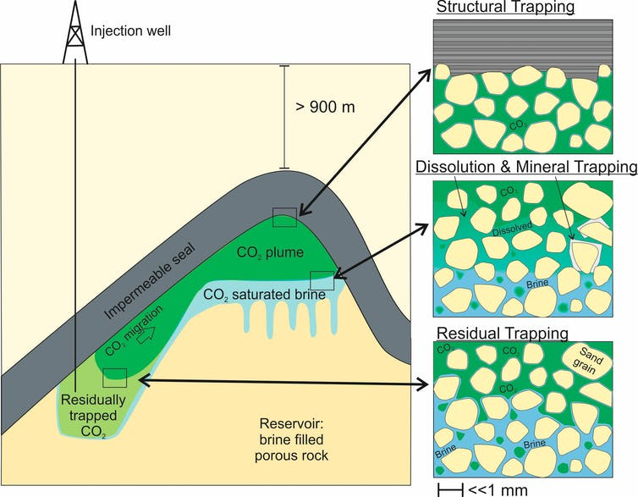
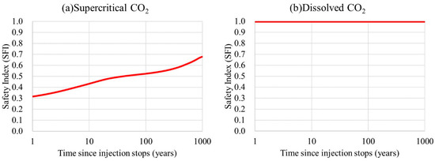

Carbon dioxide sequestration
23-27 May, 2022
About 76% of greenhouse emissions are due to CO₂
Alternative way to reduce greenhouse emissions is subsurface storage (depth > 800 m)
Storage security of the trapping mechanisms (Li et al., Energies, 2020)
Trapping mechanisms (theconversation.com)
Safety Index (SFI) of the supercritical and dissolved ${CO}_{2}$
(Li et al., Energies, 2020)
Solubility trapping has a higher Safety Index and greater storage security than other trapping mechanisms

Slide 3
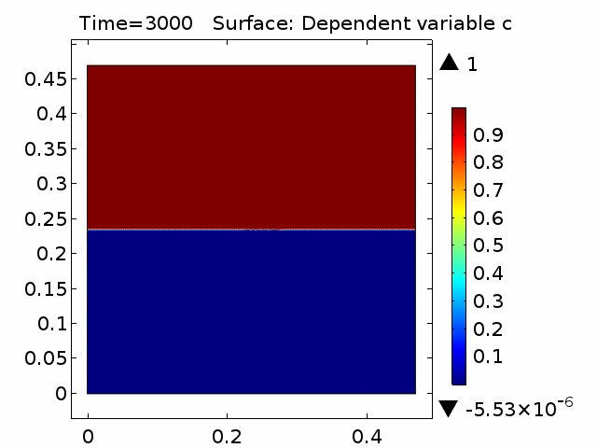
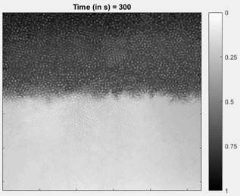
Solubility trapping: challenges
23-27 May, 2022
Motivation:
Most studies are in 2D:
  Numerical simulations are at continuum scale
  Hele-shaw cell experiments
Challenges:
  Differences in instability dynamics in Hele-shaw cells and real porous media
  It is challenging to measure flux in the studies using X ray tomography
  Non-transparency of porous media causes experimental visualisation difficulties
Discrepancies have been observed in Darcy scale numerical simulations and experiments in porous media
  Finger protrusion is much larger in experiments than in Darcy scale simulations
Discrepancy in experiments and simulations
Objectives:
Experimental investigation of the evolution of Rayleigh-Taylor instability and convection in a granular porous medium
Determining the influence of pore scale flow on continuum scale instability development

Slide 4
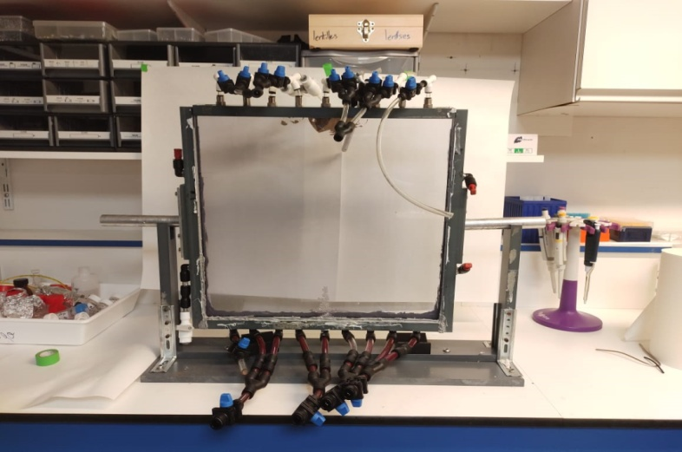
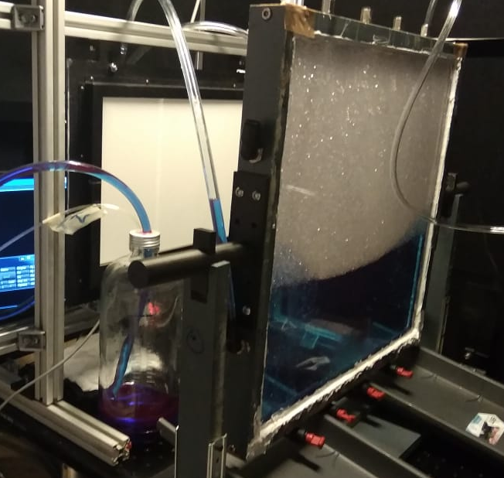
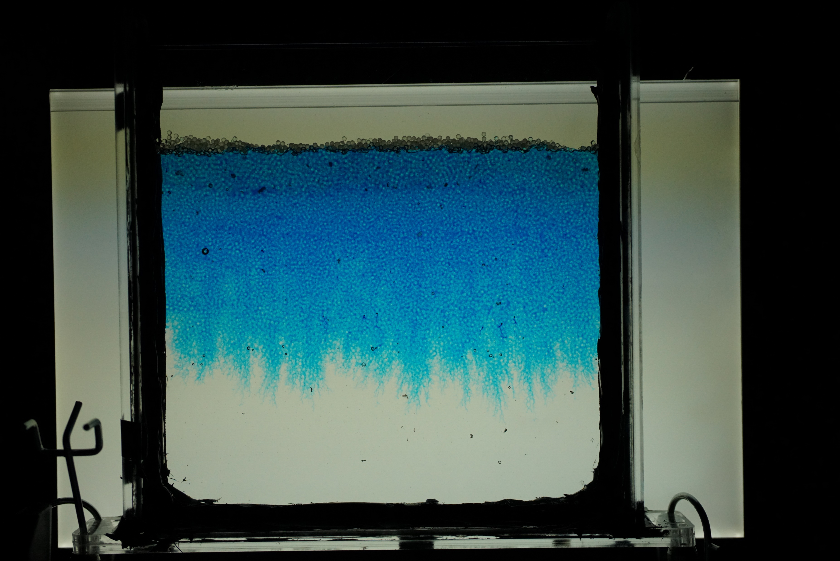
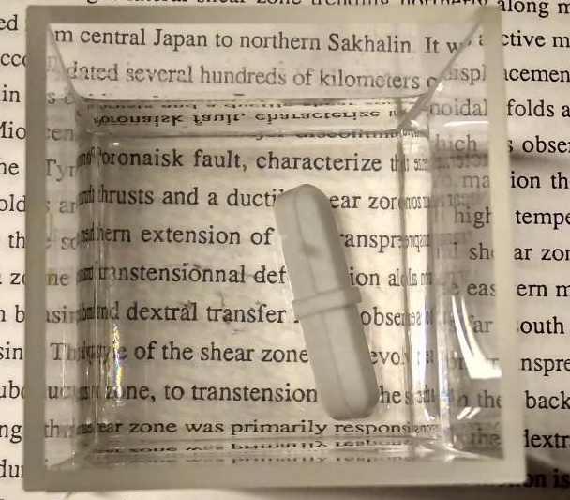
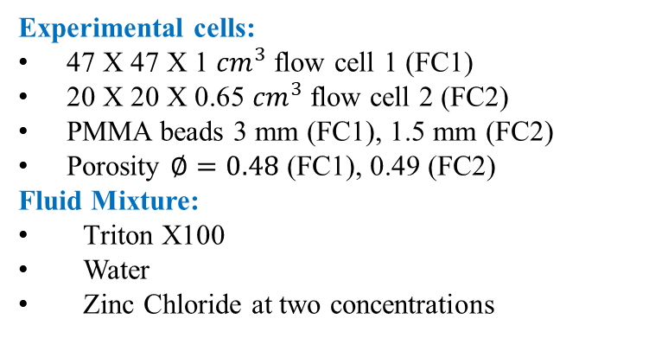
Experimental Methodology
23-27 May, 2022
Inlet pipes for heavier fluid
Experimental cells:
47 X 47 X 1 ${cm}^{3}$ flow cell 1 (FC1)
20 X 20 X 0.65 ${cm}^{3}$ flow cell 2 (FC2)
PMMA beads 3 mm (FC1), 1.5 mm (FC2)
Porosity $∅=0.48$ (FC1), 0.49 (FC2)
Fluid Mixture:
Triton X100
Water
Zinc Chloride at two concentrations
Backlight
Rotating holders
Inlet pipes for lighter fluid
Experimental setup 1
RIM Fluids:
Refractive index matching.
RIM provides a transparent medium enabling better instability visualization
Heavier fluid in the upper half of the cell is coloured and mimics the ScCO₂ dissolved brine
The low density fluid in the lower half of the cell mimics the aquifer brine
Lighter fluid
Refractive Index Matched (RIM) fluid + granular media
Heavy fluid
Backlight
Experimental setup 2
Density difference in the fluids causes the instabilities to evolve with time

Slide 5
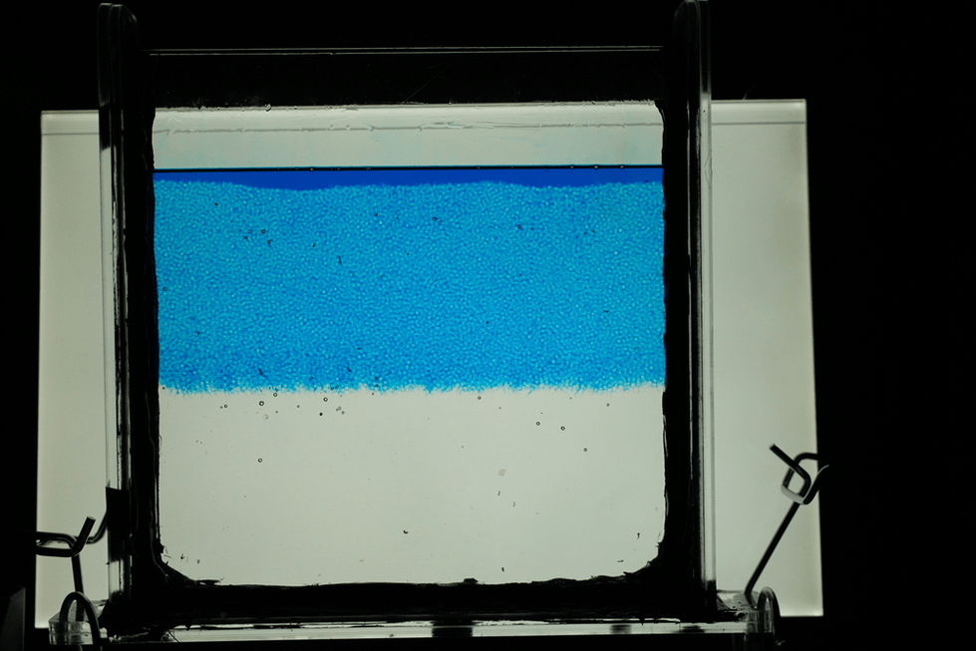
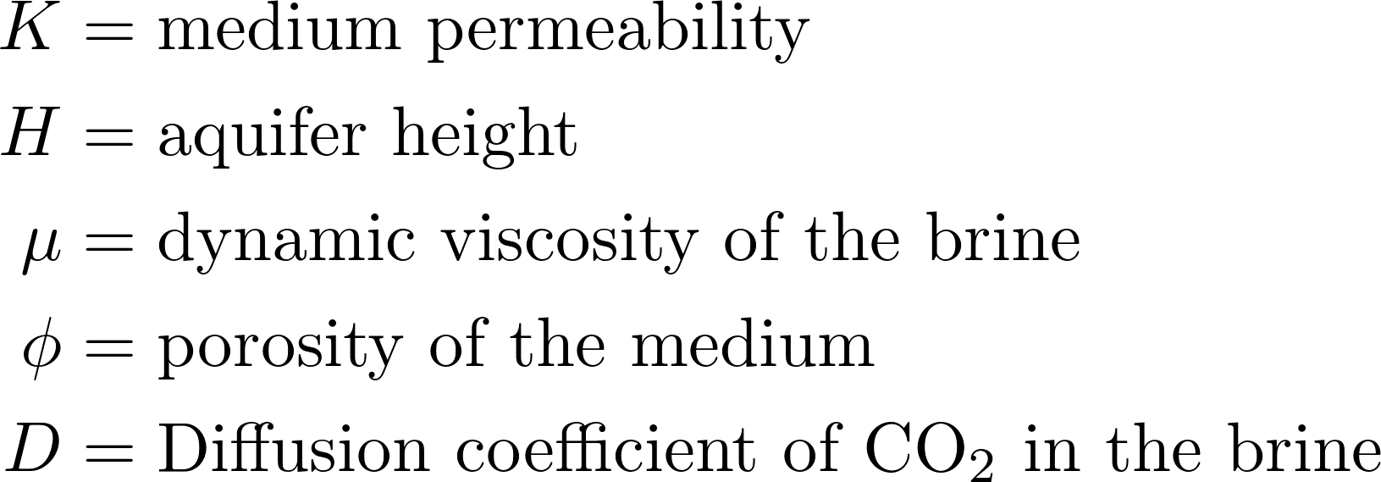
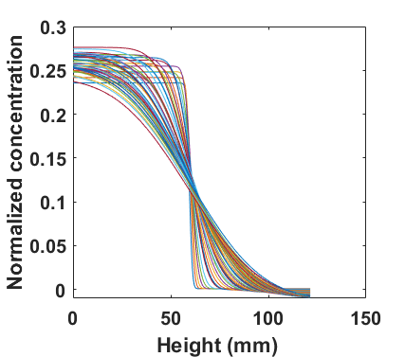
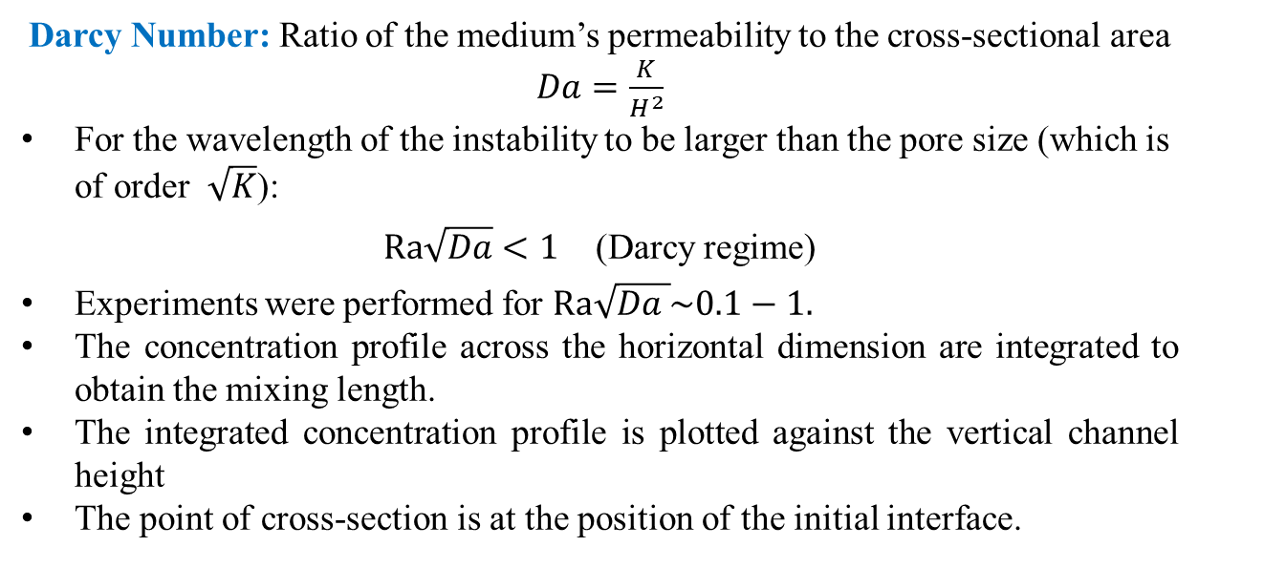
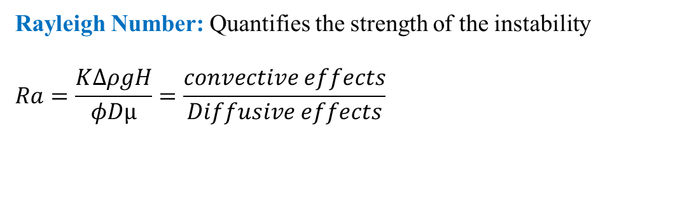

Solubility trapping: theory
23-27 May, 2022
Rayleigh Number: Quantifies the strength of the instability
$$Ra=\frac{KΔρgH}{φDµ}=\frac{convective effects}{Diffusive effects}$$
Darcy Number: Ratio of the medium’s permeability to the cross-sectional area $Da=\frac{K}{H^{2}}$
For the wavelength of the instability to be larger than the pore size (which is of order $\sqrt{K}$):
$Ra\sqrt{Da}<1$ (Darcy regime)
Experiments were performed for $Ra\sqrt{Da }\sim 0.1−1.$
The concentration profile across the horizontal dimension are integrated to obtain the mixing length.
The integrated concentration profile is plotted against the vertical channel height
The point of cross-section is at the position of the initial interface.
Instability pattern
$Ra\sqrt{Da }=0.$1
Concentration profile vs height with time

Slide 6
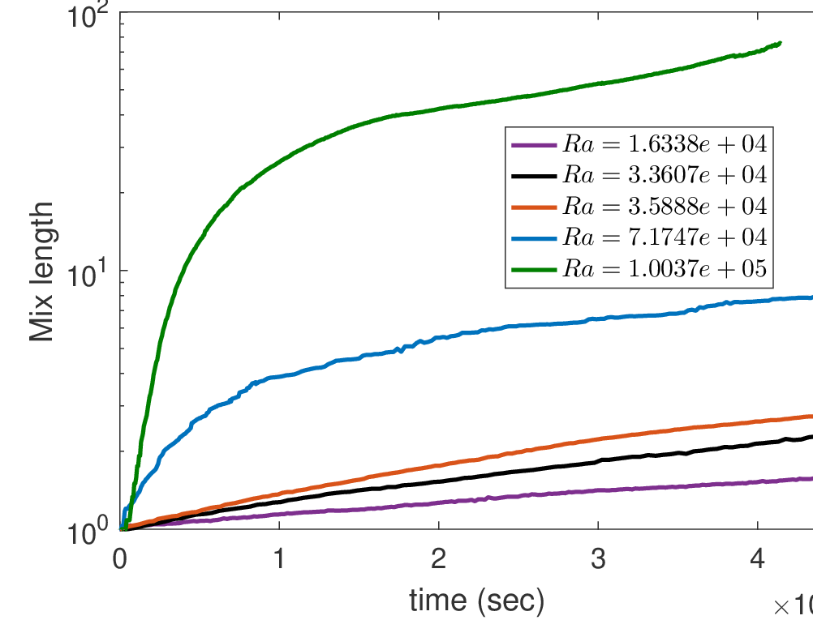
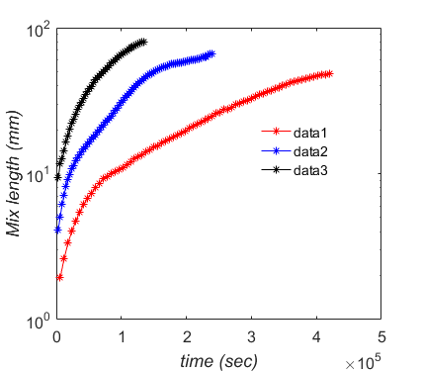
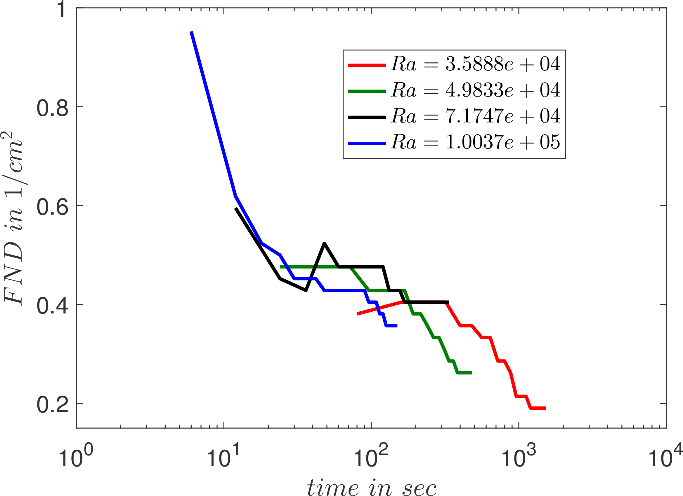
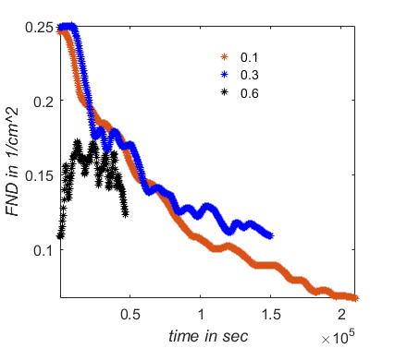

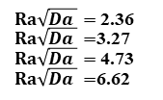
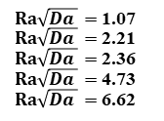

Results
23-27 May, 2022
The current study is mostly in the non-linear regime
The growth of the instability slows down with time due to the coupled effect of non-linear convection and mixing.
The classical feature of finger number density decreasing with time due to merging is observed.
FND remains less than 1/cm² which is very similar to the value reported by Wang et al. ( Int. J. Greenhouse Gas Control 2016).
$Ra\sqrt{Da }=$1.07
$Ra\sqrt{Da }=$2.21
$Ra\sqrt{Da }=$2.36
$Ra\sqrt{Da }=$4.73
$Ra\sqrt{Da }=$6.62
$Ra\sqrt{Da }=$0.1
$Ra\sqrt{Da }=0$.3
$Ra\sqrt{Da }=0.$6
$Ra\sqrt{Da }=$2.36
$Ra\sqrt{Da }=$3.27
$Ra\sqrt{Da }=$4.73
$Ra\sqrt{Da }=$6.62
$Ra\sqrt{Da }=$0.1
$Ra\sqrt{Da }=0$.3
$Ra\sqrt{Da }=0.$6

Slide 7
Conclusions and future work
23-27 May, 2022
Conclusions:
Instabilities slow down with time due coupling of convection and dispersion
The merging of fingers was observed at longer times
The experiments can provide insight into the pore scale dynamics impacting the Darcy scale simulations
Discrepancy in experiments and simulations
Future work:
Characterization of the growth rate in the linear regime and in the nonlinear regime
Experiments in stratified porous media
Experiments using continuous solute injection to replicate the coupling of dissolution to convection

Slide 8

23-27 May, 2022

