Slide 1




Two-dimensional imaging of arsenic concentration and speciation with diffusive equilibrium in thin-film (DET) gels
Andrea Castillejos Sepulveda¹, Edouard Metzger², Sten Littmann³, Heidi Taubner⁴, Arjun Chennu⁵,
Lais Gatti¹, Dirk de Beer¹, and Judith M. Klatt¹
¹Max Planck Institute for Marine Microbiology, Microsensor Working Group, Germany
²Laboratoire de Planétologie et Géosciences, CNRS, Université d’Angers, Nantes Université, Le Mans Université, Angers, France
³Max Planck Institute for Marine Microbiology, Biogeochemistry Group, Celsiusstraße 1, 28359, Bremen, Germany
⁴MARUM Center for Marine Environmental Science and Faculty of Geosciences, Organic Geochemistry Group, University of Bremen, Leobener Str. 8, 28359, Bremen, Germany.
⁵Leibniz Centre for Tropical Marine Research, Data Science und Technology, Fahrenheitstr. 6, 28359 Bremen, Germany

Slide 2
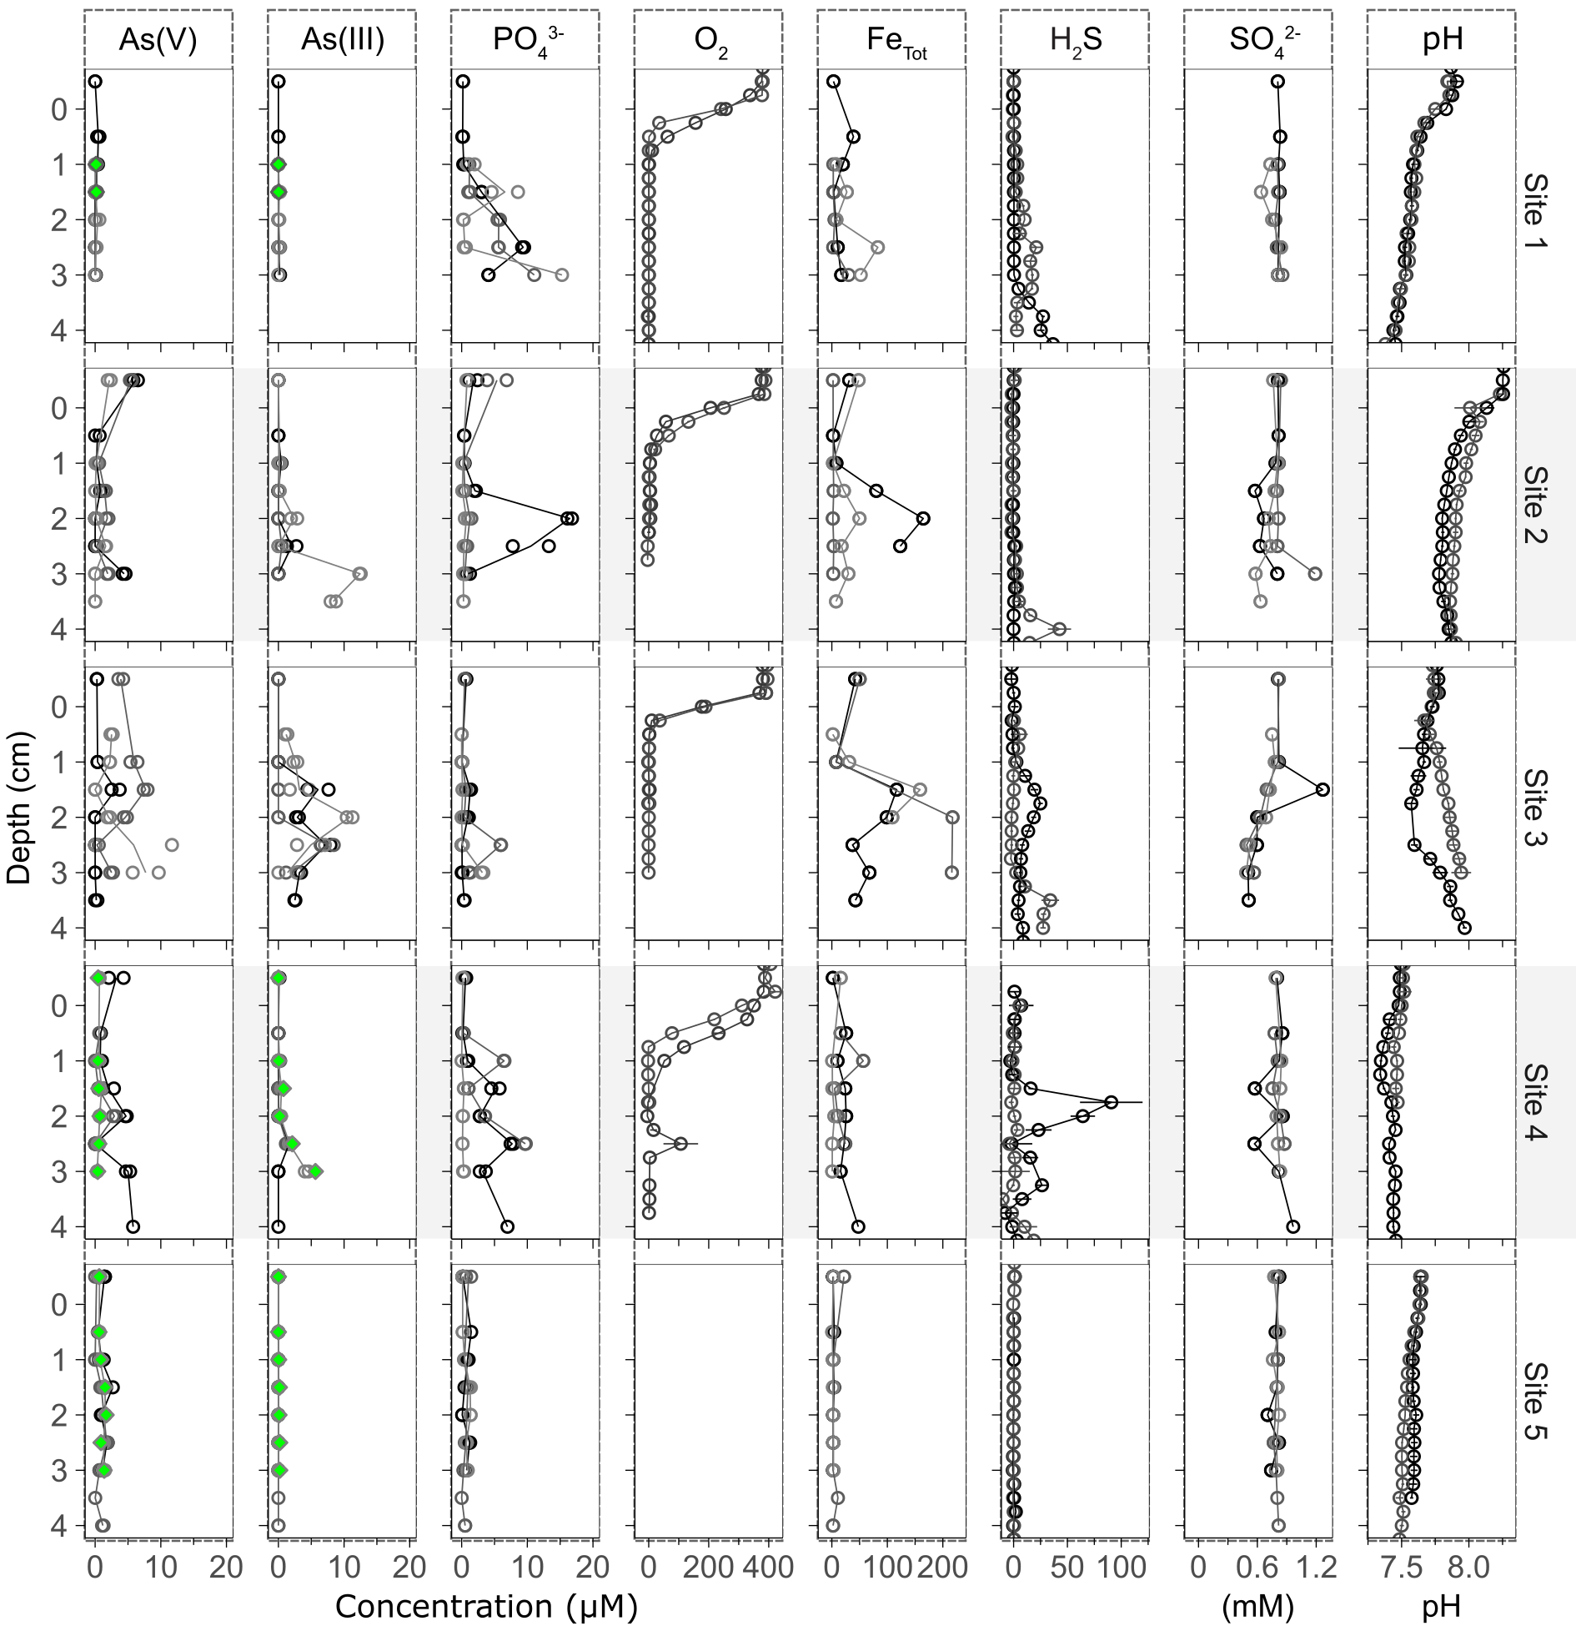
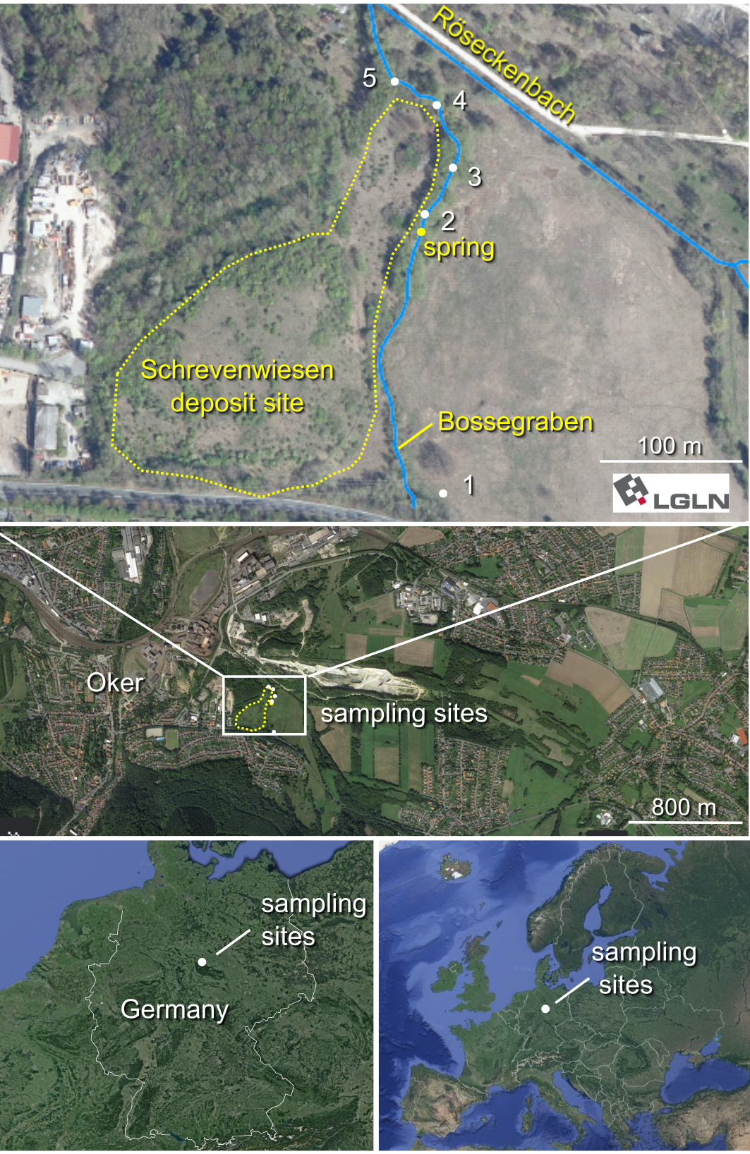
Arsenic has been measured in porewater extracted from the Bossegraben, a brook surrounding an arsenic-contaminated
mining deposit in the Harz mountains (Germany)
Castillejos Sepúlveda et al. 2022

Slide 3
Arsenic has been measured in porewater extracted from the Bossegraben, a brook surrounding an arsenic-contaminated
mining deposit in the Harz mountains (Germany)
Arsenic released into
water column through
unknown mechanism
Castillejos Sepúlveda et al. 2022

Slide 4

DET = Diffusive Equlibrium in Thin-film gels
Sample agarose gel
Reagent polyacrylamide gel

Slide 5
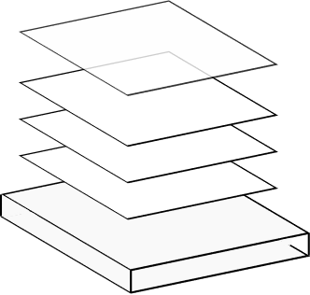
DET = Diffusive Equlibrium in Thin-film gels
Sample agarose gel
Reagent polyacrylamide gel
Porous membrane
Sampling
probe
Sample agarose gels
Plastic holder

Slide 6
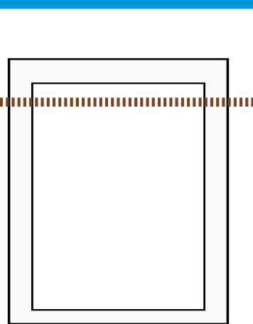
DET = Diffusive Equlibrium in Thin-film gels
Sample agarose gel
Reagent polyacrylamide gel
Porous membrane
Sampling
probe
Sample agarose gels
Plastic holder
Water surface
Soil surface
Sampling probe
submerged
until equilibrium

Slide 7
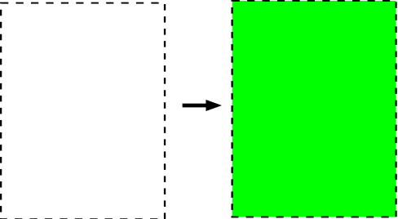
DET = Diffusive Equlibrium in Thin-film gels
Sample agarose gel
Reagent polyacrylamide gel
Porous membrane
Sampling
probe
Gels are soaked in
colorimetric reagent
Sample agarose gels
Plastic holder
Water surface
Soil surface
Sampling probe
submerged
until equilibrium

Slide 8
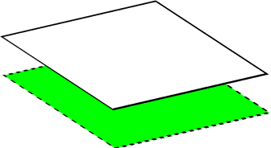
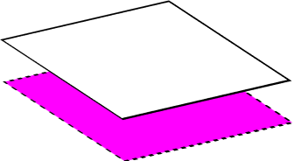
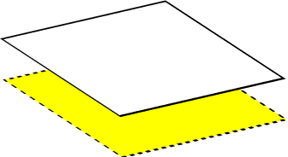
DET = Diffusive Equlibrium in Thin-film gels
Sample agarose gel
Reagent polyacrylamide gel
Porous membrane
Sampling
probe
Gels are soaked in
colorimetric reagent
Sample agarose gels
Plastic holder
Water surface
Sampling gels color developed by reagent gels
Soil surface
Sampling probe
submerged
until equilibrium
Reflectance measured with hyperspectral camera

Slide 9
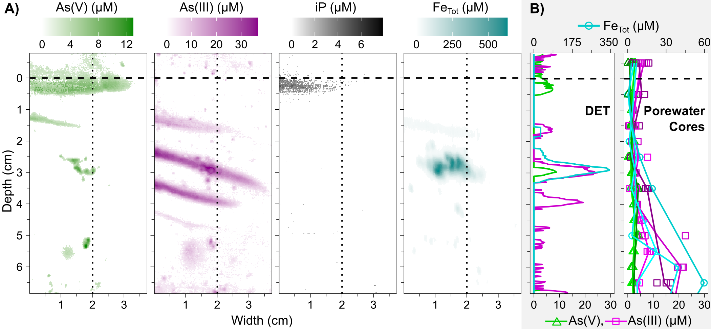
Two-dimensional mapping reveals banding patterns obscured by traditional porewater sampling
Castillejos Sepúlveda et al. submitted

Slide 10
Two-dimensional mapping reveals banding patterns obscured by traditional porewater sampling
Castillejos Sepúlveda et al. submitted

Slide 11
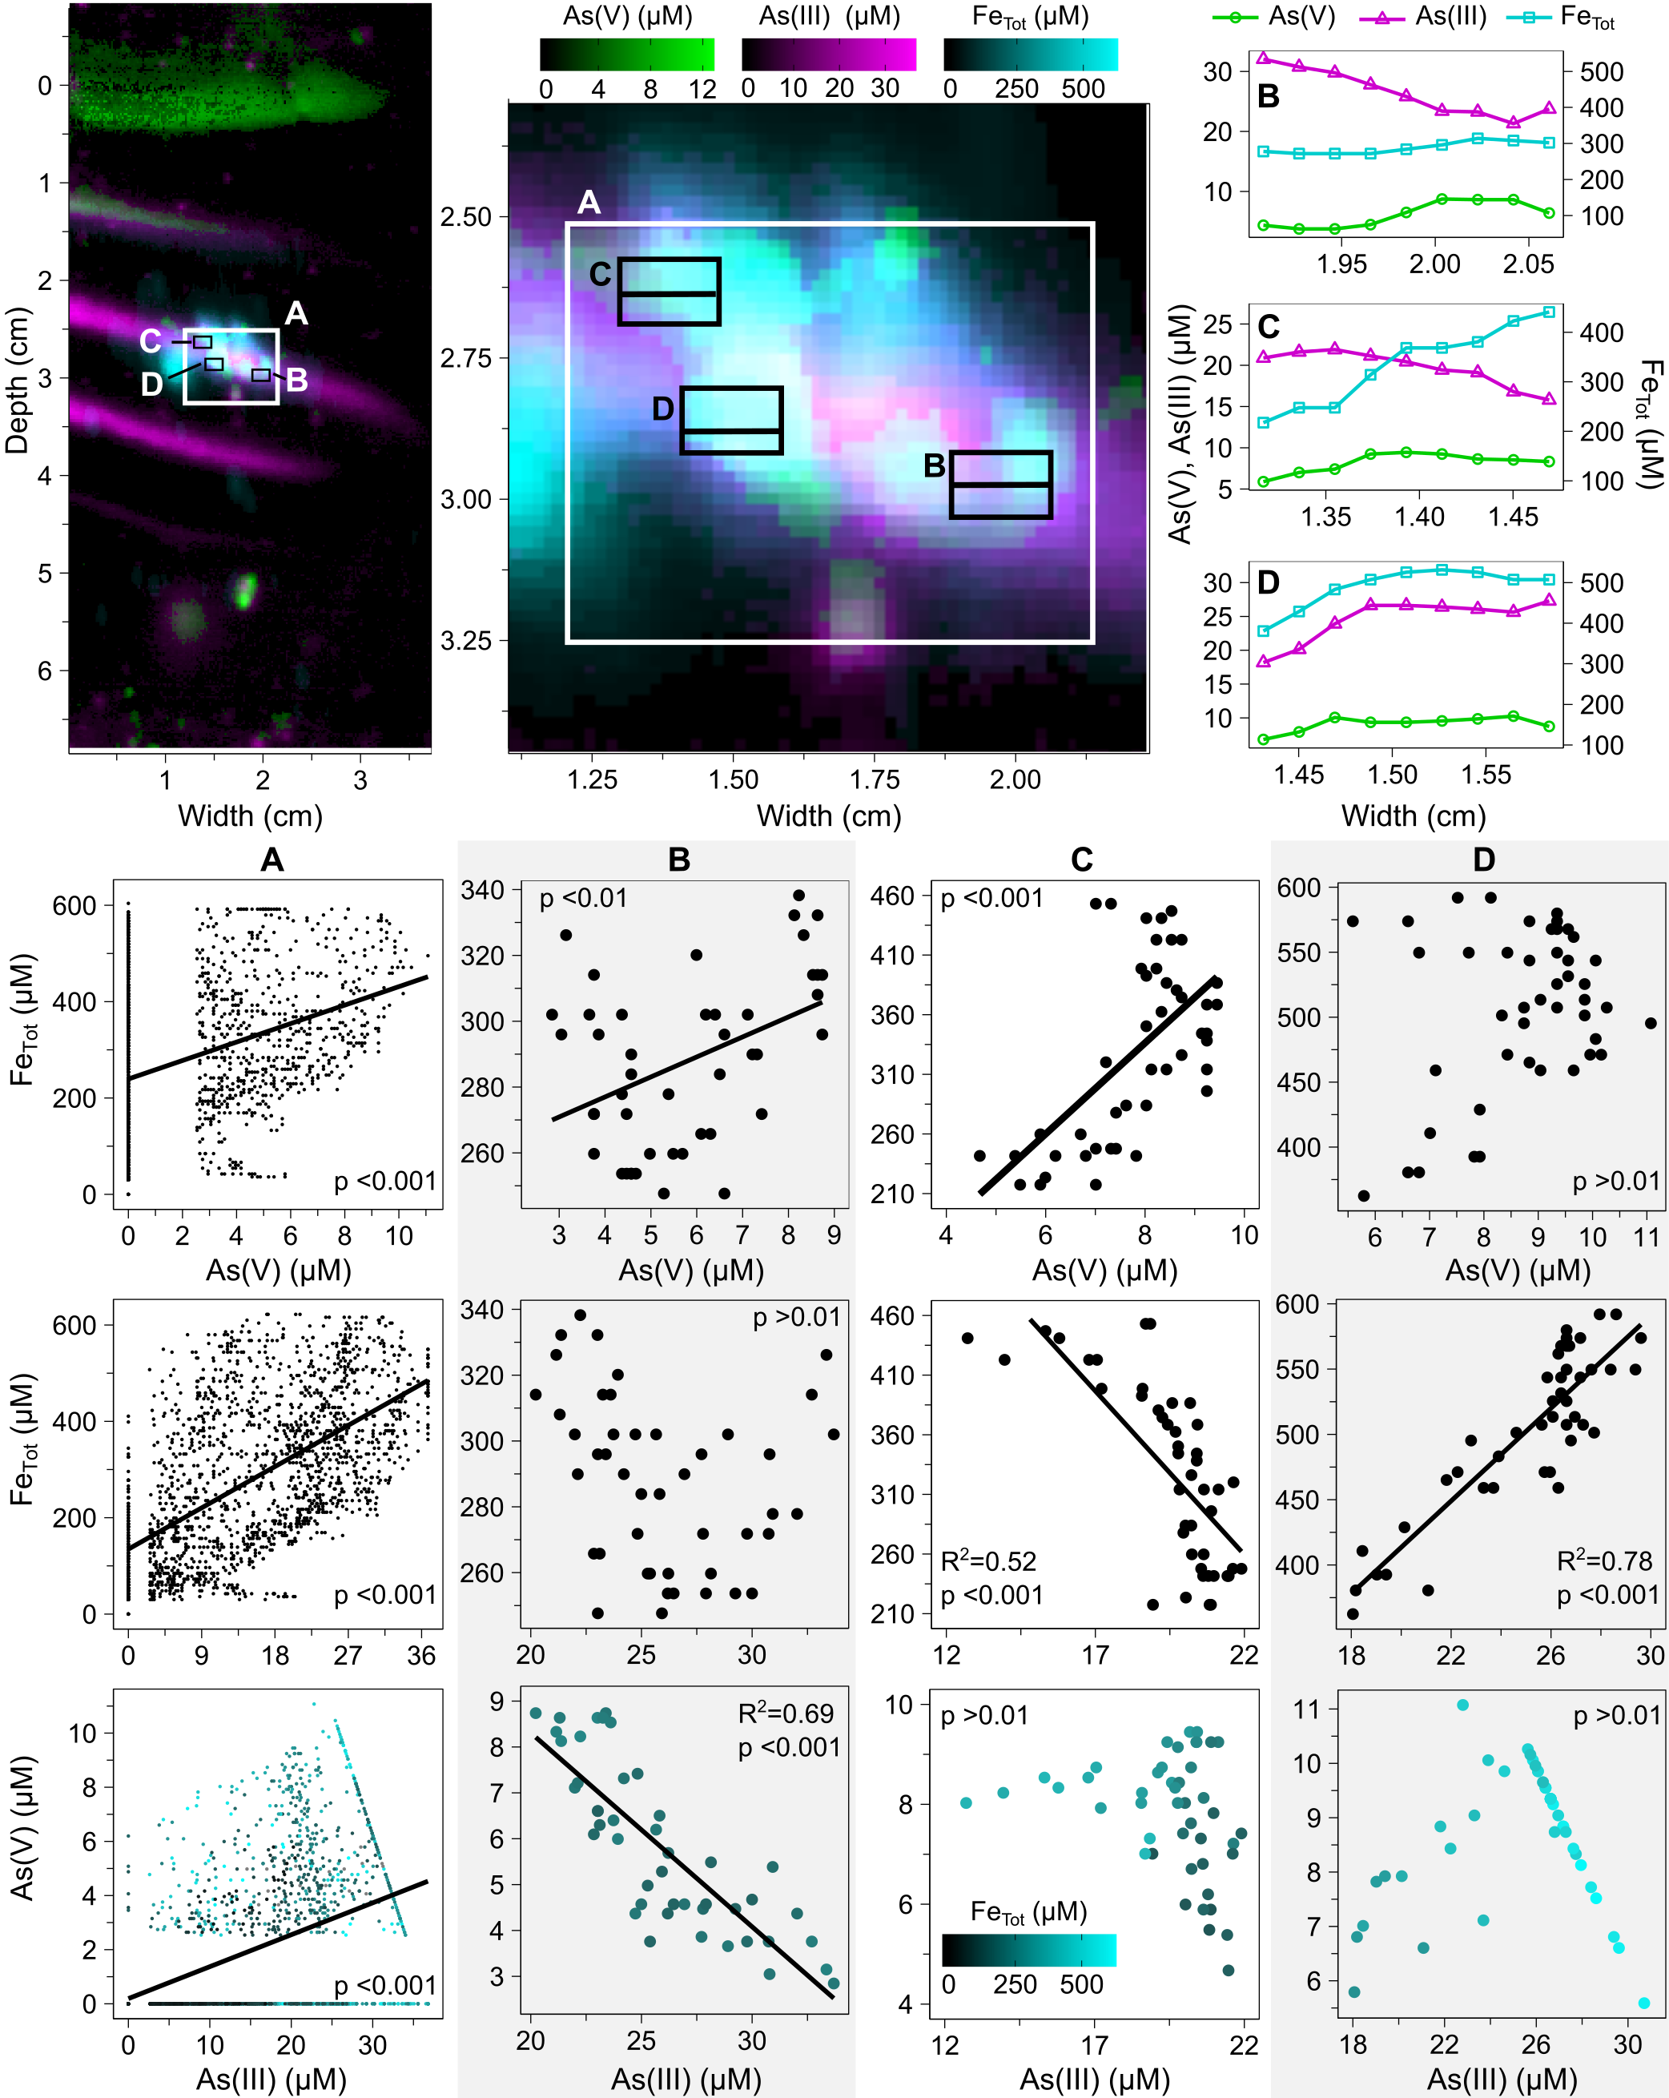
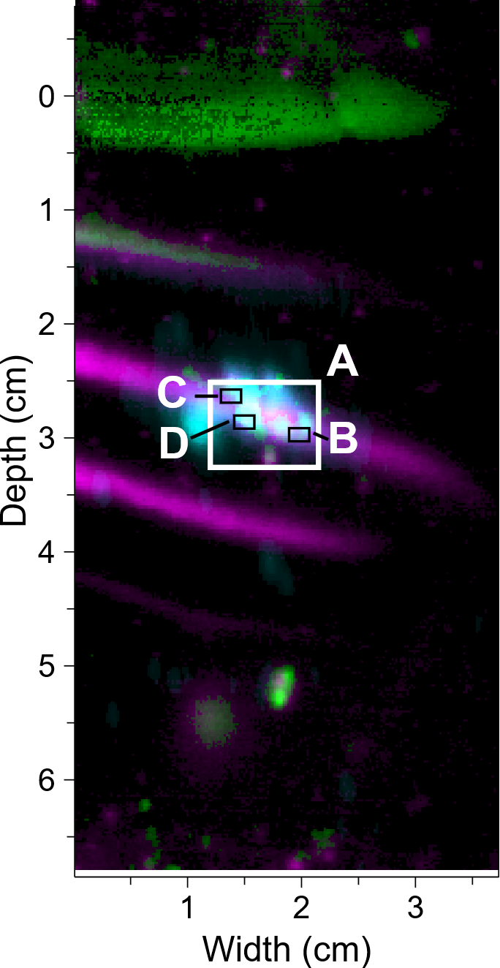
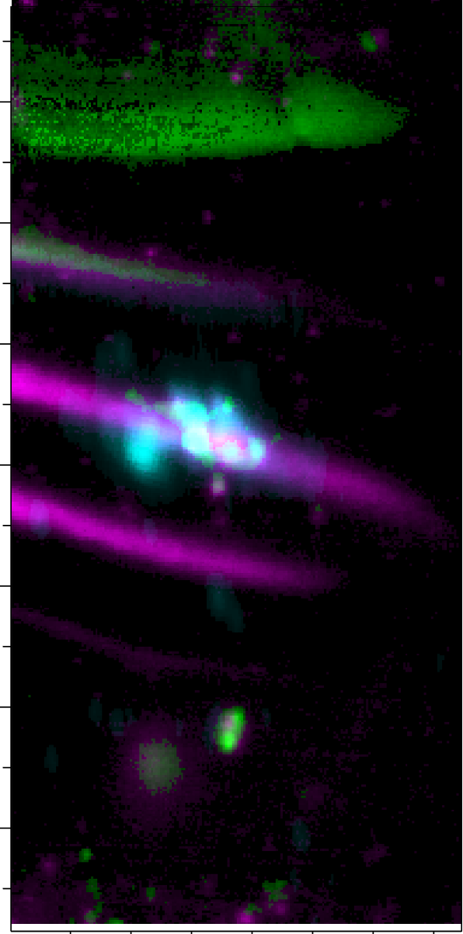
Overall, As(V) is reduced to As(III) at depth.
Central patch shows desorption of As and Fe into gel.
-> difference in desorption of As(V), As(III) from Fe
depends on pH and chemical structure of Fe minerals
Castillejos Sepúlveda et al. submitted

Slide 12
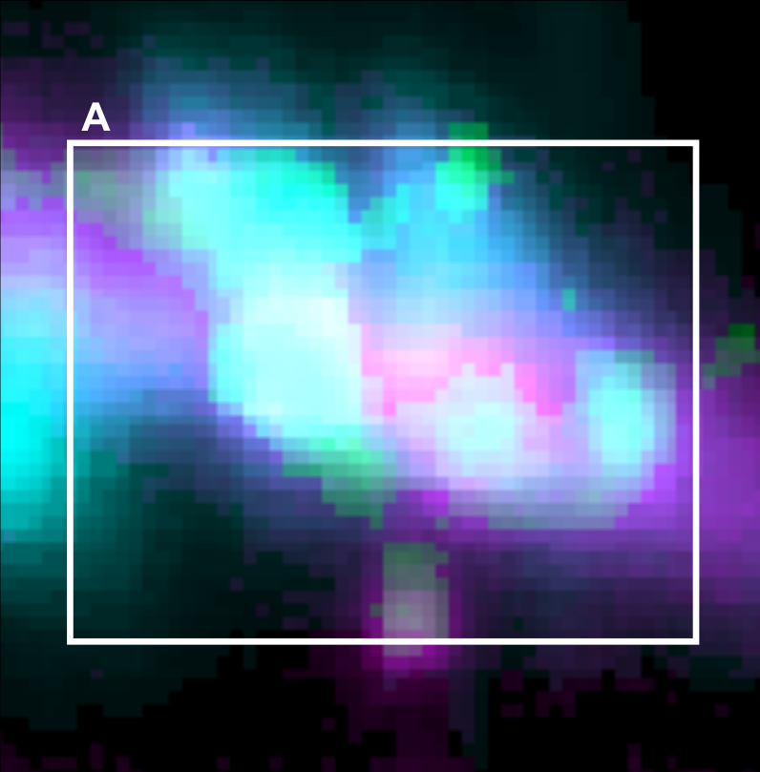
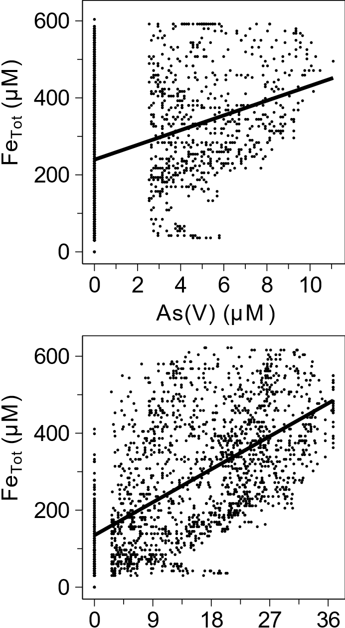

A
Over large area As(V) and As(III) generally co-localized with Fe
Castillejos Sepúlveda et al. submitted

Slide 13
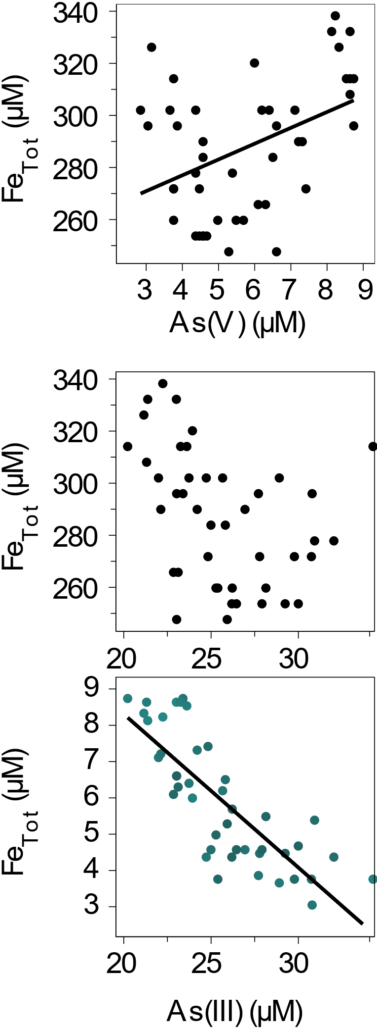
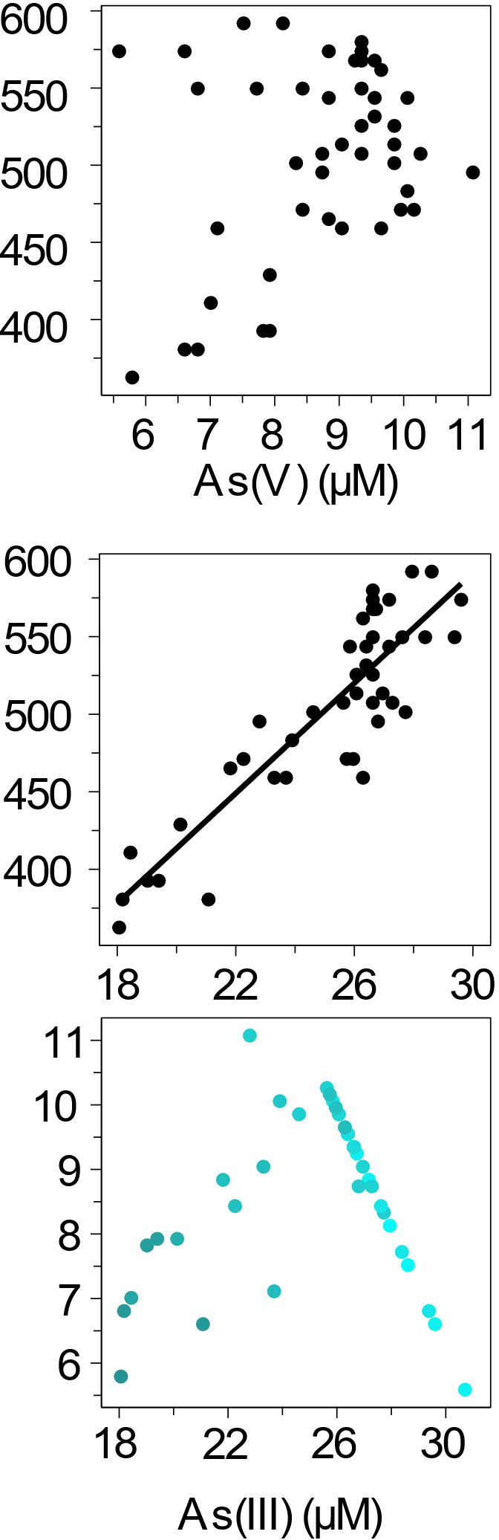
B
D
C
D
B
Castillejos Sepúlveda et al. submitted

Slide 14

Fe-As minerals -> Fe(II) + As(V) + As(III) abiotic
As(V) -> As(III) abiotic / microbially-mediated
B
D
Fe (II) +
As(V)
As(III)
C
D
B
Castillejos Sepúlveda et al. submitted

Slide 15
Fe-As minerals -> Fe(II) + As(V) + As(III) abiotic
As(V) -> As(III) abiotic / microbially-mediated
B
D
Fe (II) +
As(V)
As(III)
More mature, reduced state
Relatively less dissolved
C
D
B
Negative correlation between As(III) and As(V) ->
As released from Fe-rich particles is reduced
Castillejos Sepúlveda et al. submitted

Slide 16
Fe-As minerals -> Fe(II) + As(V) + As(III) abiotic
As(V) -> As(III) abiotic / microbially-mediated
As(III) -> As(V) microbially-mediated
As(V) + Fe (II) or surface Fe(III) → Fe-As minerals abiotic
B
D
Fe (II) +
As(V)
As(III)
More mature, reduced state
Relatively less dissolved
C
D
B
Negative correlation between As(III) and As(V) ->
As released from Fe-rich particles is reduced
Castillejos Sepúlveda et al. submitted

Slide 17

Thank you!
Stay in touch:
@Casti_Andy
acastill@mpi-bremen.de
Abstract information

