Slide 1



Performance assessment of the space-borne
Raman Lidar ATLAS
Atmospheric ThermodynamicS LidAr in Space
N. Franco, P. Di Girolamo, D. Summa, B. De Rosa, A. Behrendt, V. Wulfmeyer
27.05.2022 - Egu (vienna)

Slide 2
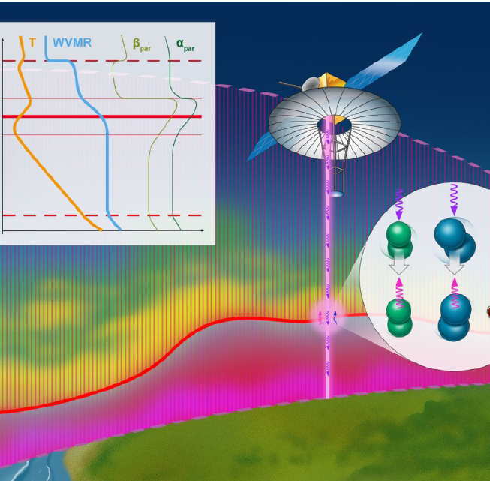
The mission concept
ATLAS
Atmospheric Thermodynamics LidAr in Space
The mission concept aims to develop the first Raman Lidar in space, capable to measure simultaneously atmospheric temperature (T) and water vapour mixing ratio (WVMR) with high temporal and spatial resolutions.
Further data products comprise relative humidity profiles, the particle extinction and backscatter coefficient profiles at 354.7 nm and the PBL depth over land and the oceans.
Notes:
The Atmospheric Thermodynamic LidAr in Space (ATLAS) is a mission concept proposed to the European Space Agency in the frame of “Earth Explorer-11 Mission Ideas” Call with the aim to develop the first Raman Lidar in space capable to measure simultaneously atmospheric temperature (T) and water vapour mixing ratio (WVMR) with high temporal and spatial resolutions.

Slide 3
Impact of the mission
Accurate, high temporal and spatial resolution observations of thermodynamic profiles in the lower troposphere from the surface to the interfacial layer at the top of the planetary boundary layer (PBL) are critically essential for improving weather forecasting and re-analyses, and for understanding the Earth system.
Global scale measurements of 3D thermodynamic profiles would have a great impact in several research areas [Wulfmeyer et al., 2015]:
  Radiative transfer, as well as regional and global water and energy budgets,
  Land-atmosphere feedback including the surface energy balance and its dependence on soil properties and land cover,
  Mesoscale circulations and convection initiation
  Data assimilation
Notes:
An in-depth understanding and advanced prediction of the Earth’s temperature and water vapour fields is fundamental for a sustainable development of the Earth system. However, our understanding of the water and energy cycles still shows critical gaps on all temporal and spatial scales [1-3]. This is mainly due to a lack of accurate high vertical resolution measurements of water vapour and temperature profiles - with high temporal-horizontal resolution, especially in the lower troposphere [4]
vertical exchange of moisture from the boundary layer to the ‘free troposphere’ significantly contributes to the water cycle. Moreover, the water vapour and temperature profiles have a strong impact on the long-wave down-welling radiation [37], which is part of the net surface radiation
The interaction between the land surface and the atmosphere occurs through the surface layer and the PBL. High-resolution TD profiles in the lower troposphere are needed to resolve the gradient functions in the stable, neutral, and unstable surface layer, as well as gradients which can be related to entrainment fluxes at the top of the PBL.
models still show deficiencies in terms of resolution and capability to represent cloud and precipitation processes, especially in connection with extreme events, mainly because of the limited spatial coverage of the available high-performance thermodynamic profiling remote sensing systems
The availability of high vertical resolution TD profiles on the mesoscale is limited mainly to the global radiosonde network and near airports, from sensors on commercial aircraft. Hence, a space Raman lidar will bring entirely new, globally-sampled information at high vertical resolution in an under-observed part of the atmosphere

Slide 4
Experimental setup
LIDAR TRANSMITTER
Source | Injection-seeded frequency tripled, diode-laser pumped Nd:YAG
Laser Wavelength | 354.7 nm
Single-shot pulse energy | 1 J
Repetition rate | 200 Hz
LIDAR RECEIVER
Telescope | f/5 a-focal Cassegrain
Telescope diameter | 2 m
Field-of-View (FWHM) | 25 μrad
SPECTRAL SELECTION AND DETECTION
Spectral selection devices | Interference Filters (IFs)
Detection Devices | Photodiodes or Photomultipliers
Quantum efficiences | 85 %

Slide 5
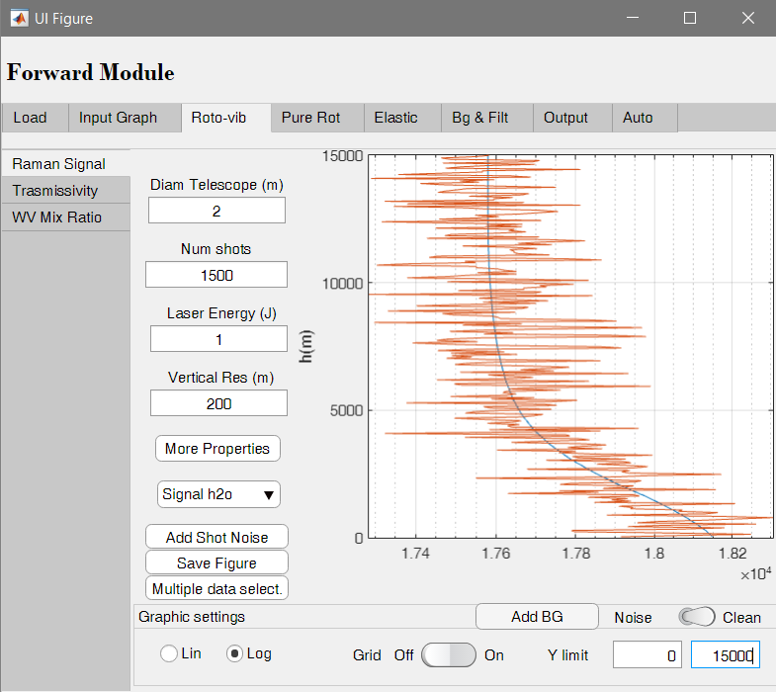
The end to end simulator
The end-to-end simulator is a numerical model for the simulations and analysis of signals collected by a space-borne Raman Lidar.

Slide 6
FORWAD MODULE
INPUT
___________________
Thermodynamic profiles and optical properties
FORWARD MODULE
___________________
Simulation of roto-vibrational and pure-rotational signals
RETREIVAL MODULE
OUTPUT
___________________
WV Mix Ratio and Temperature profiles
RETRIEVAL MODULE
___________________
Signal analysis

Slide 7
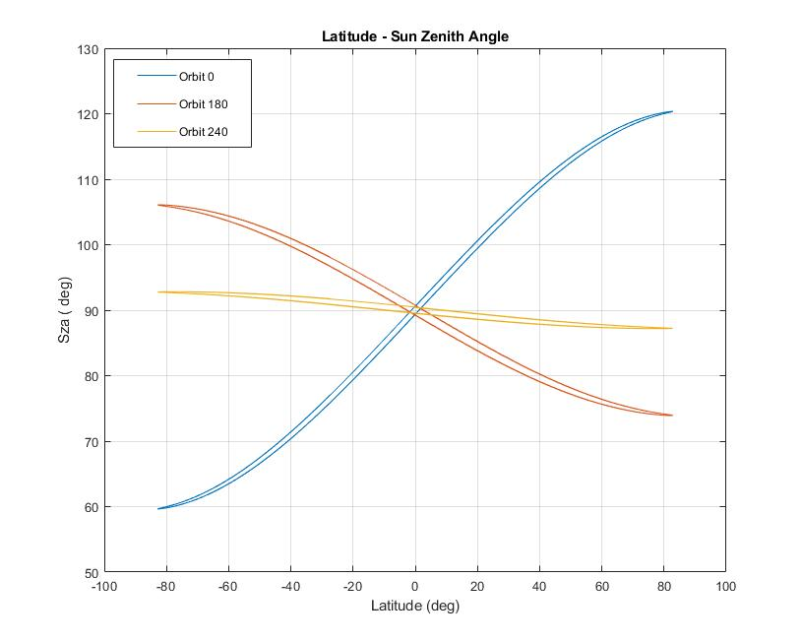

simulations
To verify the capabilities of ATLAS, simulations along several orbits around the Earth were performed.
The orbit were selected to consider the different variability of the sza during the year:
- Day 0: $90°±30°$ (High background)
- Day 180: $90°±15°$ (Mean background)
- Day 240: $90°±3 °$ (Low background)
The data are extracted from NASA's Goddard Earth Observing System Model (GEOS-5) analysis

Slide 8
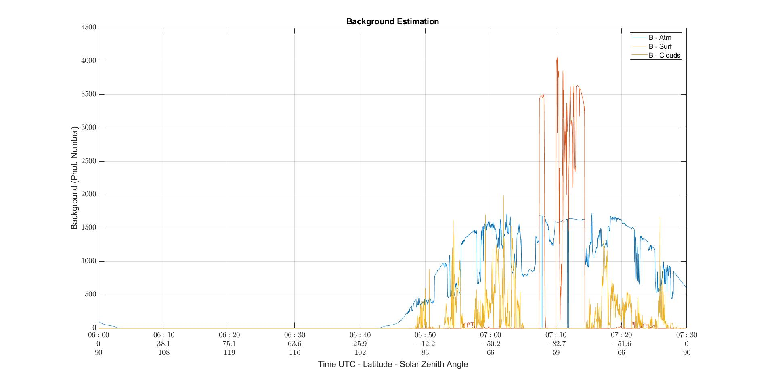

Slide 9
TOA
Cloud 1
NO CLOUDS
CLOUD 1
NO CLOUDS
CLOUD 2
NO CLOUDS
CLOUD 2
Cloud 2

Slide 10
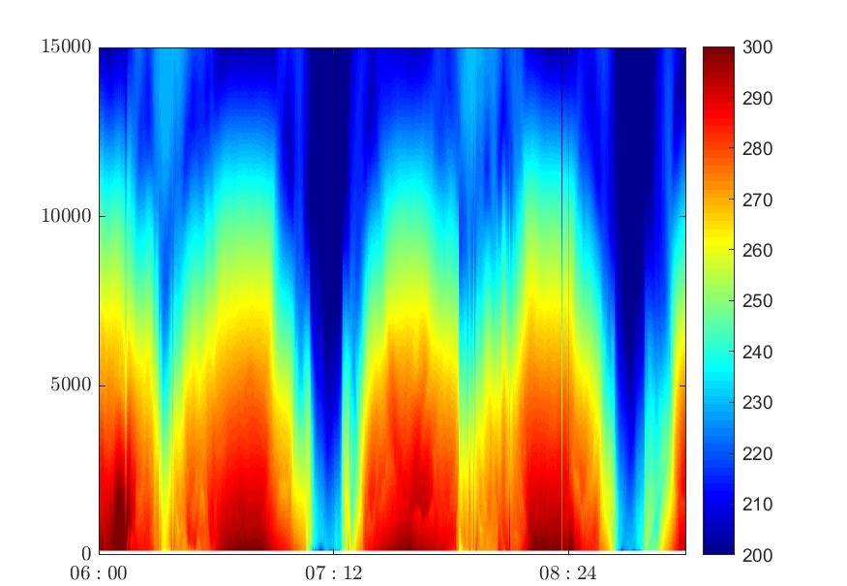

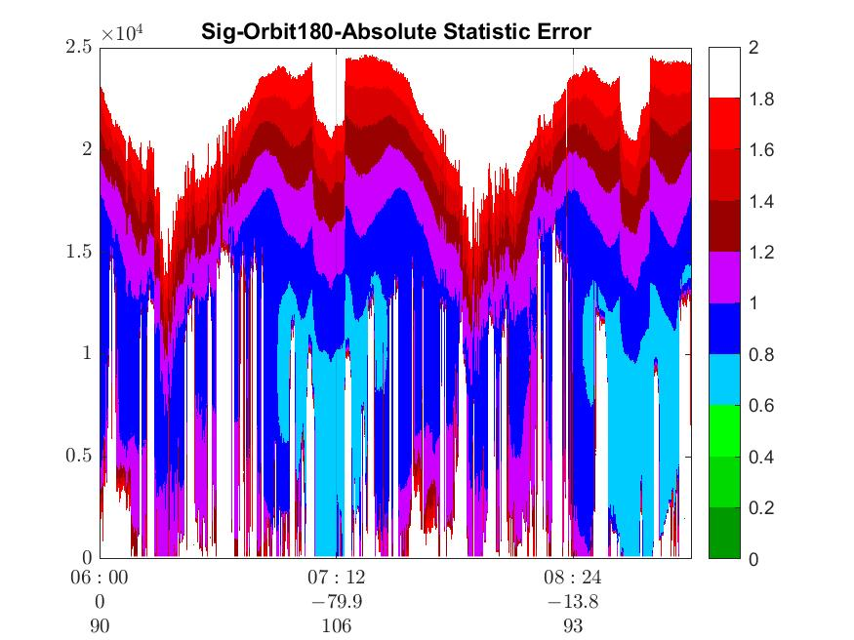
TEMPERATURE

Slide 11
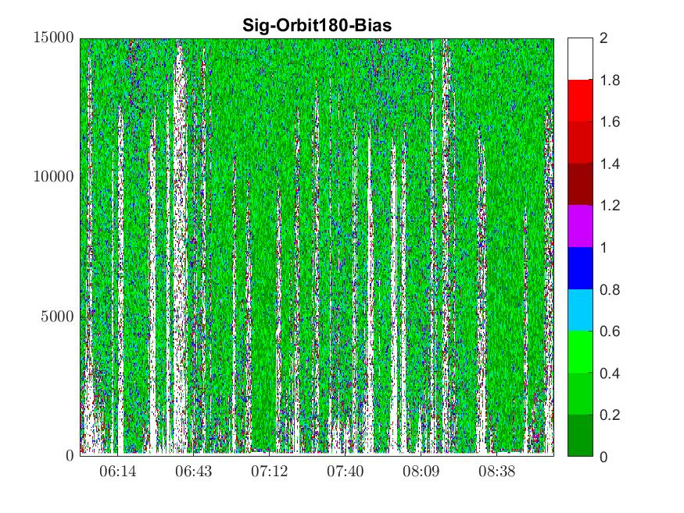


Statistical uncertainty (K) and bias (K)
K
K
$$ΔT(z)=\frac{∂T\left(z\right)}{∂R}R(z)\sqrt{\frac{N_{LoJ}\left(z\right)+bg_{LoJ}}{N_{LoJ}^{2}(z)}+\frac{N_{HiJ}\left(z\right)+bg_{HiJ}}{N_{HiJ}^{2}(z)}}$$
$$ΔT=|T_{inp}−T_{ret}|$$

Slide 12
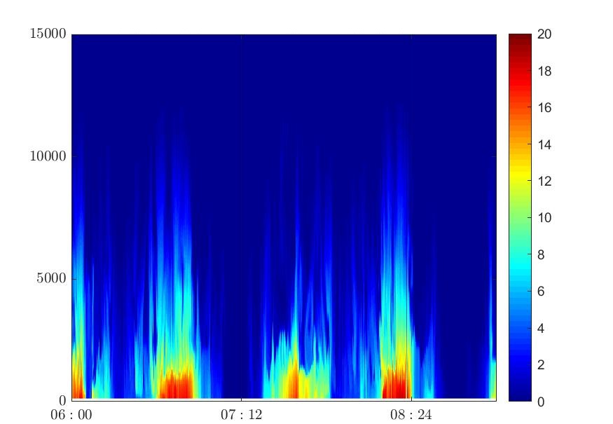
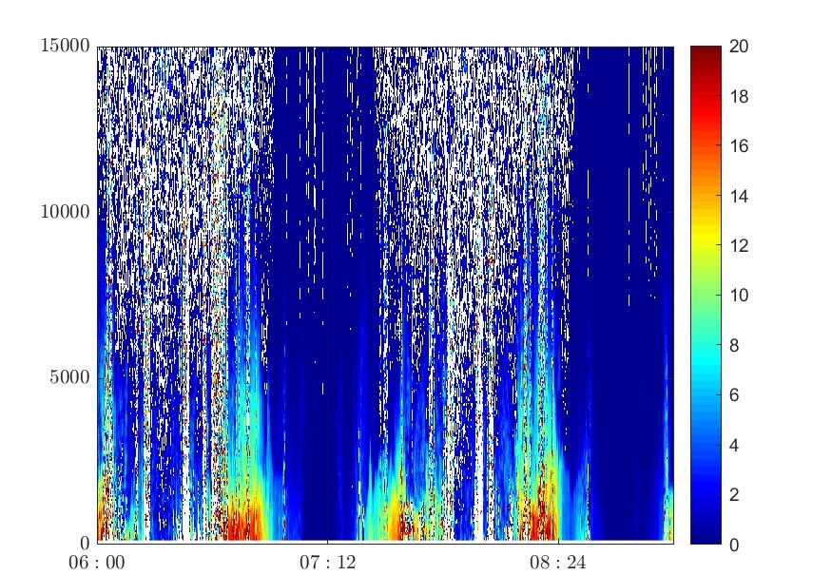
Water Vapour Mixing Ratio

Slide 13
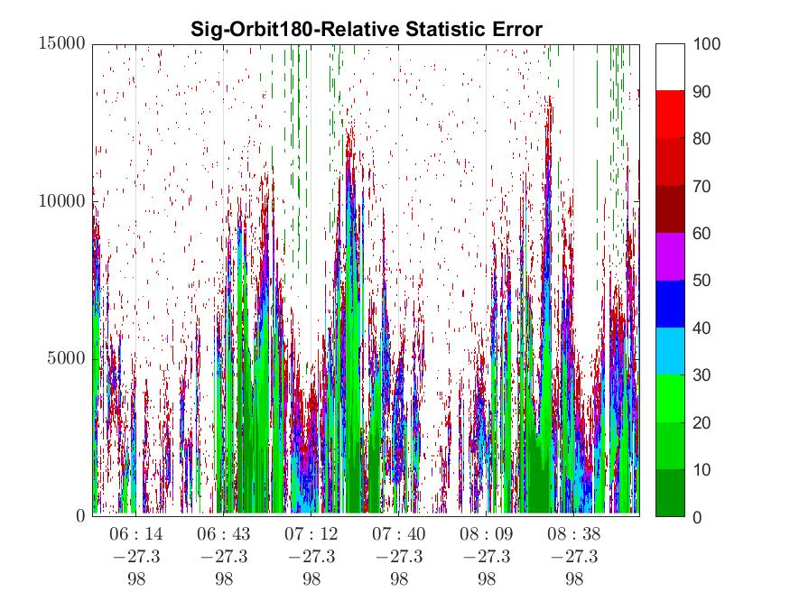
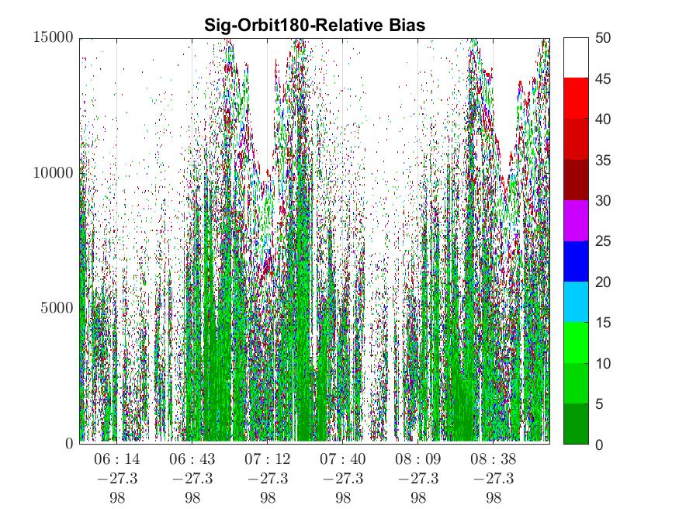


Relative Statistical Uncertainty (%) and relative Bias (%)
$$\frac{Δχ_{H_{2}O}(z)}{χ_{H_{2}O}(z)}=100×\sqrt{\frac{N_{H_{2}O}\left(z\right)+bg_{H_{2}O}}{N_{H_{2}O}^{2}(z)}+\frac{N_{ref}\left(z\right)+bg_{ref}}{N_{ref}^{2}(z)}}$$
$$\frac{Δχ_{H_{2}O}}{χ_{H_{2}O}} =100×\frac{\left|χ_{inp}−χ_{ret}\right|}{χ_{inp}}$$

