Slide 1
Mapping Arctic Sea Ice Surface Roughness with MISR (Multi-angle Imaging SpectroRadiometer)
Thomas Johnson¹, Michel Tsamados¹, Jan-Peter Muller², and Julienne Stroeve¹
¹Centre for Polar Observation and Modelling, University College London, London, United Kingdom
²Mullard Space Science Laboratory, University College London, London, United Kingdom

Slide 2
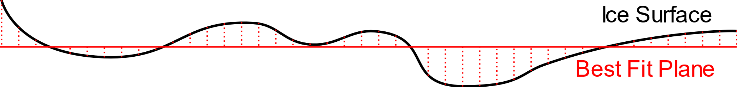
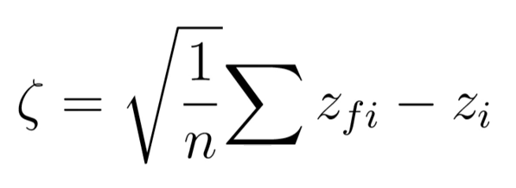
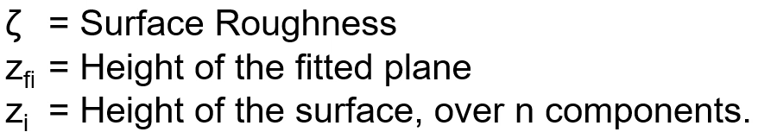
1. Introduction
Surface roughness is defined here as the standard deviation of elevations within a footprint minimized to a best fit plane.
Elevations

Slide 3
1. Introduction
Sea Ice Roughness
Momentum transfer between atmosphere and ocean
Provides preconditioning for summer melt pond extent
Proxy for sea ice age and thickness.
MISR
Optical Satellite
Multi-angular Imagery – Angular reflectance signatures / specular anisotropy
Rougher ice surfaces are optically backward scattering relative to their smoother counterparts

Slide 4
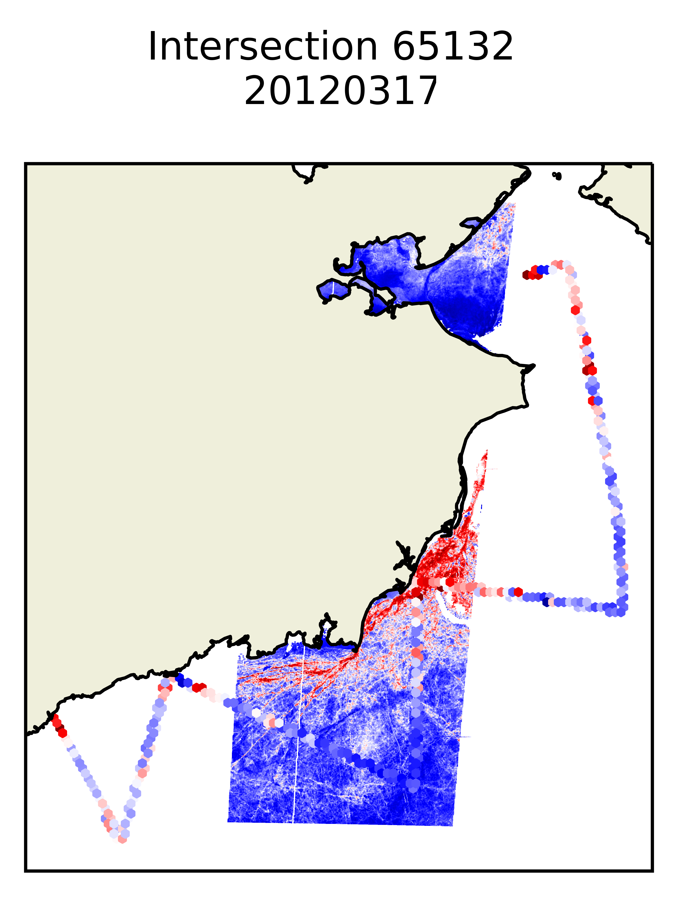
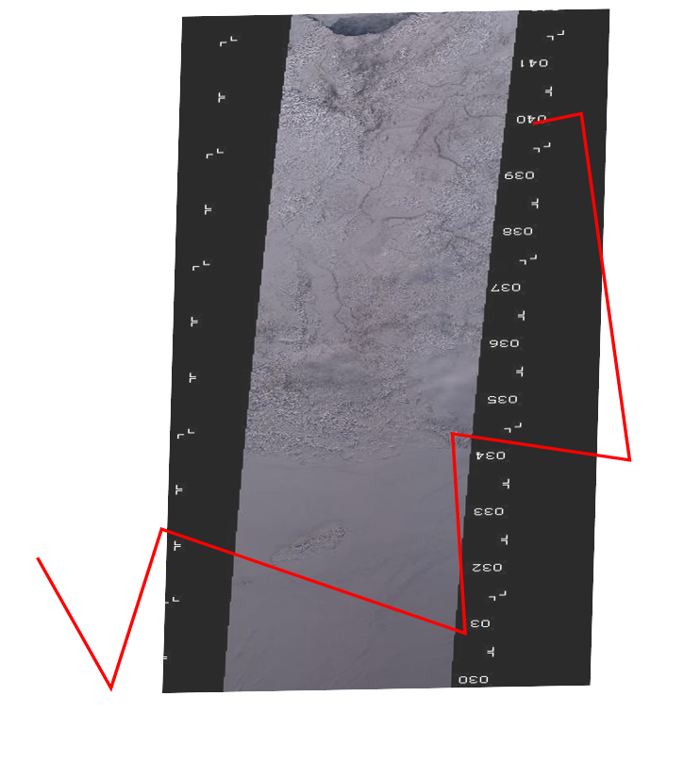
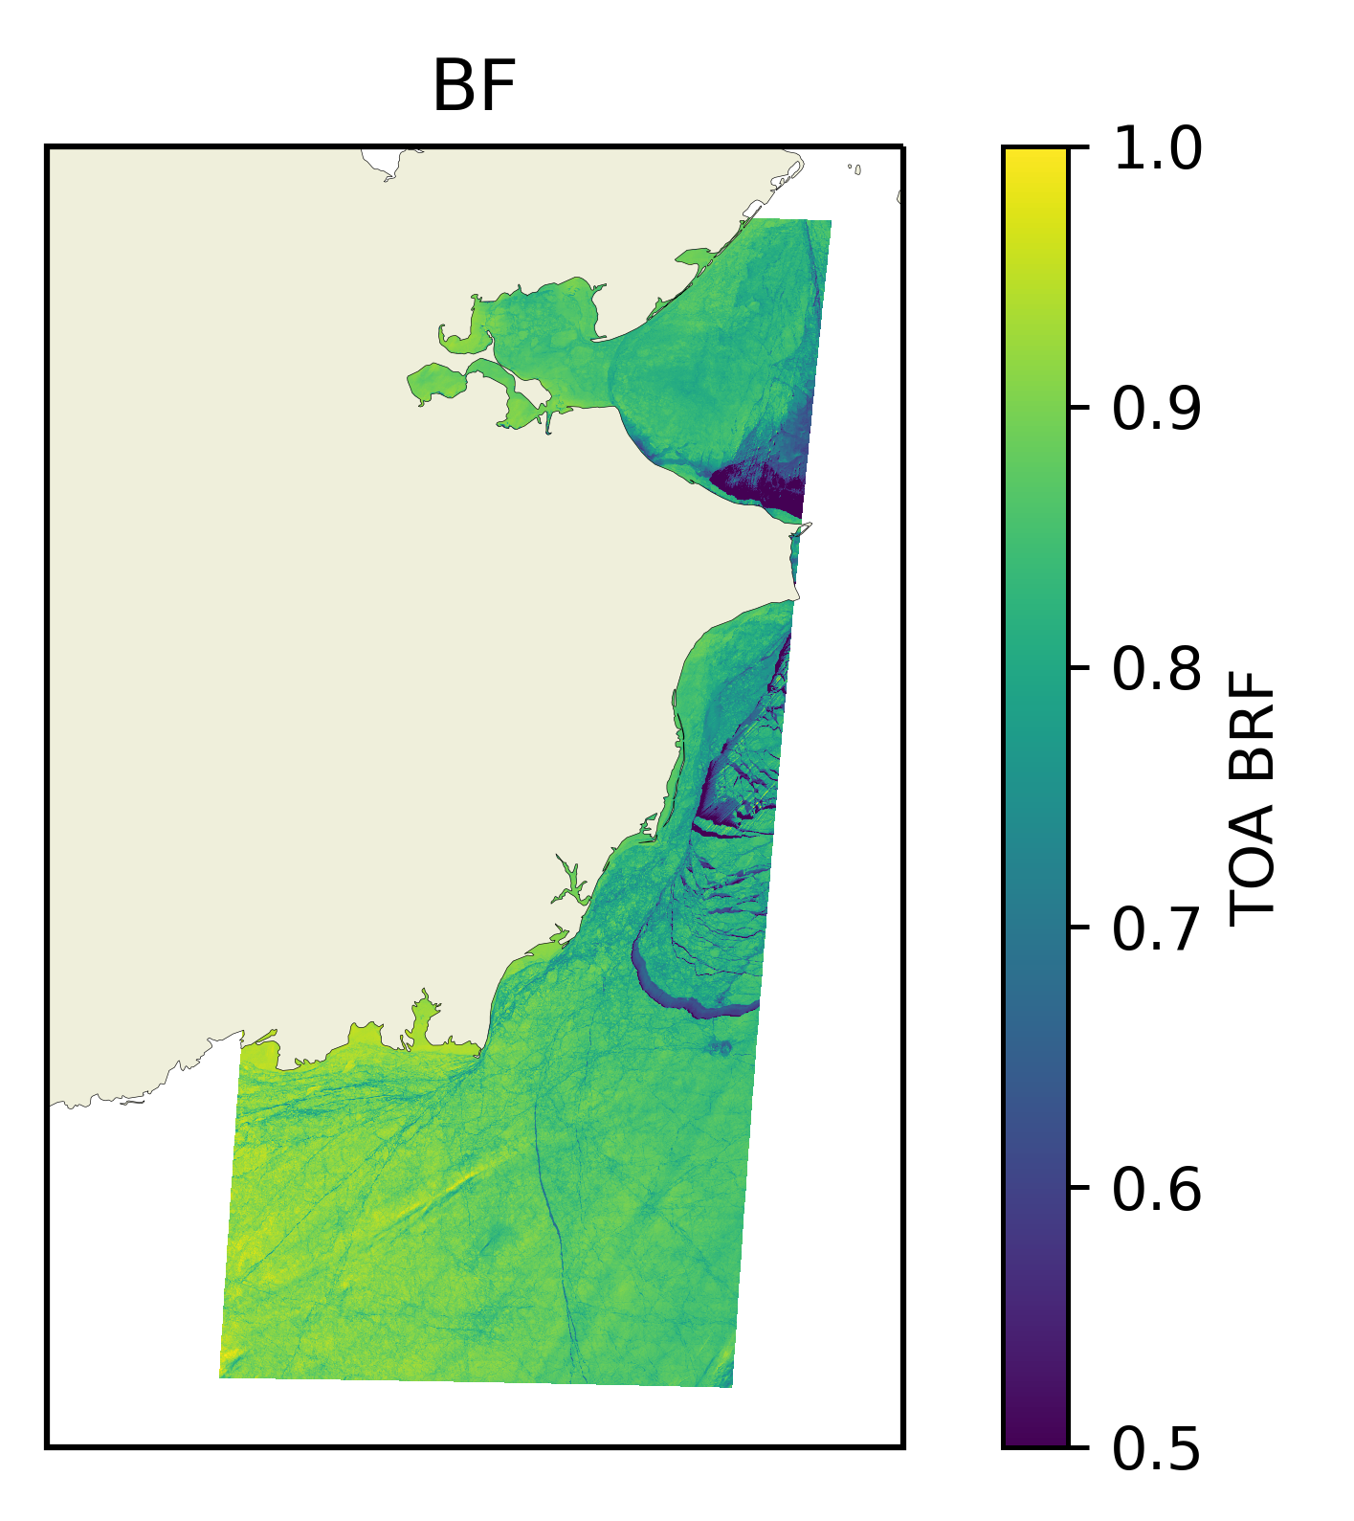
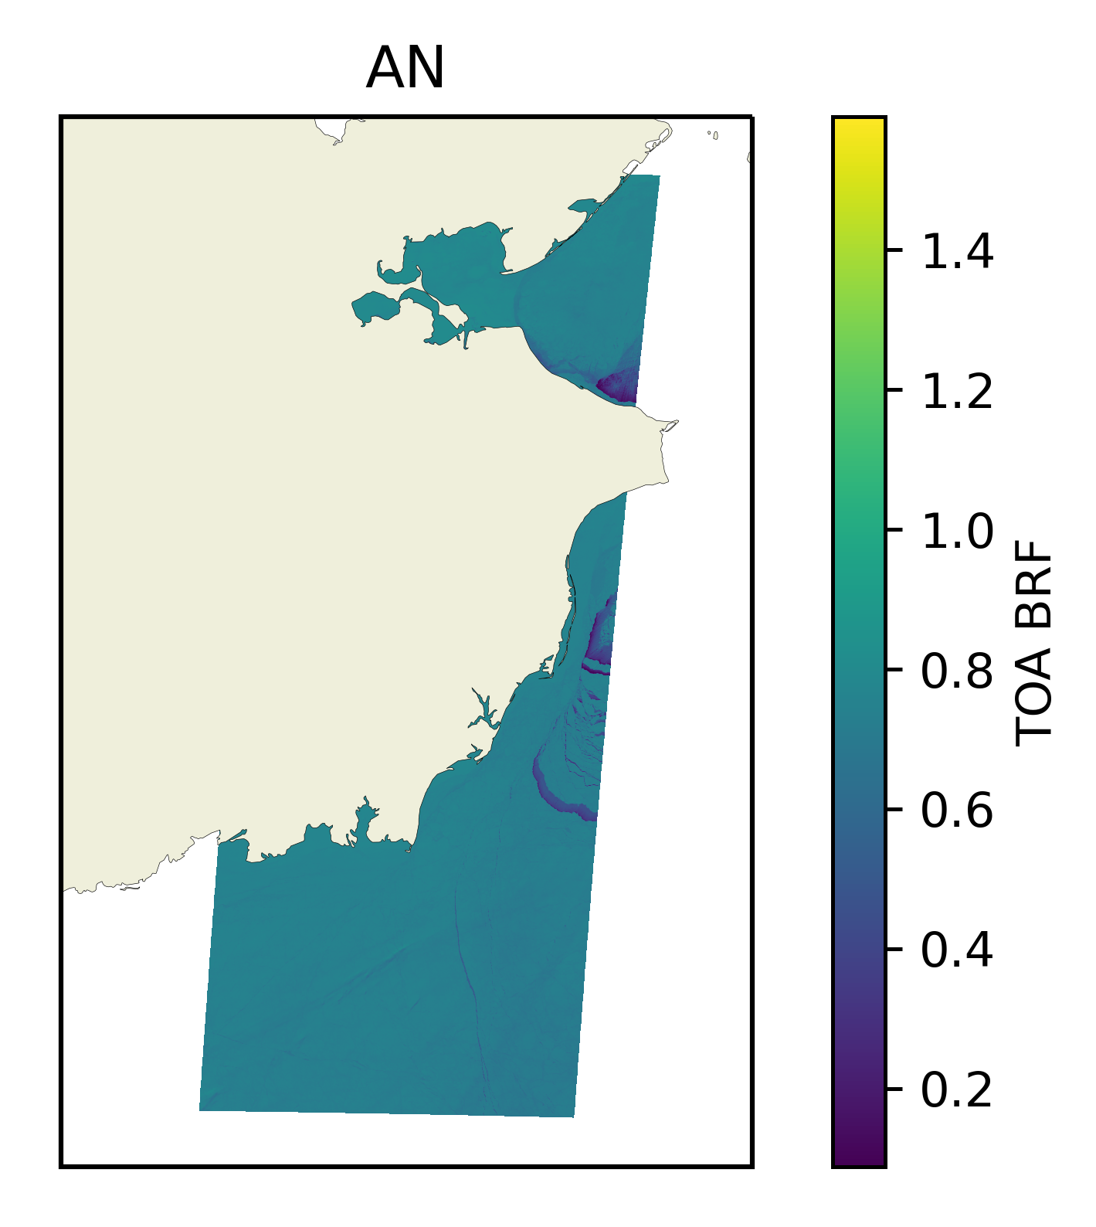
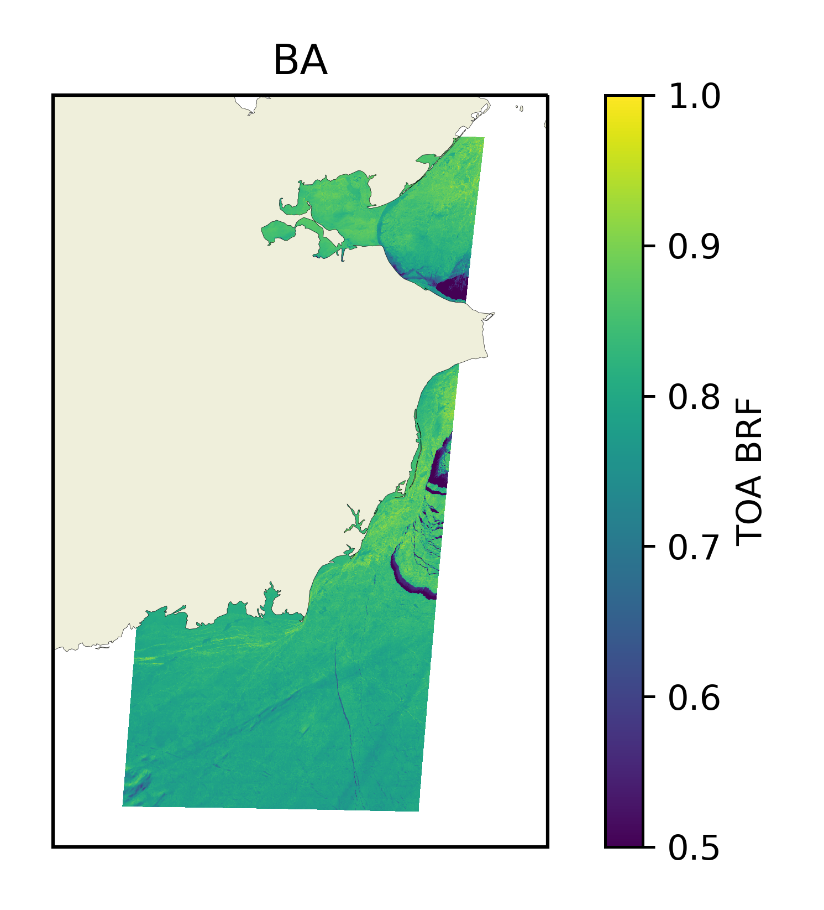
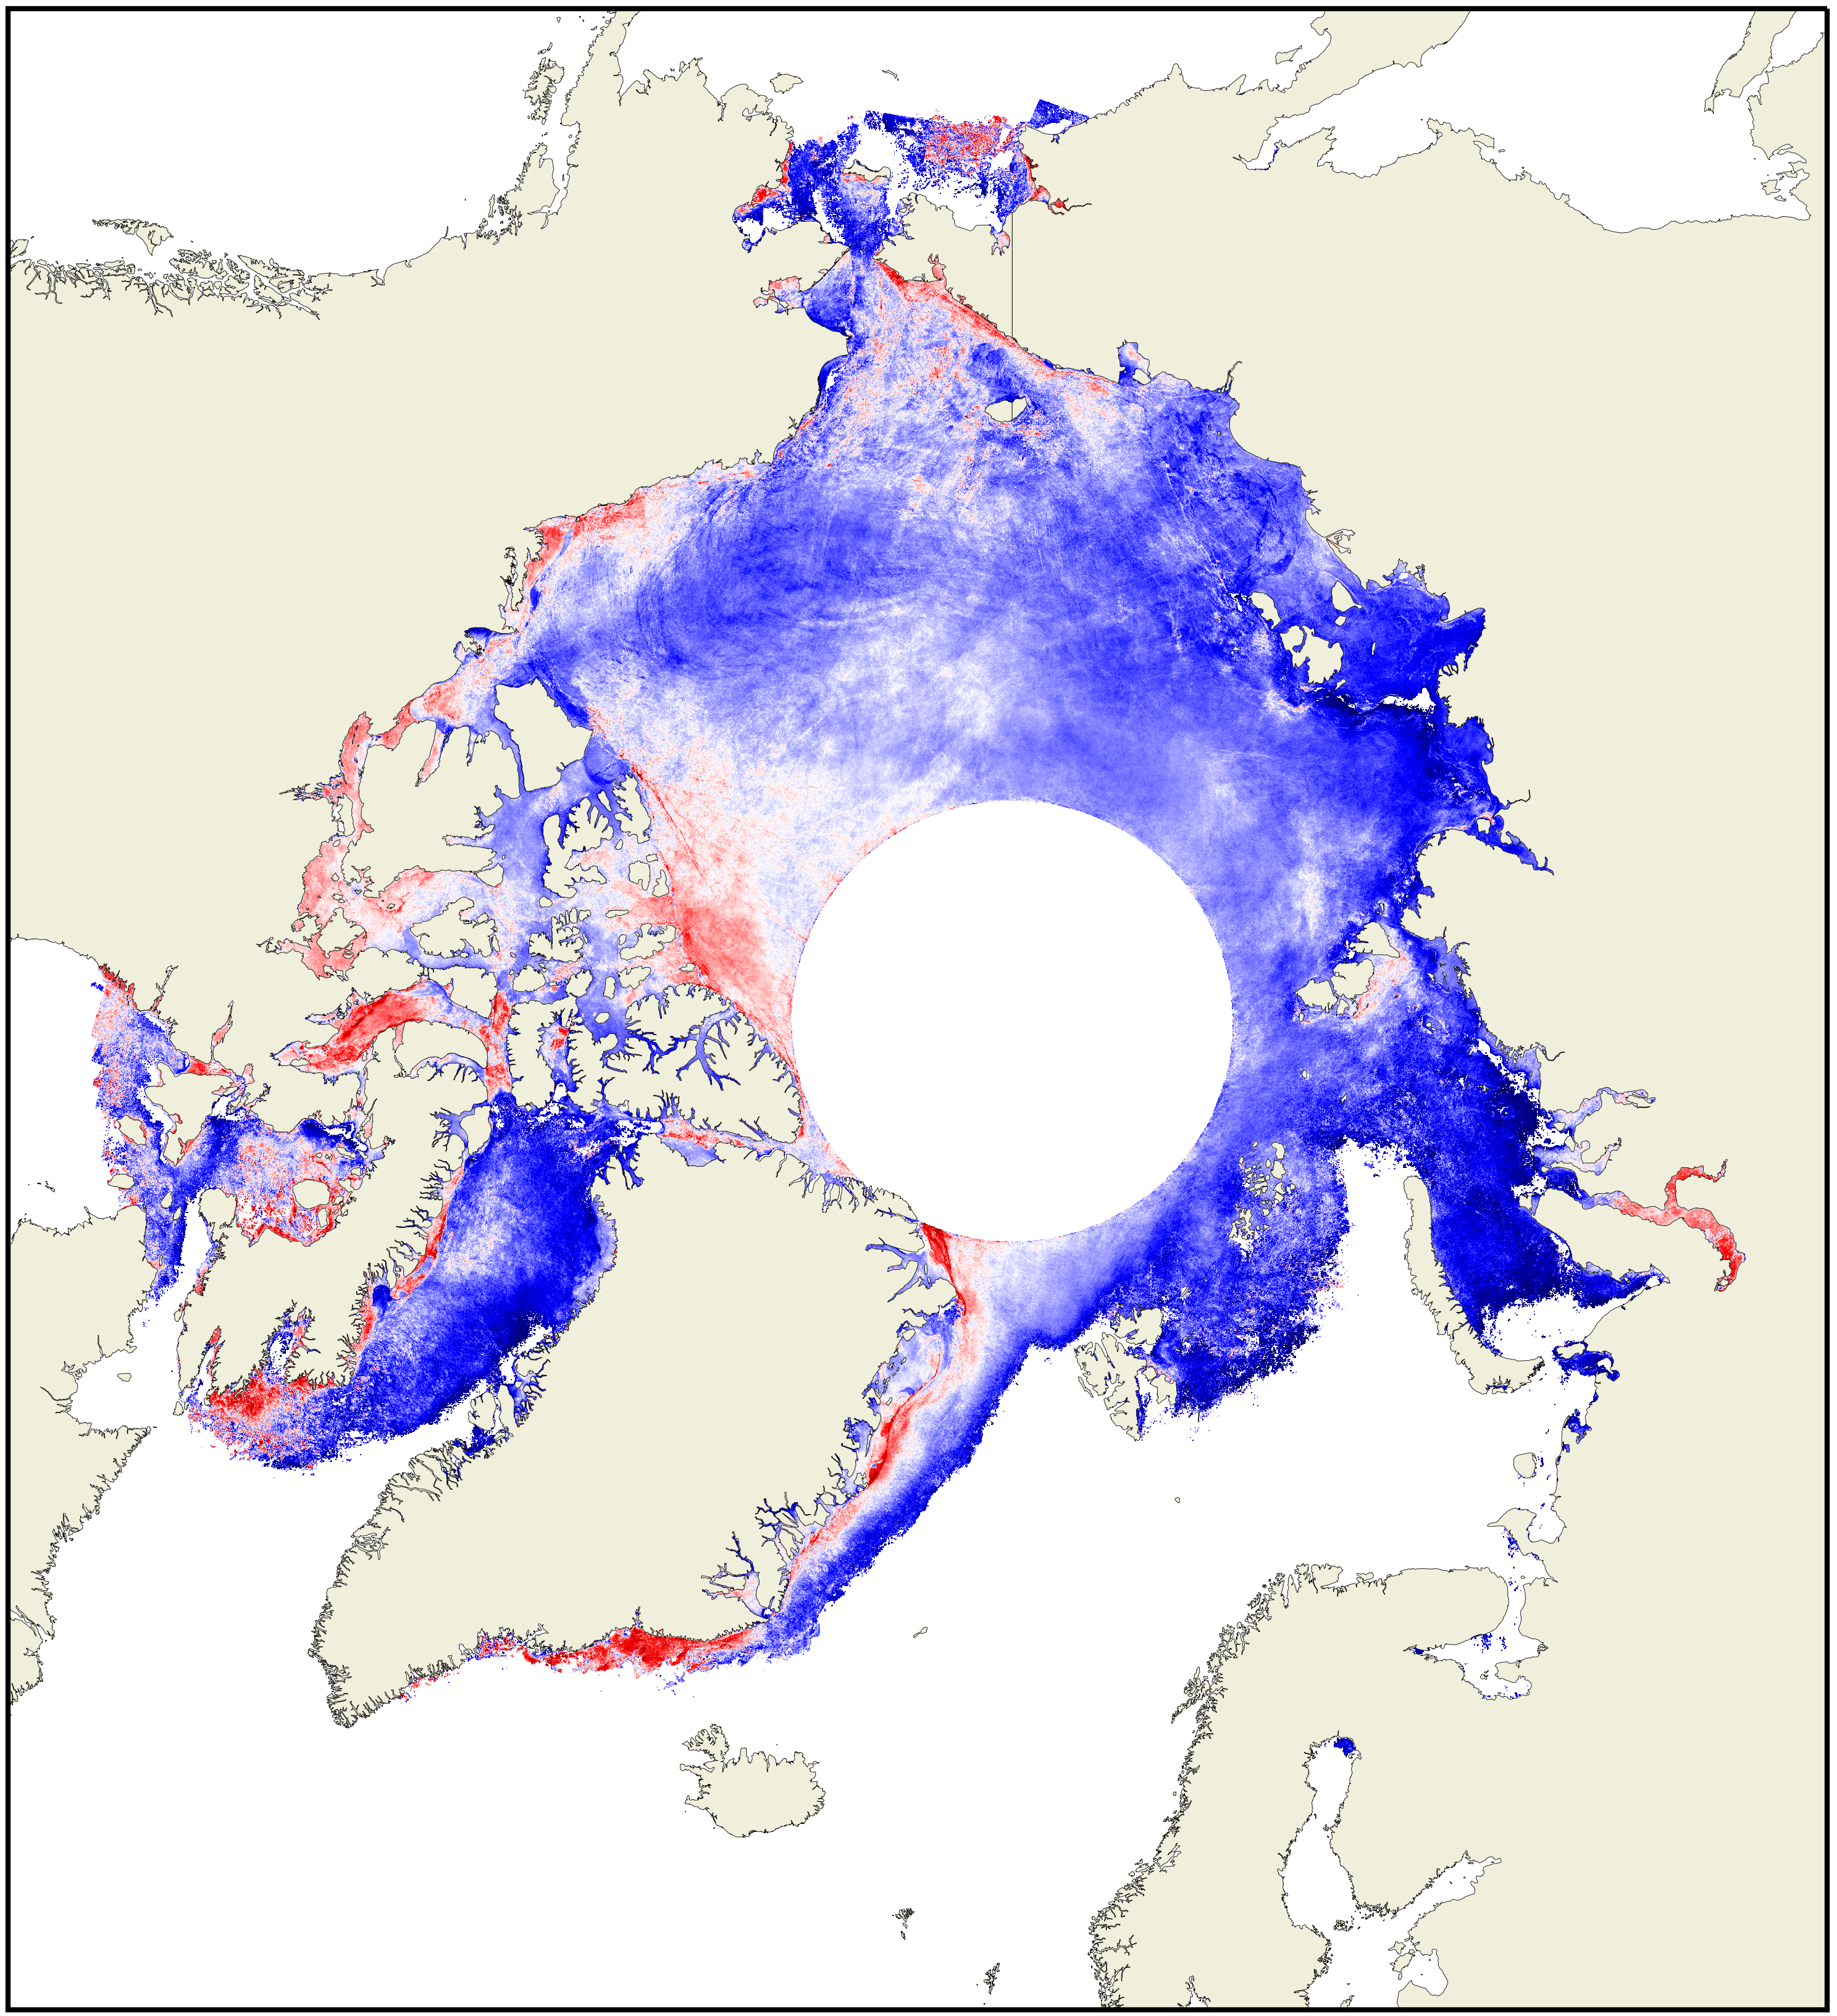
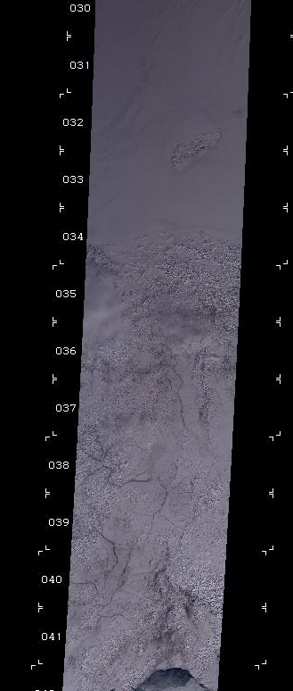
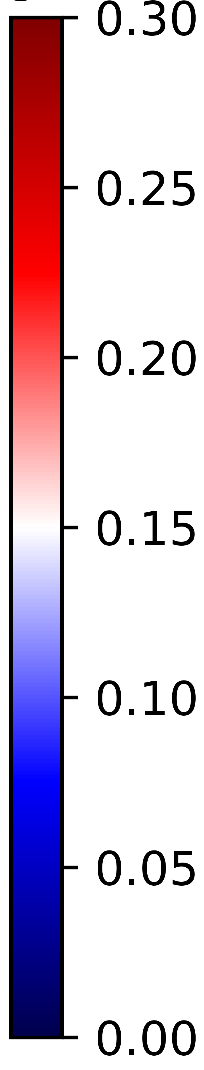

2. Method
April 2012
Multi-angular Imagery
Operation IceBridge
Intersections
Stacking
Roughness
(SVR)

Slide 5
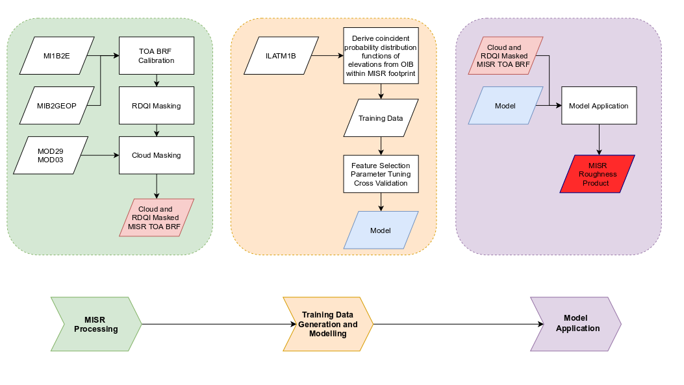
2. Method

Slide 6
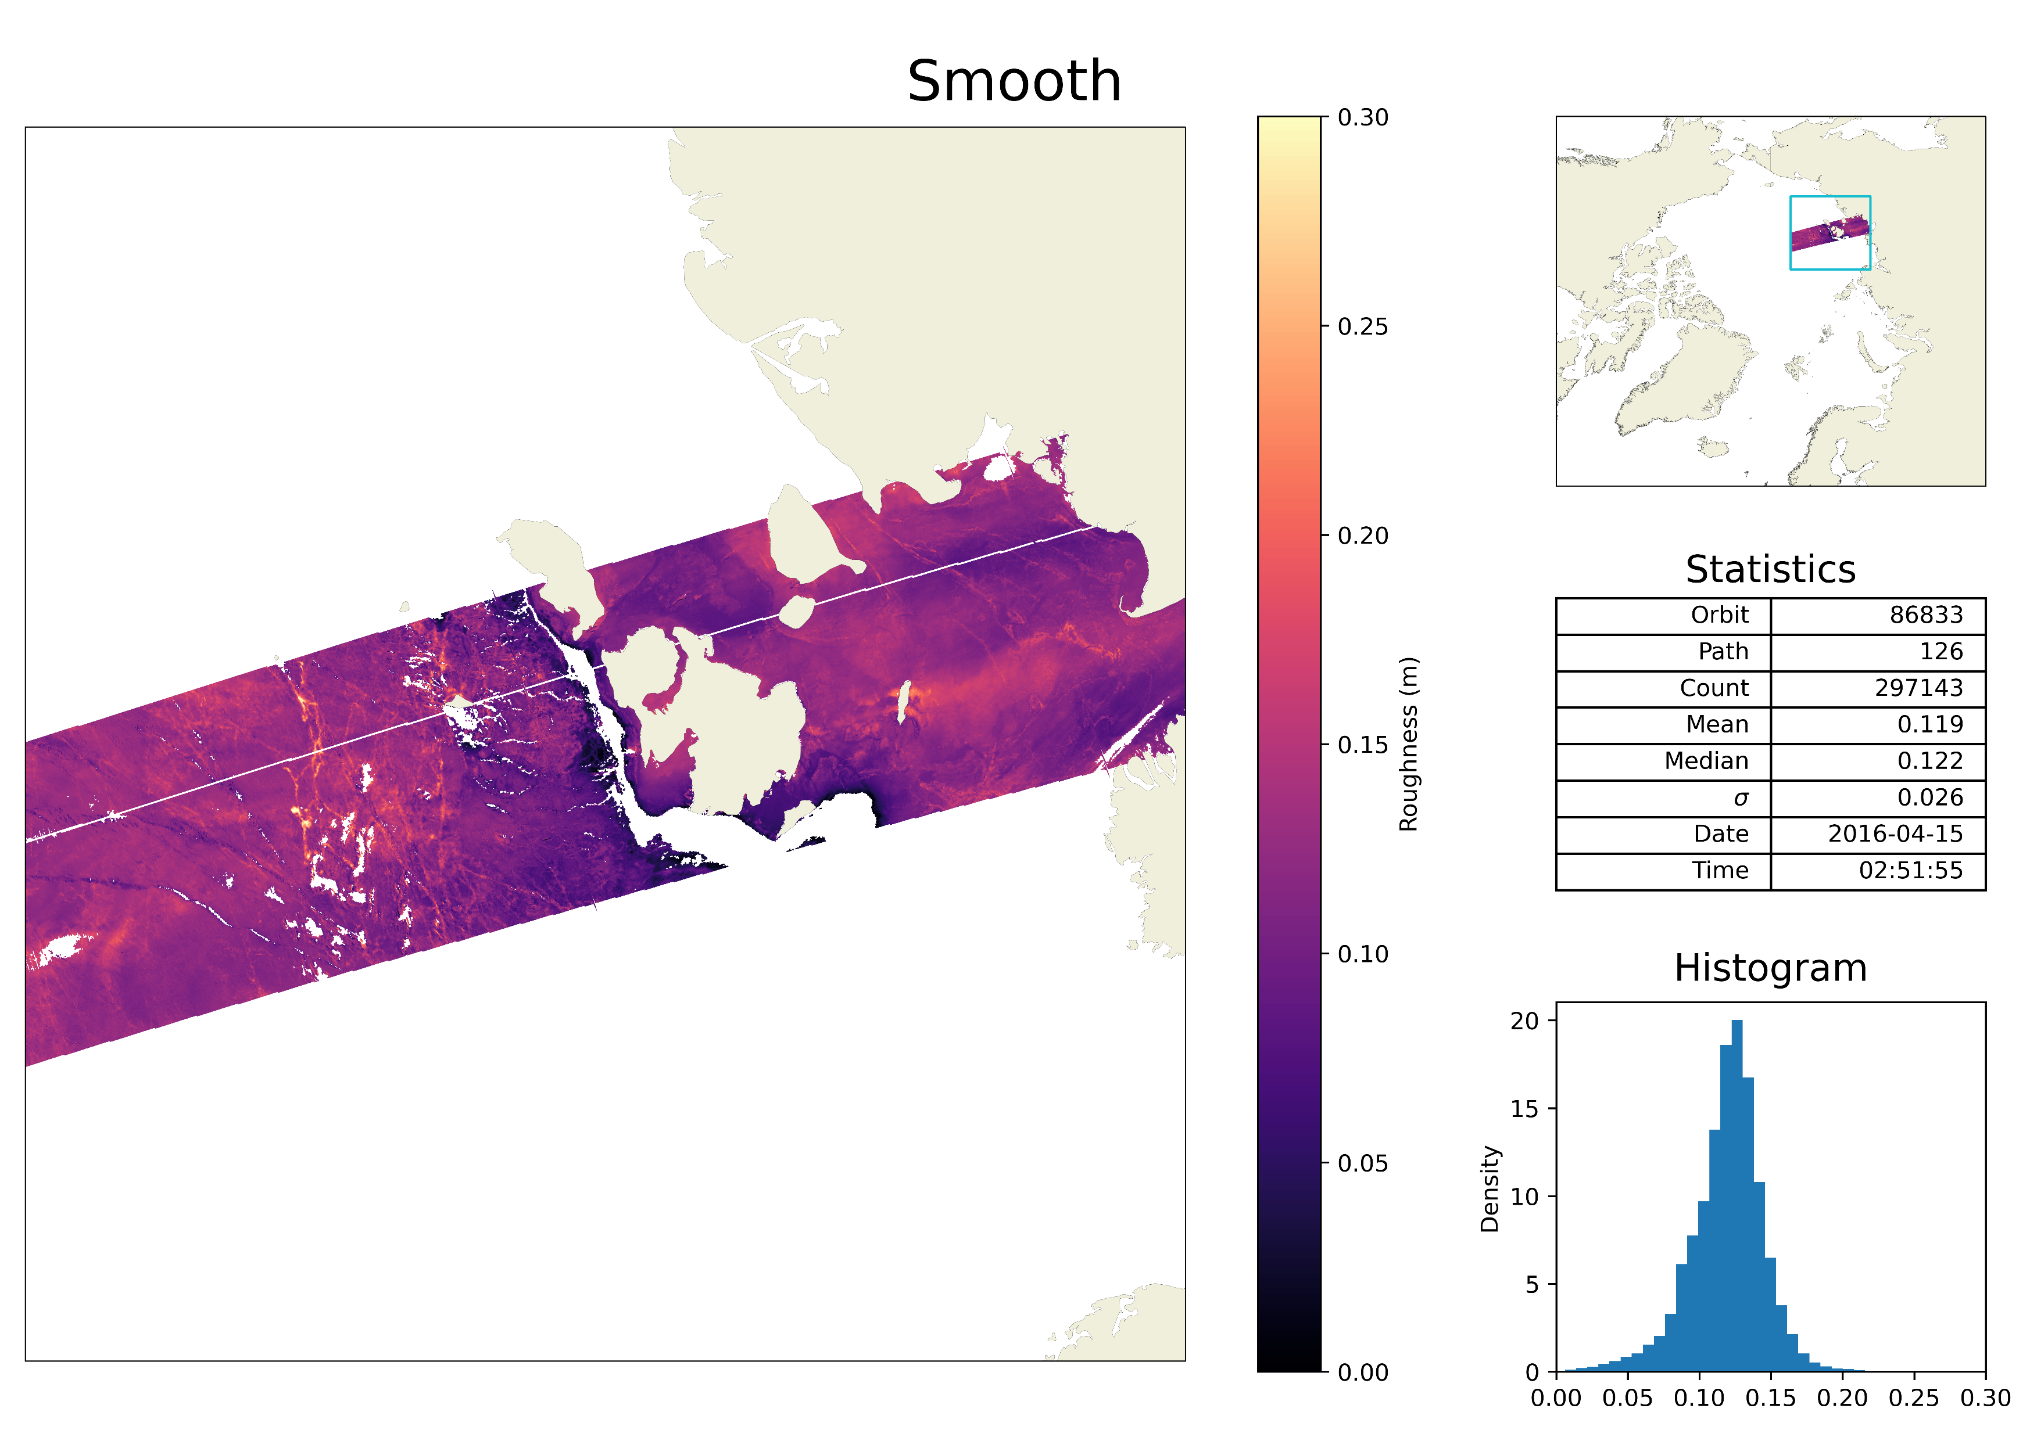
3. Results
(Polynya detection)

Slide 7
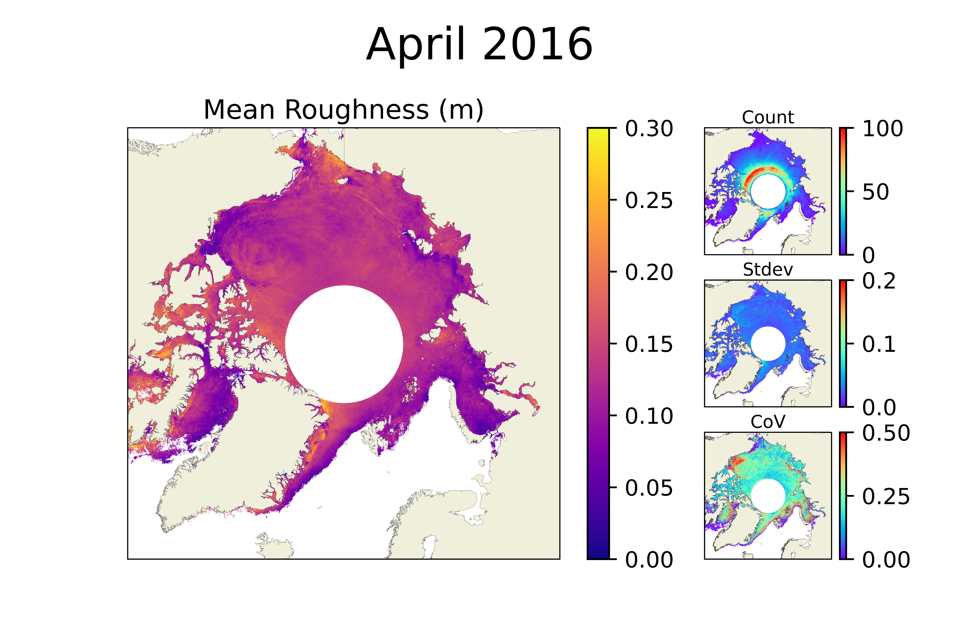
3. Results

Slide 8
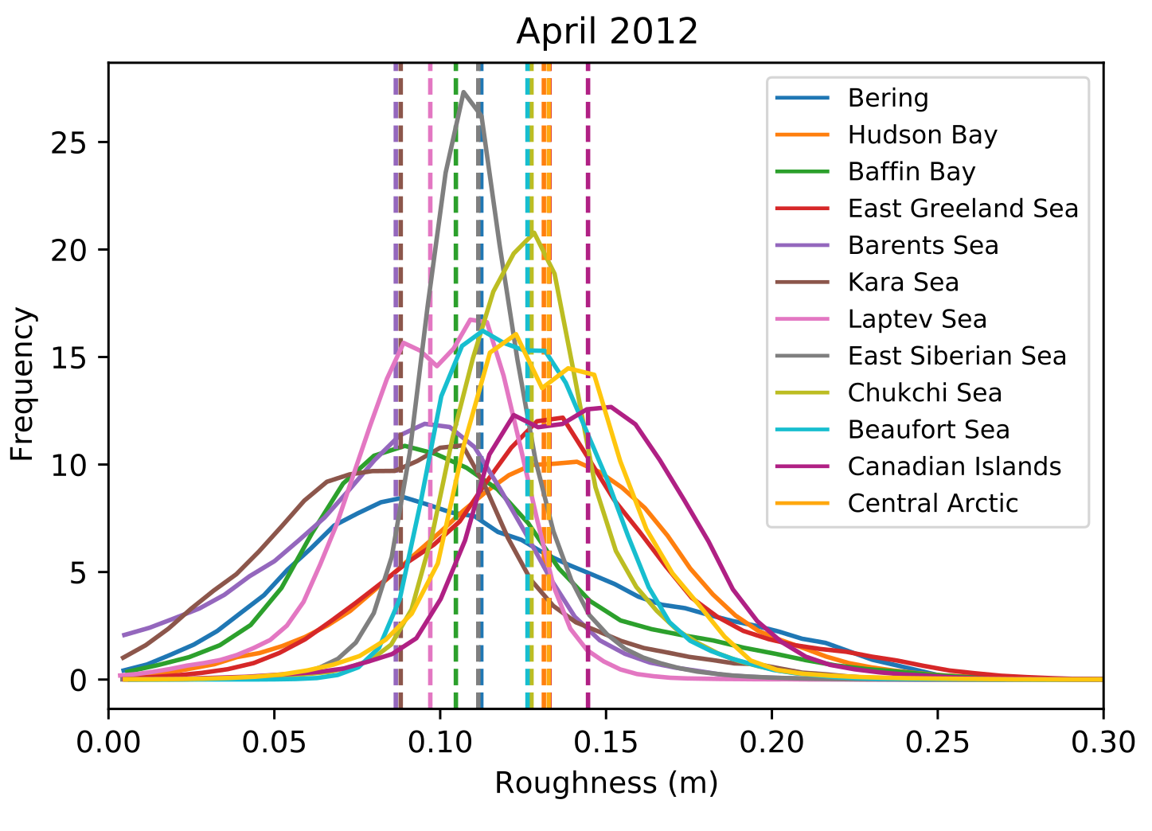
3. Results
Year | Mean | STD | Min | 25% | Median | 75% | Max
2011 | 0.122 | 0.030 | 0.012 | 0.103 | 0.123 | 0.138 | 0.501
2012 | 0.108 | 0.031 | 0.010 | 0.090 | 0.109 | 0.126 | 0.460
2013 | 0.107 | 0.027 | 0.013 | 0.089 | 0.105 | 0.124 | 0.443
2014 | 0.107 | 0.032 | 0.014 | 0.084 | 0.104 | 0.122 | 0.462
2015 | 0.118 | 0.034 | 0.014 | 0.094 | 0.114 | 0.136 | 0.503
2016 | 0.117 | 0.035 | 0.015 | 0.094 | 0.117 | 0.136 | 0.477
2017 | 0.111 | 0.032 | 0.016 | 0.089 | 0.110 | 0.131 | 0.507
2018 | 0.111 | 0.027 | 0.017 | 0.095 | 0.110 | 0.124 | 0.435
2019 | 0.109 | 0.033 | 0.010 | 0.086 | 0.107 | 0.128 | 0.522
A time series of roughness probability distribution statistics for April 2011 - 2019
A time series of roughness probability distribution functions for each Arctic regions in 2012

Slide 9
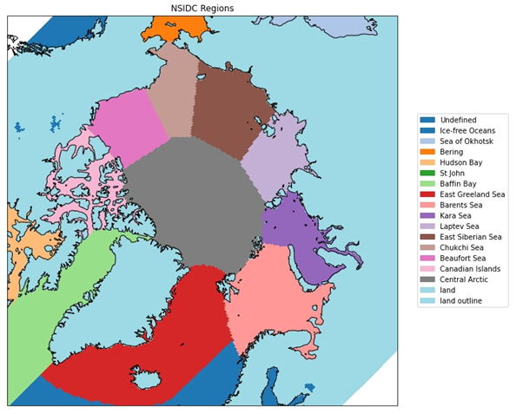
NSIDC Region Mask

Slide 10
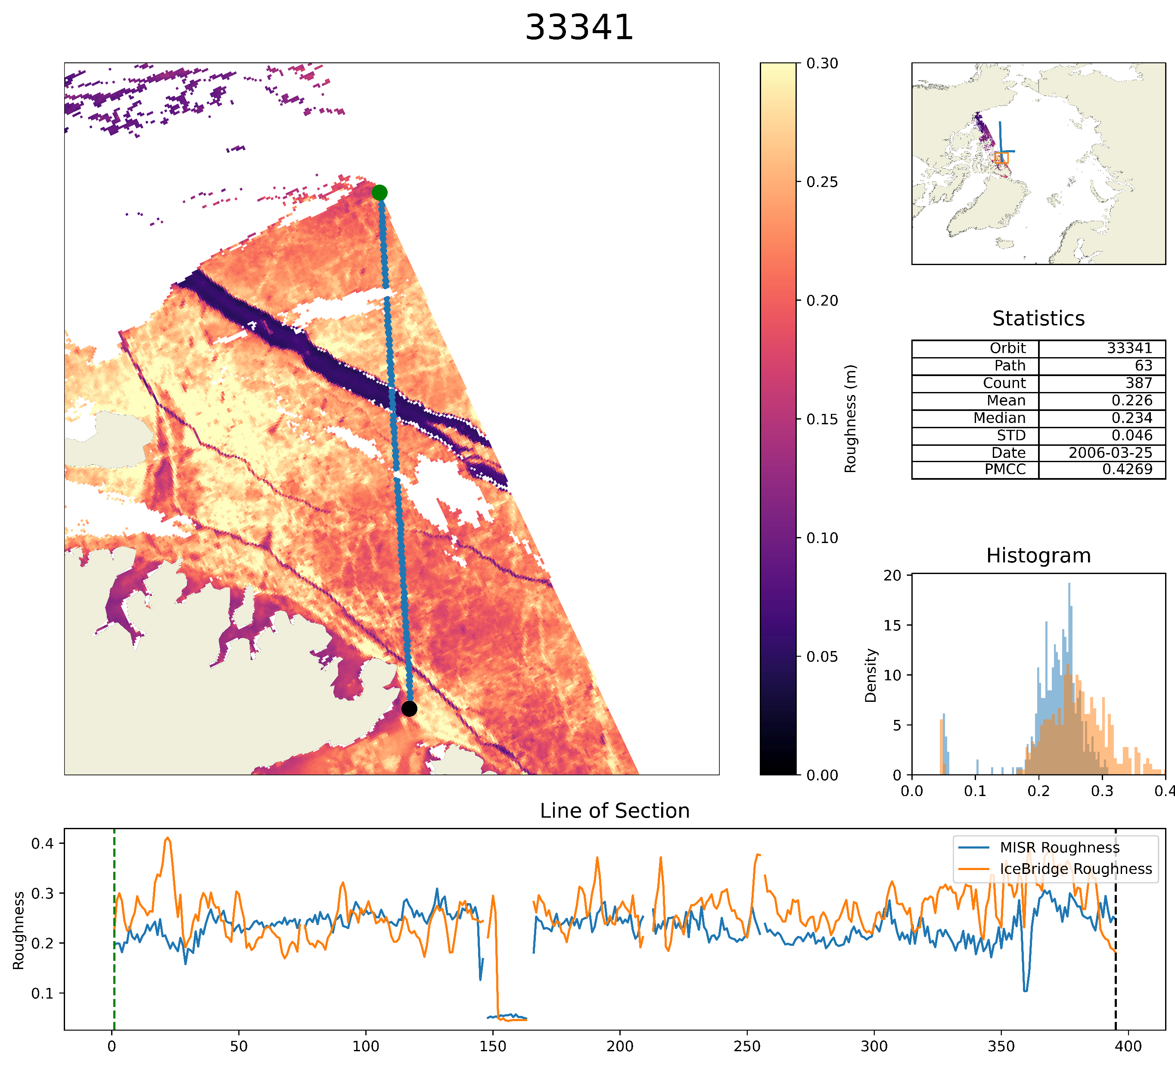
4. Validation (Swath Level)
Comparison with independent LiDAR elevations used to derive surface roughness from pre-IceBridge
Orbit | Path | Count | Mean Roughness (m) | Median Roughness (m) | Date | Time | PPMCC
33370 | 61 | 181 | 0.206 | 0.215 | 27/03/2006 | 20:09:07 | 0.61
33341 | 63 | 387 | 0.226 | 0.234 | 25/03/2006 | 20:21:29 | 0.43
33342 | 79 | 1220 | 0.150 | 0.129 | 25/03/2006 | 22:00:22 | 0.67
33313 | 81 | 2394 | 0.137 | 0.132 | 23/03/2006 | 22:12:43 | 0.37
33328 | 88 | 651 | 0.128 | 0.125 | 24/03/2006 | 22:55:59 | 0.71
33299 | 90 | 590 | 0.106 | 0.106 | 22/03/2006 | 23:08:21 | 0.69
33314 | 97 | 310 | 0.097 | 0.095 | 23/03/2006 | 23:51:36 | 0.58

Slide 11
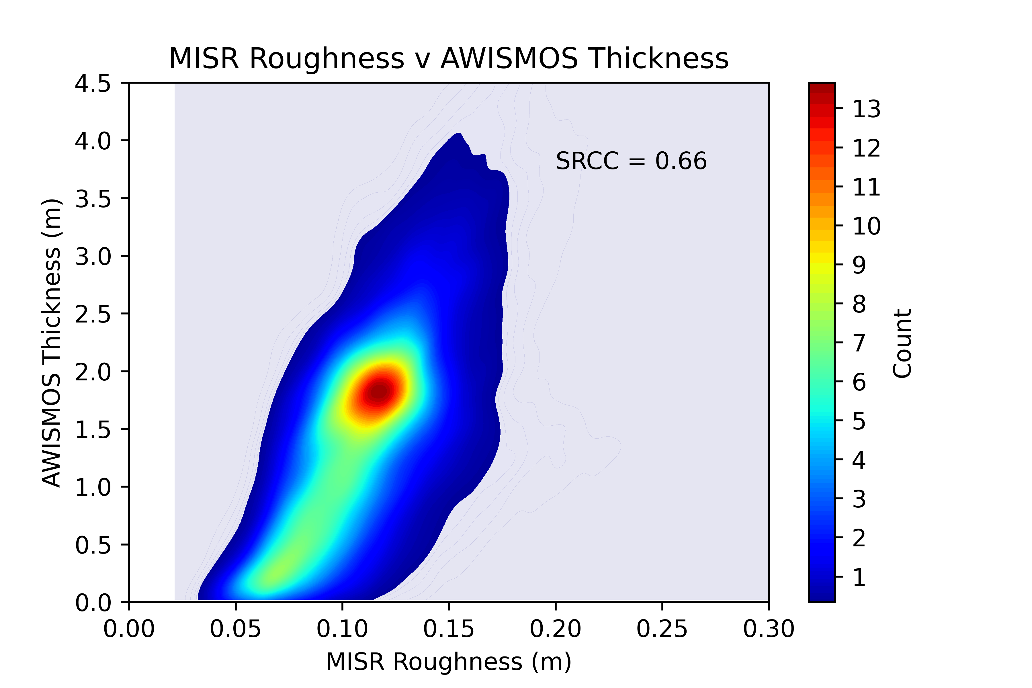
4. Validation (Pan-Arctic Level)
MISR Roughness aggregated to a 25km grid for comparison with AWISMOS*.
Comparisons for time period 01-15 April, 2011 – 2019 on a pan-Arctic basis
*Ricker, R. , Hendricks, S. , Kaleschke, L. , Tian-Kunze, X. , King, J. and Haas, C. (2017): A weekly Arctic sea-ice thickness data record from merged CryoSat-2 and SMOS satellite data , Cryosphere, 11 (4), pp. 1607-1623 . doi: 10.5194/tc-11-1607-2017

Slide 12
5. Conclusions
Generation of a novel algorithm to retrieve sea ice surface roughness from MISR via calibration of LiDAR elevation measurements from IceBridge.
High spatial (1.1km) and temporal resolution (~ 3 days) and multi-decadal archive (Spring only, 2000 onwards)
Future work: Overcome seasonality

