Slide 1
Change in Intensity-Duration-Frequency Curves with an Ensemble of
EA-CORDEX over Korea
SEJONG UNIVERSITY, Ph.D COURSE Jae-Ung YU¹
Sejong University, Seoul, Department of Civil & Environment Engineering, Korea, Jangwon Moon²
Sejong University, Seoul, Department of Civil & Environment Engineering, Korea, Yunsung Kim³
Corresponding Author, Sejong University, Seoul, Department of Civil & Environment Engineering, Korea, Hyun-Han Kwon⁴

Slide 2

CONTENTS
Introduction
Data
Methodology
Results

Slide 3
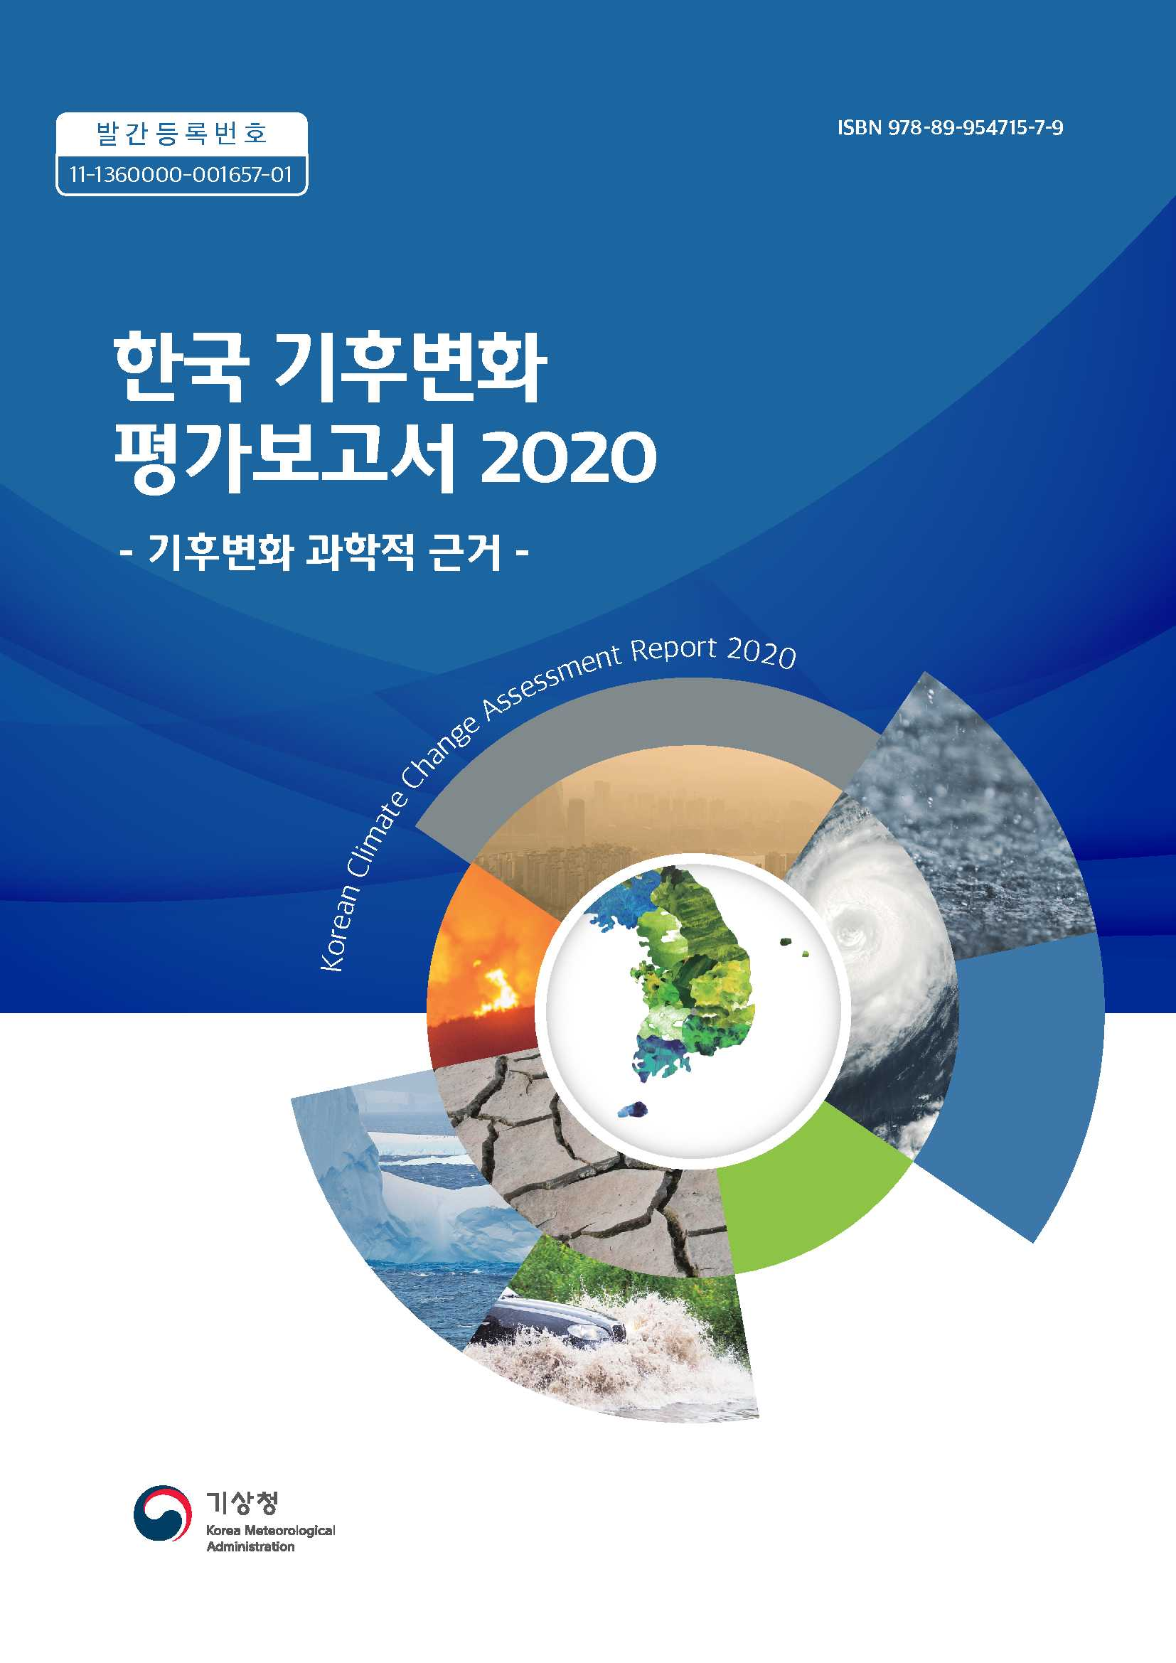

INTRODUCTION
Change In Intensity-Duration-Frequency Curves with an Ensemble of EA-CORDEX over Korea
Projection of Korean peninsula in climate change
Legal plans for water disasters in climate change
According to 『Korean Climate Change Assessment Report 2020』
Precipitation in summer season has been increased 11.6mm/decade.
Precipitation peaks in rainy season occurs more earlier.
Total precipitation, intensity and localized heavy rain has been increased in Korea
According to 『Projection of Korean Climate Change Report 2020』
The mean temperature and precipitation will be increased 2.6℃ and 3% in SSP1-2.6.
The mean temperature and precipitation will be increased 7.0℃ and 14% in SSP5-8.5.
The statute 『FRAMEWORK ACT ON WATER MANAGEMENT』 has only three provisions in Korea.
Article 18
Response to Climate Change
- The State and local governments shall minimize the vulnerabilities of water management caused by climate change and prepare water management measures to actively respond to climate change through restoration, etc. Of the water cycle
Article 27 (6)
Formulation, etc, of Master Plans for National Water Management
- Measures to respond to the vulnerabilities of management to climate change
Article 28 (5)
Formulation of Comprehensive Basin Water Management Plans
- Measures to respond to the vulnerabilities of basin water management to climate change

Slide 4
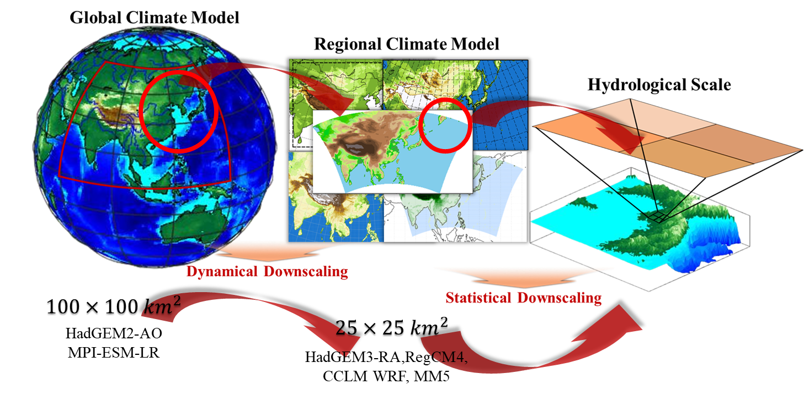
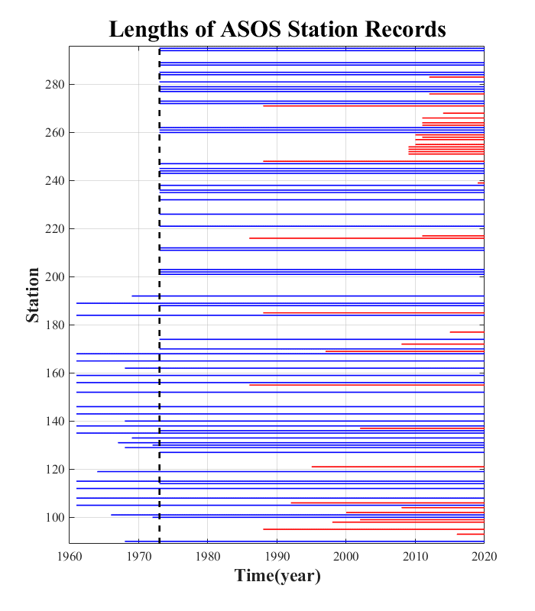
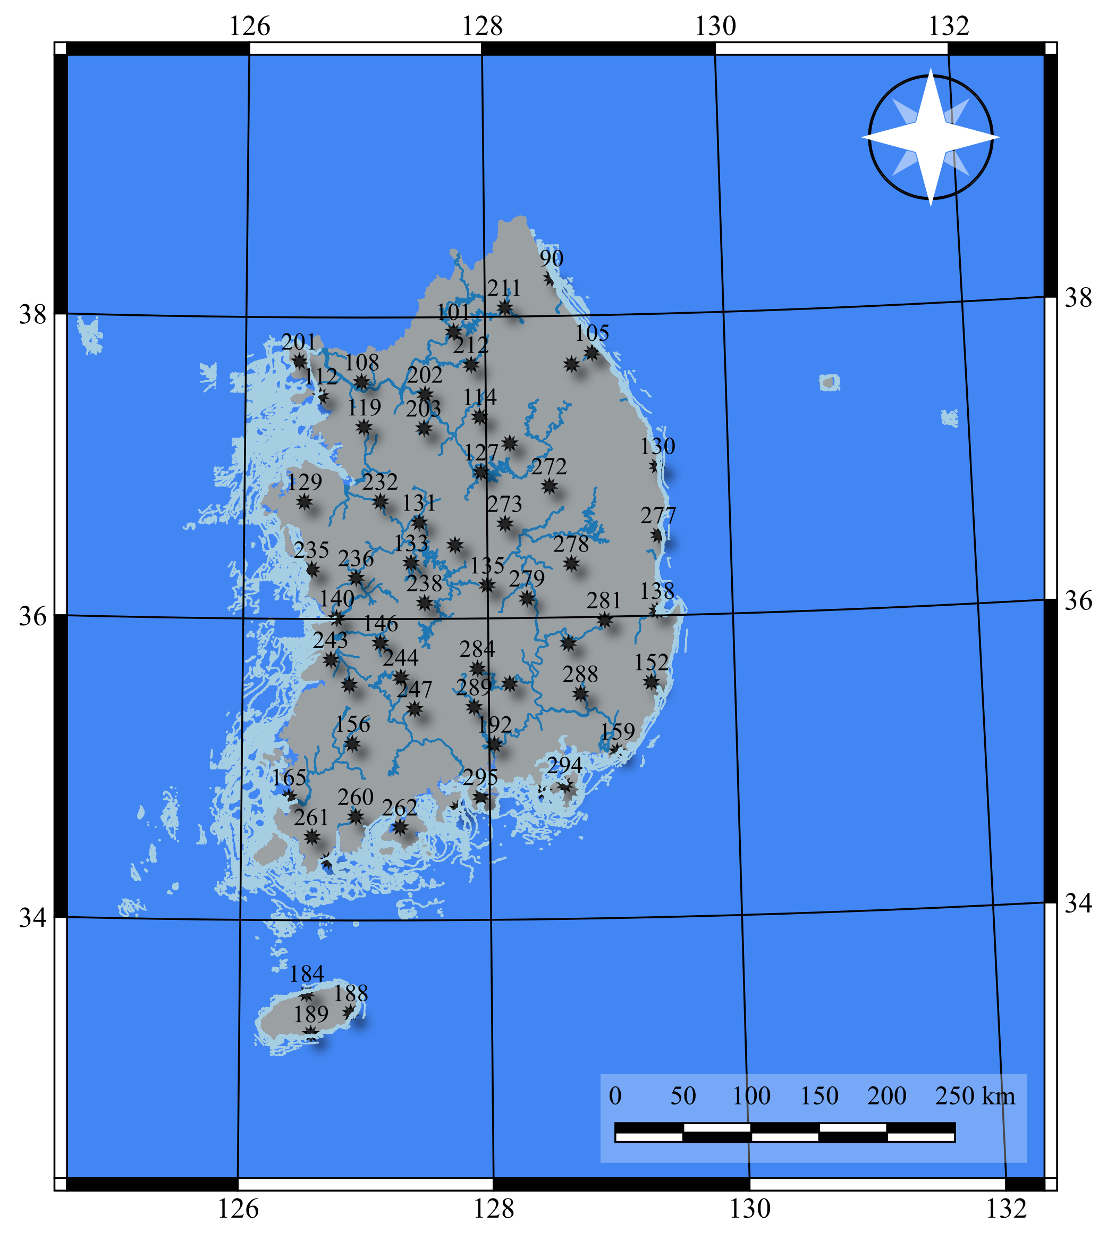
DATA
Change In Intensity-Duration-Frequency Curves with an Ensemble of EA-CORDEX over Korea
Climate change scenario is divided by GCMs and RCMs.
It is hard to use GCMs and RCMs data because of spatial-temporal size.
In East Asia, CORDEX-EA has performed dynamical downscaling and provided hydrological scale data.
CORDEX-EA Phase-2 consists of HadGEM3-RA, RegCM4, CCLM, WRF and MM5
24-hour annual maximum rainfalls are highly associated with d-duration AMRs
Hourly annual maximum rainfalls values were obtained from Automated Synoptic Observing System(ASOS) in Korea .
To acquire high-quality data of precipitation, this study gave two criterion.
- Criterion 1 : Whether Data prior to 1973 exist
- Criterion 2 : Whether the data has a long missing value

Slide 5
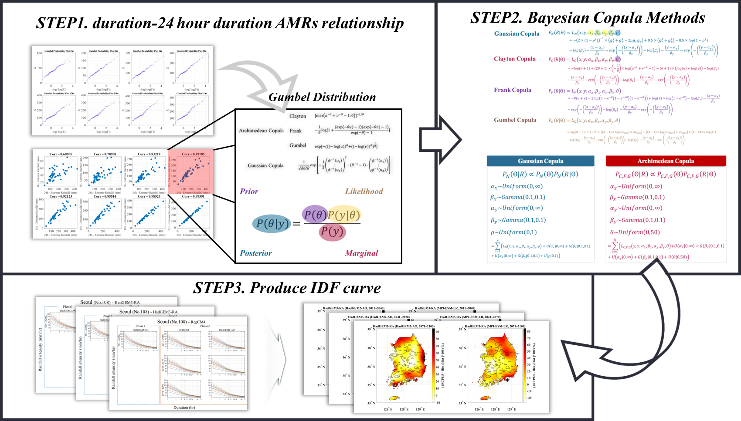

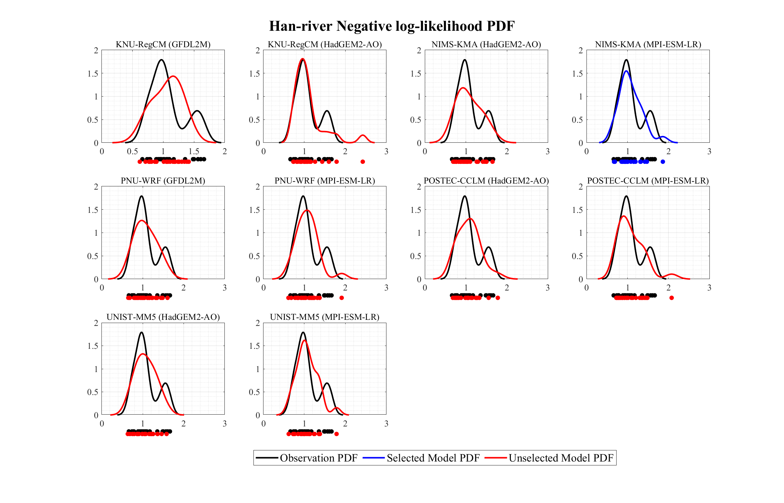
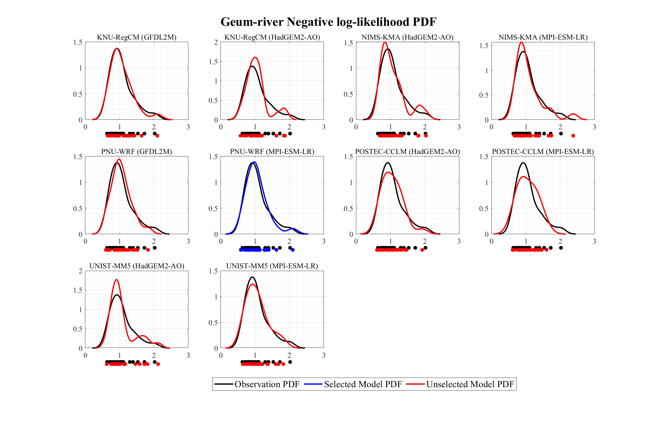
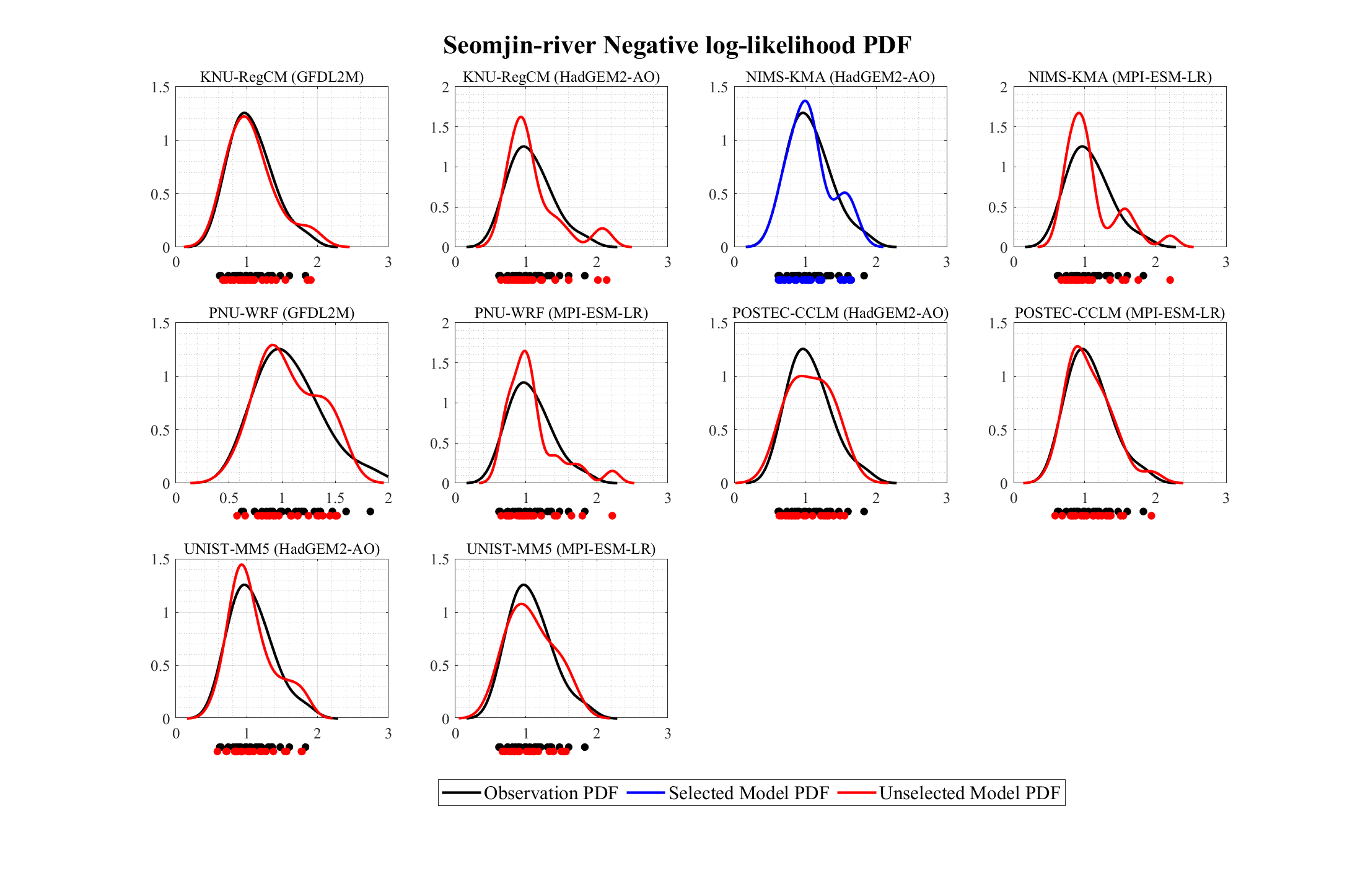
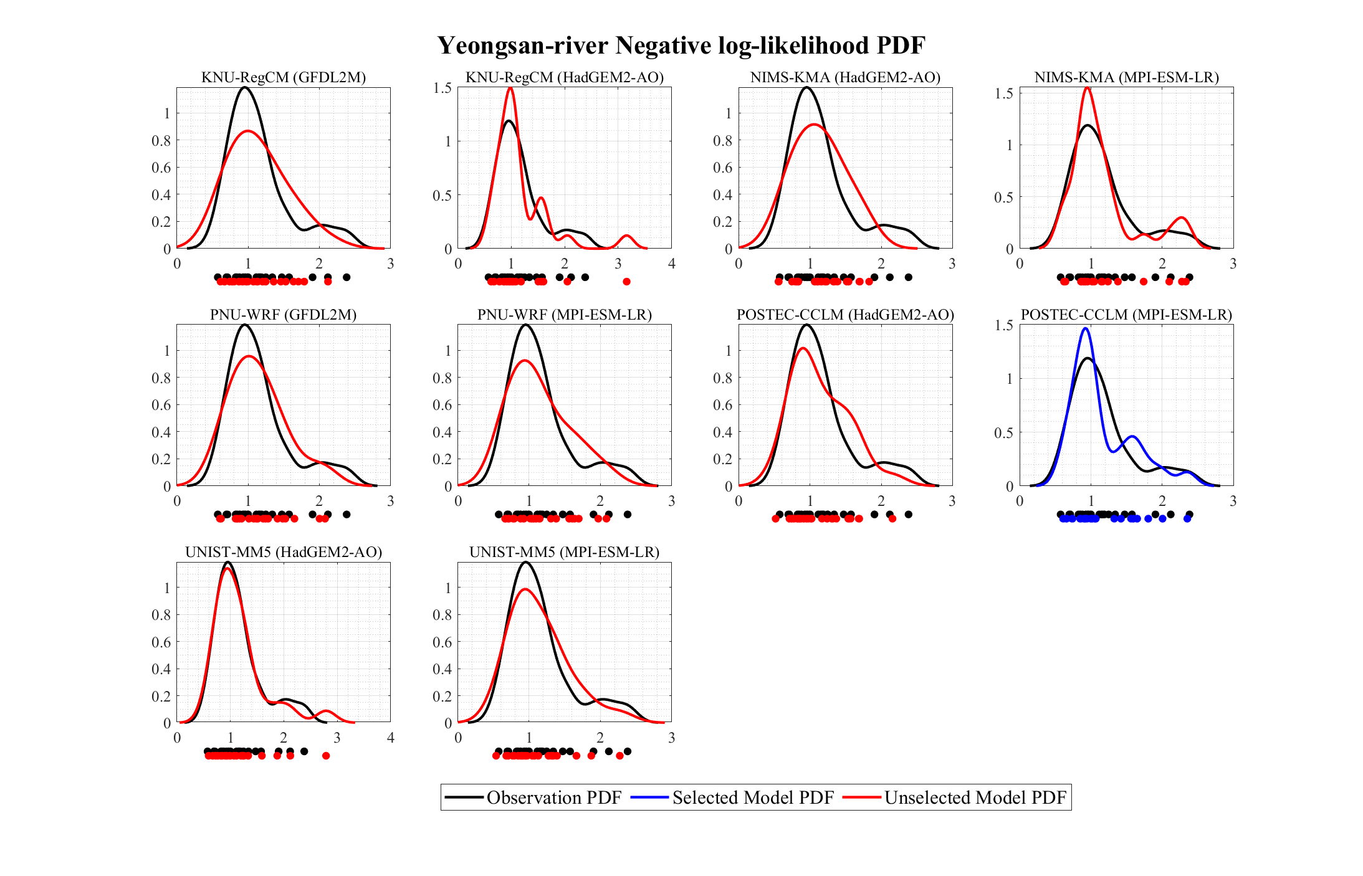
METHODOLOGY
Change In Intensity-Duration-Frequency Curves with an Ensemble of EA-CORDEX over Korea
Flowchart of Study
STEP4. Ranking Scenario
STEP5. Ensemble Model

Slide 6
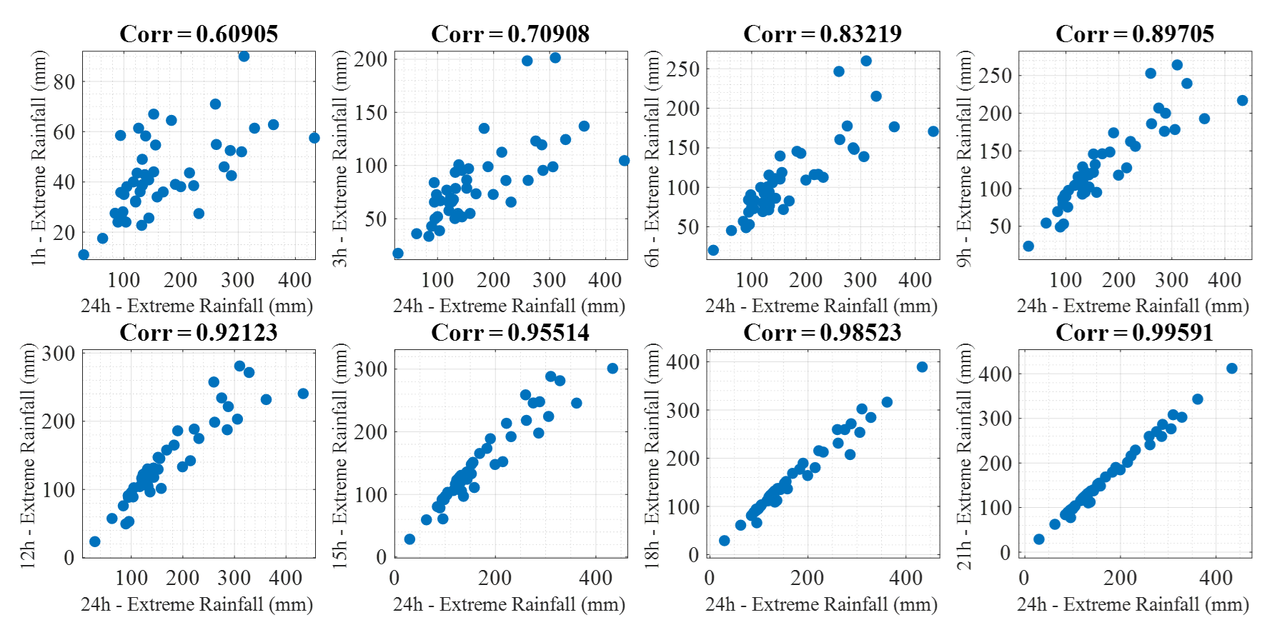
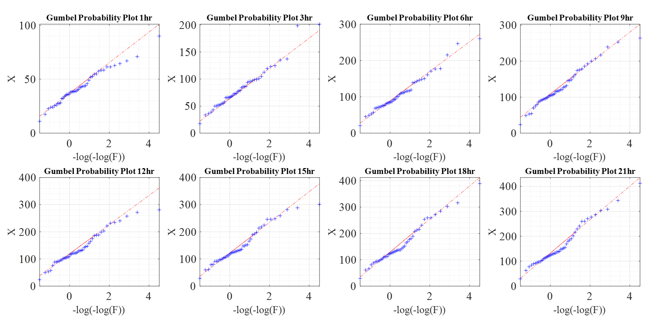
METHODOLOGY
Change In Intensity-Duration-Frequency Curves with an Ensemble of EA-CORDEX over Korea
STEP1. d-duration and 24 hour duration AMRs relationship
There are substantial relationship between the d-duration annual maximum rainfalls(AMRs) and 24-h AMRs.
The proposed approach is primarily based on the conditional copula function with extreme distributions(Gumbel, Weibull and GEV distributions)
Gumbel distributions are generally selected based on Bayesian Information Criterion(BIC).
The linear relation between the d-duration AMRs and 24-h AMRs is accentuated.

Slide 7
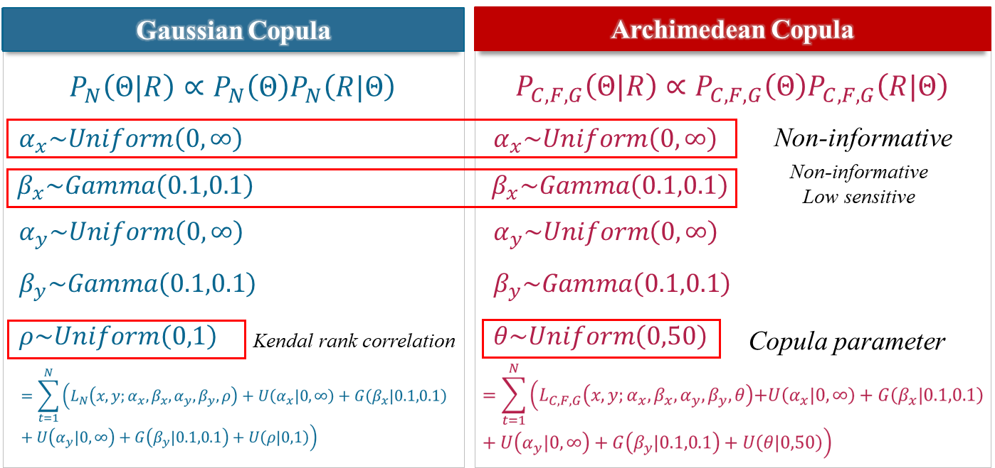
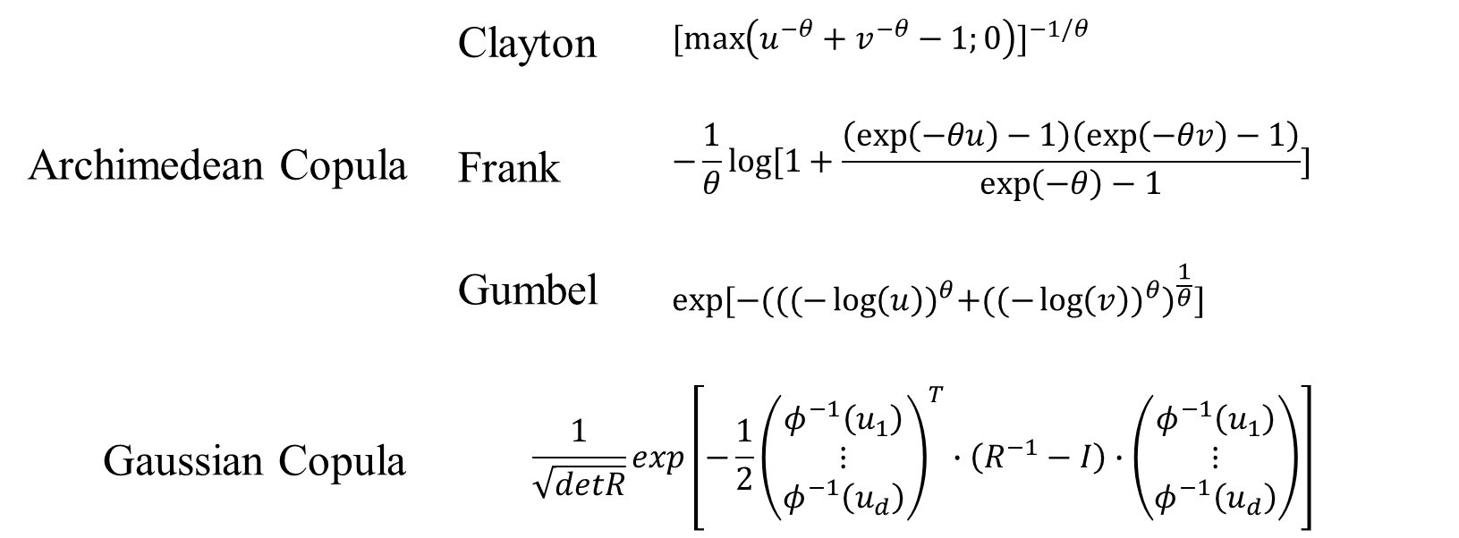
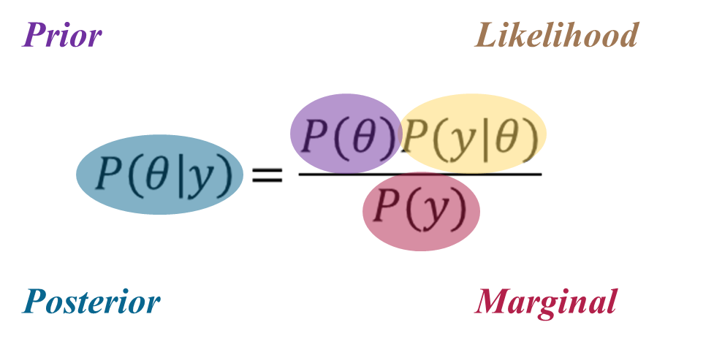
METHODOLOGY
Change In Intensity-Duration-Frequency Curves with an Ensemble of EA-CORDEX over Korea
STEP2. Bayesian Copula Methods
In this study, we initially considered three commonly used Archimedean copula(Clayton, Frank, and Gumbel copula) and one elliptical class of copula(Gaussian copula).
The joint log-likelihood function for the d-duration AMRs and 24-h AMRs based on the Gaussian, Clayton, Frank and Gumbel copula functions, along with the Gumbel distributions.

Slide 8
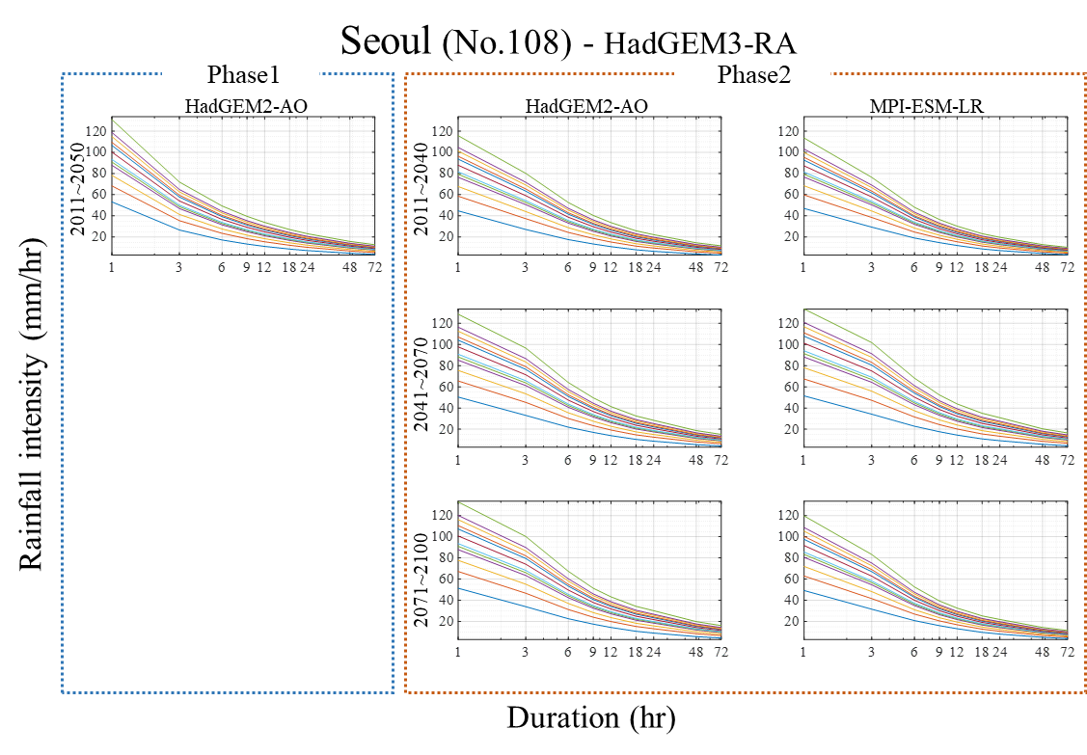
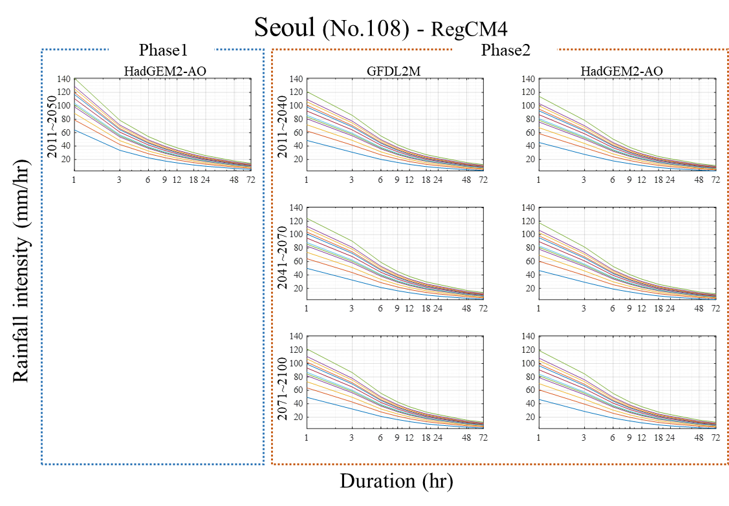
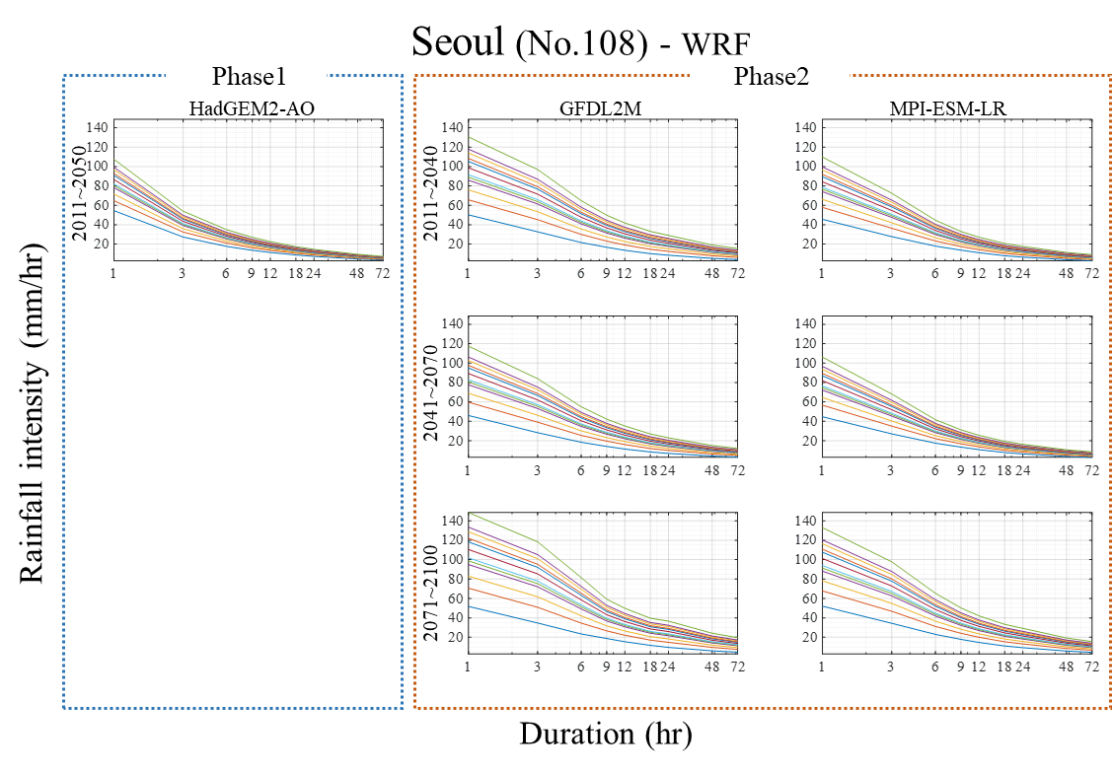
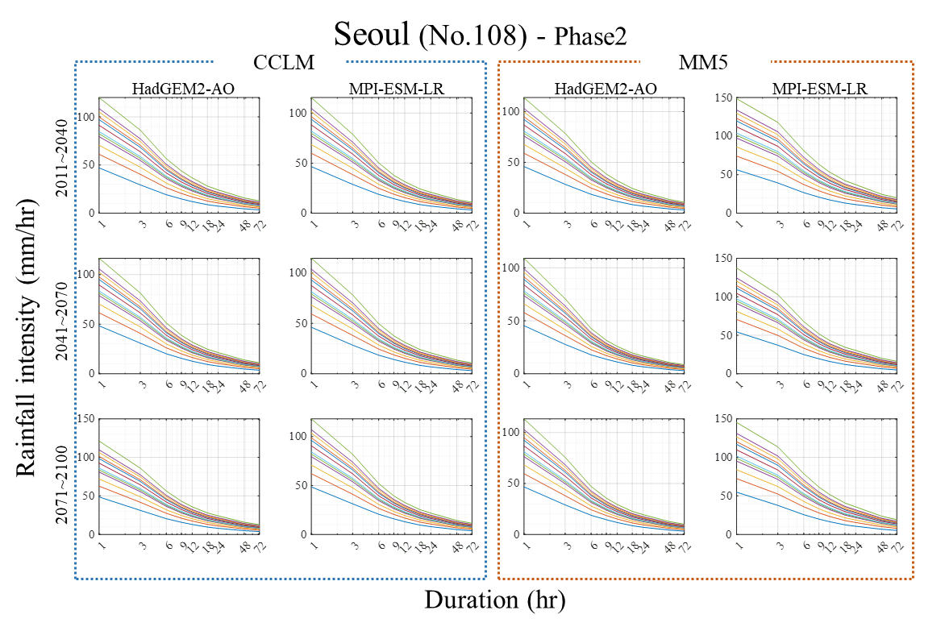
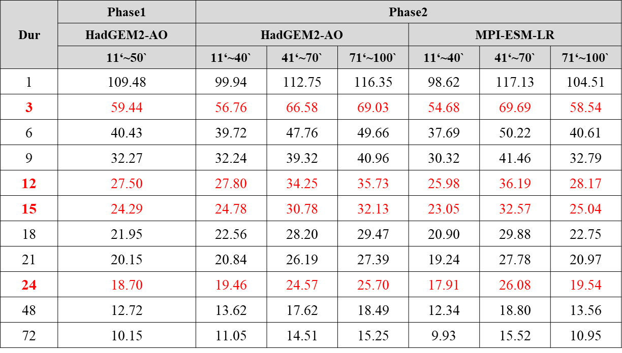
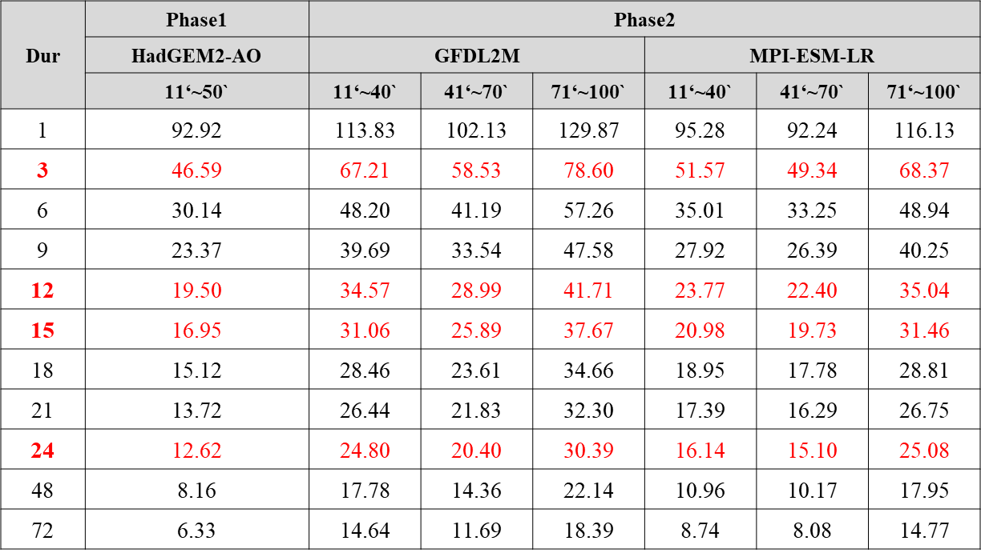
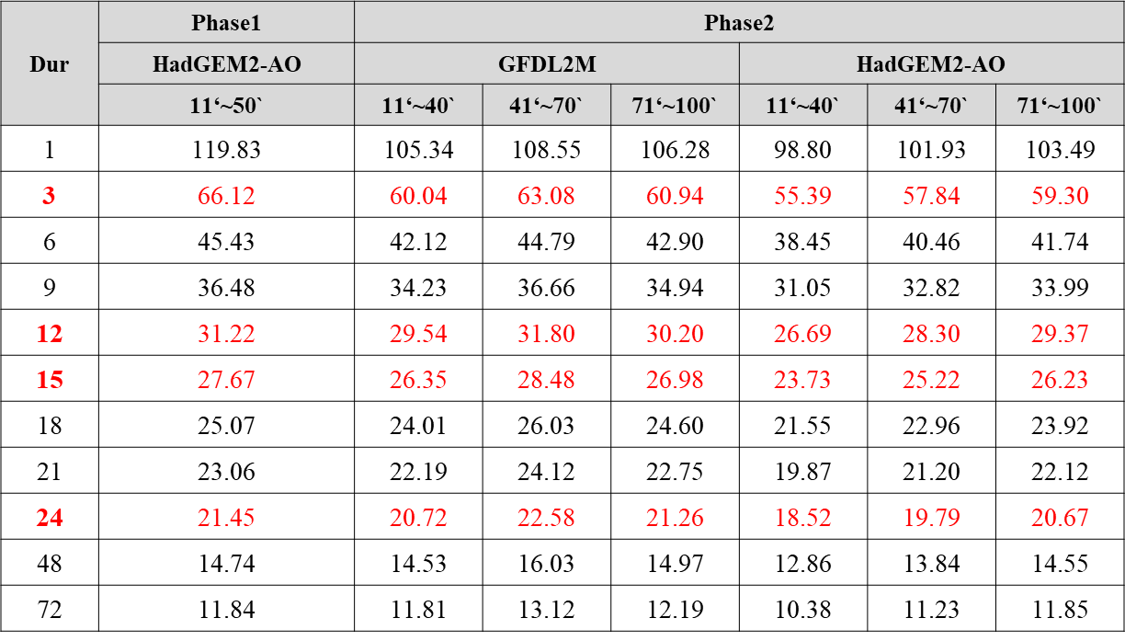
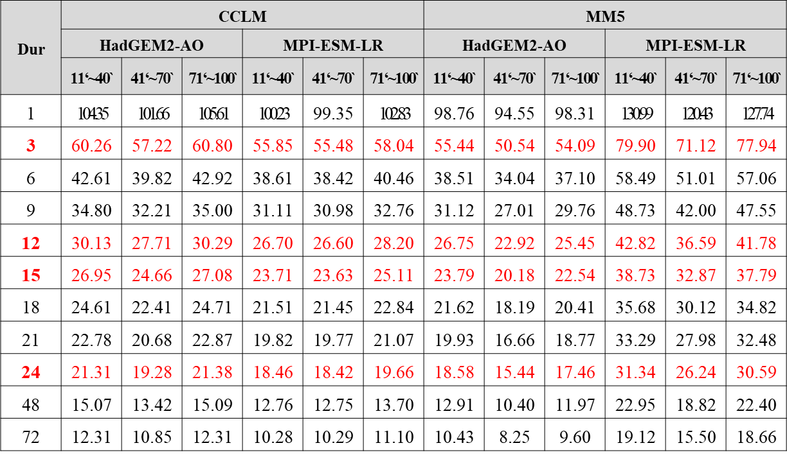
Methodology
Change In Intensity-Duration-Frequency Curves with an Ensemble of EA-CORDEX over Korea
STEP3. Produce IDF curves
The simulated IDF curves are somewhat different for each of the RCMs.
In HadGEM3-RA, Intensity based on HadGEM2-AO increased between 2011 to 2100, however, Intensity based on MPI-ESM-LR increased until 2070 but decreased slightly in 2100.
These characteristics are shown in RCMs in all models.

Slide 9
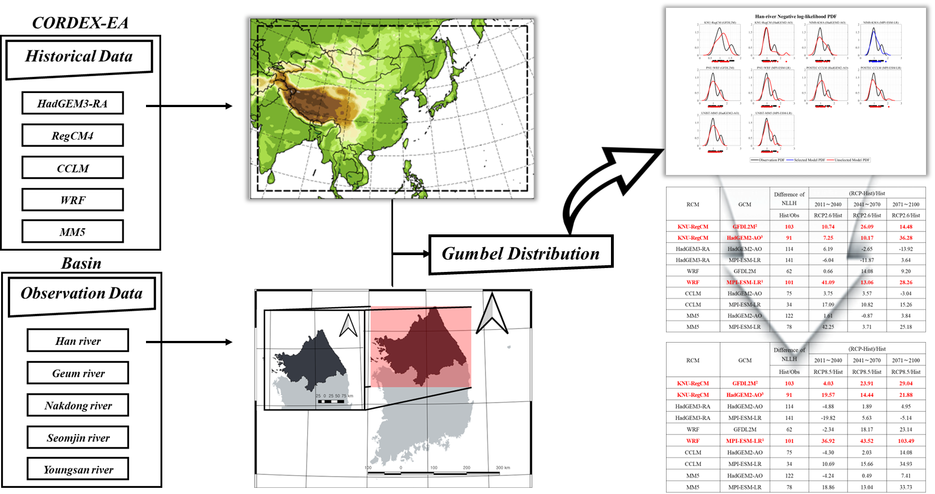
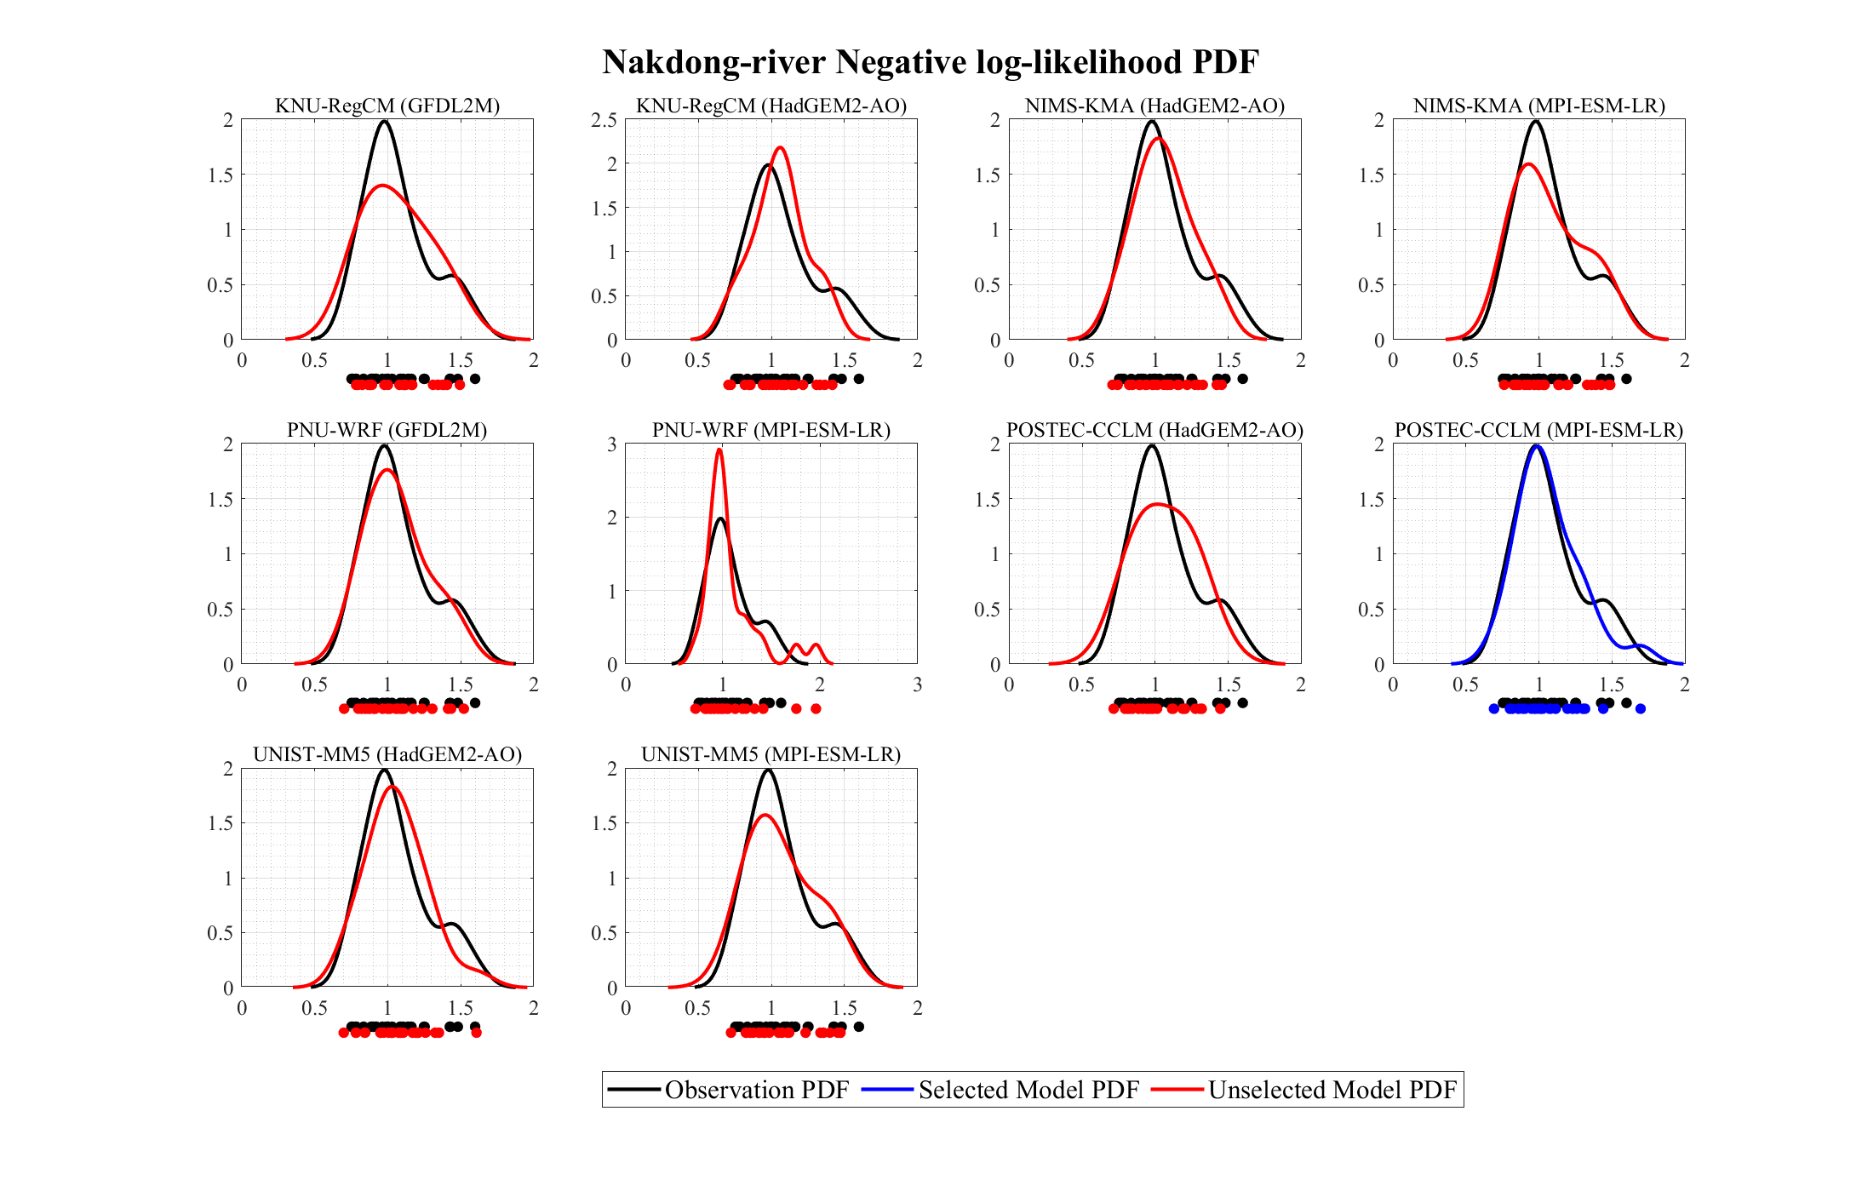
Methodology
Change In Intensity-Duration-Frequency Curves with an Ensemble of EA-CORDEX over Korea
STEP4. Ranking Scenarios
Past performance approach is comparison between observation and historical data which is proposed for the ranking of Regional Climate Models
This approach compares a probability density function(PDF) of AMRs data against all models to see which ones reproduce the value best.

Slide 10
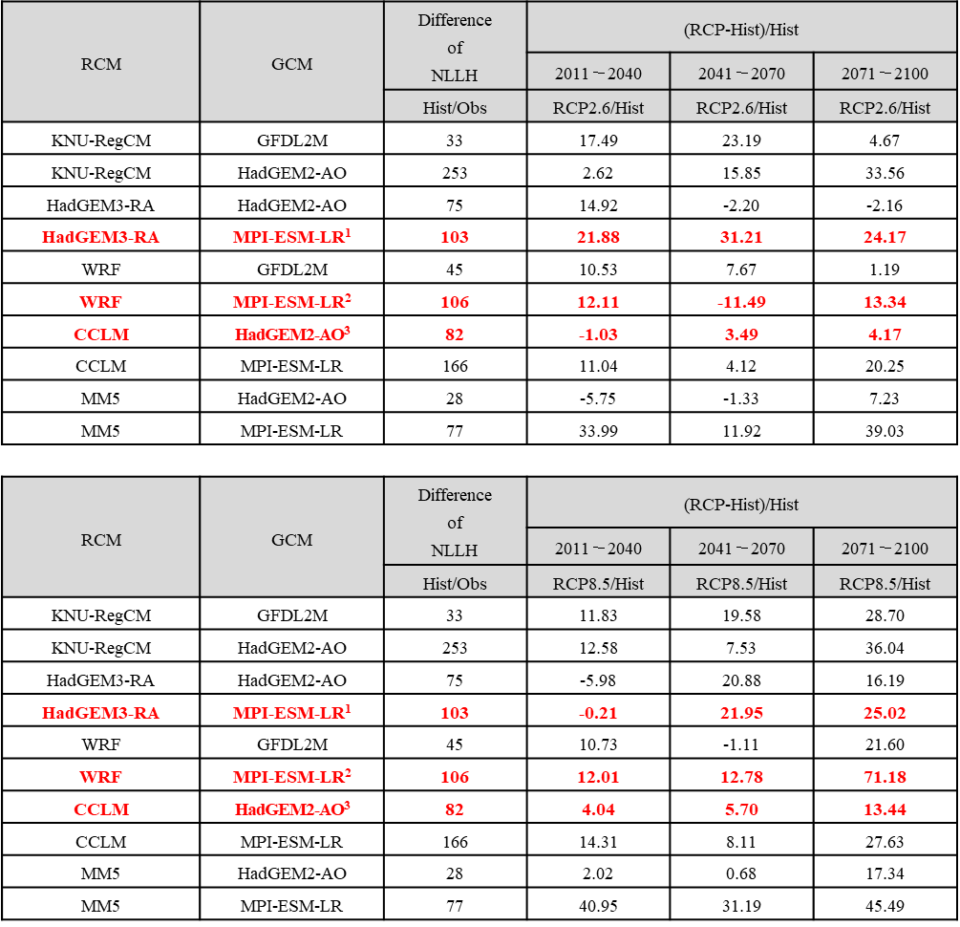
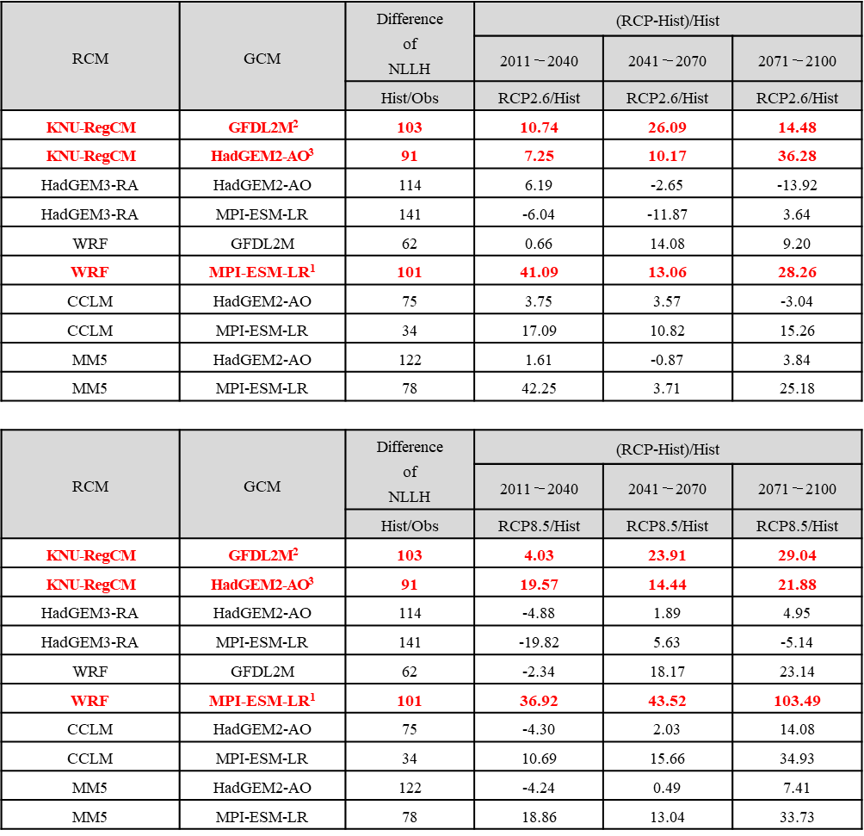
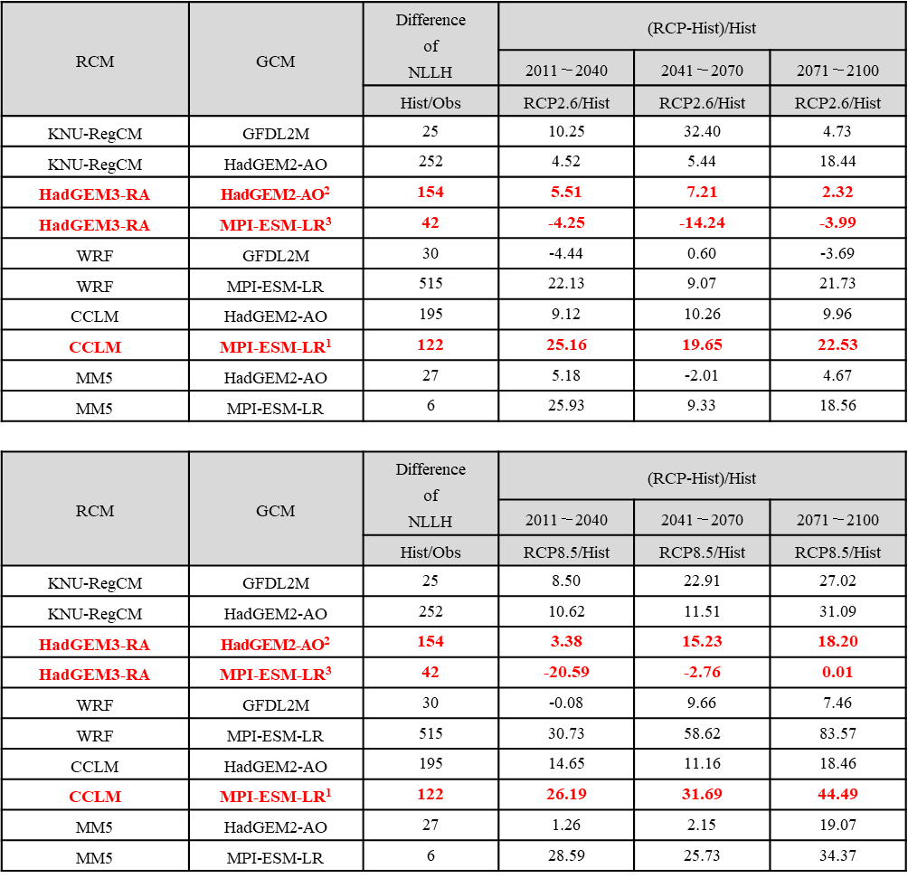
RESULTS
Change In Intensity-Duration-Frequency Curves with an Ensemble of EA-CORDEX over Korea

Slide 11
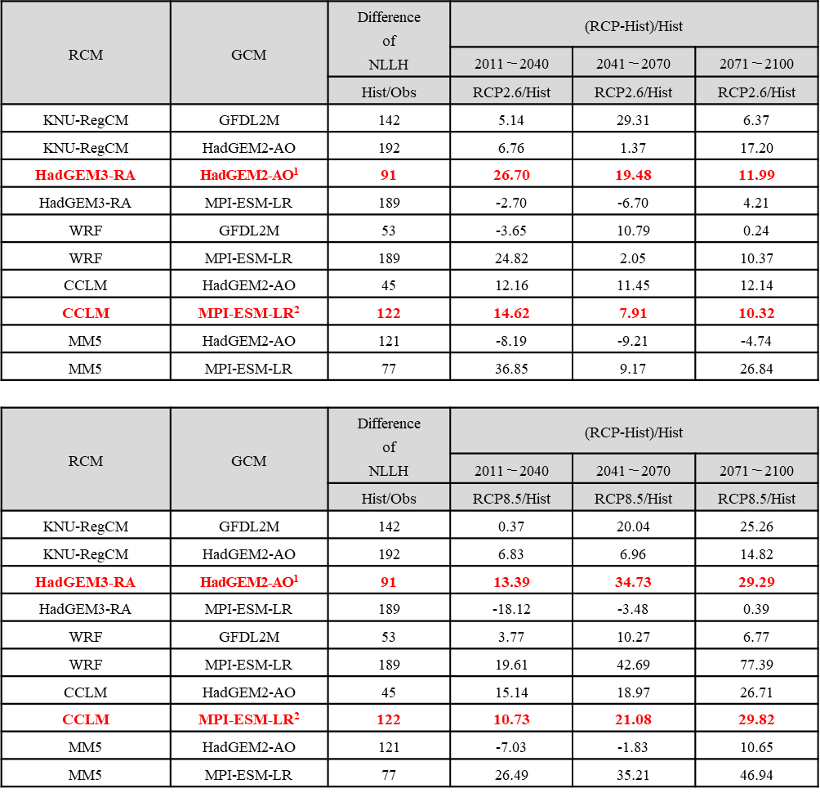
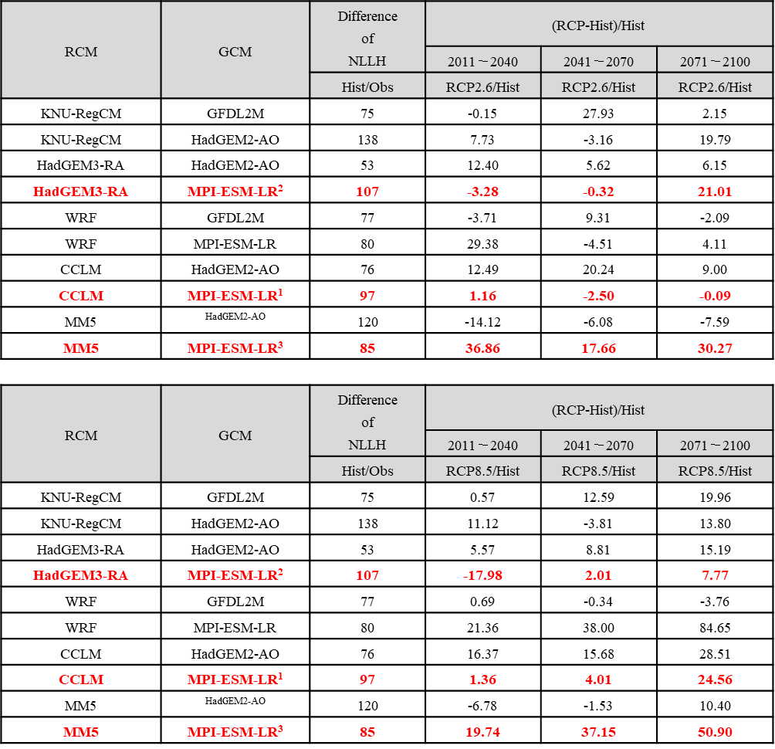
RESULTS
Change In Intensity-Duration-Frequency Curves with an Ensemble of EA-CORDEX over Korea

Slide 12
RESULTS
Change In Intensity-Duration-Frequency Curves with an Ensemble of EA-CORDEX over Korea
STEP5. Construct Ensemble Model
By weighting RCMs, IDF curves are constructed to consider future rainfall changes.
IDF curves have shown different features short period(2011-2040), medium period(2041-2070), and long period(2071-2100)
The intensity of rainfall is assessed as weaker than past in some models and the characteristics of RCMs are different.
2011~2040 RCP2.6 IDF Curve
2041~2070 RCP2.6 IDF Curve
2071~2100 RCP2.6 IDF Curve

Slide 13
RESULTS
Change In Intensity-Duration-Frequency Curves with an Ensemble of EA-CORDEX over Korea
STEP5. Construct Ensemble Model
By weighting RCMs, IDF curves are constructed to consider future rainfall changes.
IDF curves have shown different features short period(2011-2040), medium period(2041-2070), and long period(2071-2100)
The intensity of rainfall is assessed as weaker than past in some models and the characteristics of RCMs are different.
2011~2040 RCP8.5 IDF Curve
2041~2070 RCP8.5 IDF Curve
2071~2100 RCP8.5 IDF Curve

