Slide 1


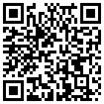





How are snowmelt rates changing across climates? Insights from a new Northern Hemisphere SWE dataset
Adrià Fontrodona-Bach¹, Josh Larsen¹, Ross Woods², Bettina Schaefli³, Ryan Teuling⁴
¹ School of Geography, Earth and Environmental Sciences, University of Birmingham, UK
² Department of Civil Engineering, University of Bristol, UK
³ Institute of Geography, University of Bern, Switzerland
⁴ Hydrology and Quantitative Water Management group, Wageningen University, The Netherlands
axf984@bham.ac.uk
@Fontro22
EGU General Assembly 2022 HS2.1.5, From snow and glacier hydrology to catchment runoff

Slide 2
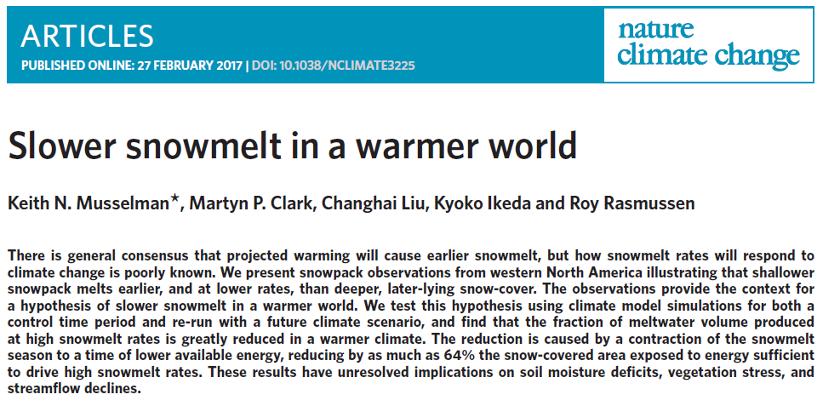
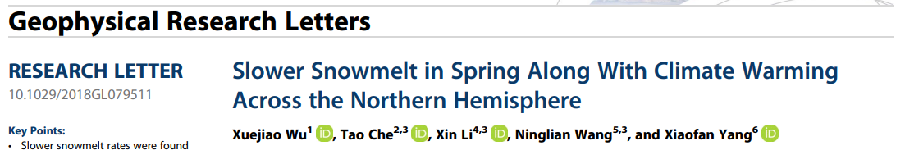
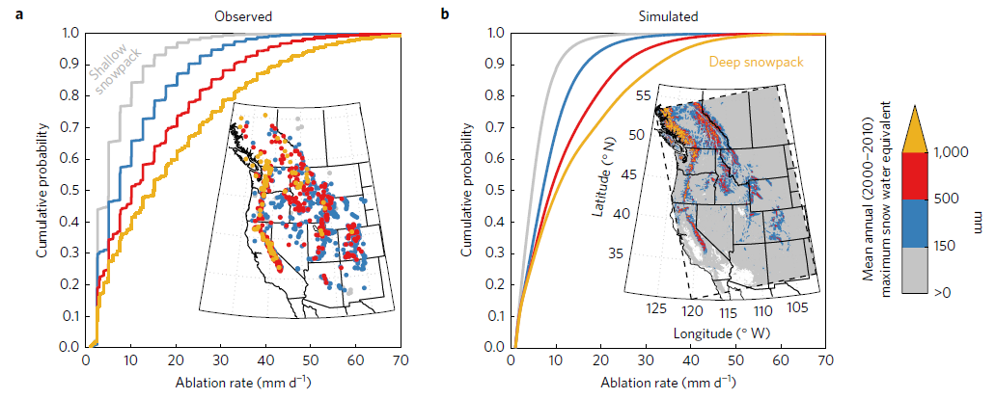
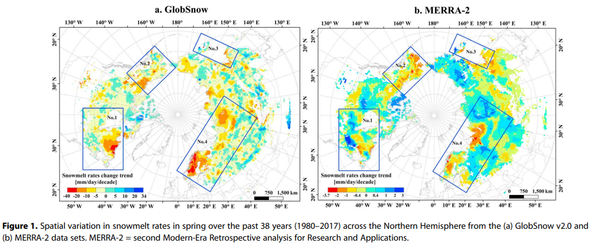
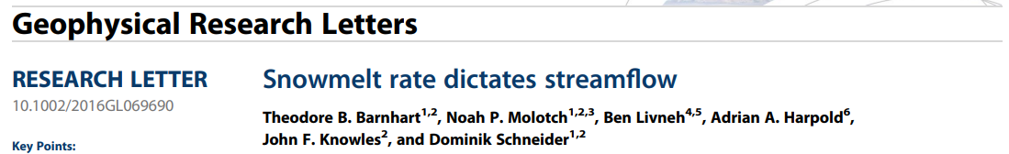
What do we know about snowmelt rates and global warming?
Wu et al., 2018
Musselman et al., 2017
Why do we want to know more?
Barnhart et al., 2016

Slide 3
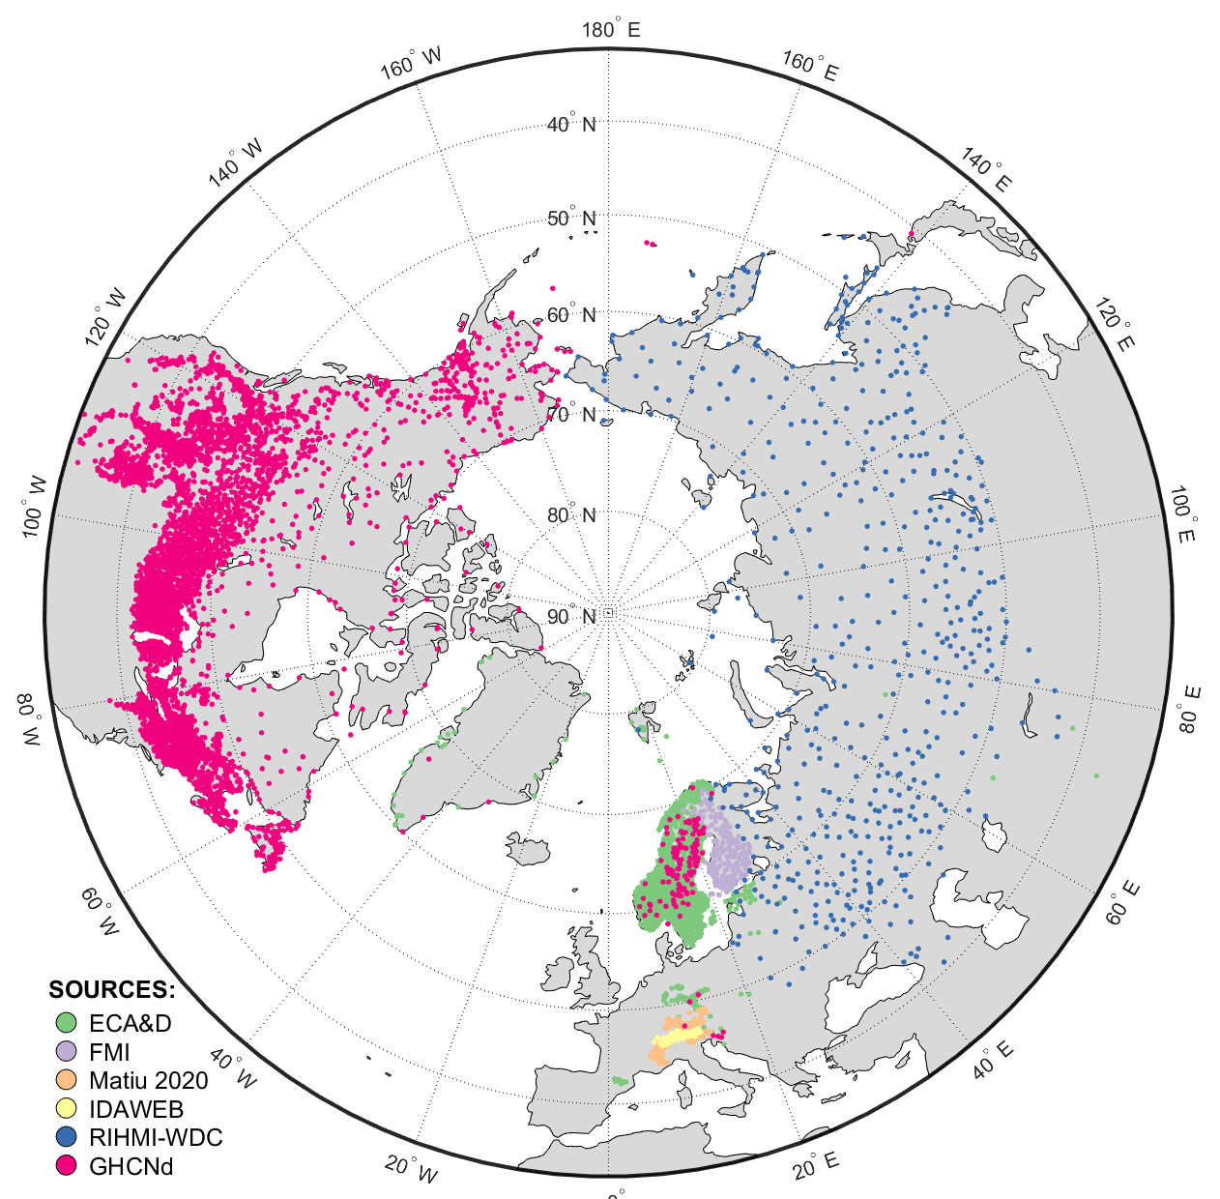
How can we know more?
Northern Hemisphere snow depth data compilation:
6 data sources (open data)
> 10.000 sites
Varying time series length (1-72 complete years)
Conversion from daily Snow depth to daily SWE
with the DeltaSNOW model (Winkler et al. 2021)
First Northern Hemisphere SWE dataset from “real” in-situ snow data
Dataset will be published
and available (in preparation)
Fontrodona-Bach et al. (in prep.)

Slide 4
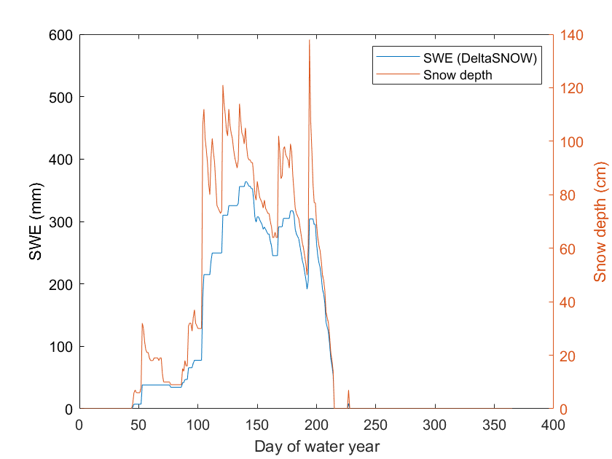
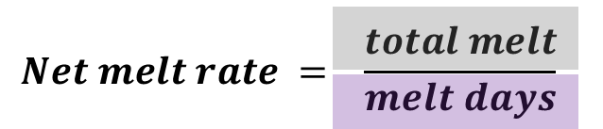
Why do we need SWE for snowmelt rates?
Snow density not known with depth
Snow metamorphism ≠ Snowmelt
Different peak depth than peak SWE
(after peak SWE)
Computation of annual melt rate and Sen Slope trends for 3,890 sites with more than 30 years of data

Slide 5
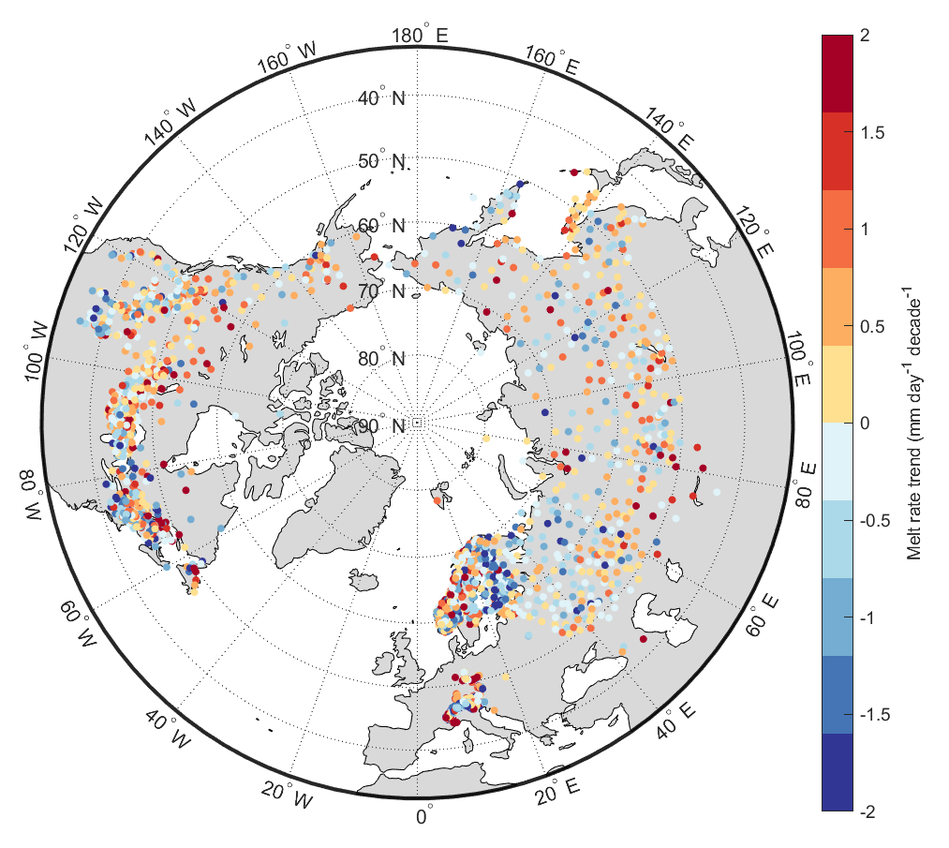
How are snowmelt rates changing across climates?
Spatial variability in melt rate trends (1979-2021)
Region and average trend in snowmelt rate | mm day⁻¹ decade⁻¹
Finland | -0.7
Norway (peakSWE > 200 mm) | -0.4
Norway (peakSWE < 200 mm) | -0.06
Russia ( > 60 ⁰N ) | -0.15
Russia ( < 60⁰N ) | +0.13
European Alps ( < 1500 m ) | +0.02
European Alps ( > 1500 m ) | -0.31
USA (SNOTEL dataset) | -0.47
Canada | +0.15
Fontrodona-Bach et al. (in prep.)

Slide 6
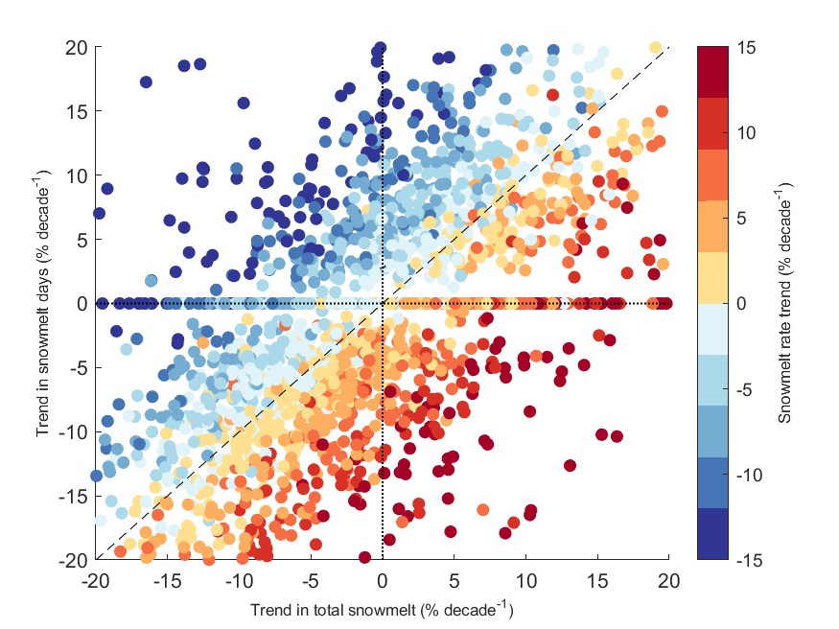
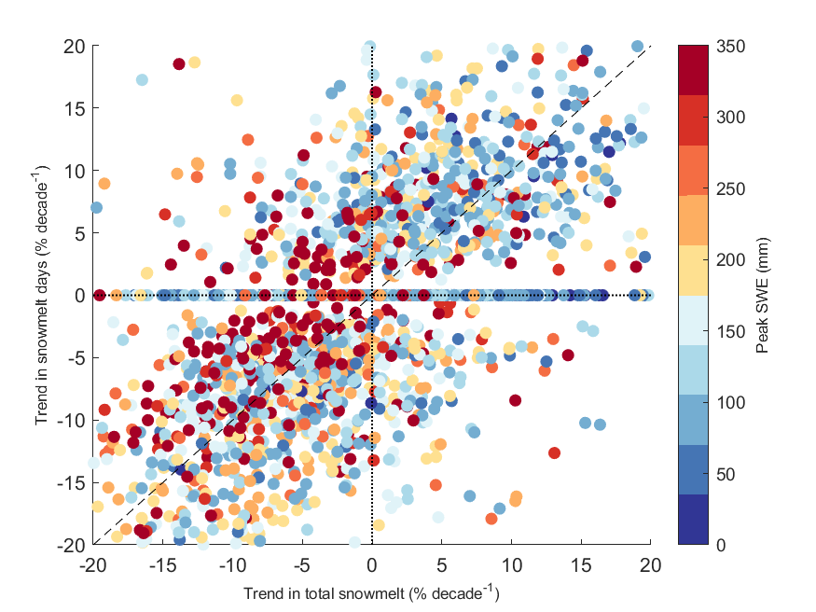
Insights into variability
Slower melt
Deep, depleted snowpacks
Faster melt
Fontrodona-Bach et al. (in prep.)

Slide 7
Thank you for your attention!
Do you want to know more?
Check the papers when published ☺
Come to IAHS Conference next week (15 min presentation)
Talk to me any time this week
Send me an e-mail: axf984@bham.ac.uk
Follow me on twitter: @Fontro22
Notes:
Daily T and P for stations – Ross Model to obtain SWE too?
Classify snowpacks with Ross’ Model

Slide 8
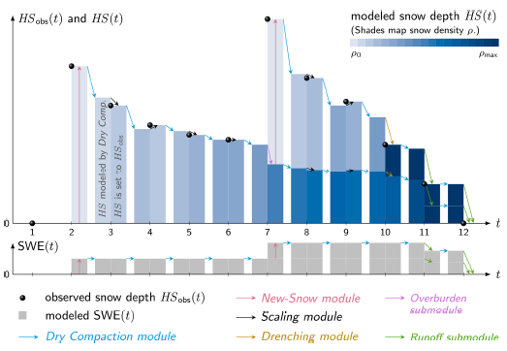
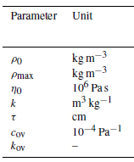
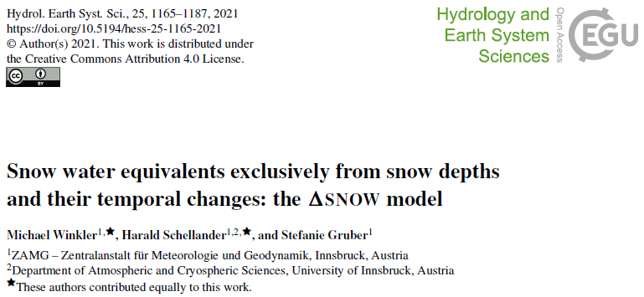
Method: Converting snow depth to snow water equivalent
DeltaSNOW model
(Winkler et al. 2021)
Intended to convert time series
Snow height only input
Calibrated for Alpine snowpacks
Requires recalibration of parameters

