Slide 1



Modern hotspot-influenced MORBs reveal anoxic conditions during deposition and subduction of recycled Proterozoic sediments in their source EGU General Assembly 2022
Qasid Ahmad, Martin Wille, Carolina Rosca, Jabrane
Labidi, Timothy Schmid, Klaus Mezger, Stephan König

Slide 2
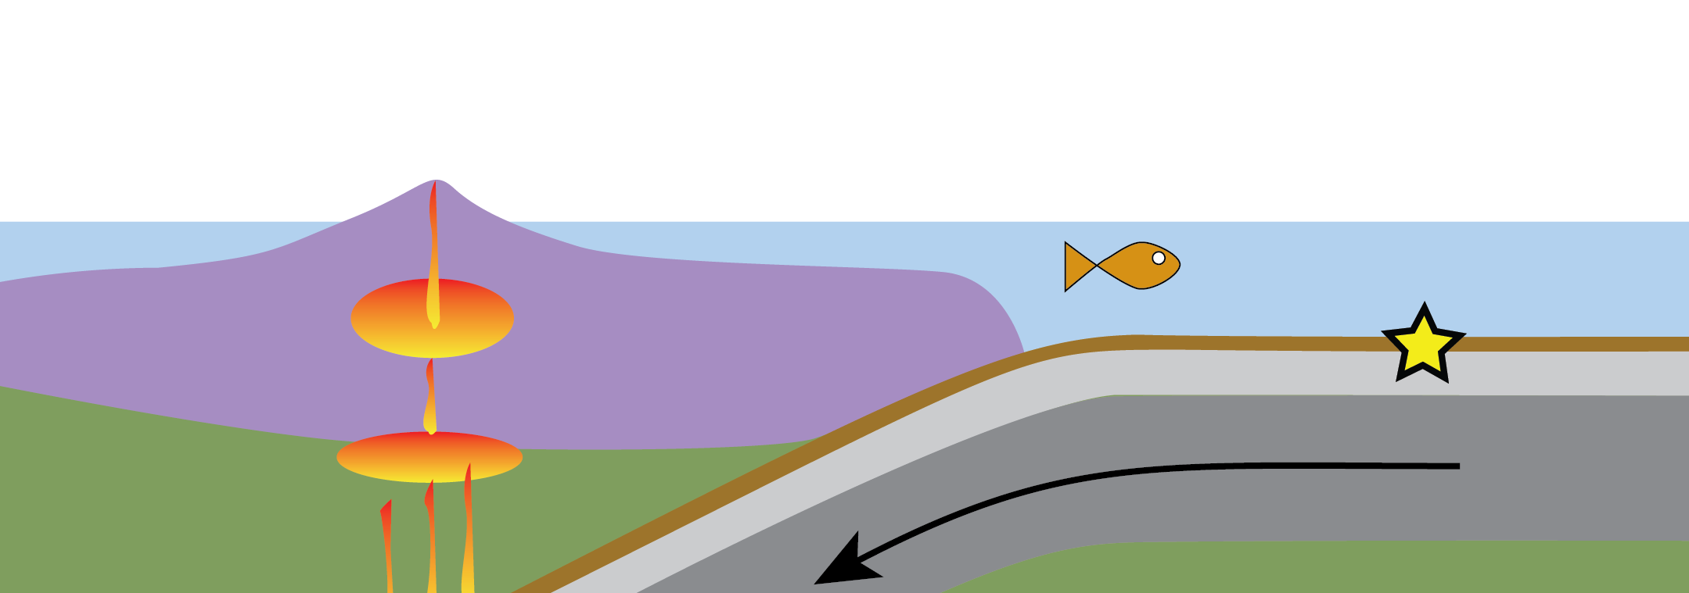
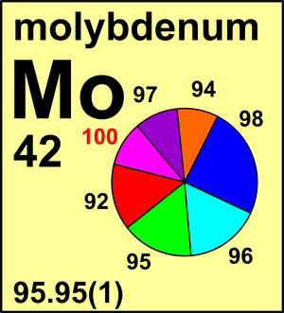
Mo mobility during subduction
Release of Mo occurs during slab dehydration (+melting) due to prograde subduction metamorphism
Mobility of Mo is strongly influenced by fO₂
Metamorphic minerals incorporate preferentially light Mo in the subducted slab
→ How do (anoxic) subducted lithologies over Earth‘s history influence the δ^{98/95}Mo of the deep mantle sources?
heavy Mo (high δ^{98/95}Mo)
light Mo (low δ^{98/95}Mo)
CIAAW
2

Slide 3
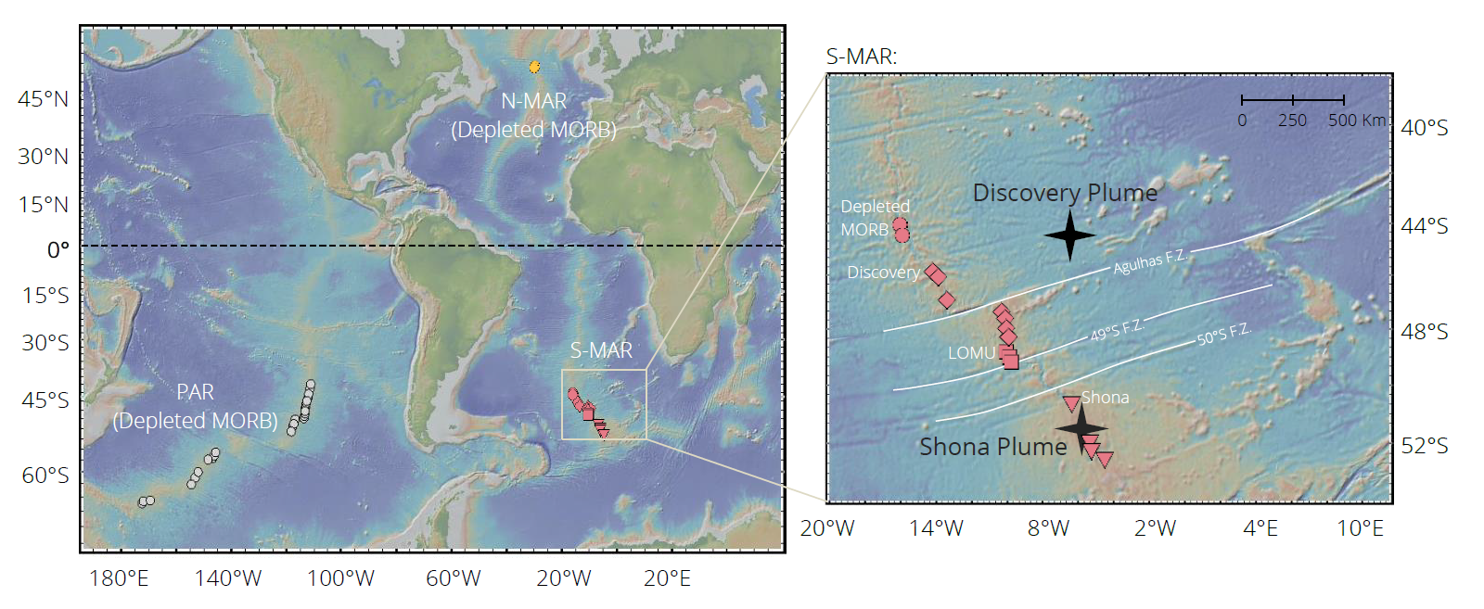
Study site
MORBs influenced by Shona and Discovery Plume
Yierpan et al., (2020)

Slide 4
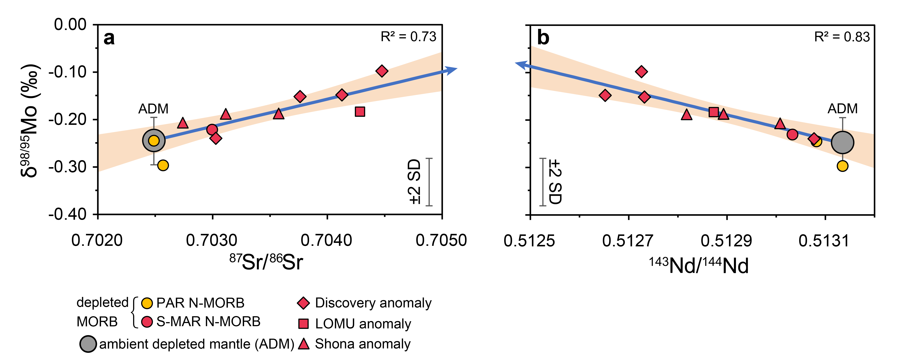
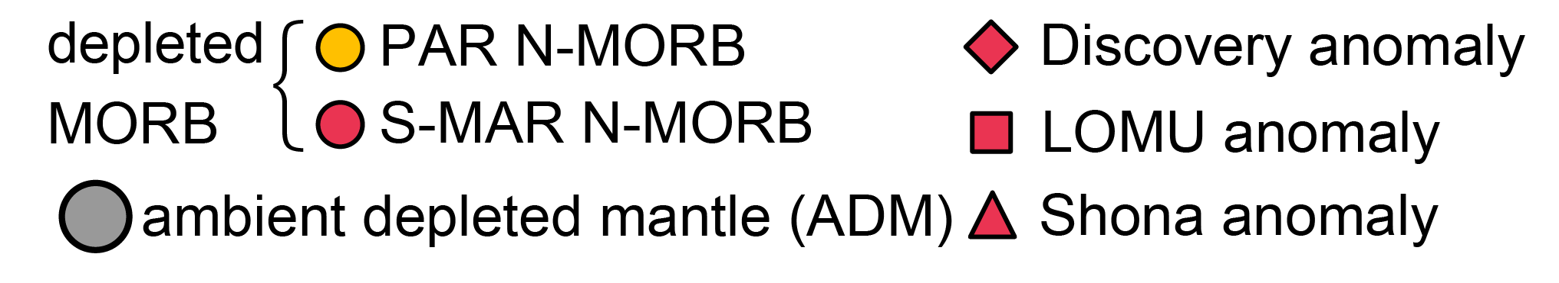
Results
recycled crustal component
Ahmad et al. (under review)

Slide 5
Results
recycled crustal component
Ahmad et al. (under review)

Slide 6
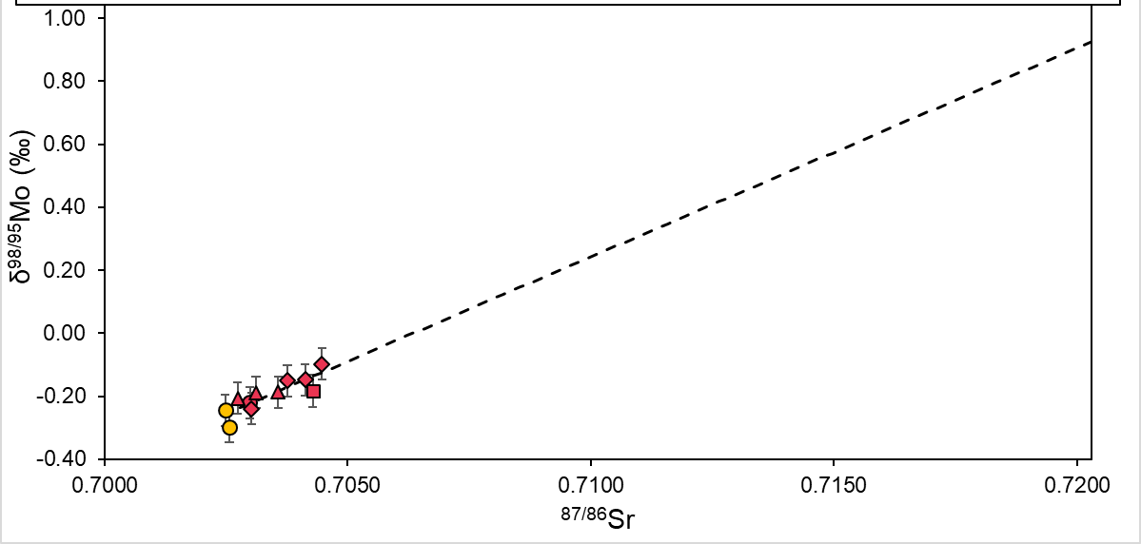
Mo – Sr correlation
Mo_{DM}/Sr_{DM} = Mo_{sediment}/Sr_{sediment}
Δ^{98/95}Mo
Mo_{DM}/Sr_{DM} < Mo_{sediment}/Sr_{sediment}
1.5 Ga sediment
Rehkämper & Hofmann (1997)

Slide 7
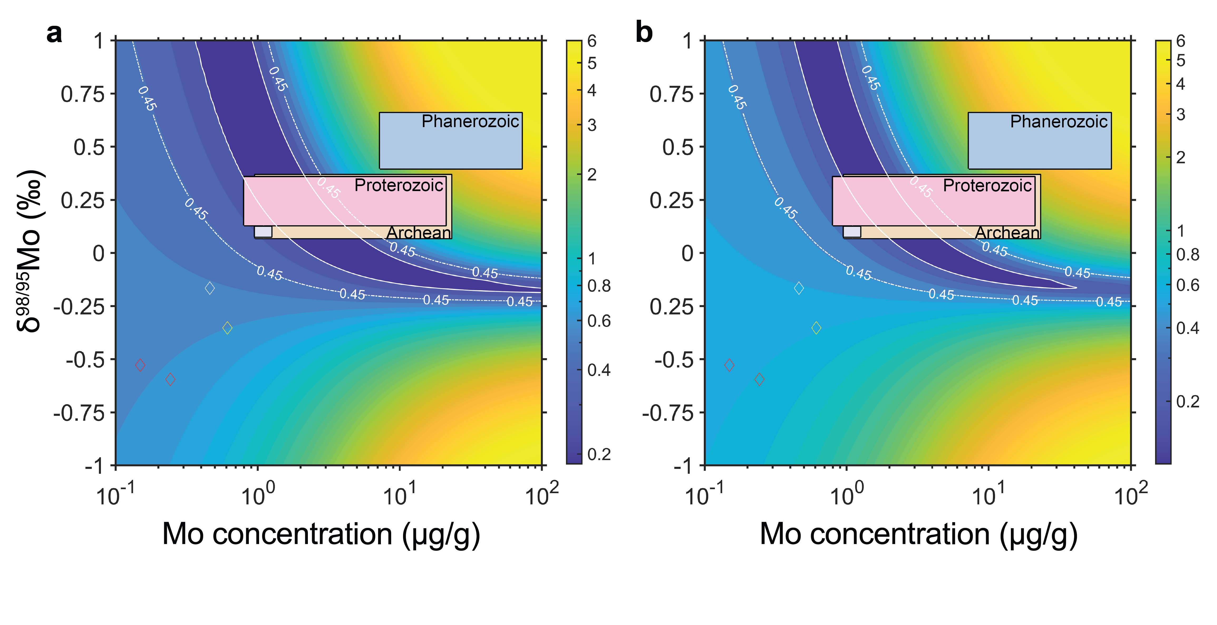
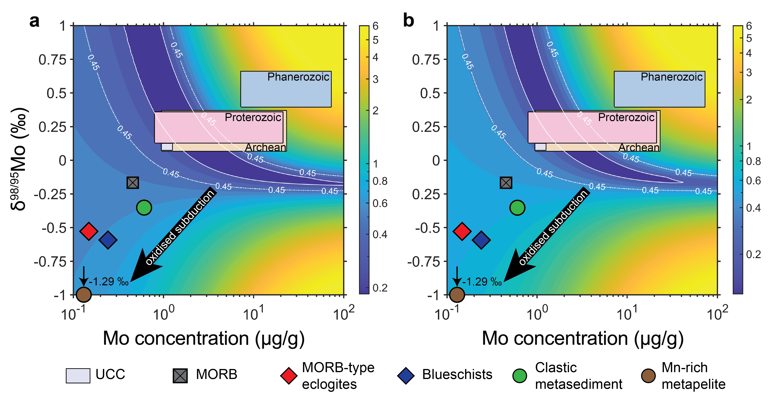
Misfit calculation
Mo-Sr
Mo-Nd
Ahmad et al. (under review)

Slide 8
Misfit calculation – potential endmember
Mo-Sr
Mo-Nd
UCC
MORB
Ahmad et al. (under review)

Slide 9
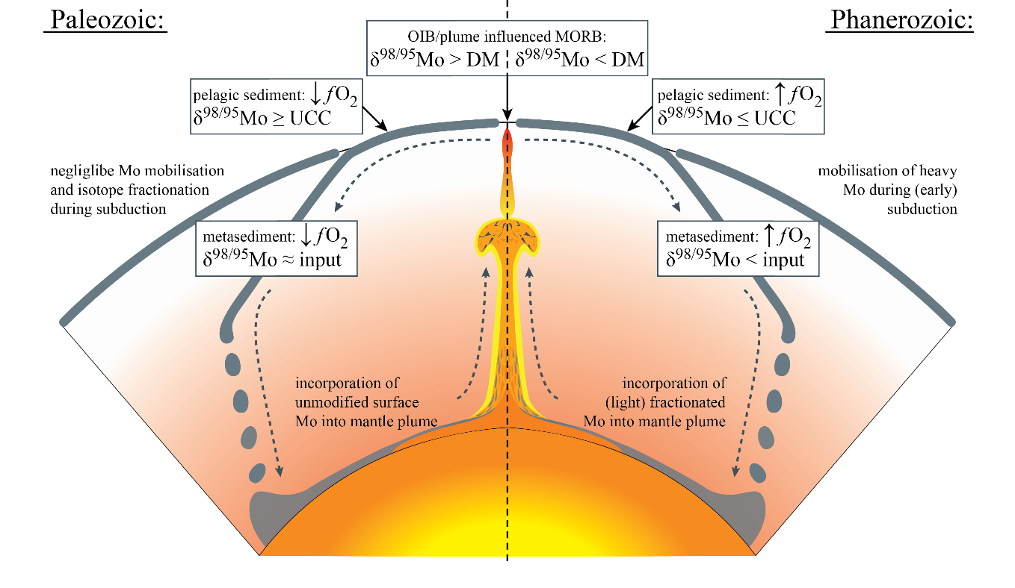
Conclusion
Ahmad et al. (under review)

