Slide 2

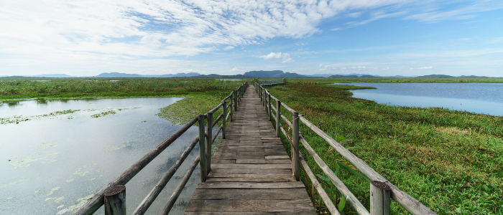

Questioning the adequacy of an invasive plant management technique with simple remote sensing observations (and more)
François Toussaint
24 May 2022

Slide 3


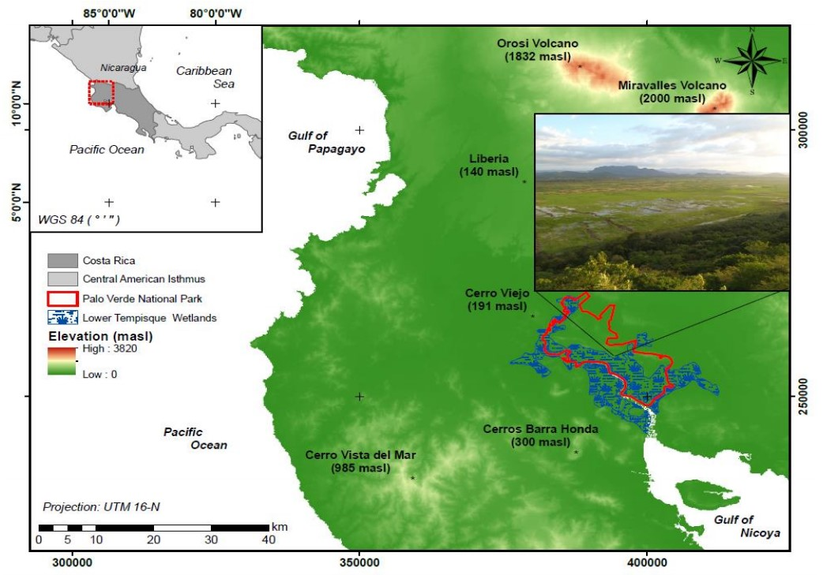
Palo Verde National Park
Northwest of Costa Rica
18 000 hectares
Important wetland: shelter for birds
Dry season: Dec - Apr
Wet season: May - Nov
C. Jiménez-Rodríguez 2019

Slide 4
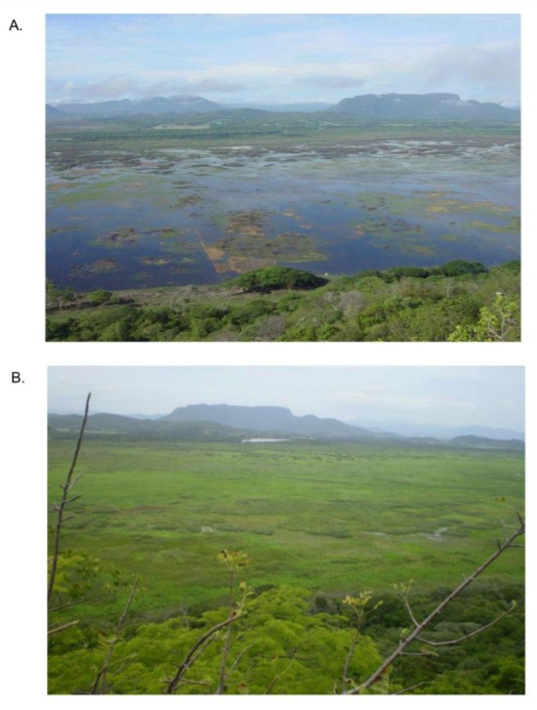
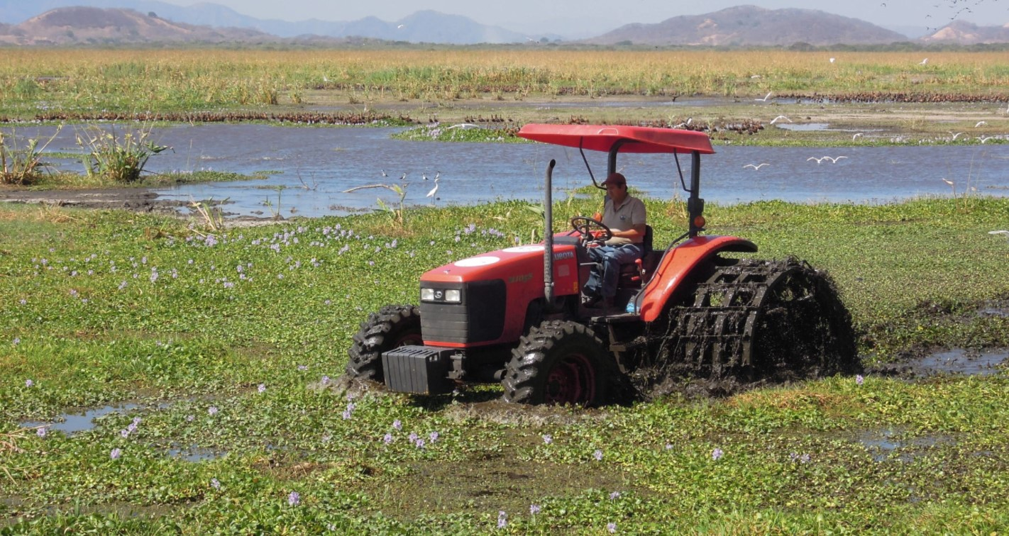
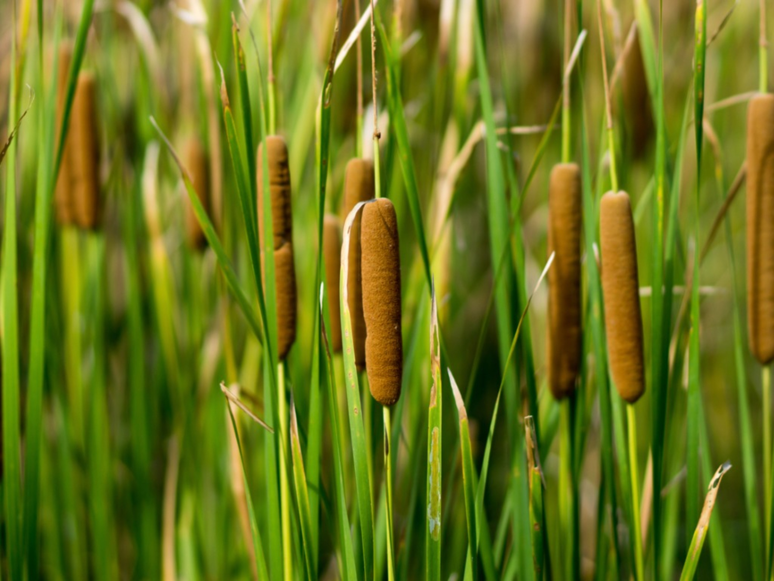
Vegetation shift in the 1980s
Illustration of the change in land cover
1986
Fangueo technique
Cattail plants
2012
iStock by Getty image
Society for ecological restoration 2014
Alonso 2017
4

Slide 5
Two questions :
Can we map the distribution of the Typha plant in the park wetlands?
What is the medium to long term impact of the Fangueo technique on vegetation and open water areas?
5

Slide 6
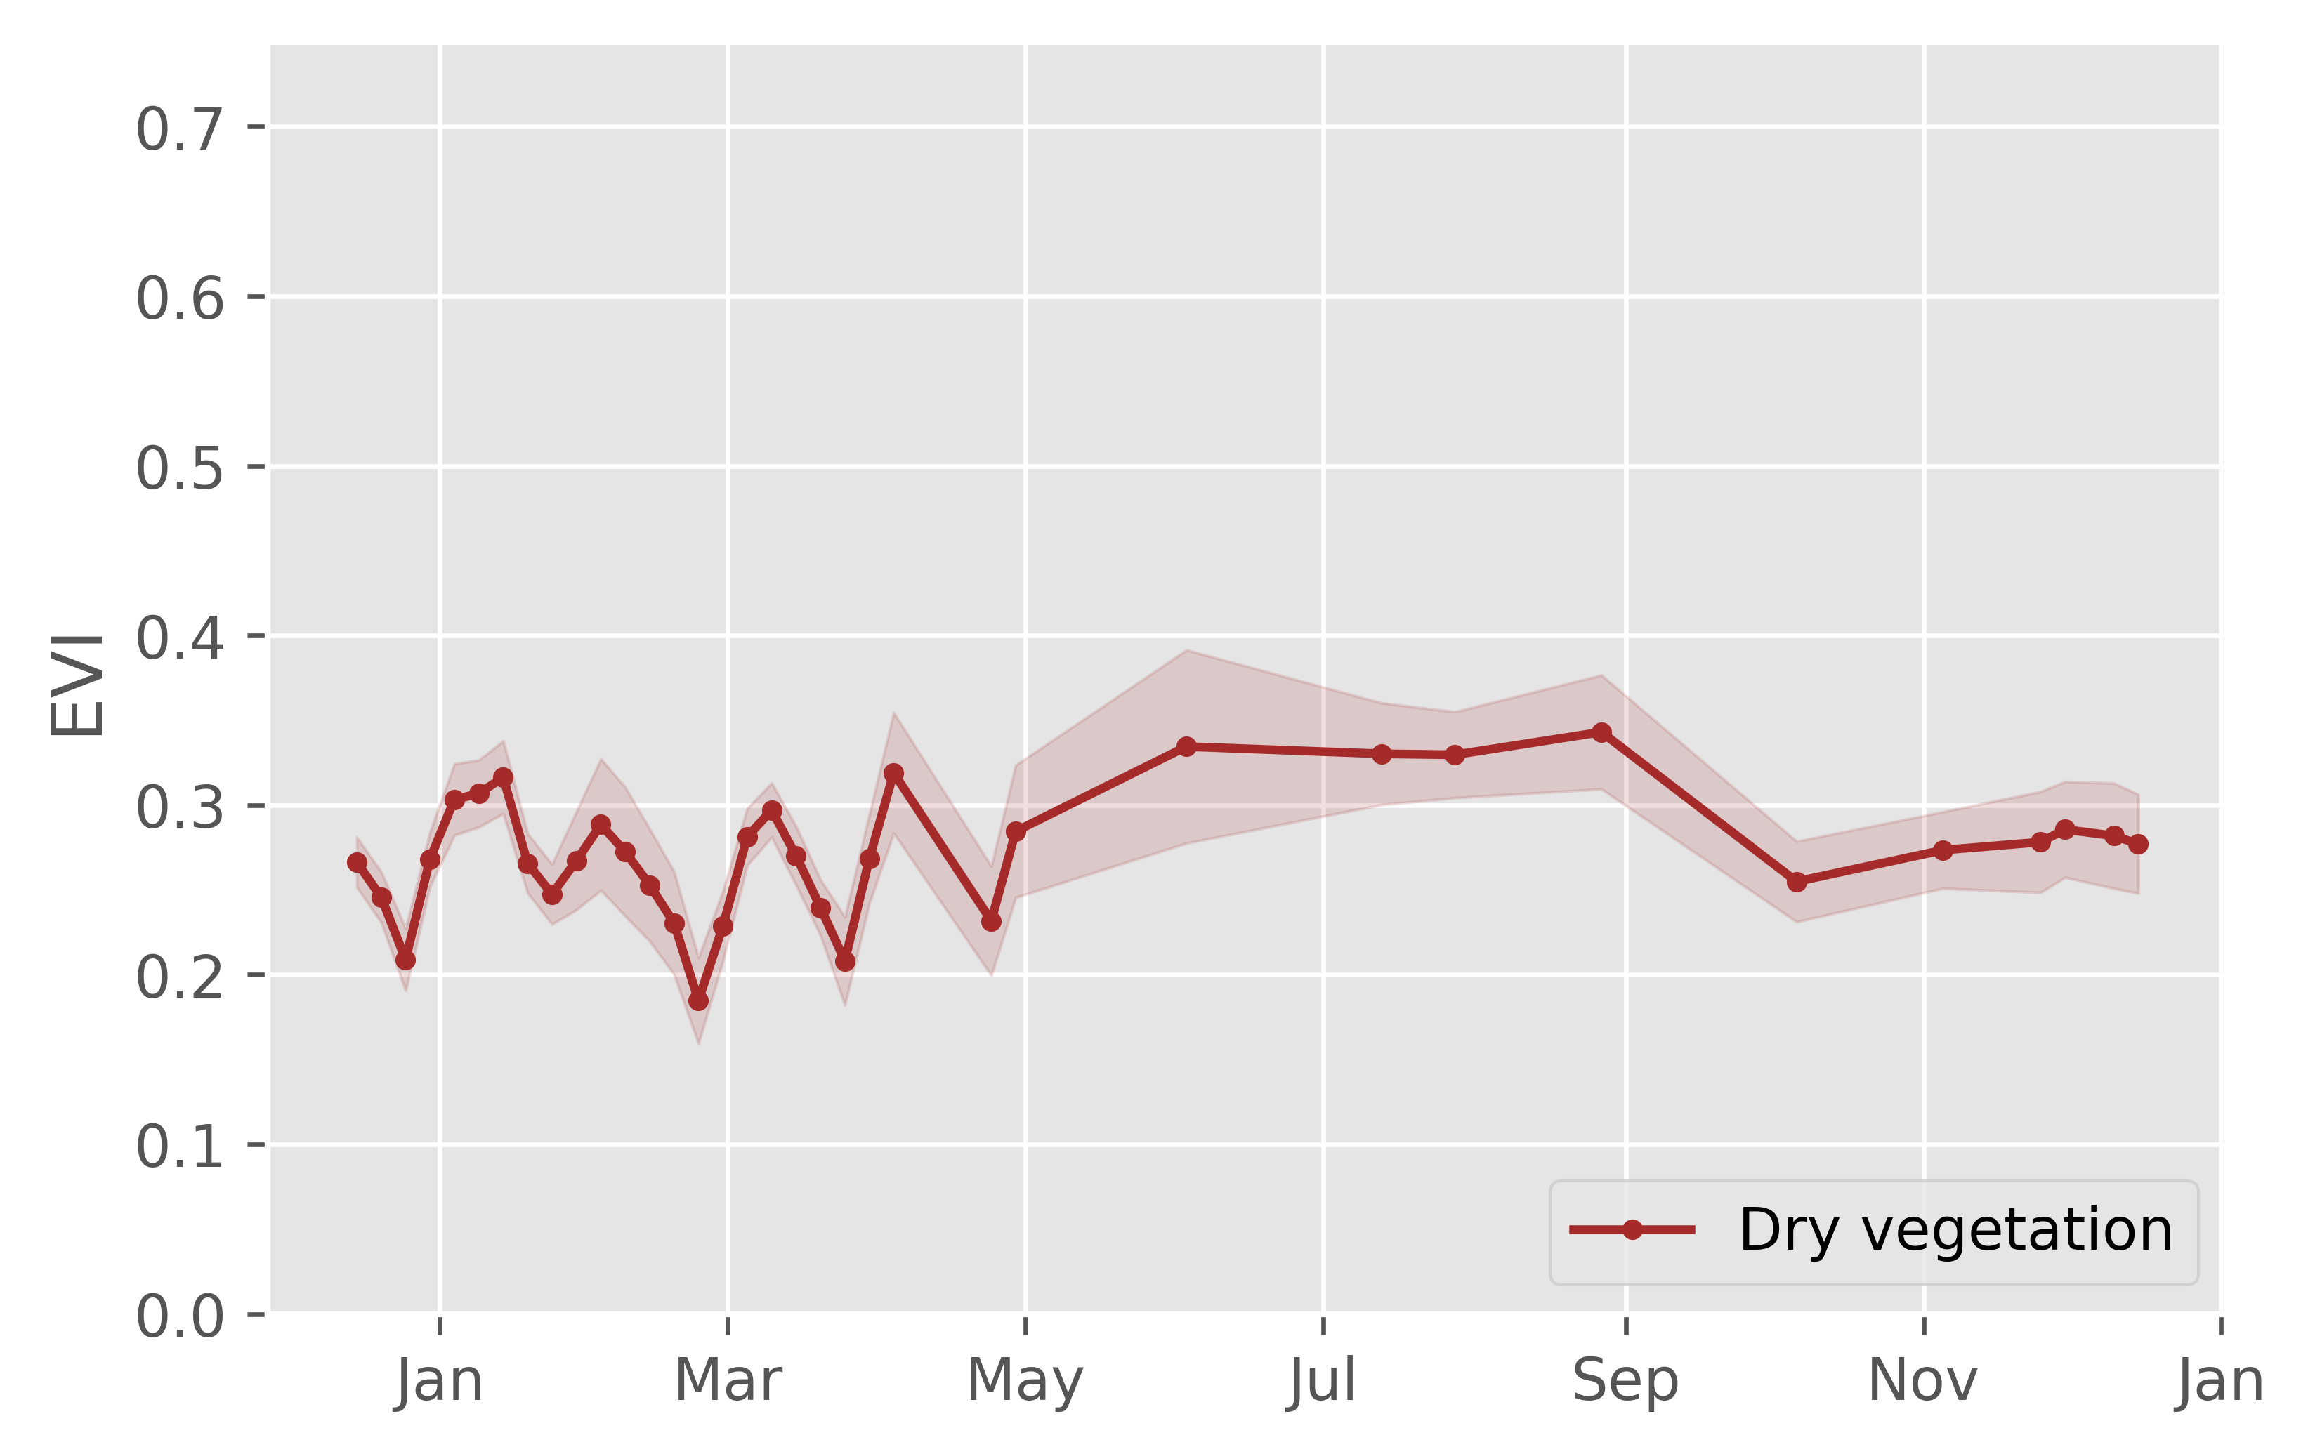
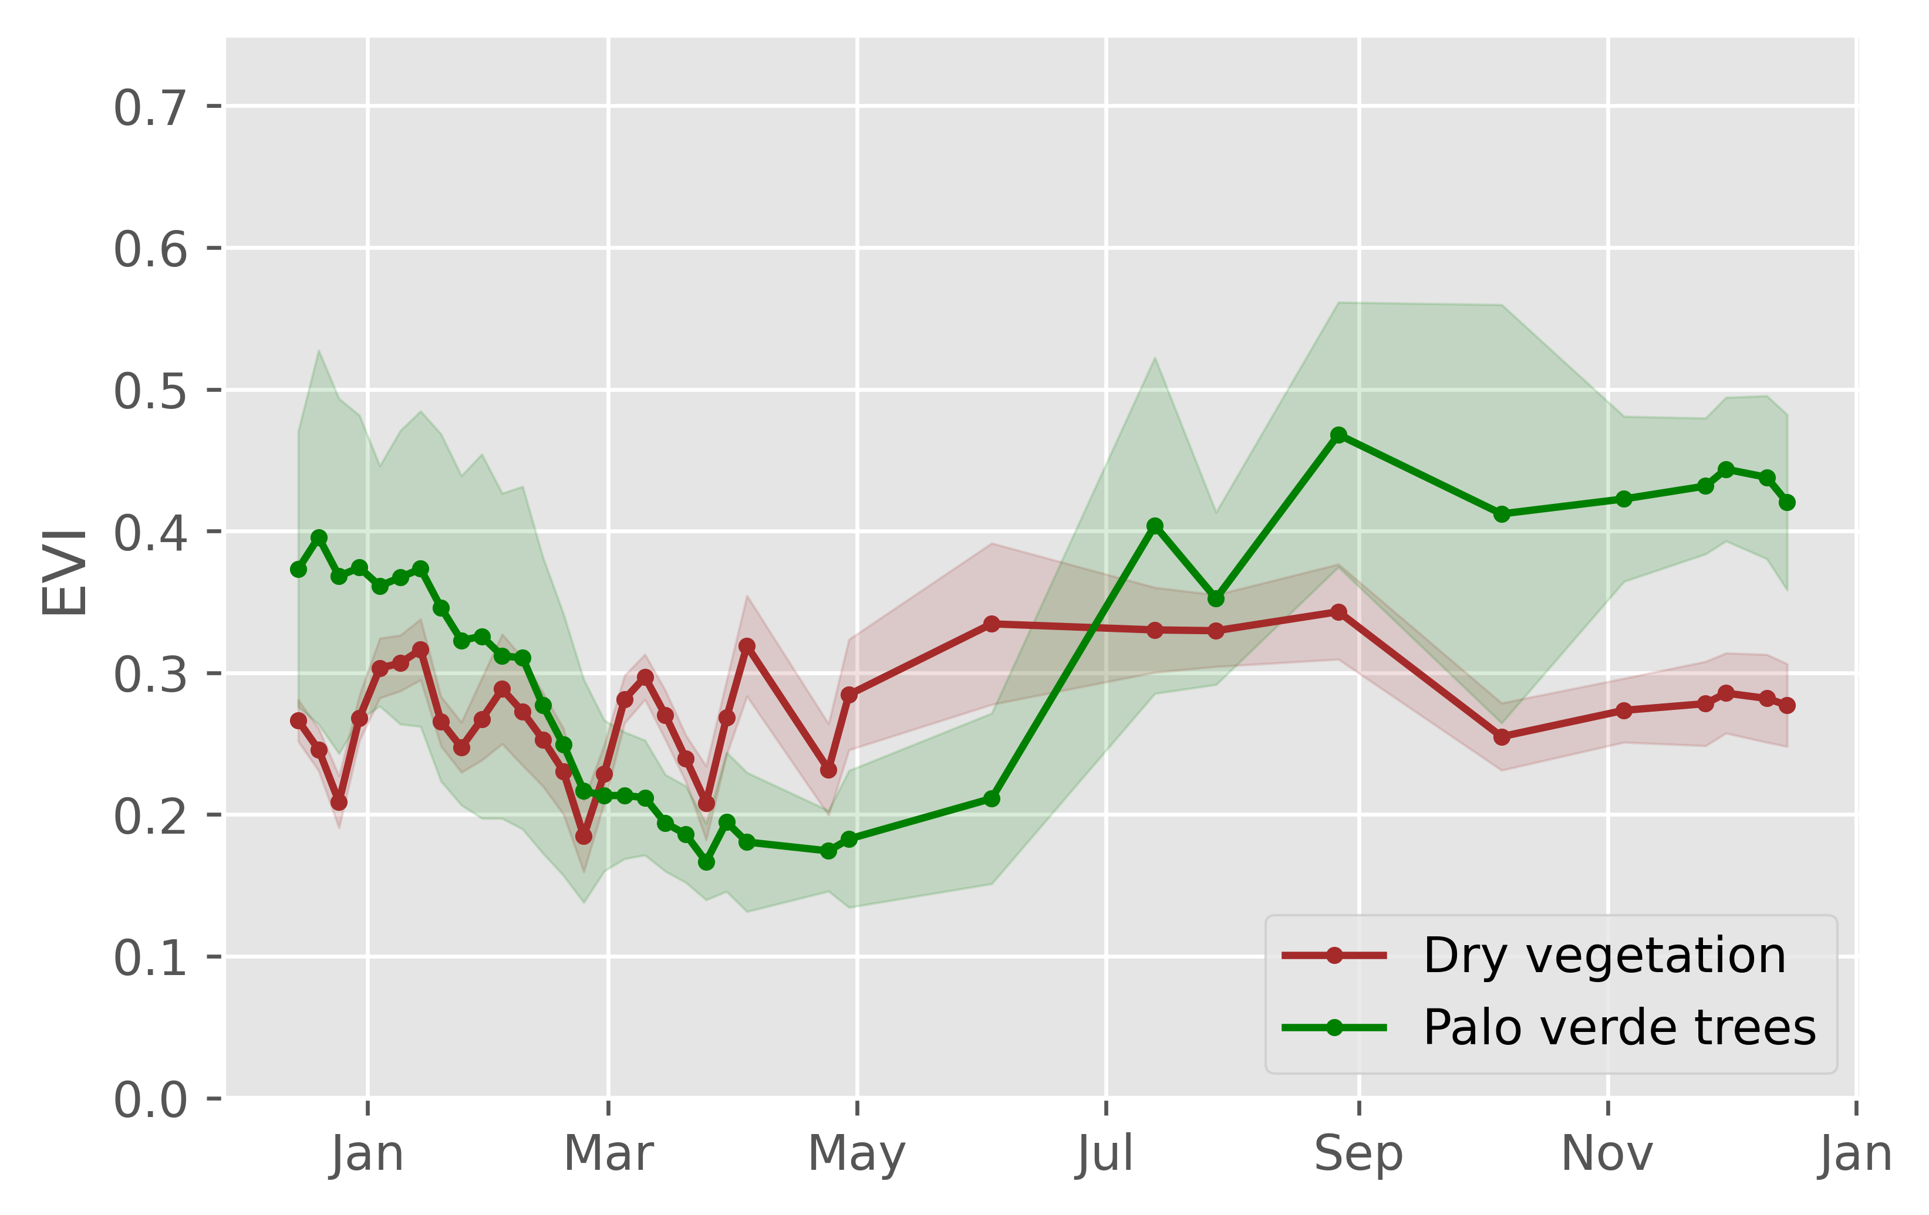
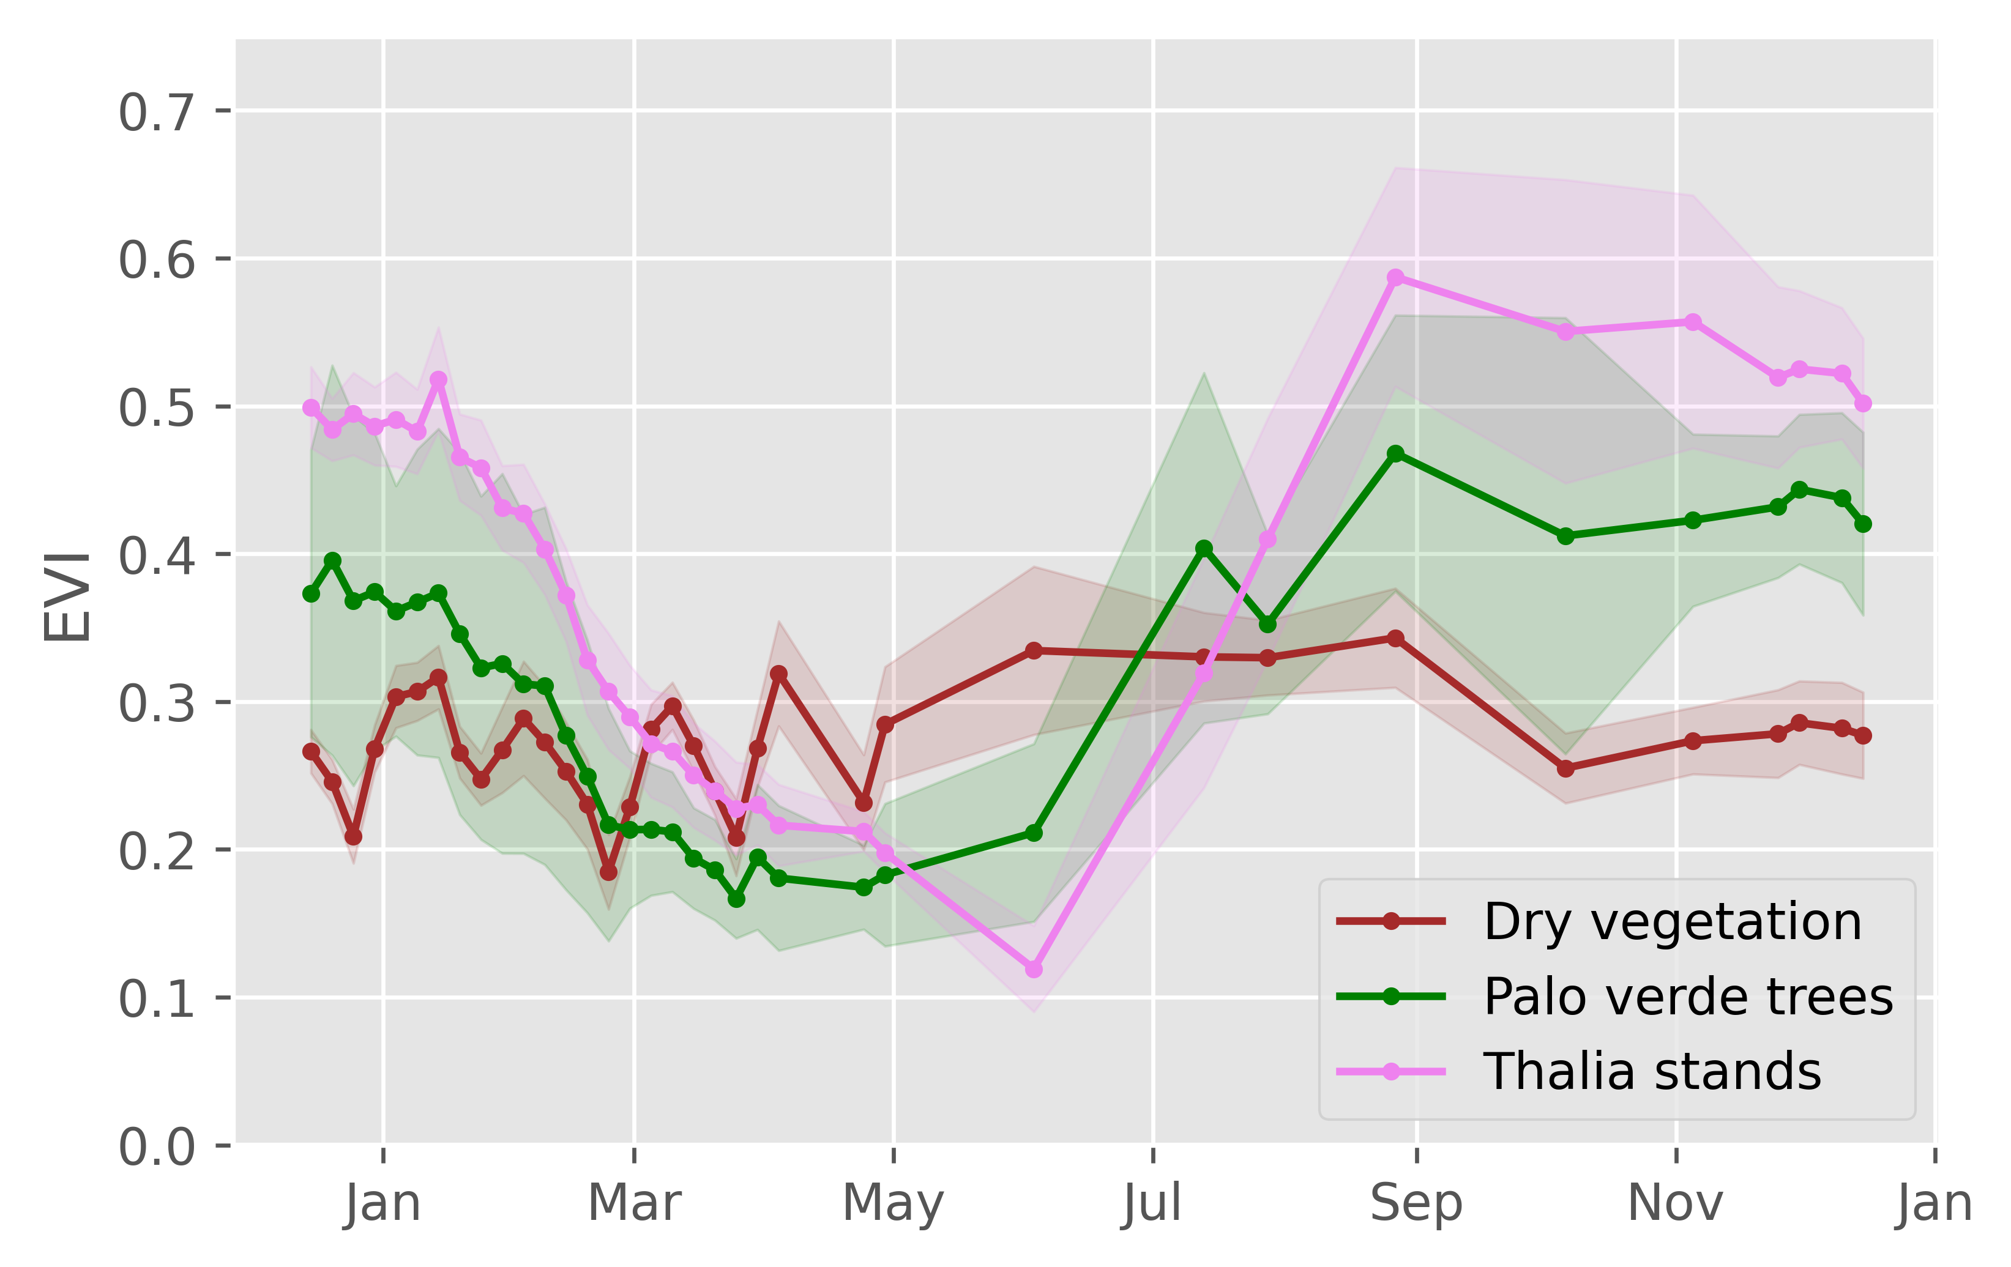
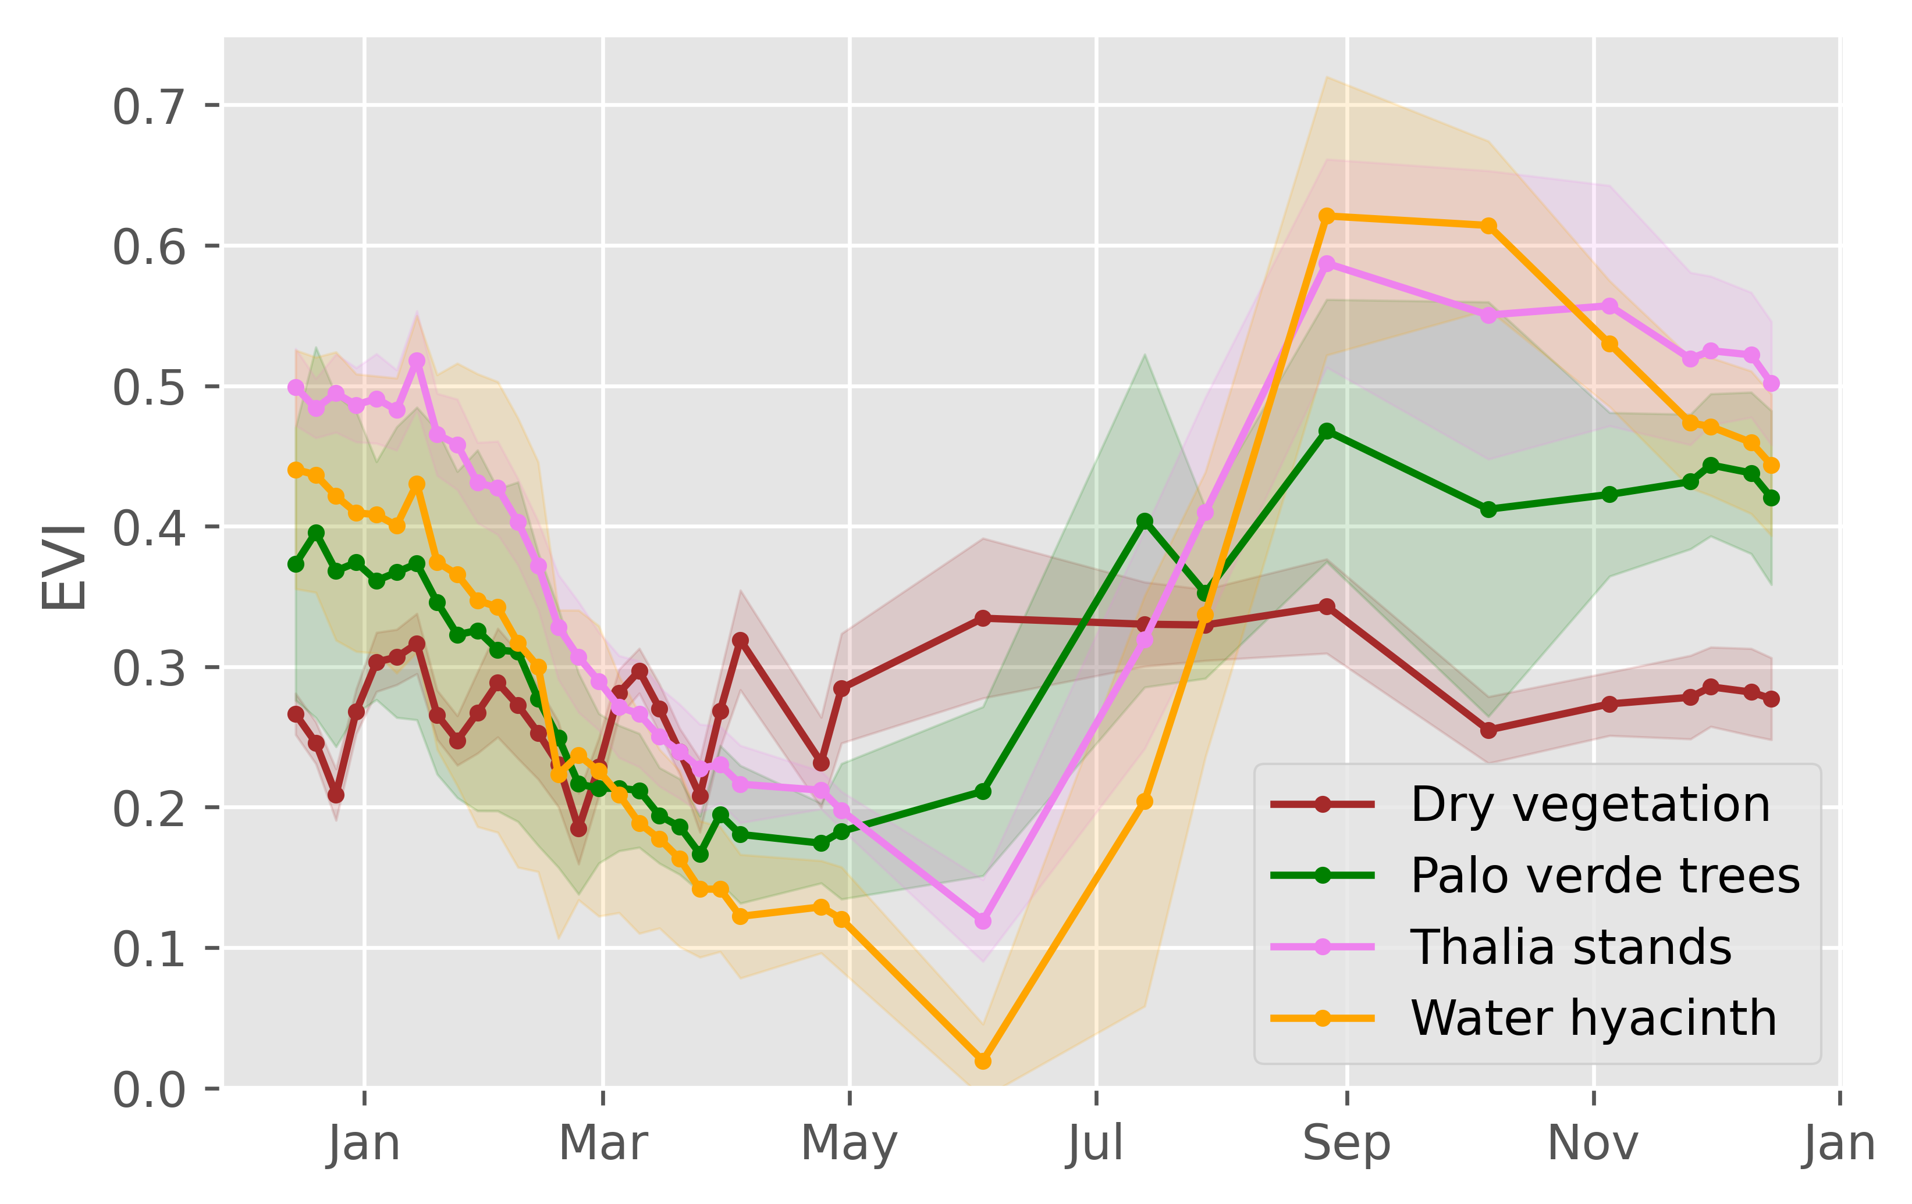
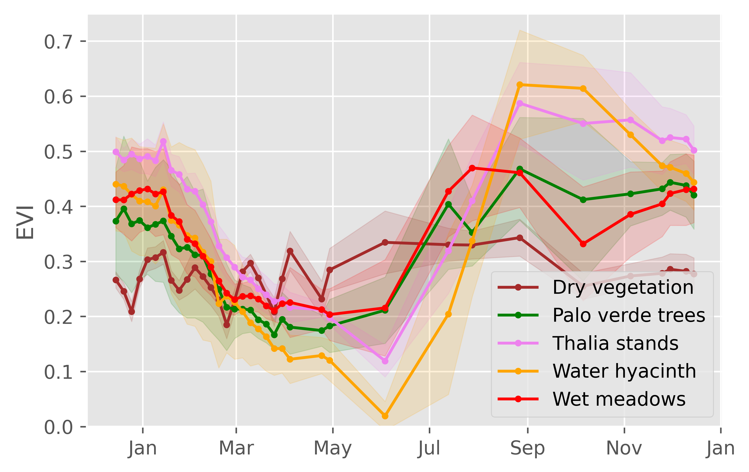
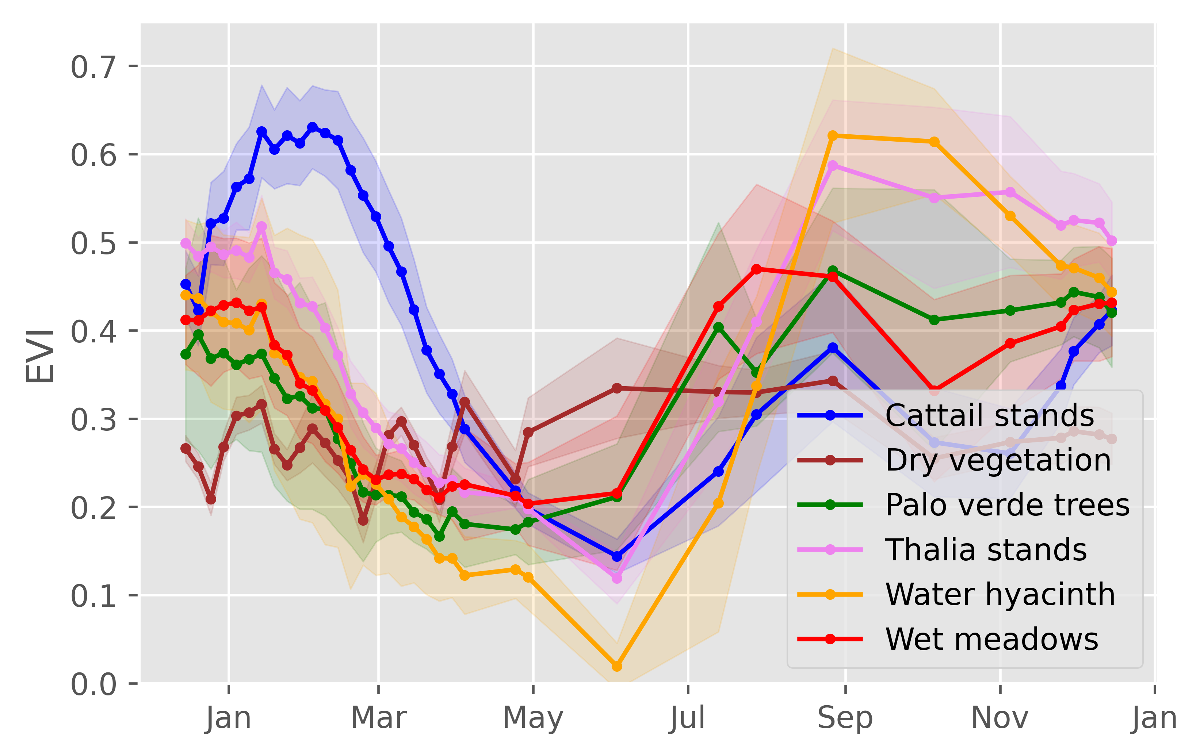
Evolution of EVI for different land covers

Slide 7
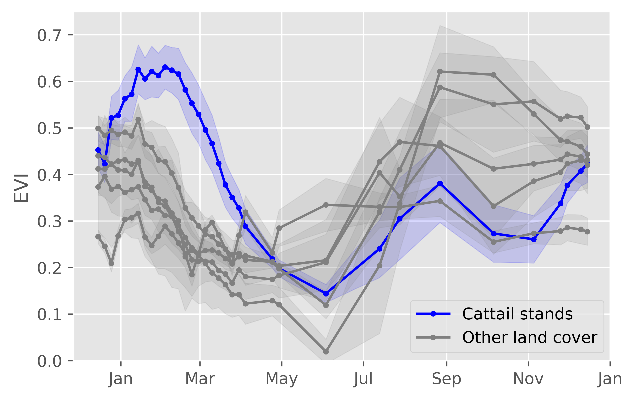
Detection of Typha based on EVI
Capture the increasing dynamics of EVI between December and February.
Absolute threshold of EVI in February

Slide 8
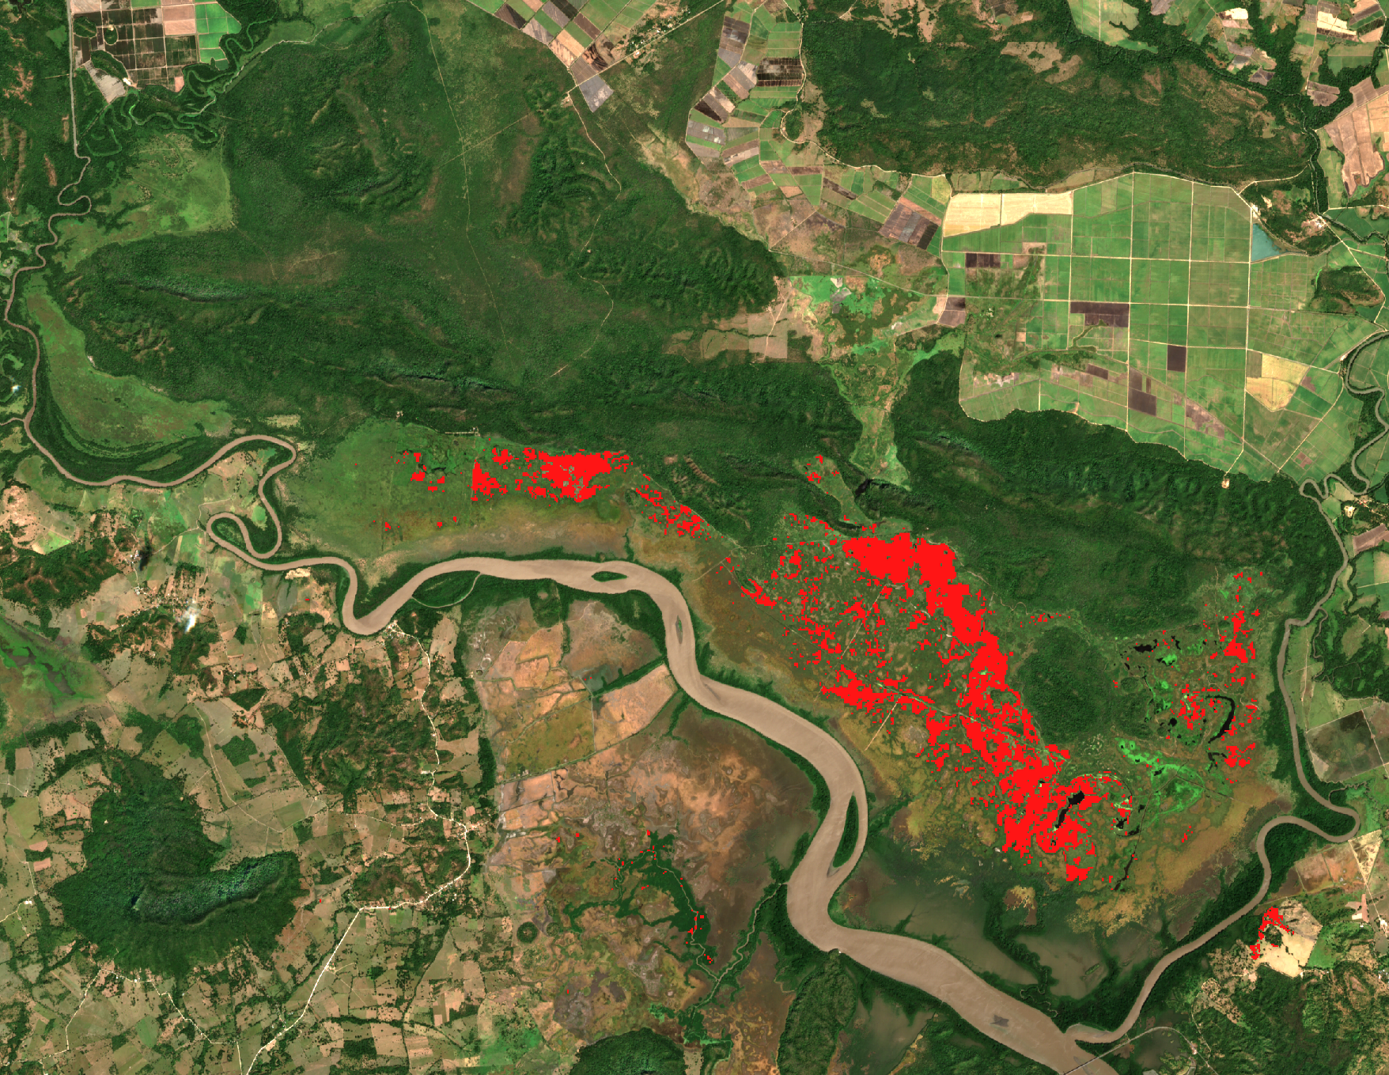
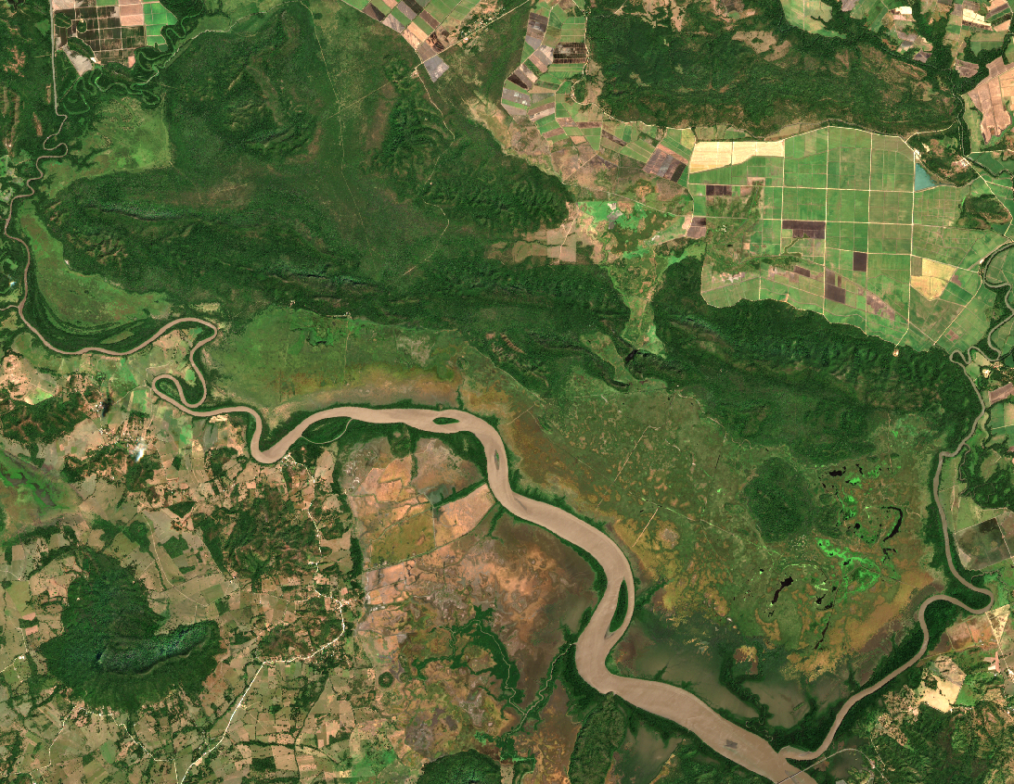

Map of "potential" distribution of Typha
Not validated
Not validated

Slide 9
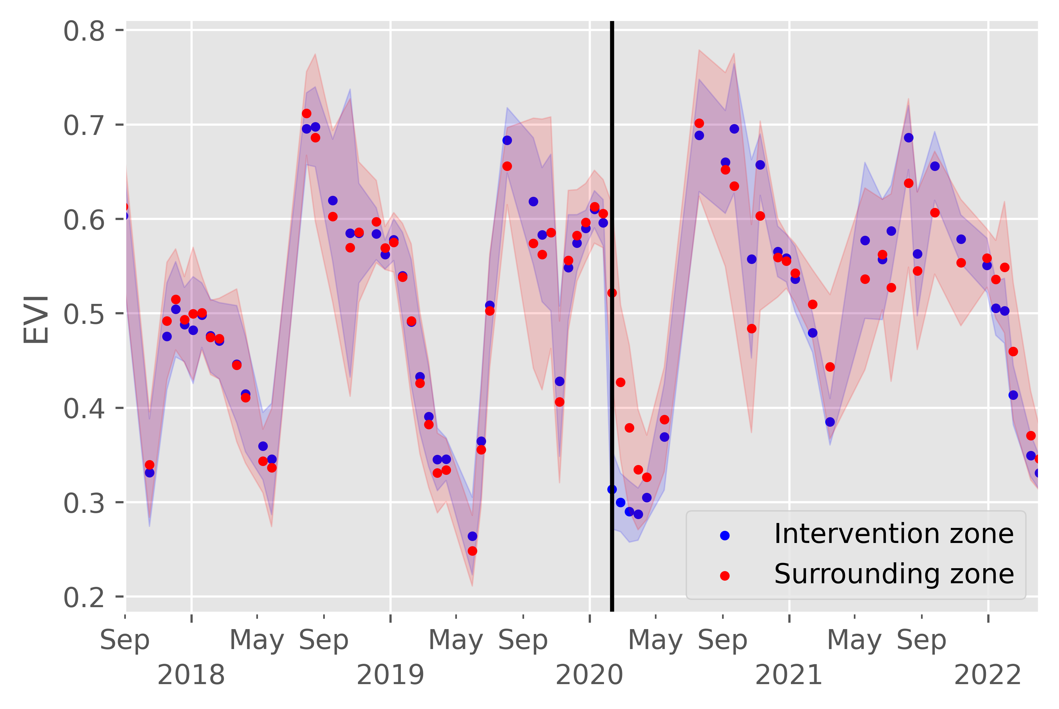
Monitoring of vegetation after Fangueo
Intervention
date

Slide 10
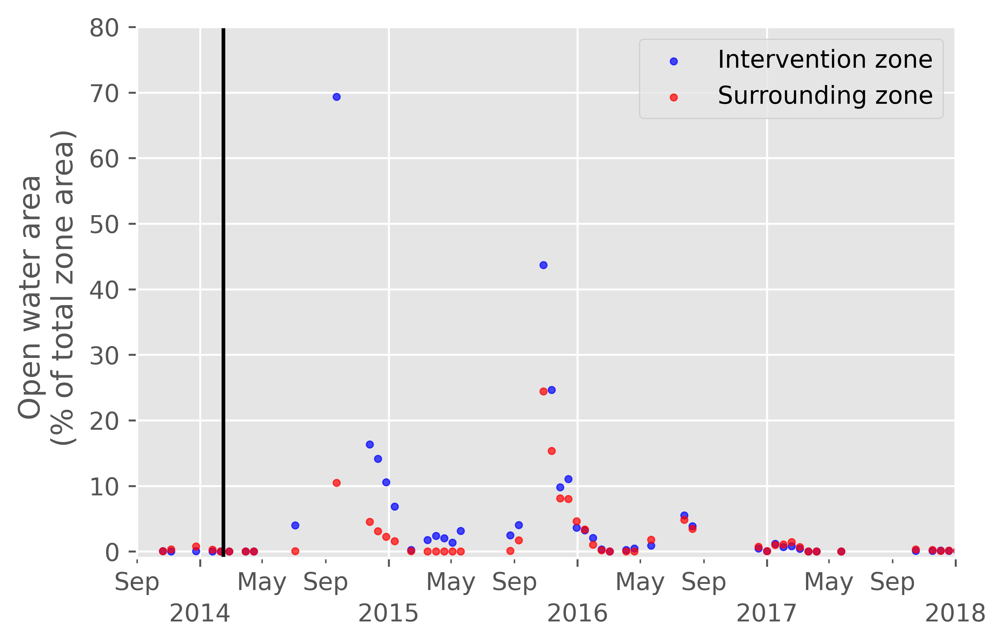
Monitoring of open water area after Fangueo
Intervention
date

Slide 11
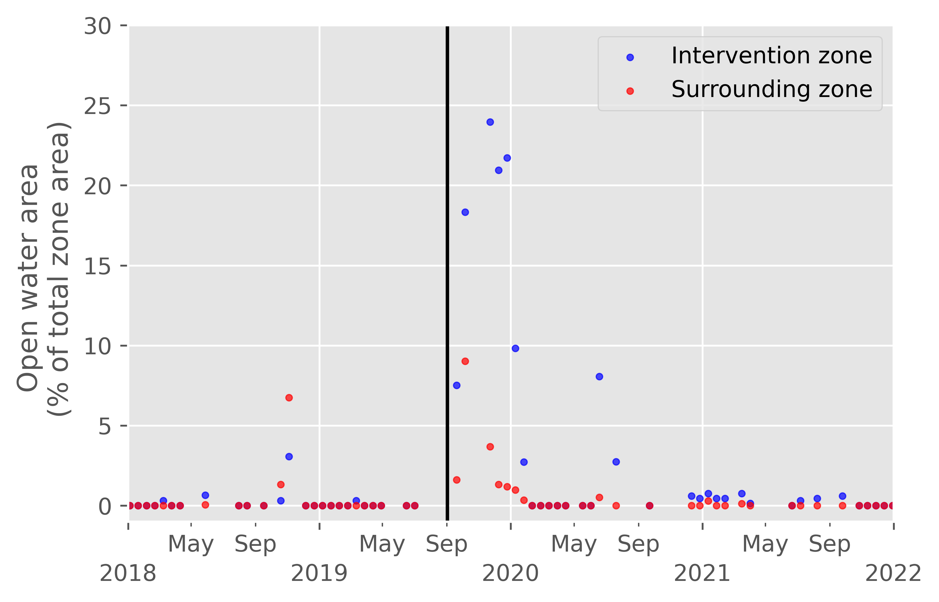
Monitoring of open water area after Fangueo
Intervention
date

Slide 12
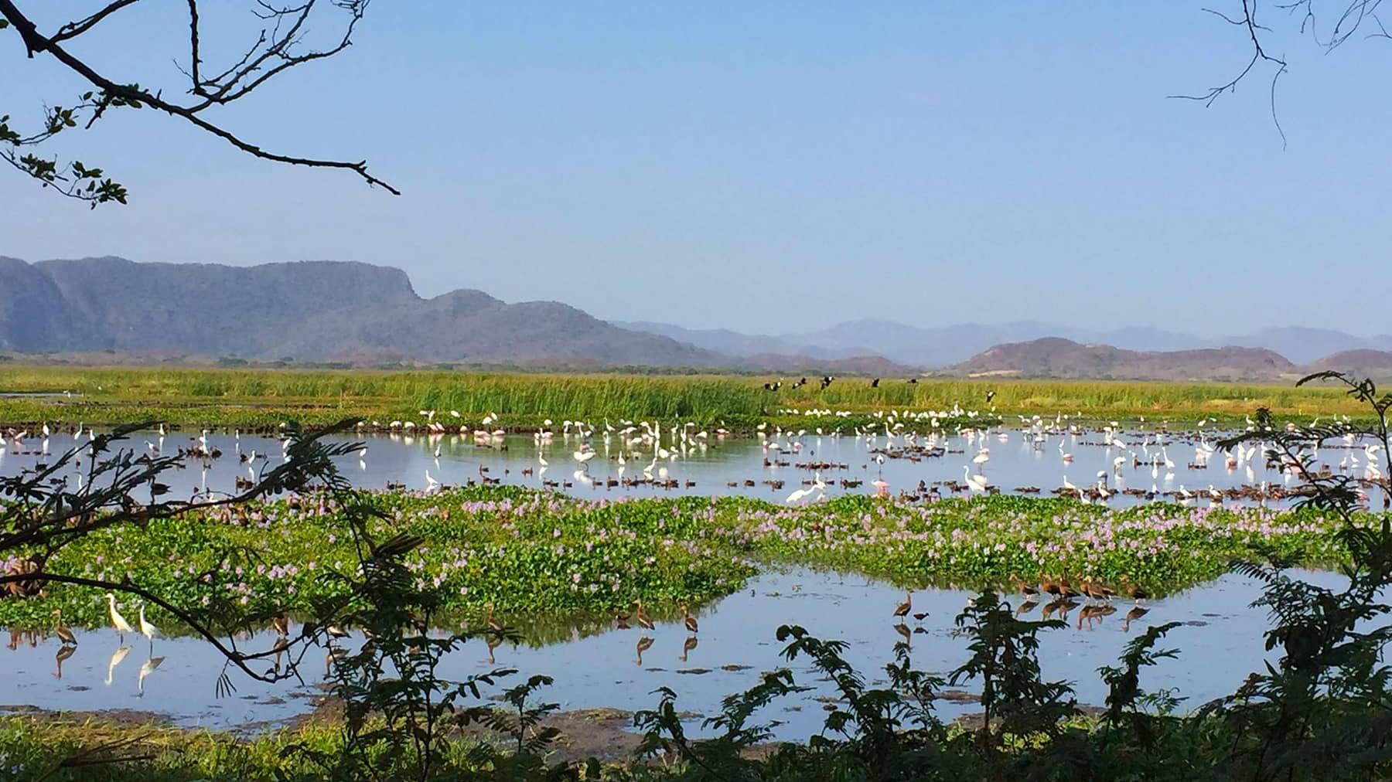



Thank you !
Special thanks to :
Rasmus Lørup Arildsen &
Christian Josef Köppl
Rafael Munoz-Carpena
The organisation for Tropical Studies

