Slide 1






Hydrodynamics in the near-wake of cylindrical obstacles in a turbulent open channel flow
Théo FERNANDEZ^{1,2}, Ingo SCHNAUDER¹, Olivier EIFF², Koen BLANCKAERT¹
¹ Technische Universität Wien, Institute of Hydraulic Engineering and Water Resources Management, Vienna, Austria
² Karlsruhe Institute of Technology, Institute for Hydromechanics, Karlsruhe, Germany
EGU General Assembly, May 23rd – 27th, 2022, Vienna, Austria - EGU22-11911, Session GM5.2

Slide 2
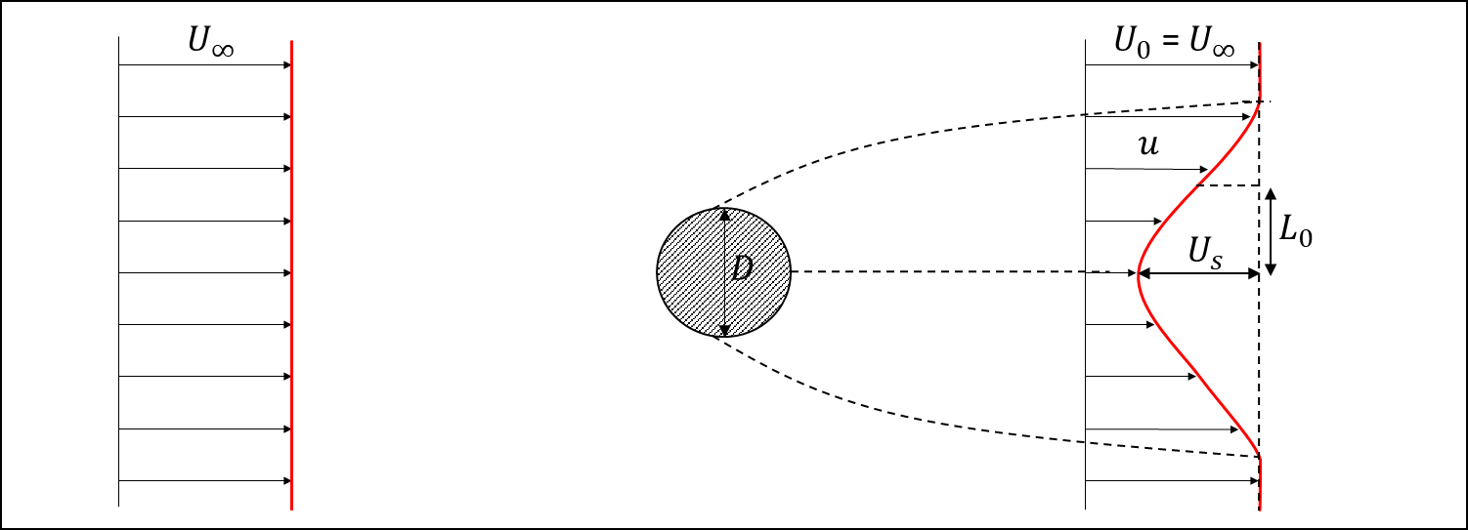
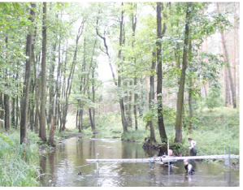
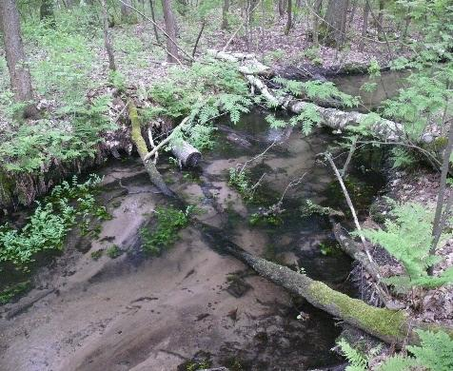
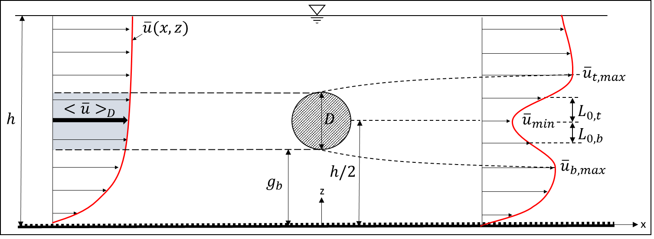
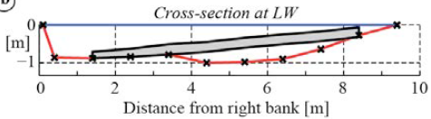
Background
Cylindrical obstructions in the flow field occur in a variety of configurations and engineering areas, such as pipeline near the see bottom, marine and offshore structures, bridge piers or Large Wood
Based on field measurements done in the Pliszka River, Poland
Large Wood have important functions in rivers (habitats, create a lot of mixing, change the bed composition)
Little is known about the hydrodynamic changes induced by Large Wood in rivers
Most of the studies related to obstacles are done in an unconfined environment with horizontal obstacles
Not representative of natural rivers
Tennekes & Lumley, 1972
Zdravkovich, 1997
Eames et al., 2011
Aljure et al., 2017
Unconfined case
Photo taken by Michael Seider
Wang & Tan, 2008
Ouro et al., 2019
Field measurements performed in the Pliszka River, Poland by Blanckaert et al., 2014
Confined case

Slide 3
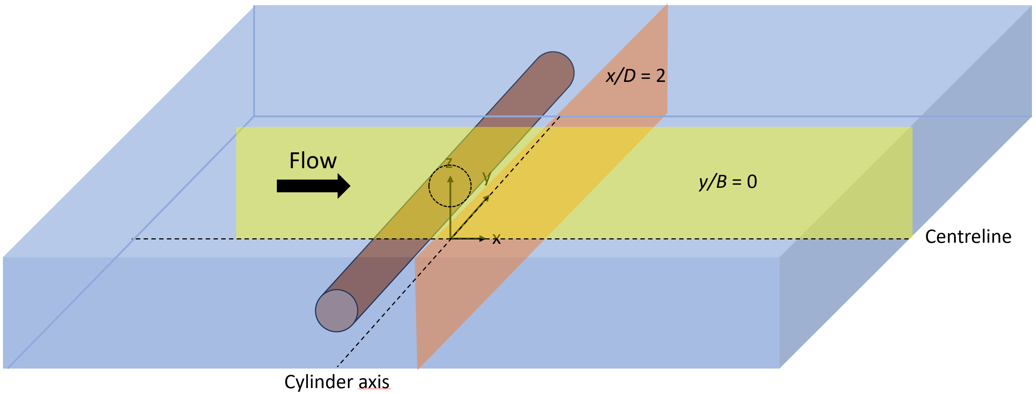
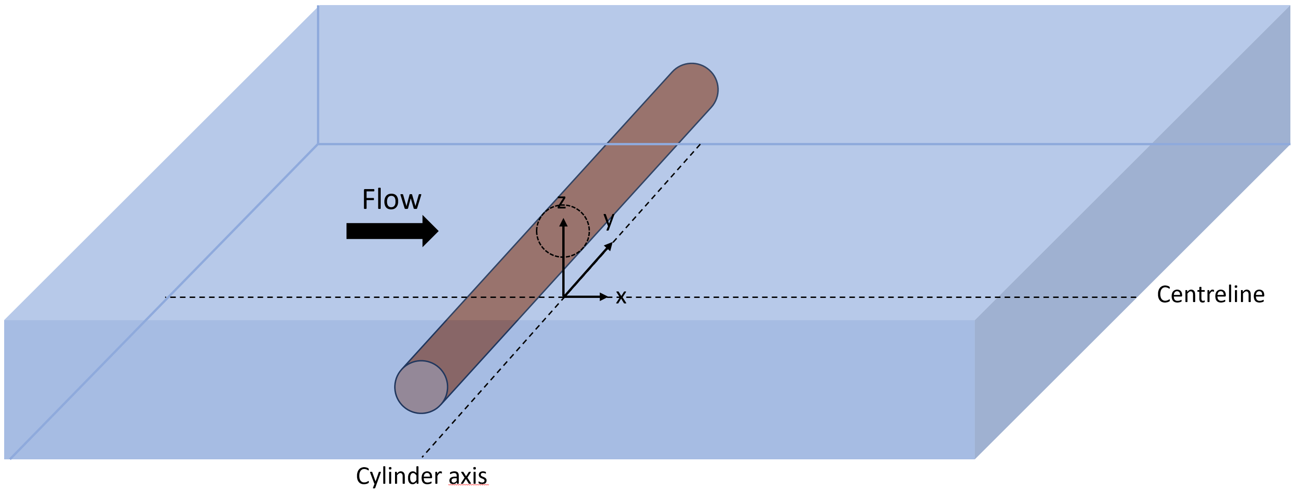
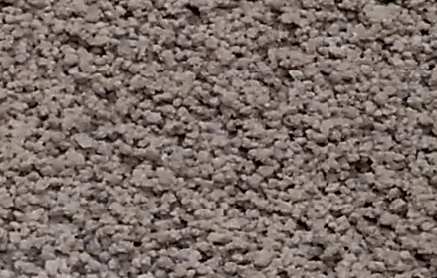
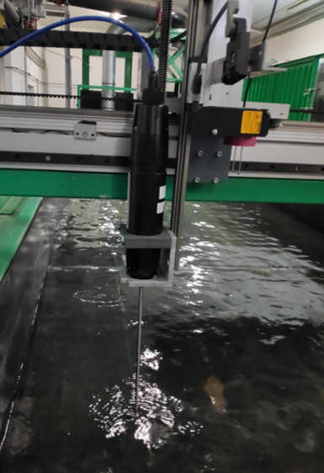
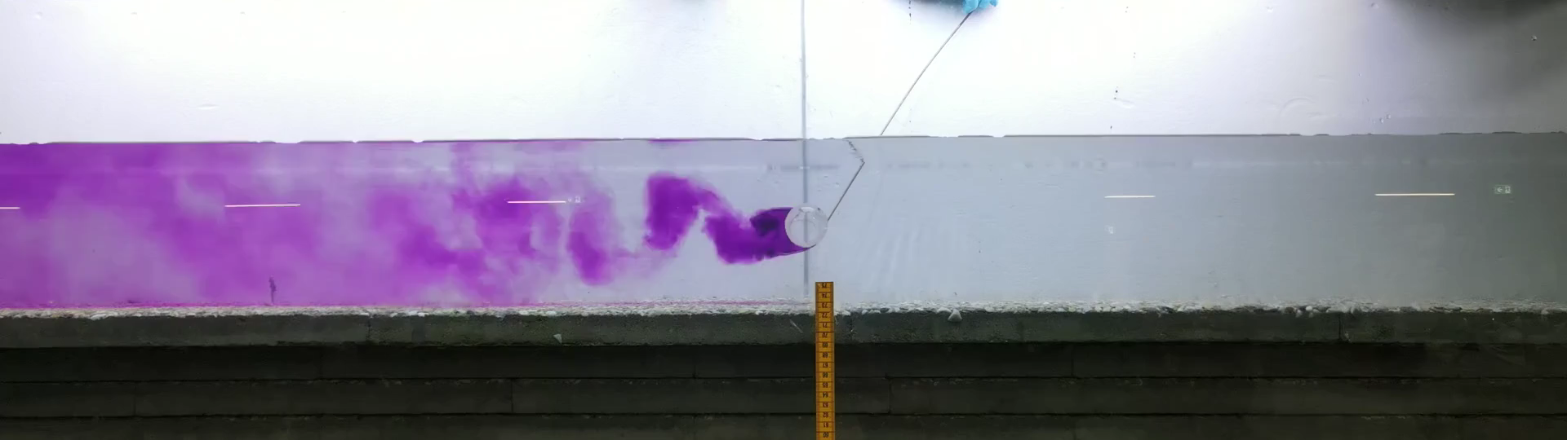
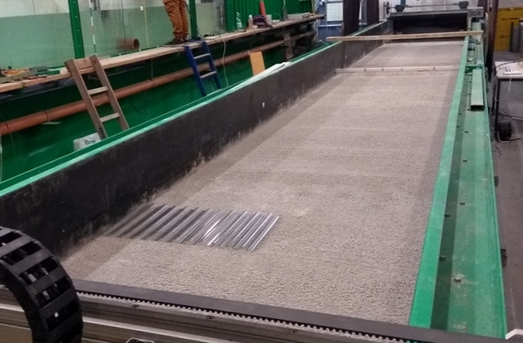
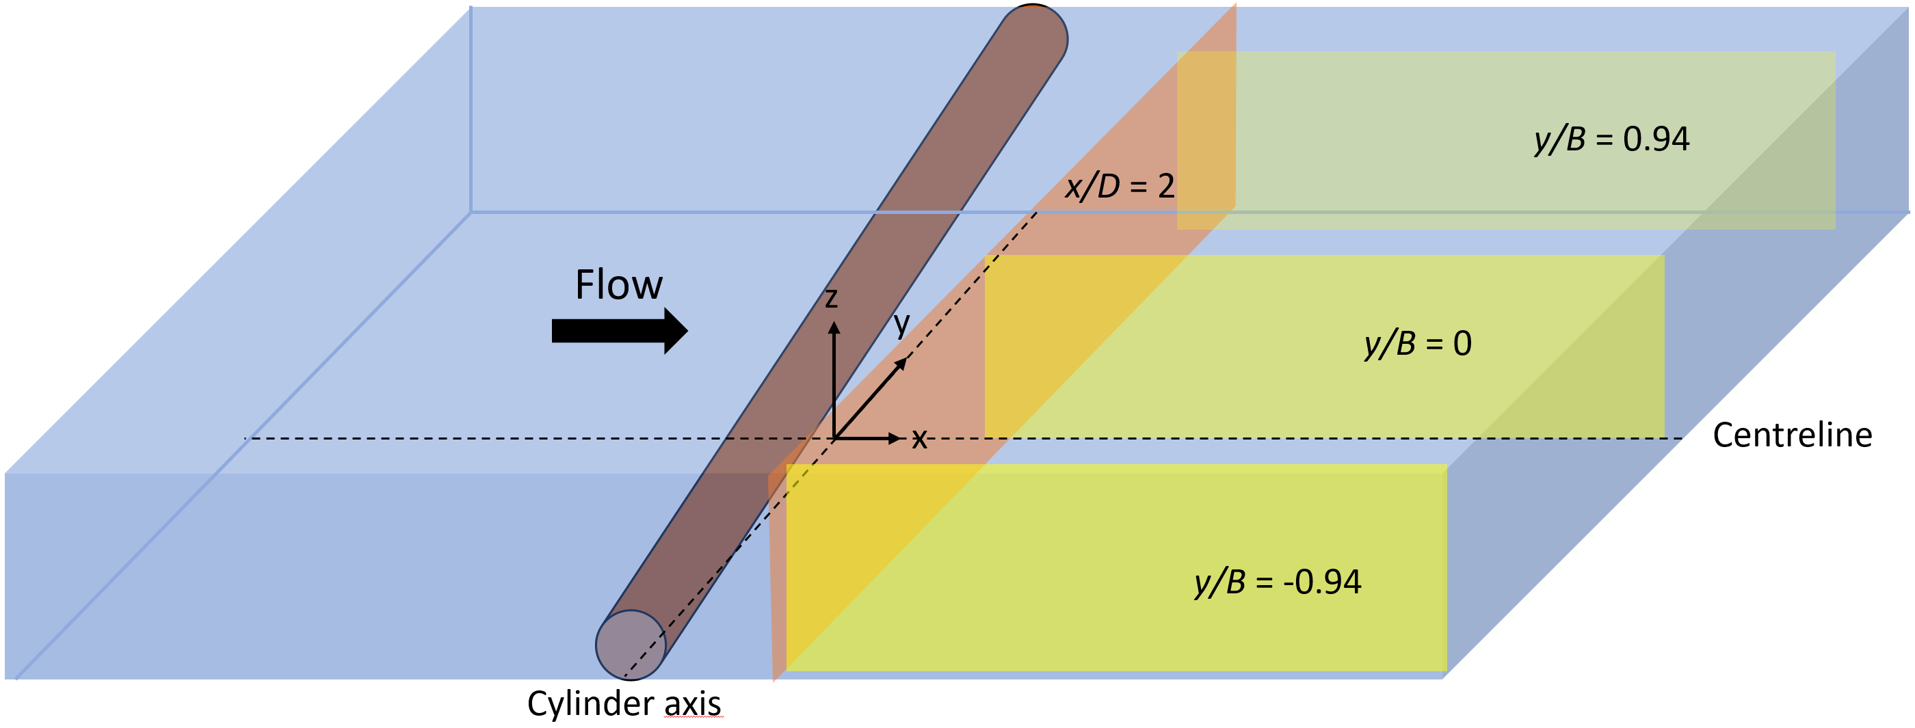
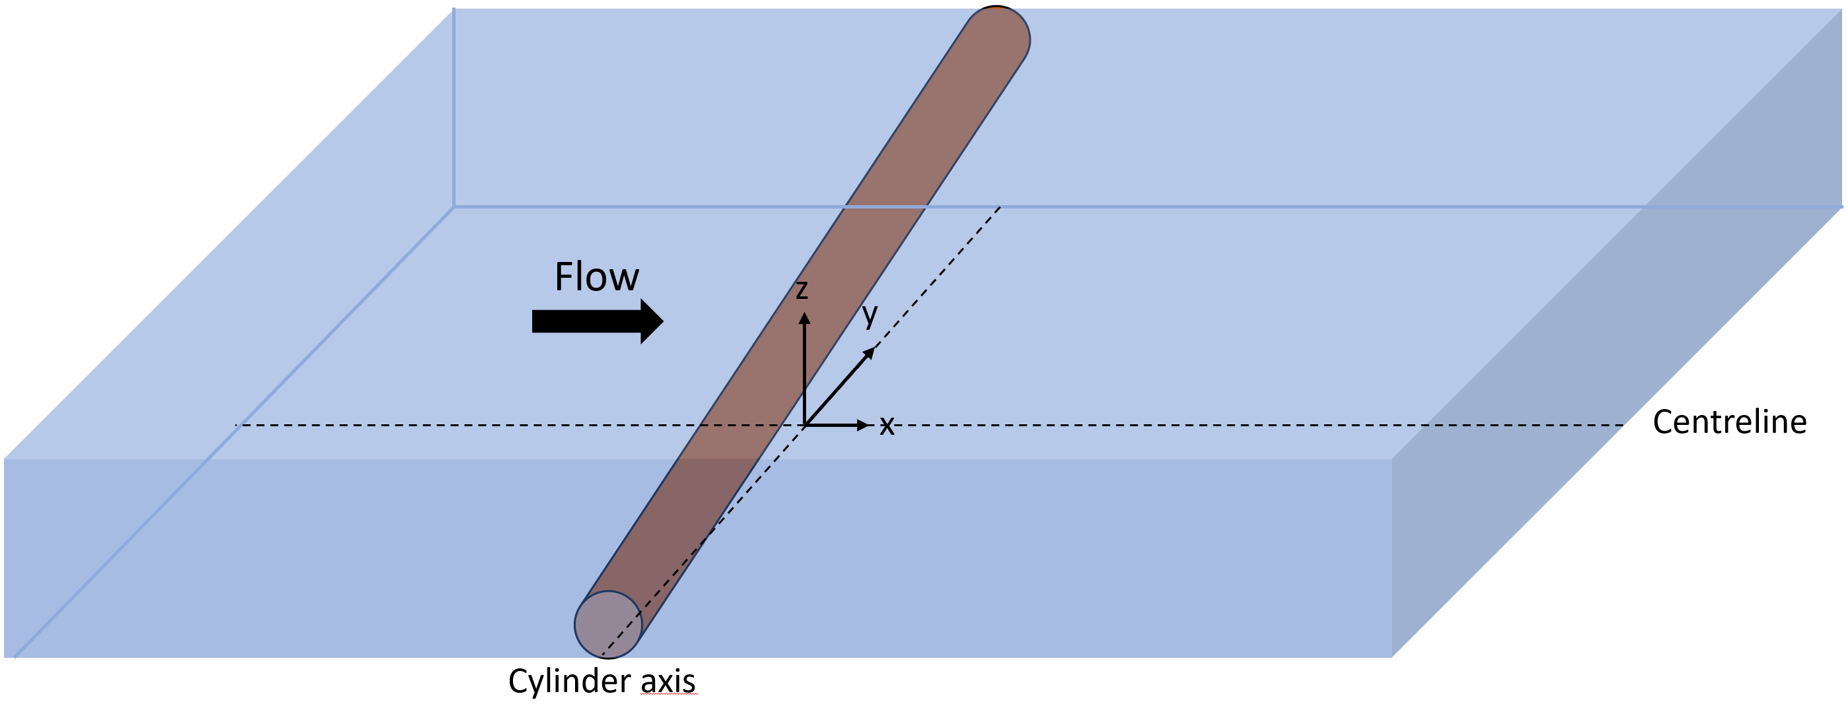
Objectives
Identify flow patterns around cylindrical obstacles in a confined environment
Compare horizontal and inclined cylinders
The effects of the confinement and the inclination are not know and yet of interest in a river environment
Effects on the hydrodynamics and the morphodynamics
2 cm
Horizontal configuration
Horizontal configuration
U
Flume with a fixed rough bed
Acoustic Doppler Velocimeter
Inclined configuration
Inclined configuration

Slide 4
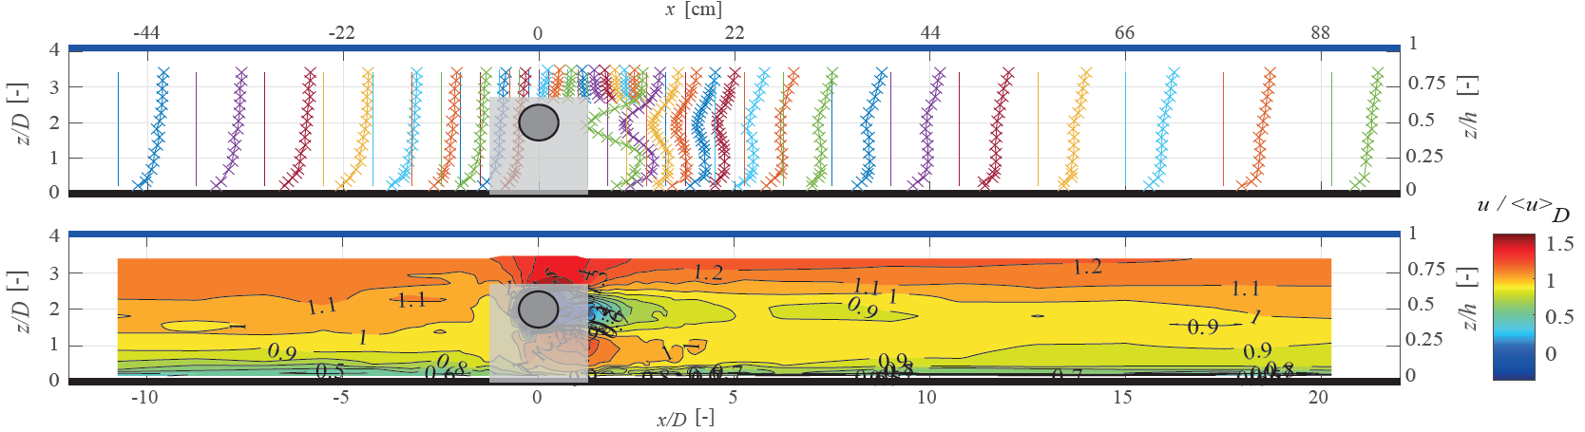
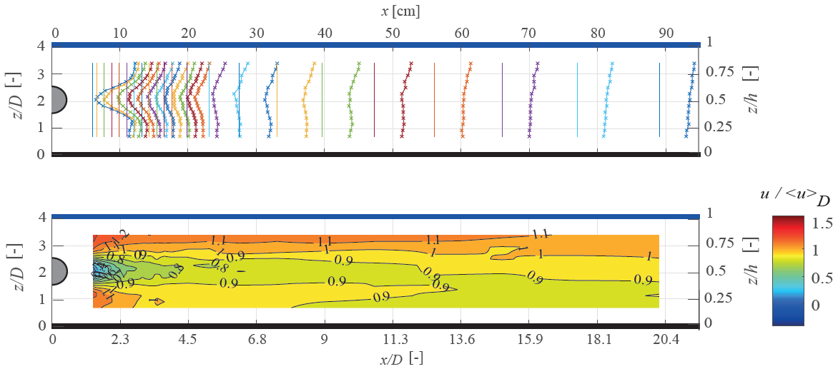
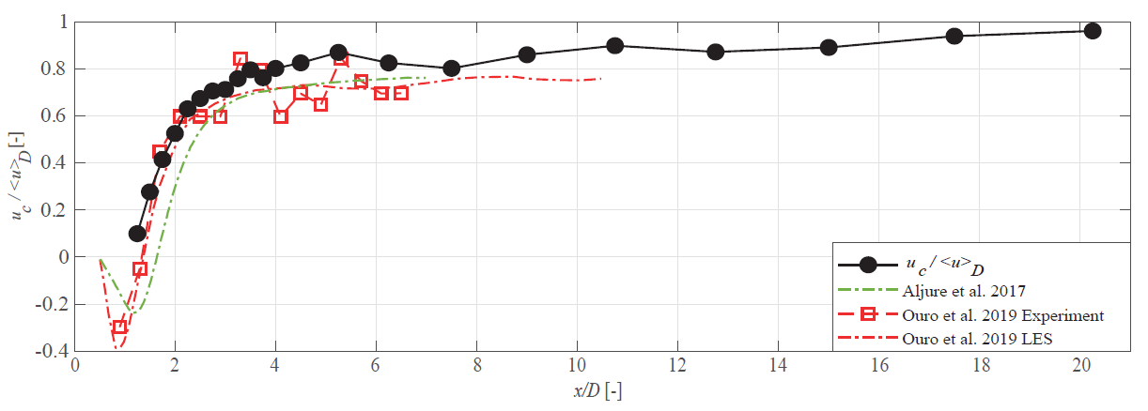
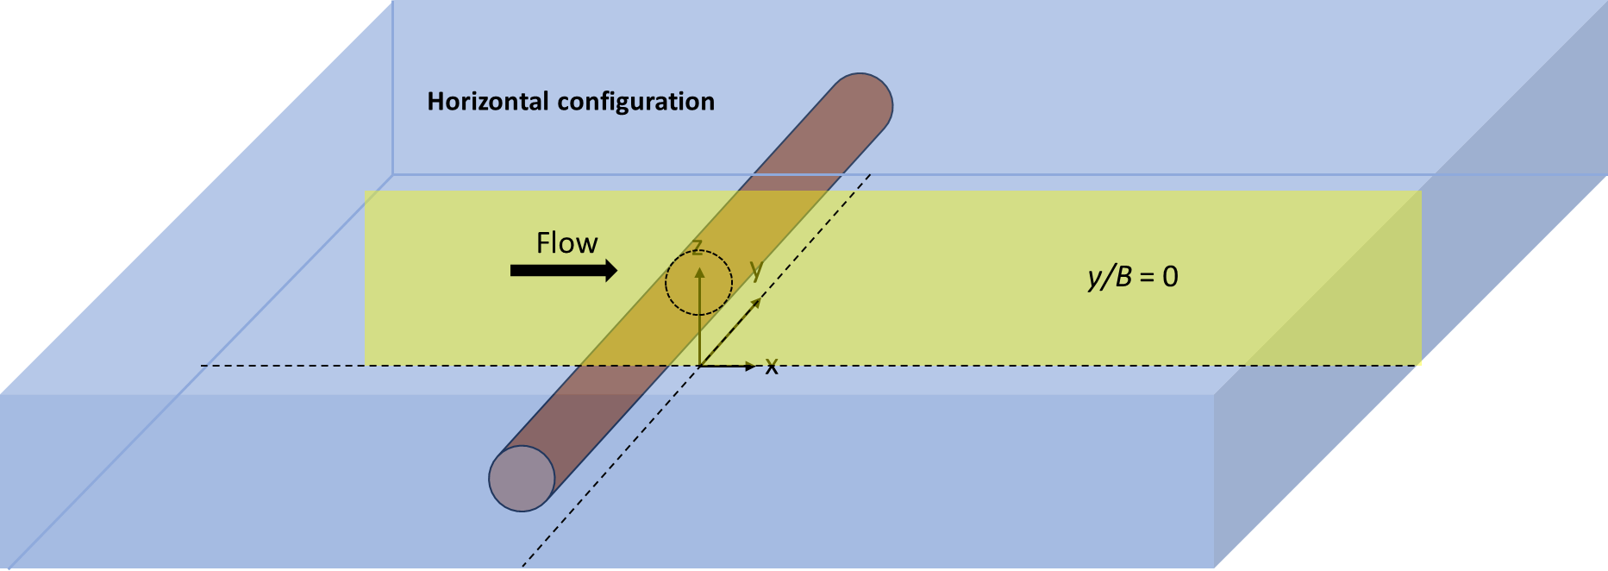
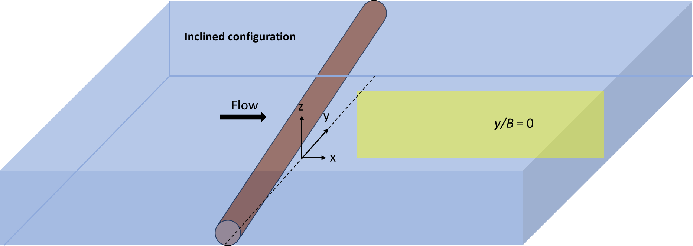
Mean streamwise velocity $\overline{u}$
Results
Horizontal configuration, y/B = 0
Inclined configuration, y/B = 0
Almost fully recovered at the end of the measurement grid
Recovery seems to be faster than in an unconfined case

Slide 5
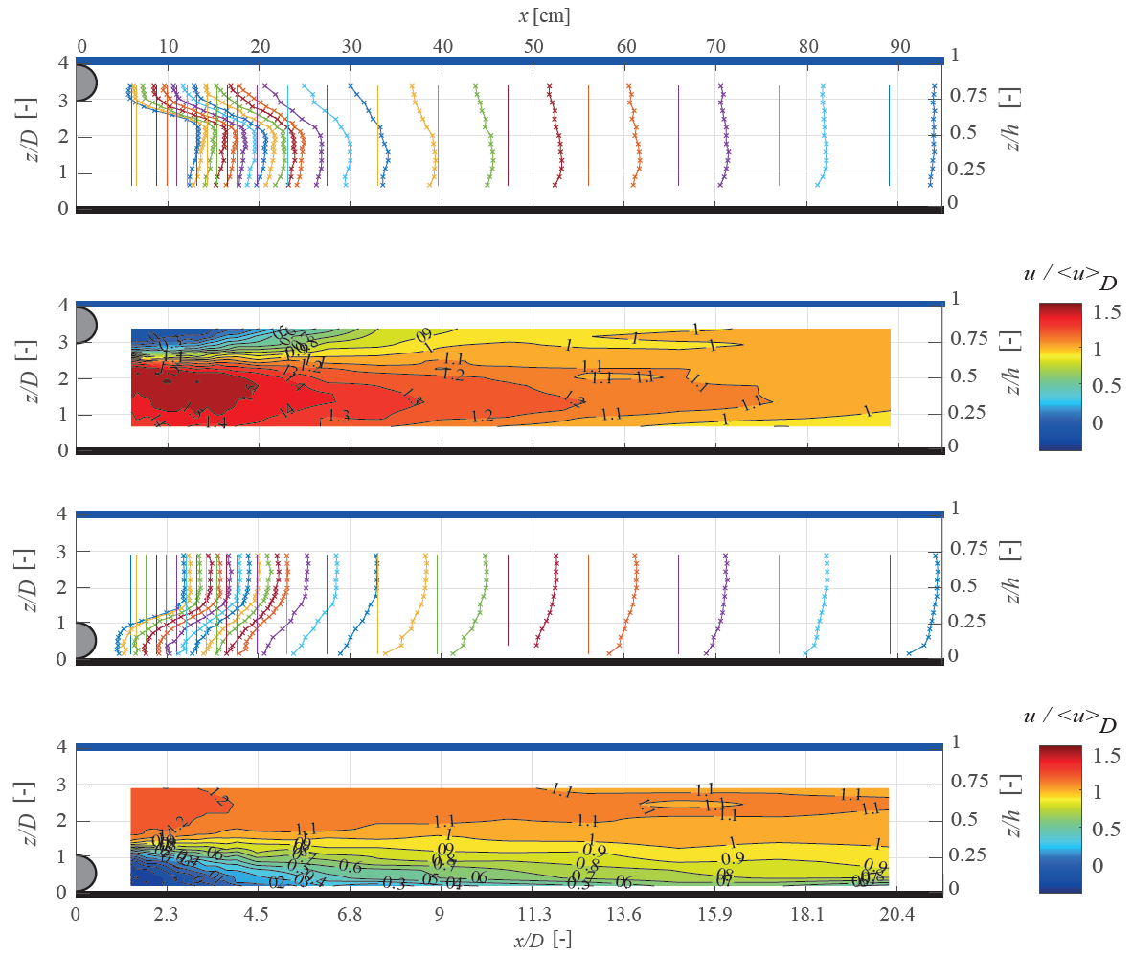
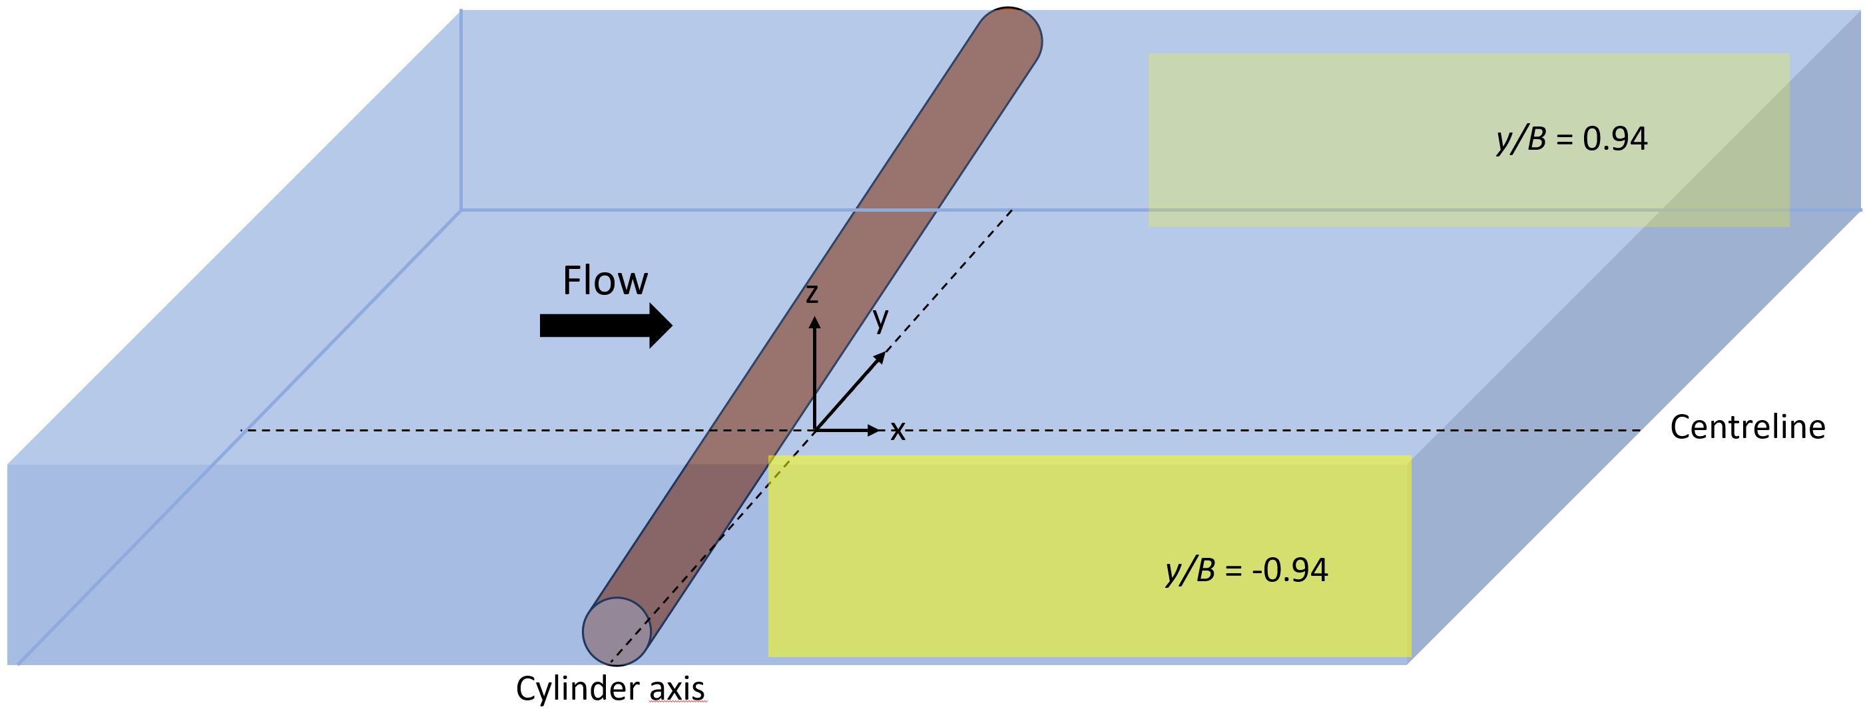
Mean streamwise velocity $\overline{u}$
Results
Inclined configuration, y/B = 0.94
Inclined configuration, y/B = -0.94
Higher velocities on only one side of the cylinder
Wake is considerably larger
Relevant for morphology (impact on the bed erosion / deposition)
Longer distance to return to undisturbed conditions

Slide 6
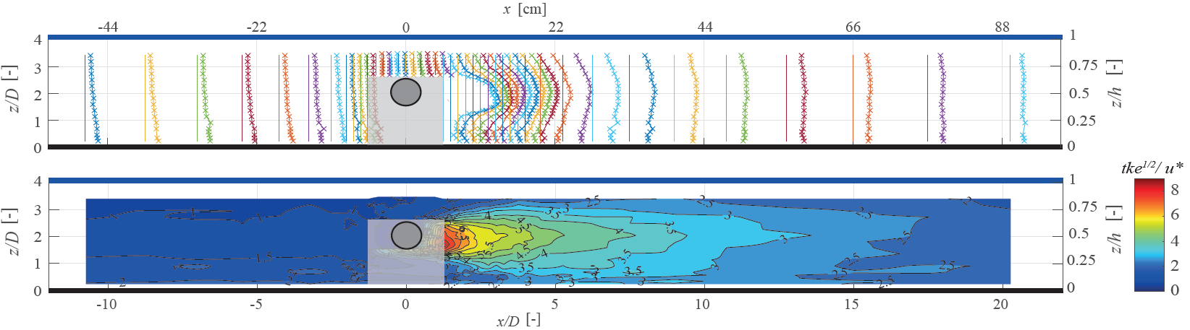
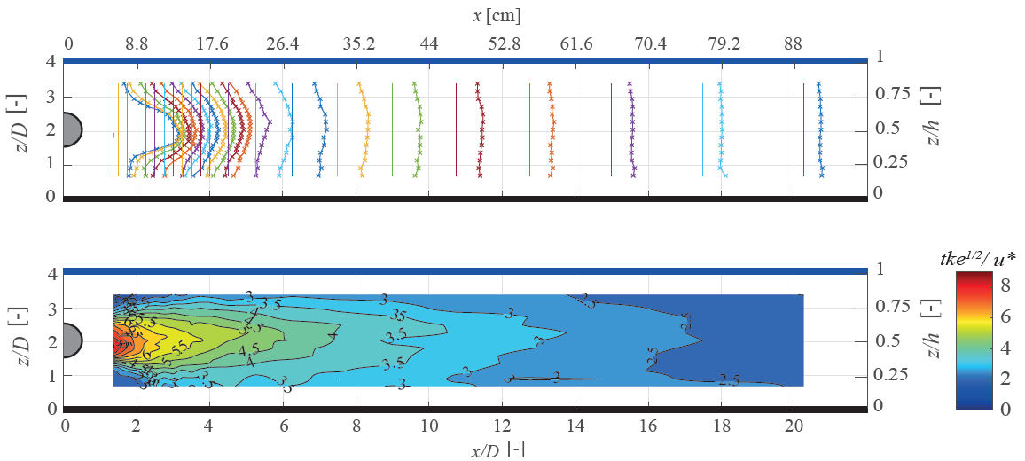

Turbulent Kinetic Energy
Results
$$tke= \frac{1}{2}\left(\overline{{\left(u′\right)}^{2}}+\overline{{\left(v′\right)}^{2}}+\overline{{\left(w′\right)}^{2}}\right)$$
Horizontal configuration, y/B = 0
Inclined configuration, y/B = 0

Slide 7
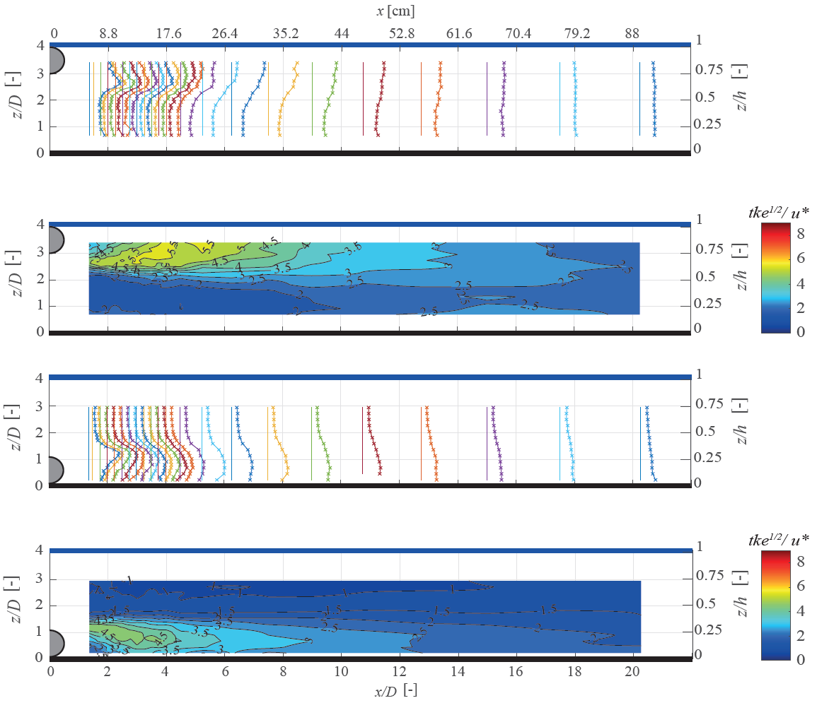
Turbulent Kinetic Energy
Results
$$tke= \frac{1}{2}\left(\overline{{\left(u′\right)}^{2}}+\overline{{\left(v′\right)}^{2}}+\overline{{\left(w′\right)}^{2}}\right)$$
Inclined configuration, y/B = 0.94
Inclined configuration, y/B = -0.94
Turbulent kinetic energy values substantially lower
Less mixing and turbulence
Explains the differences concerning the recovery of the mean velocity

Slide 8
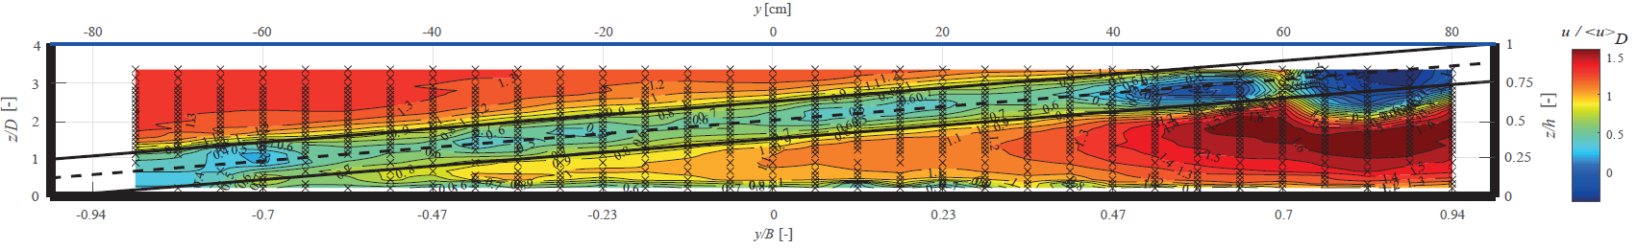
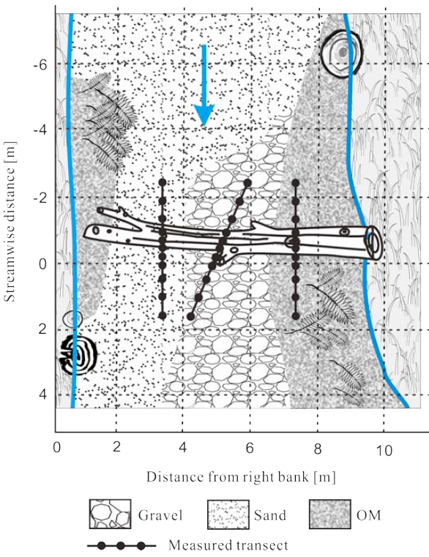
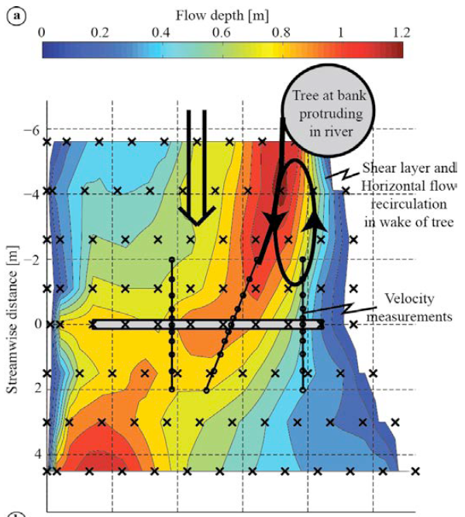
Conclusion
Both the confinement and the inclination of an obstacle changes the hydrodynamics of its wake
In a river environment, it is relevant for morphology
Differences in the bathymetry and the bed composition
Finer sediment related to smaller velocities near the bed
Coarser sediment related to higher velocities near the bed
Field measurements performed in the Pliszka River, Poland by Blanckaert et al., 2014

Slide 9
Hydrodynamics in the near-wake of cylindrical obstacles in a turbulent open channel flow
Théo FERNANDEZ^{1,2}, Ingo SCHNAUDER¹, Olivier EIFF², Koen BLANCKAERT¹
Contact : theo.fernandez@tuwien.ac.at
EGU General Assembly, May 23rd – 27th, 2022, Vienna, Austria - EGU22-11911, Session GM5.2

Slide 10
References
Aljure, D. E., Lehmkhul, O., Rodriguez, I., and Oliva, A. (2017). Three dimensionality in the wake of the flow around a circular cylinder at Reynolds number 5000. Computers and Fluids
Blanckaert, K., Han, R., Pilotto, F., and Pusch, M. (2014). Effects of Large Wood on Morphology, Flow and Turbulence in a Lowland River. In International Conference on Fluvial Hydraulics, River Flow 2014
Eames, I., Jonsson, C., and Johnson, P. B. (2011). The growth of a cylinder wake in turbulent flow. Journal of Turbulence.
Ouro, P., Muhawenimana, V., Wilson, C. A. M. E. (2019). Asymmetric wake of a horizontal cylinder in close proximity to a solid boundary for Reynolds numbers in the subcritical turbulence regime. Phys. Rev. Fluids
Tennekes, H. and Lumley, J. L. (1972). A first course in turbulence
Wang, X. K. and Tan, S. K. (2008). Comparison of flow patterns in the near wake of a circular cylinder and a
square cylinder placed near a plane wall. Ocean Engineering
Zdravkovich, M.M. (1997) Flow around Circular Cylinders. Fundamentals, Vol. 1, Oxford University Press, Oxford

Slide 11
Appendix

Slide 12
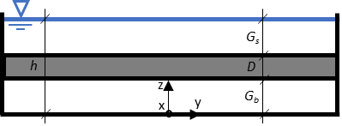
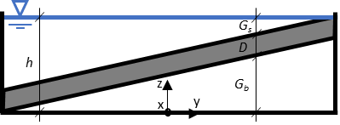
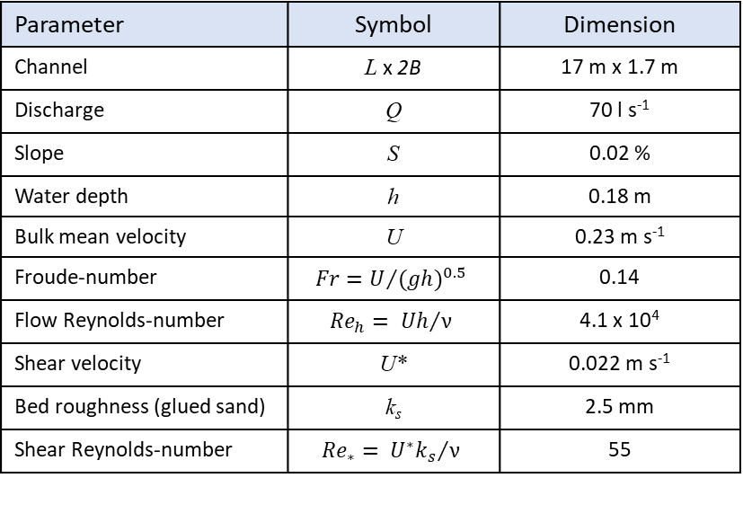
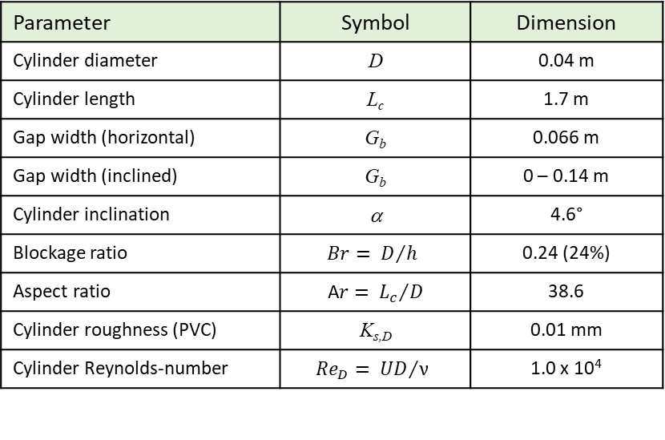
Experimental configuration and parameters
Channel flow
Wake flow
Parameter | Symbol | Dimension
Channel | L x 2B | 17 m x 1.7 m
Discharge | Q | 70 l s⁻¹
Slope | S | 0.02 %
Water depth | h | 0.18 m
Bulk mean velocity | U | 0.23 m s⁻¹
Froude-number | $$Fr=U/{{(gh)}^{0.5}}$$ | 0.14
Flow Reynolds-number | $${Re}_{h}= {Uh}/ν$$ | 4.1 x 10⁴
Shear velocity | U* | 0.022 m s⁻¹
Bed roughness (glued sand) | k_{s} | 2.5 mm
Shear Reynolds-number | $${Re}_{∗}= {U^{∗}k_{s}}/ν$$ | 55
Parameter | Symbol | Dimension
Cylinder diameter | D | 0.04 m
Cylinder length | L_{c} | 1.7 m
Gap width (horizontal) | G_{b} | 0.066 m
Gap width (inclined) | G_{b} | 0 – 0.14 m
Cylinder inclination | α | 4.6°
Blockage ratio | $$Br= D/h$$ | 0.24 (24%)
Aspect ratio | A$r= {L_{c}}/D$ | 38.6
Cylinder roughness (PVC) | K_{s,D} | 0.01 mm
Cylinder Reynolds-number | $${Re}_{D}= {UD}/ν$$ | 1.0 x 10⁴
Horizontal
Inclined
U
U
2 cm
U
α
2B
2B

Slide 13
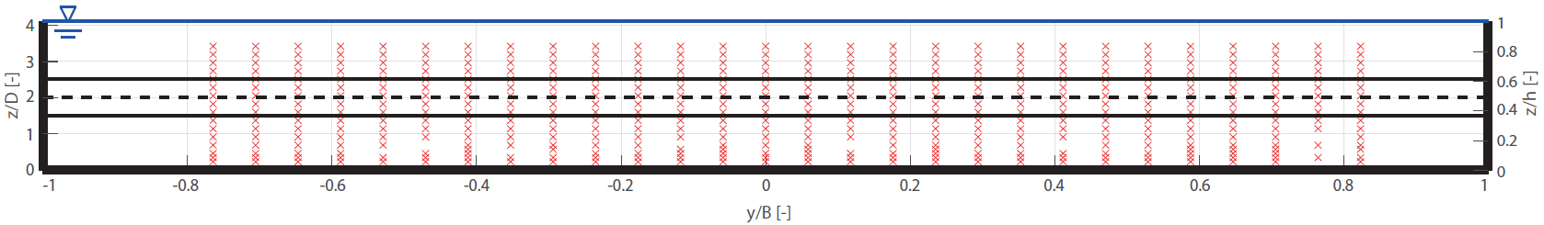
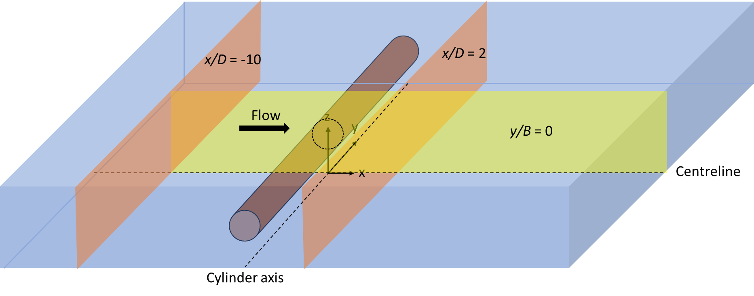
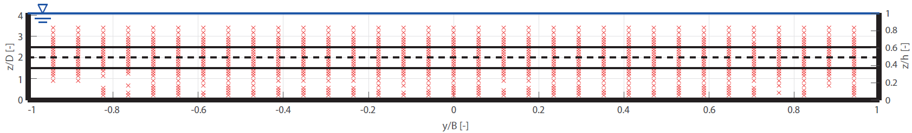
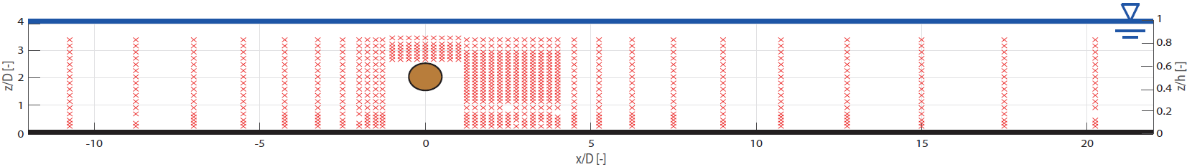
Measurement methods
Side looking ADV (Acoustic Doppler Velocimeters, Nortek Vectrino+) measures the 3 velocity components
Frequency: f = 25 Hz, acquisition time: t = 60 to 120 s
Cross-sectional plane at x/D = -10
Horizontal configuration
Cross-sectional plane at x/D = 2
Longitudinal plane at y/B = 0

Slide 14
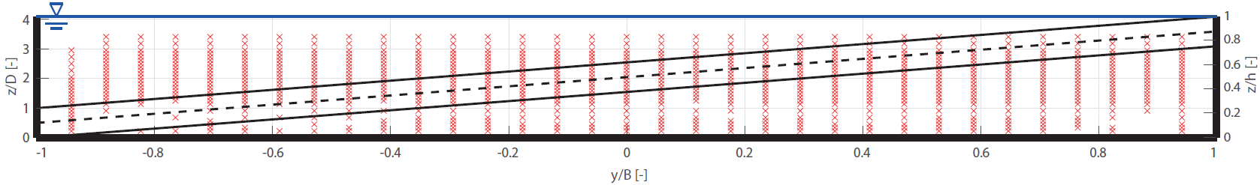
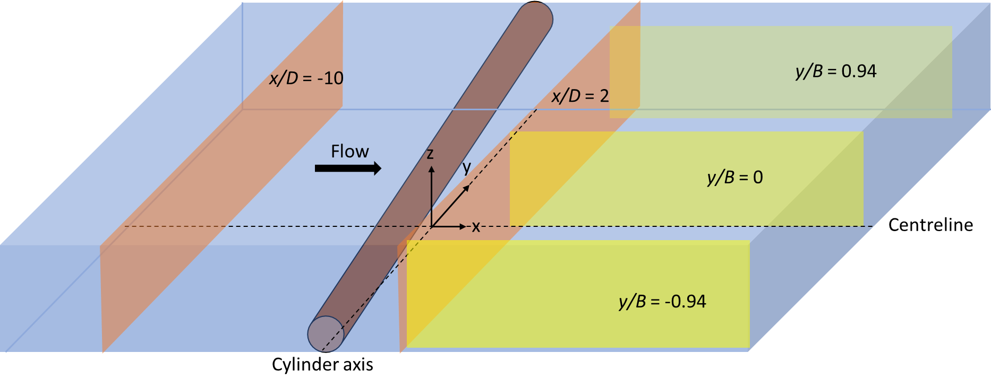
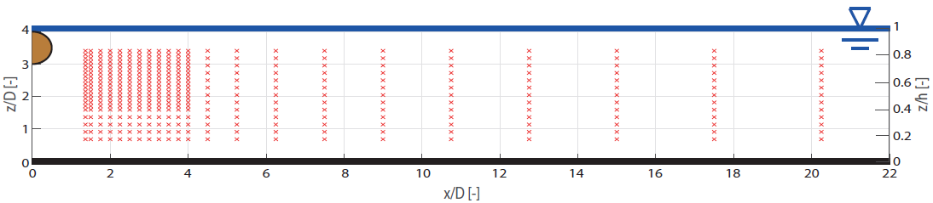
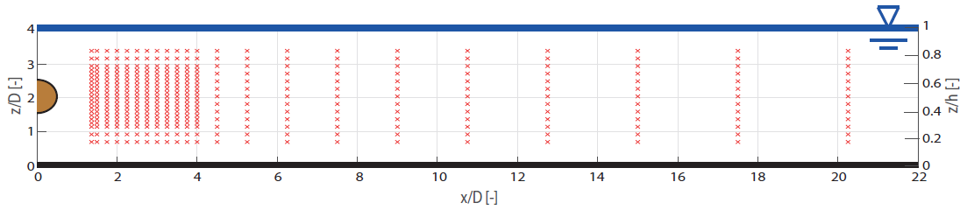
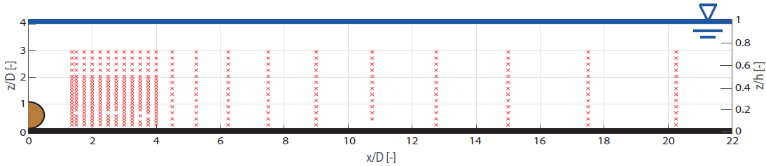
Measurement methods
Side looking ADV (Acoustic Doppler Velocimeters, Nortek Vectrino+) measures the 3 velocity components
Frequency: f = 25 Hz, acquisition time: t = 60 to 120 s
Cross-sectional plane at x/D = -10
Cross-sectional plane at x/D = 2
Horizontal configuration
Inclined configuration
Longitudinal plane at y/B = 0.94
Cross-sectional plane at x/D = 2
Longitudinal plane at y/B = 0
Longitudinal plane at y/B = 0
Longitudinal plane at y/B = -0.94

Slide 15
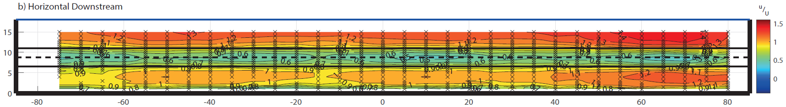
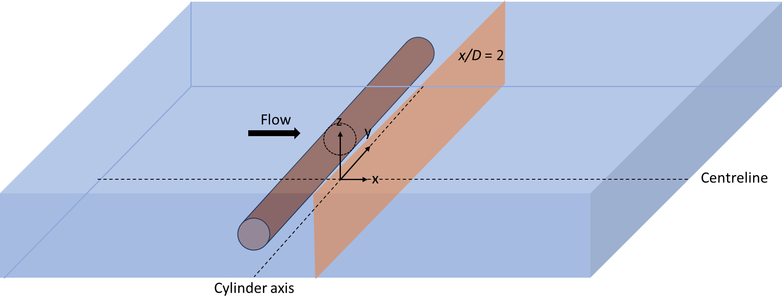
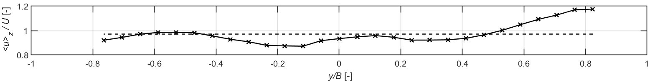
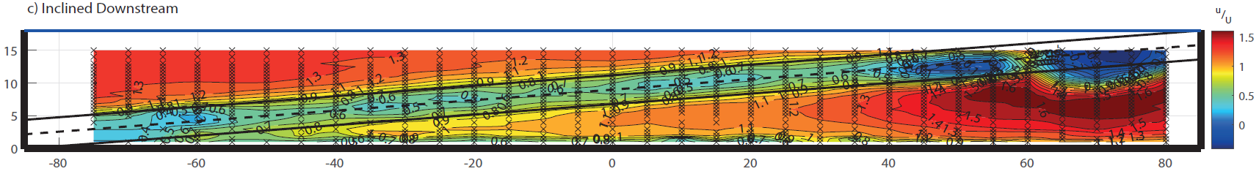
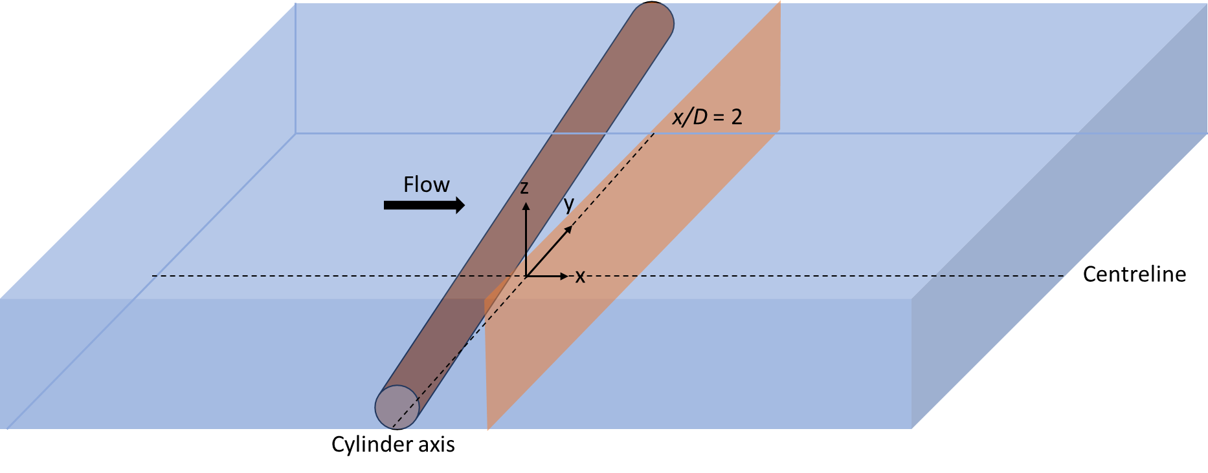
Mean streamwise velocity $\overline{u}$
Results
Depth-average mean velocity ${<u>}_{z}$, x/D = -10

Slide 16
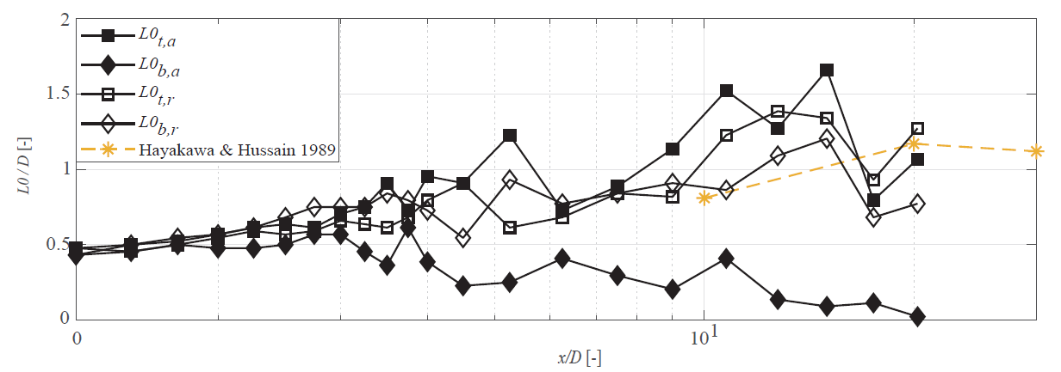
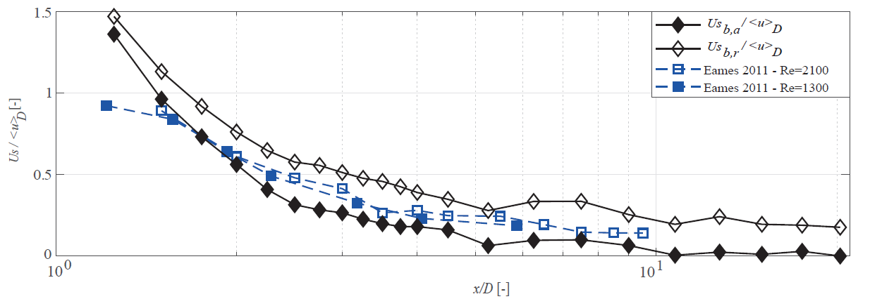
Evolution of the half-width of the wake and the velocity deficit

Slide 17

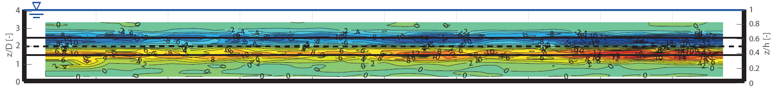
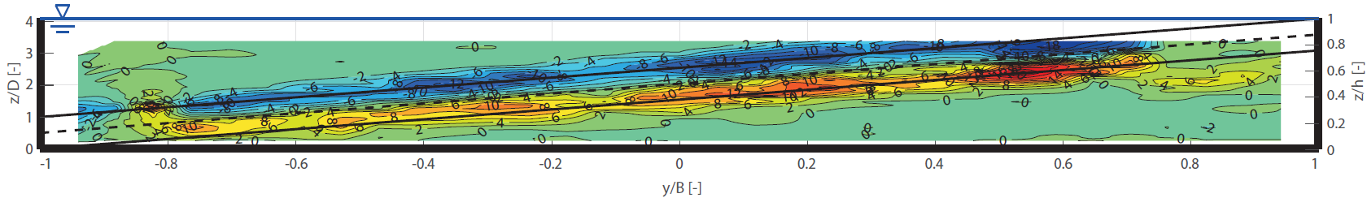
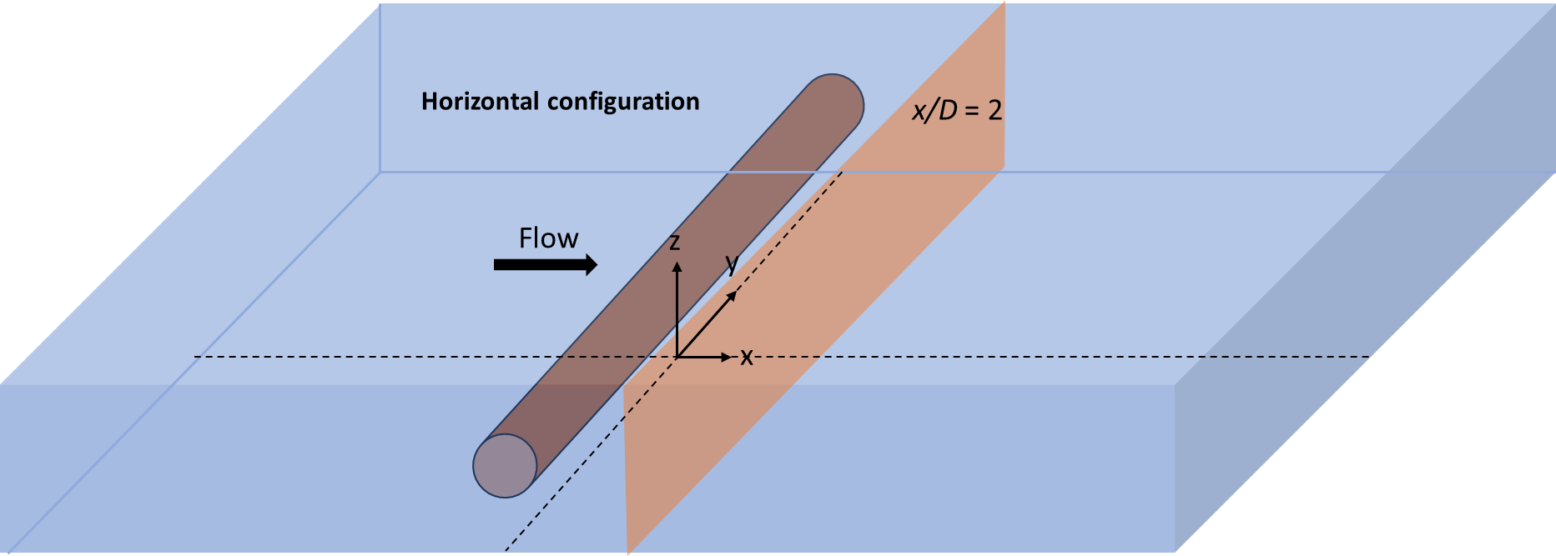
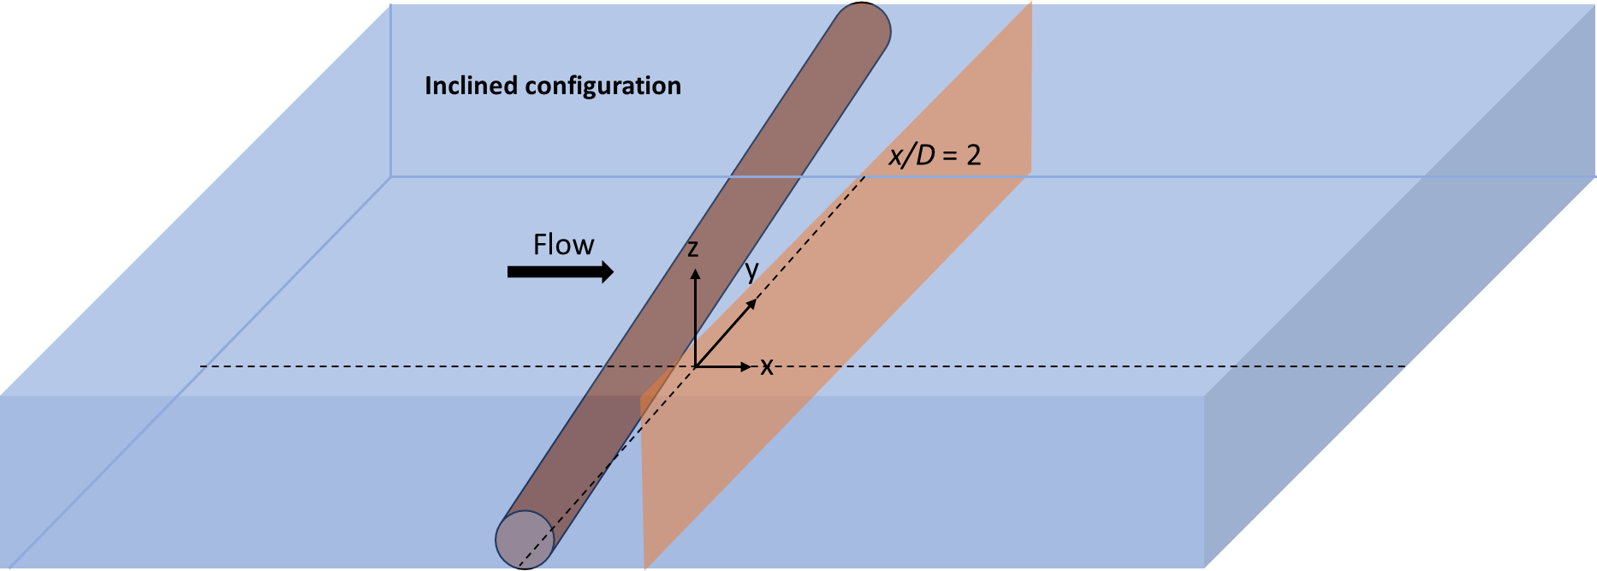
Turbulent shear stress$\overline{u^{′}w′}$
Results
Horizontal configuration, x/D = 2
Inclined configuration, x/D = 2
Depth-average mean velocity ${<u>}_{z}$, x/D = -10

Slide 18



Decay of Urms, Vrms and Wrms

Slide 19




Strouhal number
$f$: Strouhal frequency
$D$: Cylinder diameter
$U_{∞}$: Free-stream velocity
$$St= \frac{f D}{U_{∞}}$$
Infinite cylinder in uniform unbounded low-turbulent flow (wind tunnel data)
Effect of blockage
Richter (1976)
Lienhard (1966) and
Achenbach and Heinecke (1981)
Increase of blockage
Our data
Our data
Effect remains
for Re_{D} < 10⁵

Slide 20










Strouhal Number
Results
$f$: Strouhal frequency
$D$: Cylinder diameter
${<\overline{u}>}_{p}$: projected velocity
$f$: Strouhal frequency
$D$: Cylinder diameter
${<\overline{u}>}_{p}$: projected velocity
$f$: Strouhal frequency
$D$: Cylinder diameter
${<\overline{u}>}_{p}$: projected velocity
$$St= \frac{f D}{{<\overline{u}>}_{p}}$$
$$St= \frac{f D}{{<\overline{u}>}_{p}}$$
Inclined configuration,
x/D = 2, y/B = 0.64, z/D = 3.2
Inclined configuration,
x/D = 2, y/B = 0.7, z/D = 3.1
$$St= \frac{f D}{{<\overline{u}>}_{p}}$$
Peak in the spectra : vortex shedding
No peak in the spectra : no vortex shedding
Secondary flow structures
Inflow distortion

Slide 21



Strouhal Number
Results
Horizontal configuration, x/D = 2
Inclined configuration, x/D = 2

Slide 22

Appendix III: Strouhal number across the width

Slide 23






Intensity of vortex shedding

Slide 24






Turbulent normal stress u’² and w’²

Slide 25








Discussion
Central part of the cross section: 2 shear layers, presence of vortex shedding
Near the banks: Single shear layer, higher velocities, no vortex shedding
Cut-off of vortex shedding at $\left({G_{b}}/D\right) ≤0.3$ and$\left({G_{s}}/D\right) ≤0.5$
No Vortex Shedding
Vortex Shedding
No Vortex Shedding
$${G_{s}}/D$$
$${G_{b}}/D$$
$\left({G_{b}}/D\right) ≤0.3$
$\left({G_{s}}/D\right) ≤0.5$

