Slide 1





Combined DInSAR-PSI approach
for increasing the quality of deformation map estimation in the area of underground mining exploitation
Natalia Wielgocka, Kamila Pawluszek-Filipiak, Maya Ilieva
Institute of Geodesy and Geoinformatics, Wroclaw University of Environmental and Life Sciences, Poland
EGU General Assembly 2022 in Vienna, Austria – 26.05.2022

Slide 2




EPOS-PL+ Project – Task 7
Satellite Data Research Infrastructure Center
(CIBDS)
InSAR Processing
Goal: System for monitoring of surface deformation by satellite radar data
1
2
Data Integration
Visualization
5
3
4
Product Validation
Deformation Modeling
EGU General Assembly 2022

Slide 3
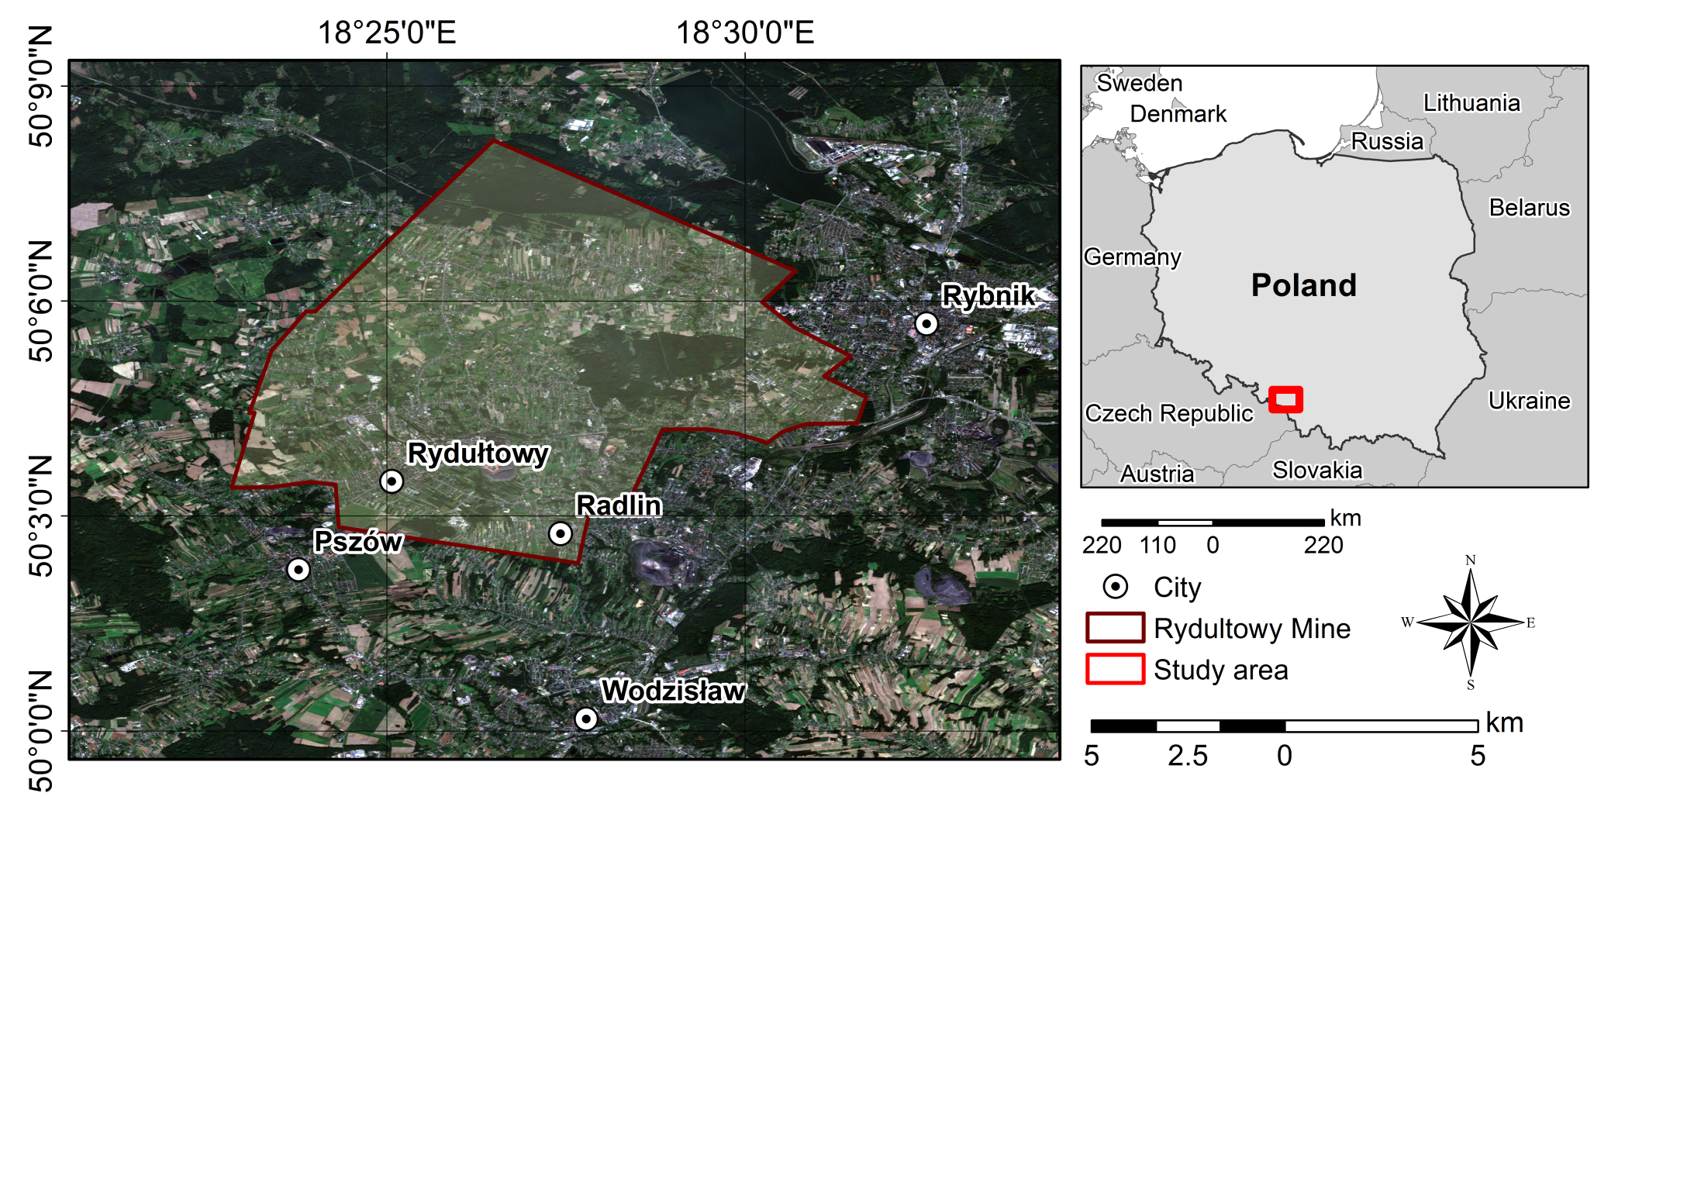

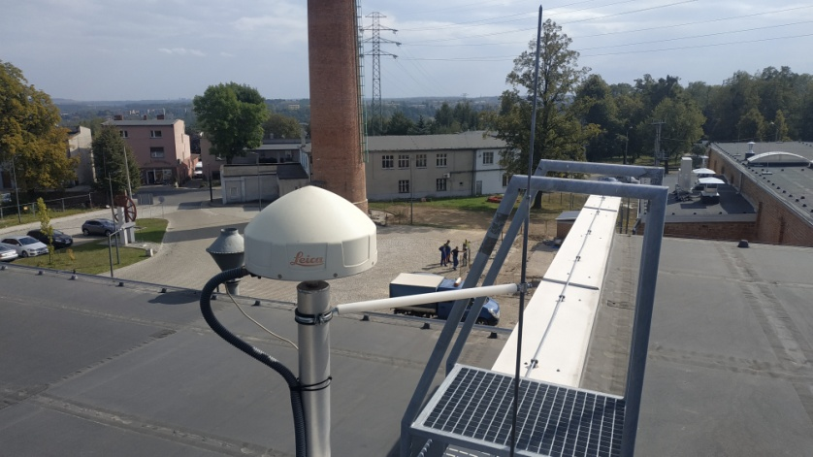
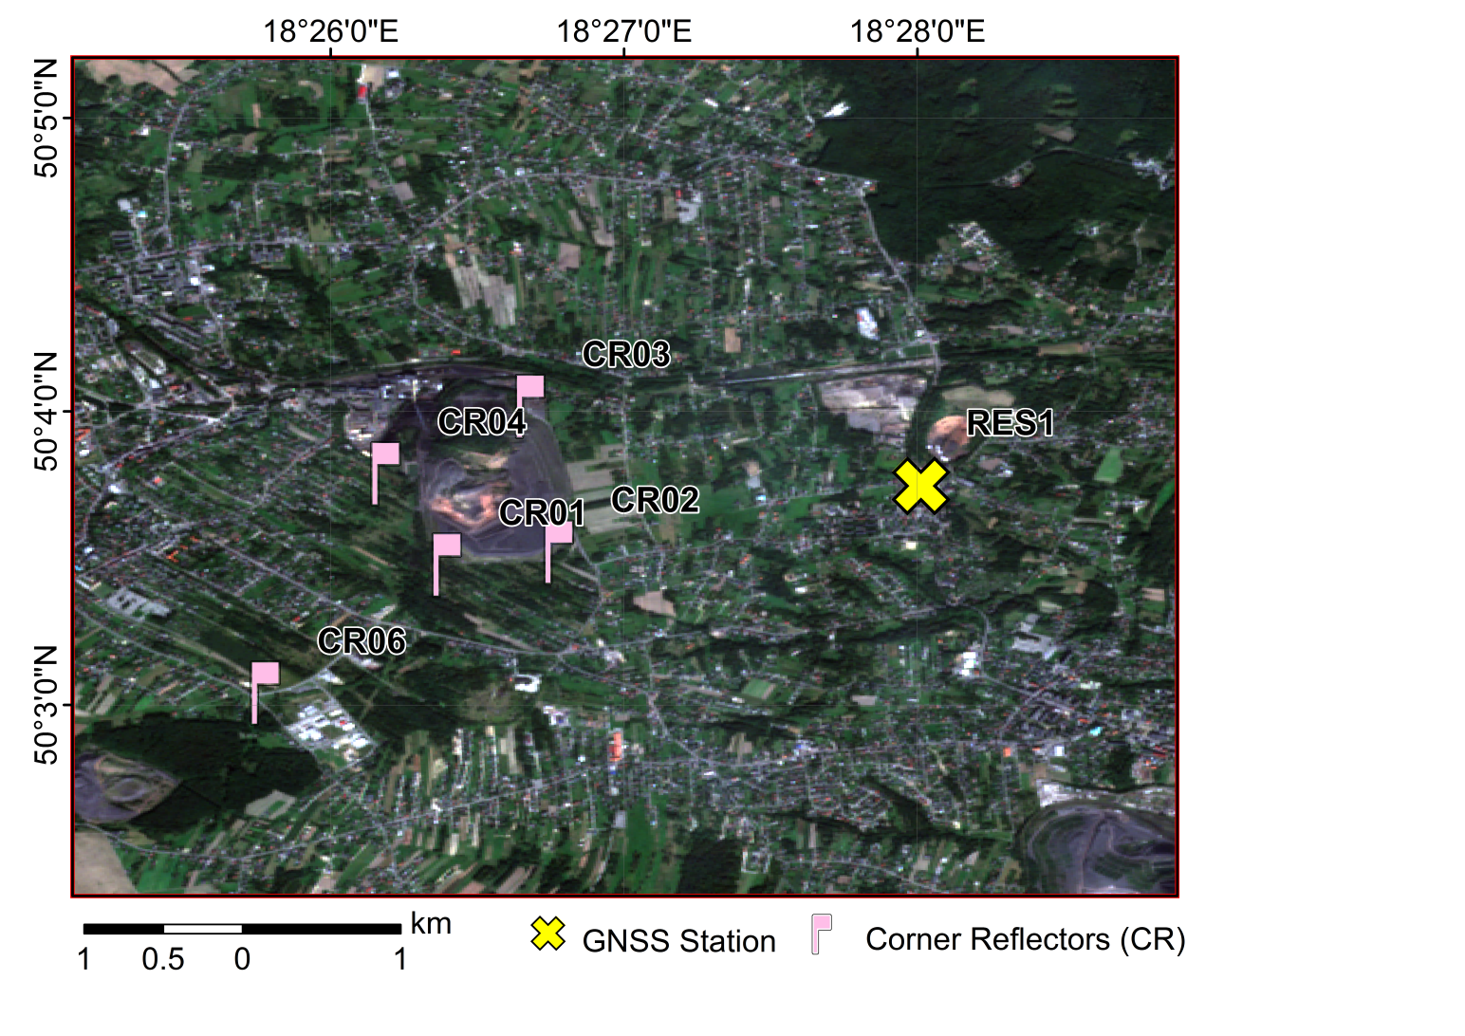
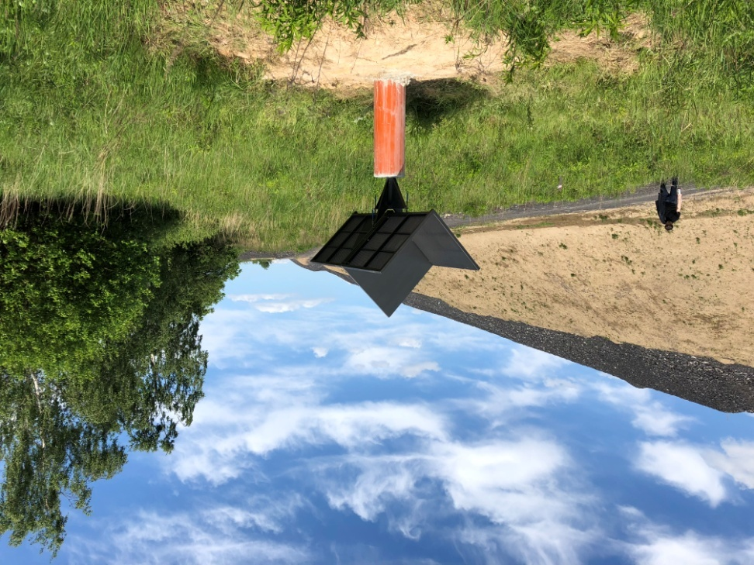
Data & Infrastructure
SAR Data
GNSS Data
Levelling & GNSS Data

Slide 4
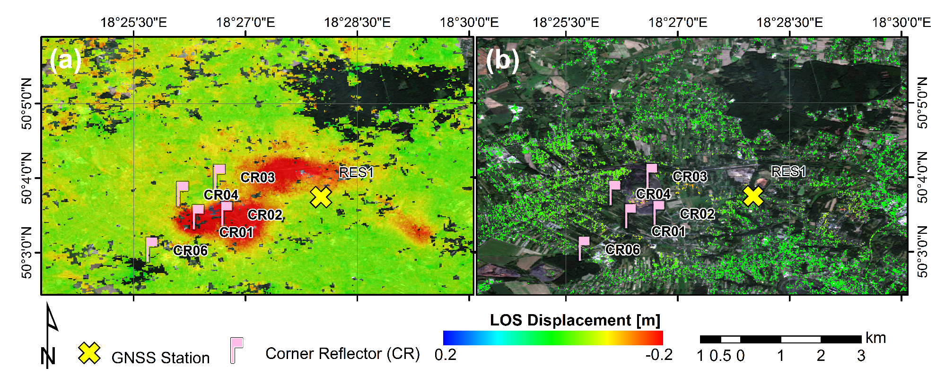
SAR Data
Sentinel-1A/B TOPSAR images - ascending (175) and descending (124),
Time span: 25 June 2018 and 14 July 2019,
DInSAR and PSI processing approach.
Fig. LOS deformation for DInSAR (a) and PSI (b) methods – ascending 175

Slide 5
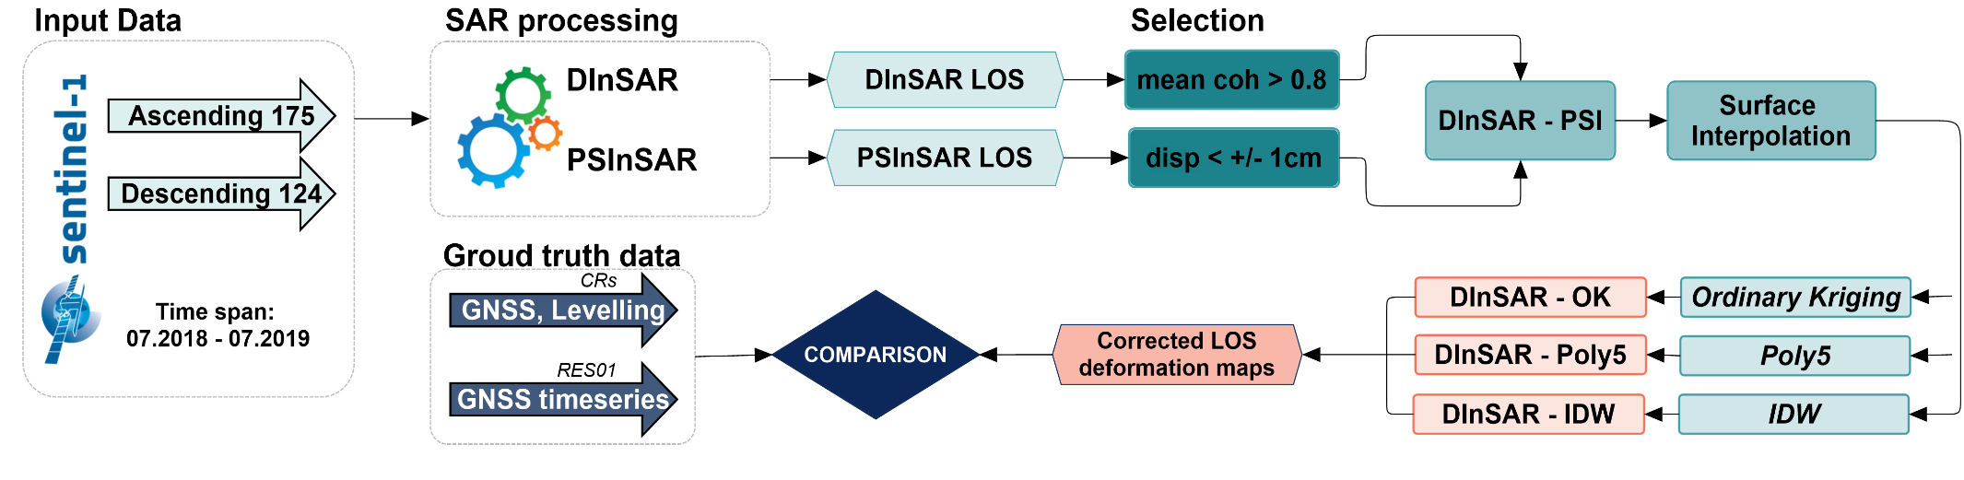
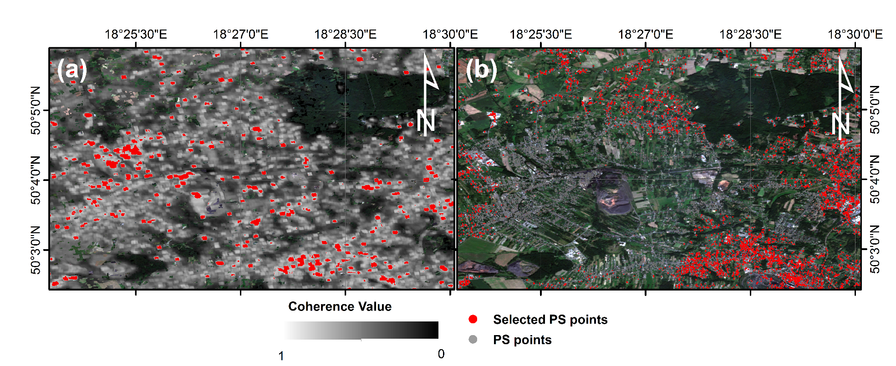
Data Processing
Fig. Selected points for DInSAR (a) and PSI (b) methods – ascending 175

Slide 6
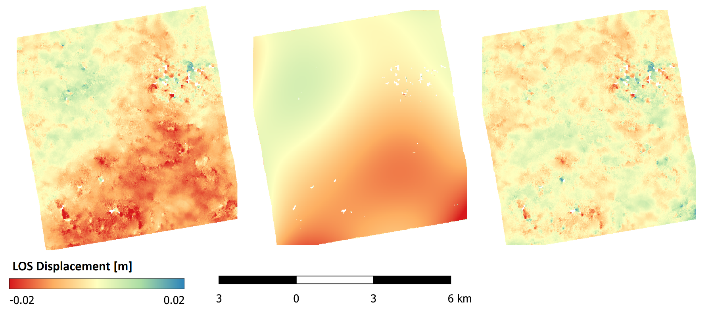
Data Processing
Original DInSAR
Interpolated surface
Corrected DInSAR

Slide 7
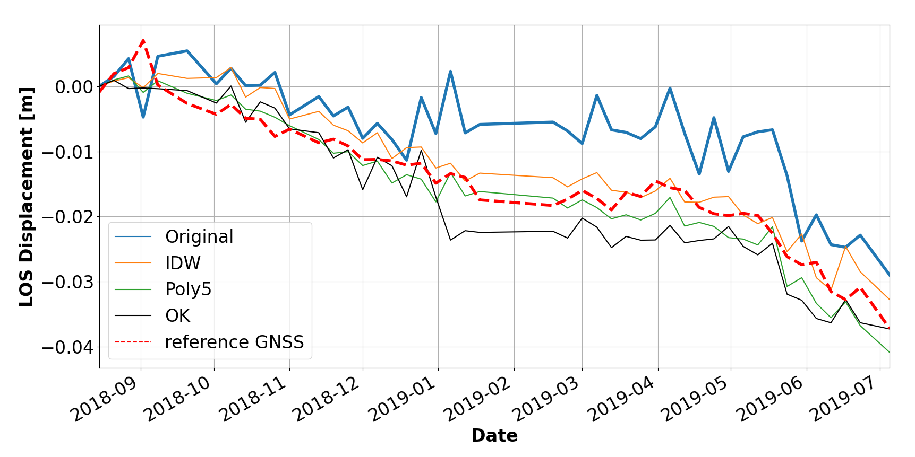
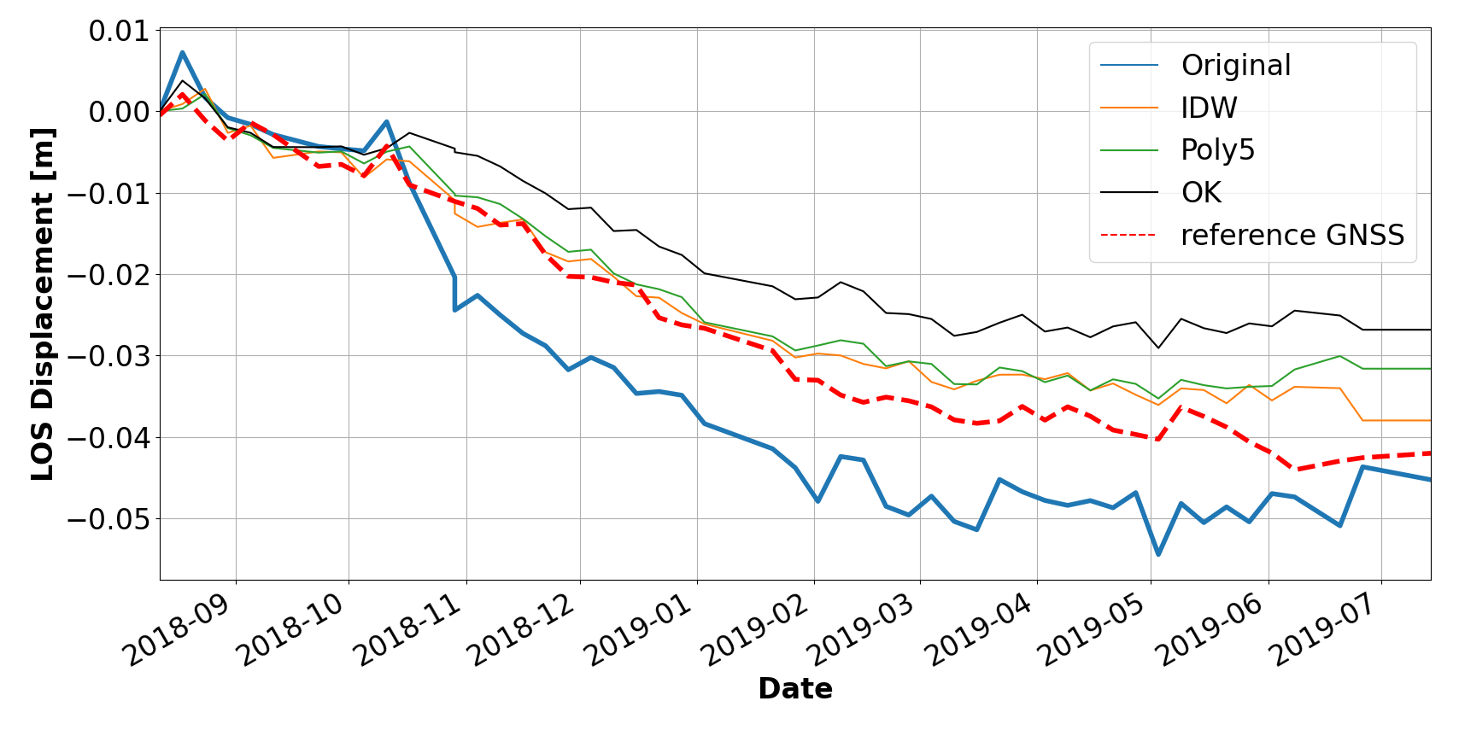
Results
Ascending 175
RMSE [m]:
Original | 0.009
IDW | 0.003
Poly5 | 0.003
Kriging | 0.005
Descending 124
RMSE [m]:
Original | 0.010
IDW | 0.003
Poly5 | 0.004
Kriging | 0.009

Slide 8
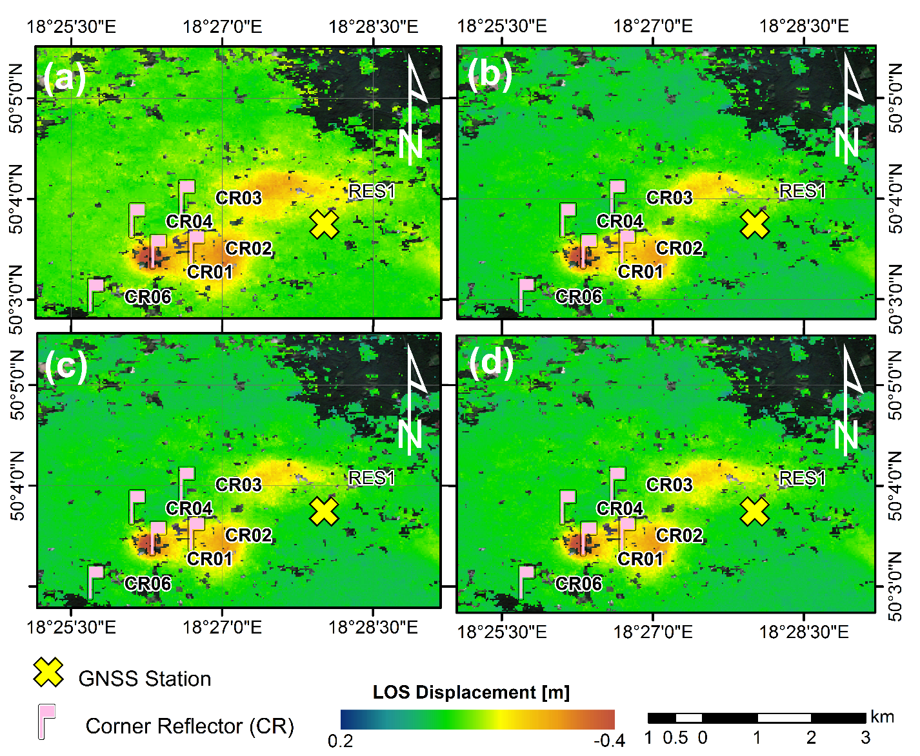
Results
Ascending 175
RMSE [m]:
Original | 0.013
IDW | 0.004
Poly5 | 0.004
Kriging | 0.006
Descending 124
RMSE [m]:
Original | 0.016
IDW | 0.004
Poly5 | 0.006
Kriging | 0.005
Fig. LOS cumulated deformation for DInSAR basic approach (a) and corrected using Polynominal 5 degree (b) Inverse Distance Weighting (c) and Ordinary Kriging (d) interpolation – ascending 175

Slide 9


Conclusions
PSI-based correction for DInSAR data, regardless of the interpolation method, reduces noise and smooths timeseries results
Thanks to the DInSAR-PSI combined approach deformation maps for the whole area with reduced atmospheric artifact were obtained.
Future work will aim to test the methodology in another study area, where more reference data will be available

Slide 10
Combined DInSAR-PSI approach
for increasing the quality of deformation map estimation in the area of underground mining exploitation
Natalia Wielgocka, Kamila Pawluszek-Filipiak, Maya Ilieva
Institute of Geodesy and Geoinformatics, Wroclaw University of Environmental and Life Sciences, Poland
Thank you for your attention!

