Slide 1



EGU22-11975ECS
New insights on the practical significance of numerical methods for surface water pollution source identification
Ruiyi Yang et al.
12032350@mail.sustech.edu.cn
Notes:
Good afternoon! Ladies and gentlemen, it’s my great honor to participate in this meeting, my topic is “New insights on the practical significance of numerical methods for surface water pollution source identification”

Slide 2
Category | Method | Advantage | Major Disadvantage
Simulation-optimization approach | Linear programming and multiple regression(Gorelick et al., 1983) Progressive genetic algorithm(Aral et al., 2001) Particle collision algorithm (PCA) and the Ant colony optimization (ACO) methods(Parolin et al., 2015) …… | Straightforwardness | The non-uniqueness problem of the inverse solution and high computational costs
Probabilistic approach | Backward location probability density function method(Cheng and Jia, 2010) Bayesian Approach(Jiang et al., 2019) Geostatistics(Boano et al., 2005) …… | The small number of simulations | Limited number of identified pollutant sources
Mathematical approach | Analytic extension method(Wang and Liu, 2012) Tikhonov regularization(Mazaheri et al., 2015) Mathematical framework(El Badia et al., 2005) ……. | Reduction of computational costs | Complexity
Notes:
Pollution source identification（PSI） is an important prerequisite for emergency treatment and disposal of pollution events. Studies on PSI in water resources date back over three decades. These studies use inverse solution of the transport equation for recovering the release history and the location of the pollutant sources. Moreover, conducted studies on pollution source identification in surface water resources are fewer in number compared to those on groundwater resources. Each of these studies has its own advantages and limitations in accordance with the methods employed and the complexity of the solutions.

Slide 3

Practical problems and technical bottlenecks
Solution path
The preconditions of model are high and calibration data demand is large.
The time for obtaining monitoring data is too long, which violates the timeliness of source identification.
There are many kinds of pollutants, but little information is extracted.
Optimal layout of monitoring network
Multi-source information fusion
Data assimilation
Notes:
Most previous studies have focused on the innovation of the above methods and the reduction of calculation cost, but there is not much discussion on the problems and technical barriers in practical application. We first summarize practical issues and technical barriers before conducting research, the first point is that the preconditions of the forward model are high and the calibration data demand is large. The second point is that it takes too long to obtain monitoring data, which violates the timeliness of source identification. Finally, there are many kinds of pollutants, but little information is extracted.
In view of the above problems, we have adopted methods such as optimal layout of monitoring network, data assimilation and multi-source information fusion to solve them.

Slide 4
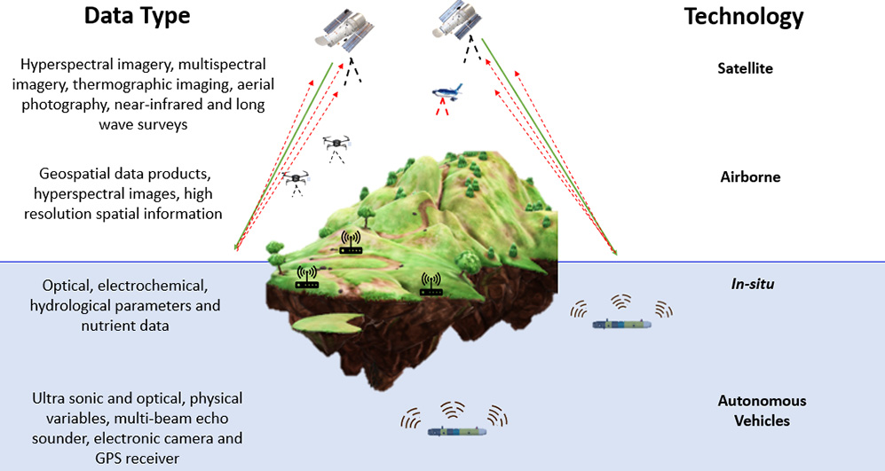
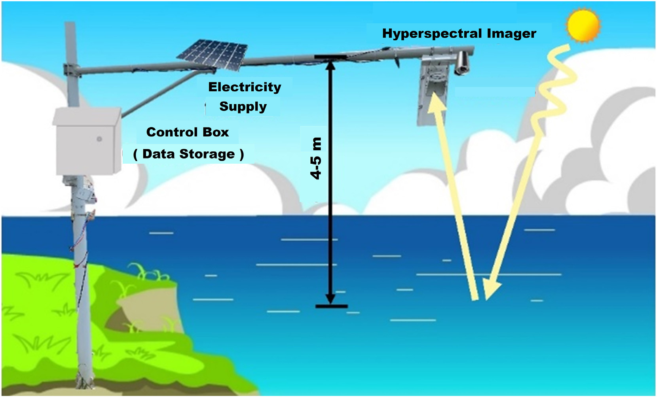
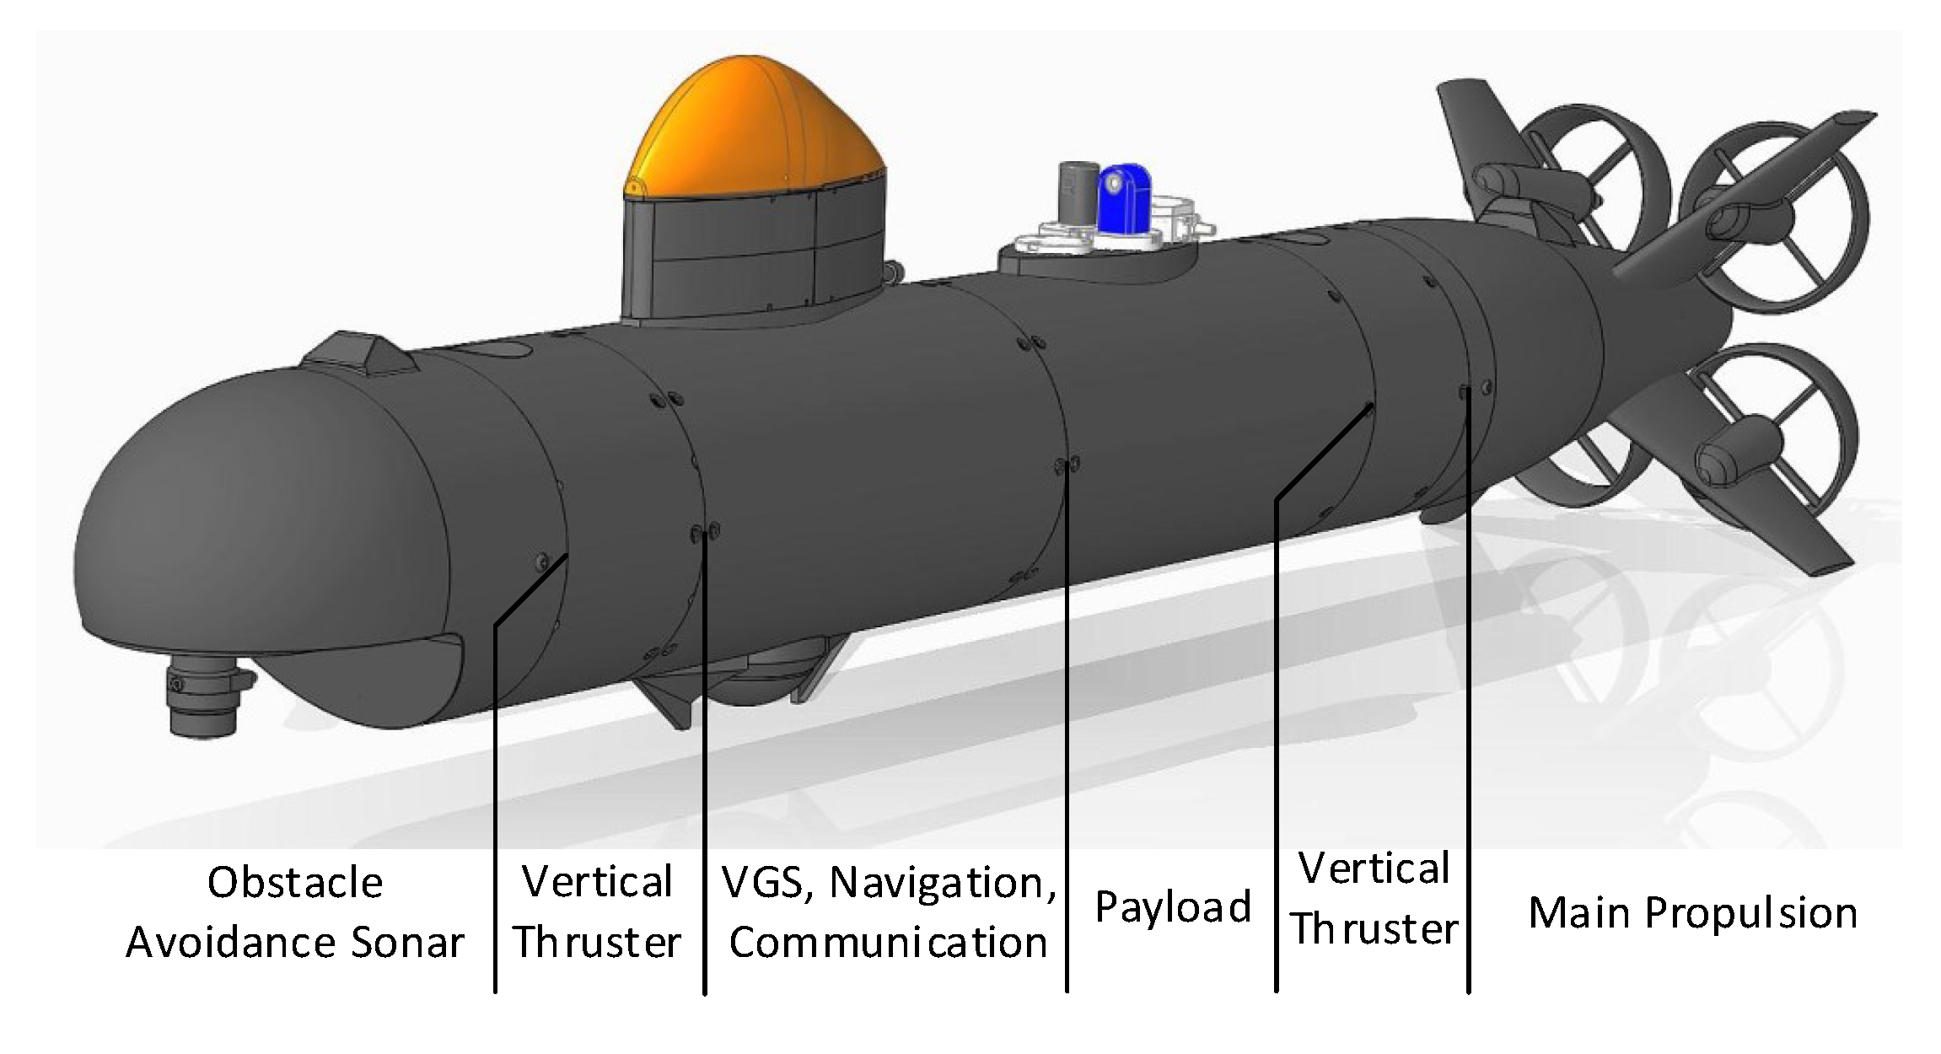
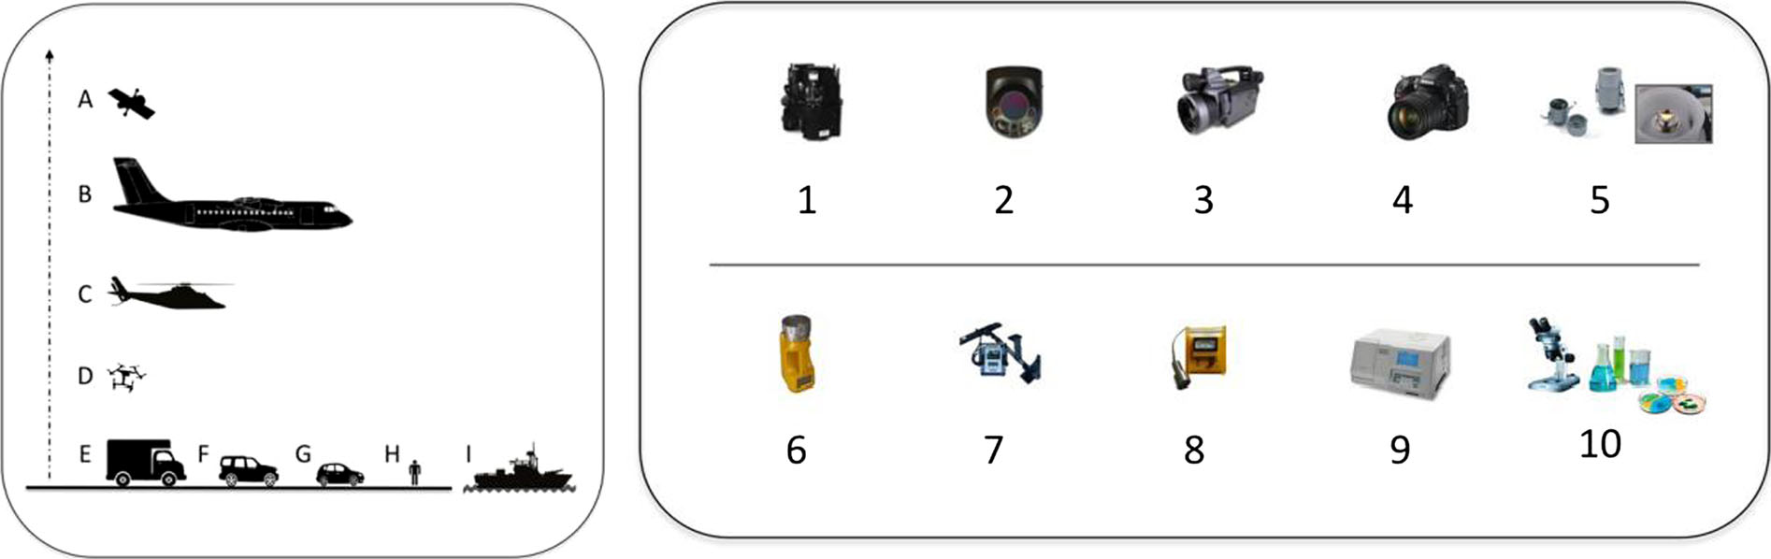
Monitoring technology innovation
A tiered monitoring framework（O'Grady et al., 2021）
In situ monitoring
AUV monitoring
remote sensing monitoring
Sun et al., 2022
Eichhorn et al., 2018
Lega et al., 2014
Notes:
In addition to the innovative application of the above methods, the innovation of monitoring technology has also contributed to the innovation of the operation process of traditional source identification. With the rapid development of sensor City, Internet of things and cloud computing, a new operation process of surface water pollution source identification is proposed.

Slide 5
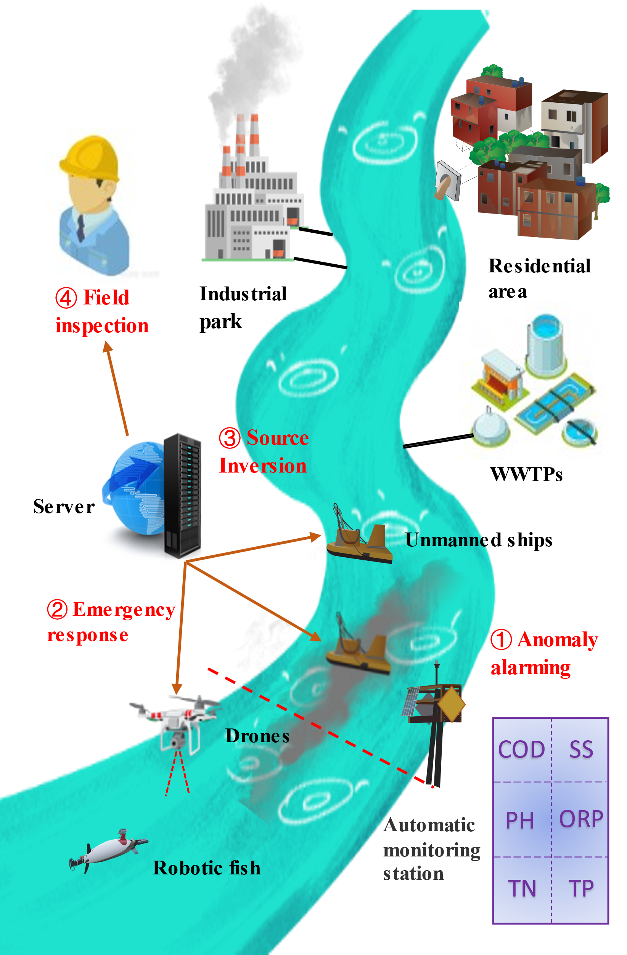
Abnormal warning
Emergency response
Source Inversion
Field inspection
The basic operation routes and technical details
When a pollution warning is received, multiple mobile monitoring platforms are dispatched to track the pollution plume and conduct monitoring.
Simultaneous monitoring of multiple pollutants in the same pollution event and used for numerical inversion calculations.
Bayesian inference inversion method is used as the standard calculation framework, because it can integrate new observation data well.
Figure 1
Notes:
The source identification process can be simplified into four steps: abnormal early warning of fixed water quality monitoring station, layout of emergency monitoring section, source inversion and on-site investigation. Some basic operation routes and technical details need to be declared

Slide 6
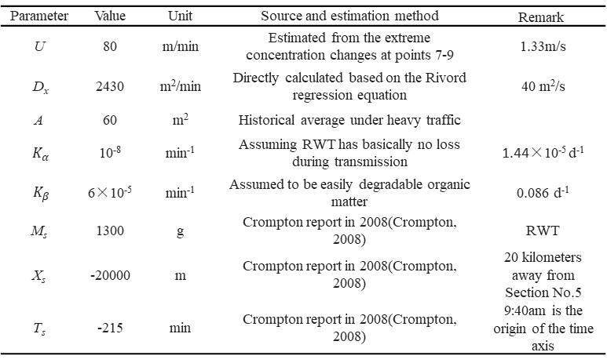
Considering the instantaneous emission of pollution sources, the analytical solution of 1-D Advection Dispersion Model is as follows(Jiang et al., 2019):
Table1. Model parameters and source parameters settings of the Case
Parameter | Value | Unit | Source and estimation method | Remark
U | 80 | m/min | Estimated from the extreme concentration changes at points 7-9 | 1.33m/s
D_{x} | 2430 | m²/min | Directly calculated based on the Rivord regression equation | 40 m²/s
A | 60 | m² | Historical average under heavy traffic
$K_{α}$ | 10⁻⁸ | min⁻¹ | Assuming RWT has basically no loss during transmission | 1.44×10⁻⁵ d⁻¹
$${ K}_{β}$$ | 6×10⁻⁵ | min⁻¹ | Assumed to be easily degradable organic matter | 0.086 d⁻¹
M_{s} | 1300 | g | Crompton report in 2008(Crompton, 2008) | RWT
X_{s} | -20000 | m | Crompton report in 2008(Crompton, 2008) | 20 kilometers away from Section No.5
T_{s} | -215 | min | Crompton report in 2008(Crompton, 2008) | 9:40am is the origin of the time axis
Figure 2
Notes:
This study uses the dye tracer test of the Truckee river of Virginia in 2006 by USGS as a basic case, and uses its data to construct hypothetical pollution incidents and sampling data for theoretical analysis. Considering the instantaneous emission of pollution sources, the analytical solution of the one-dimensional advective dispersion model is used as the forward model. The parameters of the model and the parameter settings of the source items are set as shown in Table 1.

Slide 7
Bayesian inference formalization of source identification problem
1.Model construction
2.Posterior distribution calculation
Markov chain Monte Carlo（MCMC）often used to quickly estimate the posterior distribution. This study uses Adaptive Metropolis (AM) algorithm as the sampling method.
Where p(θ|C,I) is the posterior distribution of the source parameter, p(θ,I) is the prior distribution of the source parameter, l(C,θ,I) is the likelihood function, p(C |I) is the evidence.
3.Analysis of posterior distribution
MCMC sampling finally converges to the posterior probability density (or its logarithmic form), and uses the method of numerical integration to calculate the marginal probability density of each parameter.
Where l(C|s,I) is the likelihood function; n is the number of pollutant monitoring data; C_{i} is the actual measured value of the concentration of C_{i} pollutants; R_{i} is the simulated value of the pollutant concentration; σ2 all is considered as the variance of the overall error.
4.Decision reasoning
In this study, median and Bayesian intervals were used to infer the source parameter results.
Notes:
The Bayesian inference formalization process for source identification problems is divided into four steps. Firstly, the source identification problem is formulated by Bayesian formula，then，（MCMC）often used to quickly estimate the posterior distribution. This paper uses Adaptive Metropolis (AM) algorithm as the sampling method. Finally, analysis of posterior distribution and decision reasoning process are carried out.

Slide 8
Data assimilation
Path Ⅰ
Path Ⅱ
Multi-source information fusion
Path Ⅰ
Path Ⅱ
Figure 3
Notes:
This study sets up two implementation paths for data assimilation and MIF methods respectively.
The specific implementation steps of DA-Path1 are divided into two steps: Iterative update of prior distribution of source items and Iterative update of likelihood function. The main difference between path 2 and path 1 is that path 2 does not update the prior distribution of the source item at each iteration.
In the Bayesian framework, there are two paths for multi-source information fusion: Path 1 is to Directly weight the source item results，and path 2 combines two Markov chains to weight the likelihood function.
Based on the above case data and method principles, numerical experiments are carried out to make discoveries. The experimental design of the data assimilation experiments and the multi-source information fusion experiments is shown in Figure 3.
The pollutant monitoring data of the three sections measured at the same time are input into the Bayesian inversion model group by group according to the time sequence, and each iteration obtains a source term calculation result, a total of 12. Generally, a globally optimal subset of MCMC can be searched by, such as, the AIC or BIC. But here, considering practical application, another method is adopted. The position of the maximum probability density of parameter estimation is selected as the result, and the relative error is obtained by comparing it with the actual value. For the measurement of uncertainty, the bootstrap method is used, and the maximum and minimum absolute values of the relative errors obtained by 20 calculations are used as the uncertainty interval.

Slide 9
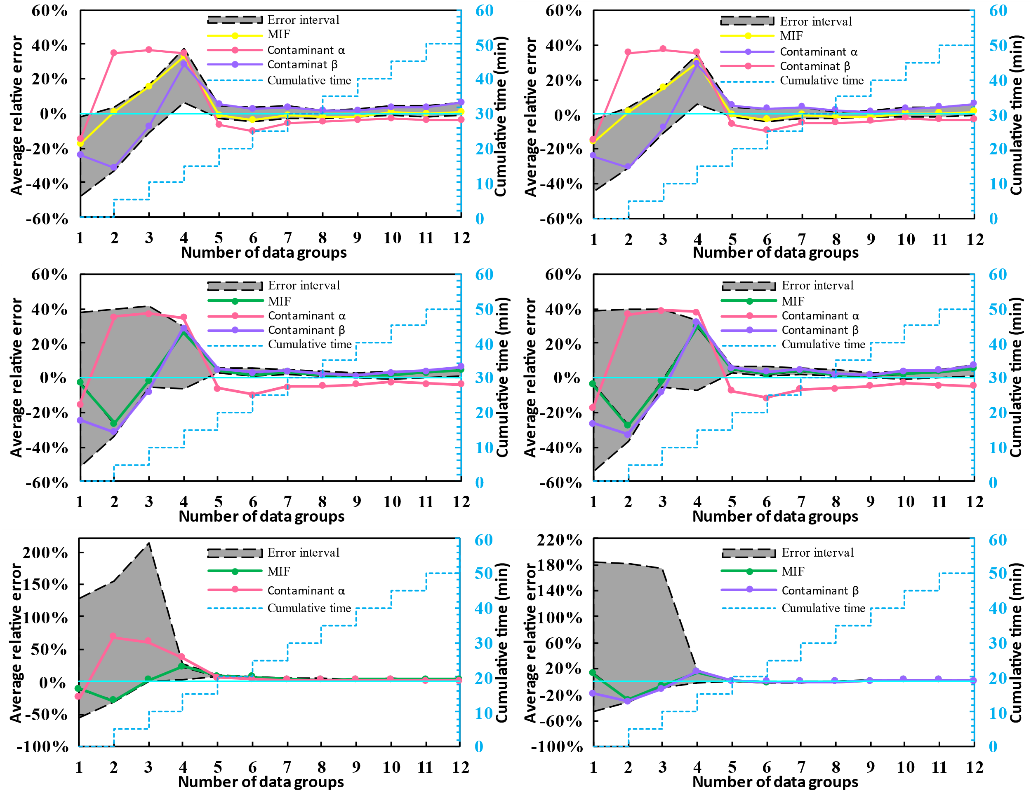
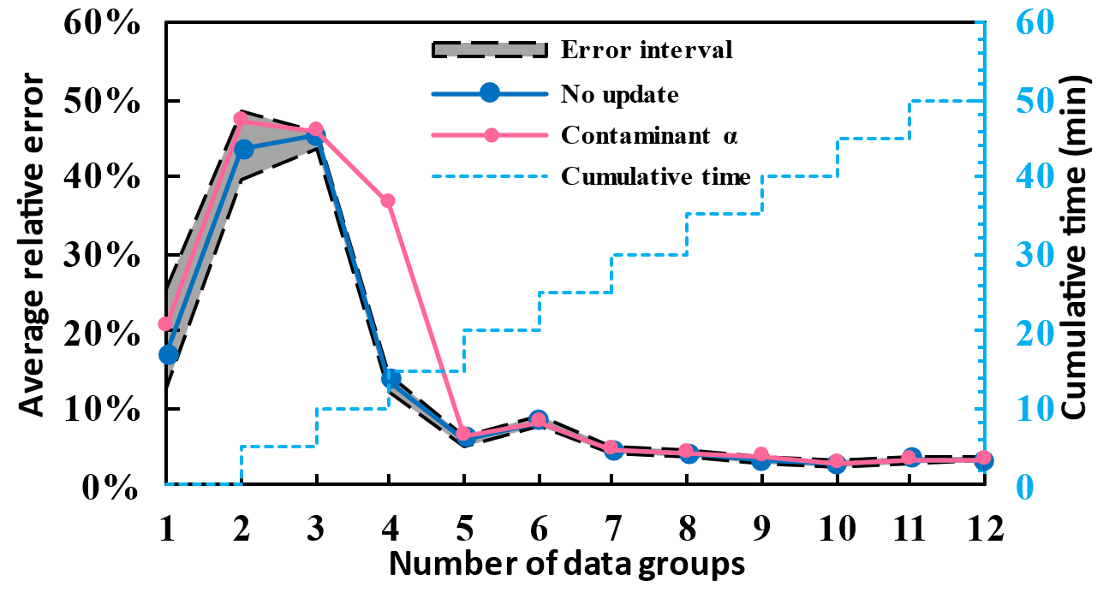
It can be seen that the error uncertainty interval of the three source term parameters of pollutant emission, emission location and emission history gradually converges, and the accuracy improves with the new monitoring data assimilation input.
For data assimilation, the results of the two implementation paths are not very different.
For information fusion, both implementation paths have improved the accuracy of the results. From the results after convergence, the path I has brought better accuracy.
(a) X_{s} by path I
(b) T_{s} by path I
(c) X_{s} by path II
(d) T_{s} by path II
(e) by path II
(f) by path II
Figure 4
Figure 5
Notes:
The results of the numerical experiments are shown in Fig 4 and Fig 5. Several main conclusions are as follows. It can be seen that the error uncertainty interval of the three source term parameters of pollutant emission, emission location and emission history gradually converges, and the accuracy improves with the new monitoring data assimilation input.
For data assimilation, the results of the two implementation paths are not very different.
For information fusion, both implementation paths have improved the accuracy of the results. From the results after convergence, the path I has brought better accuracy

Slide 10
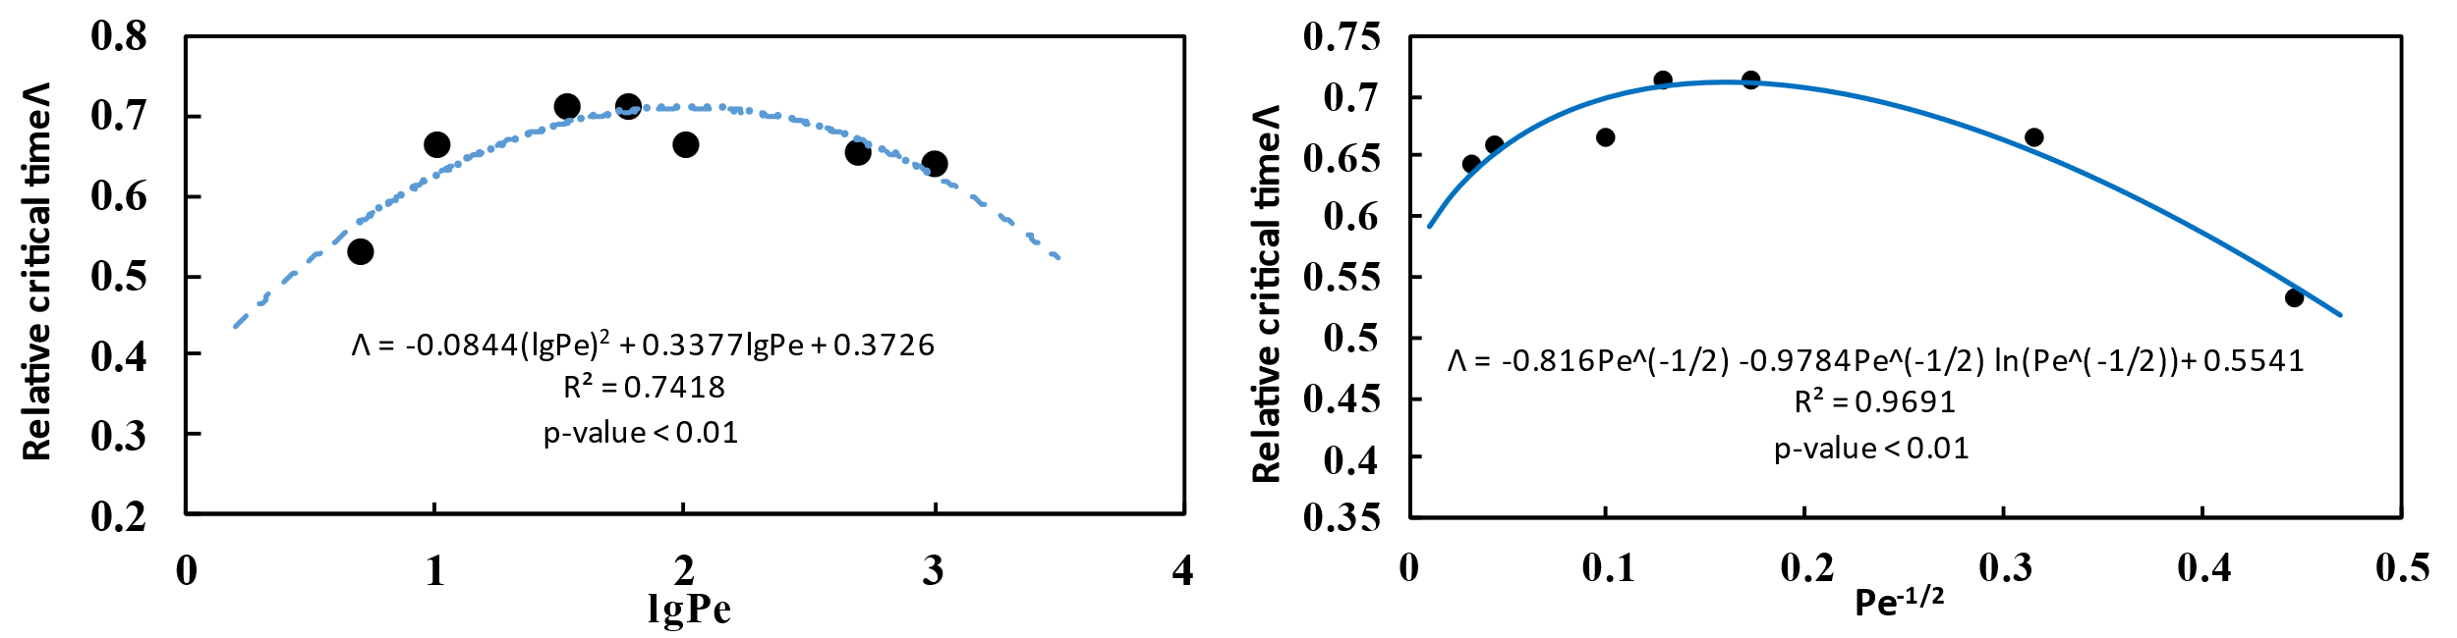
Table2. Examples representing hydrodynamic characteristics of different rivers
The analytical solution of the dimensionless 1-D Advection-Dispersion Equation is：
NO. | Pe | U (m/min) | D_{x} (m2/min) | M_{s} (g) |  | X_{s} (m) | T_{s} (min) | τ
R1 | 5 | 40 | 8000 |  |  | -16000 | -250 | 10
R2 | 10 | 60 | 6000 |  | 1300 | -14242 | -167
R3 | 33 | 80 | 2430 |  |  | -12338 | -125
R4 | 60 | 90 | 1500 |  |  | -12600 | -120
R5 | 100 | 100 | 1000 |  |  | -11341 | -100
R6 | 500 | 140 | 280 |  |  | -10600 | -71.4
R7 | 1000 | 150 | 150 |  |  | -10424 | -66.7
For fixed observation, the information entropy H in the monitoring time slice is：
Figure6. The relative critical time Λ changes with the Pe criterion
Notes:
In the above numerical experiments, we found that the error confidence curve of the source term parameters always converges at the same time, which is particularly important for the source identification practice. We use relative critical time Lambda(Λ）to characterize this phenomenon under different river hydrological conditions，which is defined as the ratio of the sampling time required for the convergence of the error interval to the total duration of the Breakthrough curve.
The pollution transport is mainly controlled by the convection process and diffusion process, and the Peclet number (Pe) measures the relative strength of the two processes. For further analysis, the dimensionless ADE-equation is used, 7 different groups of Pe were set to characterize 7 river hydrodynamic scenarios, ranging from 5 to 1000. As shown in Table 2, R1 is generally a large river and R7 is generally a small stream.
In order to facilitate theoretical analysis and data generation, a single fixed monitoring section is used to generate monitoring data.
As shown in Figure 6, for the obtained relative critical time under seven different hydrological conditions, the quadratic curve and the information entropy form of fixed observation are fitted. The results show that it is more in line with the form of information entropy

Slide 11
Increasing the monitoring section can shorten the convergence time of the source identification calculation error(See Figure 7).
As shown in Figure 9, the penetration curves of the three sections begin to overlap after 20 minutes. The calculation results of the information entropy also show that the joint entropy of the monitoring data of the three sections reaches the lowest value at 20 minutes, and then begins to increase(See Figure 8).
(a)
(b)
Figure7. The variation curve of the source term error with the update of the monitoring data. (a) Three monitoring sections;(b) One monitoring section
Figure8. The information entropy (cross-entropy and joint entropy) of the sampled data of three sections changes with time
Figure9. Pollutant concentration curve of parallel sampling section.
Notes:
Whether the theory can be extended to multiple monitoring sections, we analyze the error interval convergence process of single and multiple monitoring sections, and we found that increasing the monitoring section can shorten the convergence time of the source identification calculation error(See Figure 7).
We try to explain this phenomenon through information entropy，As shown in Figure 9, the penetration curves of the three sections begin to overlap after 20 minutes. The calculation results of the information entropy also show that the joint entropy of the monitoring data of the three sections reaches the lowest value at 20 minutes, and then begins to increase(See Figure 8).
This means that the error interval convergence time of multiple monitoring sections is the minimum redundancy time of sampling information.

Slide 12
Guidelines for the layout of emergency monitoring sections
monitoring sections N
sampling time interval ΔT.
Figure8. Practical technology roadmap
Notes:
In view of the above findings, we held a discussion on the accurate layout of monitoring network and put forward the practical technical route

Slide 13
THANK YOU FOR LISTENING
Notes:
Thank you for listening! If you have any questions or comments about my research, please communicate with me by email, I am very willing to listen to your valuable opinions

