Slide 1



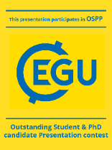
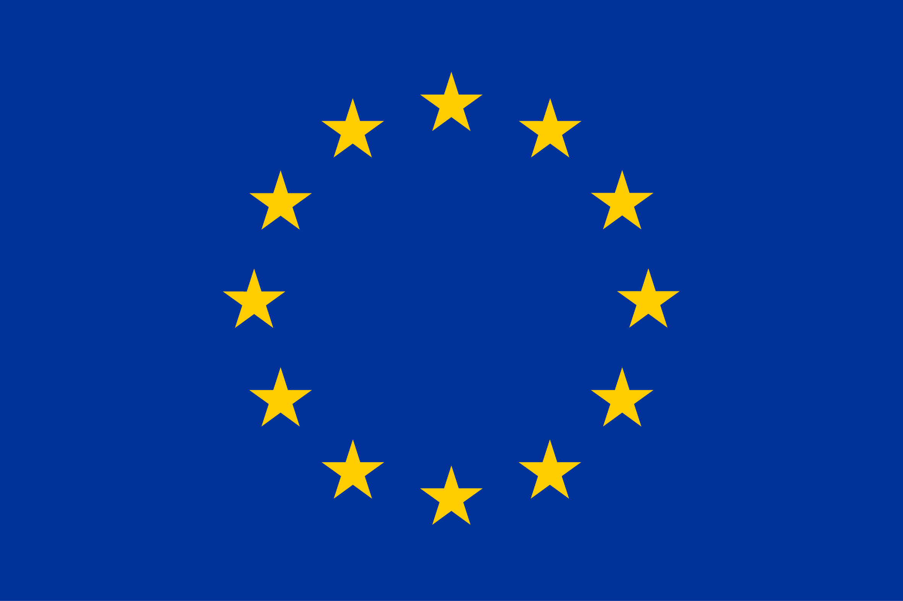

Diapositiva 1
North Atlantic co2 sink variability revealed by the go-ship a25-ovide section
López-Mozos, M., Velo, A., Fontela, M., de la Paz, M., Carracedo, L., Fajar, N., García-Ibáñez, M., Padín, X.A., Desbruyères, D., Mercier, H., Lherminier, P., Pérez, F.F.
This project has received funding from the European Union’s Horizon 2020 research and innovation programme under grant agreement No 820989 he work reflects only the author’s/authors’ view; the European Commission and their executive agency are not responsible for any use that may be made of the information the work contains

Slide 2
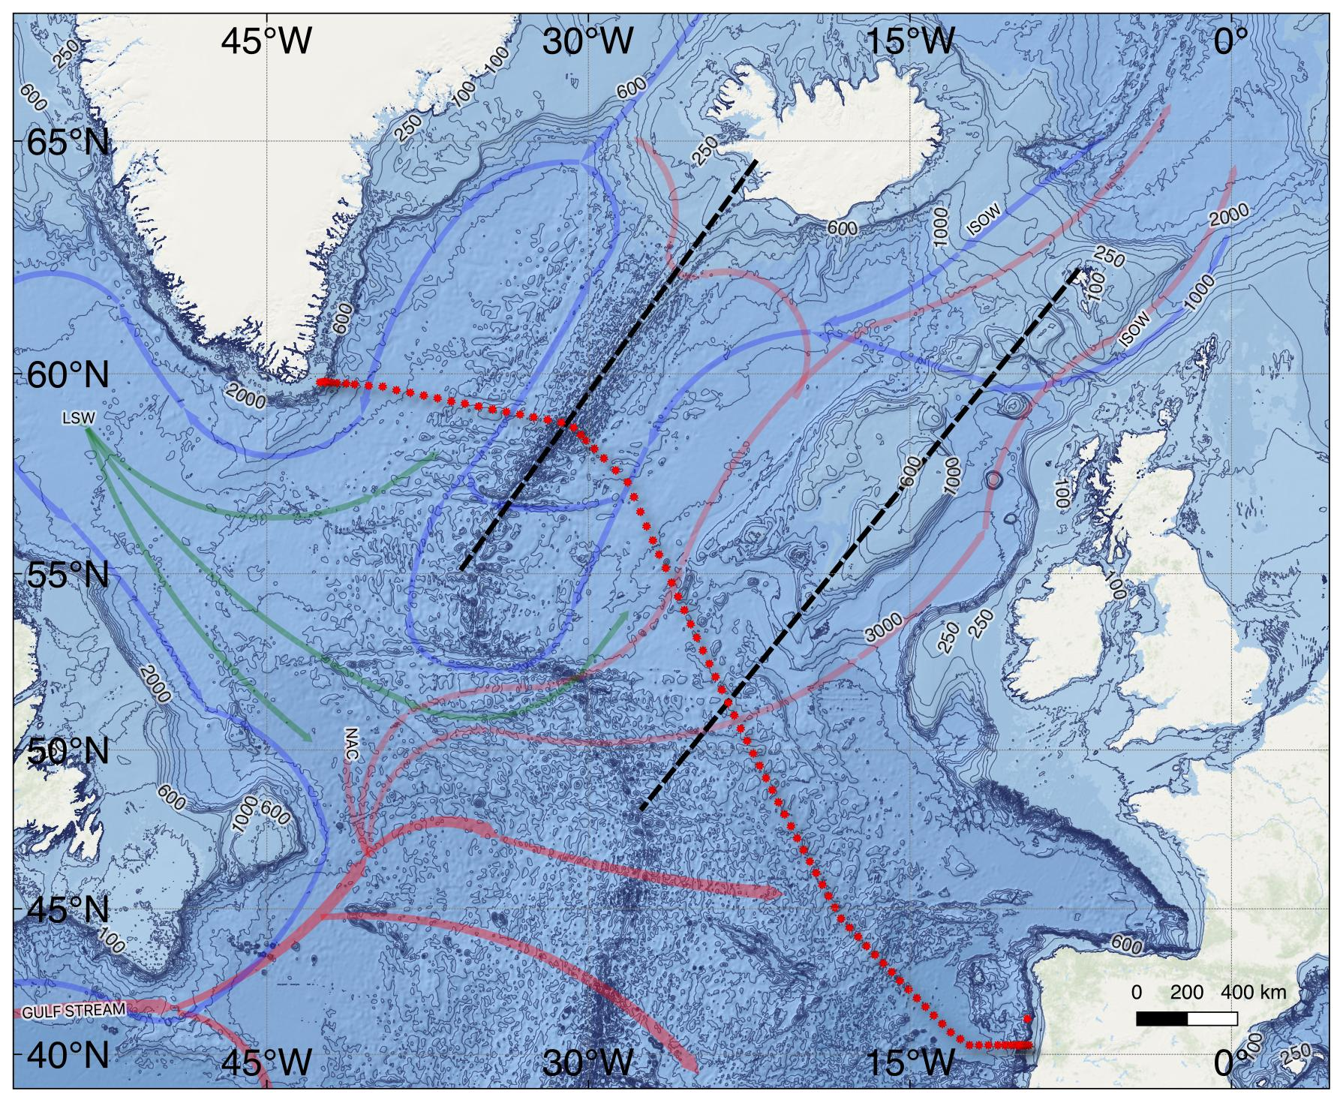
Diapositiva 8
Region of study
GO-SHIP A25 OVIDE
Currents from Daniault et al., 2016

Slide 3
Diapositiva 8
Region of study
GO-SHIP A25 OVIDE
Currents from Daniault et al., 2016
8

Slide 4
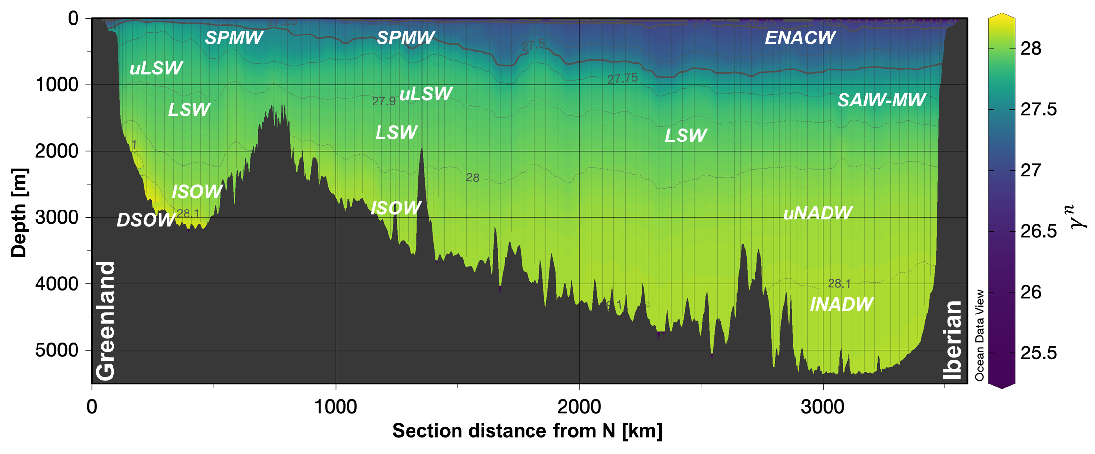
Diapositiva 8
Region of study: main water masses
Irminger Basin
Iceland Basin
GO-SHIP A25 OVIDE
Currents from Daniault et al., 2016
8

Slide 5
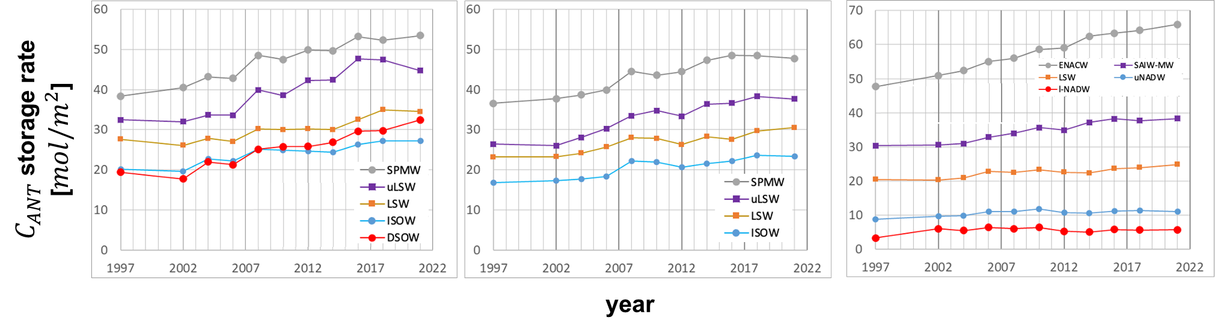
Diapositiva 8
TRENDS OF $C_{ANT}$ : partition in water masses
Irminger B.
Iceland B.
ENA B.
Overall increasing trend, but with oscillations

Slide 6
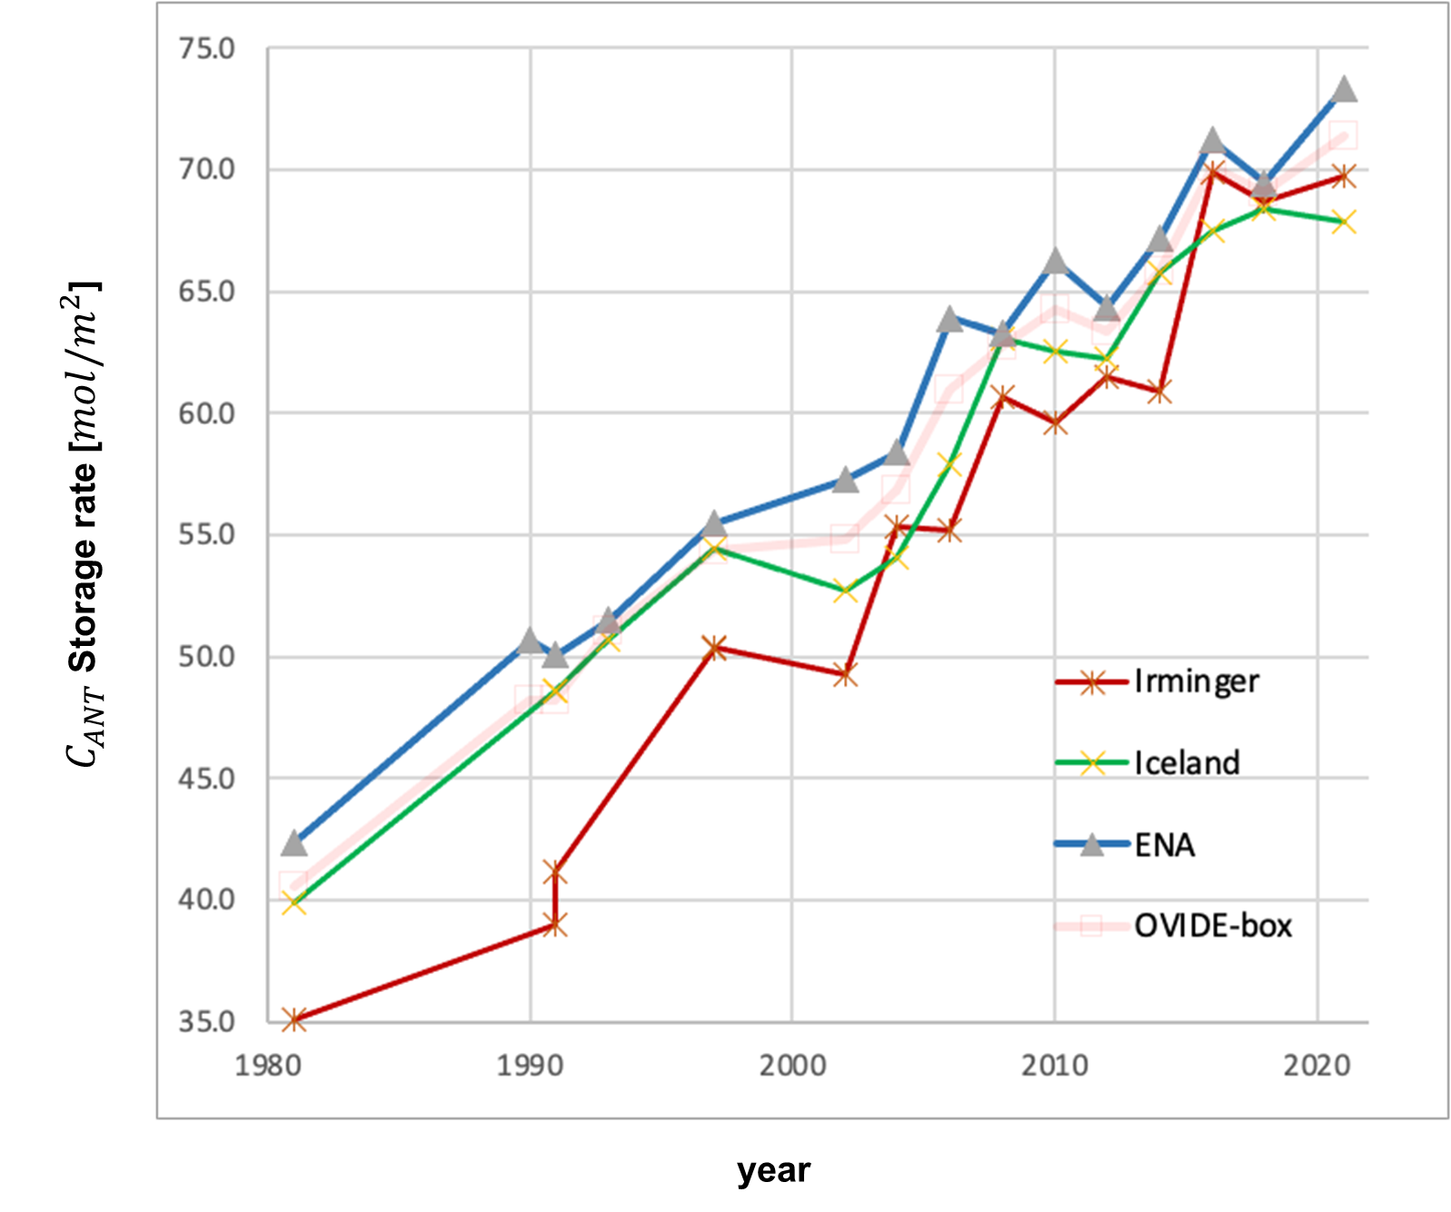
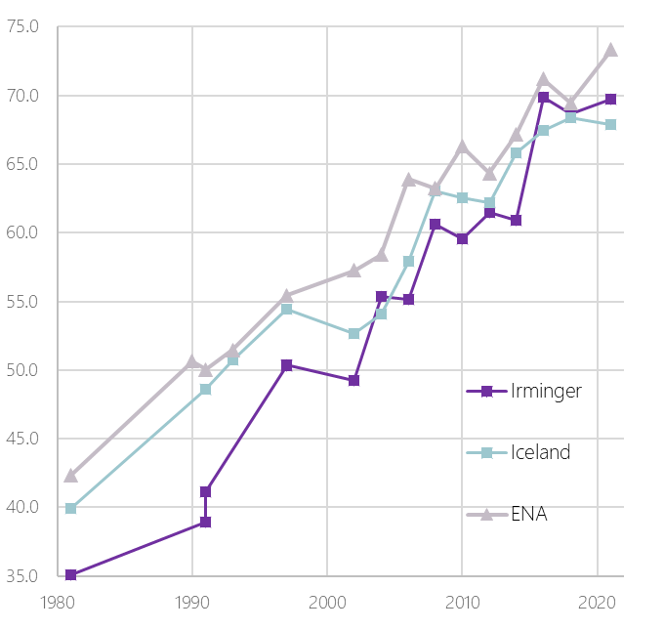
Diapositiva 8
OSCILLATIONS IN $C_{ANT}$ STORAGE RATES

Slide 7
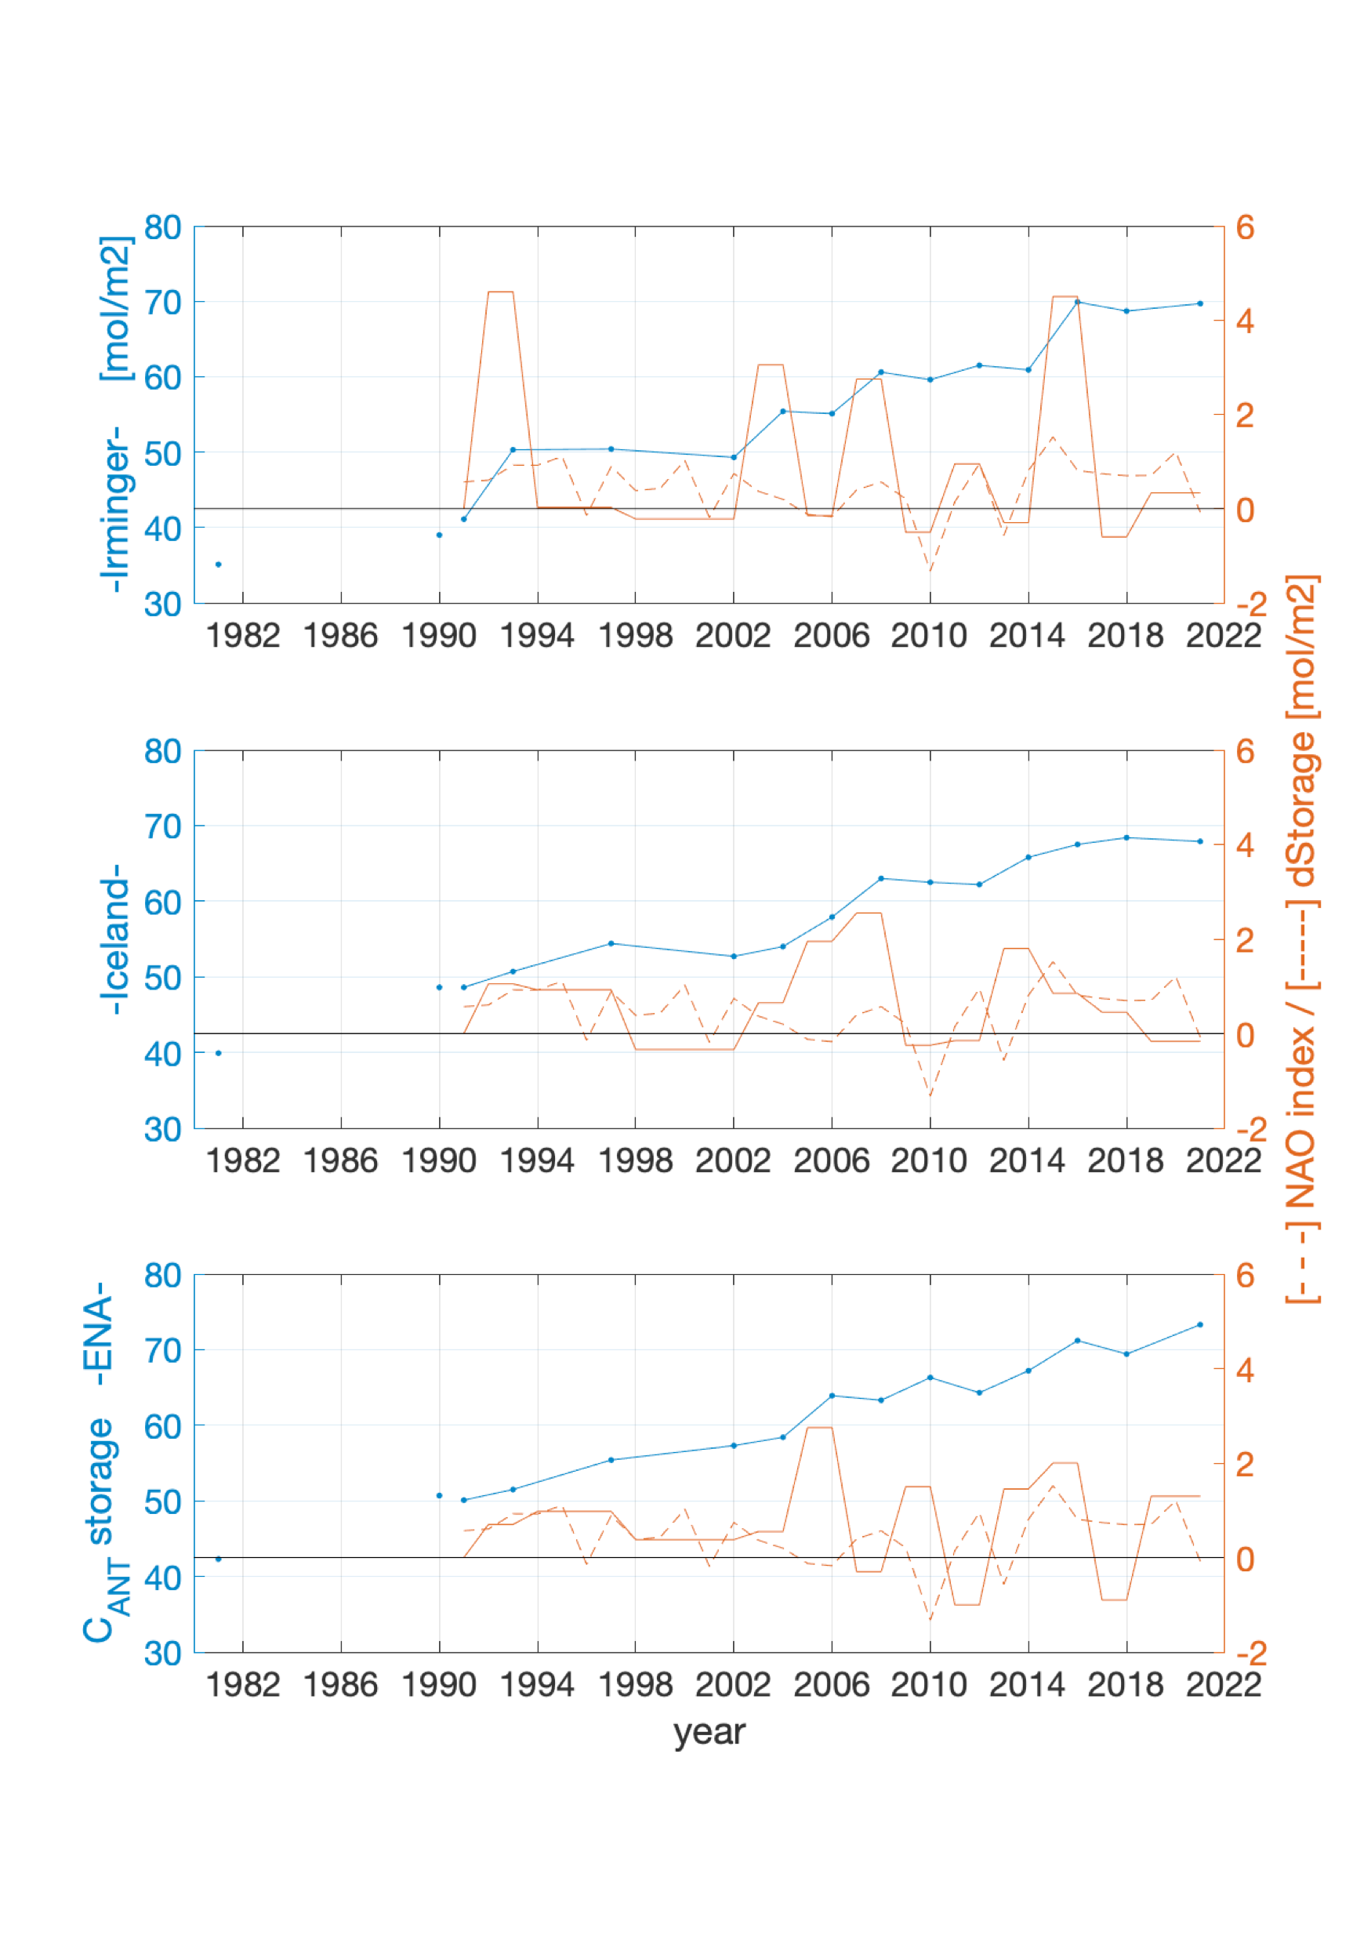
Diapositiva 8
OSCILLATIONS IN $C_{ANT}$ STORAGE RATES

Slide 8
Diapositiva 8
OSCILLATIONS IN $C_{ANT}$ STORAGE RATES

Slide 9
Diapositiva 8
OSCILLATIONS IN $C_{ANT}$ STORAGE RATES
Overall increase in North Atlantic anthropogenic carbon storage rates from 2002 to 2021
Storage rates fluctuate according to ventilation changes
Changes in carbon storage rates of all water masses in the Irminger Basin are well explained by variations in NAO
Fluctuations in storage rates of intermediate and deep water masses from Iceland and ENA Basins are not coupled to NAO variations, related to the time lag between the formation of the masses and their arrival in the basin.

Slide 10
Diapositiva 1
North Atlantic co2 sink variability revealed by the go-ship a25-ovide section
THANK YOU
López-Mozos, M., Velo, A., Fontela, M., de la Paz, M., Carracedo, L., Fajar, N., García-Ibáñez, M., Padín, X.A., Desbruyères, D., Mercier, H., Lherminier, P., Pérez, F.F.
mlopezm@iim.csic.es
This project has received funding from the European Union’s Horizon 2020 research and innovation programme under grant agreement No 820989 he work reflects only the author’s/authors’ view; the European Commission and their executive agency are not responsible for any use that may be made of the information the work contains

