Slide 1
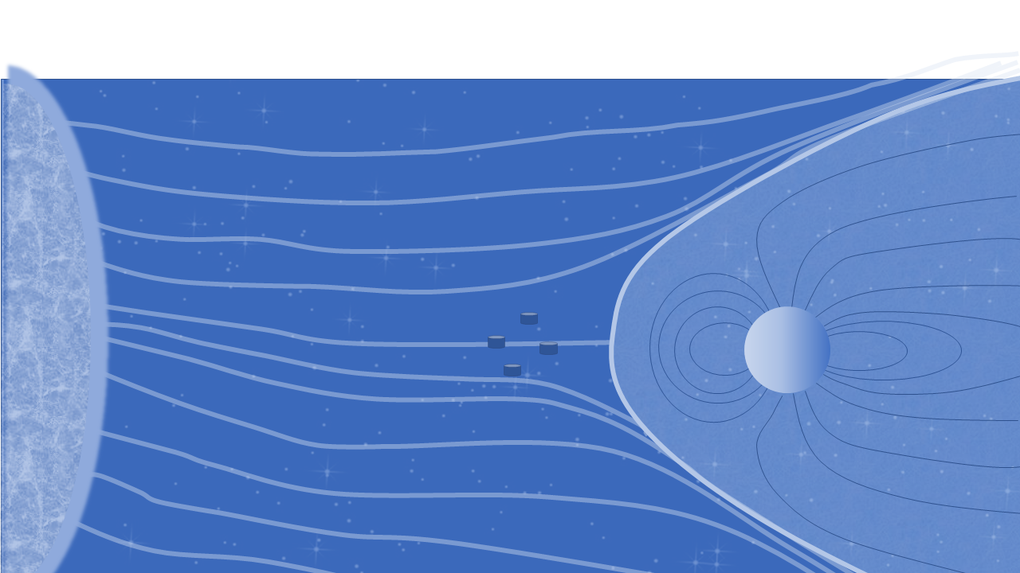
Morphology of magnetic holes in the pristine solar wind
H. Trollvik¹, T. Karlsson¹, C. P. Escoubet², S. Raptis¹
¹KTH Royal institute of Technology, Sweden
² European Space Agency, ESTEC, Keplerlaan 1, 2201AZ Noordwijk, The Netherlansds
EGU General Assembly 2022

Slide 2
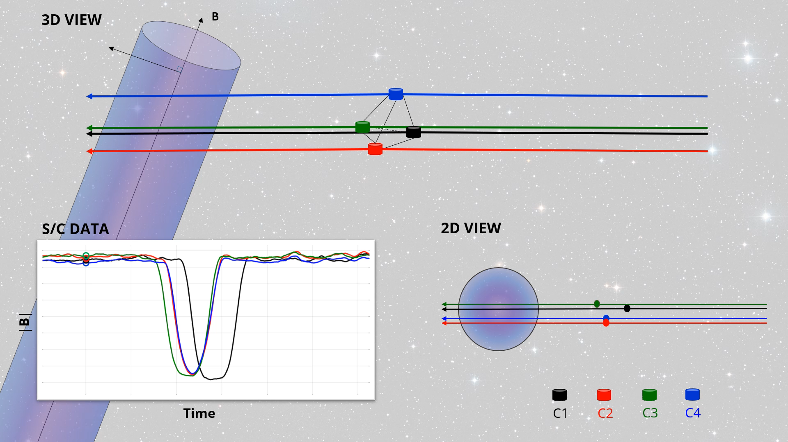


Introduction
Introduction
Magnetic holes are localized depressions of |B|.
Observed in the solar wind and planetary magnetosheaths
Background field strength: $B_{0}= {\left\langle \left|B\right|\right\rangle }_{300s}$
Relative deviation
$\frac{ΔB}{B_{0}}={\left\langle \frac{\left|B\right| −B_{0}}{B_{0}}\right\rangle }_{1s}$
MH here defined as a relative deviation of < -0.5
Henriette Trollvik
EGU General Assembly 2022
2/7
Notes:
Cluster mission

Slide 3
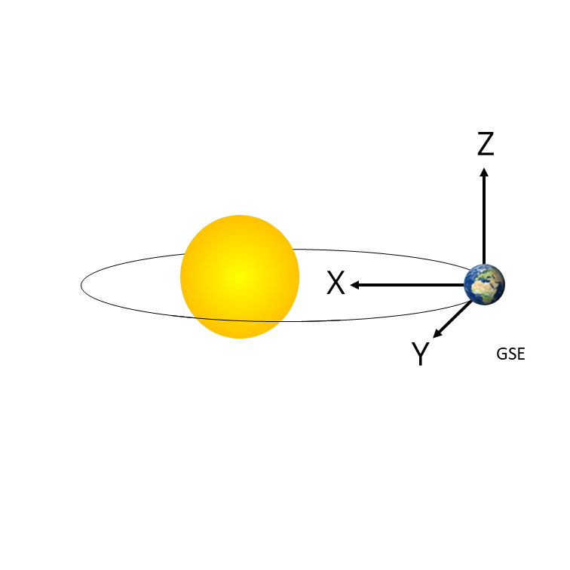
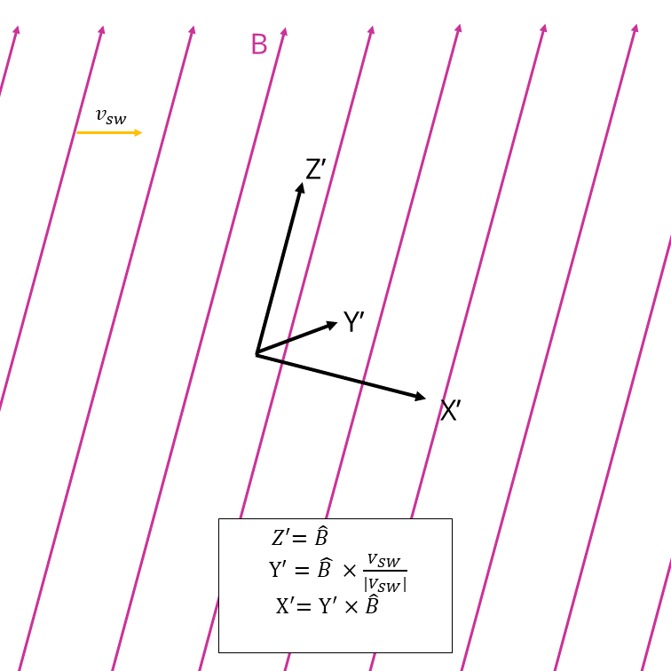
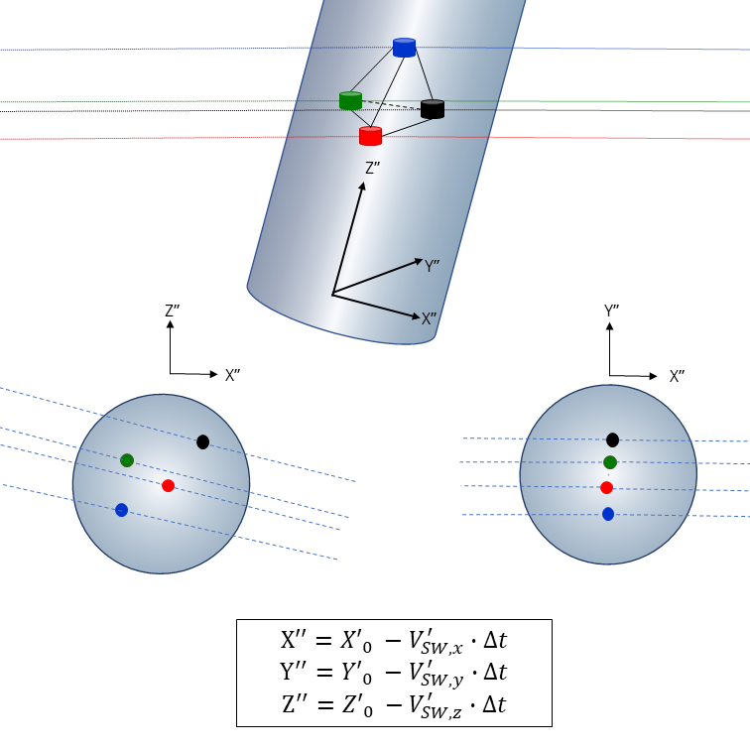
Coordinate Transformation
Coordinate transformation
Henriette Trollvik
EGU General Assembly 2022
3/7
Notes:
Astablished that the structre moves with the solar wind, and we move into a solar wind frame

Slide 4
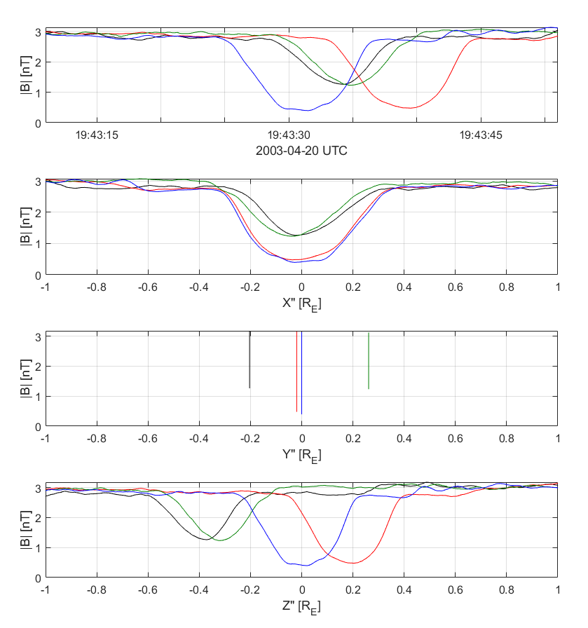
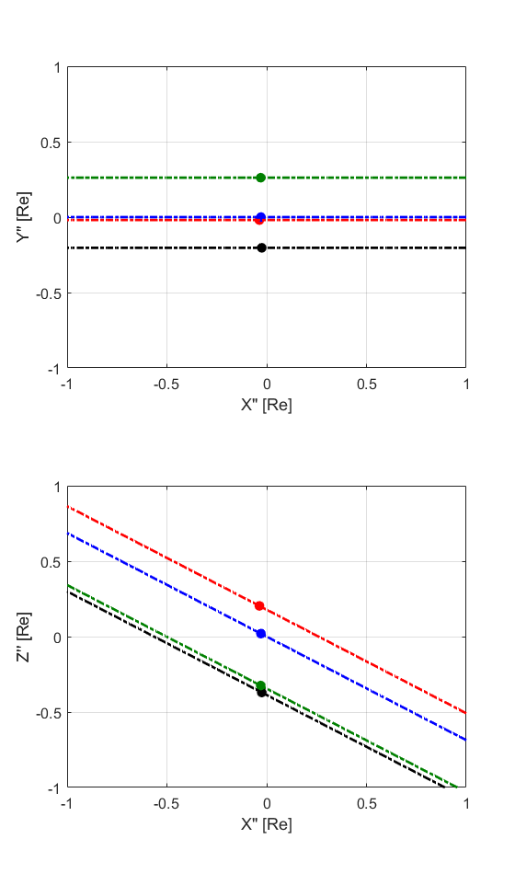



Observation
Introduction
S/C paths:
C1
C2
C3
C4
Aligned along X’’
Well ordered in both the Y’’ and Z’’ directions
$$Z^{′′}(∥B)$$
$$Y′′(⊥v_{sw})$$
$$X′′$$
Henriette Trollvik
EGU General Assembly 2022
4/7
4/8

Slide 5
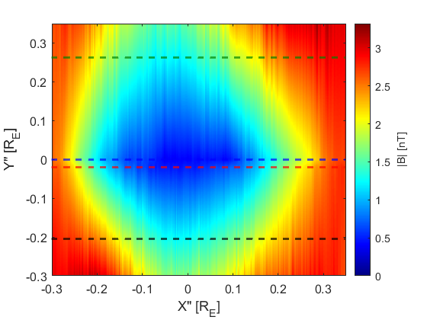
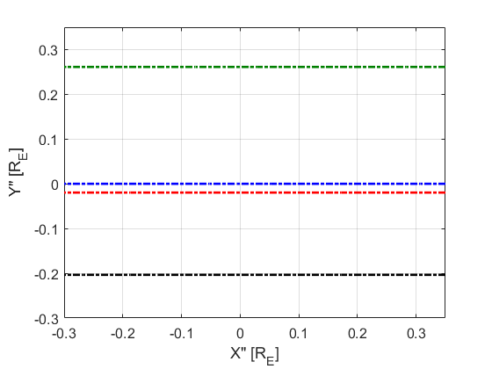
Introduction
Reconstruction
Linear interpolation along Y’’
$$Z^{′′}(∥B)$$
$$Y′′(⊥v_{sw})$$
$$X′′$$
Henriette Trollvik
EGU General Assembly 2022
5/7
Notes:
Add figure of the X’’-Y’’ , add unit

Slide 6
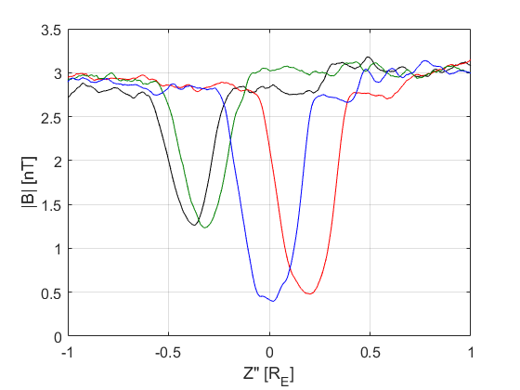



Introduction
Scales
$$\sim 0.6 R_{E}$$
$$\sim 0.6 R_{E}$$
$$\sim 1 R_{E}$$
Henriette Trollvik
EGU General Assembly 2022
6/7

Slide 7

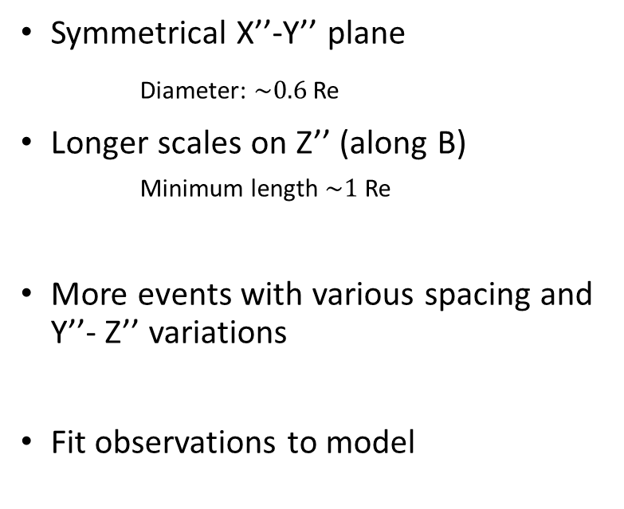


Conclusion and continued work
Introduction
Conclusion and Continued Work
Coordinate transformation
$$j_{MH}$$
Symmetrical X’’-Y’’ plane
Diameter: $\sim 0.6$ Re
Longer scales on Z’’ (along B)
  Minimum length $\sim 1$ Re
More events with various spacing and Y’’- Z’’ variations
Fit observations to model
$$B_{imf}$$
$$B_{MH}$$
Henriette Trollvik
EGU General Assembly 2022
7/7
7

