Slide 1
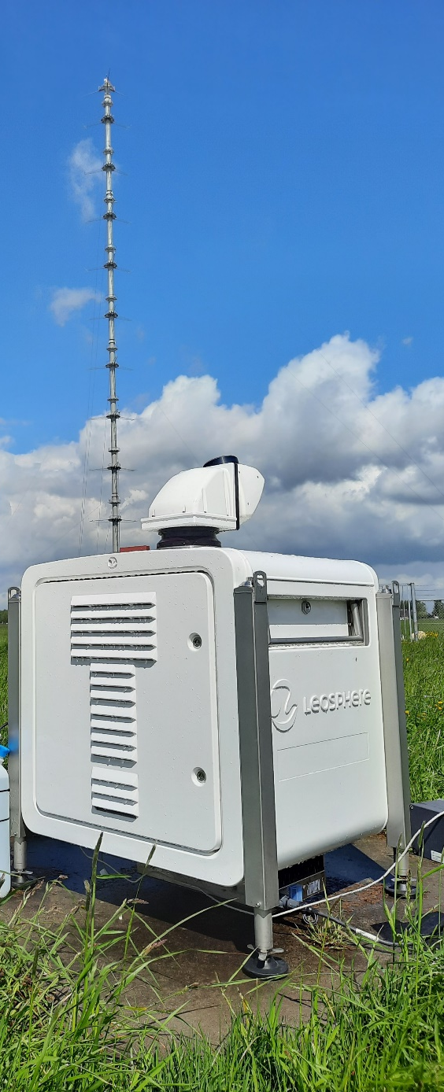
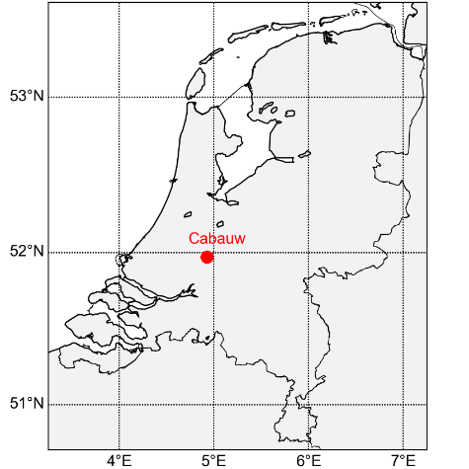


Scanning Doppler wind lidar at Ruisdael Observatory
EGU22-11985
Display material
Steven Knoop
KNMI, The Netherlands
steven.knoop@knmi.nl

Slide 2
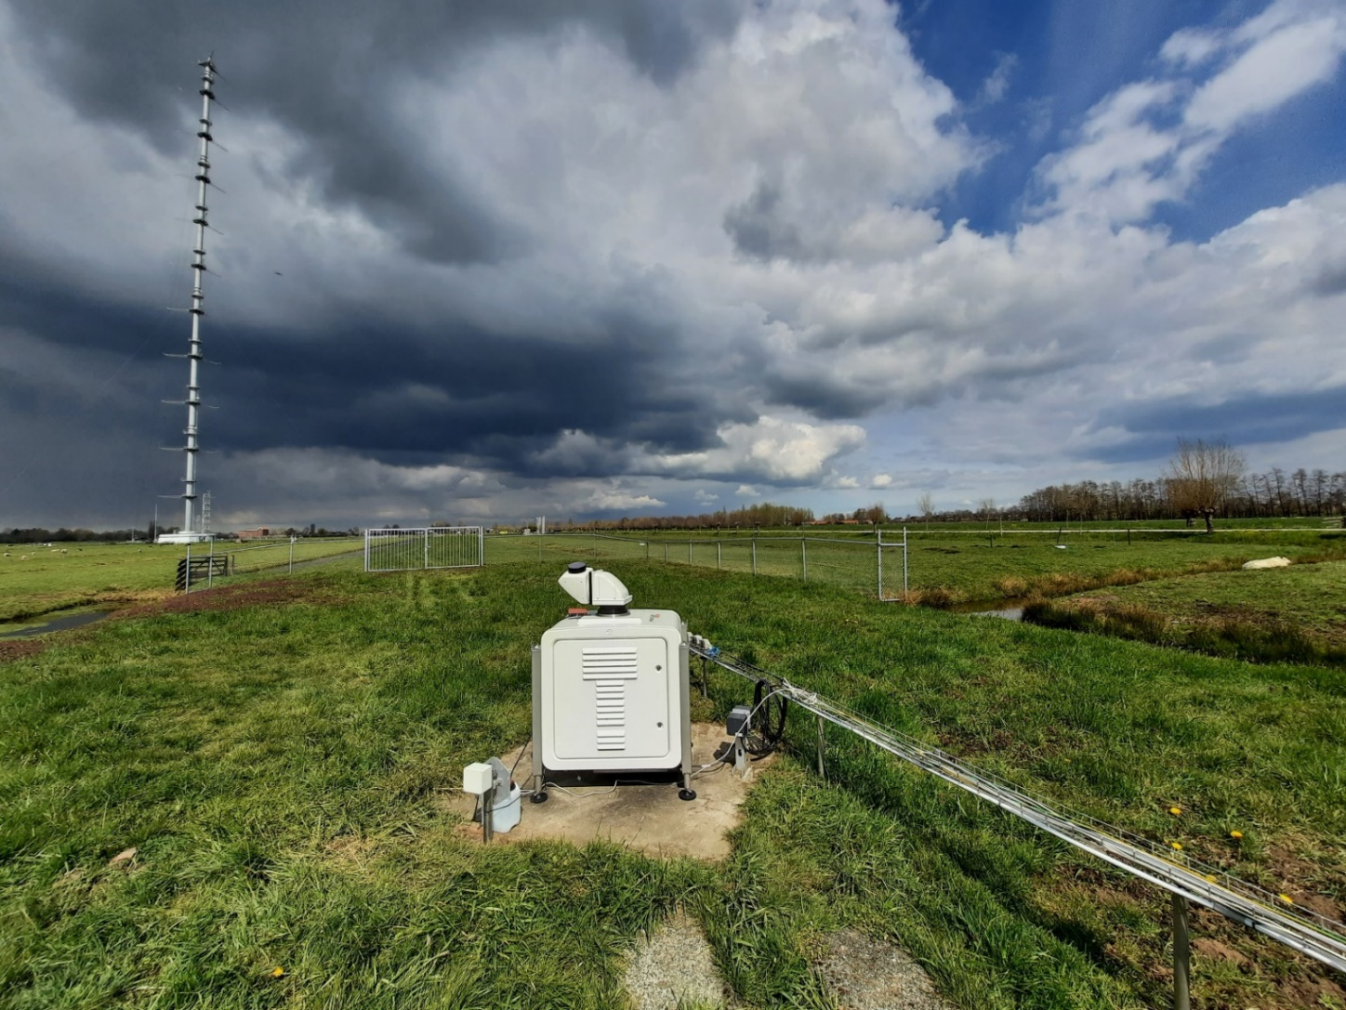
Scanning Doppler wind lidar @ Cabauw
Task: measure 3D wind field around Cabauw & wind profiles up to the boundary layer
Measuring program: Alternating between different scan patterns (DBS, vertical staring, PPI/RHI)
Dedicated measurement campaigns within Ruisdael Observatory (synergy with other (remote sensing) instruments)

Slide 3
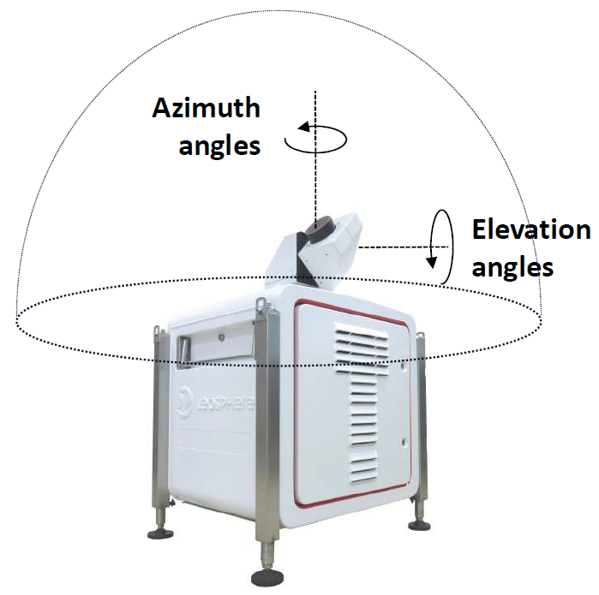
Scanning Doppler wind lidar @ Cabauw
Leosphere Windcube 200S
Pulsed lidar @ 1.5 µm
Long-range (max. 14 km, but typically 6 km)
3D-scanning (full semi-hemisphere)
Possible scans: DBS, PPI, RHI, (vertical) staring
Data: radial wind speed, horizontal wind speed & wind direction (with DBS), CNR, attenuated backscatter coefficient
Installed at Cabauw: April 6, 2021

Slide 4
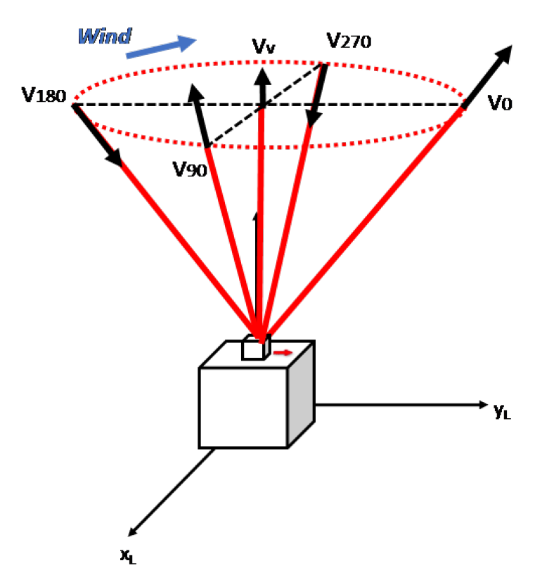
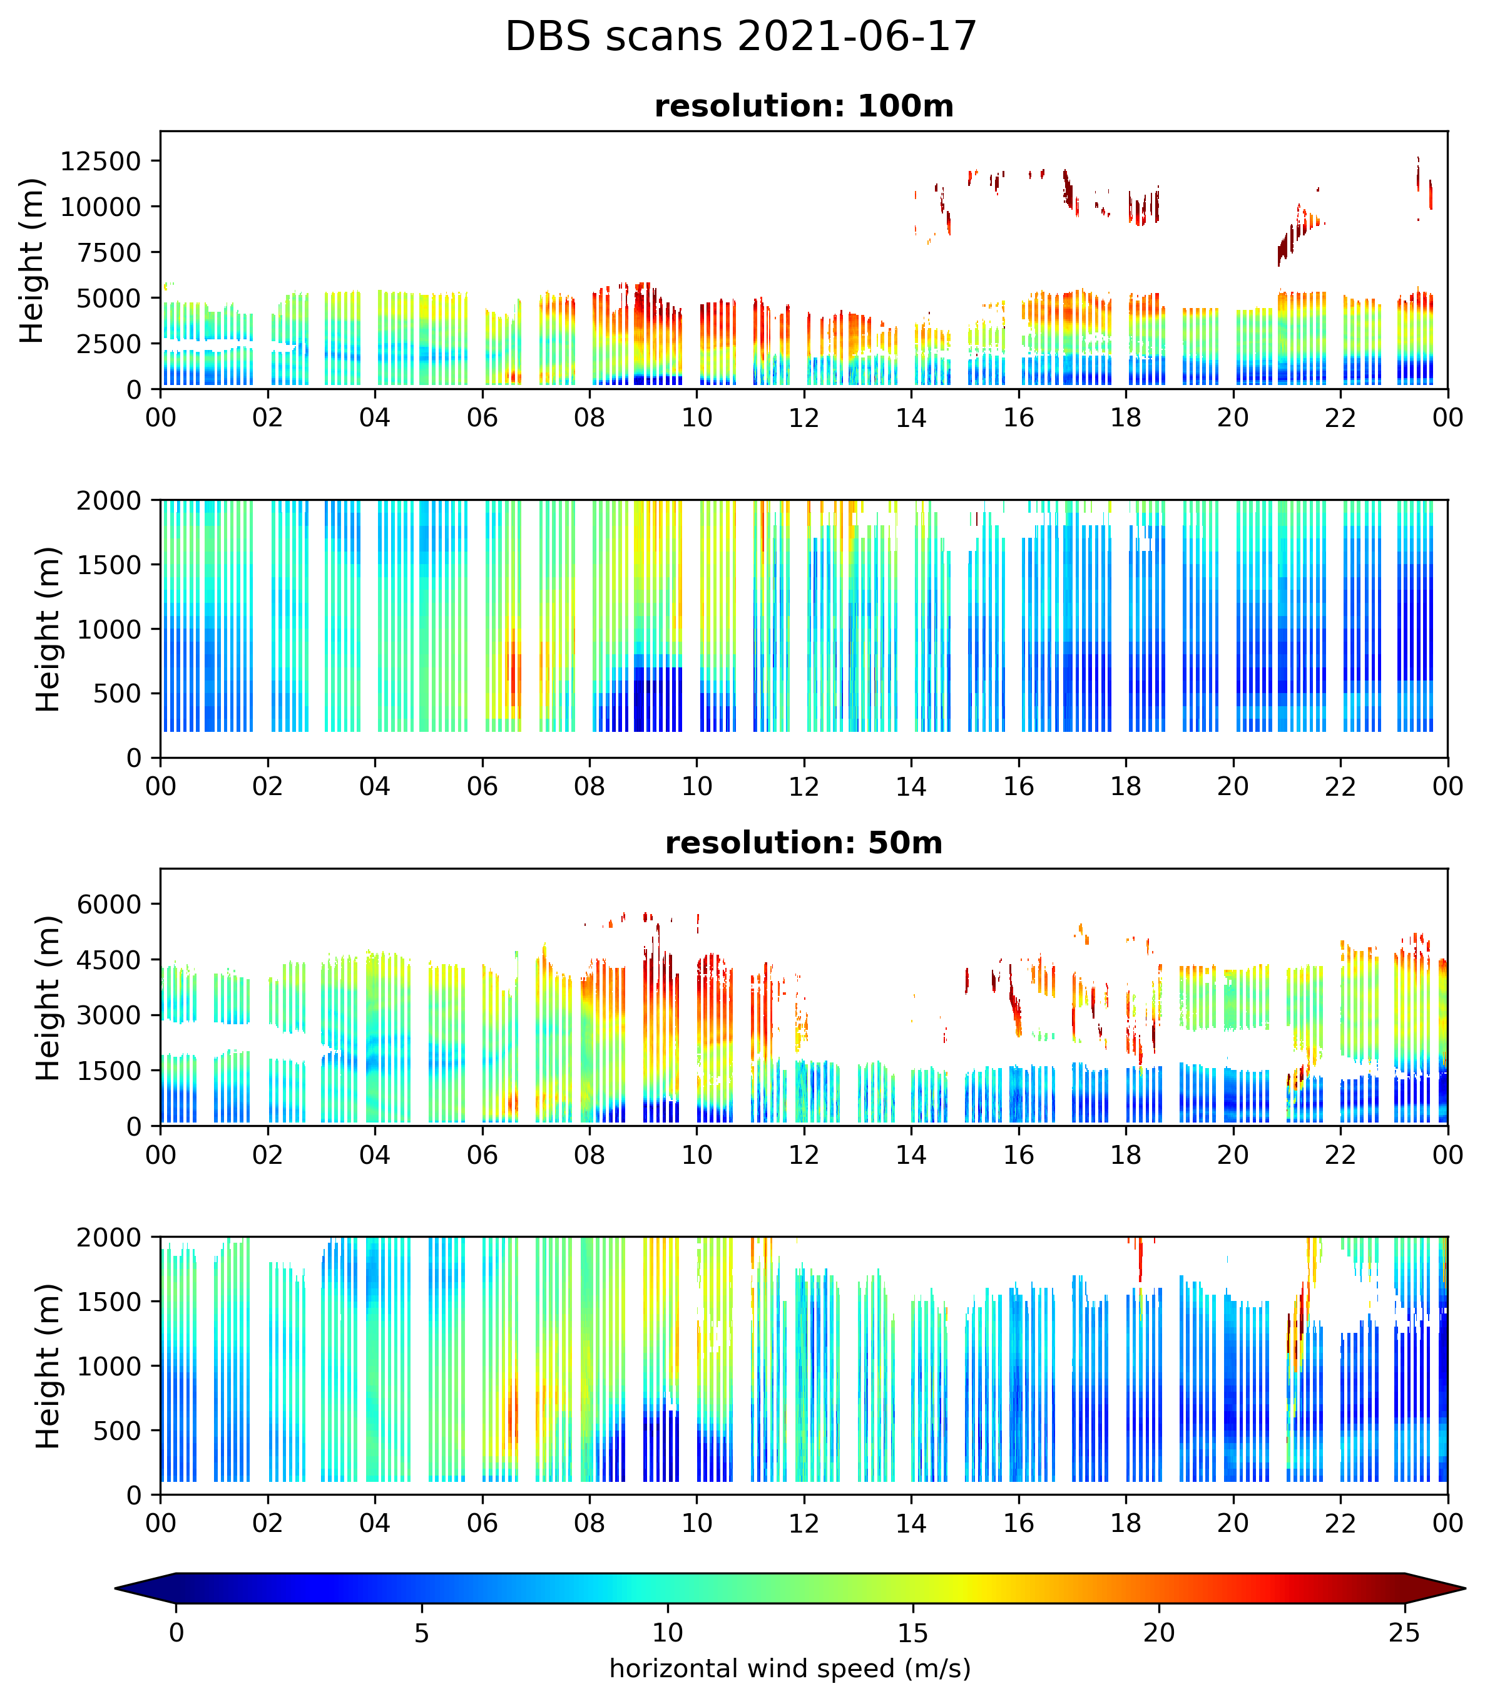
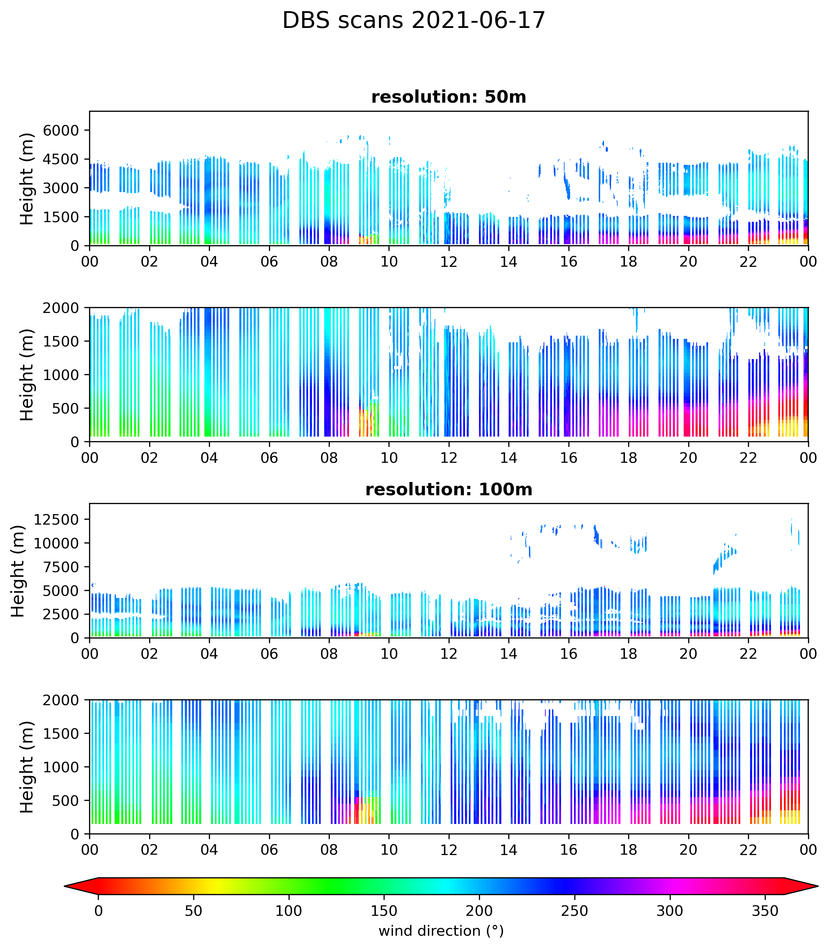
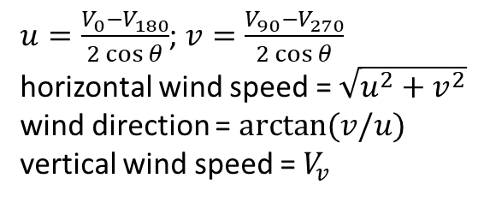
DBS (Digital Beam Swing): wind profiling
$u=\frac{V_{0}−V_{180}}{2\cos{θ}}$; $v=\frac{V_{90}−V_{270}}{2\cos{θ}}$
horizontal wind speed = $\sqrt{u^{2}+v^{2}}$
wind direction = $arctan⁡(v/u)$
vertical wind speed = $V_{v}$
Parameters: resolution, accumulation time, elevation angle
Range is limited by the number of range gates (and therefore resolution)

Slide 5
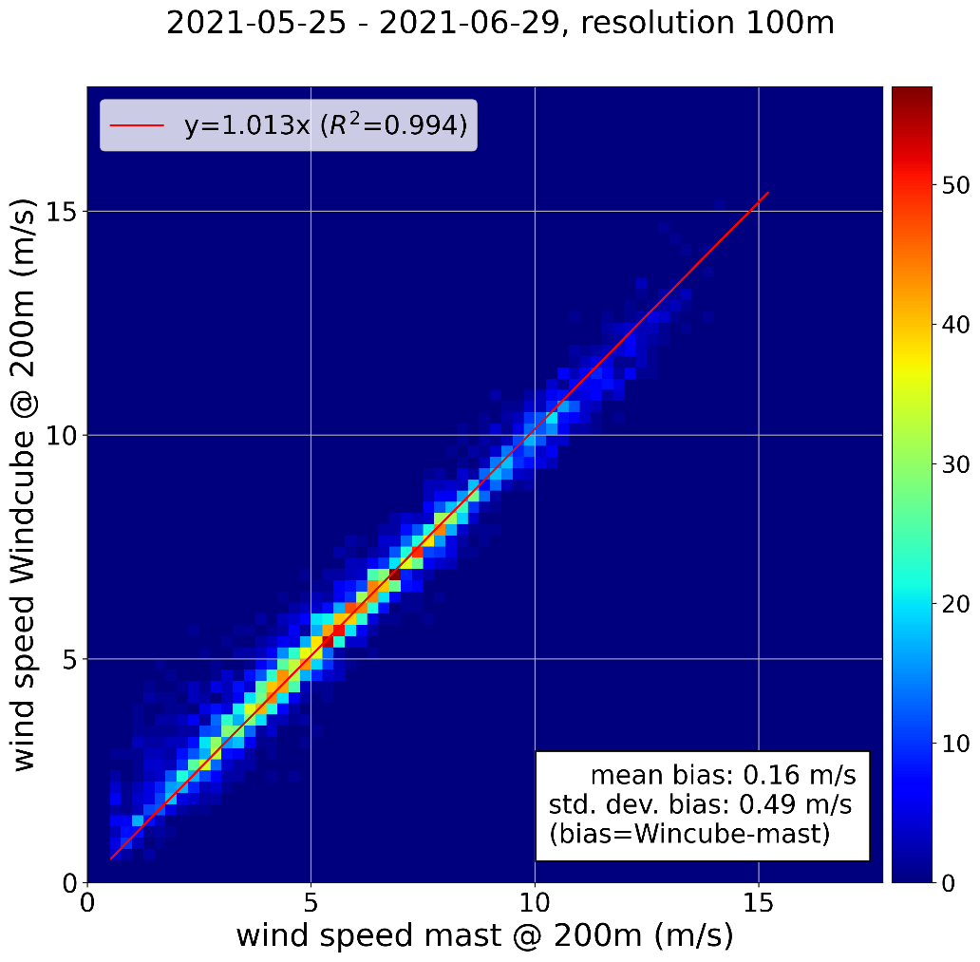
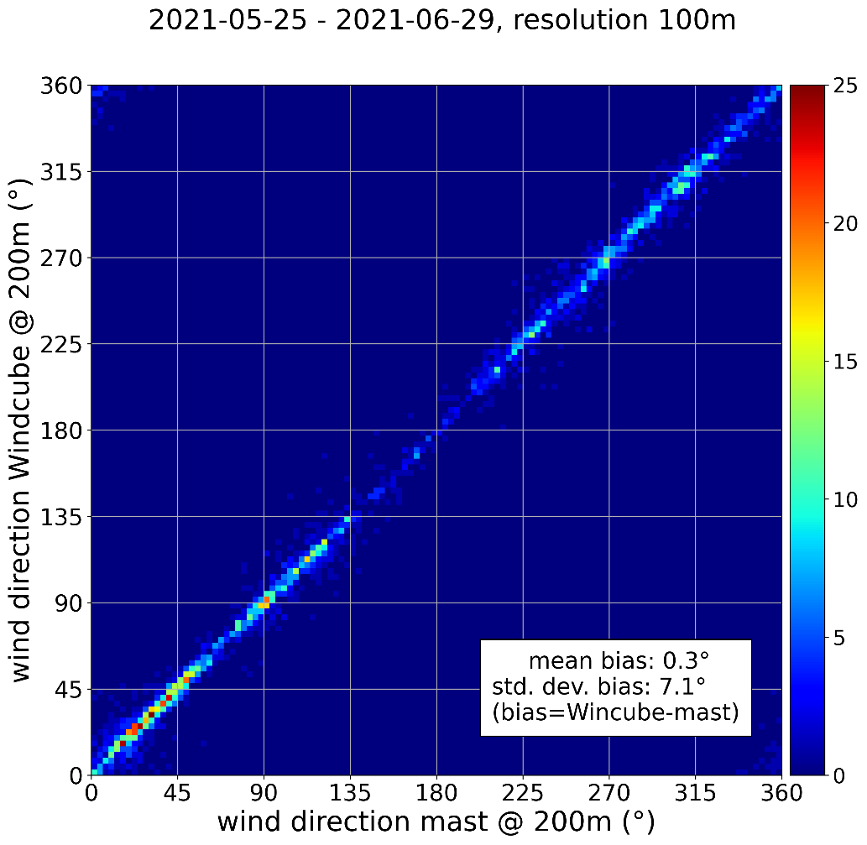
Mast comparison @ 200m

Slide 6
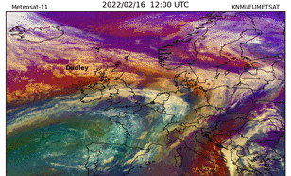
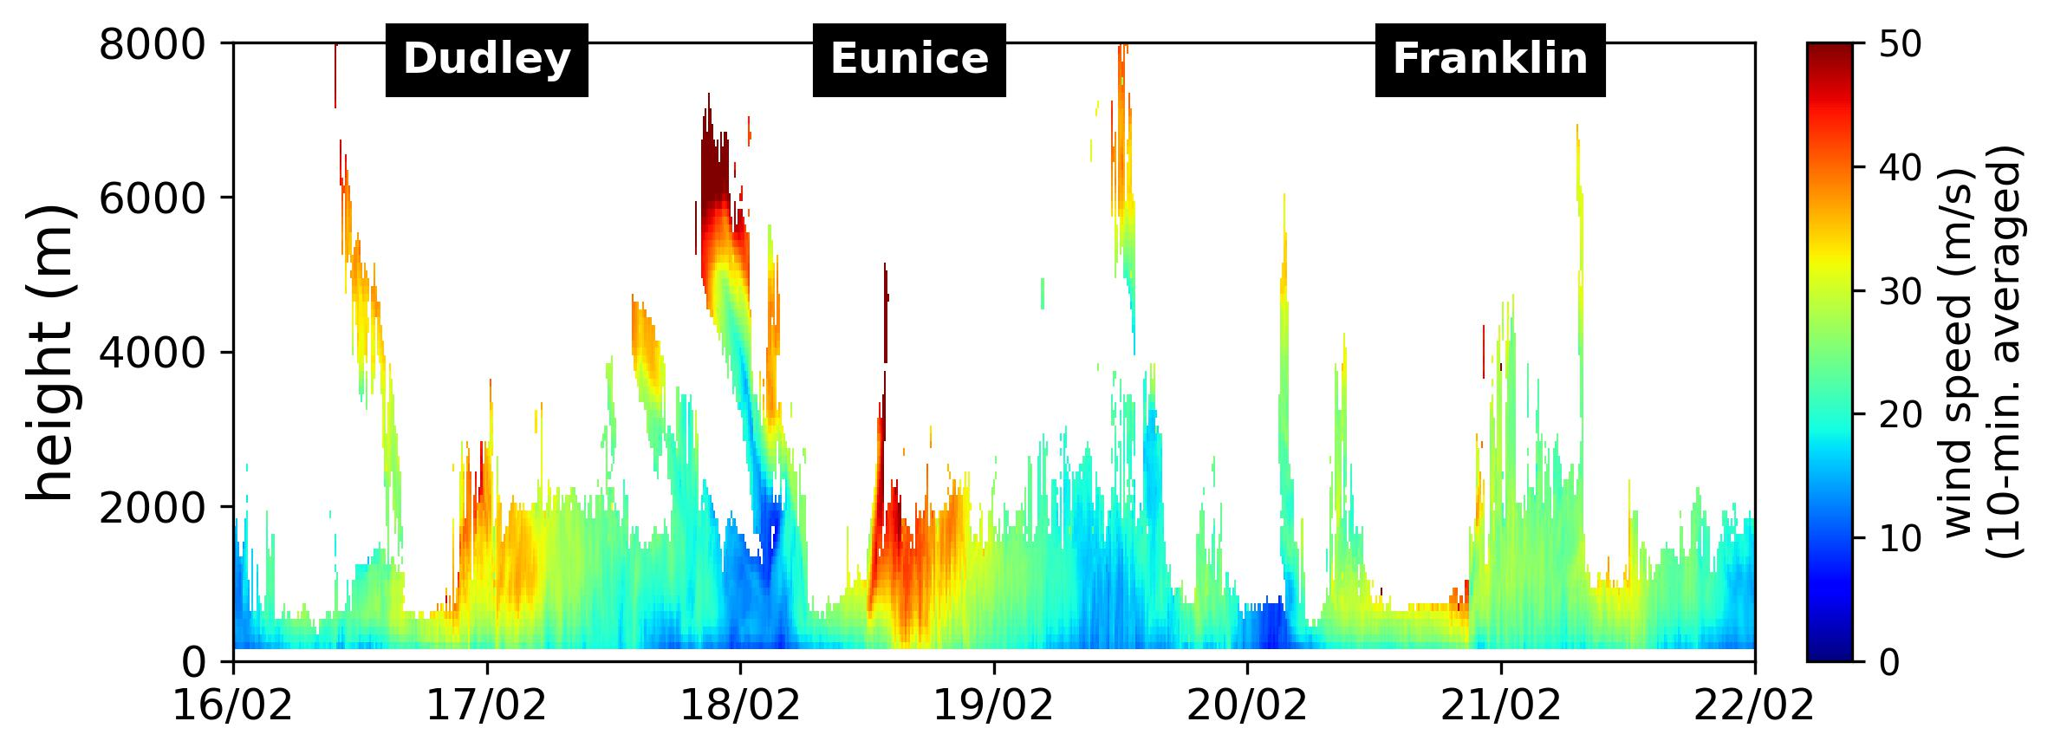
Triplet storm February 2022

Slide 7
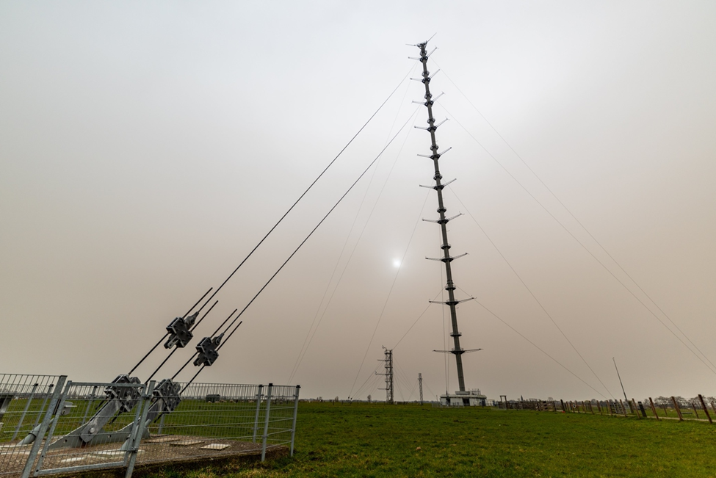
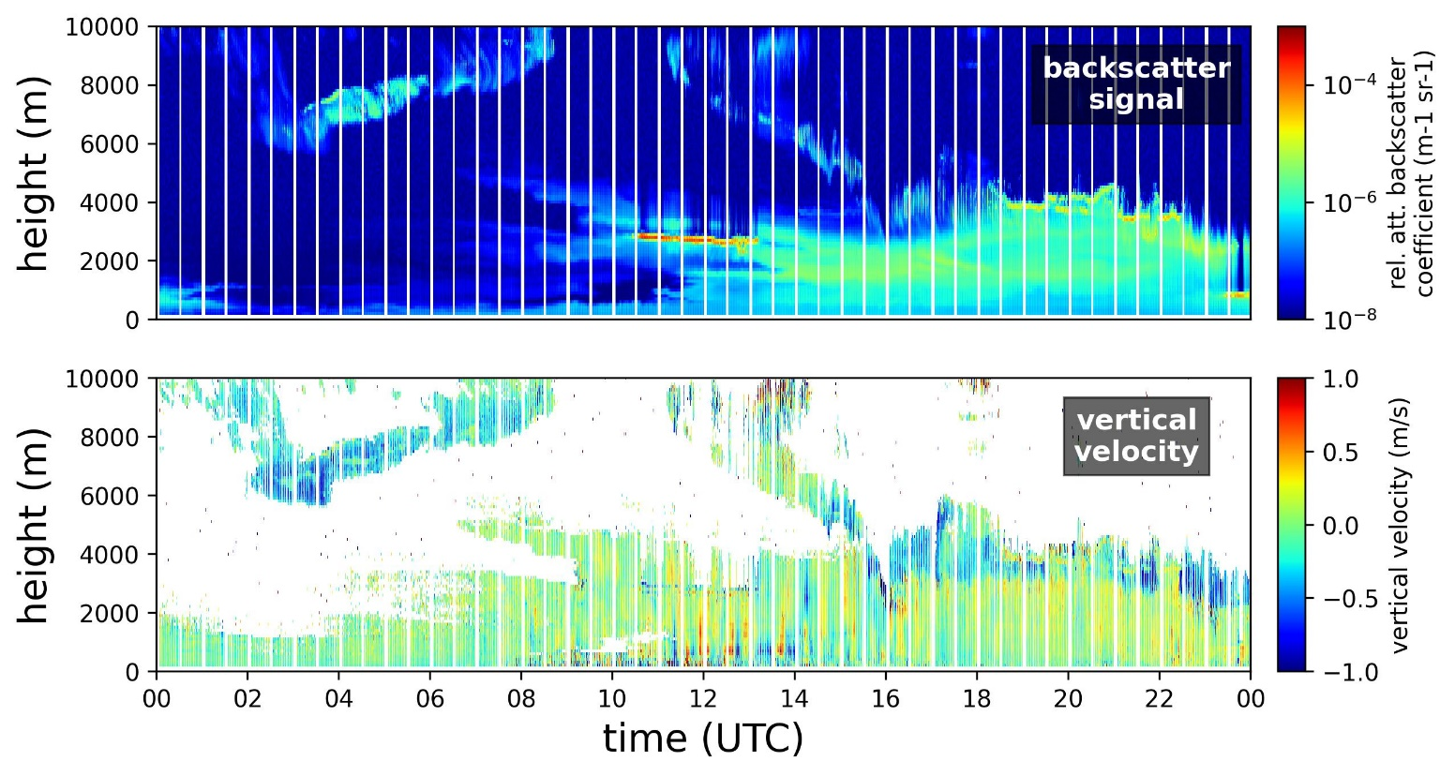
Sahara dust plume March 16, 2022
ceilometer
https://ruisdael-observatory.nl/the-saharan-dust-plume-over-the-netherlands-on-16-march-2022/

Slide 8
Range ambiguity issues
The unambiguous range is given by the pulse repetition frequency (PRF) via c/(2*PRF). Strong backscatter occurring beyond the unambiguous range can lead to a signal at a smaller range, leading to range ambiguity.
In our Windcube 200S the pulse repetition frequency (PRF) cannot be set by the user, but is linked to the chosen range resolution:
Range resolution 75m and 100m -> PRF=10 kHz -> unambiguous range 15 km.
Range resolution 50m -> PRF=20 kHz -> unambiguous range 7.5 km.
Range resotution 25m -> PRF=40 kHz -> unambiguous range 3.25 km.

Slide 9
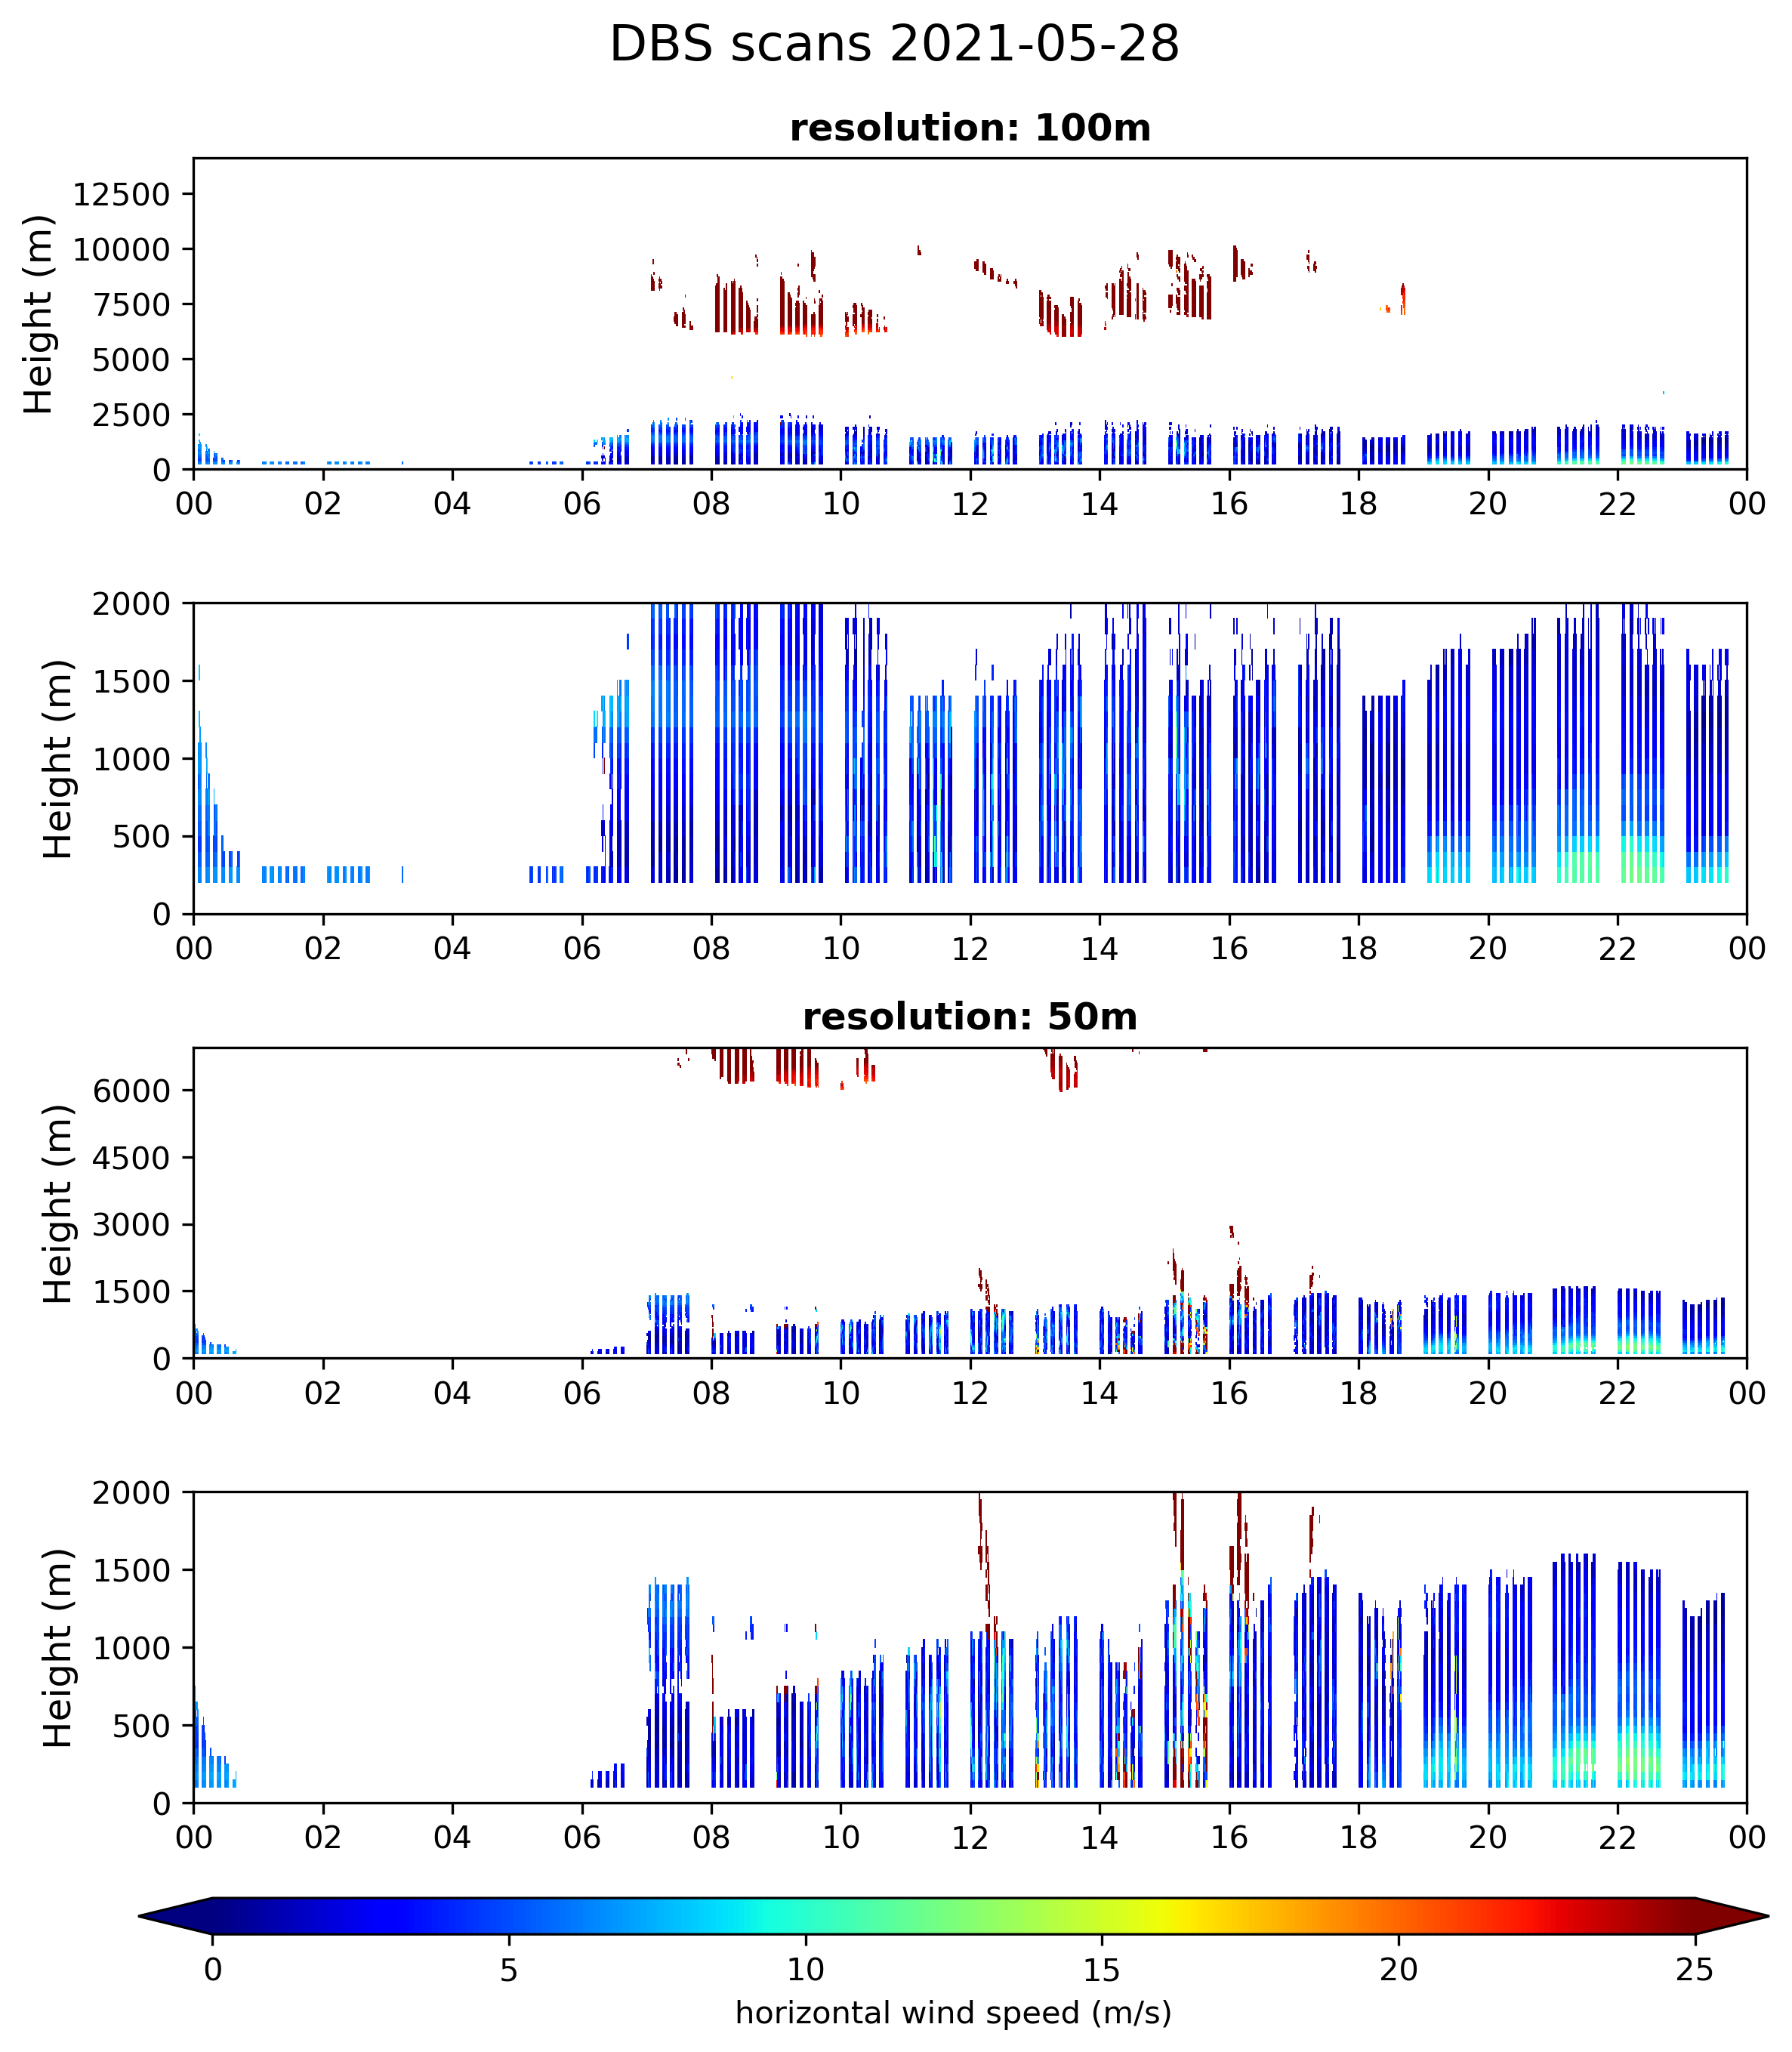
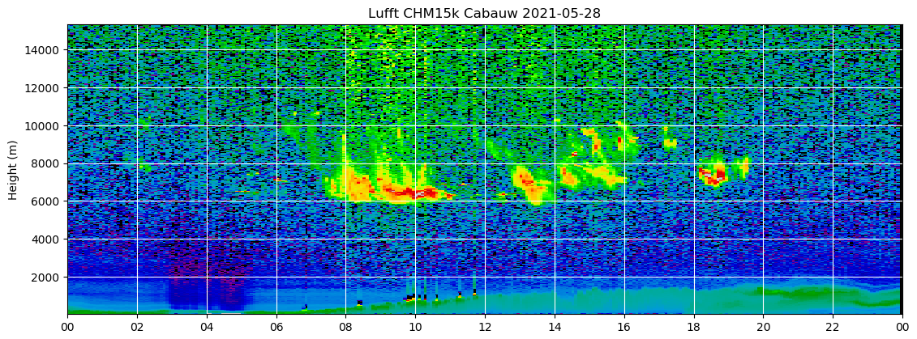
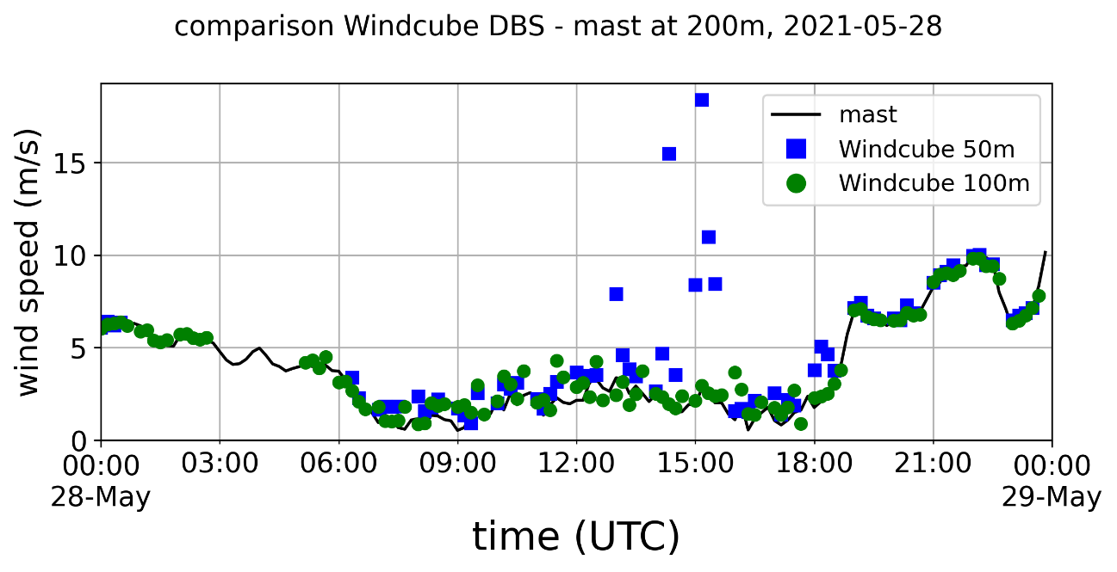
Range ambiguity
PRF=10 kHz (=15 km)
Co-located ceilometer
Clouds just above 7.5km gives signal at 50m resolution at low levels, down to the lowest range gates
PRF=20 kHz (=7.5 km)

Slide 10
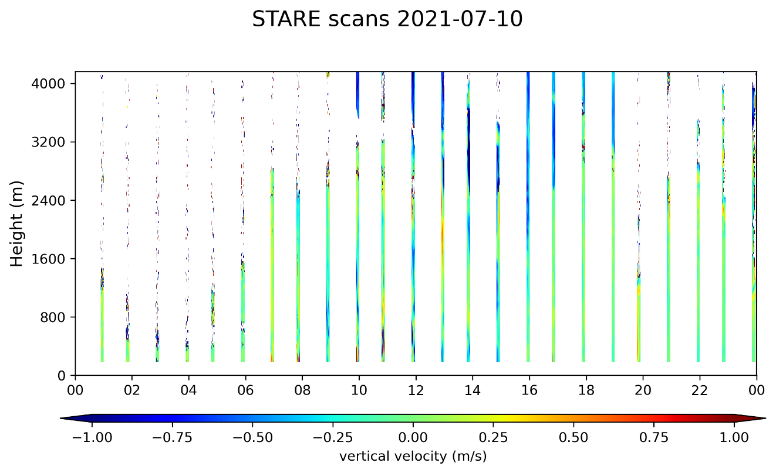
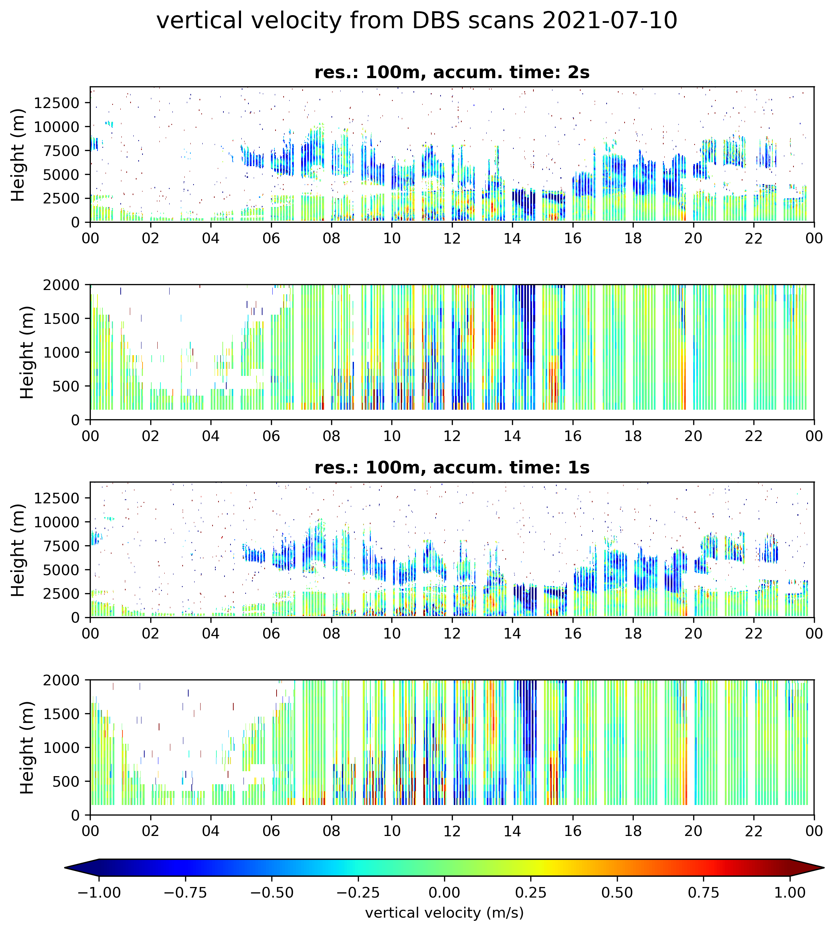
Vertical velocity
From DBS scan (one of the 5 beams)
From vertical staring scan (“continuous”)

Slide 11
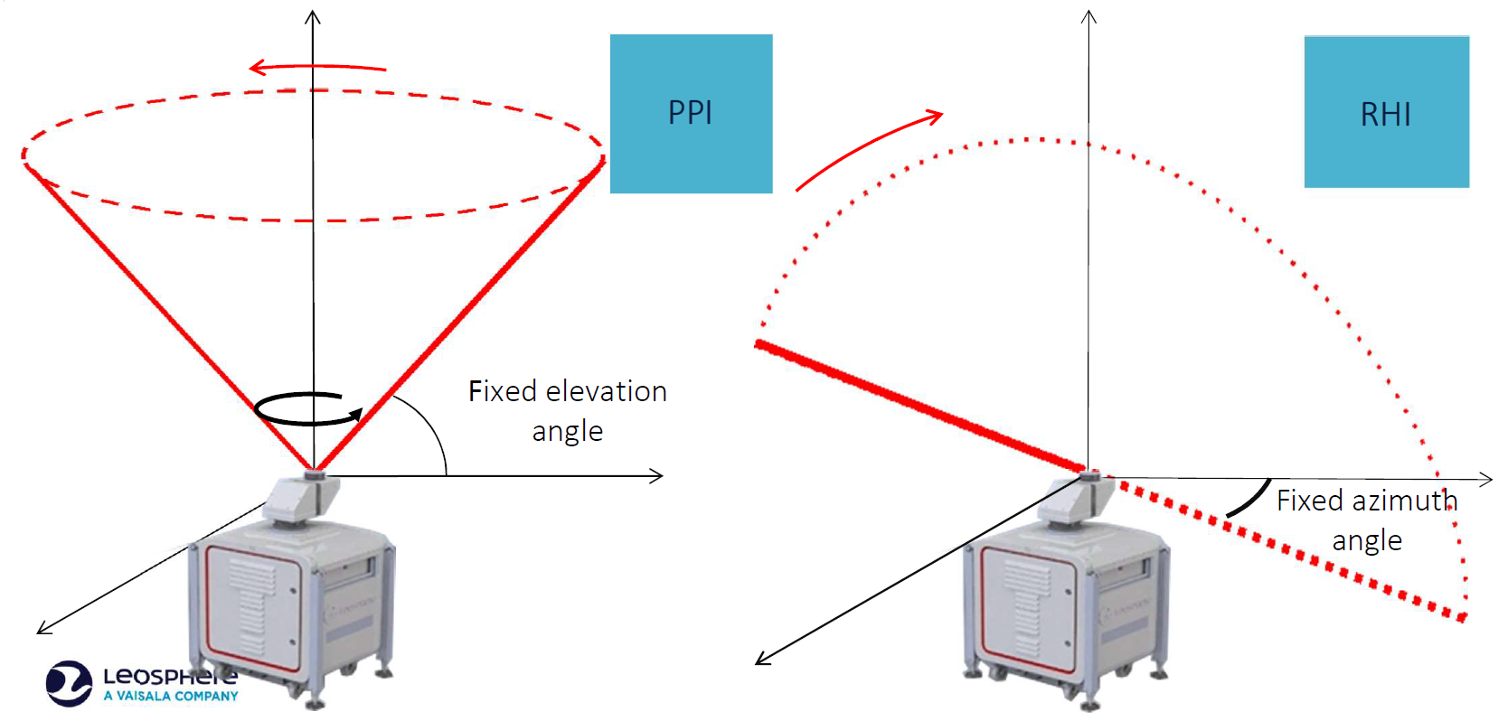
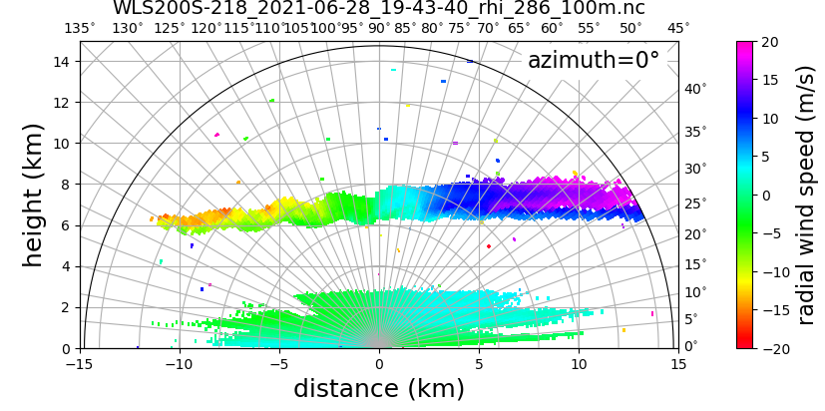
Range Height Indicator (RHI) scans
Single scan 3 minutes
(1 sec, 1°)

Slide 12
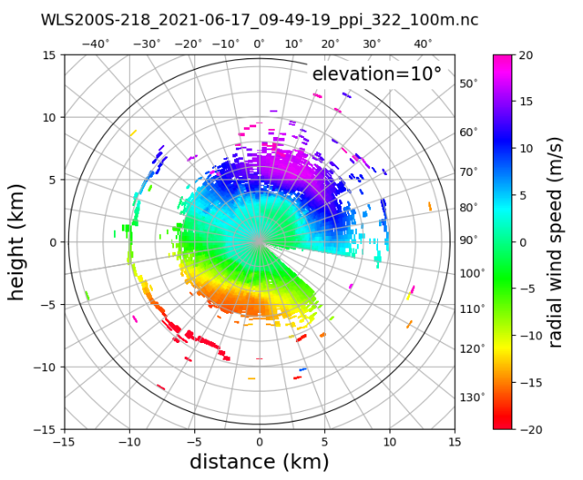
Plan Position Indicator (PPI) scans
Single scan 2 minutes
(full PPI, 1 sec, 3°)

